Slide 1
TABLEAU
BY: EZRA LANG’AT

Slide 2
Requirements
Before creating a dashboard or report in Tableau, there should requirements to be met by the project being done.
The end results should be able to address all the requirements that had been raised earlier on.

Slide 3
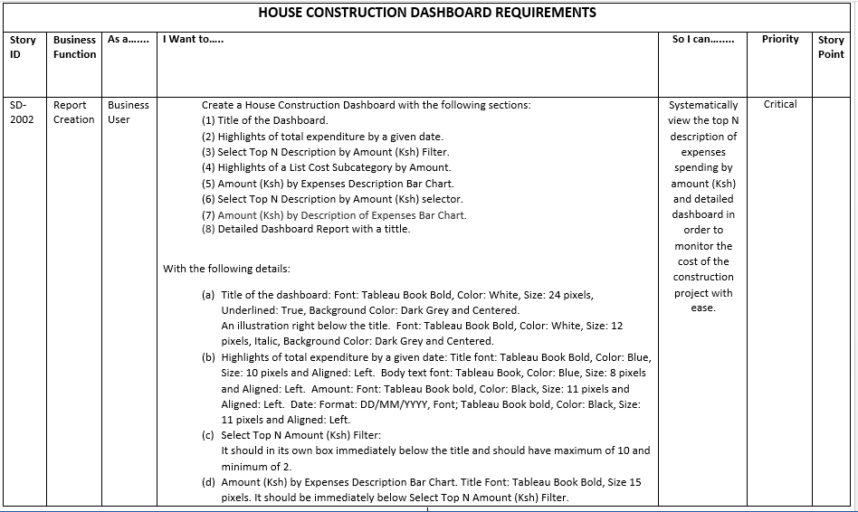
Requirements for the House Construction Dashboard.

Slide 4
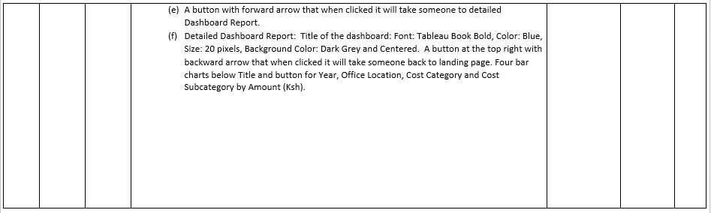
1 - Requirements for the House Construction Dashboard.

Slide 5
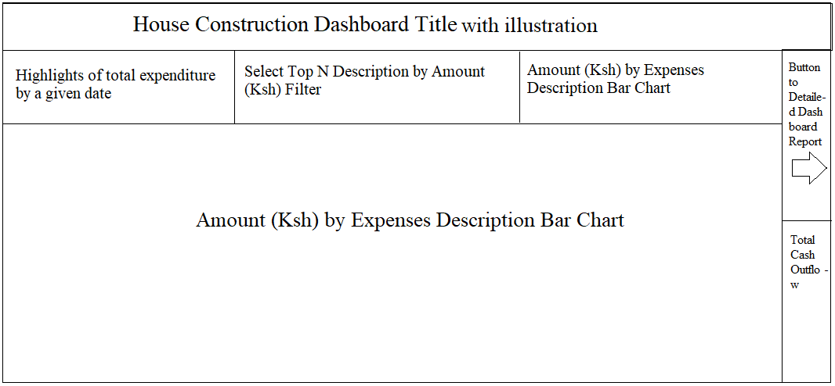
Wireframe for House Construction Dashboard created to guide in meeting the requirements

Slide 6
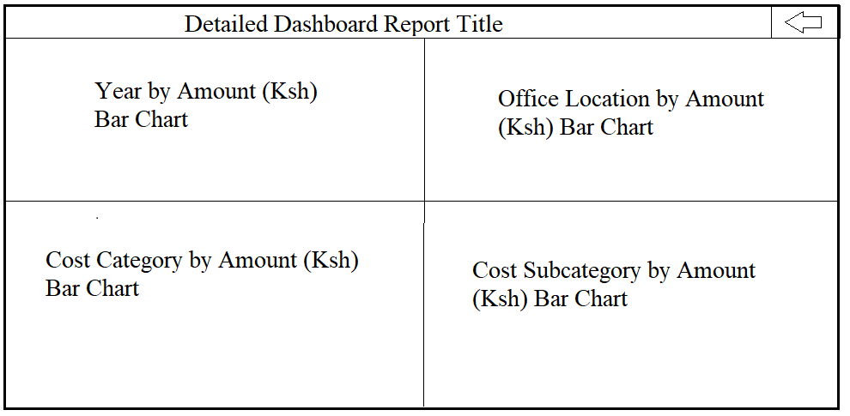
Wireframe for Detailed Dashboard Report created to guide in meeting the requirements

Slide 7
Sets and Parameters
Sometimes one of the dimensions being used in the work sheet could be having a large amount of numbers. Therefore it may not be suitable to show all of the at once in the dashboard being worked on.
This will lead to a need to select top N amount of one of the dimensions against one or several of the measures.
To achieve this, a new Parameter will be created, given a new name, data types set correctly and the allowable values are entered.
There after, a new Set will be created and linked to the Parameter created earlier on. You then will be able to filter a particular dimension on a chart on the dashboard by any value desired.

Slide 8
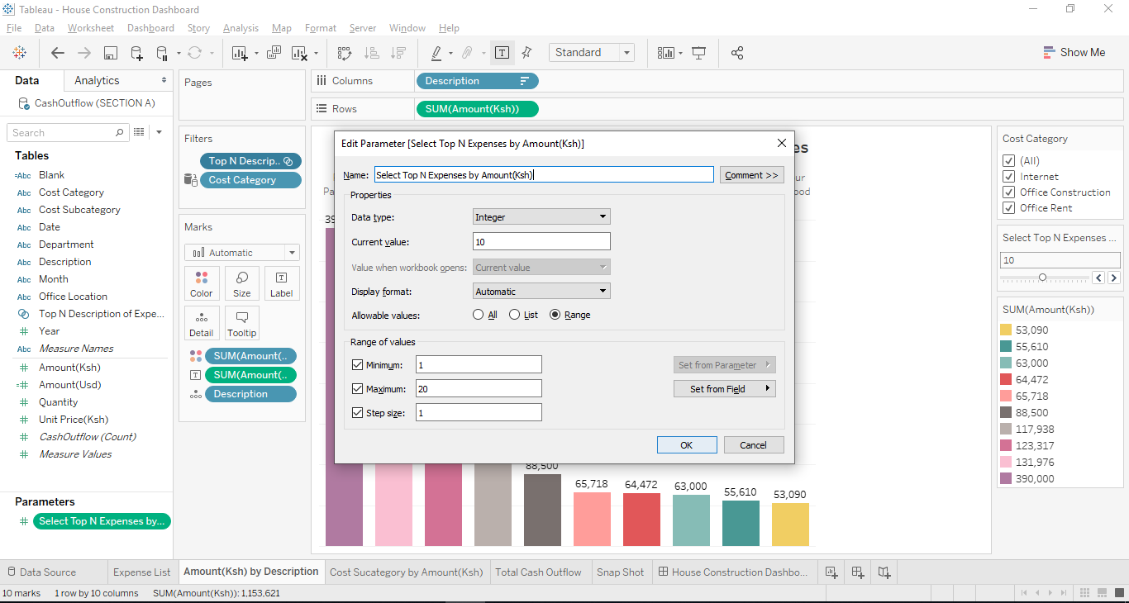
Creating a Parameter to be used in selecting top N Expenses by Amount(Ksh)

Slide 9
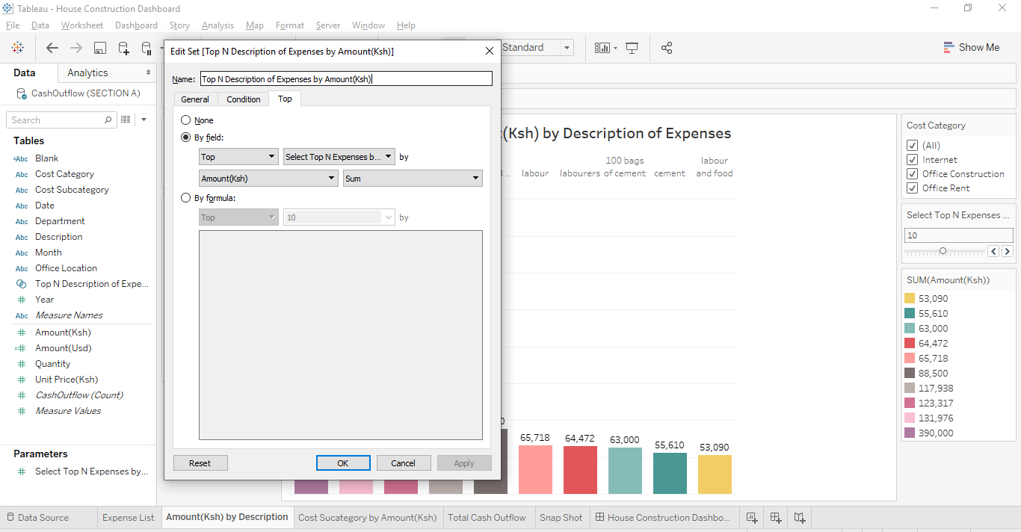
A new Set is created being connected with the Parameter that was created earlier in order to be used in selecting top N Expenses by Amount(Ksh).

Slide 10
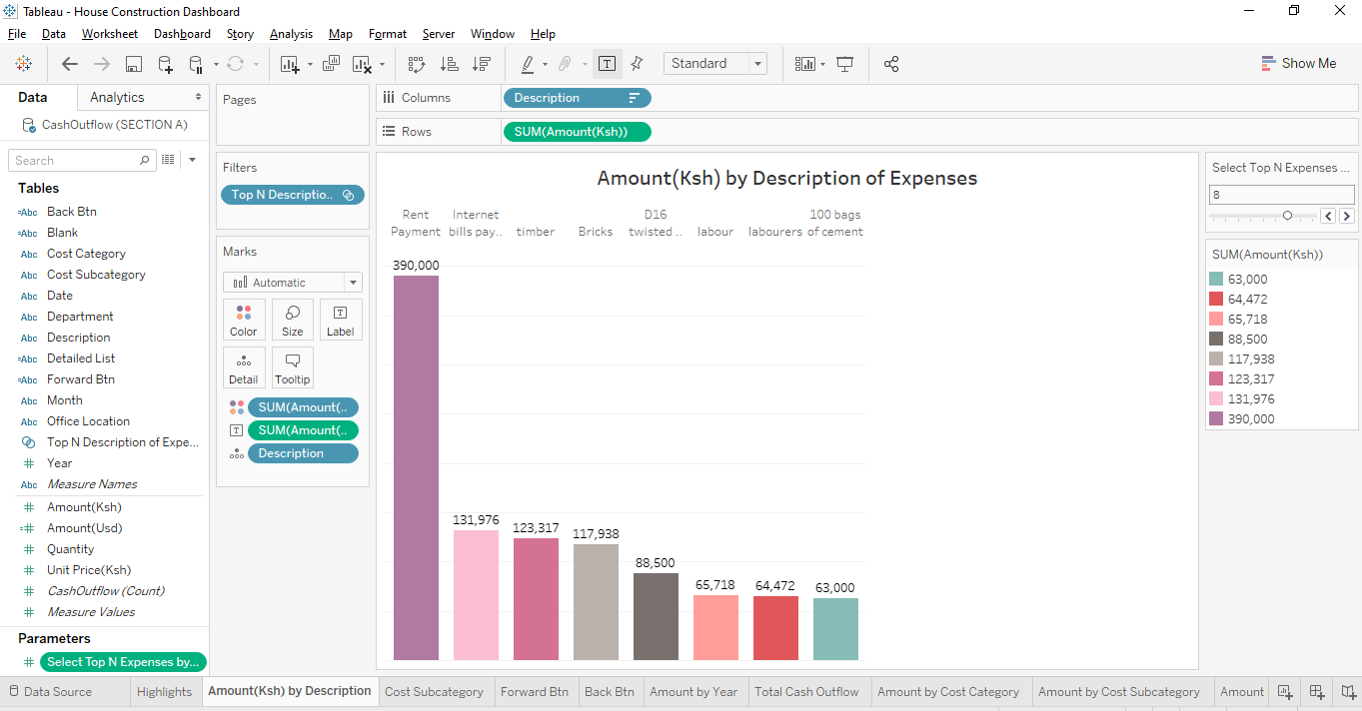
Chart showing Amount(Ksh) by Description

Slide 11
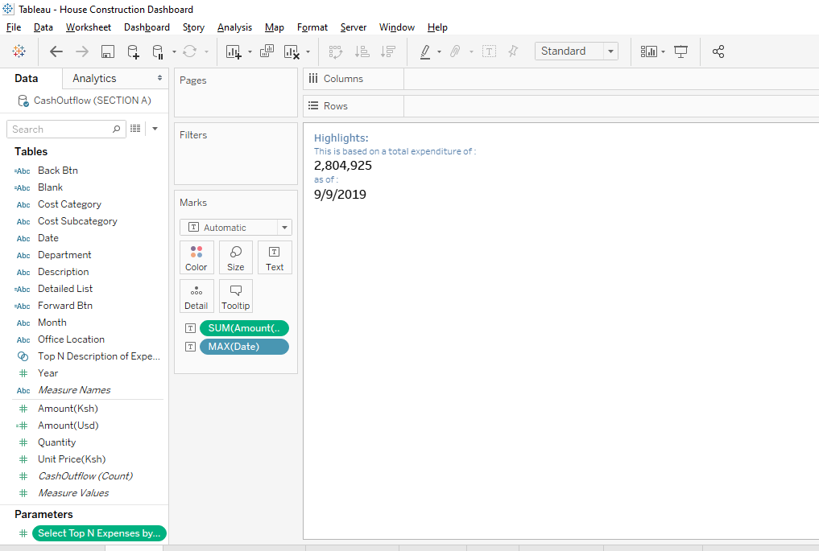
Snapshot Containing Highlights

Slide 12
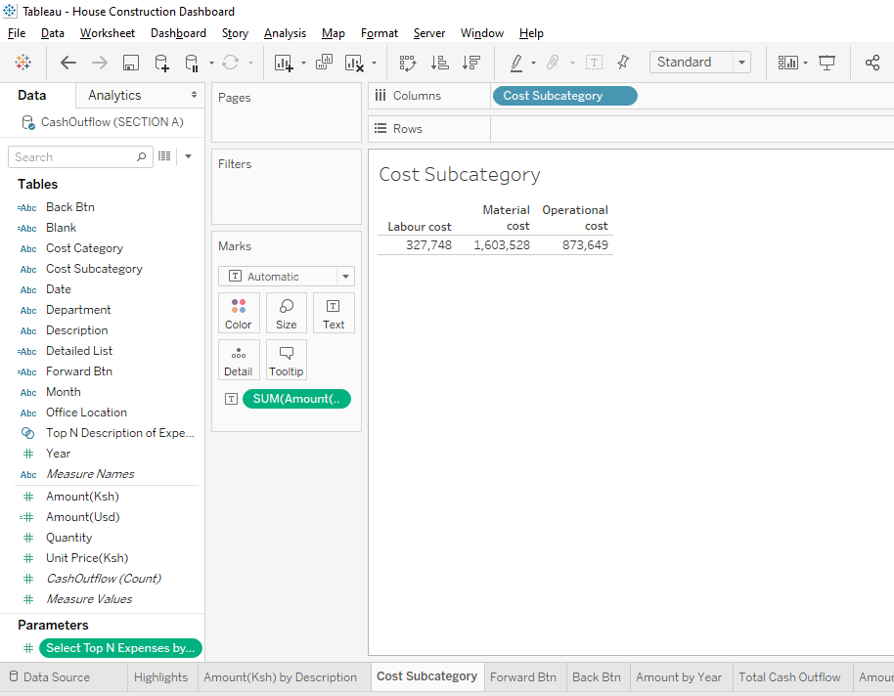
Highlights of Expenditure by Subcategory

Slide 13
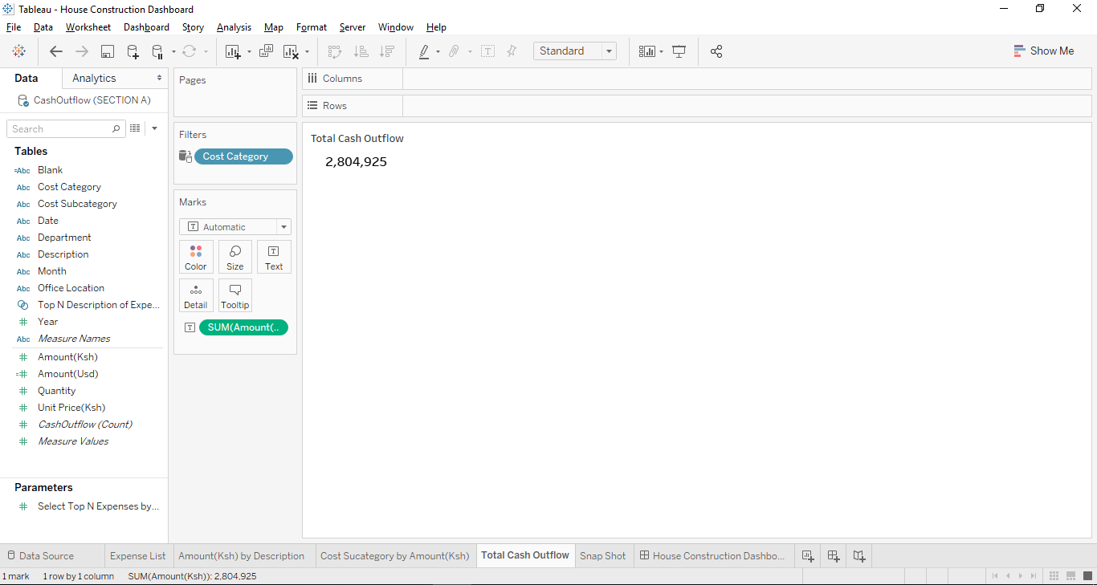
Total Cash Outflow

Slide 14
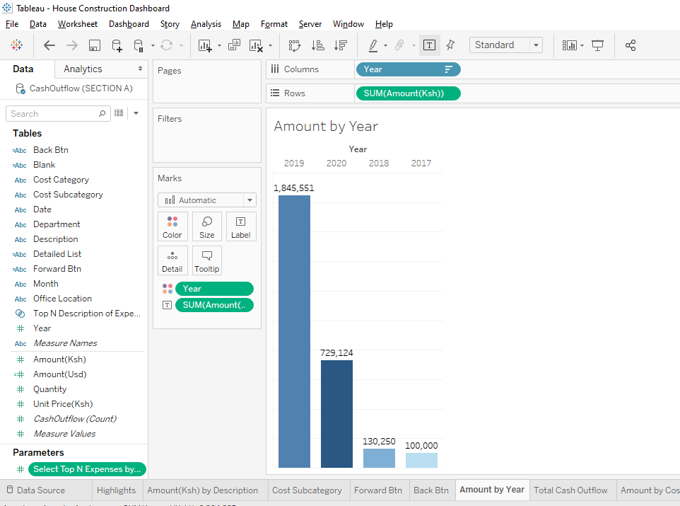
Chart showing Year by Amount(Ksh)

Slide 15
Chart showing Year by Amount(Ksh)

Slide 16
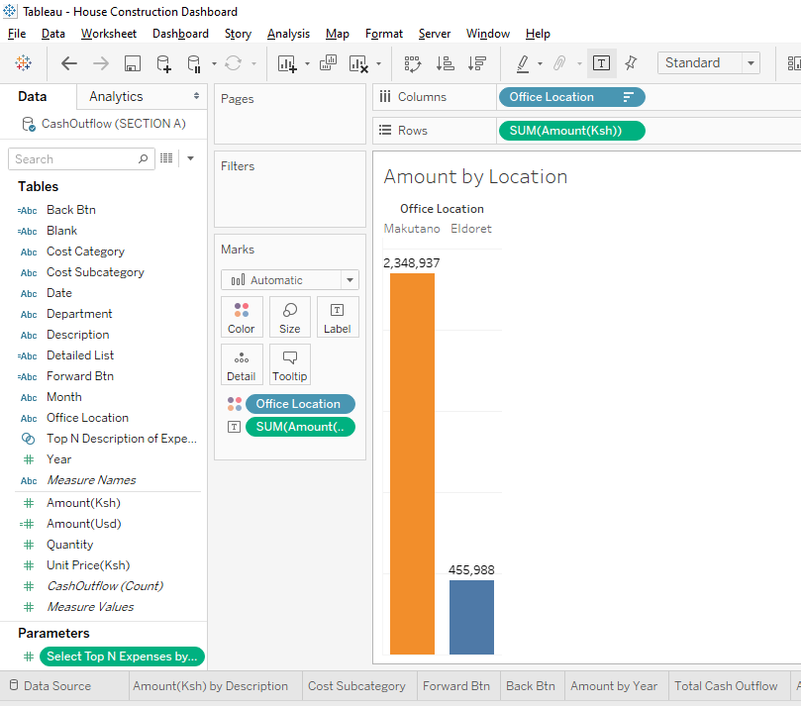
Chart showing Office Location by Amount(Ksh)

Slide 17
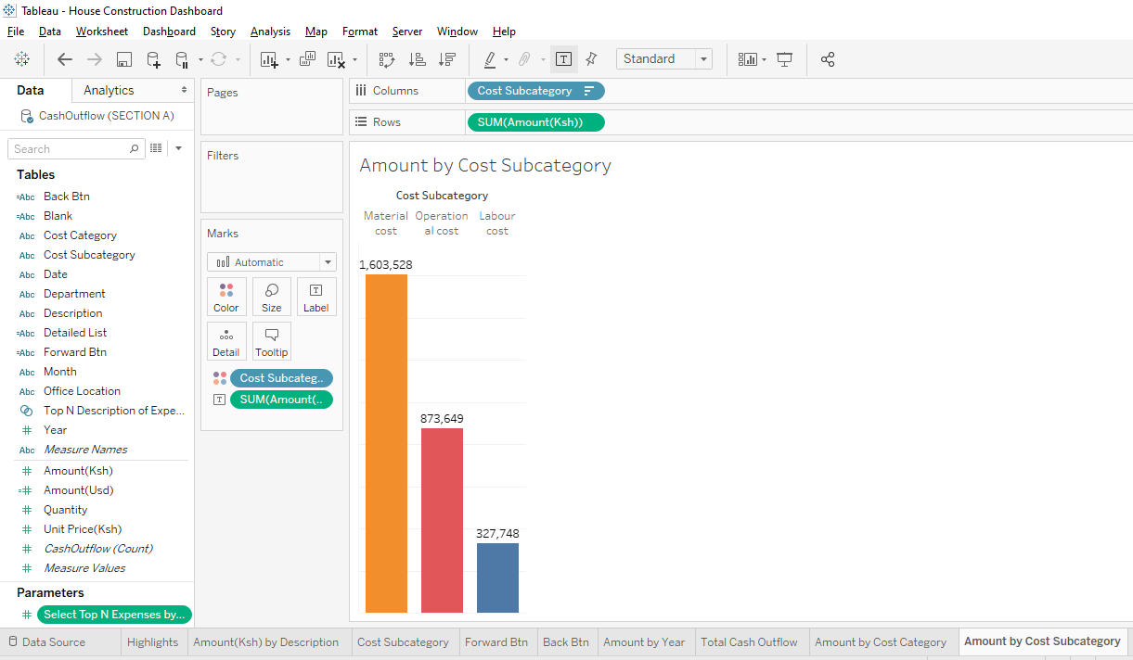
Chart showing Cost Subcategory by Amount(Ksh)

Slide 18
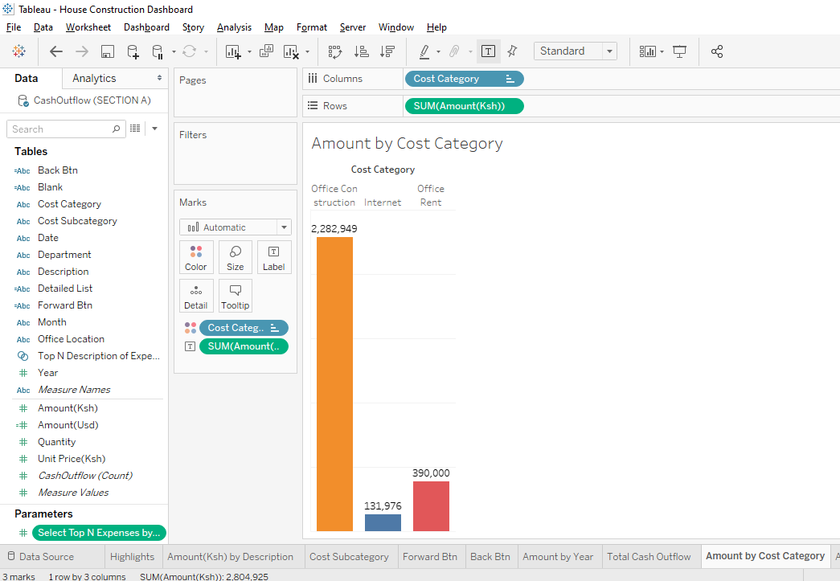
Chart showing Cost Category by Amount(Ksh)

Slide 19
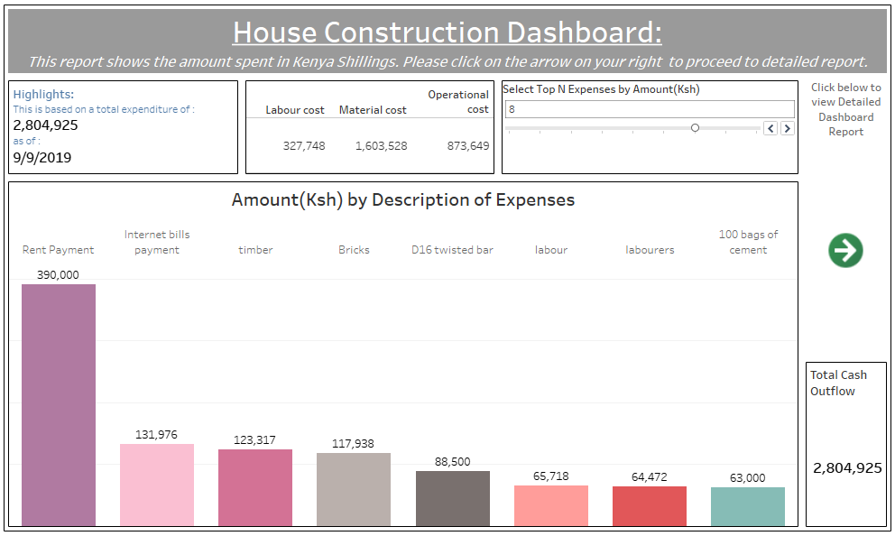
House Construction Dashboard

Slide 20
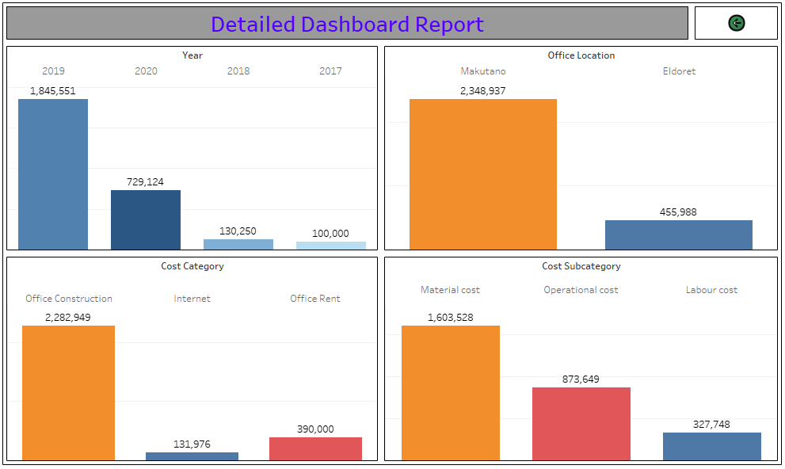
Detailed Report Dashboard

Slide 21
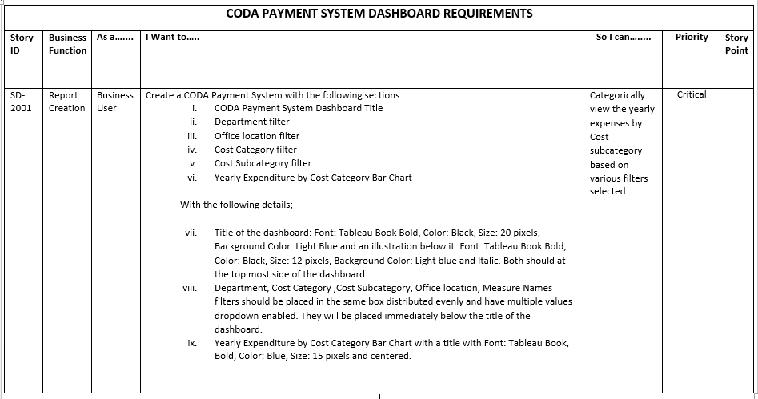
Requirements for the CODA Payment System Dashboard.

Slide 22
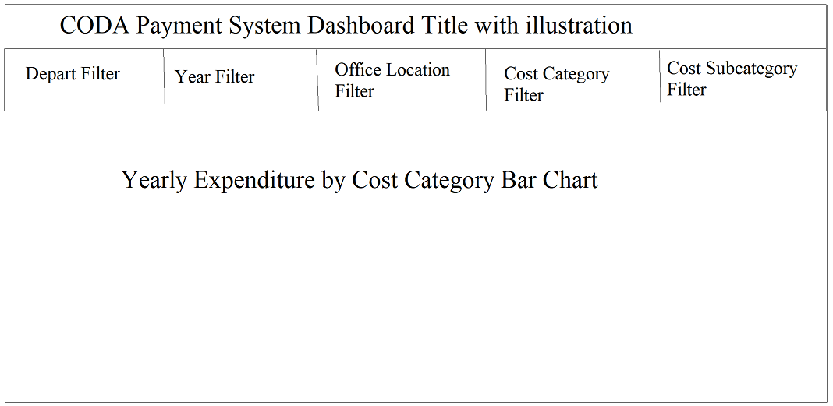
Wireframe for CODA Payment System Dashboard created to guide in meeting the requirements

Slide 23
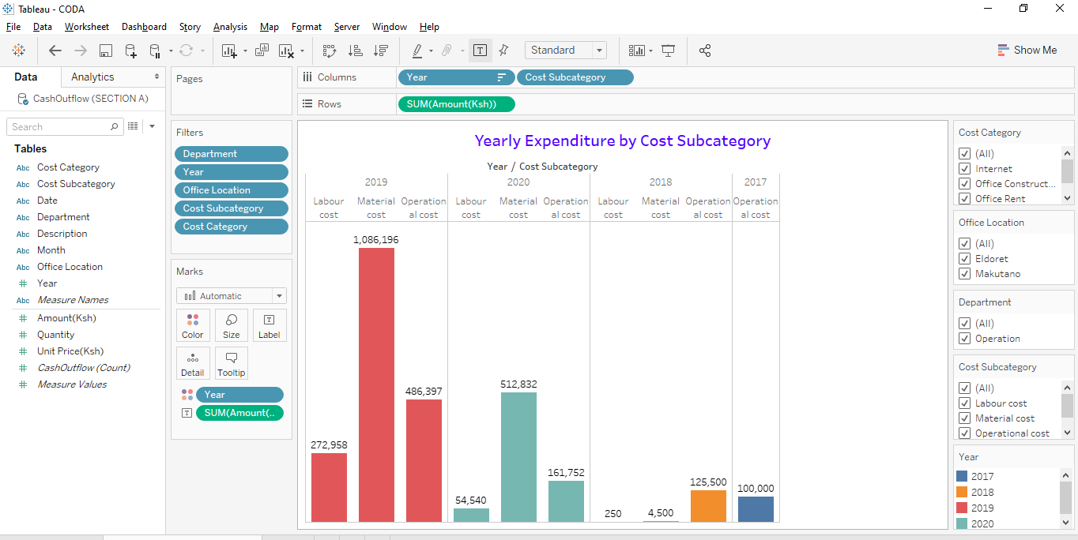
Yearly Expenditure by Cost Subcategory

Slide 24
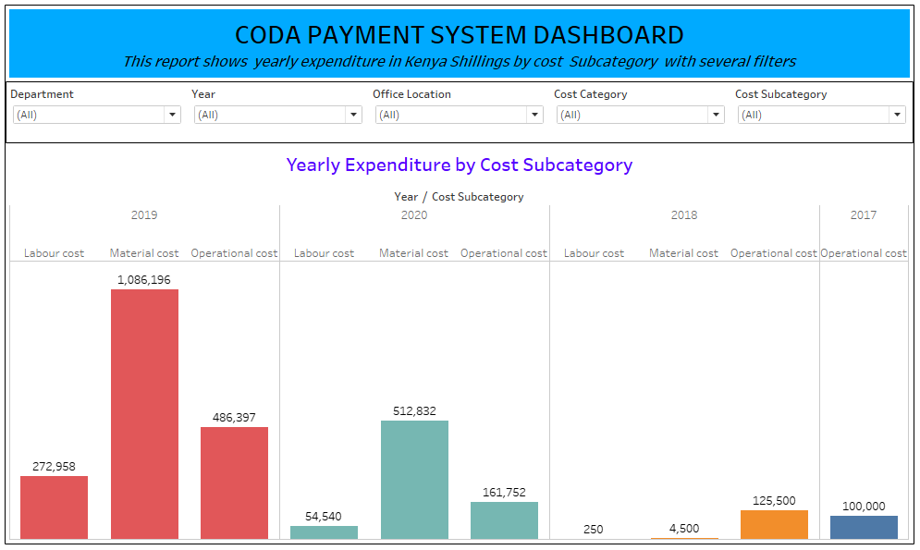
CODA Payment System Dashboard

