Slide 1
Tableau Training
Open the app and try the free trial
Create an account on the free trial and open for analysis
Select the type of data required for analysis in its format e.g excel data

Slide 2
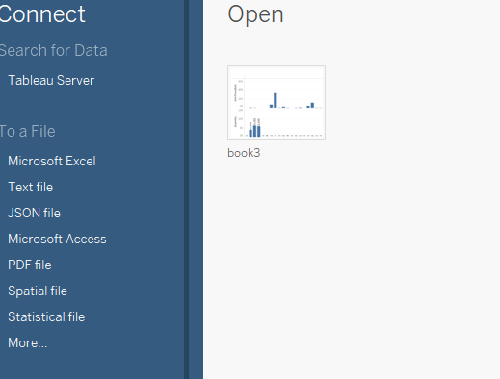

Slide 3
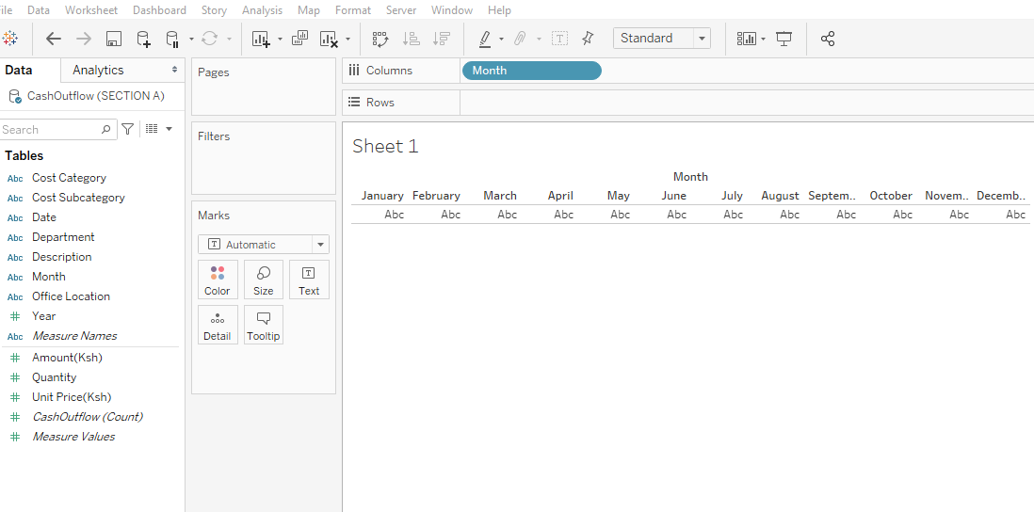
1. Place the discrete data on columns.
2. Put the continuous data on the rows

Slide 4
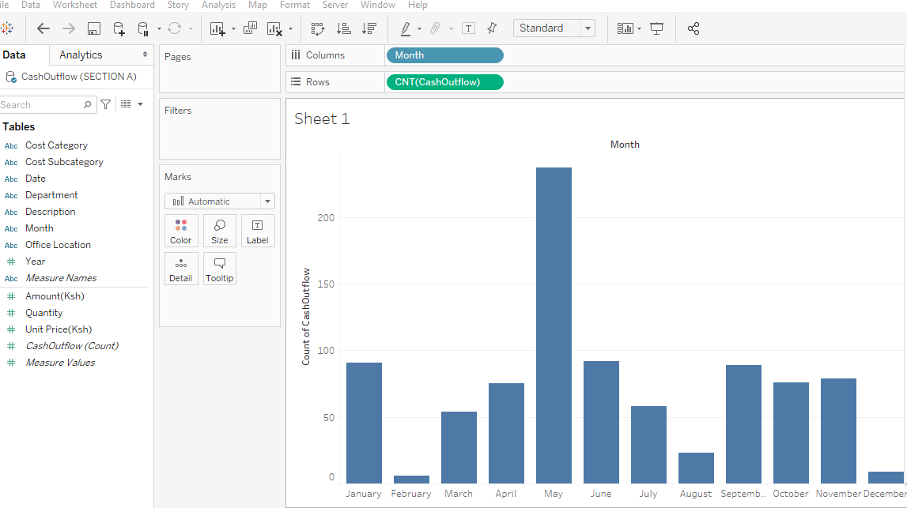
Click on the type of visualization required and check whether the data is displayed on the form of visualisation selected.

Slide 5
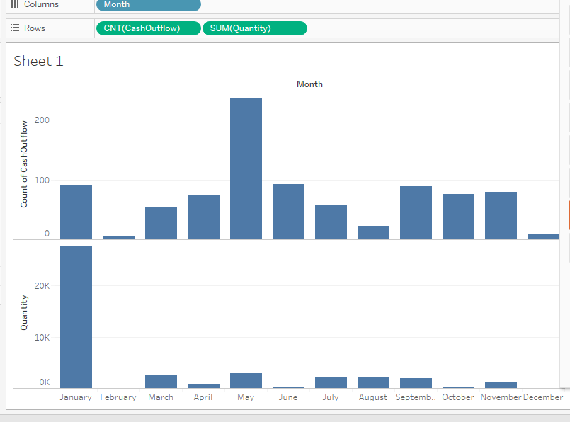
Add other variables on the columns and rows and check how they are displayed on the visualization.

Slide 6
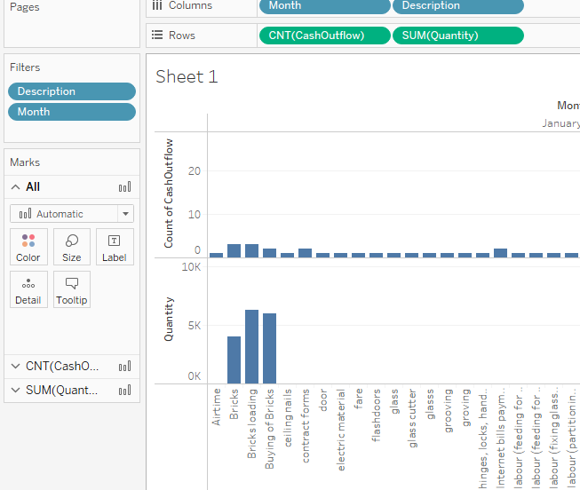
Create filters on the data
Select the descriptive data and move it on filters e.g select month or description

Slide 7
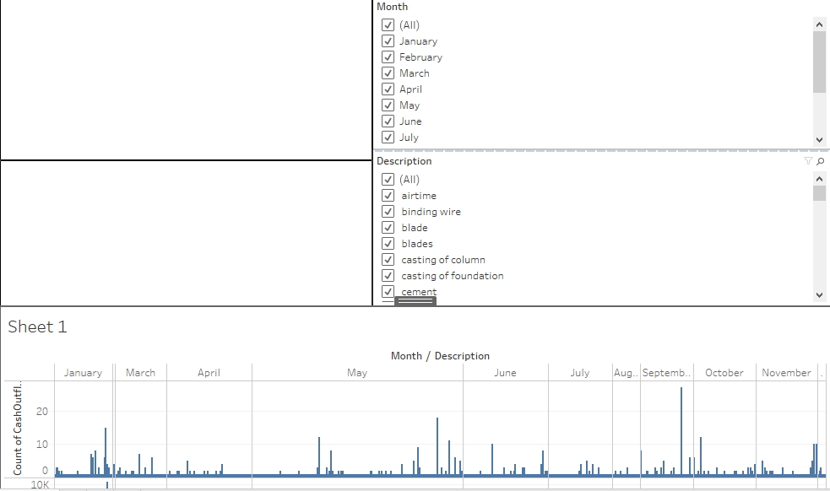
Creating a dashboard
Create a dashboard for analysis and open the analysis on the dashboard

Slide 8
