Slide 1
CoaCo: Cold Drink Fetcher
KU Leuven, Smart Embedded Systems
Cédric Gullentops, Anton Peeters, Dylan Van Assche, Olivier Van den Eede, Simon Vandevelde

Slide 2
Hier komt het filmke fullscreen

Slide 3
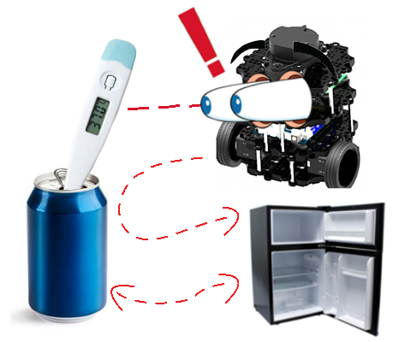
Mission
Look for cans
If the can is warm, move it to the bin
  The bin’s location is next to an AruCo marker
Take a new (cold) can, and bring it

Slide 4
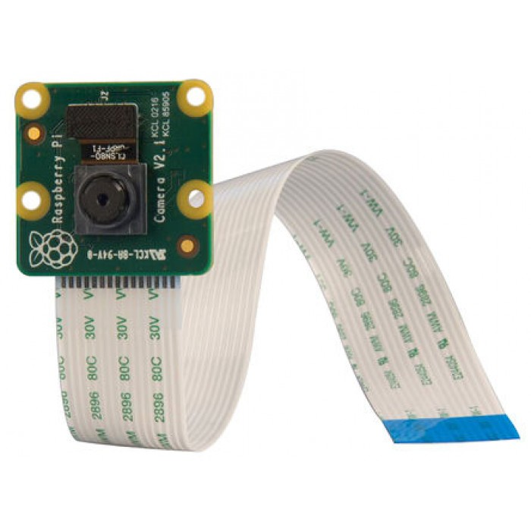
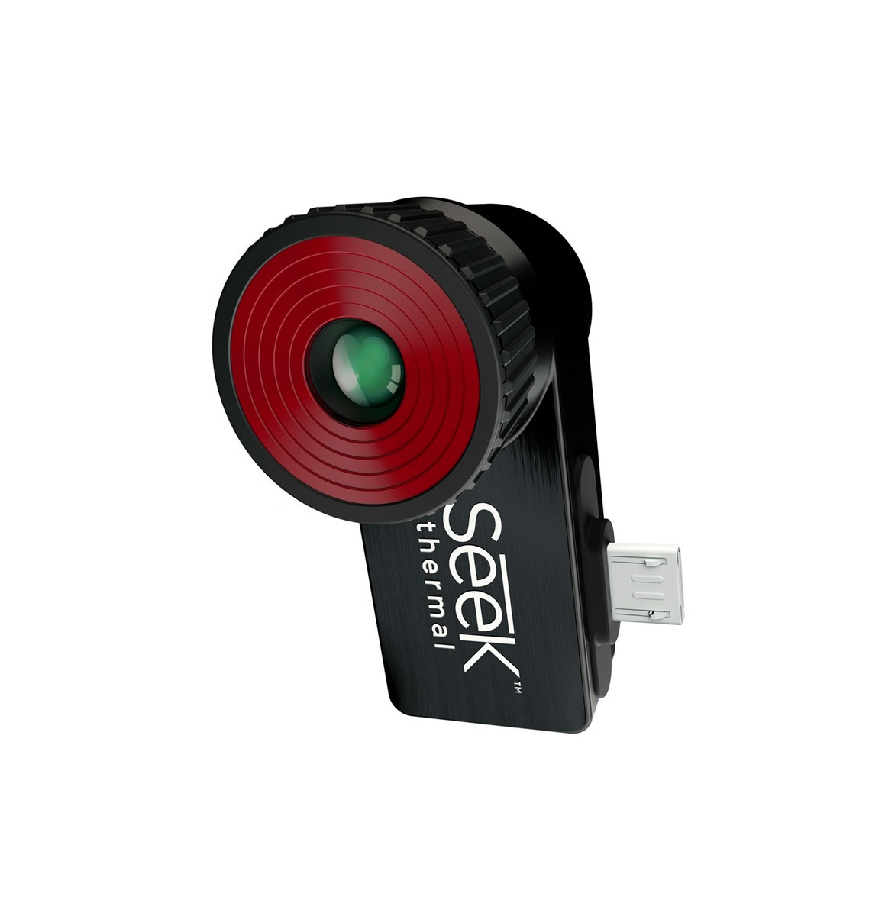
Design
Perception
Raspicam
  Used for can and AruCo detection
Thermal camera
  Used for differentiating cold and warm cans

Slide 5
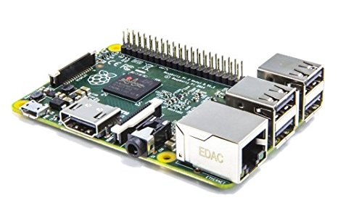
Design
Decision
Raspberry Pi

Slide 6
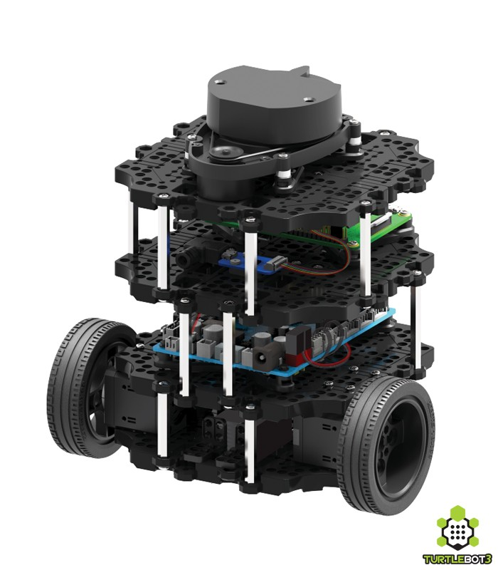
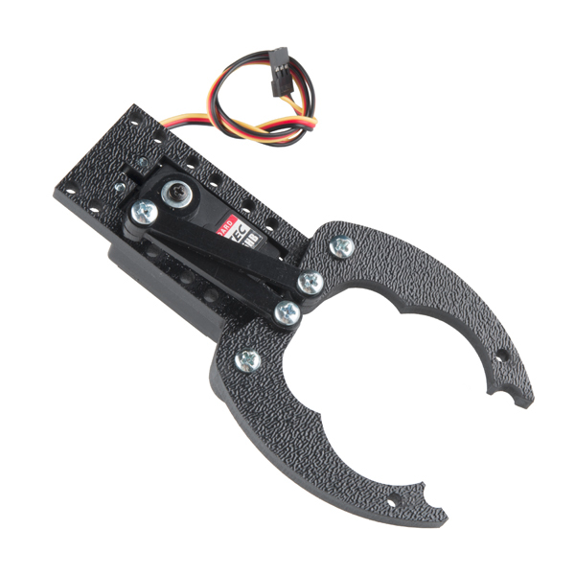
Design
Actuation
Motor: control wheels
Gripper

Slide 7
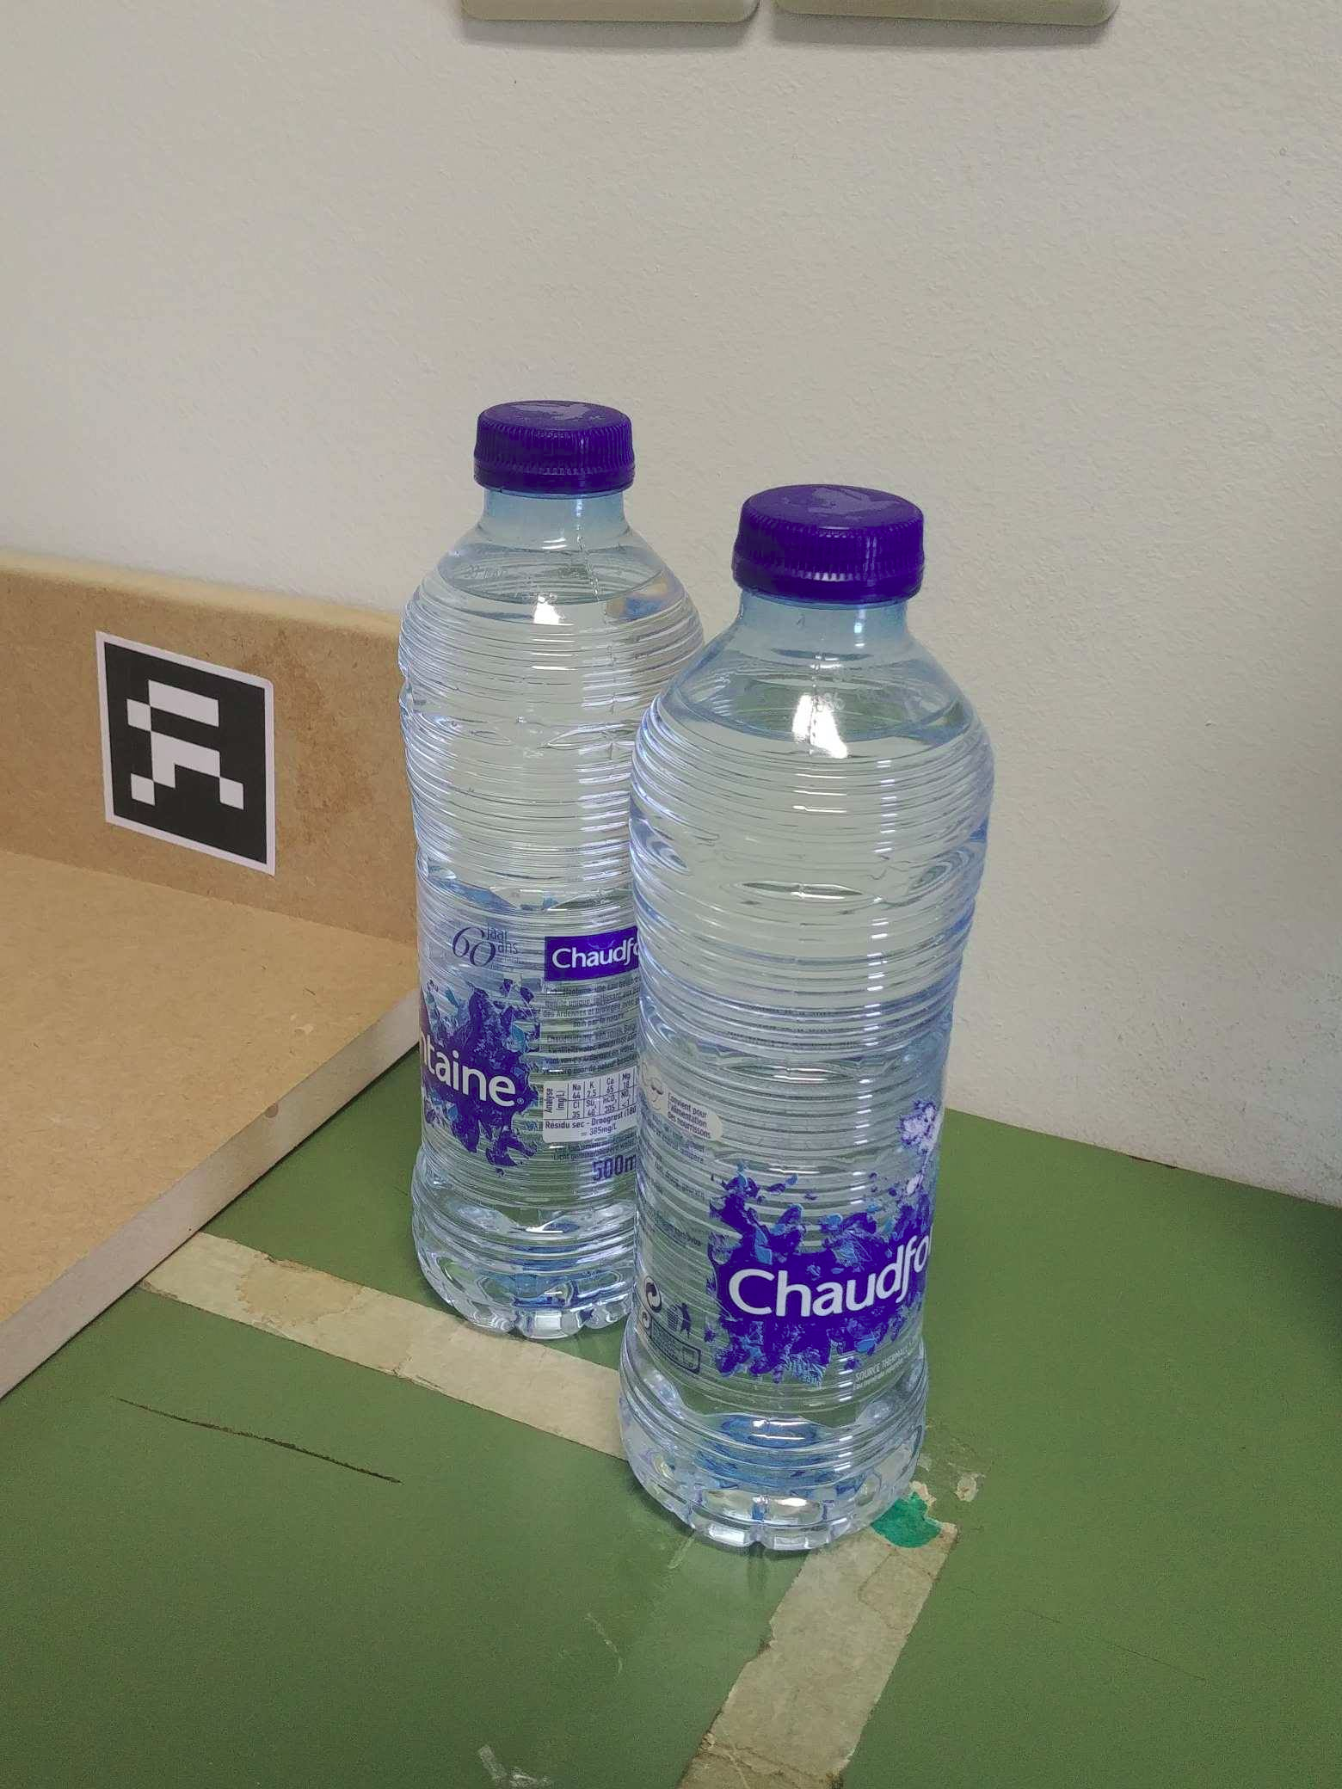
Features
RGB imaging
Raspicam node by Ubiquity Robotics
Streams the feed to the Image Feeder
Used to look for cans and AruCo markers

Slide 8
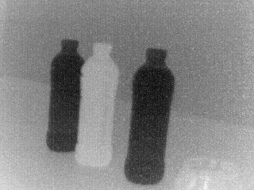
Features
Thermal imaging
Compact SEEK Pro camera
Libseek C++ library with LibUSB
Relative temperature measurement

Slide 9
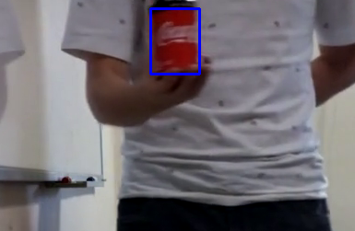
Features
Can detection
Convert image to HSV
Split the three channels & threshold
Detection based on red colour:
  H: 0 and 139
  S: 117 and 255
  V: 61 and 255
Blobdetection with bounding box

Slide 10
Features
Cold detection
Combines can detector and thermal detector
Cut out the ROI
Threshold the image
Count the ratio of white to black pixels

Slide 11

Features
AruCo detection
Using the old AruCo dictionary
Bounding box and ID identification using OpenCV
Used to represent bin and fridge

Slide 12
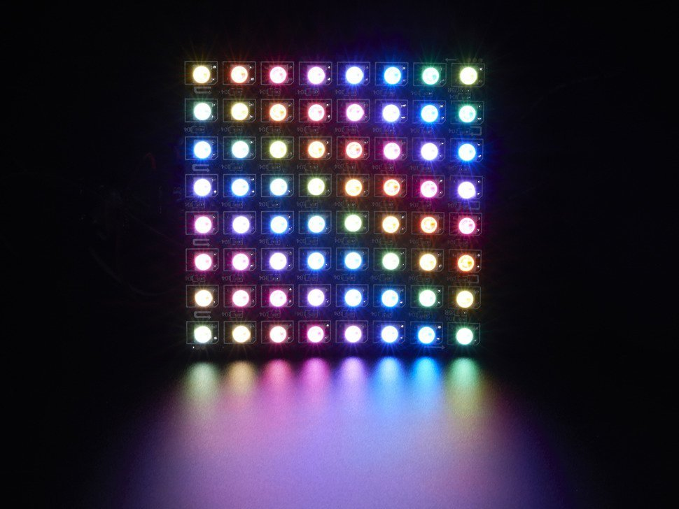
Features
NeoPixels
Individual adressable RGB LEDs
Serial 1-Wire interface
Animations and colour control

Slide 13
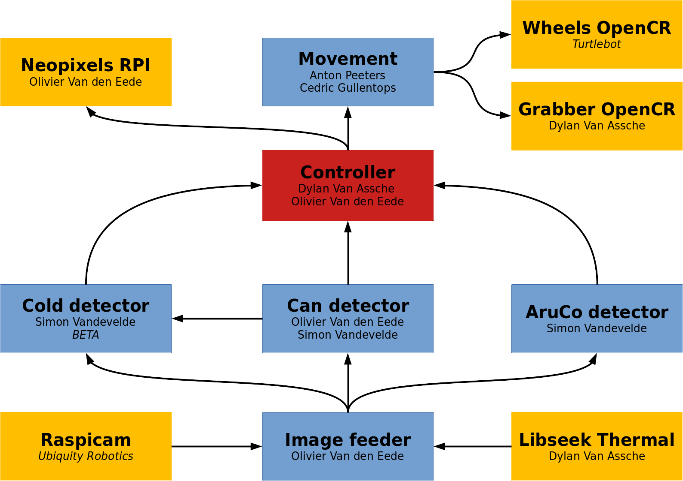
Node scheme
Hardware interaction
Control
Processing

Slide 14

Controller
Decides which step of the mission is executed
Listens to the cold, AruCo and can detector to make a decision
Commands the wheels, grabber and neopixels

Slide 15
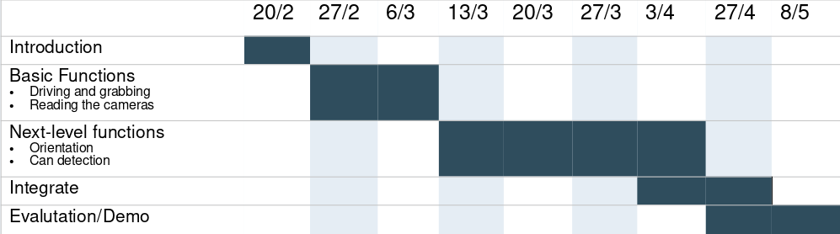
Planning

Slide 16
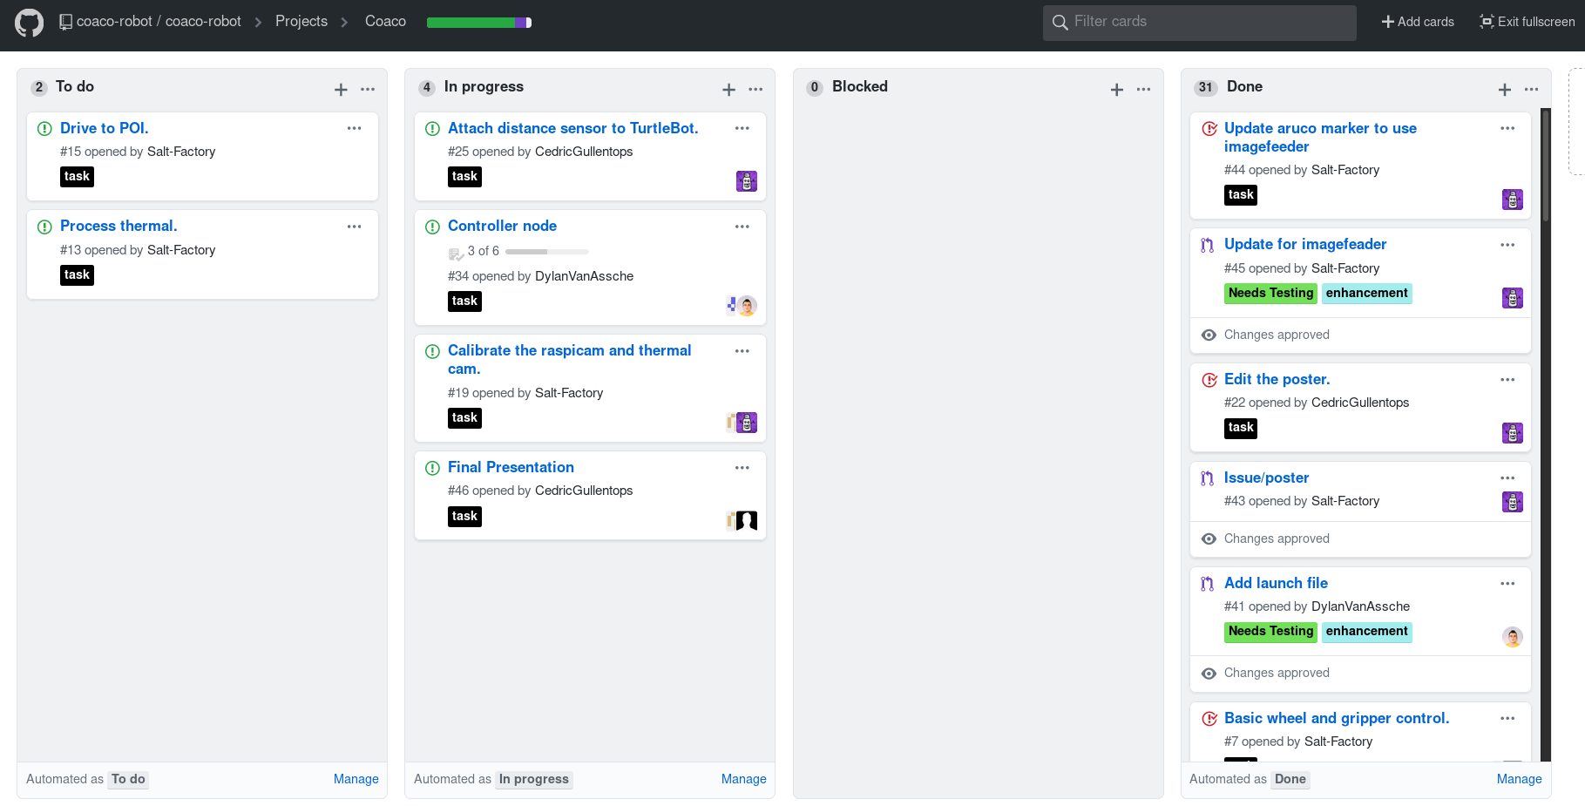
Our issues, projectboard and workflow

Slide 17
Conclusion
Never reinvent the wheel!
  Check which hardware and OS are supported
  Use existing software if possible
Building software together is hard, but doable with the right tools
  Git
  Project boards and issues
  Standup meetings
Our robot can almost completely execute the proposed mission
  Look for cans
  Go to the can
  Grab it

Slide 18
Questions?

Slide 19
The end
Thanks for listening, and don’t forget to
Crack Open A Cold One!

