Slide 1
CoaCo: Cold Drink Fetcher
KU Leuven, Smart Embedded Systems
Cédric Gullentops, Anton Peeters, Dylan Van Assche, Olivier Van den Eede, Simon Vandevelde

Slide 2
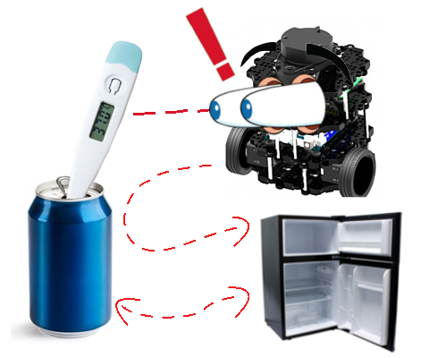
Robot’s mission
Look for cans
If the can is warm, move it to the bin
  The bin’s location is next to an AruCo marker
Take a new (cold) can, and bring it

Slide 3
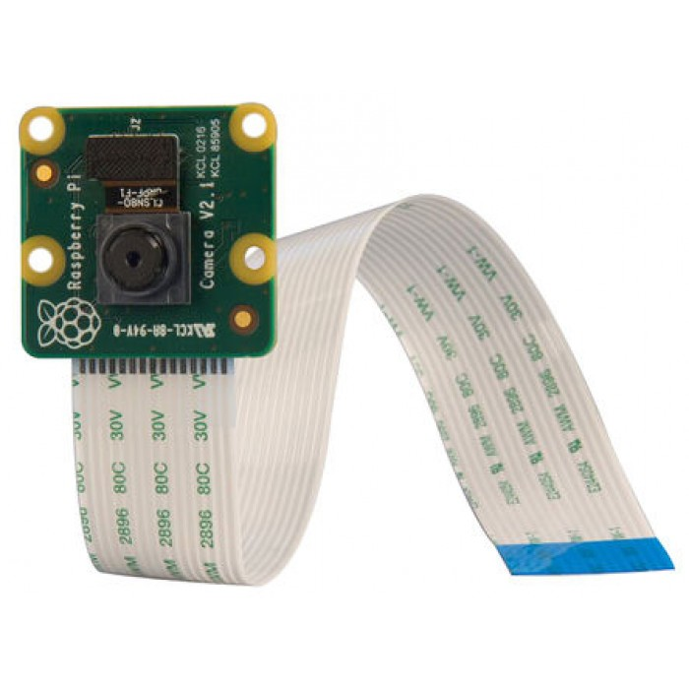
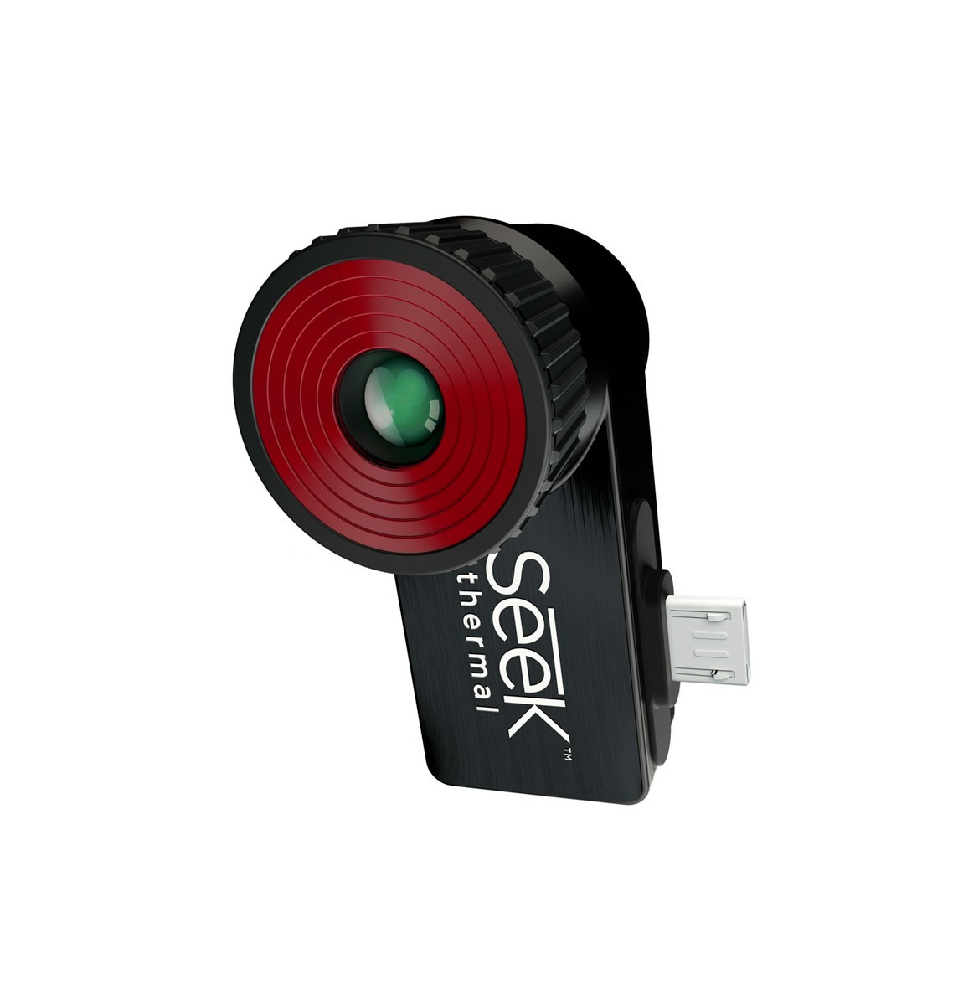
Robot’s design
Perception
Raspicam
  Used for can and AruCo detection
Thermal camera
  Used for differentiating cold and warm cans

Slide 4
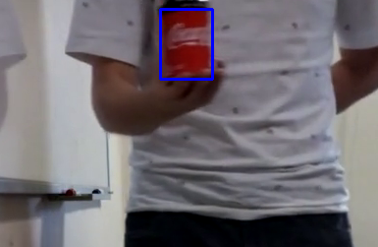
Robot’s features
Can detection

Slide 5

Robot’s features
AruCo detection

Slide 6
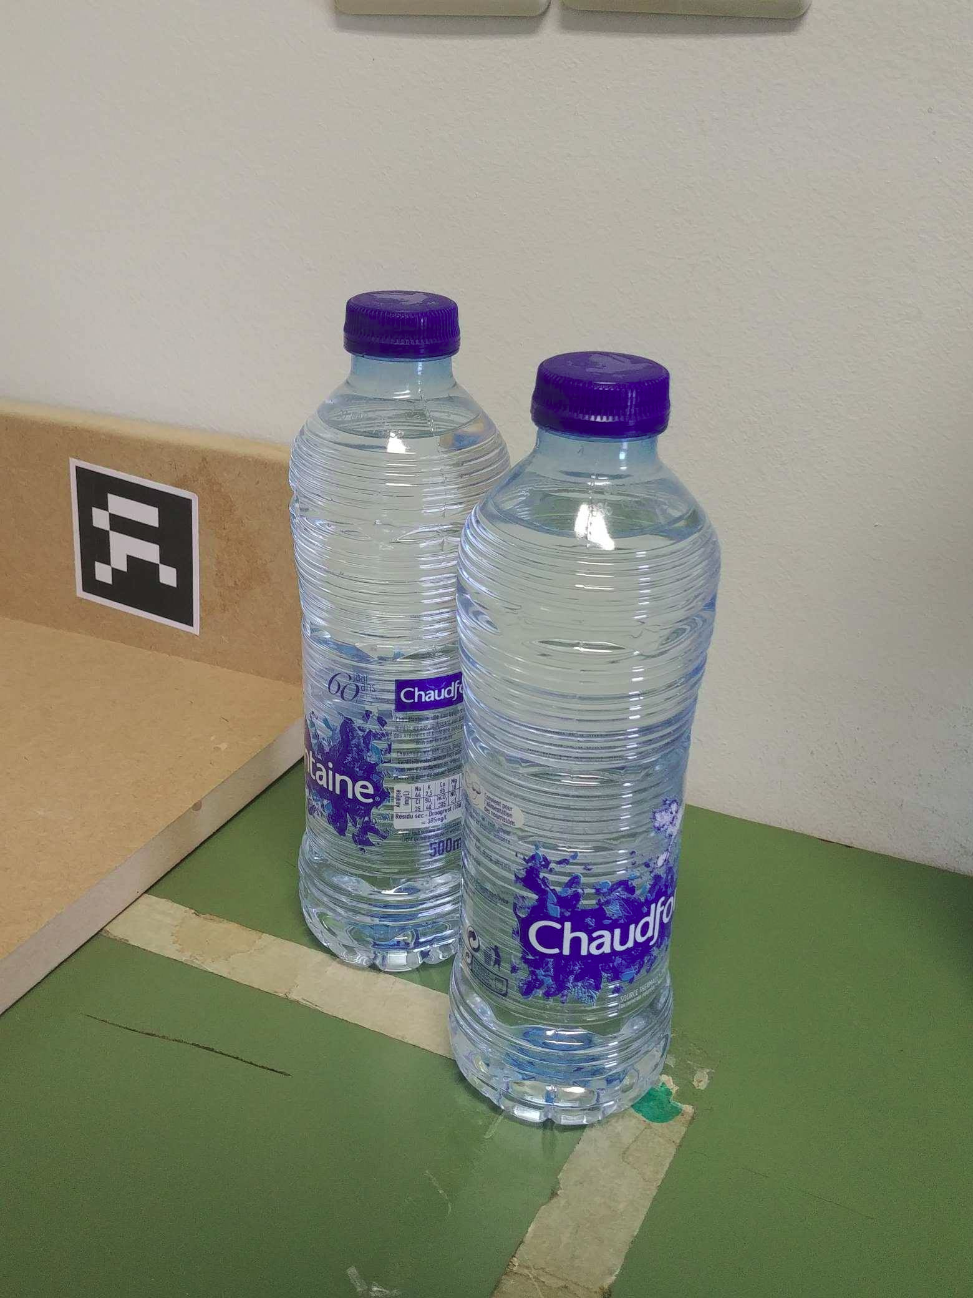
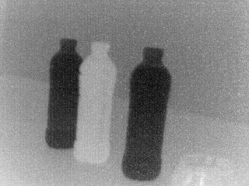
Robot’s features
Thermal imaging

Slide 7
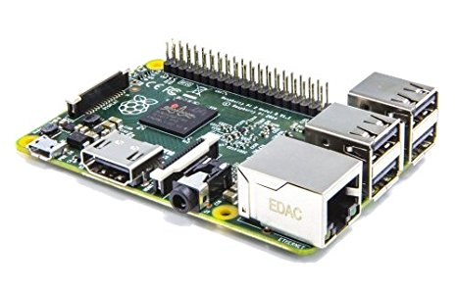
Robot’s design
Decision
Raspberry pi

Slide 8
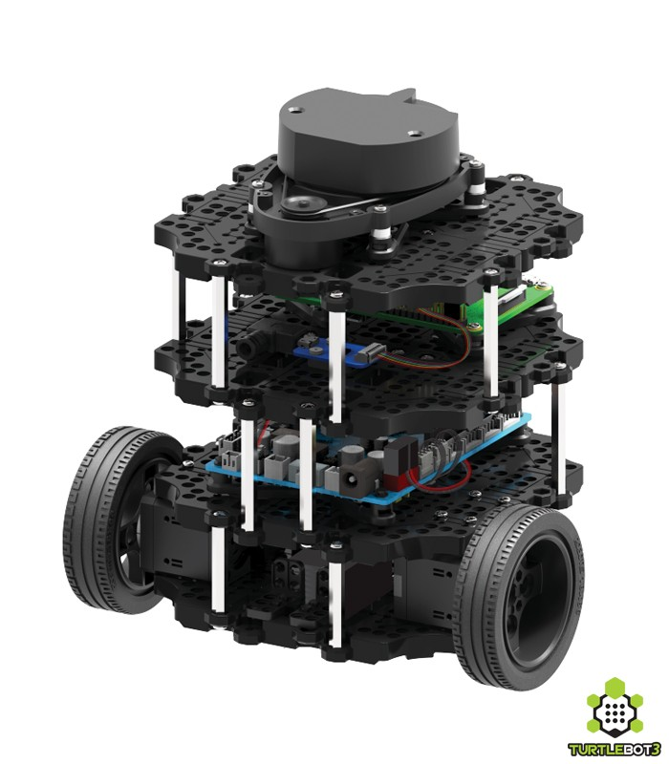
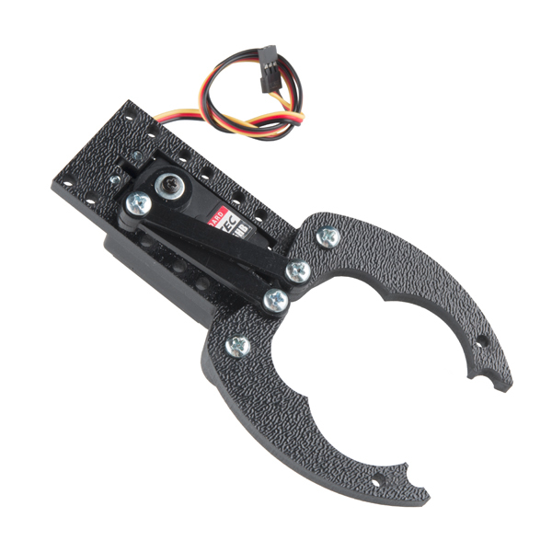
Robot’s design
Actuation
Motor: control wheels
Gripper

Slide 9
Node scheme
(Picture of the node scheme)

Slide 10
Planning:
(Picture of the planning)

Slide 11
Conclusion
(Conclusion)

