Slide 1

IP AnyCast
Group 1
池聪哲

Slide 2
Network Architecture
01 IP Communication

Slide 3
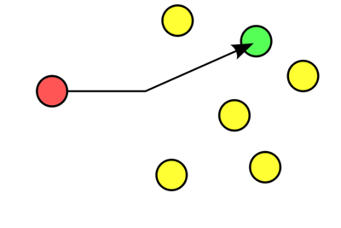
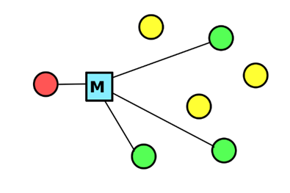
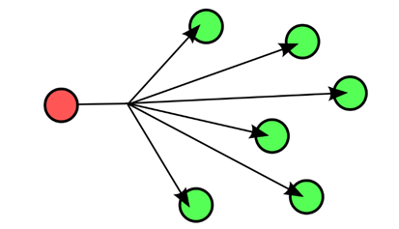
IP Communication
Network Architecture
Unicast IP
Multicast IP
Broadcast IP

Slide 4
Network Architecture
02 AnyCast

Slide 5
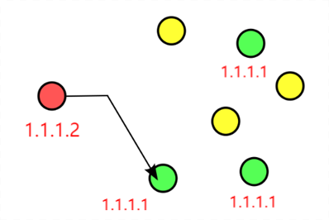
Def.
Network Architecture
IPv6
Share the same IP
One to Anyone
Basing on BGP

Slide 6
Network Architecture
03 Application

Slide 7
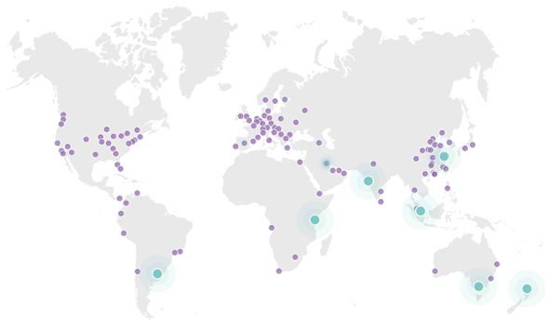
Network Architecture
CDN
Datacenters of Cloudflare

Slide 8
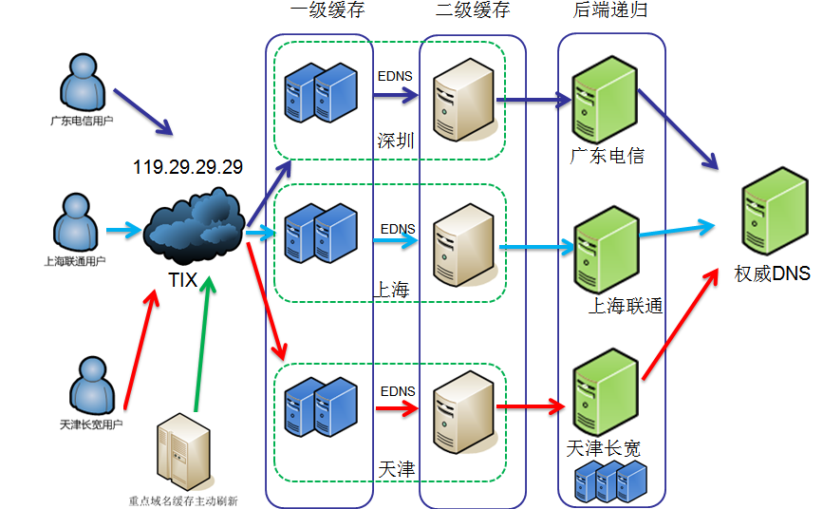
Network Architecture
DNS
DNSPod Public DNS+

Slide 9
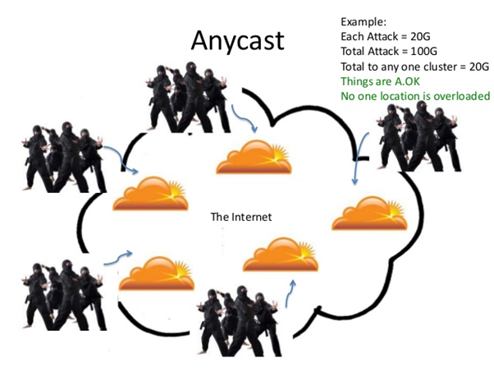
Network Architecture
DDoS Defense
Demo of DDoS Defense

Slide 10
Network Architecture
Summarize

Slide 11
Summary
Network Architecture
Advantages
Disadvantages
Load balancing
Suboptimal routing choices
DDoS defense
Complex configuration
Improve response speed
Improve robustness
Notes:
The recent Version of IP IPv6 has a greater advantage over IPv4. Here are some of the mentioned benefits:

Slide 12
Thanks
Group 1
池聪哲

