Slide 1


Group 1
池聪哲

Slide 2
Network Architecture
01Why HTTP/3 ?

Slide 3
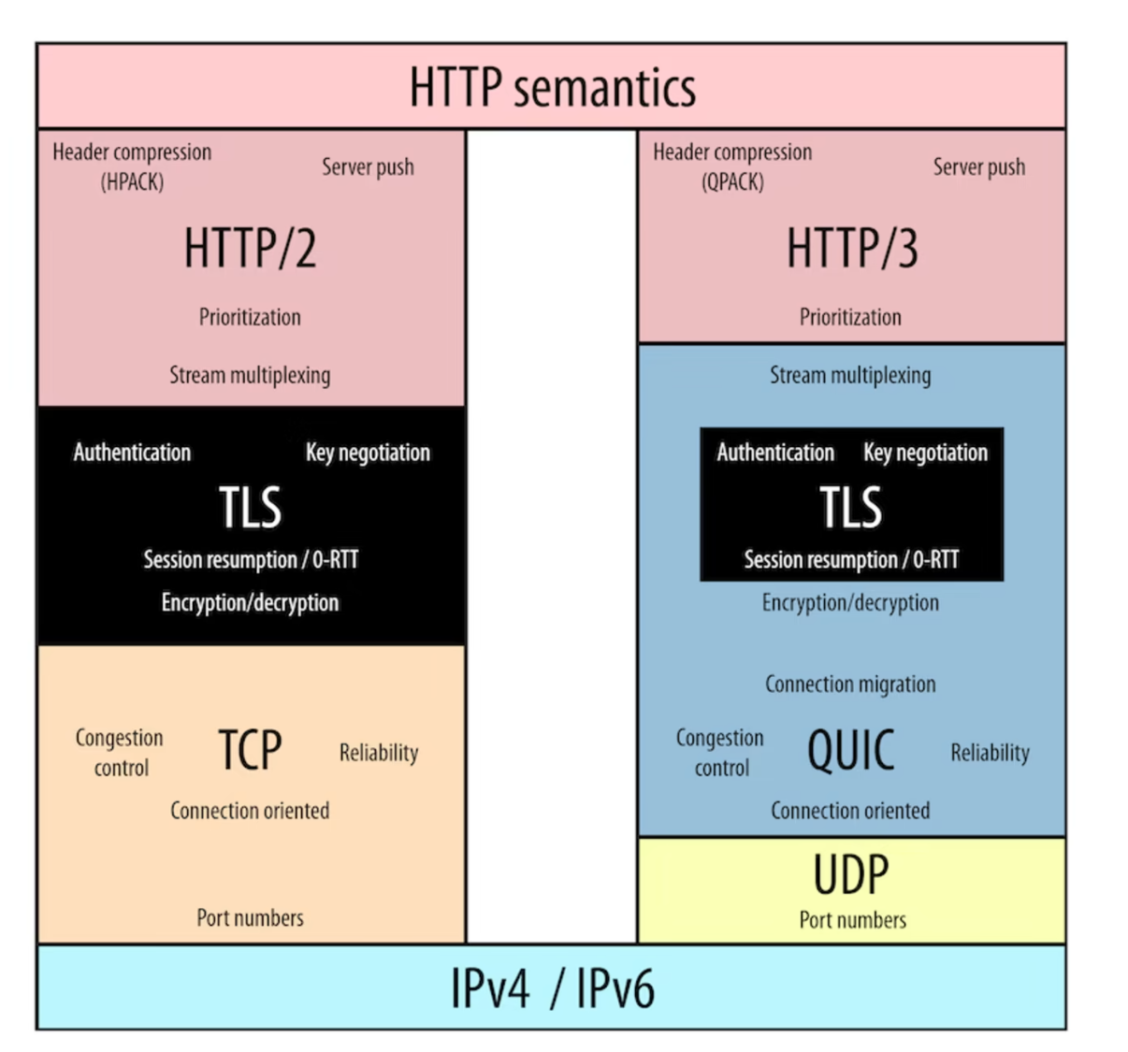
Protocol-stack HTTP/2 v.s. HTTP/3
Network Architecture
Handshake
Head-of-Line (HOL) blocking
Instead of TCP

Slide 4
Network Architecture
02 QUIC+UDP
Easier to deploy

Slide 5
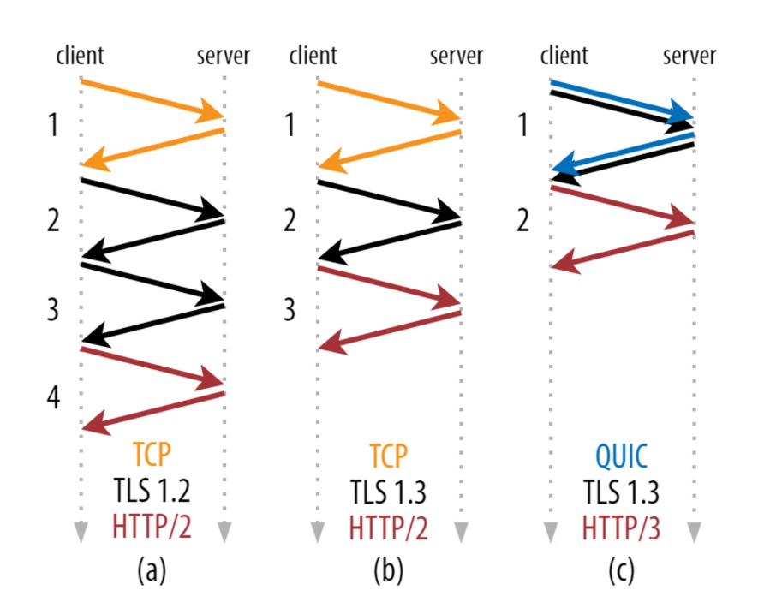
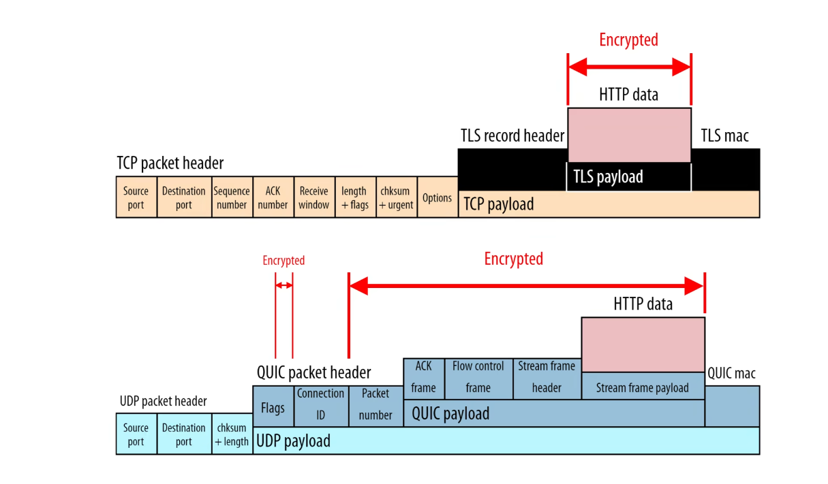
How QUIC improve TCP
Network Architecture
1.QUIC deeply integrates with TLS.
2.QUIC supports multiple independent byte streams.
3.QUIC uses connection IDs.
4.QUIC uses frames.

Slide 6
Network Architecture
03 Analysis

Slide 7
Network Architecture
Analysis
Advantages
Disadvantages
QUIC is more secure for its users.
QUIC’s connection set-up is faster.
QUIC can evolve more easily.
Many networks will hesitate to allow QUIC.
QUIC has a higher encryption overhead.
QUIC makes the web more centralized.

Slide 8
Network Architecture
03 Applications

Slide 9









Network Architecture
Applications

Slide 10
Network Architecture
Summarize

Slide 11
Summary
Network Architecture
To bypass issue while still improving TCP, we created the new QUIC protocol (which is really TCP 2.0 under the hood).
To make QUIC easier to deploy, it is run on top of the UDP protocol (which most network devices also support)
To make sure it can evolve in the future, it is almost entirely encrypted by default and makes use of a flexible framing mechanism.
Notes:
The recent Version of IP IPv6 has a greater advantage over IPv4. Here are some of the mentioned benefits:

Slide 12
Thanks
Group 1
池聪哲

