Slide 1

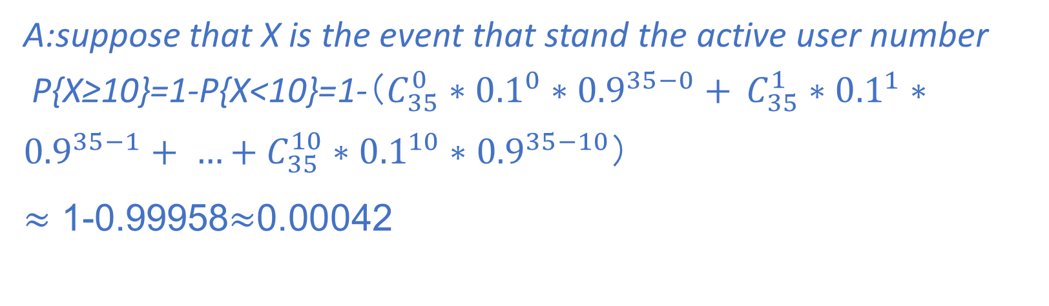
Homework for all
example:
1 Gb/s link
each user:
100 Mb/s when “active”
active 10% of time
…..
N
users
1 Gbps link
Q: how many users can use this network under circuit-switching and packet switching?
circuit-switching: 10 users
packet switching: with 35 users, probability > 10 active at same time is less than .0004 *
Q: how did we get value 0.0004?
A:suppose that X is the event that stand the active user number
P{X≥10}=1-P{X<10}=1-（$C_{35}^{0}∗{0.1}^{0}∗{0.9}^{35−0}+$ $C_{35}^{1}∗{0.1}^{1}∗{0.9}^{35−1}+ …+C_{35}^{10}∗{0.1}^{10}∗{0.9}^{35−10}$）
$≈$ 1-0.99958$≈$0.00042

Slide 2

IANA
Internet Assigned Numbers Authority

Slide 3

History
IANA was originally part of the United States Department of Defense's Advanced Research Projects Agency (ARPA) until the management of the Internet was transitioned to other organizations in the early 1990s.
In 1998, the Internet Corporation for Assigned Names and Numbers (ICANN) was formed and took over most of IANA's functions related to the Domain Name System (DNS), IP addresses, and protocol assignments.

Slide 4
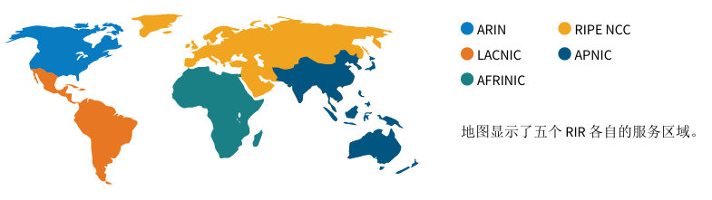
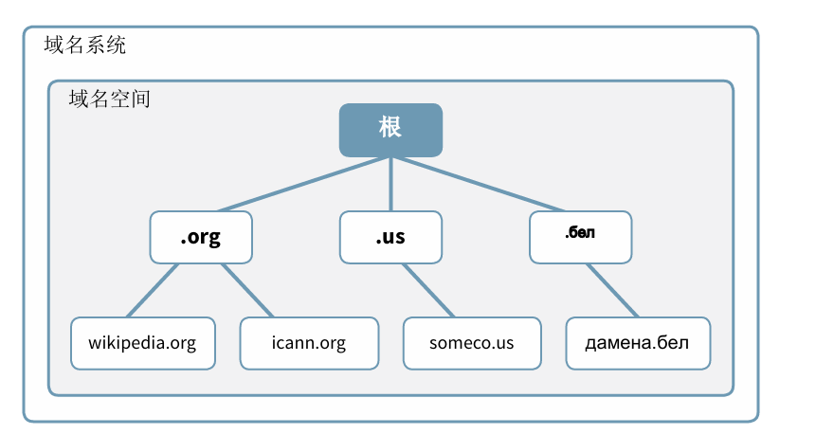
Functions
·IP Address Allocation: IANA is responsible for the global coordination of the Internet Protocol (IP) addressing system. It works with regional Internet registries (RIRs) to allocate IP address blocks to organizations.
DNS Root Zone Management: IANA manages the root zone file of the DNS, which is the authority over all top-level domains (TLDs), such as .com, .org, and country code TLDs like .us and .uk.
Protocol Assignments: IANA assigns numeric identifiers for internet protocols, which are essential for the functioning of internet applications and services.
Port Number Assignment: It assigns port numbers used by applications to ensure they can communicate over a network without interference.
Enterprise Number: IANA allocates enterprise numbers to organizations that allows them to create Object Identifiers (OIDs) for their own use in various network management and security standards.

Slide 5

Current Operator
The IANA functions are currently performed by PTI (Public Technical Identifiers), a California-based non-profit public benefit corporation that was created to take over these responsibilities.

Slide 6
Policy Remit
They do not directly set policy by which we operate, instead we implement agreed policies and principles in a neutral and responsible manner. Using the policy-setting forums provided by ICANN, policy development for domain name operations and IP addressing is arrived at by many different stakeholders. ICANN has a structure of supporting organizations that contribute to deciding how ICANN runs, which in turn informs how PTI is operated. The development of Internet protocols, which often dictate how protocol assignments should be managed, are arrived at within the Internet Engineering Task Force, the Internet Engineering Steering Group, and the Internet Architecture Board.
To improve its operations, we are actively involved in outreach too. As well as in ICANN forums, we participate in meetings and discussions with TLD operators, Regional Internet Registries, and other relevant communities. We provide manned helpdesks at key meetings to allow one-to-one interaction with our community of users, such as protocol developers and operators of critical Internet infrastructure.

Slide 7
THANKS

