Slide 1
IPv4 V.S. IPv6
Group 1
Congzhe Chi

Slide 2
Network Architecture
01 Header

Slide 3
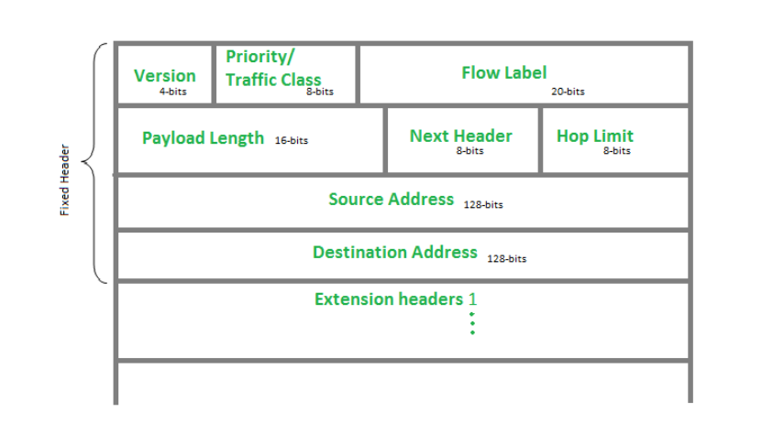
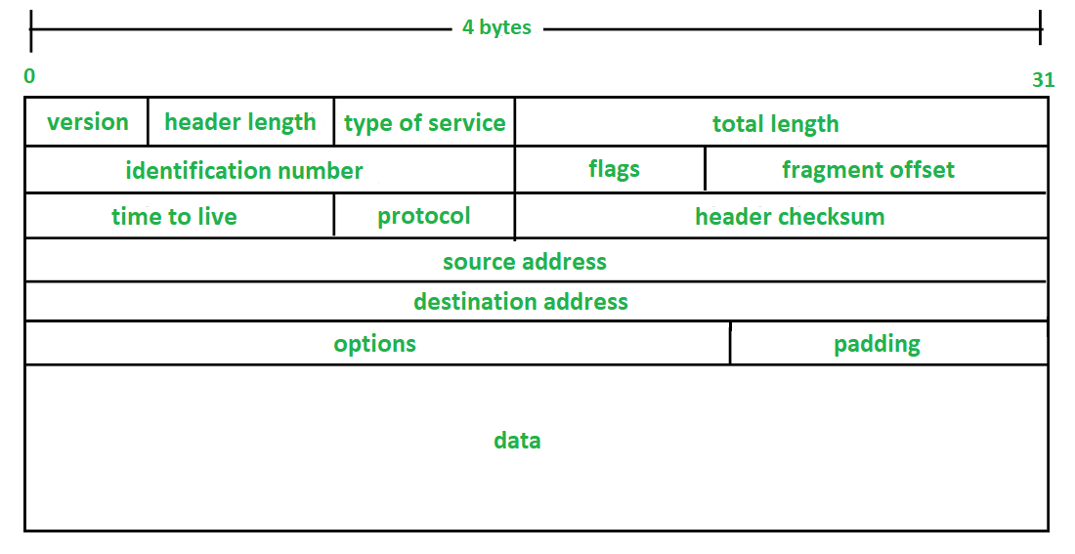
Header Analysis
Network Architecture
IPv4
IPv6

Slide 4
Network Architecture
02 Compare

Slide 5
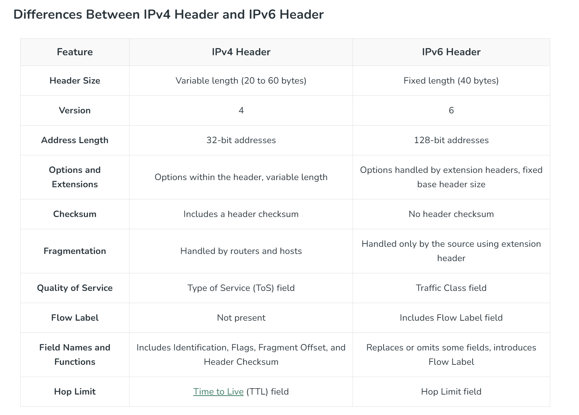
Network Architecture
Similarities and Differences

Slide 6
Network Architecture
03 Benefits

Slide 7
Network Architecture
Benefits of IPv6 over IPv4
Larger Address Space: IPv6 has a greater address space than IPv4, which is required for expanding the IP Connected Devices. IPv6 has 128 bit IP Address rather and IPv4 has a 32-bit Address.
Improved Security: IPv6 has some improved security which is built in with it. IPv6 offers security like Data Authentication, Data Encryption, etc. Here, an Internet Connection is more Secure.
Simplified Header Format: As compared to IPv4, IPv6 has a simpler and more effective header Structure, which is more cost-effective and also increases the speed of Internet Connection
Prioritize: IPv6 contains stronger and more reliable support for QoS features, which helps in increasing traffic over websites and increases audio and video quality on pages.
Improved Support for Mobile Devices: IPv6 has increased and better support for Mobile Devices. It helps in making quick connections over other Mobile Devices and in a safer way than IPv4.
Notes:
The recent Version of IP IPv6 has a greater advantage over IPv4. Here are some of the mentioned benefits:

Slide 8
Thanks
Group 1
Congzhe Chi

