Slide 1

OSPF,IS-IS&EIGRP
Group 1
Congzhe Chi

Slide 2
Network Architecture
01 OSPF

Slide 3
OSPF
Network Architecture
Type: Link-state routing protocol
Operation: OSPF uses Dijkstra’s algorithm to calculate the shortest path. It sends updates only when there are changes in the topology.
Hierarchical Design: Supports a two-level hierarchy (areas) which helps in reducing routing table size and controlling traffic.
Application Areas:
Primarily used in large enterprise networks and service provider environments.
Suitable for networks requiring scalability and fast convergence.
Percentage Usage: Approximately 30-40% in enterprise environments.

Slide 4
Network Architecture
02 IS-IS

Slide 5
Network Architecture
IS-IS
Type: Link-state routing protocol
Operation: Similar to OSPF, IS-IS also uses a link-state algorithm and operates within a two-level hierarchy.
Application Areas:
Commonly used in service provider networks, especially for IP and MPLS routing.
Often found in environments requiring robust routing solutions with a focus on scalability and stability.
Percentage Usage: Roughly 10-20%, primarily in service provider networks.

Slide 6
Network Architecture
03 EIGRP

Slide 7
EIGRP
Network Architecture
Type: Hybrid routing protocol (combines features of distance vector and link-state)
Operation: Uses the DUAL algorithm for path calculation, which allows for rapid convergence and support for variable-length subnet masking (VLSM).
Application Areas:
Widely used in Cisco environments and suitable for medium to large networks.
Excellent for networks with a mixture of different media types.
Percentage Usage: Around 20-30% in enterprise networks, particularly those that are predominantly Cisco-based.
Notes:
The recent Version of IP IPv6 has a greater advantage over IPv4. Here are some of the mentioned benefits:

Slide 8
Network Architecture
04 Comparison

Slide 9
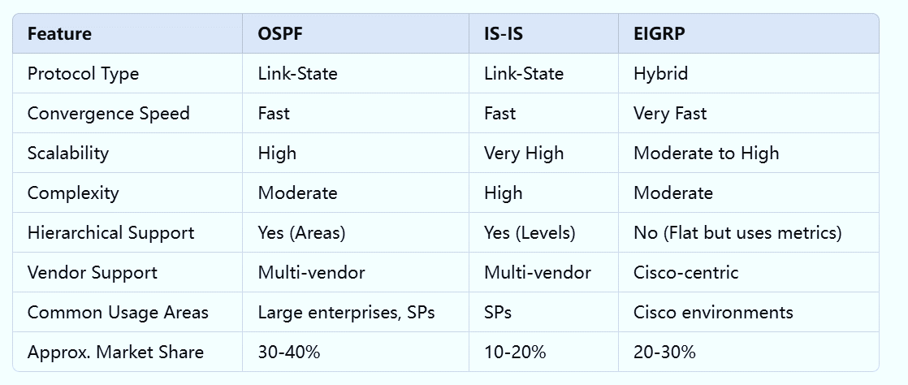
Summary of Comparison
Network Architecture
Notes:
The recent Version of IP IPv6 has a greater advantage over IPv4. Here are some of the mentioned benefits:

Slide 10
Thanks
Group 1
Congzhe Chi

