Slide 1

L2/L3/L4 switches
Group 1
池聪哲

Slide 2
Network Architecture
01 L2 switches Data Link Layer

Slide 3
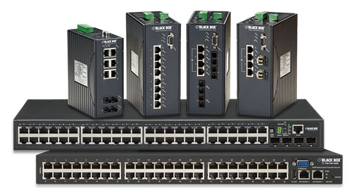
L2 switches
Network Architecture
Sort packets by MAC address
Feature more than two ports — usually four or more
May support multiple network speeds and have autosensing ports
Ports may be the same media type or may be mixed media (copper and fiber)
They are fast and easy to configure

Slide 4
Network Architecture
02 L3 switches Network Layer

Slide 5
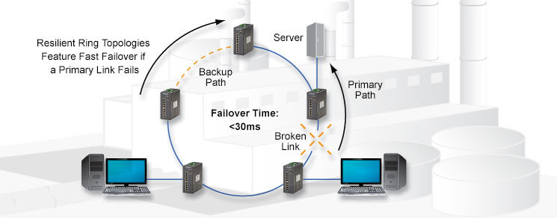
L3 switches
Network Architecture
Sort packets by MAC address
Route packets by IP address
Feature more than two ports — usually four or more
May support multiple network speeds and have autosensing ports
Ports may be the same media type or may be mixed media (copper and fiber)
They are slower and consume more power than Layer 2 switches

Slide 6
Network Architecture
03 L4 switches Transport Layer

Slide 7
L4 switches
Network Architecture
Sort packets by MAC address
Route packets by IP address
Prioritize packets by application
Feature more than two ports — usually four or more
May support multiple network speeds and have autosensing ports
Ports may be the same media type or may be mixed (copper and fiber)
They are slower and consume more power than Layer 3 switches
Before making your final decision on a switch, it would also be smart

Slide 8
Network Architecture
Summarize

Slide 9
Summary
Network Architecture
With regard to management options, the three primary classes of switches are Unmanaged Switches, Managed Switches, and Web Smart switches. Which you choose depends largely on the size of your network and how much control you need over that network.
Notes:
The recent Version of IP IPv6 has a greater advantage over IPv4. Here are some of the mentioned benefits:

Slide 10
Thanks
Group 1
池聪哲

