Slide 1
Effective Error Channels for Magic State Distillation
Aiden Karpf
2025 Global Quantum Leap Internship
Long Update

Slide 2
Outline
Ⅰ. Introduction
Research question / motivation
Magic state distillation
Steane encoding
1

Slide 3
Outline
Ⅰ. Introduction
Research question / motivation
Magic state distillation
Steane encoding
ⅠI. Effective Error Channels and Results
Process tomography
Simulating logical circuit with effective error channels
1

Slide 4
Outline
Ⅰ. Introduction
Research question / motivation
Magic state distillation
Steane encoding
ⅠI. Effective Error Channels and Results
Process tomography
Simulating logical circuit with effective error channels
ⅠII. Outlook
Simulating encoded circuit with base code for comparison?
1

Slide 5
Ⅰ. Introduction

Slide 6
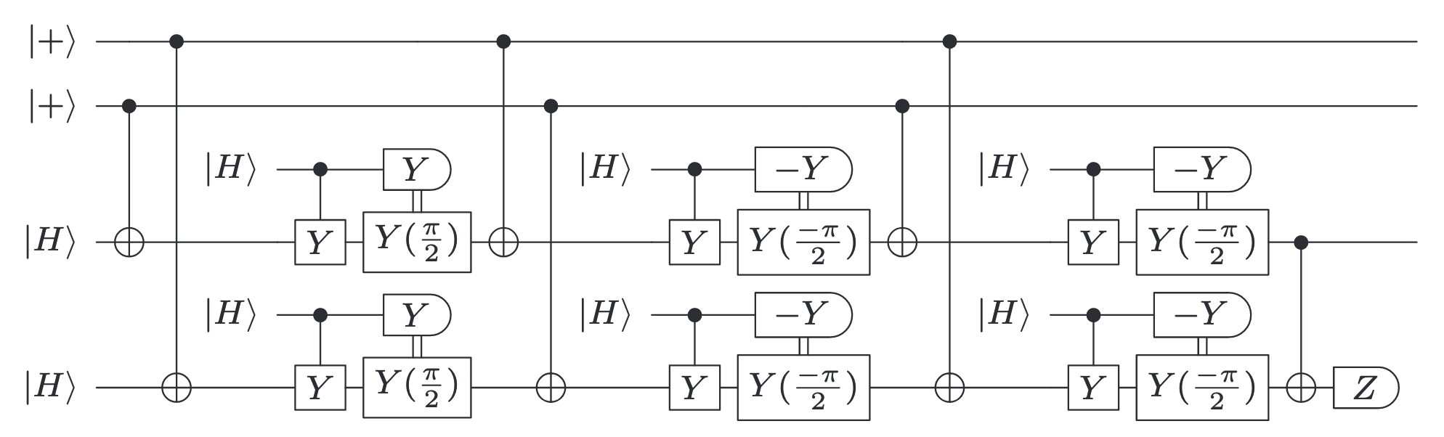
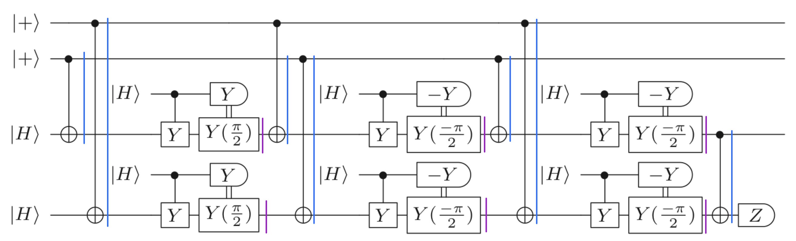
Research Question
Logical Circuit (6 qubits)
2

Slide 7
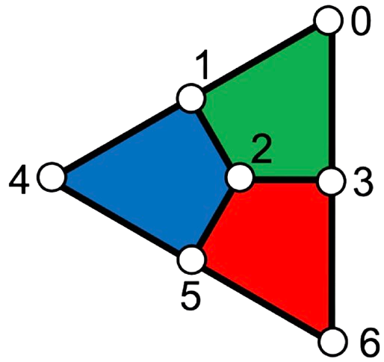
Research Question
Logical Circuit (6 qubits)
Encoded circuit with Steane code (50 qubits)
2

Slide 8
Research Question
Logical Circuit (6 qubits)
Noise depends on Steane-encoding !
Encoded circuit with Steane code (50 qubits)
2

Slide 9

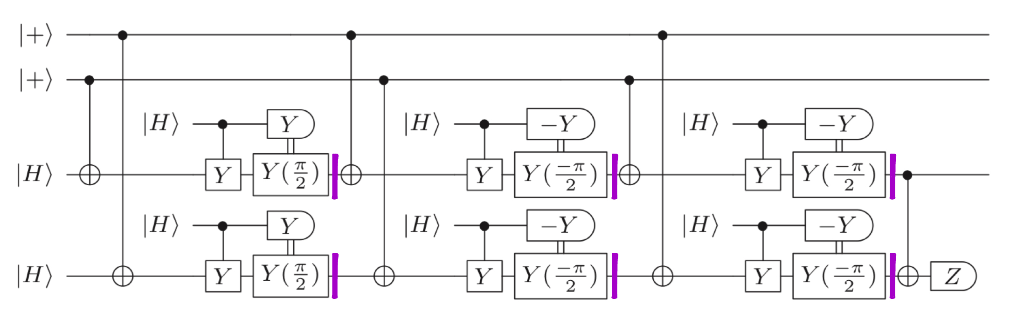
Research Question
= effective error channel 1
Logical Circuit (6 qubits)
Noise depends on Steane-encoding !
Encoded circuit with Steane code (50 qubits)
2

Slide 10
Research Question
= effective error channel 1
Logical Circuit (6 qubits)
Noise depends on Steane-encoding !
Encoded circuit with Steane code (50 qubits)
2

Slide 11

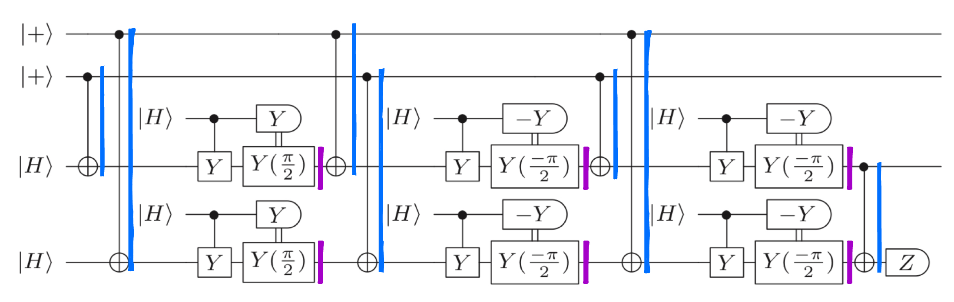
Research Question
= effective error channel 1
= effective error channel 2
Logical Circuit (6 qubits)
Noise depends on Steane-encoding !
Encoded circuit with Steane code (50 qubits)
2

Slide 12
Research Question
= effective error channel 1
= effective error channel 2
Logical circuit with effective error channels
Logical Circuit (6 qubits)
Encoded circuit with Steane code (50 qubits)
2

Slide 13
Research Question
= effective error channel 1
= effective error channel 2
Logical circuit with effective error channels
Logical Circuit (6 qubits)
Fully encoded circuit with base code
Encoded circuit with Steane code (50 qubits)
2

Slide 14

Research Question
= effective error channel 1
= effective error channel 2
Logical circuit with effective error channels
Logical Circuit (6 qubits)
Fully encoded circuit with base code
Encoded circuit with Steane code (50 qubits)
2

Slide 15
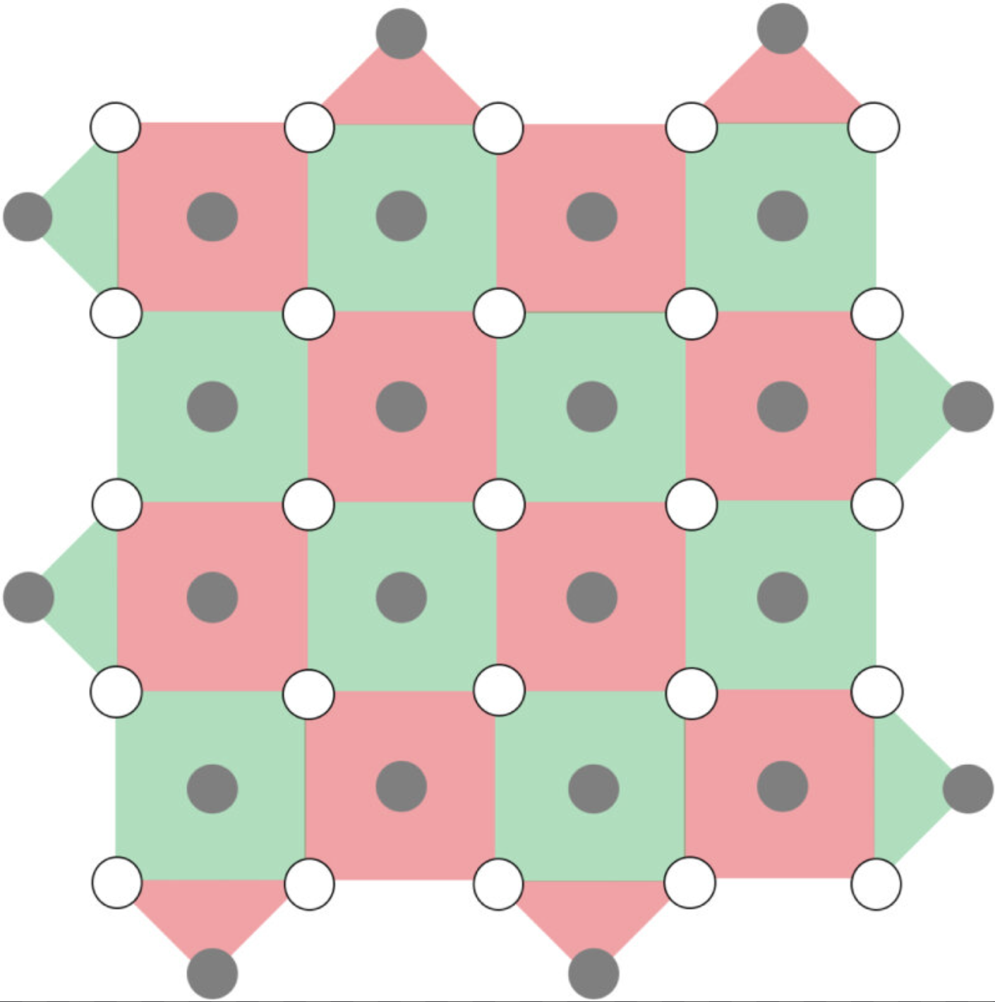
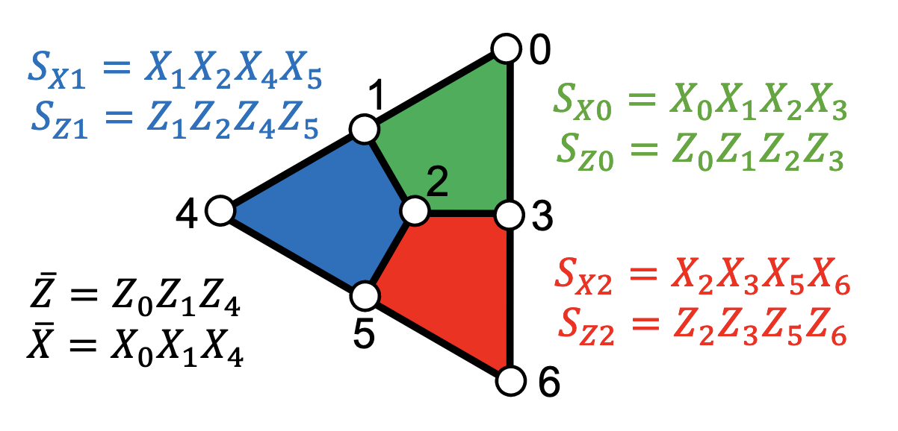
Why QEC?
3

Slide 16
Why QEC?
Physical error rates in experiment: ~10⁻⁴
3

Slide 17
Why QEC?
Physical error rates in experiment: ~10⁻⁴
Logical error rates required for algorithms: ~10⁻¹⁵
3

Slide 18
Why QEC?
Physical error rates in experiment: ~10⁻⁴
Logical error rates required for algorithms: ~10⁻¹⁵
QEC allows us to close the gap
3

Slide 19
Why Magic States?
4

Slide 20
Why Magic States?
Clifford circuits can be simulated efficiently (Gottesman-Knill)
4

Slide 21
Why Magic States?
Clifford circuits can be simulated efficiently (Gottesman-Knill)
At least one non-Clifford gate is required for a universal gate set
4

Slide 22
Why Magic States?
Clifford circuits can be simulated efficiently (Gottesman-Knill)
At least one non-Clifford gate is required for a universal gate set
No QEC code can transversally implement a universal gate set (Eastin-Knill)
4

Slide 23
Why Magic States?
Clifford circuits can be simulated efficiently (Gottesman-Knill)
At least one non-Clifford gate is required for a universal gate set
No QEC code can transversally implement a universal gate set (Eastin-Knill)
Magic states can be injected to realize a non-Clifford gate
4

Slide 24
Why Magic States?
Clifford circuits can be simulated efficiently (Gottesman-Knill)
At least one non-Clifford gate is required for a universal gate set
No QEC code can transversally implement a universal gate set (Eastin-Knill)
Magic states can be injected to realize a non-Clifford gate
4

Slide 25
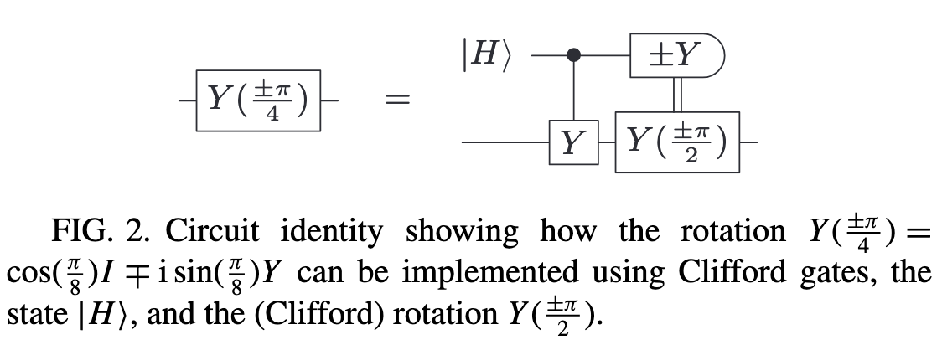
Why Magic States?
Clifford circuits can be simulated efficiently (Gottesman-Knill)
At least one non-Clifford gate is required for a universal gate set
No QEC code can transversally implement a universal gate set (Eastin-Knill)
Magic states can be injected to realize a non-Clifford gate
Magic state injection
4

Slide 26
Why Distillation?
5

Slide 27

Why Distillation?
Physical preparation of magic states (e.g., $\left|H\right\rangle$) are noisy
5

Slide 28
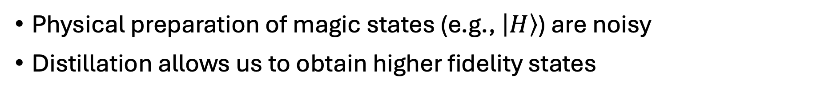
Why Distillation?
Physical preparation of magic states (e.g., $\left|H\right\rangle$) are noisy
Distillation allows us to obtain higher fidelity states
5

Slide 29
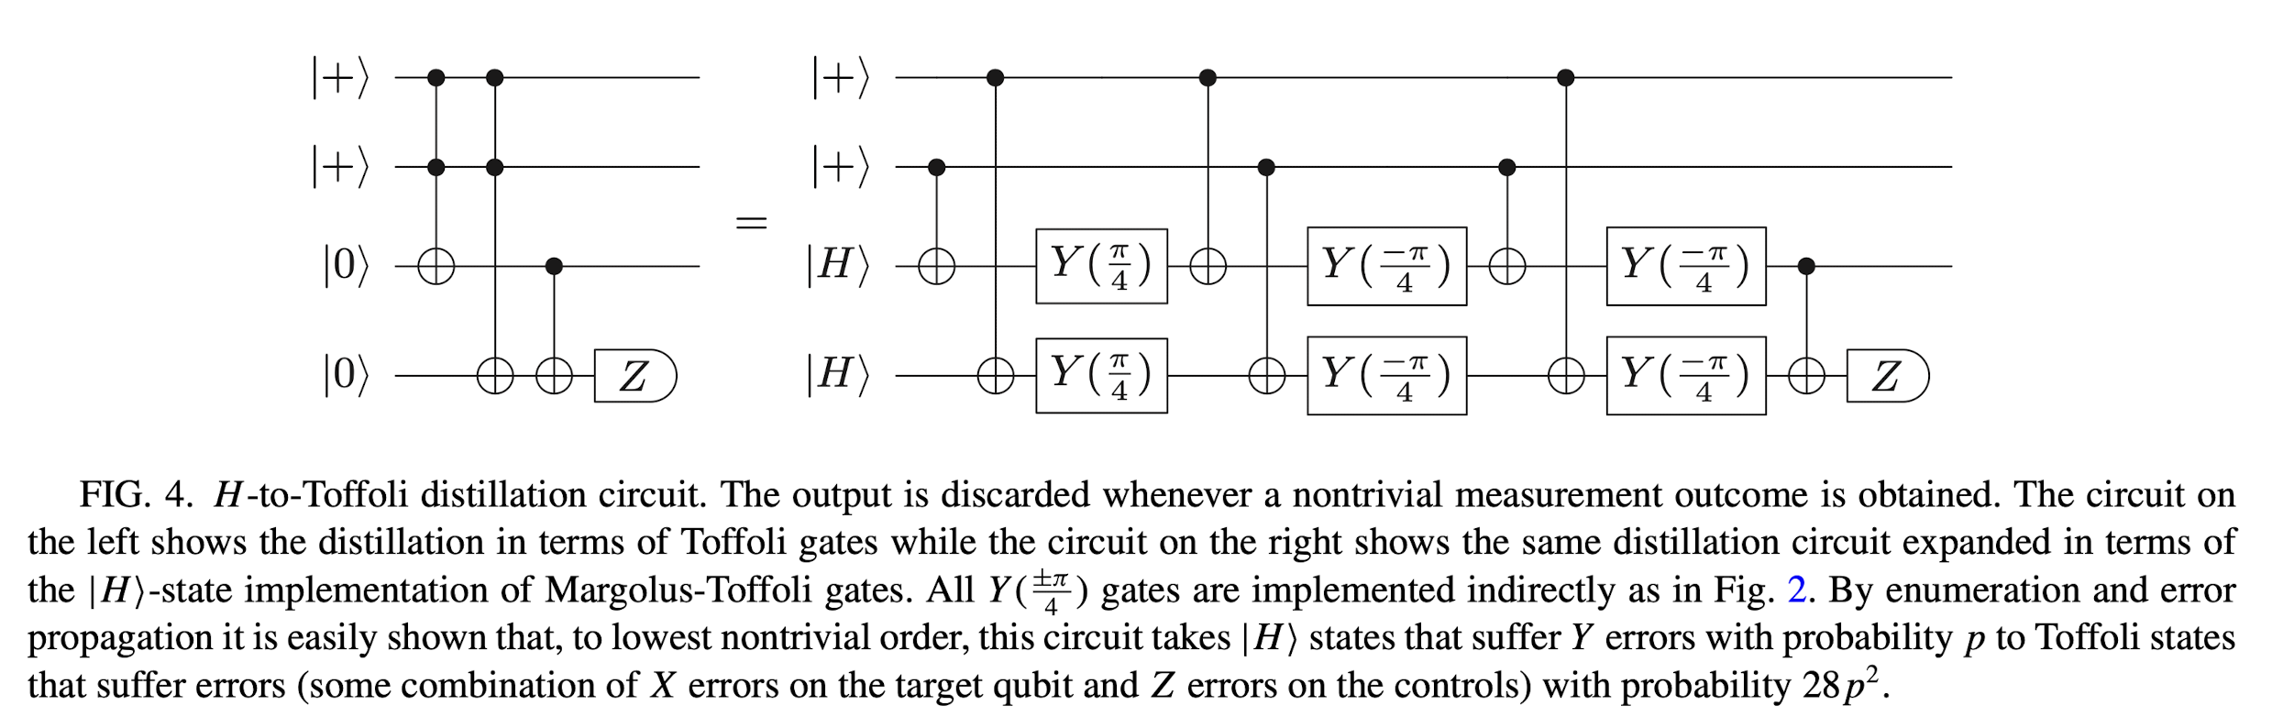
Why Distillation?
Physical preparation of magic states (e.g., $\left|H\right\rangle$) are noisy
Distillation allows us to obtain higher fidelity states
FIG. 1. $\left|H\right\rangle$- to- $\left|\text{Toffoli}\right\rangle$ Distillation Circuit (Eastin 2013)
5

Slide 30
Why Distillation?
Physical preparation of magic states (e.g., $\left|H\right\rangle$) are noisy
Distillation allows us to obtain higher fidelity states
FIG. 1. $\left|H\right\rangle$- to- $\left|\text{Toffoli}\right\rangle$ Distillation Circuit (Eastin 2013)
What’s going on here?
5

Slide 31
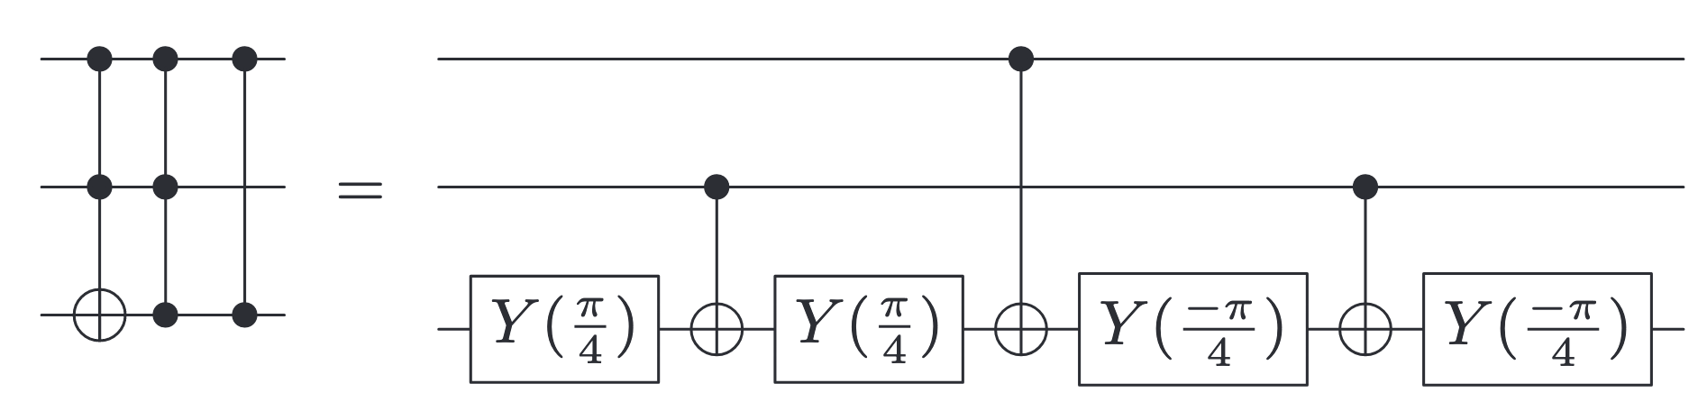
Relevant Decompositions and Identities
FIG. 2
6

Slide 32
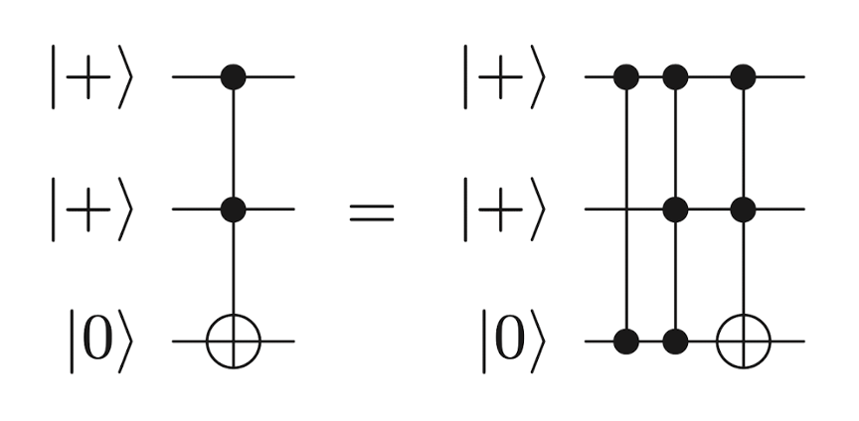
Relevant Decompositions and Identities
FIG. 2
FIG. 3
6

Slide 33

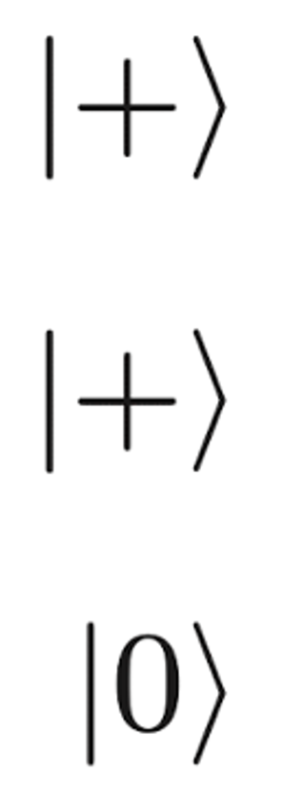
Relevant Decompositions and Identities
FIG. 2
FIG. 3
FIG. 2 + 3
6

Slide 34
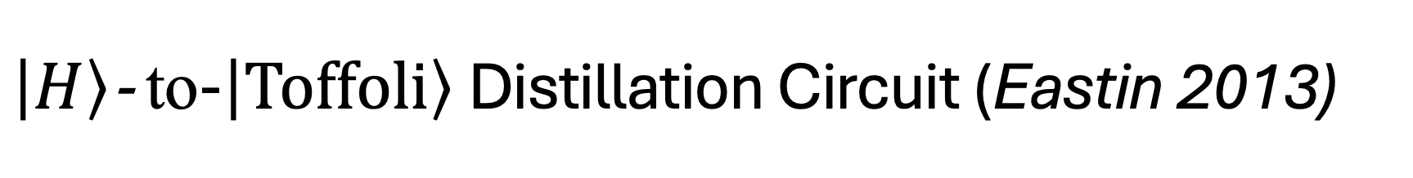
$\left|H\right\rangle$- to-$\left|\text{Toffoli}\right\rangle$ Distillation Circuit (Eastin 2013)
FIG. 1. H-to-Toffoli Distillation circuit. The output is discarded whenever a non-trivial outcome is obtained.
7

Slide 35
$\left|H\right\rangle$- to-$\left|\text{Toffoli}\right\rangle$ Distillation Circuit (Eastin 2013)
FIG. 1. H-to-Toffoli Distillation circuit. The output is discarded whenever a non-trivial outcome is obtained.
FIG. 2 + 3
7

Slide 36
$\left|H\right\rangle$- to-$\left|\text{Toffoli}\right\rangle$ Distillation Circuit (Eastin 2013)
FIG. 1. H-to-Toffoli Distillation circuit. The output is discarded whenever a non-trivial outcome is obtained.
FIG. 2 + 3
7

Slide 37
$\left|H\right\rangle$- to-$\left|\text{Toffoli}\right\rangle$ Distillation Circuit (Eastin 2013)
FIG. 1. H-to-Toffoli Distillation circuit. The output is discarded whenever a non-trivial outcome is obtained.
FIG. 2 + 3
7

Slide 38
$\left|H\right\rangle$- to-$\left|\text{Toffoli}\right\rangle$ Distillation Circuit (Eastin 2013)
Flag
Flag
FIG. 1. H-to-Toffoli Distillation circuit. The output is discarded whenever a non-trivial outcome is obtained.
7

Slide 39
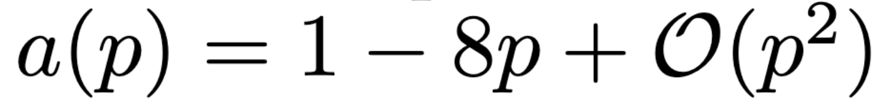
$\left|H\right\rangle$- to-$\left|\text{Toffoli}\right\rangle$ Distillation Circuit (Eastin 2013)
Flag
Flag
FIG. 1. H-to-Toffoli Distillation circuit. The output is discarded whenever a non-trivial outcome is obtained.
Output acceptance rate of the circuit is
7

Slide 40
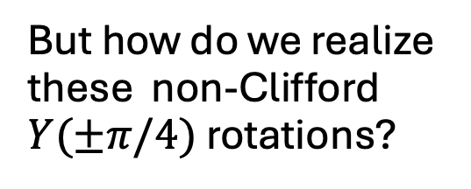
$\left|H\right\rangle$- to-$\left|\text{Toffoli}\right\rangle$ Distillation Circuit (Eastin 2013)
FIG. 1. H-to-Toffoli Distillation circuit. The output is discarded whenever a non-trivial outcome is obtained.
But how do we realize these non-Clifford $Y(±π/4)$ rotations?
7

Slide 41
$\left|H\right\rangle$- to-$\left|\text{Toffoli}\right\rangle$ Distillation Circuit (Eastin 2013)
FIG. 1. H-to-Toffoli Distillation circuit. The output is discarded whenever a non-trivial outcome is obtained.
But how do we realize these non-Clifford $Y(±π/4)$ rotations?
FIG. 4
7

Slide 42
$\left|H\right\rangle$- to-$\left|\text{Toffoli}\right\rangle$ Distillation Circuit (Eastin 2013)
= non-Clifford
FIG. 1. H-to-Toffoli Distillation circuit. The output is discarded whenever a non-trivial outcome is obtained.
But how do we realize these non-Clifford $Y(±π/4)$ rotations?
FIG. 4
7

Slide 43
Full Logical Distillation Circuit
FIG. 5. Complete logical H-to-Toffoli distillation circuit.
8

Slide 44
Full Logical Distillation Circuit
FIG. 5. Complete logical H-to-Toffoli distillation circuit.
8

Slide 45

Full Logical Distillation Circuit
$$\left|\text{Toffoli}\right\rangle$$
FIG. 5. Complete logical H-to-Toffoli distillation circuit.
8

Slide 46
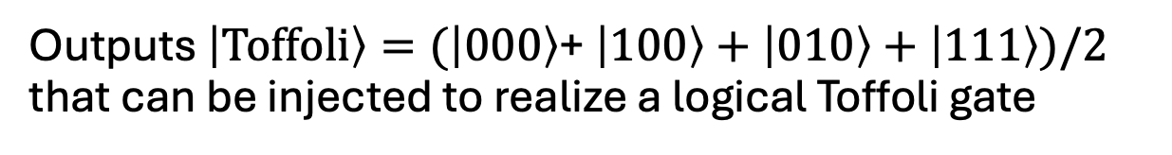
Full Logical Distillation Circuit
$$\left|\text{Toffoli}\right\rangle$$
FIG. 5. Complete logical H-to-Toffoli distillation circuit.
Outputs $\left|\text{Toffoli}\right\rangle =(\left|\text{000}\right\rangle$+ $\left|\text{1}\text{00}\right\rangle +\left|\text{0}\text{1}\text{0}\right\rangle +\left|\text{111}\right\rangle )/2$ that can be injected to realize a logical Toffoli gate
8

Slide 47
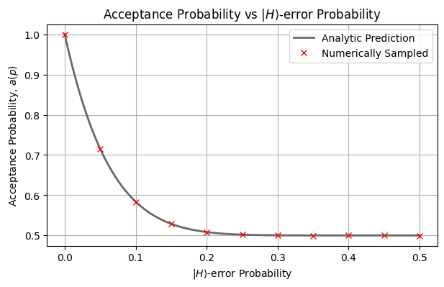

Reproducing $a(p)$, $e\left(p\right)a(p)$, for the Logical Circuit
Assuming perfect Cliffords!
9

Slide 48
Reproducing $a(p)$, $e\left(p\right)a(p)$, for the Logical Circuit
Assuming perfect Cliffords!
9

Slide 49
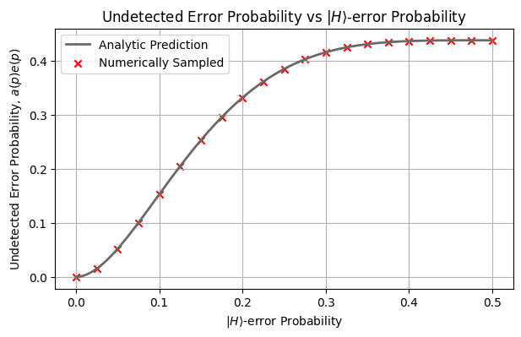
Reproducing $a(p)$, $e\left(p\right)a(p)$, for the Logical Circuit
Assuming perfect Cliffords!
9

Slide 50
Reproducing $a(p)$, $e\left(p\right)a(p)$, for the Logical Circuit
Assuming perfect Cliffords!
Confirms our circuit is implemented correctly, but…
9

Slide 51
Reproducing $a(p)$, $e\left(p\right)a(p)$, for the Logical Circuit
Assuming perfect Cliffords!
Confirms our circuit is implemented correctly, but…
when is it useful?
9

Slide 52
Undetected Error Probability, a Closer Examination
10

Slide 53
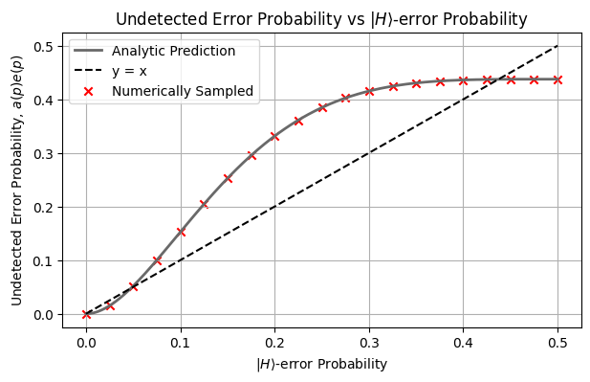
Undetected Error Probability, a Closer Examination
10

Slide 54
Undetected Error Probability, a Closer Examination
10

Slide 55
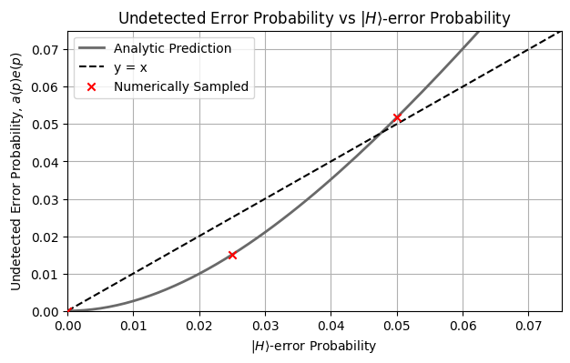
Undetected Error Probability, a Closer Examination
10

Slide 56
Undetected Error Probability, a Closer Examination
More on this later
10

Slide 57
Recall Research Question and Outline
Logical circuit with effective error channels
Fully encoded circuit with base code
11

Slide 58
Recall Research Question and Outline
Logical circuit with effective error channels
Logical circuit
Encoding our logical circuit
Constructing our effective error channels
Fully encoded circuit with base code
11

Slide 59
Recall Research Question and Outline
Logical circuit with effective error channels
Logical circuit
Encoding our logical circuit
Constructing our effective error channels
Fully encoded circuit with base code
11

Slide 60
Recall Research Question and Outline
Logical circuit with effective error channels
Logical circuit
Encoding our logical circuit
Constructing our effective error channels
Fully encoded circuit with base code
11

Slide 61
Recall Research Question and Outline
Logical circuit with effective error channels
Logical circuit
Encoding our logical circuit
Constructing our effective error channels
Fully encoded circuit with STEANE CODE
11

Slide 62
Steane-encoding
The Steane Code
Detects and corrects all weight-1 errors
All Clifford gates can be implemented transversally
12

Slide 63
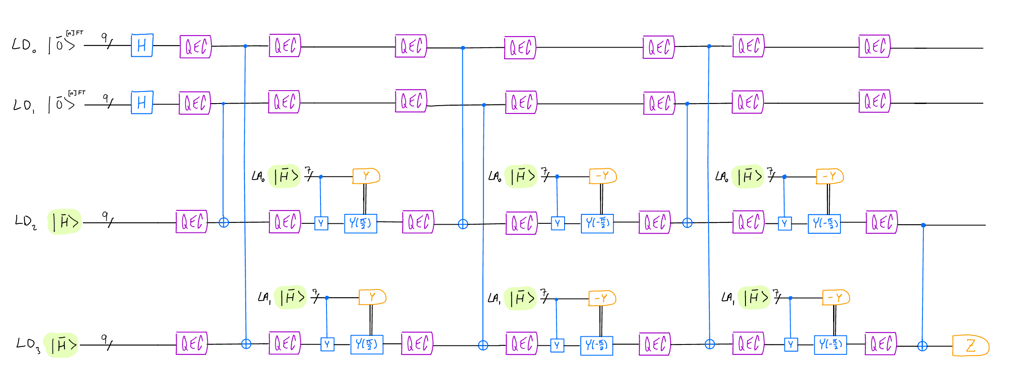
Full Steane-encoded Circuit
FIG. 6. Complete Steane-encoded $\left|H\right\rangle$- $\left|\text{Toffoli}\right\rangle$ distillation circuit we want to simulate.
12

Slide 64
ⅠⅠ. Effective Error Channels

Slide 65
Process Tomography:
A method to reconstruct a full error channel describing the noise of a component under an arbitrary input state
13

Slide 66
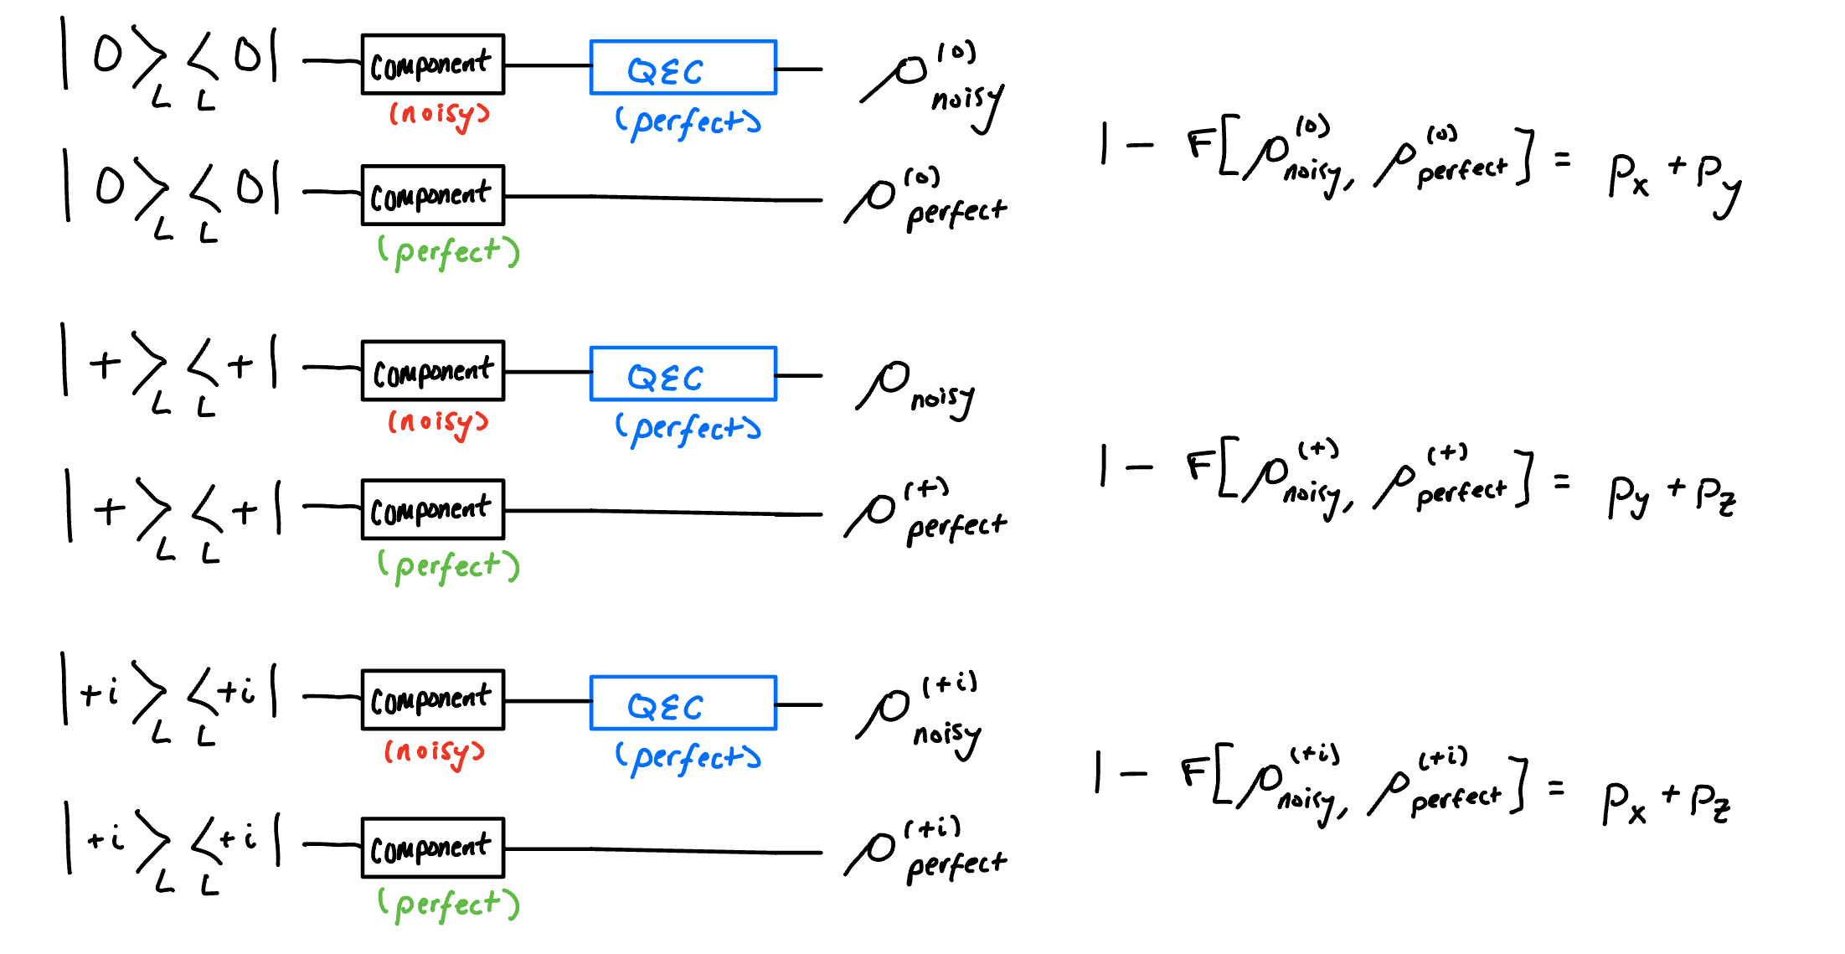
One-Qubit Process Tomography
13

Slide 67
One-Qubit Process Tomography
x
13

Slide 68
One-Qubit Process Tomography
13

Slide 69
One-Qubit Process Tomography
13

Slide 70
One-Qubit Process Tomography
13

Slide 71
One-Qubit Process Tomography
13

Slide 72
One-Qubit Process Tomography
13

Slide 73
One-Qubit Process Tomography
13

Slide 74
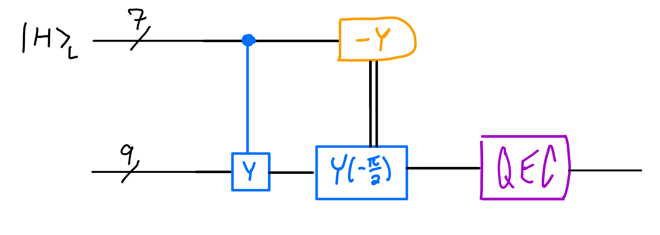
Logical Injection Circuit Tomography
14

Slide 75
Logical Injection Circuit Tomography
14

Slide 76
Logical Injection Circuit Tomography
14

Slide 77

Logical Injection Circuit Tomography
$\left|0\right\rangle L$
14

Slide 78

Logical Injection Circuit Tomography
$\left|0\right\rangle L$
14

Slide 79

Logical Injection Circuit Tomography
$\left|+\right\rangle L$
14

Slide 80
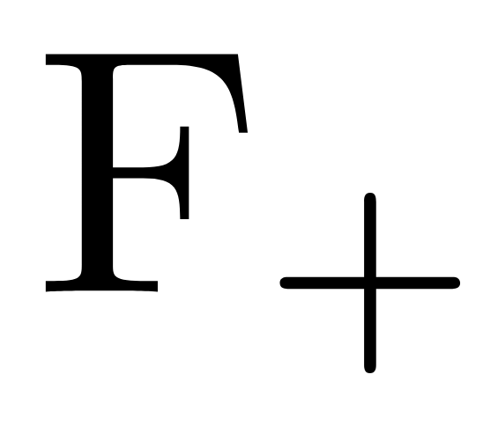

Logical Injection Circuit Tomography
$\left|+\right\rangle L$
14

Slide 81

Logical Injection Circuit Tomography
$\left|+i\right\rangle L$
14

Slide 82
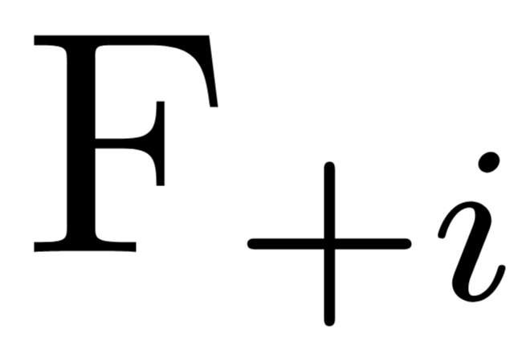
Logical Injection Circuit Tomography
$\left|+i\right\rangle L$
14

Slide 83
Logical Injection Circuit Tomography
$\left|+i\right\rangle L$
solve system of equations, construct error channel
14

Slide 84
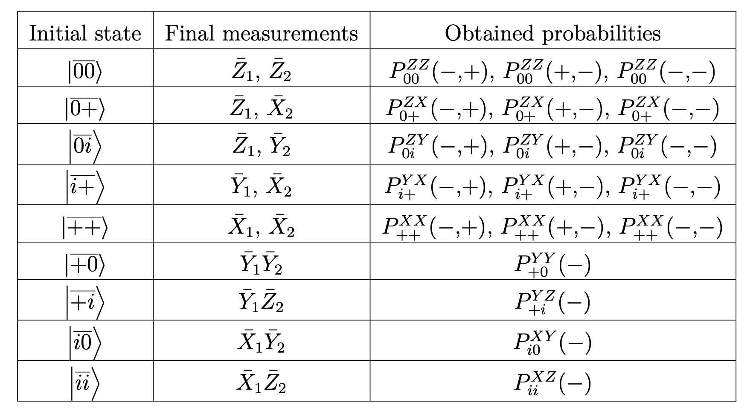
Two-Qubit Process Tomography (thanks Aron)
15

Slide 85
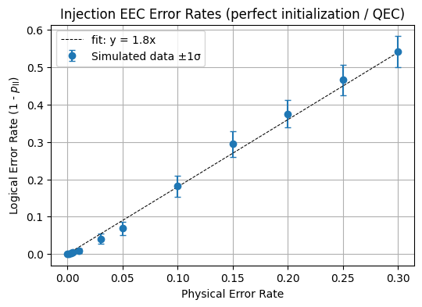

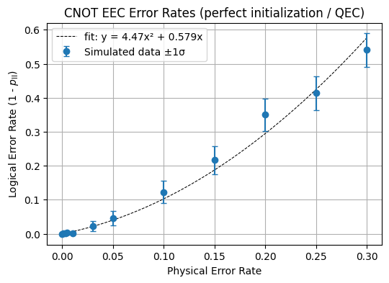
Effective Error Channels PER vs LER
16

Slide 86
Effective Error Channels PER vs LER
16

Slide 87
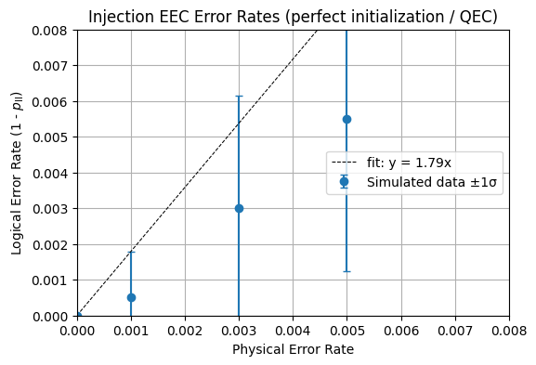
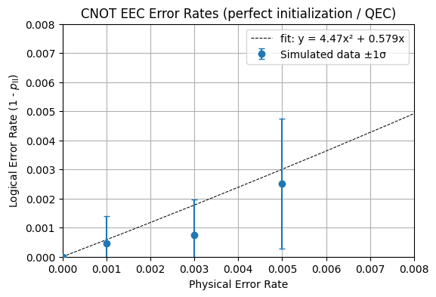
Effective Error Channels PER vs LER
16

Slide 88
Applying Effective Error Channels to Logical Circuit
17

Slide 89
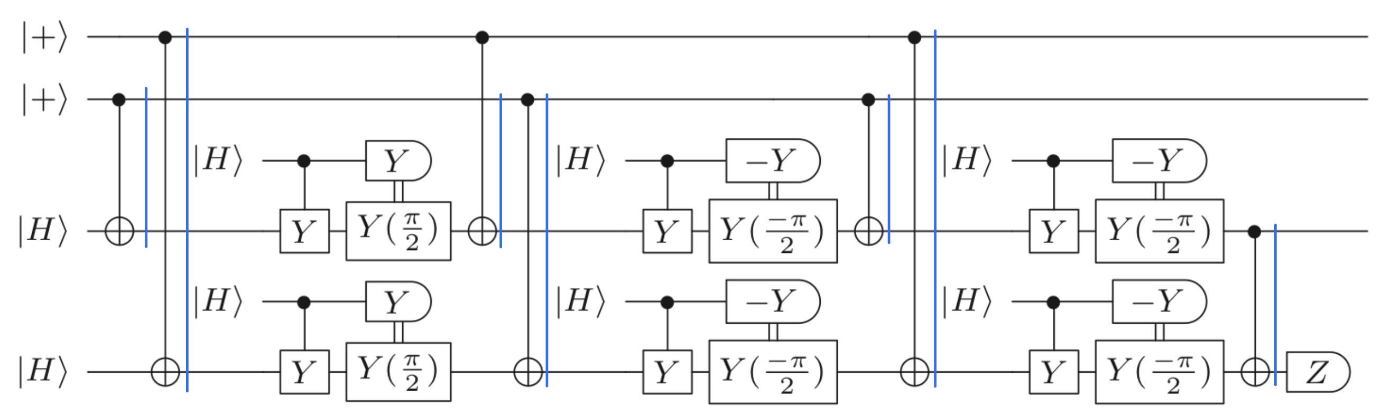
Applying Effective Error Channels to Logical Circuit
= Injection circuit effective error channel
17

Slide 90
Applying Effective Error Channels to Logical Circuit
= Injection circuit effective error channel
= CNOT effective error channel
17

Slide 91
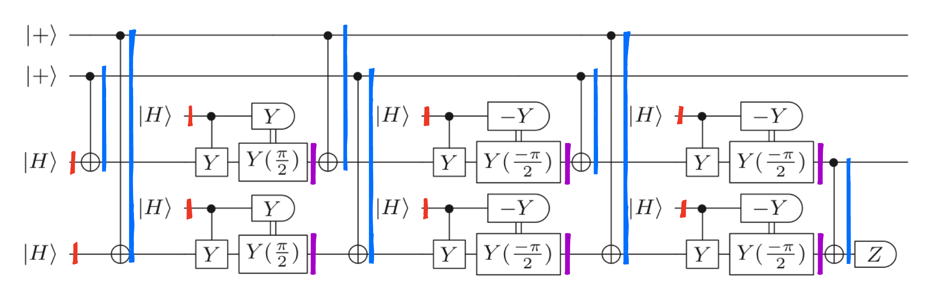
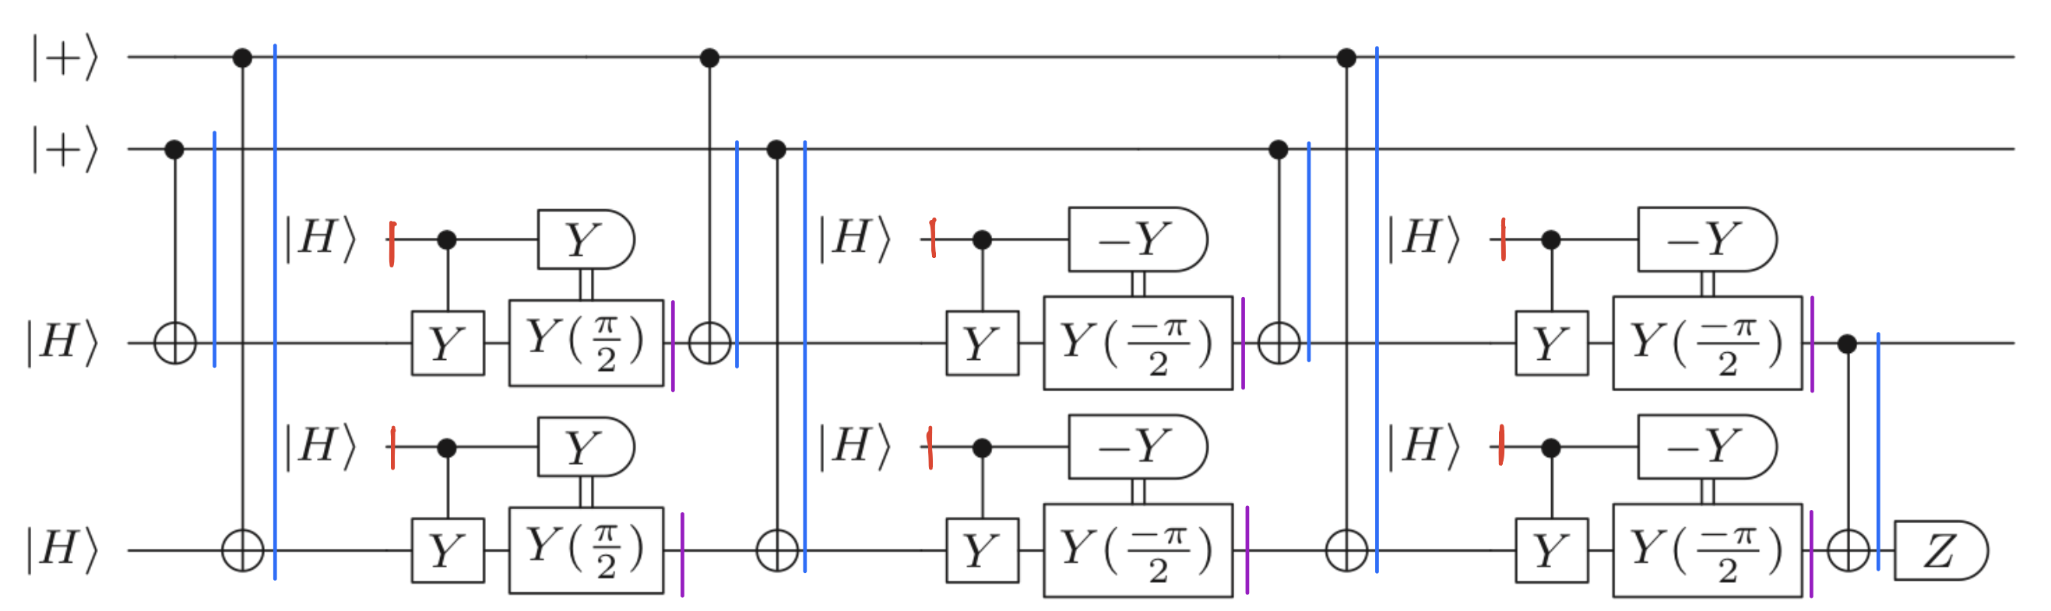


Applying Effective Error Channels to Logical Circuit
= Injection circuit effective error channel
= CNOT effective error channel
= $\left|H\right\rangle$initialization error channel
17

Slide 92
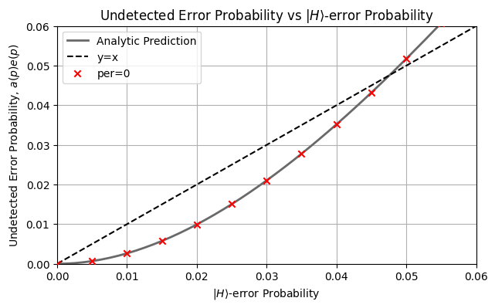
Undetected Error Probability for the Logical Circuit with Circuit-level Noise (Perfect QEC and Initialization)
18

Slide 93
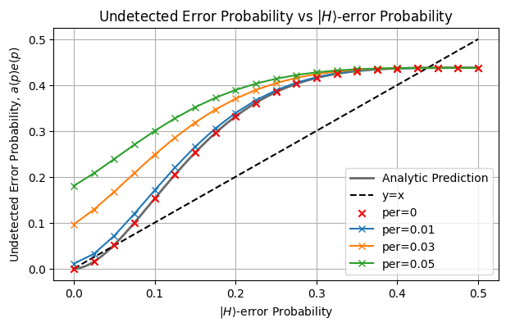
Undetected Error Probability for the Logical Circuit with Circuit-level Noise (Perfect QEC and Initialization)
18

Slide 94
Undetected Error Probability for the Logical Circuit with Circuit-level Noise (Perfect QEC and Initialization)
18

Slide 95
Undetected Error Probability for the Logical Circuit with Circuit-level Noise (Perfect QEC and Initialization)
18

Slide 96
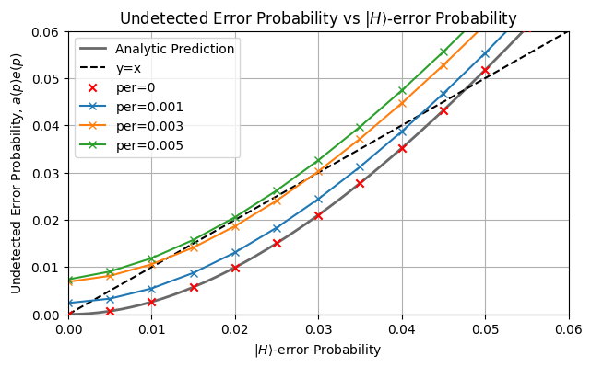
Undetected Error Probability for the Logical Circuit with Circuit-level Noise (Perfect QEC and Initialization)
18

Slide 97
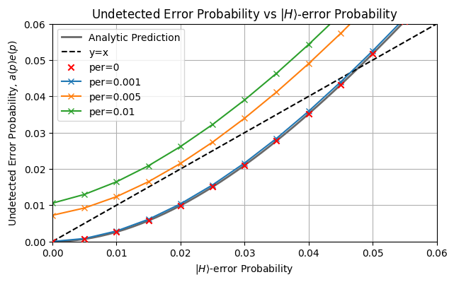
Undetected Error Probability for the Logical Circuit with Circuit-level Noise (Perfect QEC and Initialization)
Need more shots when constructing EECs at small PERs!
18

Slide 98
ⅠⅠⅠ. Outlook

Slide 99
Simulating Fully-Encoded Circuit for Comparison?
Simulation of Logical circuit with effective error channels
Simulation of fully encoded circuit with Steane code
19

Slide 100

Simulating Fully-Encoded Circuit for Comparison?
Simulation of Logical circuit with effective error channels
Simulation of fully encoded circuit with Steane code
19

Slide 101
Simulating Fully-Encoded Circuit for Comparison?
Simulation of Logical circuit with effective error channels
Simulation of fully encoded circuit with Steane code
?
19

Slide 102
Simulating Fully-Encoded Circuit for Comparison?
Qiskit’s “extended_stabilizer” simulator
Computation scales with the number of non-Clifford gates
Simulation of Logical circuit with effective error channels
Simulation of fully encoded circuit with Steane code
?
19

Slide 103
Simulating Fully-Encoded Circuit for Comparison?
Qiskit’s “extended_stabilizer” simulator
Computation scales with the number of non-Clifford gates
Problem:
The simulator does not support classically-conditioned operations mid-circuit
Simulation of Logical circuit with effective error channels
Simulation of fully encoded circuit with Steane code
?
19

Slide 104
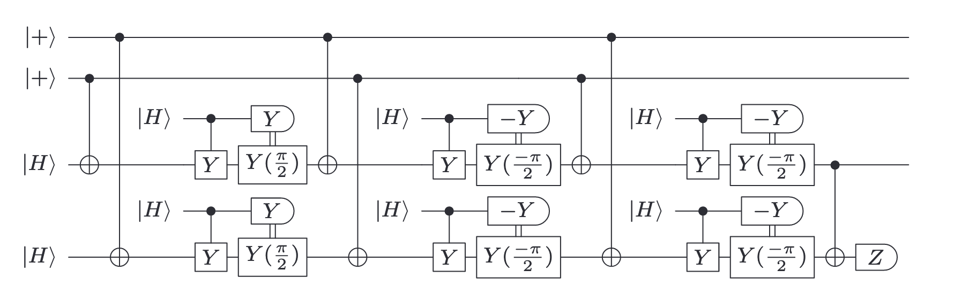
Simulating Fully-Encoded Circuit for Comparison?
Can we track the necessary recovery operations through the circuit?
20

Slide 105
Simulating Fully-Encoded Circuit for Comparison?
Can we track the necessary recovery operations through the circuit?
20

Slide 106
Simulating Fully-Encoded Circuit for Comparison?
Can we track the necessary recovery operations through the circuit?
20

Slide 107
Simulating Fully-Encoded Circuit for Comparison?
Can we track the necessary recovery operations through the circuit?
20

Slide 108
Simulating Fully-Encoded Circuit for Comparison?
Can we track the necessary recovery operations through the circuit?
C
20

Slide 109
Simulating Fully-Encoded Circuit for Comparison?
Can we track the necessary recovery operations through the circuit?
?
C
20

Slide 110
Simulating Fully-Encoded Circuit for Comparison?
Can we track the necessary recovery operations through the circuit?
?
C
Other things:
20

Slide 111
Simulating Fully-Encoded Circuit for Comparison?
Can we track the necessary recovery operations through the circuit?
?
C
Other things:
somehow modify the injection circuit so that it only contains a Pauli correction?
20

Slide 112
Simulating Fully-Encoded Circuit for Comparison?
Can we track the necessary recovery operations through the circuit?
?
C
Other things:
somehow modify the injection circuit so that it only contains a Pauli correction?
somehow use the algorithmic fault tolerance discussed by Luis in journal club?
20

Slide 113
Final Outlook
Optimize code, take more shots when defining EECs for small PER
21

Slide 114
Final Outlook
Optimize code, take more shots when defining EECs for small PER
Relax current assumptions
E.g., perfect stabilizer measurements, perfect initializations
21

Slide 115
Final Outlook
Optimize code, take more shots when defining EECs for small PER
Relax current assumptions
E.g., perfect stabilizer measurements, perfect initializations
Further investigate ways to simulate the full Steane-encoded distillation circuit
21

Slide 116
Final Outlook
Optimize code, take more shots when defining EECs for small PER
Relax current assumptions
E.g., perfect stabilizer measurements, perfect initializations
Further investigate ways to simulate the full Steane-encoded distillation circuit
Or limit scope of question? Just simulate injection circuit for comparison?
21

Slide 117
Questions ?

Slide 118
Extra Slides

Slide 119
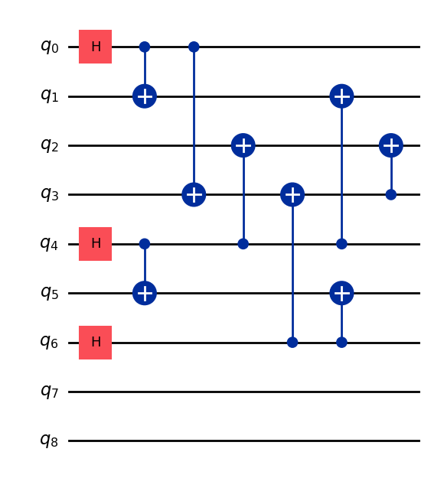
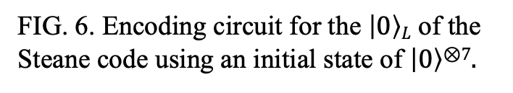
Encoding Logical Qubits
Data Qubits
Ancilla Qubits
FIG. 6. Encoding circuit for the $\left|0\right\rangle L$ of the Steane code using an initial state of $\left|0\right\rangle \text{⊗}\text{7}$.

Slide 120
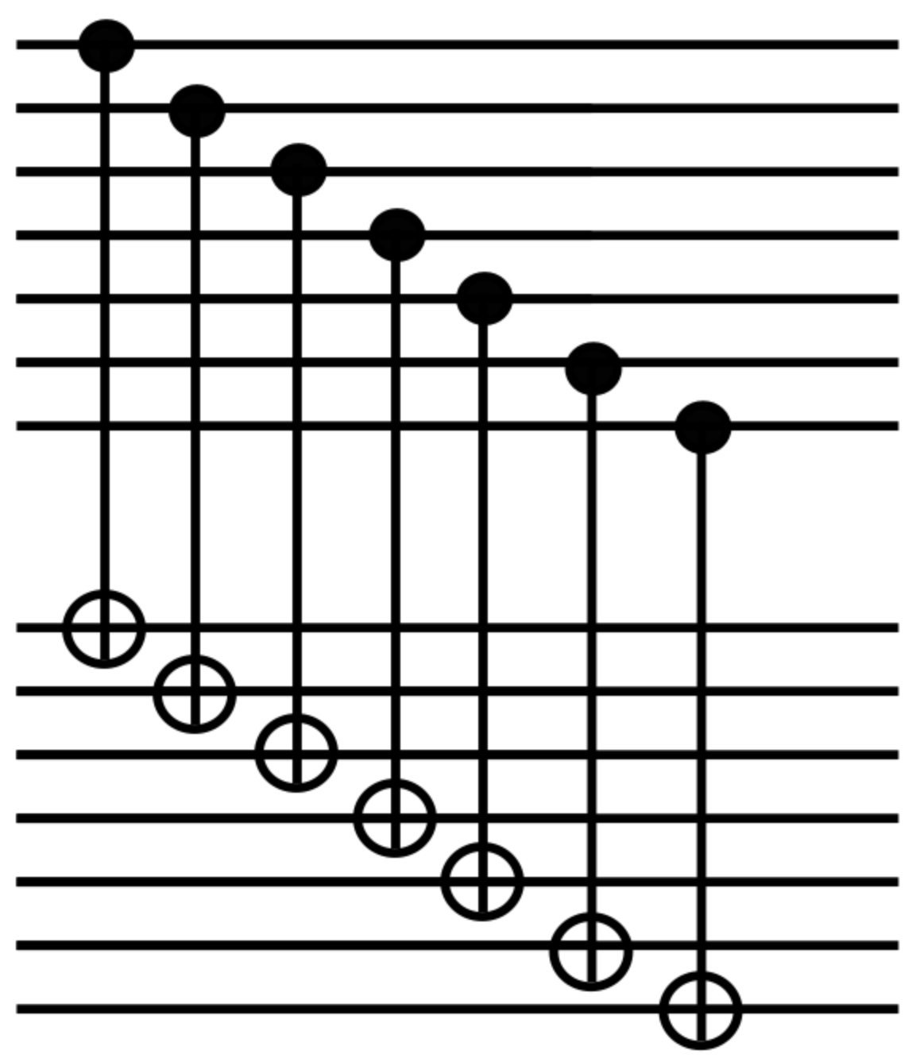

Intuition for $p2$ CNOT LER scaling
QEC
QEC

Slide 121
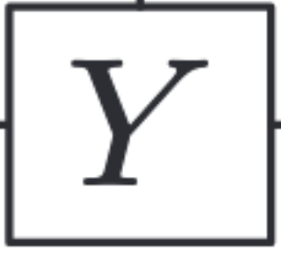
Intuition for Linear Injection LER scaling (?)
(to leading order)

Slide 122
Tracking the "Injection Correction": Possible or not?

Slide 123
Tracking the "Injection Correction": Possible or not?

Slide 124
Extra: Notice that the Ancilla Measurement is Unreliable
X

Slide 125
Extra: Notice that the Ancilla Measurement is Unreliable
X
X

Slide 126
Extra: Notice that the Ancilla Measurement is Unreliable
FLIPS ANCILLA
X

Slide 127
Tracking the "Injection Correction": Possible or not?
C

Slide 128
Tracking the "Injection Correction": Possible or not?
?
C

Slide 129
Tracking the "Injection Correction": Possible or not?
?
C
could we somehow modify the injection circuit so that it only contains a Pauli correction?

Slide 130
Tracking the "Injection Correction": Possible or not?
?
C
could we somehow modify the injection circuit so that it only contains a Pauli correction?
can we use the algorithmic fault tolerance discussed by Luis in journal club?

Slide 131
Research Question and Motivation
Can we accurately define effective error channels for the logical components of a distillation circuit?
Specifically—can we define these error channels in a way that reproduces the logical error rates of a Steane-encoded version of the logical circuit?
*DESCRIBE MOTIVATION*

