Slide 1
Sukhjit Singh
Creating Things in Database

Slide 2
Download
Go to
http://www.oracle.com/pls/db112/homepage
Download Concepts / SQL Reference.
Right click on PDF Link and save.

Slide 3
Goals
Learn how to create Database objects (Table and Constraints using Create and Alter)
Learn advanced Create Table Concepts in Oracle 9i
  Partitioned Objects
  Dealing with Physical Properties of Table - Tablespaces

Slide 4
Database Objects
Table – Basic unit of storage, composed of rows and columns
View – Subsets of data from one or more tables
Sequence – Generates primary key values
Index – Improves the performance of queries
Synonymn – Gives alternative names to objects

Slide 5
Naming Conventions
Must begin with a letter
Can be 1–30 characters long
Must contain only A–Z, a–z, 0–9, _, $, and #
Must not duplicate the name of another object owned by the same user
Must not be an Oracle Server reserved word

Slide 6
CREATE TABLE Statement
You must have :
    CREATE TABLE privilege
    A storage area
SQL> CREATE [GLOBAL TEMPORARY] TABLE [schema.]table
(column datatype [DEFAULT expr][, ...]);
You specify:
    Table name
    Column name, datatype and size

Slide 7
Referencing Another User’s Tables
Tables belonging to other users are not in the user’s schema.
You should use the owner’s name as a prefix to the table.

Slide 8
Creating Tables
SQL> CREATE TABLE dept
(deptno NUMBER(2),
dname VARCHAR2(14),
loc VARCHAR2(13));
SQL> DESC dept
Name Null? Type
---------------------- -------- ---------
DEPTNO NUMBER(2)
DNAME VARCHAR2(14)
LOC VARCHAR2(13)

Slide 9
Tables in the Oracle Database
User Tables
  Collection of tables created and maintained by the user
  Contain user information
Data Dictionary
  Collection of tables created and maintained by the Oracle server
  Contains database information

Slide 10
Data Dictionary
  Describe tables owned by the user.
SQL> SELECT *
FROM user_tables;
  View distinct object types owned by the user.
SQL> SELECT DISTINCT object_type
FROM user_objects;
  View tables, views, synonyms, and sequences owned by the user.
SQL> SELECT *
FROM user_catalog;

Slide 11
Datatypes
DATATYPE DESCRIPTION________________
VARCHAR2(size) Variable-length character data
CHAR(size) Fixed-length character data
NUMBER(p,s) Variable-length numeric data
DATE Date and time values
LONG Variable-length character data
up to 2 gigabytes
CLOB Single-byte character data up to 4 gigabytes
RAW and LONG RAW Raw binary data
BLOB Binary data up to 4 gigabytes
BFILE Binary data stored in an external file; up to 4 gigabytes

Slide 12
Create Table Using a Subquery
Create a table and insert rows by combining the CREATE TABLE statement and AS subquery option.
SQL> CREATE TABLE table
[(column, column...)]
AS subquery;
Match the number of specified columns to the number of subquery columns.
Define columns with column names and
default values.

Slide 13
Create Table Using a Subquery
SQL> CREATE TABLE dept
AS
SELECT empno, ename, sal*12 ANNSAL, hiredate
FROM emp
WHERE deptno = 30;
SQL> DESC dept
Name Null? Type
------------------------- -------- -----
EMPNO NOT NULL NUMBER(4)
ENAME VARCHAR2(10)
ANNSAL NUMBER
HIREDATE DATE

Slide 14
ALTER TABLE Statement
Used to add a new column
Modify an existing column
Define a default value for the new column
SQL> ALTER TABLE table
ADD (column datatype [DEFAULT expr]
[, column datatype]...);
SQL> ALTER TABLE table
MODIFY (column datatype [DEFAULT expr]
[, column datatype]...);

Slide 15
Add Column
You use the ADD clause to add columns
The new column becomes the last column.
SQL> ALTER TABLE dept
ADD (job VARCHAR2(9));
EMPNO ENAME ANNSAL HIREDATE JOB
------ ---------- -------- --------- ---
7698 BLAKE 3000 01-MAY-81
7654 MARTIN 1500 28-SEP-81
7499 ALLEN 1920 20-FEB-81
7844 TURNER 1800 08-SEP-81

Slide 16
Modify Column
You can change a column’s datatype, size, and default value.
A change to the default value affects only subsequent insertions to the table.
SQL> ALTER table emp
MODIFY ename(VARCHAR2(15));
SQL> DESC emp
Name Null? Type
------------------------- -------- -----
EMPNO NOT NULL NUMBER(4)
ENAME VARCHAR2(15)
…………………..

Slide 17
COMMENT Statement
Can add comments to a table or column by using the COMMENT statement.
Can be viewed through the data dictionary views:
    ALL_COL_COMMENTS
    USER_COL_COMMENTS
    ALL_TAB_COMMENTS
    USER_TAB_COMMENTS
SQL> COMMENT ON TABLE dept
IS ‘Department Information’;
Notes:
COMMENT ON TABLE table | COLUMN table.column
IS 'text';
SQL> COMMENT ON TABLE emp IS ' ';

Slide 18
Constraints
  Enforce rules at the table level.
  Prevent the deletion of a table, if there are dependencies.
  Valid constraint types in Oracle:
    NOT NULL
    UNIQUE
    PRIMARY KEY
    FOREIGN KEY
    CHECK

Slide 19
Constraint Guidelines
Name a constraint or the Oracle Server will generate a name by using the SYS_Cn format.
Create a constraint:
    At the same time as the table is created
    After the table has been created
Define a constraint at the column or table level.
View a constraint in the data dictionary.

Slide 20
Defining Constraints
SQL> CREATE TABLE emp
(
empno NUMBER(4),
ename VARCHAR2(10),
...
deptno NUMBER(2) NOT NULL,
CONSTRAINT emp_empno_pk
PRIMARY KEY (EMPNO));

Slide 21
Defining Constraints
  Column constraint level
  Table constraint level

Slide 22
NOT NULL Constraint
Ensures that null values are not permitted for the column
Defined at the column level
SQL> CREATE TABLE emp
(
empno NUMBER(4),
ename VARCHAR2(10),
...
deptno NUMBER(2) NOT NULL,
CONSTRAINT emp_empno_pk
PRIMARY KEY (EMPNO));

Slide 23
UNIQUE KEY Constraint
Defined at either the table level or the column level
Gives unique values to the field (although they can be null)
SQL> CREATE TABLE dept(
deptno NUMBER(2),
dname VARCHAR2(14),
loc VARCHAR2(13),
CONSTRAINT dept_dname_uk UNIQUE(dname));

Slide 24
PRIMARY KEY Constraint
Defined at either the table level or the column level
Primary key has unique value
Cannot have null values
SQL> CREATE TABLE dept(
deptno NUMBER(2),
dname VARCHAR2(14),
loc VARCHAR2(13),
CONSTRAINT dept_dname_uk UNIQUE (dname),
CONSTRAINT dept_deptno_pk PRIMARY KEY(deptno));

Slide 25
FOREIGN KEY Constraint
Defined at either the table level or the column level
Defines the column in the child table at the table constraint level
REFERENCES: Identifies the table and column in the parent table
SQL> CREATE TABLE emp(
empno NUMBER(4),
ename VARCHAR2(10) NOT NULL,
deptno NUMBER(7,2) NOT NULL,
CONSTRAINT emp_deptno_fk FOREIGN KEY (deptno)
REFERENCES dept (deptno));

Slide 26
CHECK Constraint
  Defines a condition that each row must satisfy
  Expressions that are not allowed:
    References to CURRVAL, NEXTVAL, LEVEL, and ROWNUM pseudocolumns
    Calls to SYSDATE, UID, USER, and USERENV functions
    Queries that refer to other values in other rows
SQL> CREATE TABLE emp(
empno NUMBER(4),
ename VARCHAR2(10) NOT NULL,
deptno NUMBER(7,2) CONSTRAINT emp_deptno_ck
CHECK (DEPTNO BETWEEN 10 AND 99);

Slide 27
Adding a Constraint
  Add or drop, but not modify, a constraint
  Enable or disable constraints
  Add a NOT NULL constraint by using the MODIFY clause
  SQL> ALTER TABLE table
ADD [CONSTRAINT constraint] type (column);

Slide 28
Adding a Constraint
Add a FOREIGN KEY constraint to the EMP table indicating that a manager must already exist as a valid employee in the EMP table.
SQL> ALTER TABLE emp
ADD CONSTRAINT emp_mgr_fk
FOREIGN KEY(mgr) REFERENCES emp(empno);

Slide 29
Dropping a Constraint
To remove a constraint
SQL> ALTER TABLE emp
DROP CONSTRAINT emp_mgr_fk;
Remove the PRIMARY KEY constraint on the DEPT table and drop the associated FOREIGN KEY constraint on the EMP.DEPTNO column.
SQL> ALTER TABLE dept
DROP PRIMARY KEY CASCADE;

Slide 30
Disabling Constraints
  Execute the DISABLE clause of the ALTER TABLE statement to deactivate an integrity constraint.
  Apply the CASCADE option to disable dependent integrity constraints.
SQL> ALTER TABLE emp
DISABLE CONSTRAINT emp_empno_pk CASCADE;

Slide 31
Enabling Constraints
  Activate an integrity constraint currently disabled in the table definition by using the ENABLE clause.
  A UNIQUE or PRIMARY KEY index is automatically created if you enable a UNIQUE key or PRIMARY KEY constraint.
  SQL> ALTER TABLE emp
ENABLE CONSTRAINT emp_empno_pk;

Slide 32
Cascading Constraints
  Used with the DROP COLUMN clause.
  Drops referential integrity constraints that refer to the primary and unique keys defined on the dropped columns.

Slide 33
Cascading Constraints
The CASCADE CONSTRAINTS clause also drops all multicolumn constraints defined on the dropped columns.

Slide 34
Viewing Constraints
USER_CONSTRAINTS table - constraint definitions and names.
SQL> SELECT constraint_name, constraint_type,
search_condition
FROM user_constraints
WHERE table_name = 'EMP';
CONSTRAINT_NAME C SEARCH_CONDITION
------------------------ - -------------------------
SYS_C00674 C EMPNO IS NOT NULL
SYS_C00675 C DEPTNO IS NOT NULL

Slide 35
Viewing the Columns with Constraints
View the columns associated with the constraint names in the USER_CONS_COLUMNS view.
SQL> SELECT constraint_name, column_name
FROM user_cons_columns
WHERE table_name = 'EMP';
CONSTRAINT_NAME COLUMN_NAME
------------------------- ----------------------
EMP_DEPTNO_FK DEPTNO
EMP_EMPNO_PK EMPNO
EMP_MGR_FK MGR
SYS_C00674 EMPNO
SYS_C00675 DEPTNO

Slide 36
Advanced Create Table
Building a TableSpace
Partitioned Objects

Slide 37
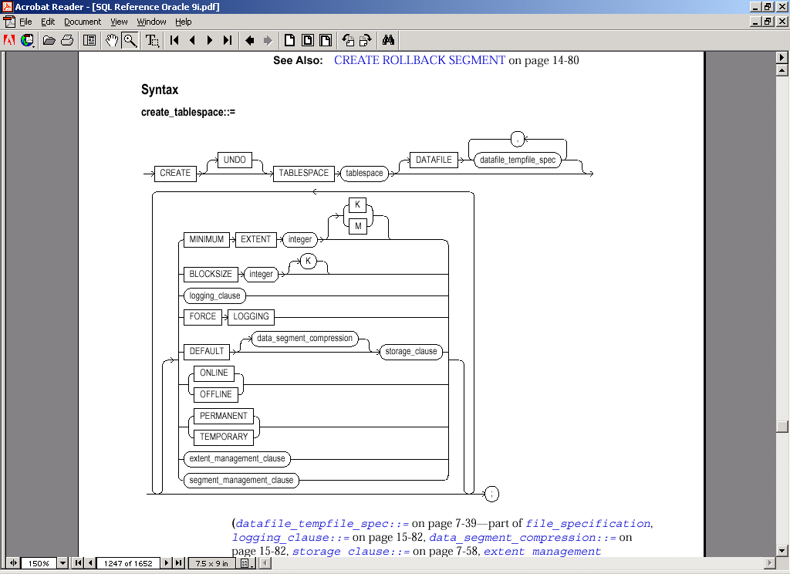
Create Tablespace
Mapping Oracle to Physical Devices

Slide 38
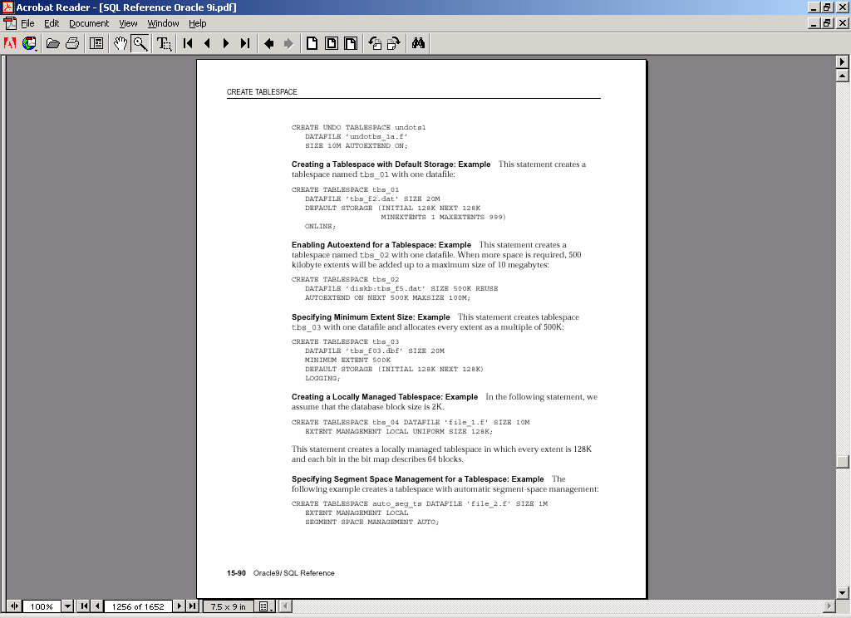
Create Tablespace - Example

Slide 39
Create Tablespace - Example

Slide 40
Partitioning
Partitioning is the ability to break tables and indexes into smaller, more manageable pieces.
When a table or index is partitioned, the column/constraint/index column definitions must stay the same.
Partitions can have different physical attributes and can be placed in physically different locations.

Slide 41
Partitioning - Advantages
Allow for better I/O load balancing.
Improve and enhance backup and recovery capability.
Minimize data corruption.
SQL> create table… ( col1 number, col2 number……..)
partition by range (col1, col2)
(partition p1 values less than (…, …) tablespace p1,
partition p2 values less than (…, ….) tablespace p2);

Slide 42
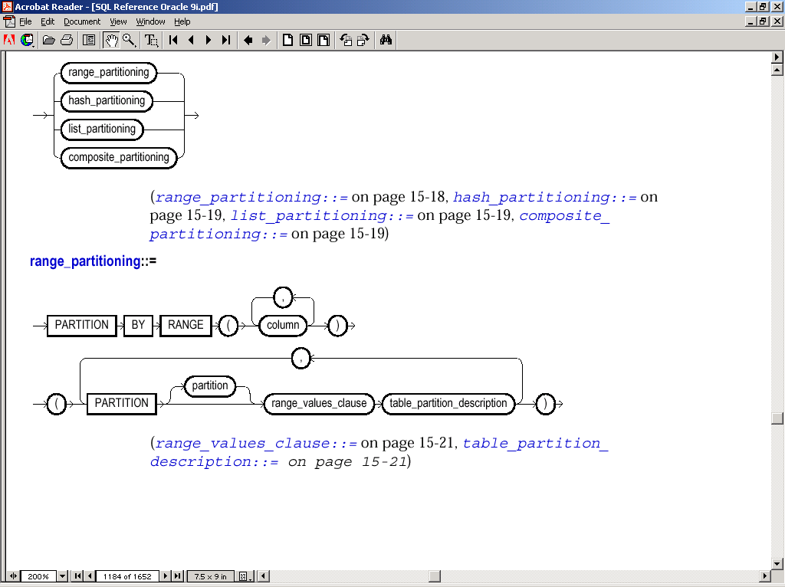
Partitioning Types

Slide 43
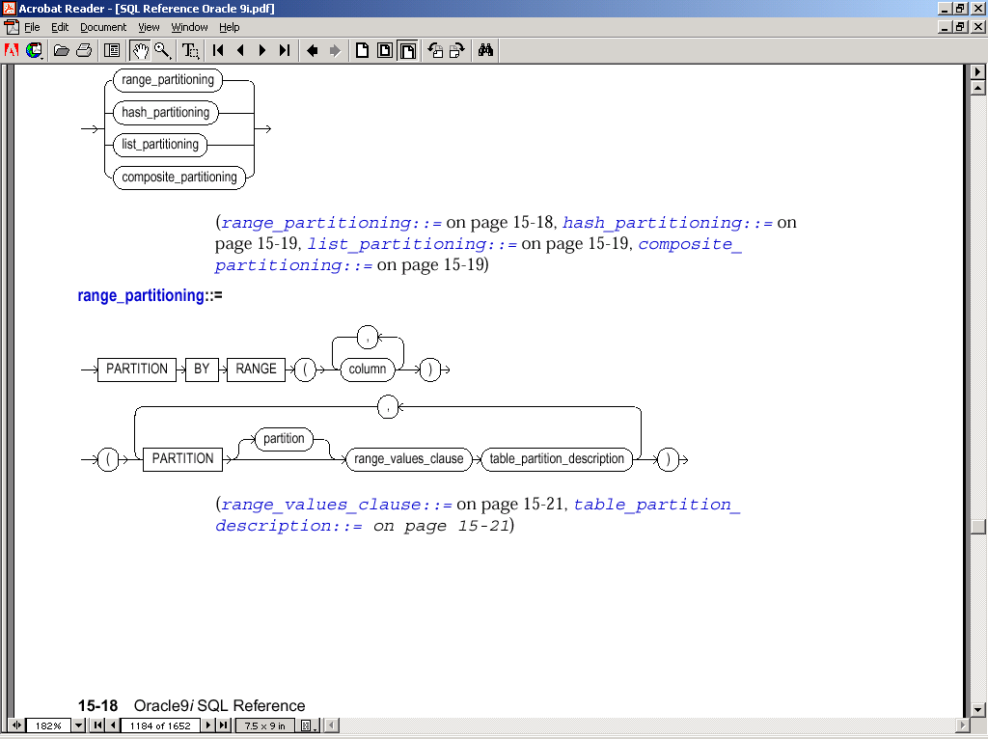
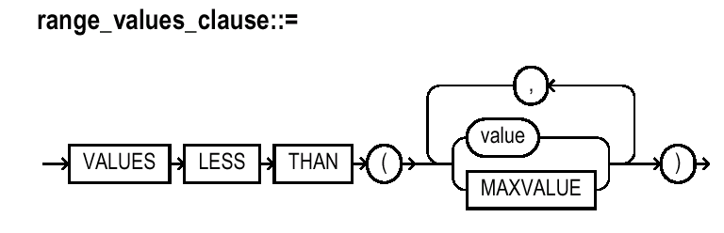
Partition by Range

Slide 44
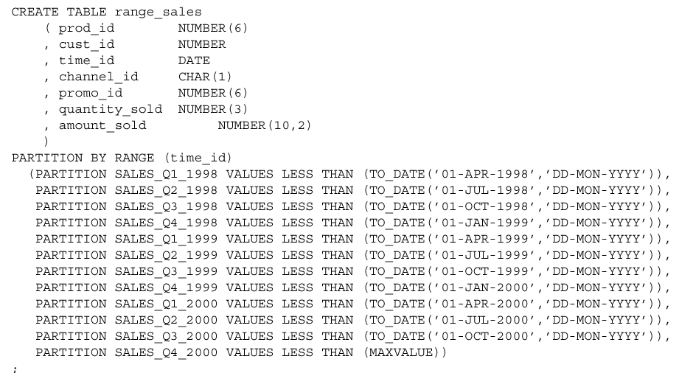
Partition by Range - Example

Slide 45
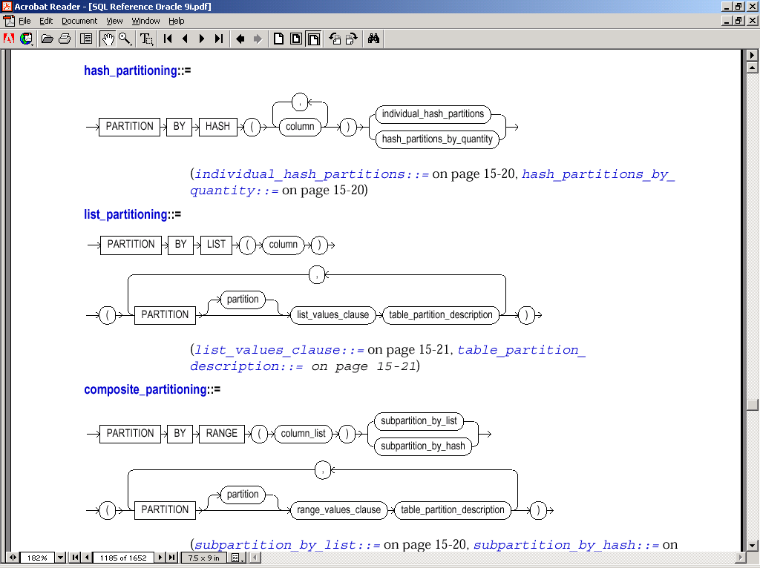
Partition by Hash

Slide 46
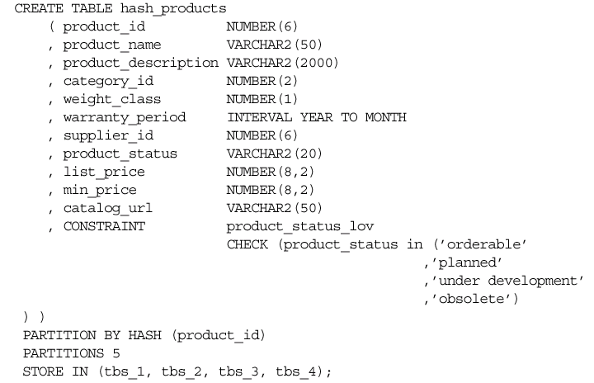
Partition by Hash

Slide 47
List Partitioning

Slide 48
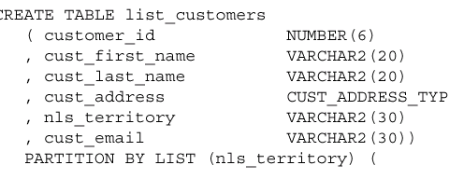
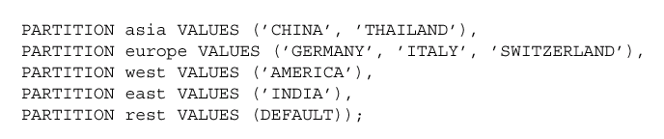
List Partitioning contd..

Slide 49
List Partitioning

Slide 50
Partition by Composite

Slide 51
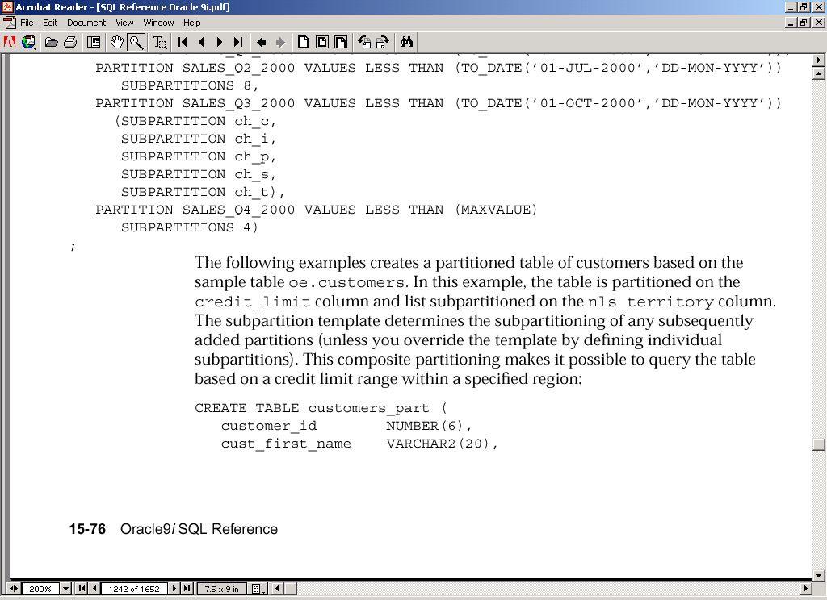
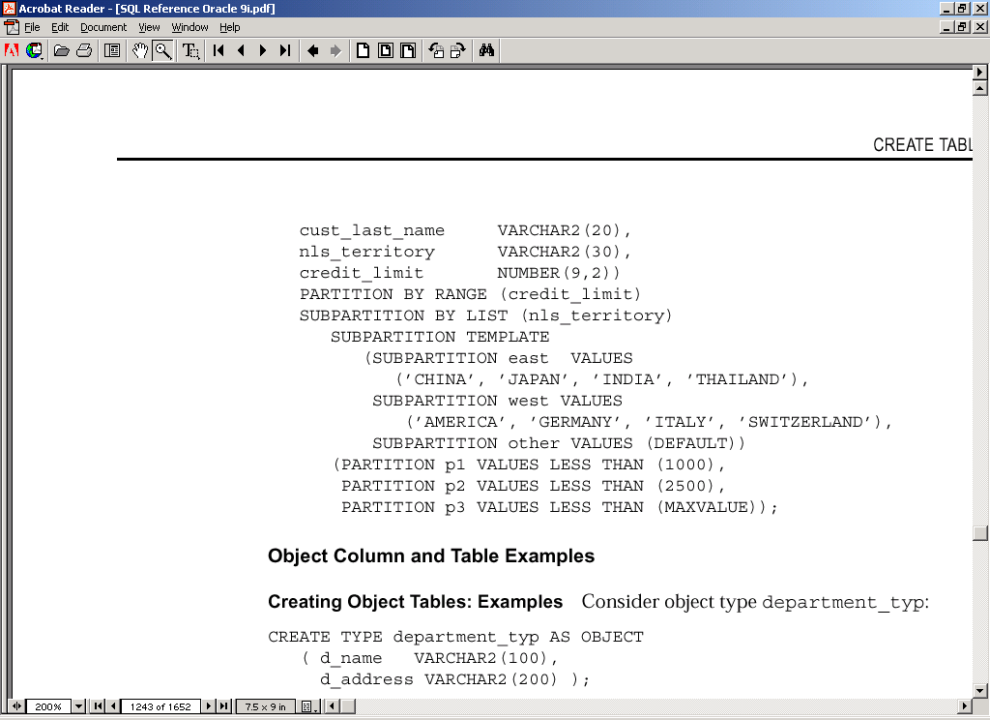
Composite List - Example

Slide 52
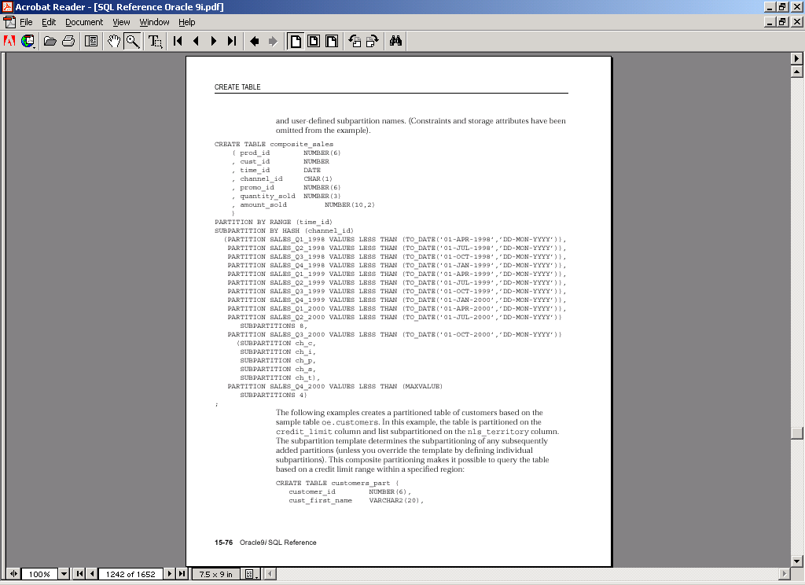
Composite Hash – Example

Slide 53
Composite Hash – Example contd.

Slide 54
Composite Hash – Example contd.

Slide 55
Partitioning
High Availability - Oracle supports partition independence – this means operations such as database recovery can be happening on one partition, while applications are running SQL operations or DML statements on other partitions.

Slide 56
Clusters
Clusters allow for a different method of storing table data.
When applications continually work with a set of two or more tables, the DBA may consider using a cluster to store the data from the tables, so commonly joined.

Slide 57
Clusters
Tables in a cluster share the same data blocks.
Improves performance
USER_CLUSTERS table gives description of user’s own clusters.

