Slide 1
Partitioning
Sukhjit Singh

Slide 2
Partitioned Indexes

Slide 3
Partitioned Indexes
Partitioning Concepts Review
  Partitioned Tables
  Types – Range, Hash, List, Composite
  Partition Key with 1 or > 1 column
  Sub-Partitioning Key
Which table should be partitioned
  > 2GB in size.
  Tables consisting of historical data in which data is added in new partition and removed from the oldest to a data warehouse

Slide 4
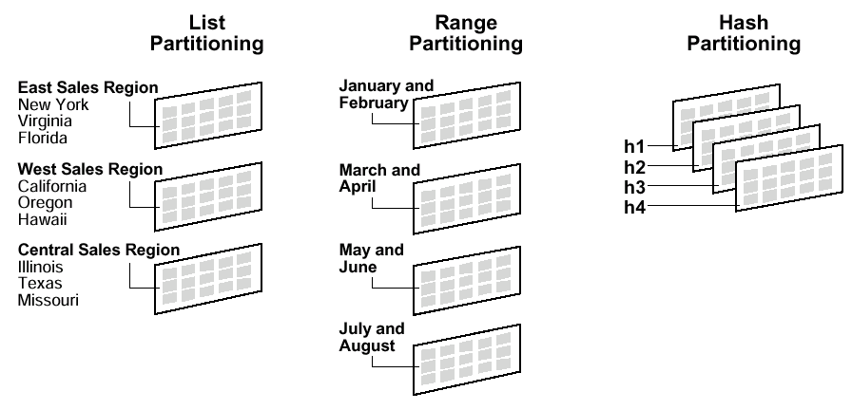
Partitioned Indexes

Slide 5
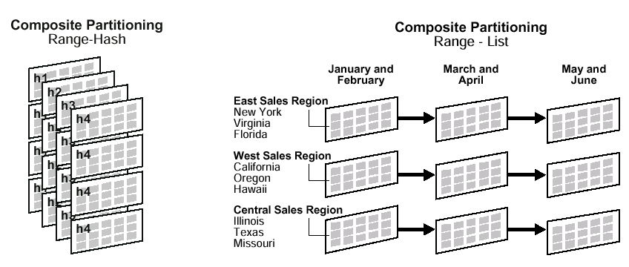
Partitioned Indexes

Slide 6
Why use Partitions
N’02
Partitions
Insert a new table partition
J’98
Archive the old partition into
the date warehouse
Transactional System
J’98
Data Warehouse

Slide 7
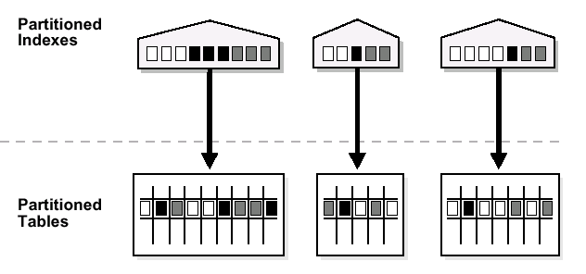
Local Partitioned Indexes
Local Indexes stay in sync with their respective partitions.
Easy access to relative data in same Tablespace improves performance.
Local Index can be unique or non-unique
Tablespace
T1
Tablespace
T2
Tablespace
T3

Slide 8
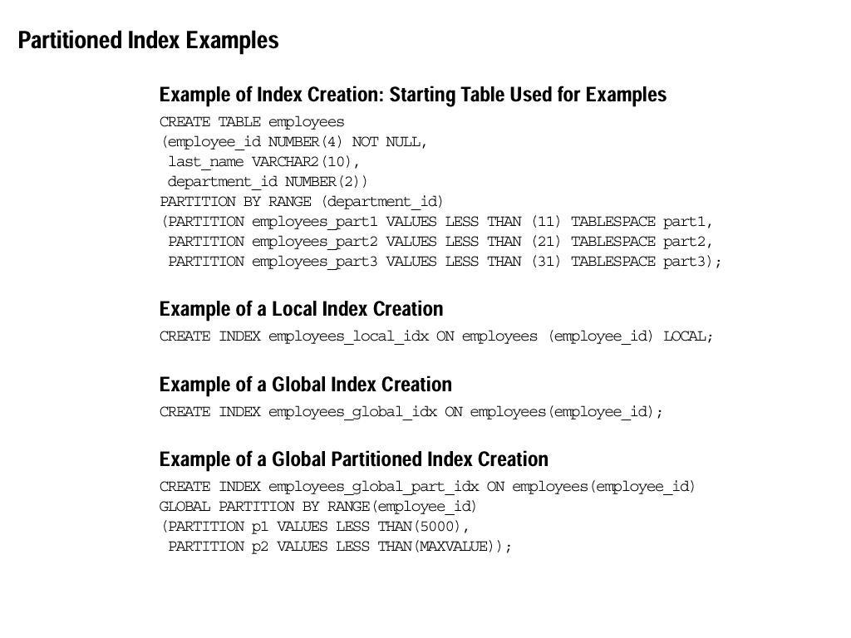
How to create local indexes
Consider the following table:
Build a local partitioned index on respective partitions.

Slide 9
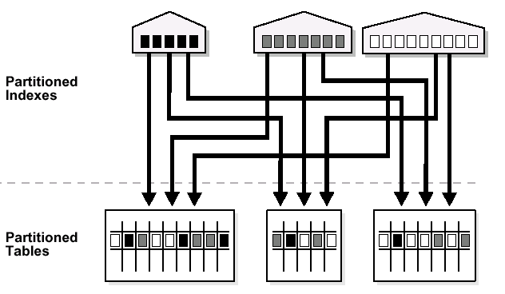
Global Partitioned Indexes
Partitioning key for index has relation with partitioning key of Table
Cross Linkage of data leads to poor performance.

Slide 10
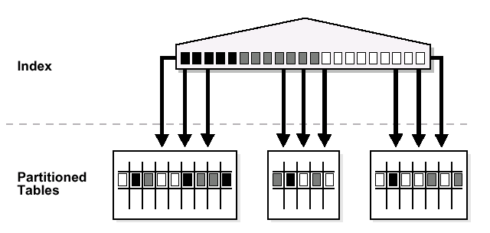
Global Index
Regular Index that exists above all partitions.
Behaves the same as a index on regular table.
Gives poor performance on large tables.

Slide 11
Creating Global Indexes
Consider this Table
Create a Global Index

Slide 12
How to maintain Indexes?
Rebuild – Will Rebuild the Entire Index
Add – Adds a partition to an existing index.
Coalesce – Removes Free Space
Drop – Removes the index partition
Exchange – Exchanges the given partition with another table.
Merge – Combines the two partitions indexed data.
Move – Moves the partition from one tablespace to another.
Split – Splits the two partitions to avoid having a very large index. Improves performance.
Truncate – Empties the data from a given partition.

Slide 13
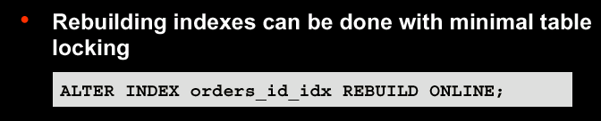
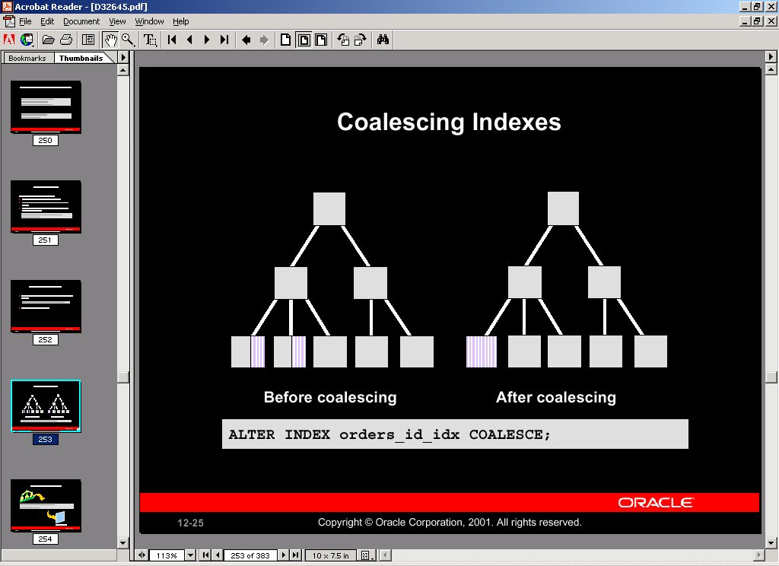
How to Maintain Indexes?
Rebuild
Coalesce

Slide 14
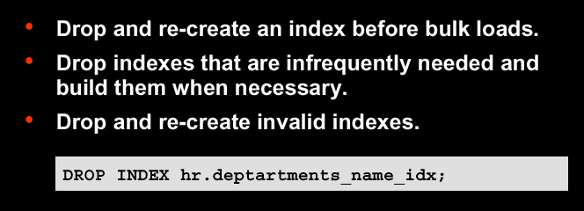
How to Maintain Indexes?
Dropping
Indexes
Check SQL Reference for more information on how to use these commands.

Slide 15
Index Dictionaries
DBA_Indexes
DBA_IND_COLUMNS
DBA_IND_EXPRESSIONS
V$OBJECT_USAGE

Slide 16
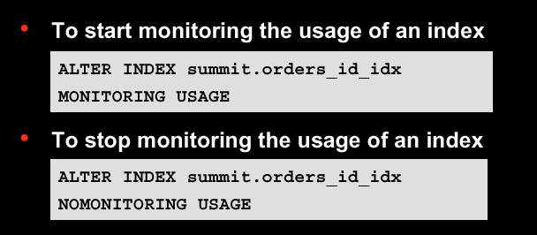
Monitor Usage on Indexes

