Slide 1
Storage Management stuff
Sukhjit Singh

Slide 2
Agenda
Data Storage Clause – including Storage Mgmt
Sequences, Synonyms
Indexes

Slide 3
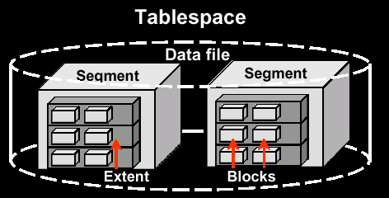
Storage Management

Slide 4
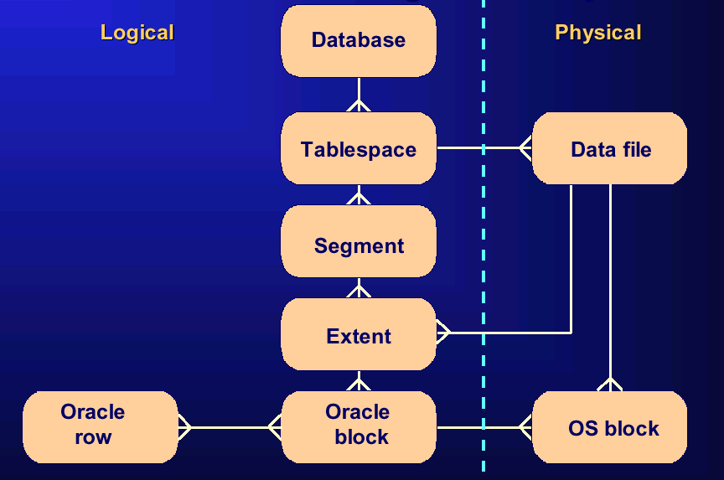
Data Storage and Management

Slide 5
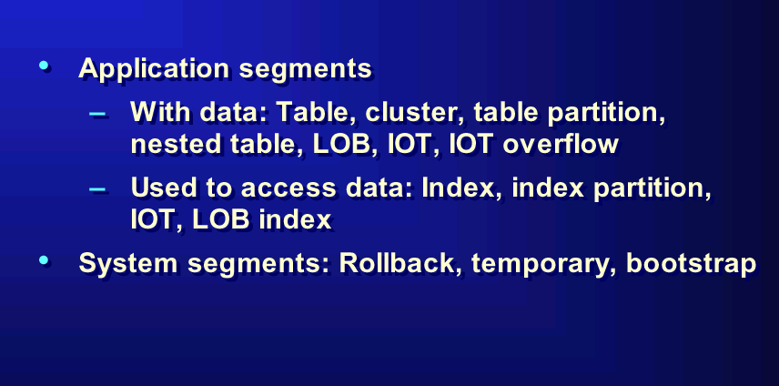
Segment Organization

Slide 6
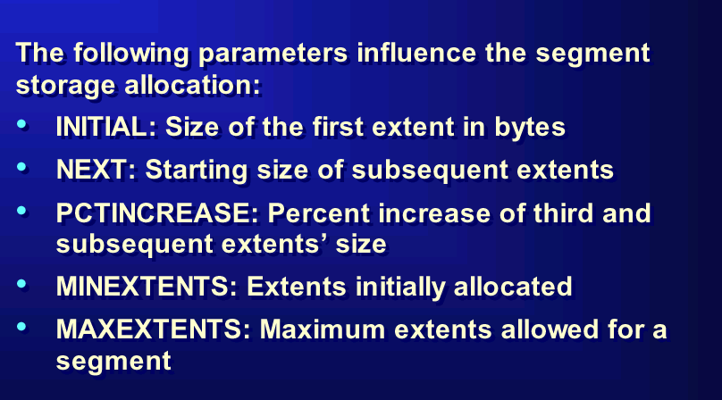
Storage Management Parameters

Slide 7
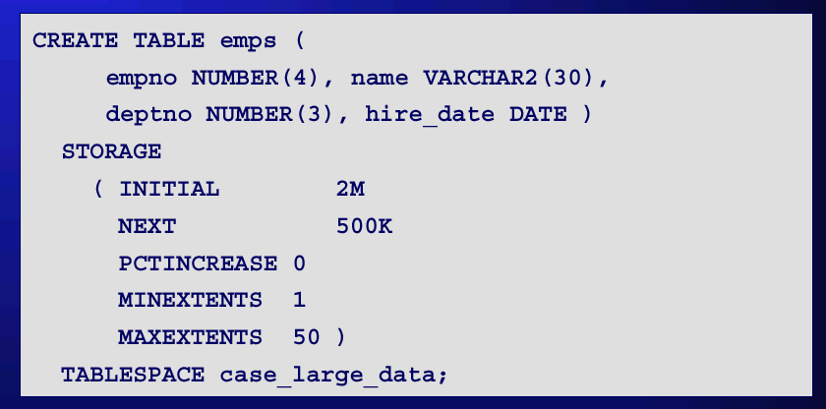
Storage Mgmt. – Example

Slide 8
Storage Clause
Can be specified at Tablespace level and Table Level
Default Storage Clause in “Create TableSpace” command, sets the default properties for Tables
Blocks, Extents are allocated when a Segment is allocated.

Slide 9
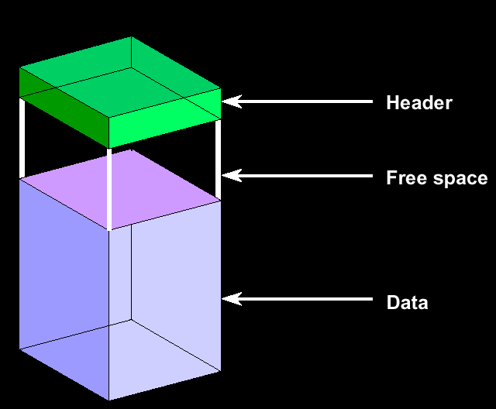
DataBase Blocks Organization
Consists of one or more data blocks organized as follows.

Slide 10
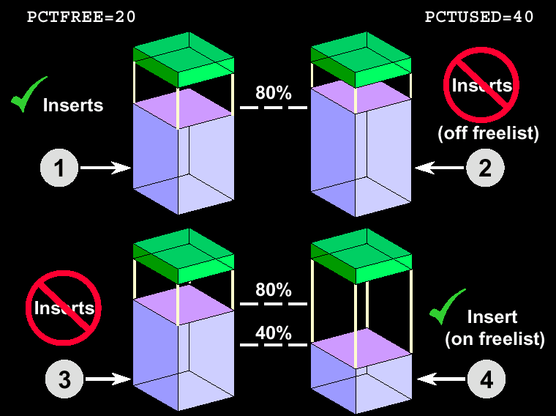
Storage Clause Usage

Slide 11
Storage Clause – Dictionaries
• Data Dictionary Views
  – DBA_TABLESPACES
  – DBA_DATA_FILES
  – DBA_SEGMENTS
  – DBA_EXTENTS
  – DBA_FREE_SPACE

Slide 12
SEQUENCES

Slide 13
SEQUENCES
  Automatically generates unique numbers
  Is a sharable object
  Is typically used to create a primary key value
  Replaces application code
  Speeds up the efficiency of accessing sequence values when cached in memory

Slide 14
Create Sequence
Define a sequence to generate sequential numbers automatically.
CREATE SEQUENCE sequence
[INCREMENT BY n]
[START WITH n]
[{MAXVALUE n | NOMAXVALUE}]
[{MINVALUE n | NOMINVALUE}]
[{CYCLE | NOCYCLE}]
[{CACHE n | NOCACHE}];

Slide 15
Create Sequence - Example
  Create a sequence named DEPT_DEPTNO to be used for the primary key of the
  DEPT table.
  Do not use the CYCLE option.
SQL> CREATE SEQUENCE dept_deptno
2 INCREMENT BY 1
3 START WITH 91
4 MAXVALUE 100
5 NOCACHE
6 NOCYCLE;
Sequence created.

Slide 16
Sequences – Dictionary View
  Verify your sequence values in the USER_SEQUENCES data dictionary table.
  The LAST_NUMBER column displays the next available sequence number.
SQL> SELECT sequence_name, min_value, max_value,
2 increment_by, last_number
3 FROM user_sequences;

Slide 17
NEXTVAL OR CURRVAL
NEXTVAL returns the next available sequence value.
  It returns a unique value every time it is referenced, even for different users.
CURRVAL obtains the current sequence value.
  NEXTVAL must be issued for that sequence before CURRVAL contains a value.

Slide 18
Using a Sequence
  Insert a new department named “MARKETING” in San Diego.
  View the current value for the DEPT_DEPTNO sequence.
SQL> INSERT INTO dept(deptno, dname, loc)
2 VALUES (dept_deptno.NEXTVAL,
3 'MARKETING', 'SAN DIEGO');
1 row created.
SQL> SELECT dept_deptno.CURRVAL
2 FROM dual;

Slide 19
Modify Sequence
SQL> ALTER SEQUENCE dept_deptno
2 INCREMENT BY 1
3 MAXVALUE 999999
4 NOCACHE
5 NOCYCLE;
Sequence altered.

Slide 20
Using a Sequence
Caching sequence values in memory allows faster access to those values.
Gaps in sequence values can occur when:
  A rollback occurs
  The system crashes
  A sequence is used in another table
View the next available sequence, if it was created with NOCACHE, by querying the USER_SEQUENCES table.
Change the increment value, maximum value, minimum value, cycle option, or cache option.

Slide 21
Modify Sequence
Must be the owner or have the ALTER privilege for the sequence.
Only future sequence numbers are affected.
The sequence must be dropped and
re-created to restart the sequence at a different number.
Some validation is performed.

Slide 22
Dropping Sequence
Remove a sequence from the data dictionary by using the DROP SEQUENCE statement.
Once removed, the sequence can no longer be referenced.
SQL> DROP SEQUENCE dept_deptno;
Sequence dropped.

Slide 23
Synonyms

Slide 24
Synonyms
Simplify access to objects by creating a synonym (another name for an object).
  Refer to a table owned by another user.
  Shorten lengthy object names.
CREATE [PUBLIC] SYNONYM synonym
FOR object;

Slide 25
Synonyms
Create a shortened name for the DEPT_SUM_VU view.
Drop a Synonyms
SQL> CREATE SYNONYM d_sum
2 FOR dept_sum_vu;
Synonym Created.
SQL> DROP SYNONYM d_sum;
Synonym dropped.

Slide 26
Indexes

Slide 27
Index
Is a schema object
Is used by the Oracle Server to speed up the retrieval of rows by using a pointer
Can reduce disk I/O by using rapid path access method to locate the data quickly
Is independent of the table it indexes
Is used and maintained automatically by the Oracle Server

Slide 28
Index
Created automatically, when you define a PRIMARY KEY or UNIQUE constraint in a table definition.
Created manually: Users can create nonunique indexes on columns to speed up access time to the rows.

Slide 29
Index
An Index can be created one or more columns – using a composite key.
Improve the speed of query access on the ENAME column in the EMP table.
CREATE INDEX index
ON table (column[, column]...);
SQL> CREATE INDEX emp_ename_idx
2 ON emp(ename);
Index created.

Slide 30
When to create Indexes?
The column is used frequently in the WHERE clause or in a join condition.
The column contains a wide range of values.
The column contains a large number of null values.
Two or more columns are frequently used together in a WHERE clause or a join condition.
The table is large and most queries are expected to retrieve less than 2–4% of the rows.

Slide 31
When not to create Indexes?
The table is small.
The columns are not often used as a condition in the query.
Most queries are expected to retrieve more than 2–4% of the rows.
The table is updated frequently.

Slide 32
Index Dictionaries
The USER_INDEXES data dictionary view contains the name of the index and its uniqueness.
The USER_IND_COLUMNS view contains the index name, the table name, and the column name.
SQL> SELECT ic.index_name, ic.column_name,
2 ic.column_position col_pos,ix.uniqueness
3 FROM user_indexes ix, user_ind_columns ic
4 WHERE ic.index_name = ix.index_name
5 AND ic.table_name = 'EMP';

Slide 33
Function Based Indexes
A function-based index is an index based on expressions.
The index expression is built from table columns, constants, SQL functions, and user-defined functions.
SQL> CREATE TABLE test (col1 NUMBER);
SQL> CREATE INDEX test_index on test(col1,col1+10);
SQL> SELECT col1+10 FROM test;

Slide 34
Remove Index
Remove an index from the data dictionary.
Remove the EMP_ENAME_IDX index from the data dictionary.
To drop an index, you must be the owner of the index or have the DROP ANY INDEX privilege.
SQL> DROP INDEX index;
SQL> DROP INDEX emp_ename_idx;
Index dropped.

Slide 35
Unique vs Non-Unique Indexes
Unique Indexes are created with Primary Keys. Assure no duplicates records are stored in table.
Non-Unique Indexes impose no restriction on data columns.
Unique Indexes can also be created explicitly on columns that unique constraint on them.
NULL Values with Unique Indexes are considered to be distinct.

Slide 36
Index Storage
B-tree indexes
Bitmap indexes
Bitmap Join indexes
Indexes useful in clustering (Covered in future classes.)
  B-tree cluster indexes
  Hash cluster indexes
  Reverse key indexes

Slide 37
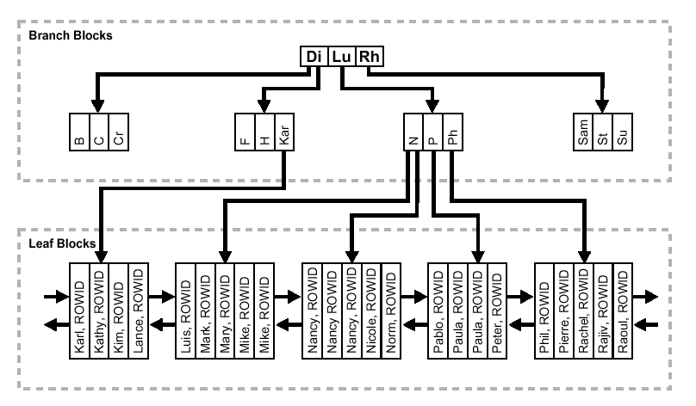
Index Storage
Balanced B-Tree

Slide 38
Index Storage
Bitmap Index –
  Columns with low cardinality are good as Bitmap Indexes.
  Provide Good performance with And or OR Operations.
  Columns with high cardinality are not good candidates for Bitmap indexes.
  Bitmap Indexes include columns that have NULLS.

Slide 39
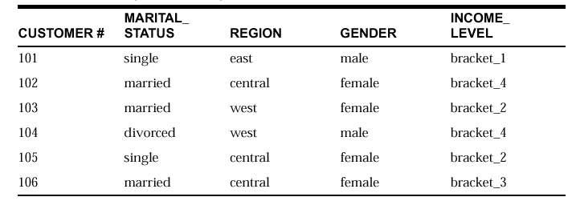
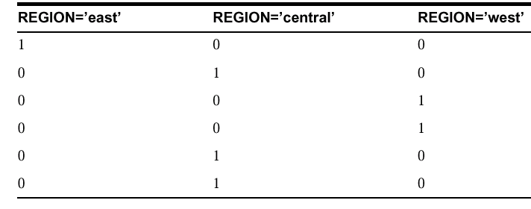
Index Storage
Bitmap Index Example

Slide 40
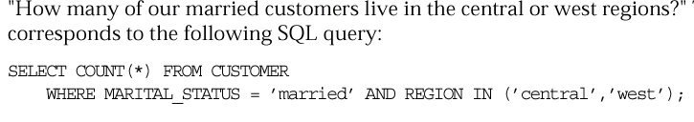
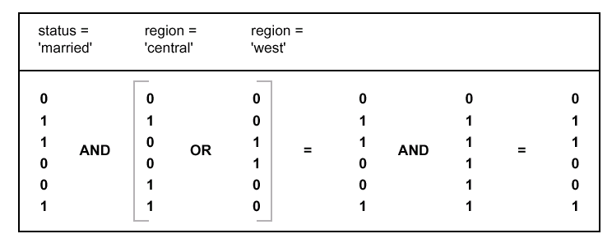
Index Storage

Slide 41
Index Storage
Bitmap Join Index
  A bitmap index created using two or more tables with a join.
  Used Traditionally in Data-Warehousing.
  Efficient in Storage given the amount of space taken is less.
  Provides High performance since the indexes are pre-calculated.

Slide 42
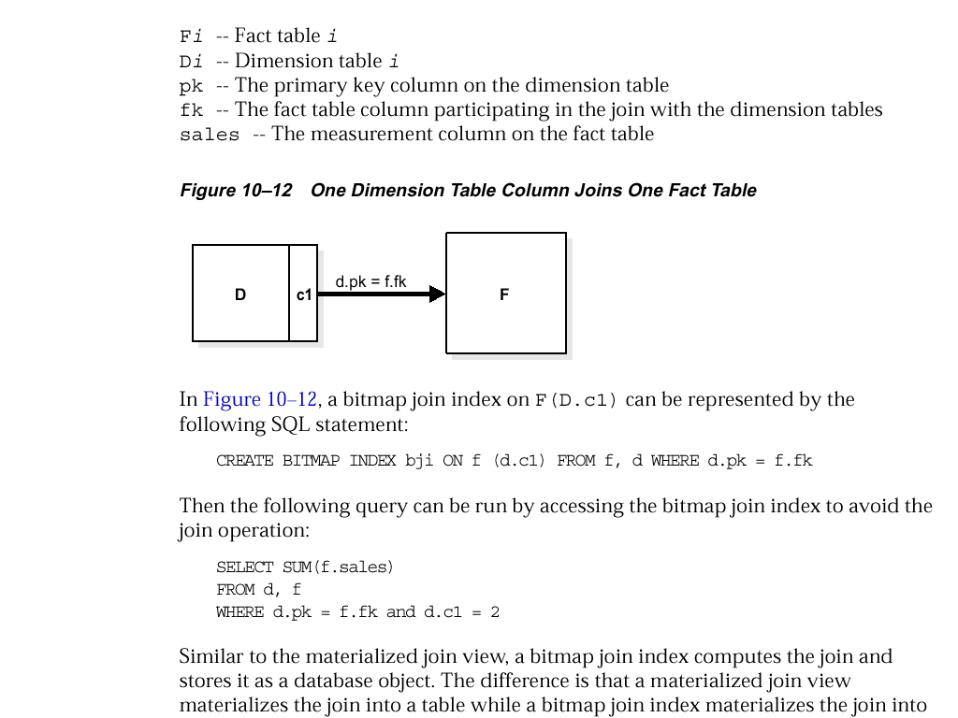
Index Storage
How to Bitmap Indexes work?

