Slide 1
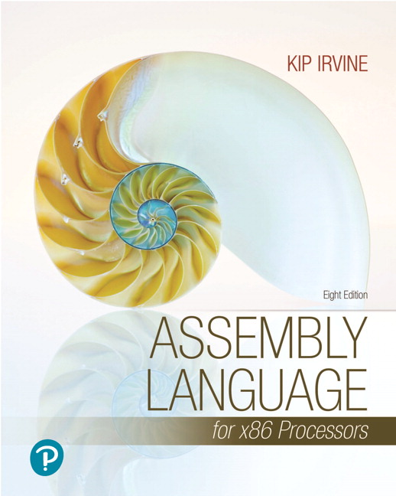
Assembly Language for x86 Processors
Eighth Edition
Chapter 3
Assembly Language Fundamentals
Copyright © 2020, 2015, 2011 Pearson Education, Inc. All Rights Reserved

Slide 2
Chapter Overview
Basic Elements of Assembly Language
Example: Adding and Subtracting Integers
Assembling, Linking, and Running Programs
Defining Data
Symbolic Constants
64-Bit Programming

Slide 3
Basic Elements of Assembly Language
Integer constants
Integer expressions
Character and string constants
Reserved words and identifiers
Directives and instructions
Labels
Mnemonics and Operands
Comments
Examples

Slide 4
Integer Constants
Optional leading + or – sign
binary, decimal, hexadecimal, or octal digits
Common radix characters:
h – hexadecimal
d – decimal
b – binary
r – encoded real
Examples: 30d, 6Ah, 42, 1101b
Hexadecimal beginning with letter: 0A5h

Slide 5
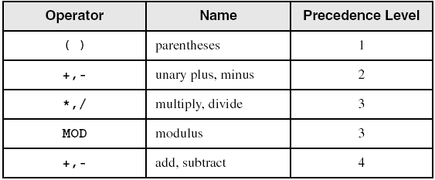
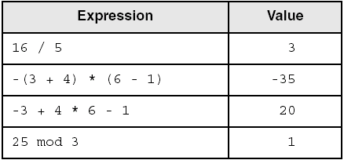
Integer Expressions
Operators and precedence levels:
Examples:

Slide 6
Character and String Constants
Enclose character in single or double quotes
'A', "x"
ASCII character = 1 byte
Enclose strings in single or double quotes
"ABC"
'xyz'
Each character occupies a single byte
Embedded quotes:
'Say "Goodnight," Gracie'

Slide 7
Reserved Words and Identifiers
Reserved words cannot be used as identifiers
Instruction mnemonics, directives, type attributes, operators, predefined symbols
See MASM reference in Appendix A
Identifiers
1-247 characters, including digits
not case sensitive
first character must be a letter, _, @, ?, or $

Slide 8
Directives
Commands that are recognized and acted upon by the assembler
Not part of the Intel instruction set
Used to declare code, data areas, select memory model, declare procedures, etc.
not case sensitive
Different assemblers have different directives
NASM not the same as MASM, for example

Slide 9
Instructions
Assembled into machine code by assembler
Executed at runtime by the CPU
We use the Intel IA-32 instruction set
An instruction contains:
Label (optional)
Mnemonic (required)
Operand (depends on the instruction)
Comment (optional)

Slide 10
Labels
Act as place markers
marks the address (offset) of code and data
Follow identifer rules
Data label
must be unique
example:myArray (not followed by colon)
Code label
target of jump and loop instructions
example: L1: (followed by colon)

Slide 11
Mnemonics and Operands
Instruction Mnemonics
memory aid
examples: MOV, ADD, SUB, MUL, INC, DEC
Operands
constant
constant expression
register
memory (data label)
Constants and constant expressions are often called immediate values

Slide 12
Comments (1 of 2)
Comments are good!
explain the program's purpose
when it was written, and by whom
revision information
tricky coding techniques
application-specific explanations
Single-line comments
begin with semicolon (;)

Slide 13
Comments (2 of 2)
Multi-line comments
begin with COMMENT directive and a programmer-chosen character
end with the same programmer-chosen character

Slide 14
Instruction Format Examples
No operands
stc ; set Carry flag
One operand
inc eax ; register
inc myByte ; memory
Two operands
add ebx,ecx ; register, register
sub myByte,25 ; memory, constant
add eax,36 * 25 ; register, constant-expression

Slide 15
What's Next (1 of 5)
Basic Elements of Assembly Language
Example: Adding and Subtracting Integers
Assembling, Linking, and Running Programs
Defining Data
Symbolic Constants
64-Bit Programming

Slide 16
Example: Adding and Subtracting Integers
; AddTwo.asm – adds two 32-bit integers
.386
.model flat,stdcall
.stack 4096
ExitProcess PROTO, dwExitCode:DWORD
.code
main PROC
mov eax,5 ; move 5 to the EAX register
add eax,6 ; add6 to the EAX register
INVOKE ExitProcess,0
main ENDP
END main

Slide 17
Example Output
Showing registers and flags in the debugger:
EAX=00030000EBX=7FFDF000 ECX=00000101 EDX=FFFFFFFF
ESI=00000000EDI=00000000 EBP=0012FFF0 ESP=0012FFC4
EIP=00401024EFL=00000206CF=0 SF=0ZF=0OF=0

Slide 18
Suggested Coding Standards (1 of 2)
Some approaches to capitalization
capitalize nothing
capitalize everything
capitalize all reserved words, including instruction mnemonics and register names
capitalize only directives and operators
Other suggestions
descriptive identifier names
spaces surrounding arithmetic operators
blank lines between procedures

Slide 19
Suggested Coding Standards (2 of 2)
Indentation and spacing
code and data labels – no indentation
executable instructions – indent 4-5 spaces
comments: right side of page, aligned vertically
1-3 spaces between instruction and its operands
ex: movax,bx
1-2 blank lines between procedures

Slide 20
Required Coding Standards
(to be filled in by the professor)

Slide 21
Program Template
; Program Template (Template.asm)
; Program Description:
; Author:
; Creation Date:
; Revisions:
; Date:Modified by:
.386
.model flat,stdcall
.stack 4096
ExitProcess PROTO, dwExitCode:DWORD
.data
; declare variables here
.code
main PROC
; write your code here
INVOKE ExitProcess,0
main ENDP
; (insert additional procedures here)
END main

Slide 22
What's Next (2 of 5)
Basic Elements of Assembly Language
Example: Adding and Subtracting Integers
Assembling, Linking, and Running Programs
Defining Data
Symbolic Constants
64-Bit Programming

Slide 23
Assembling, Linking, and Running Programs
Assemble-Link-Execute Cycle
Listing File
Map File

Slide 24
Assemble-Link Execute Cycle
The following diagram describes the steps from creating a source program through executing the compiled program.
If the source code is modified, Steps 2 through 4 must be repeated.

Slide 25
Listing File
Use it to see how your program is compiled
Contains
source code
addresses
object code (machine language)
segment names
symbols (variables, procedures, and constants)

Slide 26
What's Next (3 of 5)
Basic Elements of Assembly Language
Example: Adding and Subtracting Integers
Assembling, Linking, and Running Programs
Defining Data
Symbolic Constants
64-Bit Programming

Slide 27
Defining Data (1 of 2)
Intrinsic Data Types
Data Definition Statement
Defining BYTE and SBYTE Data
Defining WORD and SWORD Data
Defining DWORD and SDWORD Data
Defining QWORD Data
Defining TBYTE Data

Slide 28
Defining Data (2 of 2)
Defining Real Number Data
Little Endian Order
Adding Variables to the AddSub Program
Declaring Uninitialized Data

Slide 29
Intrinsic Data Types (1 of 2)
BYTE, SBYTE
8-bit unsigned integer; 8-bit signed integer
WORD, SWORD
16-bit unsigned & signed integer
DWORD, SDWORD
32-bit unsigned & signed integer
QWORD
64-bit integer
TBYTE
80-bit integer

Slide 30
Intrinsic Data Types (2 of 2)
REAL4
4-byte IEEE short real
REAL8
8-byte IEEE long real
REAL10
10-byte IEEE extended real

Slide 31
Data Definition Statement
A data definition statement sets aside storage in memory for a variable.
May optionally assign a name (label) to the data
Syntax:
[name] directive initializer [,initializer] . . .
value1 BYTE 10
All initializers become binary data in memory

Slide 32
Defining BYTE and SBYTE Data
Each of the following defines a single byte of storage:
value1 BYTE 'A' ; character constant
value2 BYTE 0 ; smallest unsigned byte
value3 BYTE 255 ; largest unsigned byte
value4 SBYTE -128; smallest signed byte
value5 SBYTE +127 ; largest signed byte
value6 BYTE ? ; uninitialized byte
MASM does not prevent you from initializing a BYTE with a negative value, but it's considered poor style.
If you declare a SBYTE variable, the Microsoft debugger will automatically display its value in decimal with a leading sign.

Slide 33
Defining Byte Arrays
Examples that use multiple initializers:
list1 BYTE 10,20,30,40
list2 BYTE 10,20,30,40
BYTE 50,60,70,80
BYTE 81,82,83,84
list3 BYTE ?,32,41h,00100010b
list4 BYTE 0Ah,20h,‘A’,22h

Slide 34
Defining Strings (1 of 3)
A string is implemented as an array of characters
For convenience, it is usually enclosed in quotation marks
It often will be null-terminated
Examples:
str1 BYTE "Enter your name",0
str2 BYTE 'Error: halting program',0
str3 BYTE 'A','E','I','O','U'
greeting BYTE "Welcome to the Encryption Demo
program "
BYTE "created by Kip Irvine.",0

Slide 35
Defining Strings (2 of 3)
To continue a single string across multiple lines, end each line with a comma:
menu BYTE "Checking Account",0dh,0ah,0dh,0ah,
"1. Create a new account",0dh,0ah,
"2. Open an existing account",0dh,0ah,
"3. Credit the account",0dh,0ah,
"4. Debit the account",0dh,0ah,
"5. Exit",0ah,0ah,
"Choice> ",0

Slide 36
Defining Strings (3 of 3)
End-of-line character sequence:
0Dh = carriage return
0Ah = line feed
str1 BYTE "Enter your name: ",0Dh,0Ah
BYTE "Enter your address: ",0
newLine BYTE 0Dh,0Ah,0
Idea: Define all strings used by your program in the same area of the data segment.

Slide 37
Using the DUP Operator
Use DUP to allocate (create space for) an array or string. Syntax: counter DUP (argument)
Counter and argument must be constants or constant expressions
var1 BYTE 20 DUP(0) ; 20 bytes, all equal to zero
var2 BYTE 20 DUP(?) ; 20 bytes, uninitialized
var3 BYTE 4 DUP("STACK"); 20 bytes:
"STACKSTACKSTACKSTACK"
var4 BYTE 10,3 DUP(0),20; 5 bytes

Slide 38
Defining WORD and SWORD Data
Define storage for 16-bit integers
or double characters
single value or multiple values
word1WORD65535 ; largest unsigned value
word2SWORD –32768 ; smallest signed value
word3WORD? ; uninitialized, unsigned
word4WORD"AB" ; double characters
myList WORD1,2,3,4,5 ; array of words
arrayWORD5 DUP(?) ; uninitialized array

Slide 39
Defining DWORD and SDWORD Data
Storage definitions for signed and unsigned 32-bit integers:
val1 DWORD12345678h ; unsigned
val2 SDWORD –2147483648 ; signed
val3 DWORD20 DUP(?) ; unsigned array
val4 SDWORD –3,–2,–1,0,1 ; signed array

Slide 40
Defining QWORD, TBYTE, Real Data
Storage definitions for quadwords, tenbyte values, and real numbers:
quad1 QWORD1234567812345678h
val1TBYTE 1000000000123456789Ah
rVal1 REAL4 -2.1
rVal2 REAL8 3.2E-260
rVal3 REAL10 4.6E+4096
ShortArray REAL4 20 DUP(0.0)

Slide 41
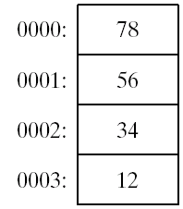
Little Endian Order
All data types larger than a byte store their individual bytes in reverse order. The least significant byte occurs at the first (lowest) memory address.
Example:
val1 DWORD 12345678h

Slide 42
Adding Variables to AddSub
TITLE Add and Subtract, Version 2(AddSub2.asm)
; This program adds and subtracts 32-bit unsigned
; integers and stores the sum in a variable.
INCLUDE Irvine32.inc
.data
val1 DWORD 10000h
val2 DWORD 40000h
val3 DWORD 20000h
finalVal DWORD ?
.code
main PROC
mov eax,val1 ; start with 10000h
add eax,val2 ; add 40000h
sub eax,val3 ; subtract 20000h
mov finalVal,eax ; store the result (30000h)
call DumpRegs ; display the registers
exit
main ENDP
END main

Slide 43
Declaring Unitialized Data
Use the .data? directive to declare an unintialized data segment:
.data?
Within the segment, declare variables with "?" initializers:
smallArray DWORD 10 DUP(?)
Advantage: the program's EXE file size is reduced.

Slide 44
What's Next (4 of 5)
Basic Elements of Assembly Language
Example: Adding and Subtracting Integers
Assembling, Linking, and Running Programs
Defining Data
Symbolic Constants
64-Bit Programming

Slide 45
Symbolic Constants
Equal-Sign Directive
Calculating the Sizes of Arrays and Strings
EQU Directive
TEXTEQU Directive

Slide 46
Equal-Sign Directive
name = expression
expression is a 32-bit integer (expression or constant)
may be redefined
name is called a symbolic constant
good programming style to use symbols
COUNT = 500
.
.
mov ax,COUNT

Slide 47
Calculating the Size of a Byte Array
current location counter: $
subtract address of list
difference is the number of bytes
list BYTE 10,20,30,40
ListSize = ($ - list)

Slide 48
Calculating the Size of a Word Array
Divide total number of bytes by 2 (the size of a word)
list WORD 1000h,2000h,3000h,4000h
ListSize = ($ - list) / 2

Slide 49
Calculating the Size of a Doubleword Array
Divide total number of bytes by 4 (the size of a doubleword)
list DWORD 1,2,3,4
ListSize = ($ - list) / 4

Slide 50
EQU Directive
Define a symbol as either an integer or text expression.
Cannot be redefined
PI EQU <3.1416>
pressKey EQU <"Press any key to continue...",0>
.data
prompt BYTE pressKey

Slide 51
TEXTEQU Directive
Define a symbol as either an integer or text expression.
Called a text macro
Can be redefined
continueMsg TEXTEQU <"Do you wish to continue (Y/N)?">
rowSize = 5
.data
prompt1 BYTE continueMsg
count TEXTEQU %(rowSize * 2) ; evaluates the expression
setupAL TEXTEQU <mov al,count>
.code
setupAL ; generates: "mov al,10"

Slide 52
What's Next (5 of 5)
Basic Elements of Assembly Language
Example: Adding and Subtracting Integers
Assembling, Linking, and Running Programs
Defining Data
Symbolic Constants
64-Bit Programming

Slide 53
64-Bit Programming
MASM supports 64-bit programming, although the following directives are not permitted:
INVOKE, ADDR, .model, .386, .stack
(Other non-permitted directives will be introduced in later chapters)

Slide 54
64-Bit Version of AddTwoSum
1: ; AddTwoSum_64.asm - Chapter 3 example.
3: ExitProcess PROTO
5: .data
6: sum DWORD 0
8: .code
9: mainPROC
10: moveax,5
11: addeax,6
12: movsum,eax
13:
14: movecx,0
15: call ExitProcess
16: main ENDP
17: END

Slide 55
Things to Notice About the Previous Slide
The following lines are not needed:
.386
.model flat,stdcall
.stack 4096
INVOKE is not supported.
CALL instruction cannot receive arguments
Use 64-bit registers when possible

Slide 56
Summary
Integer expression, character constant
directive – interpreted by the assembler
instruction – executes at runtime
code, data, and stack segments
source, listing, object, map, executable files
Data definition directives:
BYTE, SBYTE, WORD, SWORD, DWORD, SDWORD, QWORD, TBYTE, REAL4, REAL8, and REAL10
DUP operator, location counter ($)
Symbolic constant
EQU and TEXTEQU

Slide 57
4C 61 46 69 6E

Slide 58

Copyright
This work is protected by United States copyright laws and is provided solely for the use of instructors in teaching their courses and assessing student learning. Dissemination or sale of any part of this work (including on the World Wide Web) will destroy the integrity of the work and is not permitted. The work and materials from it should never be made available to students except by instructors using the accompanying text in their classes. All recipients of this work are expected to abide by these restrictions and to honor the intended pedagogical purposes and the needs of other instructors who rely on these materials.
Notes:
If this slide was not included in the original PPT, it should be added.

