Slide 1
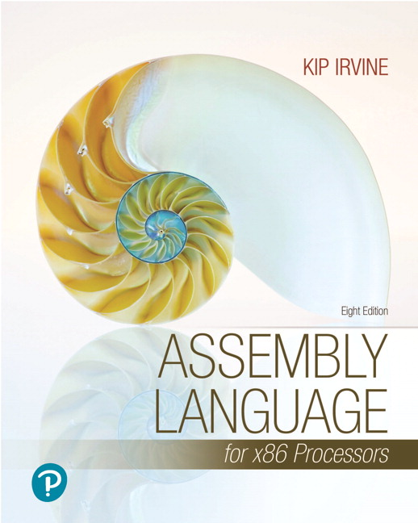
Assembly Language for x86 Processors
Eighth Edition
Chapter 1
Basic Concepts
Copyright © 2020, 2015, 2011 Pearson Education, Inc. All Rights Reserved

Slide 2
Chapter Overview
Welcome to Assembly Language
Virtual Machine Concept
Data Representation
Boolean Operations

Slide 3
Welcome to Assembly Language
Some Good Questions to Ask
Assembly Language Applications

Slide 4
Questions to Ask
Why am I learning Assembly Language?
What background should I have?
What is an assembler?
What hardware/software do I need?
What types of programs will I create?
What do I get with this book?
What will I learn?

Slide 5
Welcome to Assembly Language (cont)
How does assembly language (AL) relate to machine language?
How do C++ and Java relate to AL?
Is AL portable?
Why learn AL?

Slide 6
Assembly Language Applications
Some representative types of applications:
Business application for single platform
Hardware device driver
Business application for multiple platforms
Embedded systems & computer games
(see next panel)

Slide 7
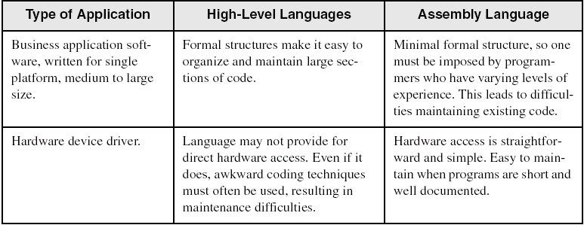
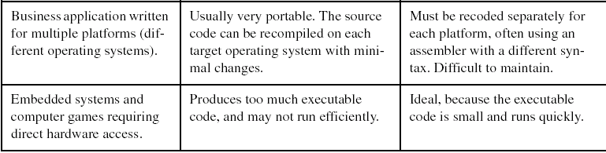
Comparing ASM to High-Level Languages

Slide 8
What's Next (1 of 3)
Welcome to Assembly Language
Virtual Machine Concept
Data Representation
Boolean Operations

Slide 9
Virtual Machine Concept
Virtual Machines
Specific Machine Levels

Slide 10
Virtual Machines (1 of 2)
Tanenbaum: Virtual machine concept
Programming Language analogy:
Each computer has a native machine language (language L0) that runs directly on its hardware
A more human-friendly language is usually constructed above machine language, called Language L1

Slide 11
Virtual Machines (2 of 2)
Programs written in L1 can run two different ways:
Interpretation – L0 program interprets and executes L1 instructions one by one
Translation – L1 program is completely translated into an L0 program, which then runs on the computer hardware

Slide 12
Translating Languages
English: Display the sum of A times B plus C.
C++: cout << (A * B + C);
Assembly Language:
mov eax,A
mul B
add eax,C
call WriteInt
Intel Machine Language:
A1 00000000
F7 25 00000004
03 05 00000008
E8 00500000

Slide 13
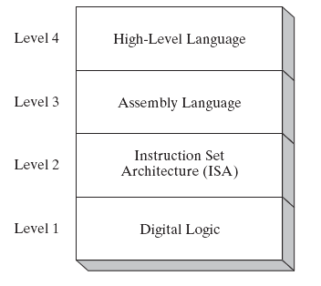
Specific Machine Levels
(descriptions of individual levels follow . . . )

Slide 14
High-Level Language
Level 4
Application-oriented languages
C++, Java, Pascal, Visual Basic . . .
Programs compile into assembly language
(Level 4)

Slide 15
Assembly Language
Level 3
Instruction mnemonics that have a one-to-one correspondence to machine language
Programs are translated into Instruction Set Architecture Level - machine language (Level 2)

Slide 16
Instruction Set Architecture (ISA)
Level 2
Also known as conventional machine language
Executed by Level 1 (Digital Logic)

Slide 17
Digital Logic
Level 1
CPU, constructed from digital logic gates
System bus
Memory
Implemented using bipolar transistors
next: Data Representation

Slide 18
What's Next (2 of 3)
Welcome to Assembly Language
Virtual Machine Concept
Data Representation
Boolean Operations

Slide 19
Data Representation
Binary Numbers
Translating between binary and decimal
Binary Addition
Integer Storage Sizes
Hexadecimal Integers
Translating between decimal and hexadecimal
Hexadecimal subtraction
Signed Integers
Binary subtraction
Character Storage

Slide 20
Binary Numbers (1 of 2)
Digits are 1 and 0
1 = true
0 = false
MSB – most significant bit
LSB – least significant bit
Bit numbering:

Slide 21
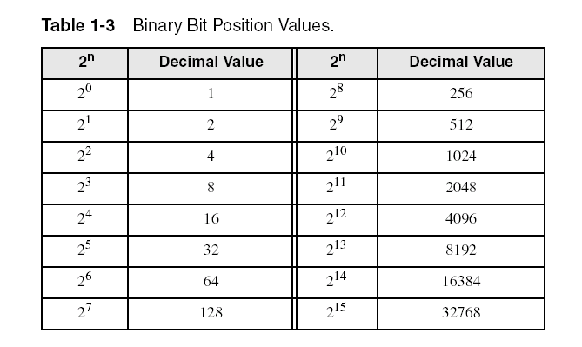
Binary Numbers (2 of 2)
Each digit (bit) is either 1 or 0
Each bit represents a power of 2:
Every binary number is a sum of powers of 2

Slide 22
Translating Binary to Decimal
Weighted positional notation shows how to calculate the decimal value of each binary bit:
dec = (D_{n-1} 3 2^{n-1}) + (D_{n-2} 3 2^{n-2}) + ... + (D₁ 3 2¹) + (D₀ 3 2⁰)
D = binary digit
binary 00001001 = decimal 9:
(1 3 2³) + (1 3 2⁰) = 9

Slide 23
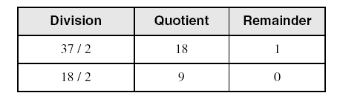
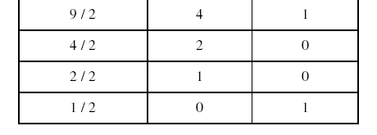
Translating Unsigned Decimal to Binary
Repeatedly divide the decimal integer by 2. Each remainder is a binary digit in the translated value:
37 = 100101

Slide 24
Binary Addition
Starting with the LSB, add each pair of digits, include the carry if present.

Slide 25
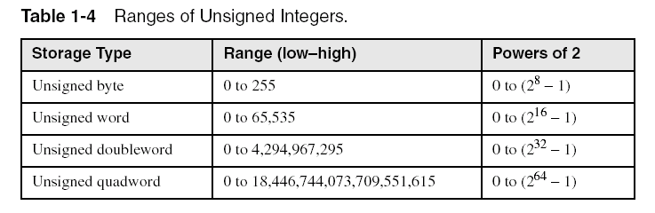
Integer Storage Sizes
Standard sizes:
What is the largest unsigned integer that may be stored in 20 bits?

Slide 26
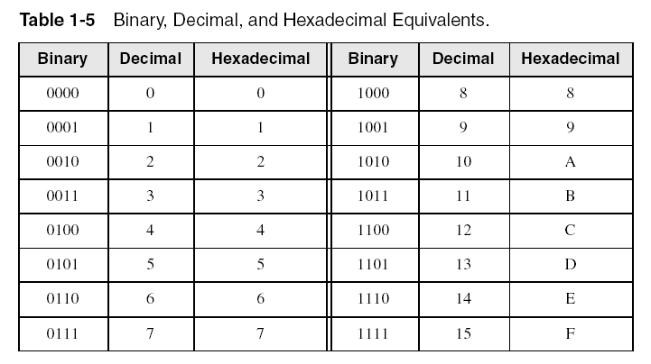
Hexadecimal Integers
Binary values are represented in hexadecimal.

Slide 27

Translating Binary to Hexadecimal
Each hexadecimal digit corresponds to 4 binary bits.
Example: Translate the binary integer 000101101010011110010100 to hexadecimal:

Slide 28
Converting Hexadecimal to Decimal
Multiply each digit by its corresponding power of 16:
dec = (D₃ 316³) + (D₂316²) + (D₁316¹) +
(D₀ 316⁰)
Hex 1234 equals (1316³) + (2316²) + (3316¹) + (4316⁰), or decimal 4,660.
Hex 3BA4 equals (3316³) + (11 * 16²) + (10316¹) + (4316⁰), or decimal 15,268.

Slide 29
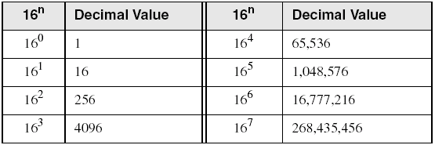
Powers of 16
Used when calculating hexadecimal values up to 8 digits long:

Slide 30
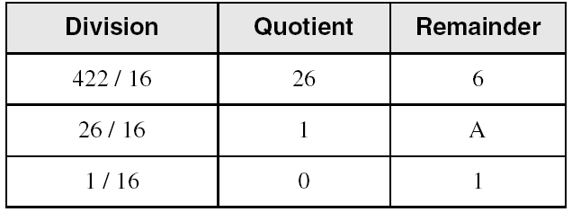
Converting Decimal to Hexadecimal
decimal 422 = 1A6 hexadecimal

Slide 31
Hexadecimal Addition
Divide the sum of two digits by the number base (16). The quotient becomes the carry value, and the remainder is the sum digit.
1
1
36 28 28 6A
42 45 58 4B
78 6D 80 B5
21 / 16 = 1, rem 5
Important skill: Programmers frequently add and subtract the addresses of variables and instructions.

Slide 32
Hexadecimal Subtraction
When a borrow is required from the digit to the left, add 16 (decimal) to the current digit's value:
16 + 5 = 21
−1
C6 75
A2 47
24 2E
Practice: The address of var1 is 00400020. The address of the next variable after var1 is 0040006A. How many bytes are used by var1?

Slide 33
Signed Integers
The highest bit indicates the sign.1 = negative, 0 = positive
If the highest digit of a hexadecimal integer is > 7, the value is negative. Examples: 8A, C5, A2, 9D

Slide 34
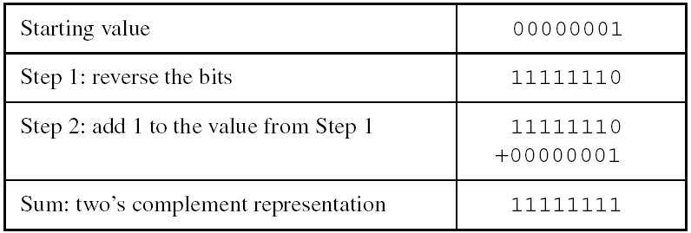
Forming the Two's Complement
Negative numbers are stored in two's complement notation
Represents the additive Inverse
Note that 00000001 + 11111111 = 00000000

Slide 35
Binary Subtraction
When subtracting A – B, convert B to its two's complement
Add A to (–B)
0 0 0 0 1 1 0 0 0 0 0 0 1 1 0 0
– 0 0 0 0 0 0 1 1 1 1 1 1 1 1 0 1
0 0 0 0 1 0 0 1
Practice: Subtract 0101 from 1001.

Slide 36
Learn How To Do the Following:
Form the two's complement of a hexadecimal integer
Convert signed binary to decimal
Convert signed decimal to binary
Convert signed decimal to hexadecimal
Convert signed hexadecimal to decimal

Slide 37
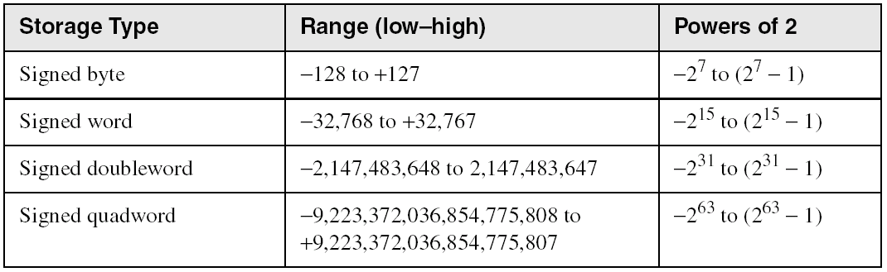
Ranges of Signed Integers
The highest bit is reserved for the sign. This limits the range:
Practice: What is the largest positive value that may be stored in 20 bits?

Slide 38
Character Storage
Character sets
Standard ASCII (0 – 127)
Extended ASCII (0 – 255)
ANSI (0 – 255)
Unicode(0 – 65,535)
Null-terminated String
Array of characters followed by a null byte
Using the ASCII table
back inside cover of book

Slide 39
Numeric Data Representation
pure binary
can be calculated directly
ASCII binary
string of digits: "01010101"
ASCII decimal
string of digits: "65"
ASCII hexadecimal
string of digits: "9C"
next: Boolean Operations

Slide 40
What's Next (3 of 3)
Welcome to Assembly Language
Virtual Machine Concept
Data Representation
Boolean Operations

Slide 41
Boolean Operations
NOT
AND
OR
Operator Precedence
Truth Tables

Slide 42
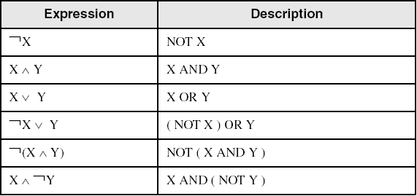
Boolean Algebra
Based on symbolic logic, designed by George Boole
Boolean expressions created from:
NOT, AND, OR

Slide 43
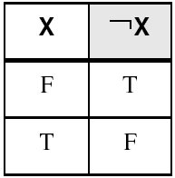
NOT
Inverts (reverses) a boolean value
Truth table for Boolean NOT operator:

Slide 44
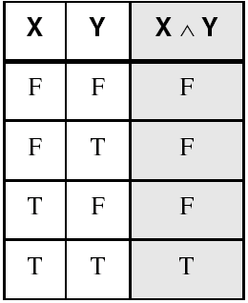
AND
Truth table for Boolean AND operator:
Digital gate diagram for AND:

Slide 45
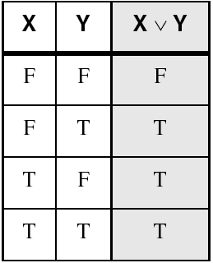
OR
Truth table for Boolean OR operator:
Digital gate diagram for OR:

Slide 46
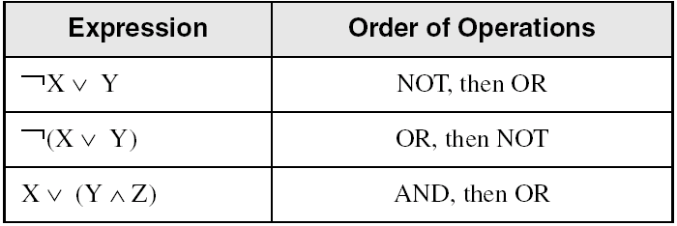
Operator Precedence
Examples showing the order of operations:

Slide 47
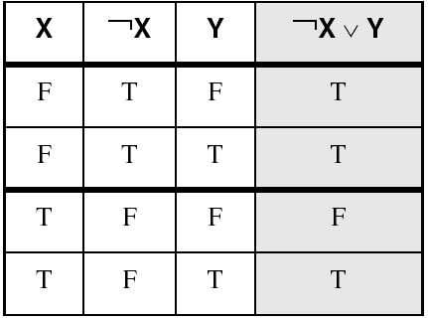
Truth Tables (1 of 3)
A Boolean function has one or more Boolean inputs, and returns a single Boolean output.
A truth table shows all the inputs and outputs of a Boolean function
Example: ¬X ∨ Y

Slide 48
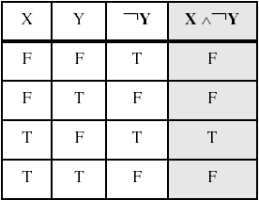
Truth Tables (2 of 3)
Example: X ∧ ¬ Y

Slide 49
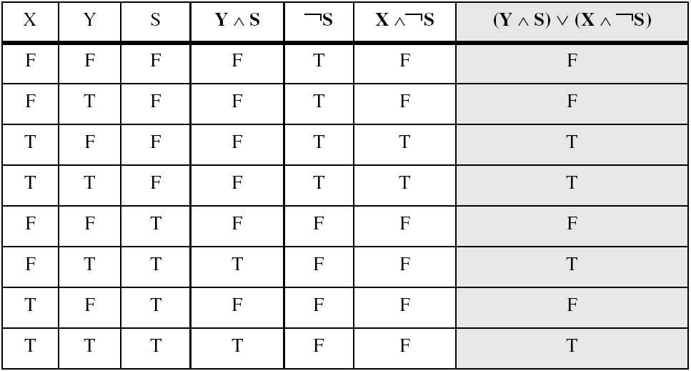
Truth Tables (3 of 3)
Example: (Y∧S) ∨ (X∧ ¬S)
Two-input multiplexer

Slide 50
Summary
Assembly language helps you learn how software is constructed at the lowest levels
Assembly language has a one-to-one relationship with machine language
Each layer in a computer's architecture is an abstraction of a machine
layers can be hardware or software
Boolean expressions are essential to the design of computer hardware and software

Slide 51
Extra
54 68 65 20 45 6E 64
What do these numbers represent?

Slide 52

Copyright
MIT LICENSE HAHAHAHA
This work is protected by United States copyright laws and is provided solely for the use of instructors in teaching their courses and assessing student learning. Dissemination or sale of any part of this work (including on the World Wide Web) will destroy the integrity of the work and is not permitted. The work and materials from it should never be made available to students except by instructors using the accompanying text in their classes. All recipients of this work are expected to abide by these restrictions and to honor the intended pedagogical purposes and the needs of other instructors who rely on these materials.
shut the fuck up
Notes:
If this slide was not included in the original PPT, it should be added.

