Slide 1

Project 1 ML Classifiers
Group 5 Jaxon Ham
Cody Uhl

Slide 2
Preprocessing
Main Steps:
Handling Missing Values (no NANs or ‘?’ placeholders)
Encoding Categorical values
Turning string cats into numeric via one-hot encoding
Standardizing numerical features to be on a consistent scale
Important for gradient-based methods

Slide 3
PerceptronGD
Init: Sets learning rate, epochs, random seed, random weights, and error tracker.
Fit: For each epoch and sample, predicts output, calculates update = eta * (target - prediction), adjusts weights/bias, and counts misclassifications.
Predict: Uses weighted sum + step function to classify new inputs.
Tracks: Errors per epoch for plotting convergence. Model Accuracy: 0.7835

Slide 4
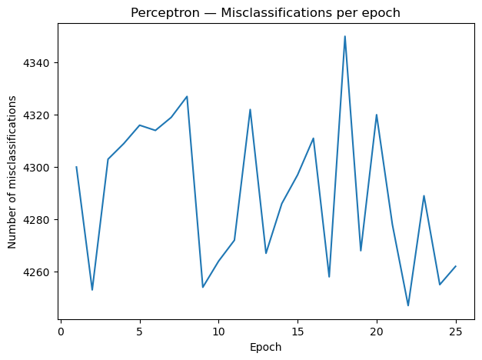
PerceptronGD
Why Doesn’t it Converge?
Only updates weights when sample is misclassified
Non-linearly separable data
Learning rate Sensitivity
High-Dimensional, imbalanced data

Slide 5
AdalineGD
Init: Sets learning rate, epochs, random seed, random weights, and loss tracker.
Fit: Each epoch computes net input for all samples, applies linear activation, calculates errors (y – output), updates weights using gradient descent, and record MSE
Predict: Uses linear activation followed by a step function to classify inputs.
Tracks: MSE per epoch to monitor convergence.
Updates weights using magnitude of errors instead of just misclassifications, which gives smoother learning.
Model Accuracy: 0.7852

Slide 6
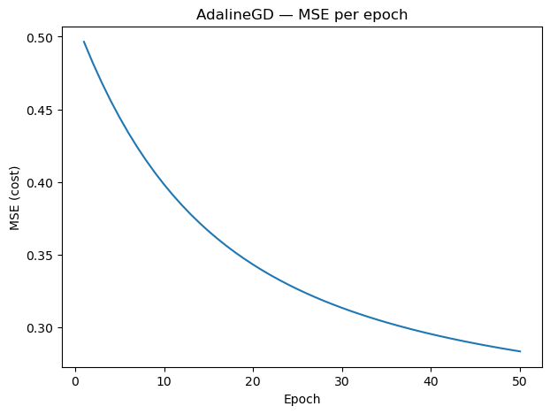
AdalineGD
MSE steadily decreases
About 0.28 after 50 epochs
Curve flattening toward the end → approaching a minimum
Learning Rate = 0.01 was appropriate

Slide 7
AdalineSGD
Init: Sets learning rate, epochs, random seed, random seed, random weights, shuffle option, and cost tracker.
Fit: For each epoch, shuffles samples, then for each sample computes output, error, updates weights immediately, and accumulates cost.
Predict: uses linear activation (net input) followed by a step function or classification.
Tracks: Average cost (MSE per sample) per epoch → faster but noiser convergance than AdalineGD.
Model Accuracy: 0.7858

Slide 8
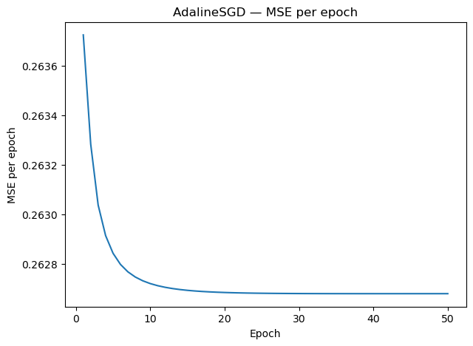
AdalineSGD
sharper early drop
converges faster (updates after each sample)
though sometimes noisier

Slide 9
SKLearn Perceptron & Adaline
SKLearn Perceptron:
SKLearn Adaline:
Efficient perceptron using SGD
Supports regularization, learning rate tuning, and class weights
Faster and more stable
Perceptron SKLearn Accuracy: 0.7950
Adaline with SGD
Minimizes mean squared error
Includes regularization, adaptive learning rates, and shuffling
Adaline SKLearn Accuracy: 0.8301

Slide 10
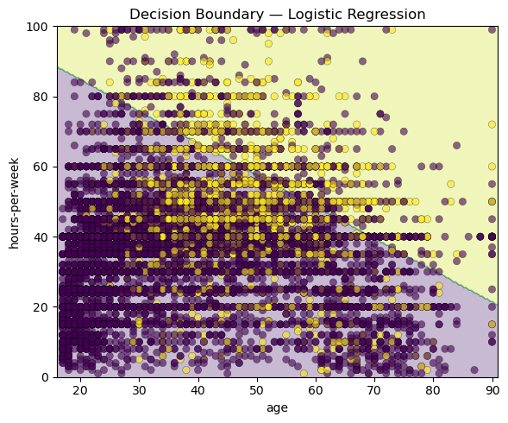
Log Reg + GridSearchCV
Best params:
C: 1.0
Accuracy:
0.8486

Slide 11
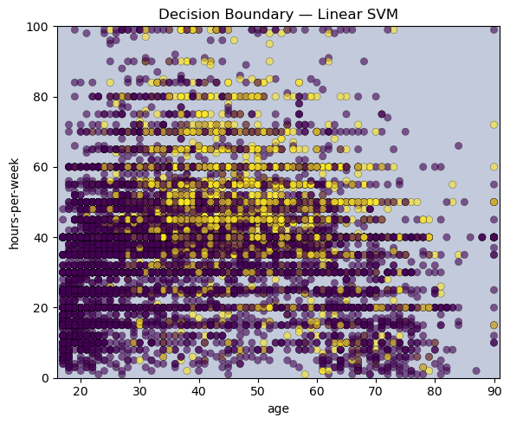
Linear SVM + GridSearchCV
Best params:
C: 1.0
Accuracy:
0.8463

Slide 12

RBF SVM + GridSearchCV
Best params:
C: 1.0
gamma: 0.05
Accuracy:
0.8488

Slide 13
Decision Boundaries – Log Reg. vs. SVM
Logistic Regression → Linear boundary, probability-based
Linear SVM → Linear margin, relies on support vectors
RBF SVM → Nonlinear boundary, adapts to complex patterns
Key Difference → RBF captures curves; linear models stick to straight lines
Observation → RBF gave the highest accuracy (0.8488)

Slide 14
Why is Feature Scaling Important for Gradient-Based Algorithms?
Gradient descent updates depend on feature magnitudes
Without scaling, large-scale features dominate updates
Leads to slow convergence or unstable learning
Standardizing features puts them on the same scale
Result: smoother, faster, and more reliable convergence (as seen in AdalineGD/SGD curves)

Slide 15
Batch Gradient Descent vs. Stochastic Gradient Descent
Batch Gradient Descent
Stochastic Gradient Descent
Updates weights once per epoch using entire dataset
Produces smooth, gradually declining MSE curve
Slower to converge
More stable
Updates weights after each training sample
Learns much faster
Sharper early drop in MSE
Curve can be noisier, but converges quicker on large datasets

Slide 16
Custom Perceptron & Adaline vs. SKLearn Why does SKLearn outperform the book code?
Optimized Implementation: scikit-learn is highly optimized → faster and more efficient than our python loops
Regularization: built in options like alpha helps prevent overfitting
Better Learning Rate Handling: Adaptive learning rate schedules vs. our fixed learning rate
Robustness: handles edge cases (non-separable data, convergence issues) more gracefully

Slide 17
Using Regularization to Prevent Overfitting
Role:
Adds a penalty term to the loss function
Discourages overly large weights
Simplifies the decision boundary
Effect:
Reduces variance & improves generalization
Helps balance bias-variance tradeoff
In Code:
Log Reg & SVM in scikit-learn use C as a regularization strength
Smaller C = stronger regularization = smoother boundaries & less overfitting

Slide 18
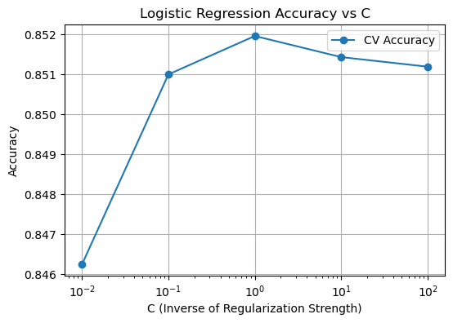
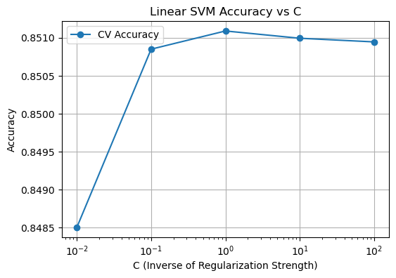
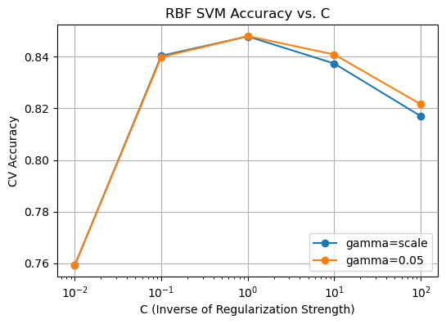
Varying C in Log Reg and Linear SVC Models
C = 0.01 → strong regularization → smoother boundaries, lower accuracy
C = 1.0 → balanced regularization → best performance across models
C = 100 → weak regularization → tighter fit, small drop in accuracy
Linear models (LogReg & Linear SVM): accuracy stable around 0.85
RBF SVM: more sensitive to C & γ, peaked near C=1, γ=0.05 (~0.8488)

