Slide 1

Machine Learning Project 2 — Applying MLP to the Adult Income Dataset
Course: DASC 41103 Machine Learning
Authors: Group 5- Jaxon Ham & Cody Uhl
Notes:
“Hi everyone, we’re Group 5 — Jaxon Ham and Cody Uhl — and today we’ll be presenting our Machine Learning Project 2.
In this project, we used a Multi-Layer Perceptron to predict whether someone earns more than fifty thousand dollars a year based on demographic and employment data from the UCI Adult Income dataset.”

Slide 2
Project Overview
Objective:
Predict if a person earns > $50K per year using demographic and employment features.
Dataset:
Source: UCI Adult Income (project_adult.csv)
Rows: ≈ 32 000 | Features: 15 | Target: income (> 50K vs ≤ 50K)
Tasks:
Clean and preprocess data
Build MLP model with GridSearchCV
Evaluate on holdout test set
Predict validation inputs → CSV submission
Notes:
“Our main objective was to build a classifier that predicts high or low income using the Adult Income dataset.
The dataset contains approximately 32,000 rows and 15 features, including both numeric and categorical variables.
We started by cleaning the data, performing encoding and scaling, and then used an MLP model tuned with GridSearch CV.
Finally, we evaluated performance on a hold-out test set and submitted predictions for the validation file.”

Slide 3
Data Preparation
Cleaning Steps:
Replaced "?" and blanks with NaN
Trimmed whitespace from string columns
Encoded target (>50K → 1, ≤50K → 0)
Stratified 80/20 train-test split
Feature Types:
7 Numeric Columns: Unnamed: 0, age, fnlwgt, education-num, capital-gain, capital-loss, hours-per-week
8 Categorical Columns: workclass, education, marital-status, occupation, relationship, race, sex, native-country
Notes:
“For data cleaning, we replaced missing or unknown values — shown as question marks — with NaN, and trimmed extra whitespace in text fields.
The target variable was encoded so that ‘greater than fifty K’ became 1 and ‘less than or equal to fifty K’ became 0.
We also used a stratified 80/20 train-test split to maintain a balanced income distribution.
Out of the fifteen columns, we had seven numeric ones like age, capital gain, and hours per week, and eight categorical ones such as workclass, education, occupation, and race.”

Slide 4
MLP Model Setup
Estimator: MLPClassifier (scikit-learn)
Base Parameters:
max_iter = 300
early_stopping = True, n_iter_no_change = 10
solver = 'adam', random_state = 42
GridSearch Parameters:
Hyperparameter | Values
Hidden Layers | (64,), (128,), (64, 32), (128, 64)
Activation | ReLU, tanh
Alpha (L2) | 1e-4, 1e-3, 1e-2
Learning Rate Init | 0.001, 0.0005
Solver | Adam
Notes:
“We used scikit-learn’s MLPClassifier as our estimator.
The base configuration included 300 maximum iterations, early stopping with a patience of ten epochs, and the Adam solver for optimization.
In our GridSearch, we tuned the activation function, hidden-layer sizes, alpha for L2 regularization, and learning rate.
This setup allowed us to systematically compare combinations and find the architecture that performed best.”

Slide 5
Cross-Validation Results
Best Parameters Found:
Activation = ReLU
Hidden Layers = (64, 32)
Alpha = 0.01
Learning Rate = 0.001
Solver = Adam
5-Fold CV Accuracy: 0.8537
Notes:
“After running five-fold cross-validation, the best parameters we found were:
a ReLU activation function, hidden layers of 64 and 32 neurons, alpha equal to 0.01, and a learning rate of 0.001 with the Adam optimizer.
The average cross-validation accuracy was about 0.8537, which showed good generalization without overfitting.”

Slide 6
Holdout Test Performance
Holdout Accuracy: 0.8495
Macro F1: 0.78 Weighted F1: 0.84
Confusion Matrix:
[[3666 290]
[ 494 760]]
Metric | ≤ 50K | > 50K
Precision | 0.88 | 0.72
Recall | 0.93 | 0.61
F1-Score | 0.90 | 0.66
Notes:
“On our holdout test set, the model achieved an accuracy of around 0.85, with a macro F1 score of 0.78 and a weighted F1 of 0.84.
The confusion matrix showed that the model was more conservative when predicting high-income individuals — it had higher precision than recall for the greater-than-50 K class.
That means it was less likely to incorrectly label someone as high-income when they weren’t, which can be useful in real-world applications where false positives carry a cost.”

Slide 7
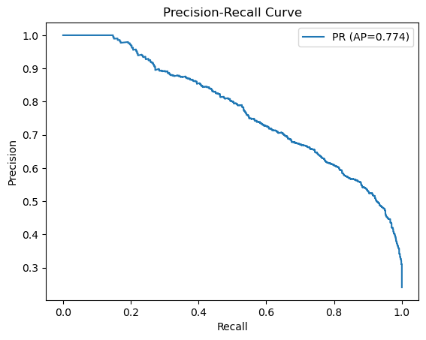
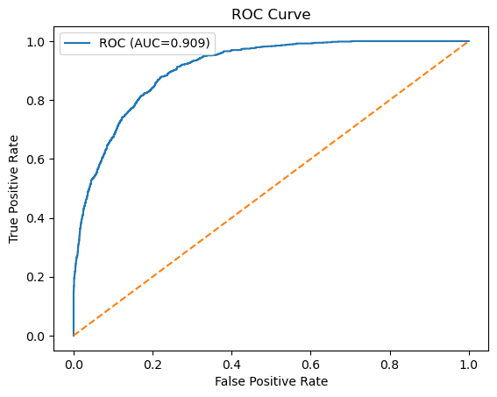
Performance Visualization
Insights:
Early stopping + regularization kept validation loss stable
Model learns quickly and plateaus ≈ epoch 20
Precision > Recall for > 50K → conservative classification
Notes:
“Here we can see that early stopping and regularization helped keep the validation loss stable.
The training curve shows rapid learning in the first few epochs and then plateauing around epoch twenty.
This suggests the model reached an optimal state early and avoided over-training — a sign that our parameters and stopping criteria were well-chosen.”

Slide 8
Reflection & Conceptual Questions
Architecture Choice:
(64, 32) + ReLU → best balance of accuracy and stability
(b) Overfitting Control:
Early stopping | L2 regularization | 5-fold CV
(c) Ethical Concerns:
Bias in features (“sex”, “race”) → need fairness audits + human oversight
(d) Activation Functions:
Add non-linearity → enable MLP to model complex relationships
Notes:
“For our architecture choice, the 64-32 structure with ReLU activation gave the best balance between accuracy and stability.
To control overfitting, we used early stopping, L2 regularization, and five-fold cross-validation.
One ethical consideration is that the dataset includes sensitive features like sex and race, which could introduce bias.
We recommend fairness audits and human oversight for models like this before deployment.
Finally, activation functions like ReLU add non-linearity so the MLP can capture complex relationships in the data.”

Slide 9
Github
https://github.com/coaluh/ML_Project
Notes:
“Our code and results are available on GitHub at the link shown here.
It includes our main Jupyter notebook, the training and validation scripts, and the predicted output CSV files for submission.
Thank you for listening — we’re happy to answer any questions.”

