Slide 1
Acceleration OF FINANCIAL ALGORITHM FOR OPTION PRICING
Group ASSIGNMENT PROPOSAL - PMPH course ‘17
Wojciech Michal Pawlak SENIOR Research Engineer, SimCorp Technology Labs
19TH Septmeber 2017, DIKU, Copenhagen

Slide 2
Agenda
19TH Septmeber 2017
About my project in SimCorp
Option pricing
The Problem
The Model Implementation

Slide 3
About ME
Wojciech Michal Pawlak
Senior Research Engineer at SimCorp Technology Labs, SimCorp A/S
Industrial Ph.D. Student at Department of Computer Science (DIKU)
Joint industry-academic collaboration supported by Innovation Fund Denmark
Period: February 2017 – January 2020
Project Title: Accelerated Financial Algorithms
Project Goal: Utilization of current HPC techniques and modern commodity many-core architectures to target large compute loads in core financial calculations for risk management and pricing of financial instruments
Supervisors: Martin Elsman and Cosmin Oancea
Master thesis at DTU in High-Performance Computing
More details: https://www.linkedin.com/in/wojciechpawlak/
Contact: Wojciech.M.Pawlak@simcorp.com or wmp@di.ku.dk

Slide 4

About SIMCORP
Largest Danish FinTech company
More than 20 offices globally
More than 1500 employees
More than 20% of revenue invested in R&D
Leading provider of investment management software solutions
More than 180 clients worldwide, mainly large financial organizations
SimCorp Technology Labs
Internal strategic innovation unit focused on innovative technology and enterprise architecture research
High-performance computing
Artificial Intelligence
More details: www.simcorp.com

Slide 5
Derivative Pricing
A contract between two or more parties that derives its value from the performance of an underlying asset, index, or entity
Exchange-traded or Over-the-Counter (OTC)
Examples: Futures, Forward, Options, Warrants, Swaps, etc.
Low-end estimate of the size and scope of global derivative markets
$630 trillion
High-end estimate can be as high as $1.2 quadrillion
Some of the derivative types (CDOs, CDSs) played an infamous role in the 2008 Financial Crisis
More regulation introduced since then
Increased focus on risk management in investment portfolios in financial institutions
What leads to more pricing and larger computation loads
Reference: http://money.visualcapitalist.com/all-of-the-worlds-money-and-markets-in-one-visualization/

Slide 6
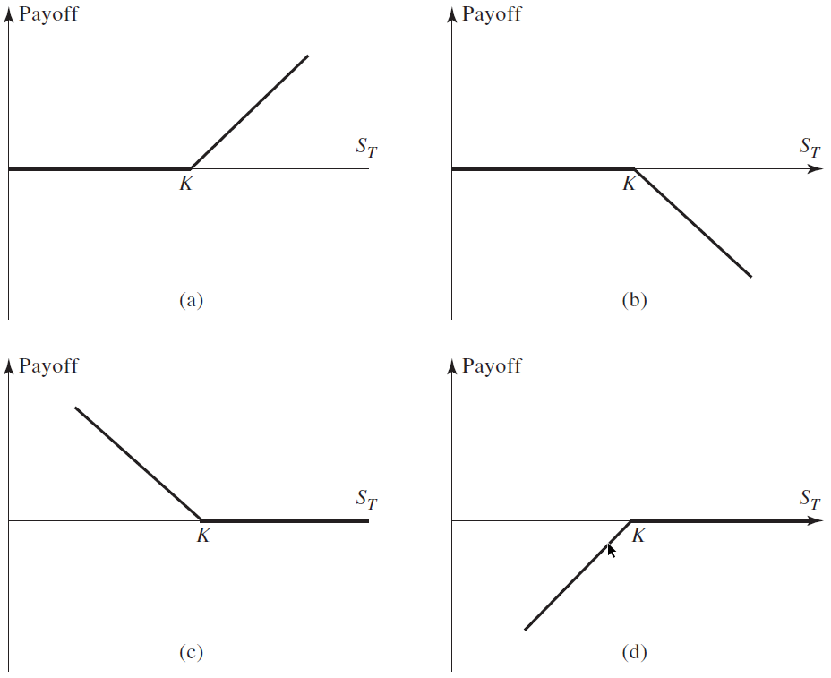

What is an Option?
Option gives the buyer (holder) the right, but not the obligation, to buy (call) or sell (put) 1 unit of the underlying asset
at a specified price K (strike price)
at a specified time T (maturity, expiration) (European)
Or
at any time until a specified time T (American)
${Payoff}_{call}=\max\left\{S_{T}−K,0\right\}$
${Payoff}_{put}=max⁡\{K−S_{T},0\}$
Payoffs from positions in European options:
(a) long call; (b) short call; (c) long put; (d) short put.
Price of an underlying asset at expiration = $S_{T}$ .

Slide 7
The Problem

Slide 8
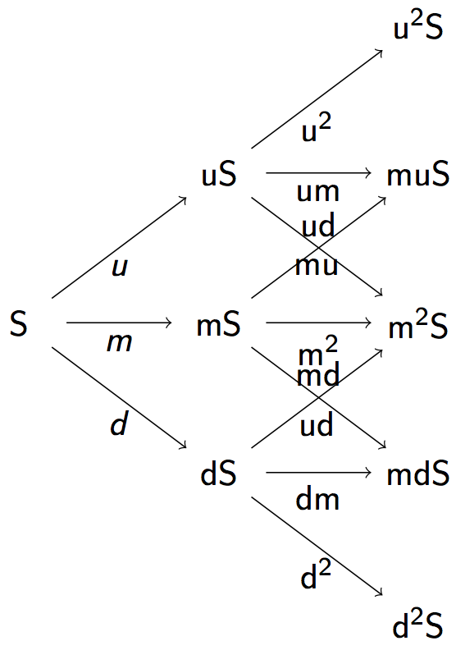
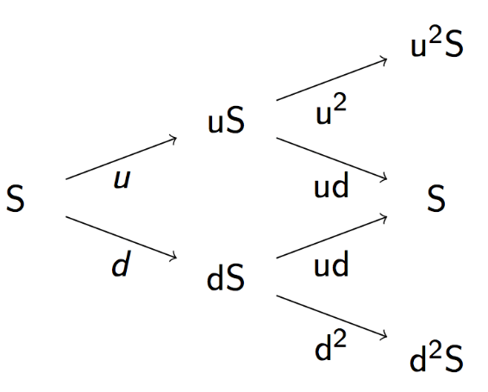
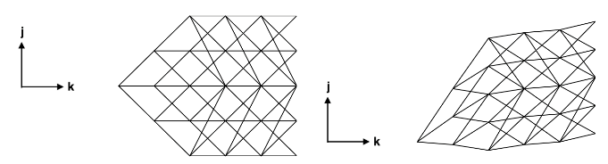
CLASSICAL TRINOMIAL ALGORITHMS
We consider basic Lattice Methods (algorithms) for the pricing of European Call/Put Options using fixed interest rates. The underlying asset is a zero-coupon bond defined by a term structure (yield curve).
From the initial time, a tree represent the range of prices the asset might have at a given time.
Binomial tree
Cox, Ross & Rubenstein (CRR) (1979)
Trinomial tree
Boyle (1986)
Trinomial tree
Hull & White 1F (1994a)
Increasing model complexity

Slide 9
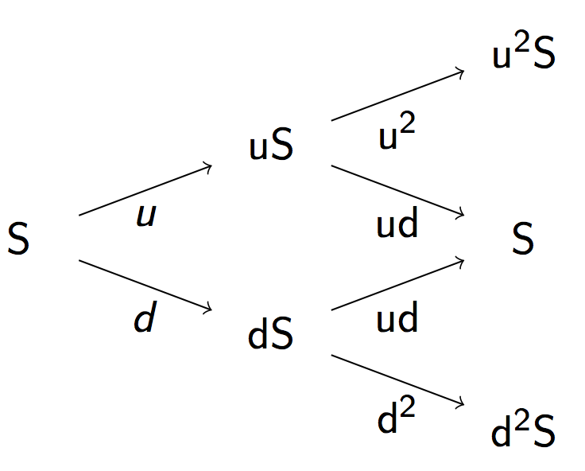
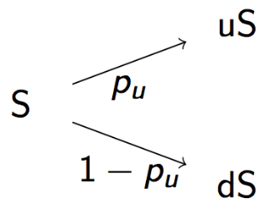
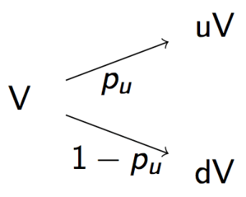
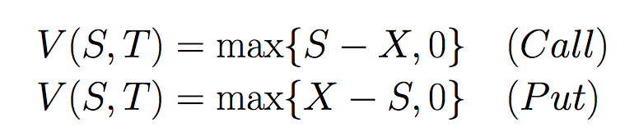


OPTION PAYOFF VALUATION
Procedure for valuation of option payoff of an asset at maturity.
Binomial tree
Cox, Ross & Rubenstein (CRR) (1979)
1. Generate tree
2. Assign probabilities
3. Discounting
Using principles of
Replication
No arbitrage
4. Payoff estimation determined by strike price X at maturity T.

Slide 10

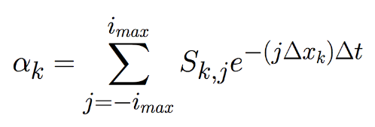
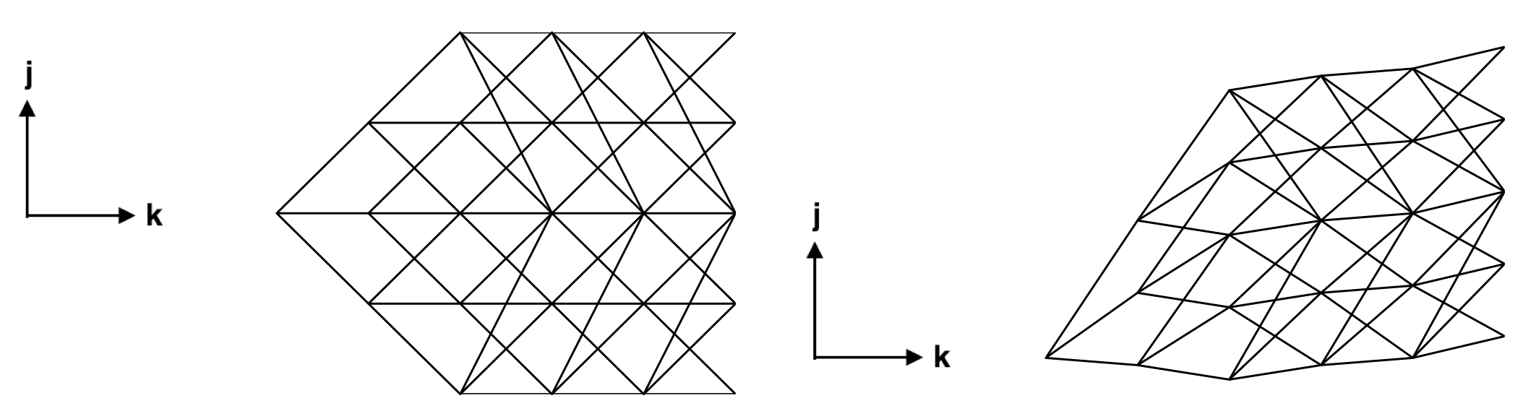

HULL-WHITE Single-Factor Trinomial Tree Model
The Hull-White 1F model for the short rate with a single source of uncertainty is expressed by the stochastic differential equation (SDE)
In Hull & White (1994) a trinomial tree building procedure is outlined. We assume that the model parameters a and σ (sigma) are constant parameters.
Procedure:
Forward propagation step. Do one new time step. Determine neutral risk rate for new time step using estimated yield curve data and estimated current asset values.
Backward propagation step. Discount the asset prices to estimate option payoff at maturity.

Slide 11
Tree Construction
Tree width is dependent on
Input parameter – mean-reversion rate a
Number of terms
Tree height/depth is dependent on the number of time steps
Maturity of the underlying bond/number of terms
E.g. Bond with maturity of 9 years and a time step of 1 month will have 9*12=108 terms, thus 108 iterations to construct the whole tree
More steps mean more precision
What is optimal thread block size?
How to match threads to computed nodes in the tree?
How to organize memory accesses?

Slide 12
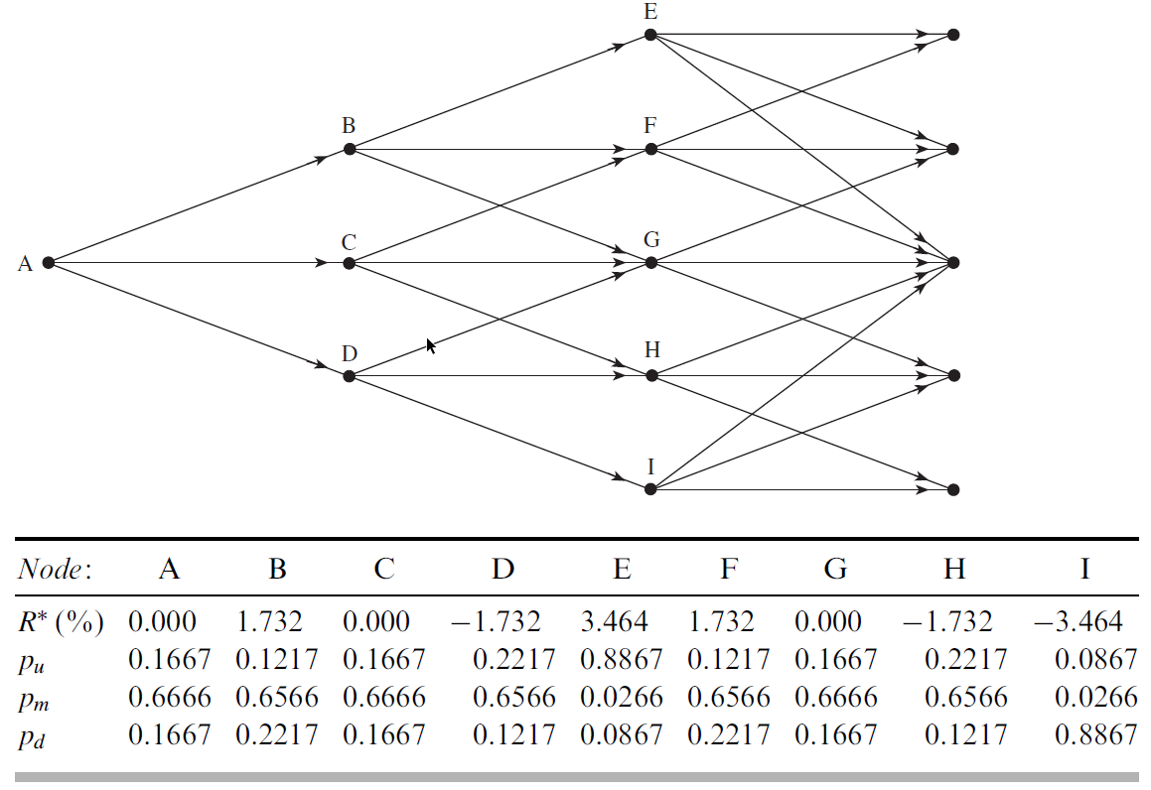
Tree for R in Hull–White model (first stage)

Slide 13
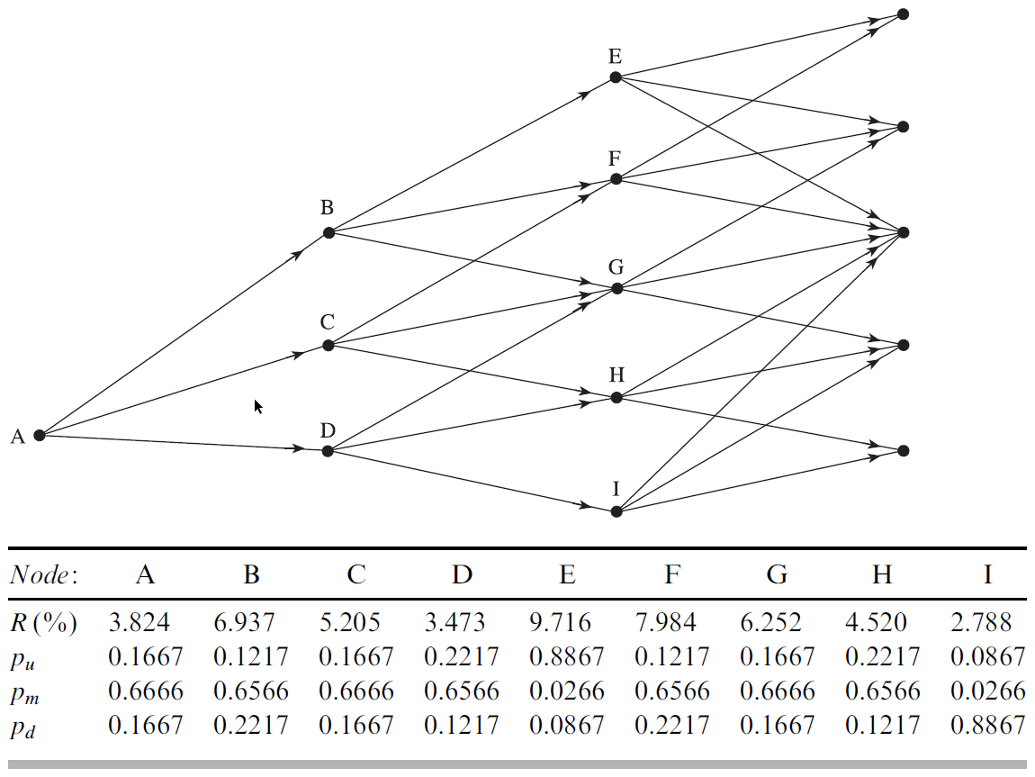
Tree for R in Hull–White model (second stage)

Slide 14
Parallelization Approach and challenges
One option per thread
One option per threadblock
First assuming that all options have the same maturity
Threads collaborating on tree construction and option valuation
Multiple options per threadblock
Taking into account different maturities of options leading to different sizes of trees
How to keep the whole tree inside a threadblock?
How to implement time stepping so the consecutive values of an option are calculated efficiently?
Without unnecessary memory accesses

Slide 15
The Group Project
Parallel Implementation of HULL-WHITE SINGLE-FACTOR Trinomial TREE MODEL
Supervised by Cosmin and me
2 groups
Futhark
CUDA
Groups will be provided with relevant information
Source codes, e.g. golden version
Input datasets
Output to validate the results

Slide 16
ReferENCES
J. Hull, A. White, Numerical Procedures for Implementing Term Structure Models I: Single-Factor Models, Journal of Derivatives, Fall 1994, pp 7-16
J. Hull, Options, futures, and other derivatives, 9th Edition, Pearson Education, 2015

Slide 18
LEGAL
disclaimer
The contents of this presentation are for general information and illustrative purposes only and are used at the reader’s own risk. SimCorp uses all reasonable endeavours to ensure the accuracy of the information.
However, SimCorp does not guarantee or warrant the accuracy, completeness, factual correctness, or reliability of any information in this publication and does not accept liability for errors, omissions, inaccuracies, or typographical errors.
The views and opinions expressed in this publication are not necessarily those of SimCorp.
© 2017 SimCorp A/S. All rights reserved. Without limiting rights under copyright, no part of this document may be reproduced, stored in, or introduced into a retrieval system, or transmitted in any form, by any means (electronic, mechanical, photocopying, recording, or otherwise), or for any purpose without the express written permission of SimCorp A/S.

