Slide 1

Ocean Color
NOAA CoastWatch Satellite Course
Last Updated 10/7/2020
Notes:
Welcome to the Ocean Color portion of our online course on oceanographic satellite data products, which has been produced by NOAA’s CoastWatch
Program. My name is Shelly Tomlinson and I’m the node manager of the East Coast Node of NOAA’s CoastWatch Program. The materials I will present in
this video were produced from a collaboration from many members of NOAA’s CoastWatch Program including Dale Robinson, Melanie
Abecassis, Ron Vogel, Cara Wilson, myself, and the late Dave Foley.

Slide 2
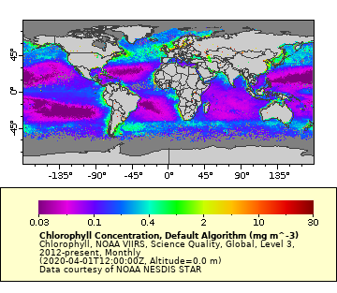
Ocean Color
Ocean color measurements from space have revolutionized our understanding of the ocean on every scale, from local to global and from days to decades.
Ocean color measurements reveal a wealth of ecologically important characteristics including:
chlorophyll concentration
phytoplankton bloom monitoring
primary productivity
sediment transport
dispersion of pollutants
responses of oceanic biota to long-term climate changes
water clarity and quality
IOCCG, 2008
Notes:
Ocean color estimates through remote sensing have revolutionized our understanding of the living ocean on small to global scales, and provides important information for daily monitoring and long-term trend analyses. Ocean color refers to the “color” of the ocean as determined by the interactions of incident light with substances or particles present in the water. These measurements reveal many ecologically important parameters related to chlorophyll concentration, phytoplankton bloom monitoring, primary productivity, sediment transport, the dispersion of pollutants, responses of oceanic biota to long-term climate changes, and water clarity and quality, to name a few.

Slide 3






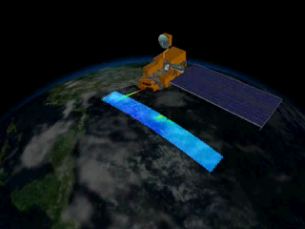
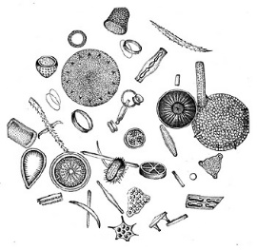

jeremy.werdell@nasa.gov
🛰
Measurements of ocean color are based on electromagnetic energy emitted by sunlight, transmitted through atmosphere, and reflected by Earth’s surface.
V/UV
Water-leaving Radiance, L_{w}
B
Downwelling Irradiance, E_{d}
G
Y
O
R
NIR
AIR
SEA
SCATTERING (b_{b})
Two possible fates for a photon in water
Organic Matter
Detritus
Phytoplankton
ABSORPTION (a)
Notes:
The way an ocean color sensor works is by measuring the electromagnetic energy that passes through the atmosphere, is transmitted through the surface of the ocean and then reflected back to the satellite. The electromagnetic spectrum usually used for ocean color algorithms include the visible wavelengths from 400 nm to 700 nm (blue to red), some infrared wavelengths and higher wavelengths for atmospheric corrections. As the atmosphere causes the most scattering and absorption of the light from the sun (Downwelling Irradiance, Ed), you will often hear that an “Atmospheric correction” must be applied to the measurements we use for algorithm development. This is to remove the effects of the atmosphere. As the light is transmitted through the water column, there are both absorbing materials (which can be the water itself plus pigments from phytoplankton, dissolved organic material and other particles containing absorbing compounds such as detritus. In addition, particles can scatter the light, preventing it to return to the satellite. This can be sediment, organic matter, as well as detritus and phytoplankton. So what the satellite measures, the Water Leaving Radiance (Lw) at each wavelength of light, is actually measuring a combination of what was returned from the water column as a result of the scattering and absorption properties. You often see what is referred to as Remote Sensing Reflectance, Rrs, which is water-leaving radiance, Lw(λ), corrected for bidirectional effects of the air-sea interface and sub-surface light field, and normalized by downwelling solar irradiance, Ed(λ), just above the sea surface.

Slide 4
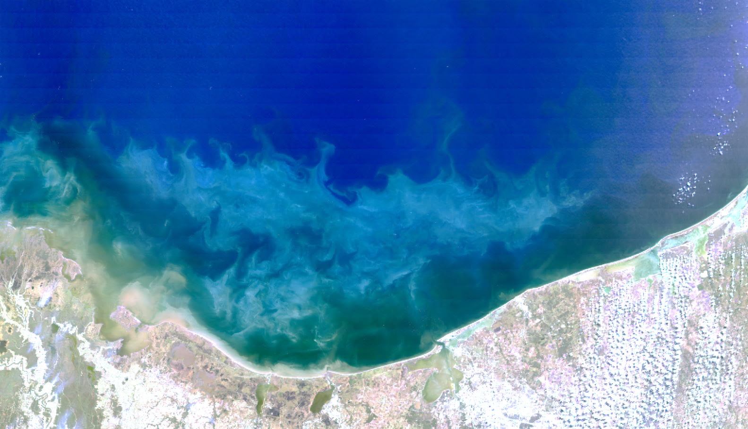
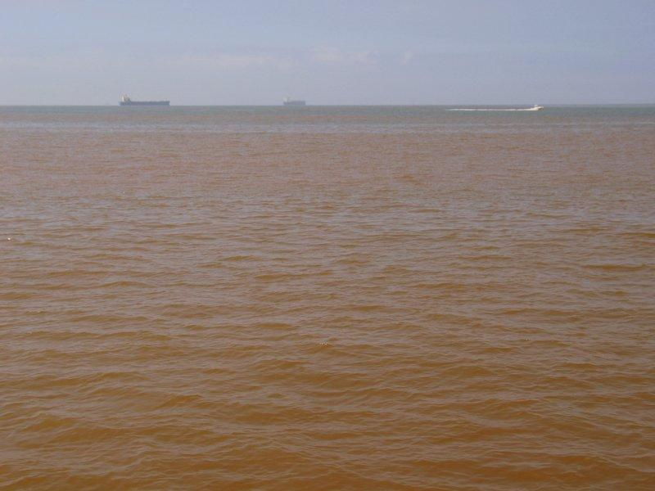
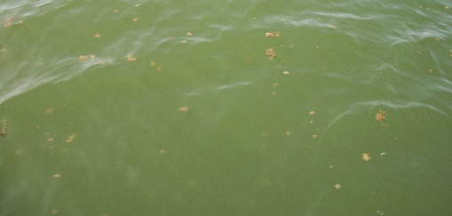
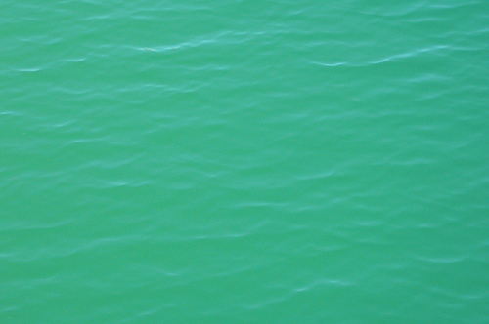
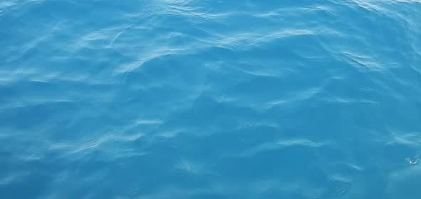
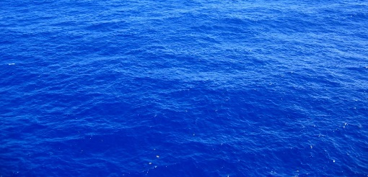
What causes variation in the color of the ocean?
Water-leaving Radiance
The color of the ocean is a function of light that is absorbed or scattered as a result of constituents in the water.
Phytoplankton and pigments, Dissolved organic matter
Detritus (fecal pellets, dead cells), Inorganic particles (sediment)
Water absorption
jeremy.werdell@nasa.gov
Notes:
So, what affects the variations in color within the ocean? First of all, I should mention that what the satellite is seeing is what is called the first optical depth, which we tend to associate with about a secchi depth. So it cannot see all the way to the bottom in turbid or deeper waters. The color you see is related to these absorption and scattering properties. So for instance, far offshore the water appears very blue. This is because the water has less absorption in the blue wavelengths (400) as there is less dissolved organic matter from land, and less phytoplankton and chla, which absorbs blue and red light. There are also less scattering particles , such as sediment, in the red wavelengths (600-700 nm) which would cause red reflectance back to the satellite. So as you move closer to the coast, the increase in absorbing and scattering particles causes the blue Rrs to go down, as the red Rrs increases. The relative combination of these various scattering and absorbing materials is what affects the color of the ocean in different regions.

Slide 5
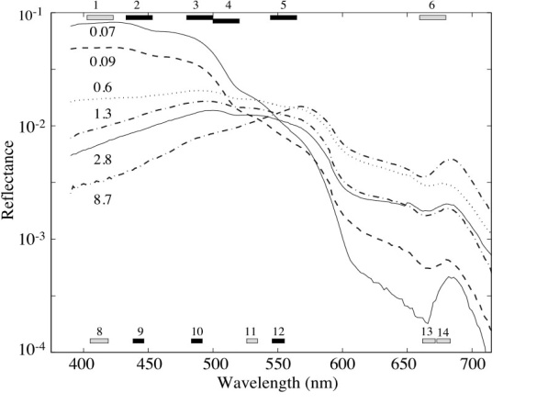

Chlorophyll Concentration and Reflectance
Reflectance is affected by the concentration of pigments in the water
chlorophyll-a
concentrations
UV
Notes:
So, when looking at just the effects of chlorophyll a (chla), which can provide an estimate of the amount of phytoplankton in the water, you may often hear of blue-green ratios. Common ocean color algorithms look at the changes in the blue to green peaks in the reflectance spectra to determine the concentration of chla in the water. So from this figure, you can see that as the chla increases in concentration, the reflectance is decreasing. This is the result of an increase in absorption by chla. You can think of reflectance as the inverse of absorption, so when there is more absorption occurring at a specific wavelength, there is less reflectance back to the satellite of that wavelength of light. One thing also to note is that there is a peak occurring around 680 nm which becomes more predominant as chla increases. This is related to a peak in chlorophyll a fluorescence.

Slide 6
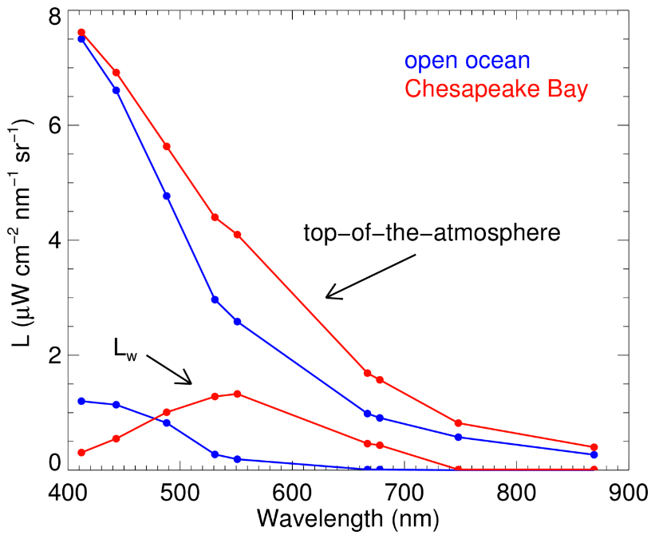
Atmospheric correction
The radiance from the water signal (L_{w}) is often less than 10% of the total signal measured by the sensor (L)
Good atmospheric correction is critical.
IR
jeremy.werdell@nasa.gov
Notes:
As I mentioned earlier, the atmosphere is responsible for about 90% of the signal measured by the sensor. So if only 10% of the signal returning back to the satellite is coming from the water, it is very important to provide an accurate atmospheric correction. This becomes even more important in coastal or estuarine areas, as the signal gets more complicated by the increased scattering and absorption closer to land.

Slide 7
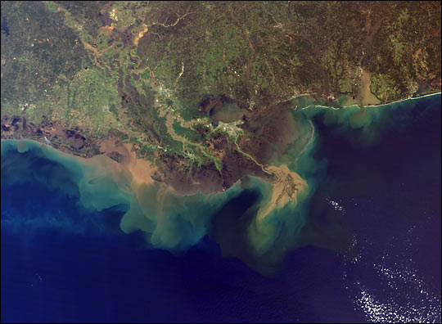
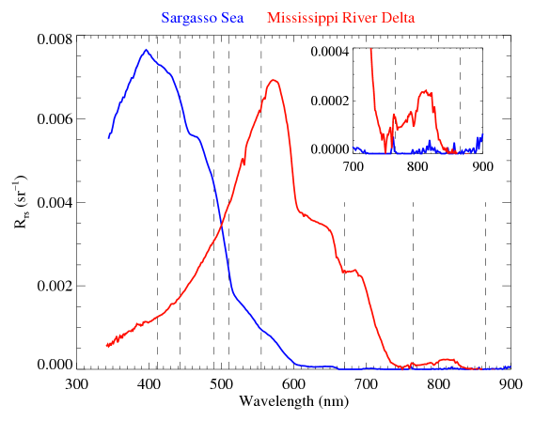
Case-1 versus Case-2 waters
Case 1 - Open Ocean
Water where the optical properties are determined primarily by phytoplankton and their derivative products
Case 2 - Everything Else
Namely water where the optical properties are significantly influenced by other constituents, such as mineral particles, Colored Dissolved Organic Matter (CDOM), or microbubbles, whose concentrations do not covary with the phytoplankton concentration
Notes:
We often refer to clear open ocean water as Case 1 or optically deep water, whereas Case 2 waters, or optically shallow, tend to be more complex due to influences from land. Ocean color algorithms in Case 1 waters are more straightforward as the absorption is primarily due to phytoplankton and their derivative products. In case 2 waters, there is much more absorption at all wavelengths due to absorbing compounds (dissolved and particulate matter such as Colored Dissolved Organic Matter (CDOM), phytoplankton, detritus, etc). There is also more scattering as a result of sediment from land and these other particles.
‹#›

Slide 8
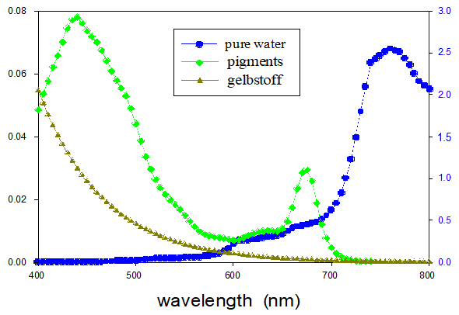
Absorption Spectra and MODIS reflectance bands
Sensor bands are chosen to target specific peaks in absorption spectra
412 443 488 531 551 667 678 748
Satellite sensor bands
Pure water
Pigments
CDOM
Pigments and CDOM Absorption Coefficient (1/m)
Pure Water Absorption Coefficient (1/m)
Wavelength (nm)
Notes:
So, given all of these absorbing and scattering characteristics, satellite bands are selected to try to capture these changes in the optical signature. For example, Colored Dissolved Organic Matter (CDOM), often called gelbstoff absorbs in the blue wavelengths, as does chl a. Chlorophyll a also absorbs in the red wavelengths, which is why plants and phytoplankton often appear green. Pure water absorbs more in the red wavelengths. For those of you who are divers, this is why the deeper you dive the fish and coral will look more blue and start to lose the red colors first. There are also various accessory pigments in phytoplankton with different absorption peaks. There are efforts to use these differences to separate out various phytoplankton types.

Slide 9
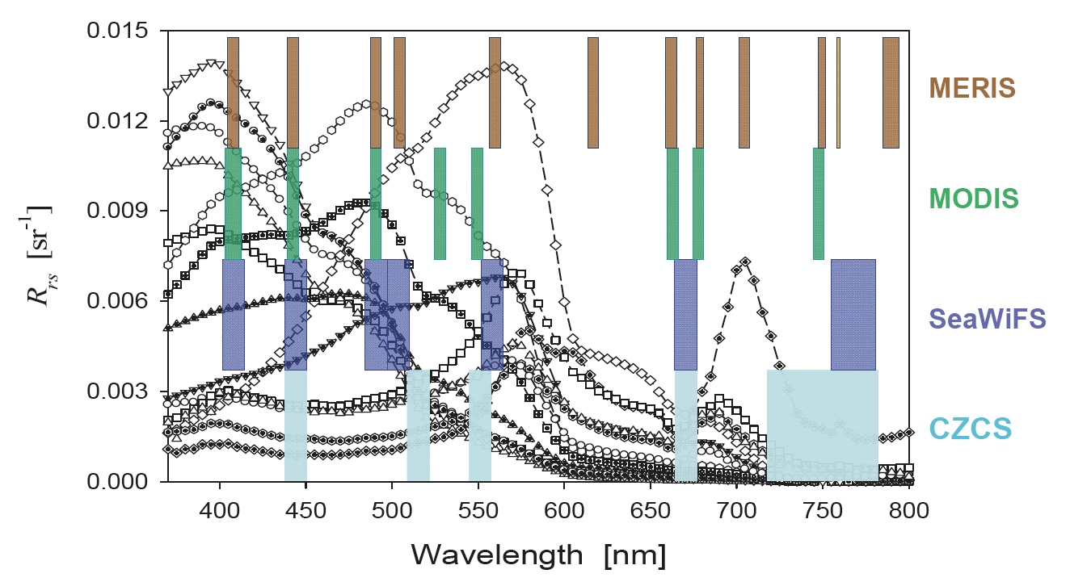
Sensor band comparison
CDOM Chlorophyll Fluor. Atm. Correction
Examples of different measured spectral remote-sensing reflectance, overlain with different sensor bands.
OLCI
VIIRS
Modified from Lee et al., Sensors (2007).
Notes:
So, for example, this is showing the various reflectance peaks due to the effects of CDOM absorption, chlorophyll absorption and fluorescence. The atmospheric correction is calculated using the infrared bands. The colored boxes represent the individual bands for each satellite sensor, and also shows the width of each band. For detecting certain characteristics, it is important to have narrower bands for certain features, as the light returning back to the satellite is averaged within those wavelengths.

Slide 10
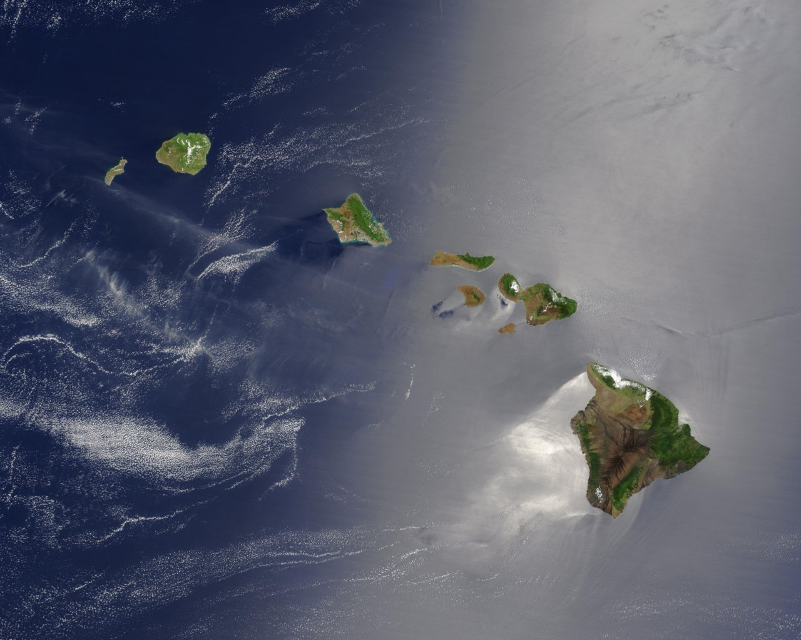
Sunglint
Sunglint is the mirror reflection of sunlight off the sea surface.
With strong sunglint the OC measurement can severely compromised, often impossible.
However sunglint is very effective for detecting oil spills
Notes:
‹#›
Sunglint can be a problem when using ocean color imagery during certain times of the year.. The angle of the sun can cause a mirror reflection off the sea surface that causes the reflectance to increase at all of the wavelengths. This usually makes the imagery unusable when this happens. However, sunglint can be used to identify oil, due to it’s reflective nature.

Slide 11
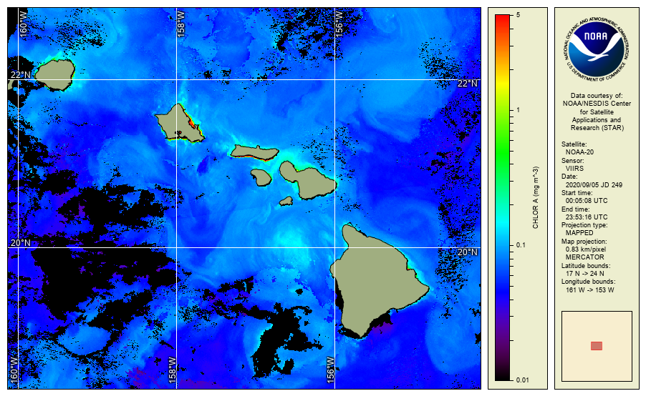
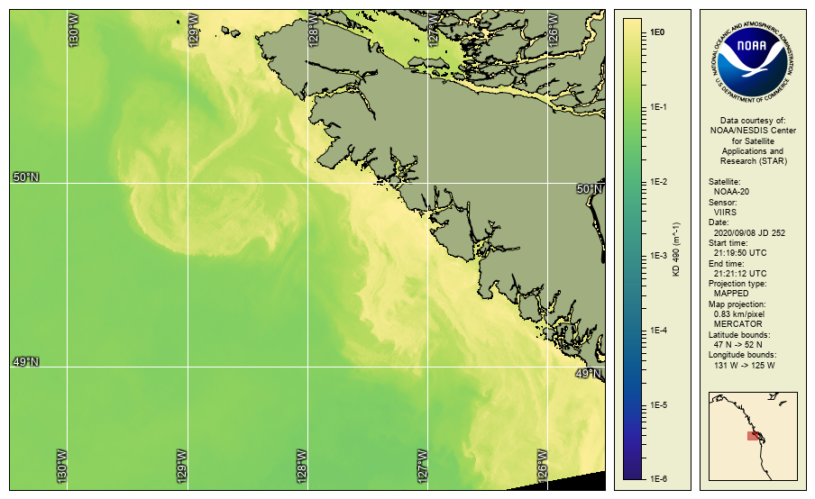
Ocean color data products
Normalized water-leaving (nLw) radiance at visible bands
Chlorophyll-a concentration (single sensor, merged, gap-filled)
Diffuse attenuation coefficient at 490 nm (Kd490)
Diffuse attenuation coefficient of photosynthetically active radiation (KdPAR)
QA score (an empirical product quality assessment available in Level-2 datasets)
Various regional products (HAB, sediment, phytoplankton composition, primary productivity, etc)
NOAA CoastWatch Satellite Class http://coastwatch.noaa.gov
Notes:
There are a suite of ocean color products available from NOAA’s CoastWatch Program. Some are available globally from the various satellite sensors, whereas others are more regional in nature. Normalized water-leaving radiance is available for all of the visible wavelengths. Various chlorophyll a products are available, with regional algorithms in some locations. Kd490, KdPAR and turbidity can aid in assessing water clarity. NOAA ocean color processing includes a QA score which assigns a 0 to 1 score to each pixel, where higher values indicate a likely reliability of the measurement. Through the CoastWatch regional nodes various products are available such as Harmful Algal Bloom products, total suspended sediment, phytoplankton composition and primary productivity, to name a few.

Slide 12
Kd490
The diffuse attenuation coefficient is a measure of the attenuation of light in the water column.
Kd490 is an indicator of water clarity. Particles absorb in the blue, so when there are a lot of absorbing particles in the water the attenuation at 490 nm is greater.
Higher Kd value means smaller attenuation depth, and lower clarity of ocean water.
Notes:
Briefly, Kd490 (the vertical attenuation coefficient for downward irradiance at 490-nm) describes the rate of change of Ed490 (downward irradiance at 490-nm) with depth. In other words, it is a measure of the loss of blue light which is related to the absorbing particles in the water column. In is inversely proportional to the clarity of the water (the higher Kd490 is, the lower the clarity of the water).

Slide 13
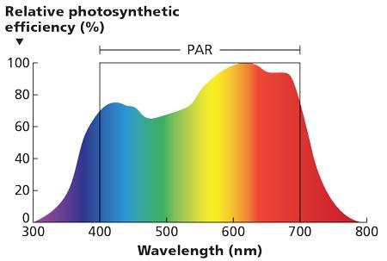
KdPAR
Photosynthetically Active Radiation (PAR), is light from 400 to 700 nm, the range of wavelengths used in photosynthesis.
With Kd490, surface PAR from satellites, and some assumptions, we can calculate PAR at depth
PAR is a common input used in modeling marine primary productivity.
As with Kd490, a higher KdPAR value means the visible light is attenuated more strongly as it travels through the water column, making less light available for photosynthesis.
Notes:
There is also a product called KdPAR (PAR stands for Photosynthetically Active Radiation) which measures the attenuation of light available for phytosynthesis. PAR covers the light in the visible (400-700 nm) portion of the spectrum. KdPAR can be estimated from satellite using Kd490 and some general assumptions. PAR is an important parameter in marine primary productivity models. As with Kd490, the higher the KdPAR value, the less visible light which is available for photosynthesis.

Slide 14
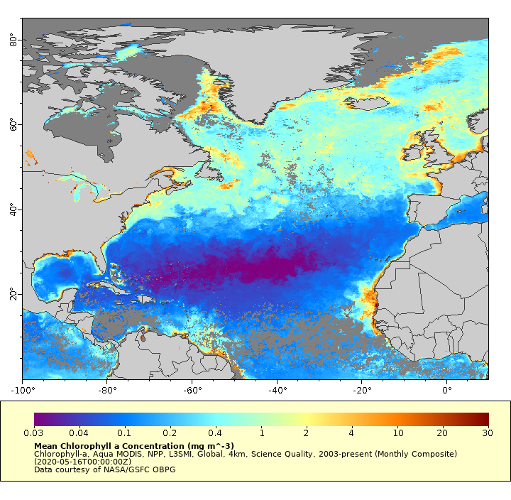
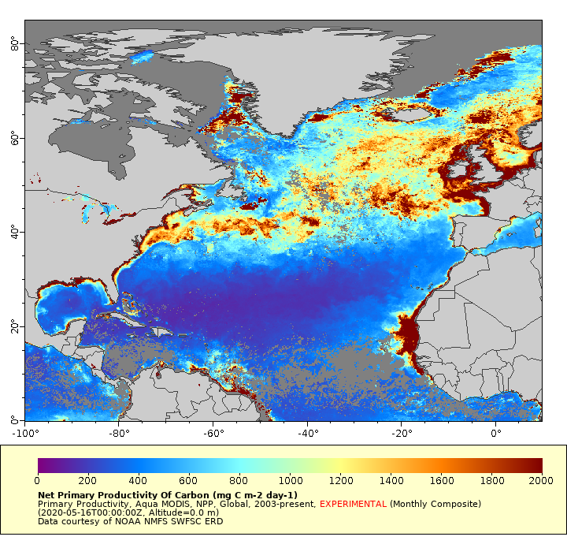
Primary Productivity (PP)
Chlorophyll, May 2020
Primary Productivity, May 2020
Primary productivity is the rate of carbon fixation by the phytoplankton during photosynthesis.
PP can be estimated globally from satellite data using chlorophyll, PAR, SST and daylength.
Notes:
Primary productivity is a measure of the rate of carbon fixation by the phytoplankton during phytosynthesis. Primary production can be estimated from satellite using chlorophyll a, PAR, Sea Surface Temperature and daylength, and is an important parameter as input to ocean biogeochemisty and fisheries models.

Slide 15
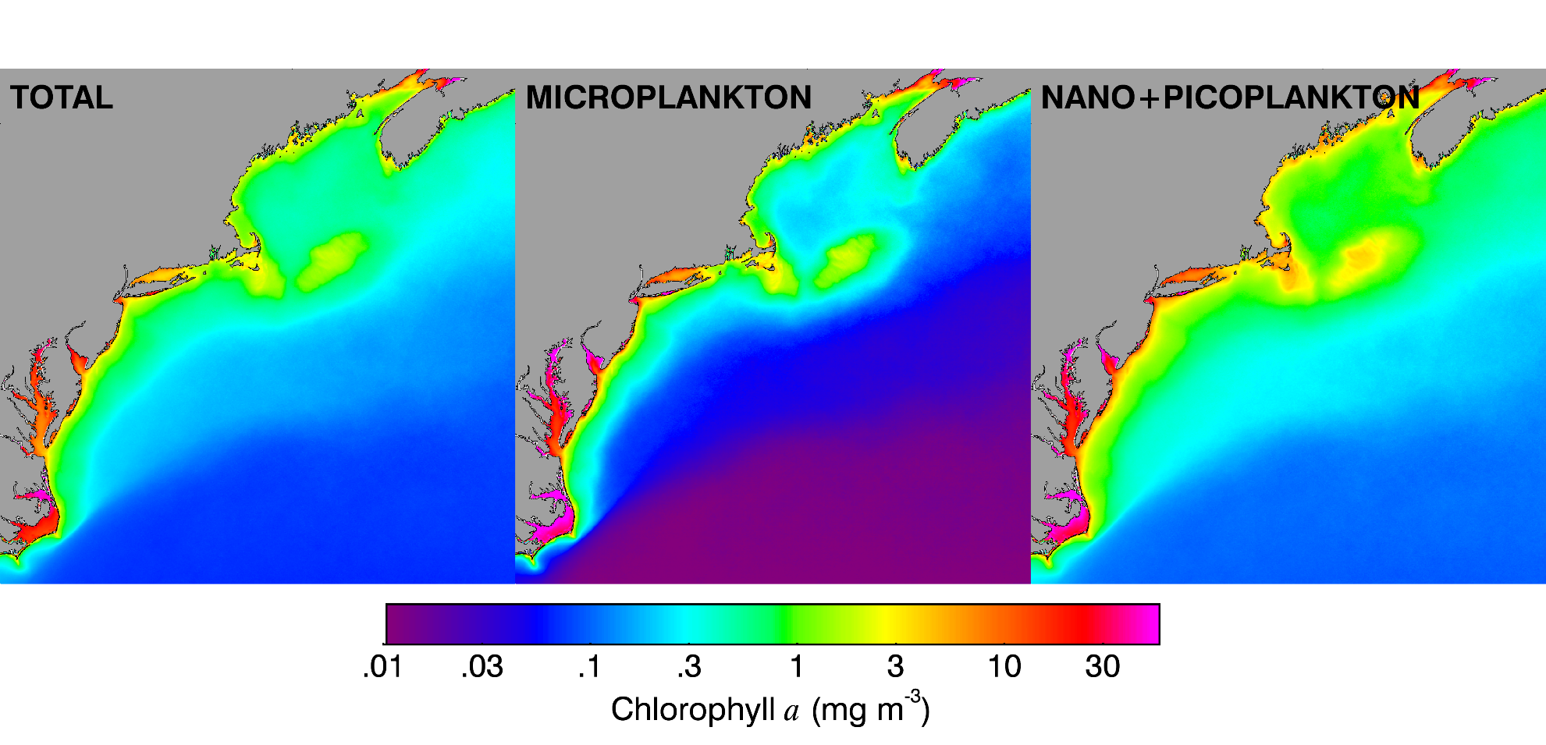
Phytoplankton Composition
Satellite ocean color data is used to derive phytoplankton functional groups using a series of Remote Sensing Reflectance (R_{RS}) band ratio algorithms at 490, 555 and 670 nm.
(Pan 2010 & 2011)
Kim Hyde and colleagues
Notes:
The measurement of phytoplankton size classes and functional groups from remote sensing imagery is an emerging field that is limited by the spectral resolution of the current ocean color sensors. New sensors look to increase the spectral resolution, thereby expanding our capability to better distinguish phytoplankton groups in the sea.
We also have models that incorporate several remote sensing products to estimate total primary production, but we need to derive how much of the production is from each size class.

Slide 16
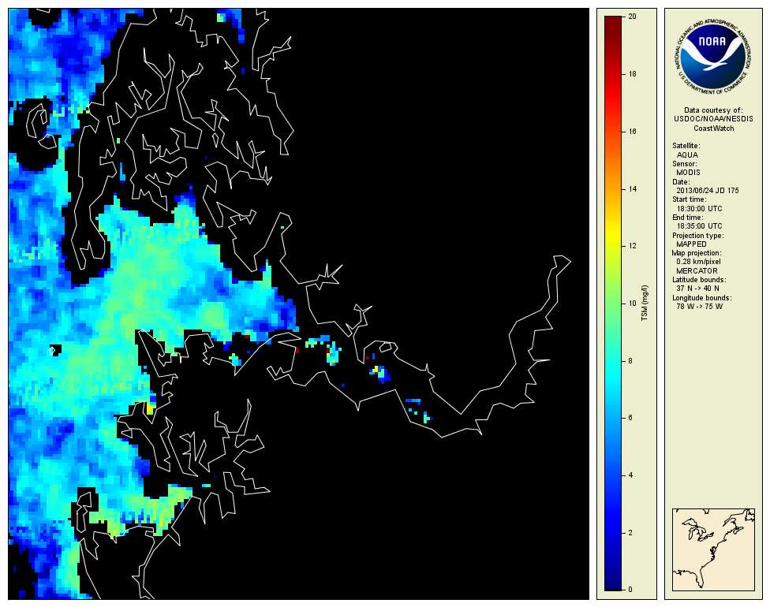
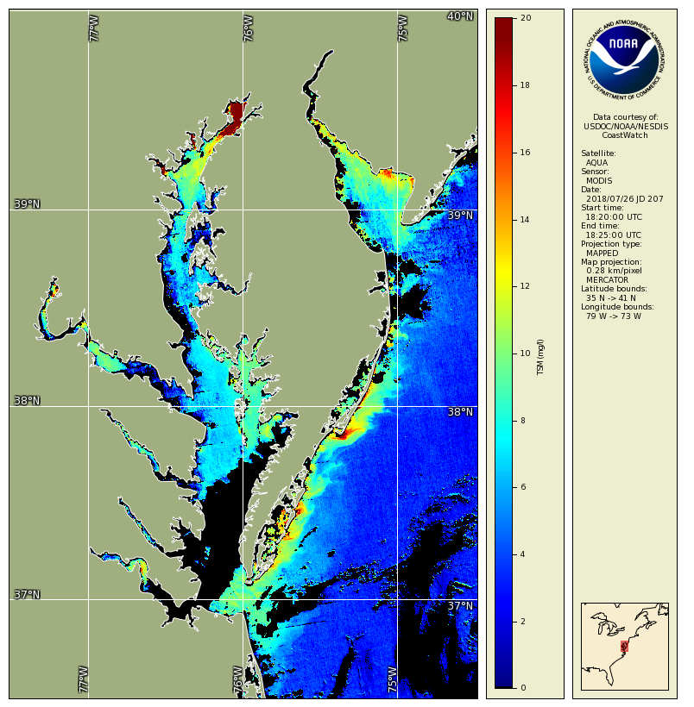
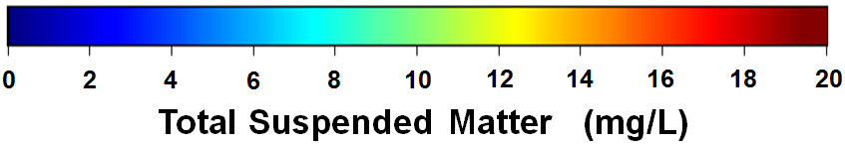
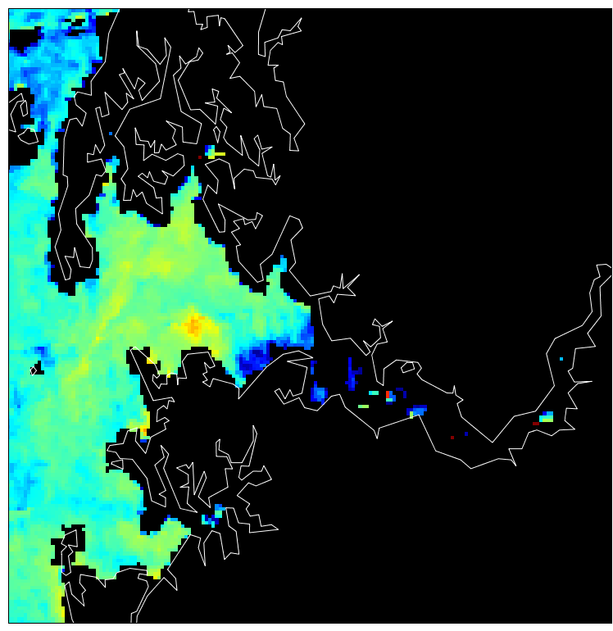
Total Suspended Matter (TSM)
Sediment concentration (mg/L) in surface water (top 1m)
TSM algorithm specifically developed by NOAA for Chesapeake Bay (Ondrusek et al., 2012)
Once daily observation (from a single satellite)
- Clouds cause missing data
Provides spatial overview
- Detect spatial patterns
Monitor change over time
250 m spatial resolution
Data from NASA’s Aqua satellite, MODIS instrument
June 24,
2013
July 26,
2018
June 26,
2013
Notes:
In the Chesapeake Bay, Total Suspended Matter (TSM) is available at 250 m spatial resolution, using a regional algorithm developed by Ondrusek et al, 2012. The algorithm is applied to the MODIS high resolution bands at 250 m resolution, on a daily basis. These products provide a spatial overview of turbidity patterns, and due to the high spatial resolution, can provide information on turbidity plumes in the tributaries.

Slide 17
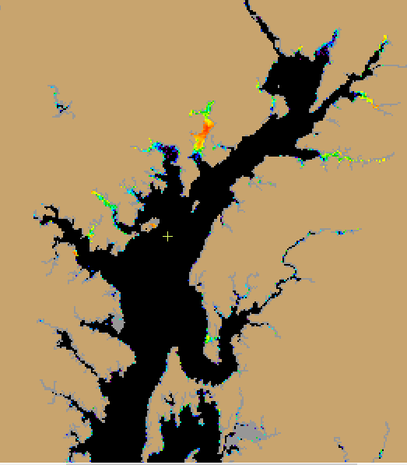
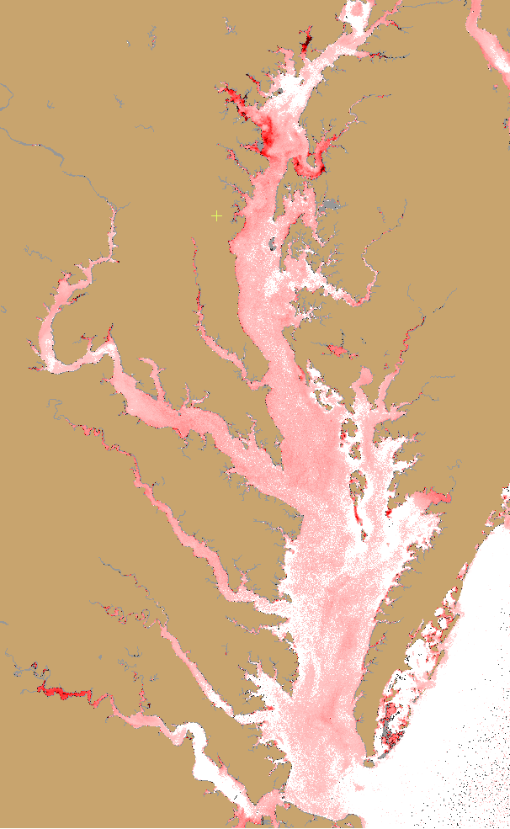
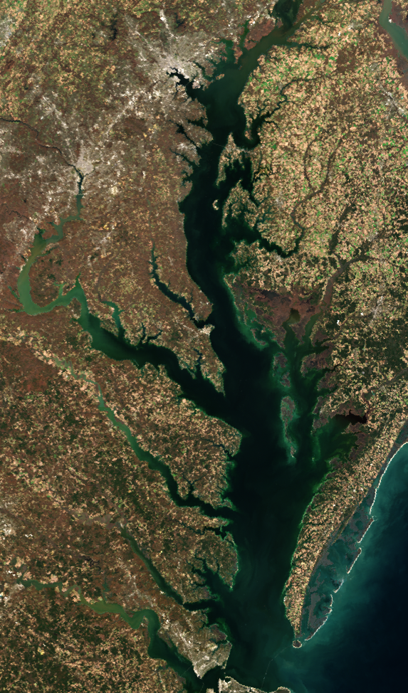
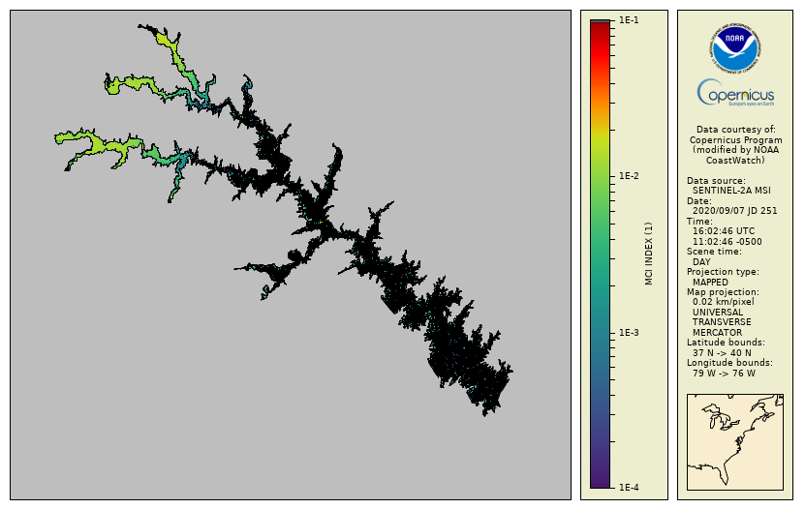
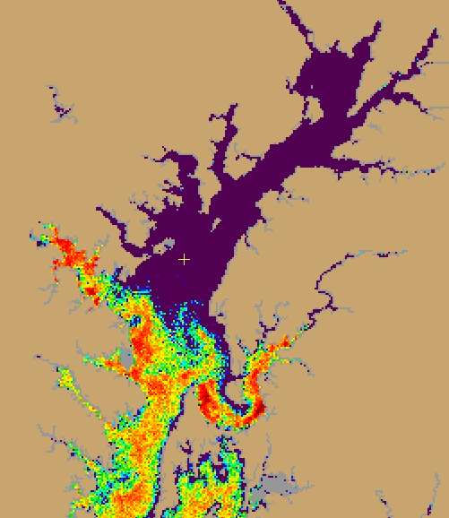
Custom Satellite-derived products for algal bloom monitoring
Non-Cyano Index (chl-a with negligible fluorescence)
Relative Chlorophyll
True Color
Hi-res MCI for cyanobacteria
RBD Fluorescence
Note: Imagery derived from Copernicus Sentinel data from EUMETSAT
Available from Chesapeake Bay at https://coastwatch.noaa.gov/cw_html/NCCOS.html
Notes:
Other regional products include a suite of experimental bloom products for the Chesapeake Bay. Efforts are underway to validate these products with field collected data from the Chesapeake Bay program. While a prototype website has been developed at CoastWatch to deliver these products for the Bay, we plan to extend delivery of these OLCI products for other coastal regions. Several algorithms are being applied for Chlorophyll a, using a ratio of NIR to Red bands, which is less influenced by sediment and CDOM in coastal areas. An additional Red Band Difference algorithm (RBD) provides a fluorescence product which is useful for detecting high biomass blooms. We are also providing a low-non-fluorescing product as it tends to highlight dinoflagellate blooms of several harmful species. There are several theories as to why this happens, either due to a switch to mixotrophy, when the cells aren’t releasing energy from phytosynthesis through fluorescence, or due to low irradiance during winter or high turbidity conditions. A maximum chlorophyll index is also being applied to higher resolution Sentinel 2 imagery, to help resolve harmful cyanobacteria blooms in smaller lakes.

Slide 18
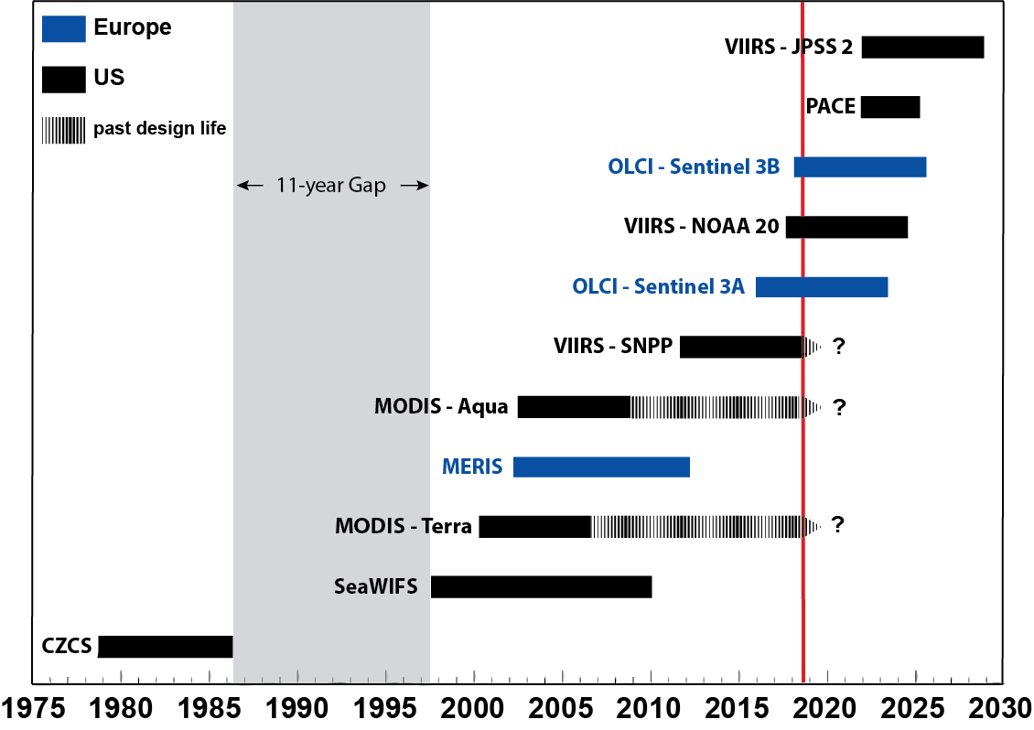
Global Ocean Color Sensors
Notes:
This figure demonstrates the current set of ocean color satellites provided by the CoastWatch program. Historical data going back to 1997 from SeaWiFS are available for short-term climate studies. MODIS-Aqua was then launched in 2002, and has been supporting ocean studies ever since. Unfortunately, this sensor is past its design life and has begun to deteriorate. The VIIRS-NPP and NOAA-20 satellites are NOAA’s operational ocean color satellites and support global ocean color monitoring. While the European MERIS sensor, which supported higher resolution ocean color with a set of bands conducive to work in coastal regions, stopped working in 2012, the Sentinel 3 series started in 2016, with follow-on launches every 2 years, to provide 300 m data on a global scale.

Slide 19
Blended Ocean Color dataset: ESA CCI dataset
European Space Agency’s Climate Change Initiative (CCI) produces merged satellite products for assessing long-term trends.
Merged MERIS, Aqua-MODIS, SeaWiFS and VIIRS data with associated per-pixel uncertainties
Date from 1997 through 2018.
Daily, weekly & monthly data are available the West Coast and Central Pacific Node data servers
Notes:
Efforts are underway to merge chlorophyll a products to develop a time-series for climate applications in order to assess long-term trends in ocean ecosystems. The European Space Agencies Climate Change Initiative have developed a long-term time-series of satellite chlorophyll spanning the SeaWiFS, MODIS, MERIS and VIIRS launch periods. This dataset is available from 1997 in weekly and monthly merged products on the West Coast and Central Pacific Node data servers.

Slide 20
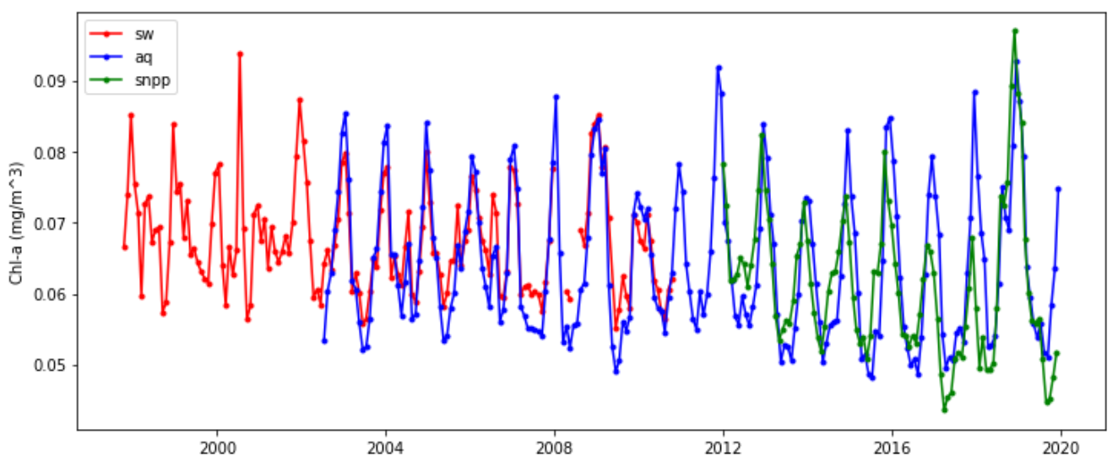
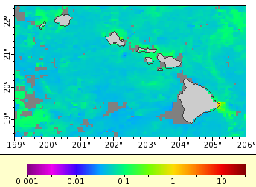
Looking at OC time-series
Measurements from different sensors are not always in close agreement during periods of overlap, making it challenging to study long-term trends.
Notes:
Developing a long-term ocean color time-series isn’t easy, as there are gaps in the datasets, and often one satellite may overestimate chlorophyll while others are lower. Therefore, it is necessary to adjust the various ocean color satellite datasets to provide a consistent dataset over time, and to avoid anomalous jumps in the data due to the sensor’s retrieval rather than real climatological changes.

Slide 21
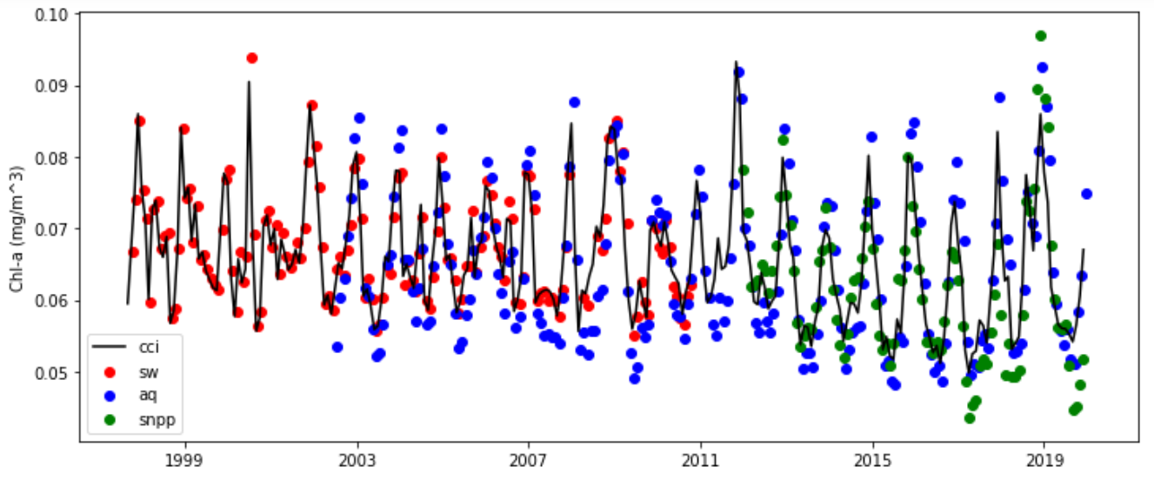
Time-series of ESA CCI Dataset
With the ESA CCI dataset overlain
Notes:
The ESA CCI dataset attempts to adjust these ocean color time series to provide a more accurate assessment of ocean color trends over time.

Slide 22
Geostationary Ocean Color Sensors
Almost all of the OC sensors are on polar-orbiting satellites, providing one observation per day, if there are no clouds.
GOCI is the only geo-stationary OC sensor operating. S. Korea launched it in 2010, and it only observes the region around S. Korea.
In the US, GLIMR (Geosynchronous Littoral Imaging and Monitoring Radiometer) is planned for 2027.
A Day in the East Korea Current, from GOCI
May 12, 2016
https://earthobservatory.nasa.gov
Notes:
Most ocean color sensor used to monitor conditions in the U.S. are provided by polar-orbiting sensors. This limits the temporal resolution of the imagery, as these produce a single image per day. Also, ocean color sensors cannot see through clouds, so while daily imagery is available, they may be obscured during cloudy conditions, as well as when glint occurs. Therefore, there is a need for higher temporal resolution from geostationary sensors. The GOCI sensor has been providing OLCI-like spectral bands over Korea since 2010, at 250 m resolution. In the US, a research geostationary satellite, the Geosynchronous Littoral Imaging and Monitoring Radiometer (GLIMR) is expected to launch in 2027. This will provide high temporal resolution over the Gulf of Mexico, parts of the East Coast and South America, at almost hyperspectral spectral resolution.

Slide 23
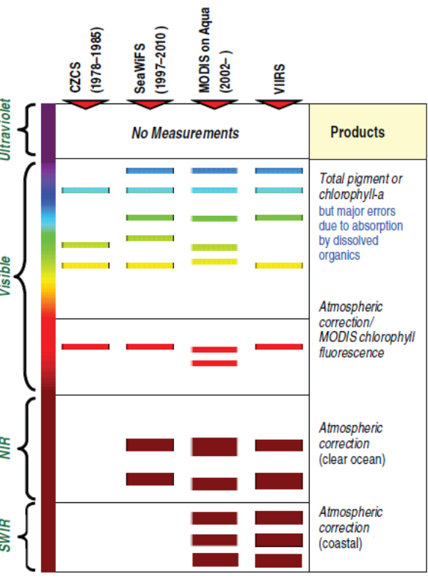
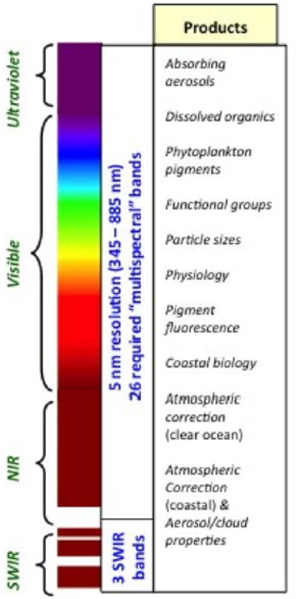
Towards hyperspectral sensors
PACE
Currently,
Dec 2022 launch
https://pace.gsfc.nasa.gov/
Notes:
The Plankton, Aerosol, Cloud, ocean Ecosystem (PACE) program is expected to launch a hyperspectral polar orbiting sensor in 2022. There are high expectations for this satellite sensor, as it will provide more information related to phytoplankton pigments to further tease out optical signatures, important to separating phytoplankton functional groups, address coastal biology and physiology, assess particle sizes and to improve absorbing aerosols near land and atmospheric correction properties.

Slide 24
Ocean Color Summary
Measurements are made in the visible wavelegths and can not be made through clouds or at night.
Atmospheric correction is extremely important!
There are a suite of products measured by “ocean color” satellites:
• Chlorophyll (most commonly used) • CDOM (Colored Dissolved Organic Matter) • Primary Productivity • Water Clarity • Fluorescence, • Photosynthetically Available Radiation (PAR) • and more
Algorithms were developed for Case-1 (open ocean) waters.
Care must be taken when using data from Case-2 (coastal) waters.
The most recently launched U.S. OC sensors are VIIRS
Joint NASA/NOAA missions were launched Oct. 2011 (SNPP) and Nov 2017 (NOAA-20)
Primary US satellites: • SeaWiFS 1997-2010 • MODIS/Aqua 2002- 2016-present • VIIRS 2011- 2016-present
European satellites: • MERIS 2002-2012 • OLCI April 2016-present
Notes:
So, in summary, when we discuss ocean color imagery, we are generally talking about the visible portion of the electromagnetic spectrum. One caveat is that ocean color imagery cannot see through clouds, and is unavailable at night. Given that 90% of the signature pertains to atmospheric effects, having a robust atmospheric correction is extremely important. There are a suite of ocean color products looking at pigments, phytoplankton blooms and productivity, water clarity and quality. Many of these are regionally based, especially in coastal areas, while there are other products which are available on a global scale. Care must be taken when using data in Case-2, coastal regions, which is why regional algorithms are necessary. The most recent U.S. ocean color sensor, VIIRS was first launched in 2011, with a subsequent launch aboard NOAA-20 in 2017. While several polar orbiting ocean color sensors have been launched starting with SeaWiFS in 1997, with MODIS and VIIRS following afterwards, long-term time-series are available by leveraging imagery from both US and other global satellite launches, such as the European satellites MERIS and OLCI, to begin to look at climatic changes in the ecosystem. In addition, each satellite has advantages and disadvantages based on their spatial, temporal, and spectral resolution, therefore, it is important to understand the limitations of the products before selecting imagery to address your particular oceanographic question.

Slide 25
NOAA CoastWatch Satellite Course - Narrated Presentations
Satellite 101 – Part 1
Satellite 101 – Part 2
Fundamentals of Ocean Color
Fundamentals of Sea-Surface Temperature
Fundamentals of Altimetry, Wind and Salinity
Introduction to ERDDAP
What Dataset to Choose?
Bringing Satellite Data into ARCGIS

