Slide 1

Sea Surface Temperature NOAA CoastWatch Satellite Course
Last Updated: 8/25/2020
Notes:
Welcome to the Sea Surface Temperature, or SST lecture, part four of an online course on oceanographic satellite data products that is produced by NOAA’s CoastWatch Program. My name is Cara Wilson, I’m the node manager of the West Coast Node of NOAA’s CoastWatch Program. The materials I will present in this video were produced from a collaboration from many members of NOAA’s CoastWatch Program including Dale Robinson, Melanie Abecassis, Ron Vogel, Shelly Tomlinson, me, and the late Dave Foley.

Slide 2
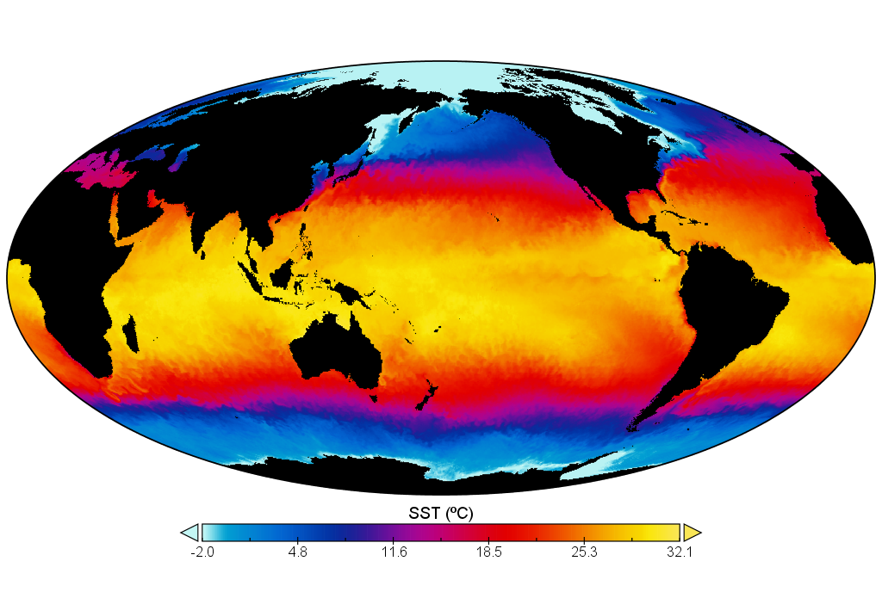
NOAA GeoPolar Blended SST – 02/25/2019
Notes:
Measurements of SST provide fundamental information on the global climate system, including making accurate weather forecasts, studying marine ecosystems, and identifying the onset of El Niño and La Niña cycles.

Slide 3
Topics covered in this presentation
What is SST?
Which SST is measured from space?
Infrared vs microwave measurements
Measurements in the infrared
Measurements in the microwaves
L4 Products
A word of caution on L4 products
Notes:
In this presentation, I will go over the definition of SST. I will discuss how SST is measured from space, including the use of both infrared and microwave measurements. Finally, I will describe several of the level 4 SST products.

Slide 4
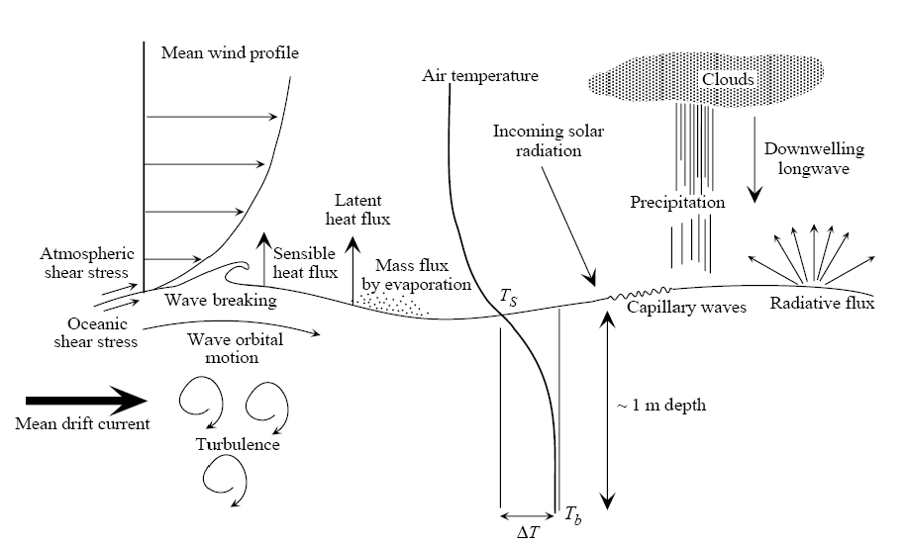
Defining SST is complicated by ocean surface processes
Martin 2010
Notes:
SST is a difficult parameter to define because the upper few meters of the ocean has a complex and variable temperature structure. This complexity and variability is due to changing solar heating, ocean currents, wind-driven surface mixing, and the air-sea fluxes of heat, moisture, and momentum. Let’s take a better look at what I mean by this.

Slide 5
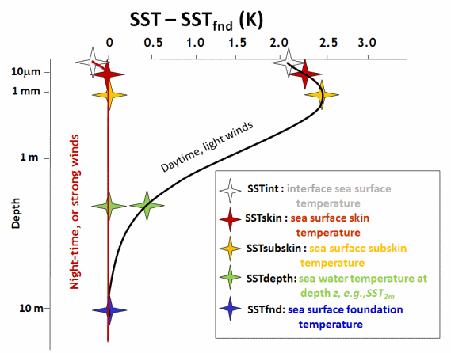
What is SST?
SST is Sea Surface Temperature
So more precisely the question is what surface (or depth) is being measured? The answer depends on the how the measurement is being made.
Infrared sensors measure the sea temperature at ~ 20 micrometers.
Microwave sensors measure the sea temperature at ~ 2 millimeters.
Infrared Measurement
Microwave Measurement
www.ghrsst.org
Notes:
So what is SST? Well we know SST means sea surface temperature, so perhaps the better question is what Surface is being referred to when we say SST? And the answer depends on the measurement. Infrared instruments measure to a depth of about 20 micrometers, called SSTskin, the symbols shown in red here, while microwave radiometers measure to a depth of a few millimeters, called SSTsubskin, the symbols in yellow. But there is more complication going on here as well. This plot is showing two schematic SST profiles for the same location, one during the day, where temperature varies in the top few meters of the ocean, and one at night where wind has mixed the surface resulting in a homogeneous layer where the temperature is all the same, and can be considerably lower than daytime values. If you were out here making measurements with a CTD from a ship your surface measurement would probably be at about 1 meter, roughly the green symbols on this plot , and would measure a different value that satellite measurements would. The foundational temperature, shown here in blue, is the temperature that is unaffected by diurnal changes. These changes can be considerable, as we will see on the next slide.

Slide 6
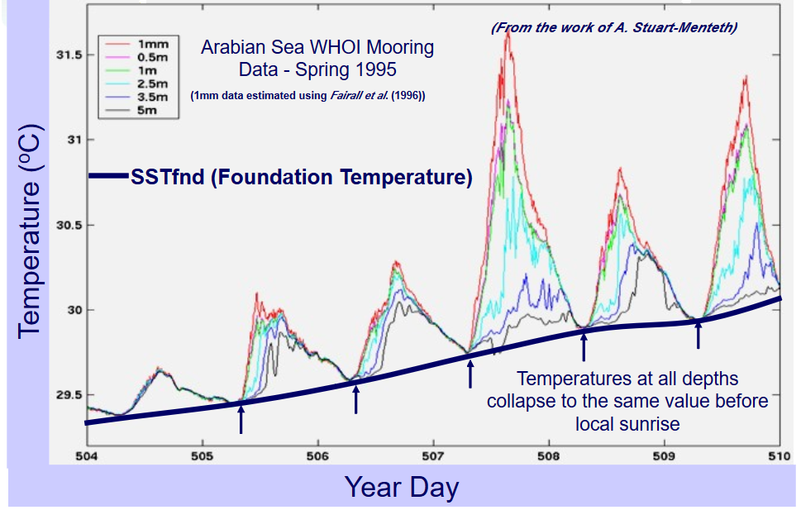
Foundation SST is not influenced by diurnal solar heating
Solar heating near the sea surface causes diurnal changes in SST_{skin} and SST_{subskin}
The foundation SST (SST_{fnd}) is the free of diurnal temperature variability.
SST_{fnd} can only be measured with in-situ instruments
Analysis procedures must be used to estimate the SST_{fnd} from satellite retrievals of SST_{skin} and SST_{subskin}.
www.ghrsst.org
Notes:
This graph shows the diurnal variation in near surface temperatures with depth. The closer to the surface, the more variability is observed. At around 1-10m depth, the water temperature is no longer affected by the diurnal cycle. The temperature at that depth is called the foundation SST and can be estimated analytically from satellite measurements.

Slide 7
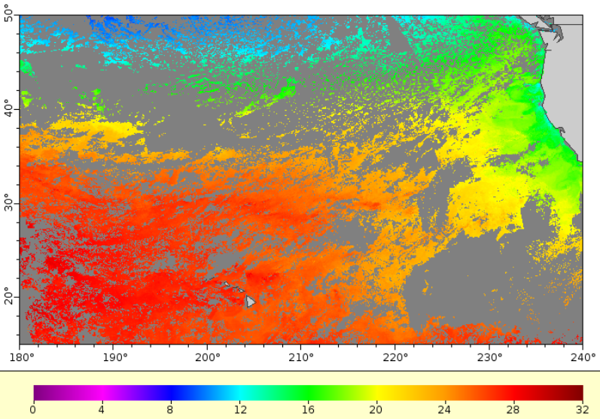
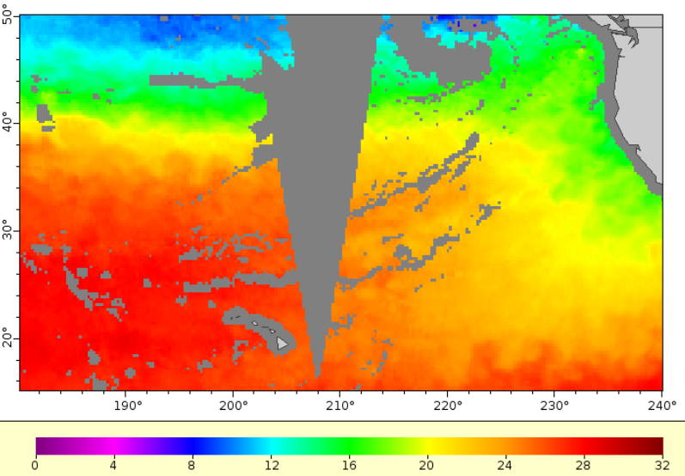
SST can be measured with infrared and microwave sensors
3-day Aqua MODIS (Infrared)
3-day Aqua AMSR-E (Microwave)
0.025º (~2.5 km) resolution
No data under clouds
0.25º (~25 km) resolution
Can see through most clouds
No data close to the coast
Notes:
As I’ve previously mentioned SST can be measured in both the infrared and the microwave. Infrared measurements have a higher spatial resolution, on the order of 1-5 km, but can not make measurements through clouds.Microwave measurements have a lower spatial resolution, around 25 km. They are generally not affected by cloud cover, but measurements are not possible close to the coast.

Slide 8
Characteristics of SST measurements
Orbit | Wavelength Band | Coverage | Spatial Resolution | Temporal Resolution | Accuracy (⁰ K) | Penetration Depth | Cloud Effect
Polar | Infrared | Global | 1 - 4 km | 12 hrs - 3 days | 0.4-0.6 | ~ 20 um | Blocked
Geostationary | Infrared | Global | 2 - 4 km | 30 minutes | 0.4-0.6 | ~ 20 um | Blocked
Polar | Microwave | Regional | 25 - 50 km | 1 - 3 days | 0.4-1.0 | ~ 2 mm | Not Blocked except heavy rain
Adapted from Donlon et al, 2007
Notes:
This table summarizes the main types of SST sensors, infrared vs microwave, polar-orbiting or geostationary, along with their typical resolutions, resampling interval , accuracy, and cloud effect.

Slide 9
Measurements of SST in the infrared
SST has been measured accurately in the infrared since 1978
Measurements are made in both polar orbit and geosynchronous orbit
Notes:
Let’s talk about infrared measurements in more detail. SST has been measured using infrared sensors since 1978, it’s the longest running time-series of ocean satellite measurements.

Slide 10
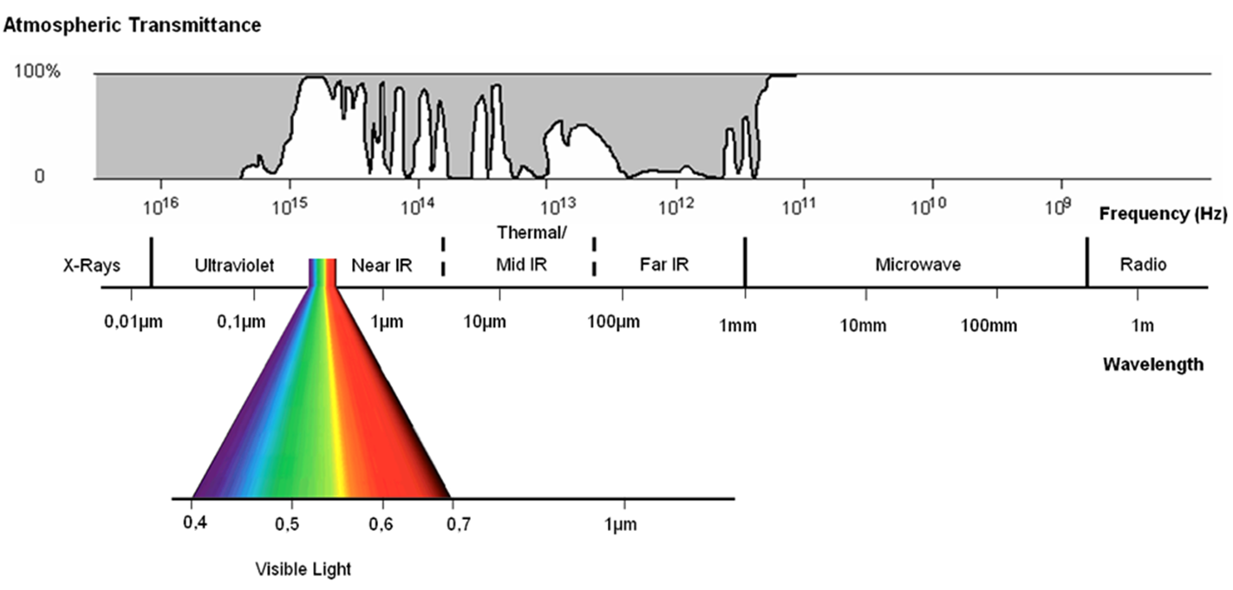






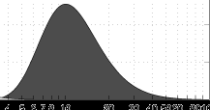
Reminder: Infrared passes through narrow atmospheric windows
High transmittance occurs in narrow bands in the infrared.
These “optical windows” overlap the infrared emissions of the Earth.
Atmospheric Transmission
WAVELENGTH (μm)
10⁻²
10⁻¹
10⁻⁰
10¹
10²
10³
10⁴
10⁵
10⁶
Infrared EMR Emitted by the Earth
EMR Intensity
Notes:
Remember that in the infrared, satellite sensors can “see” through the atmosphere only at specific wavelengths, or windows, which are represented by the yellow bands on this figure.

Slide 11
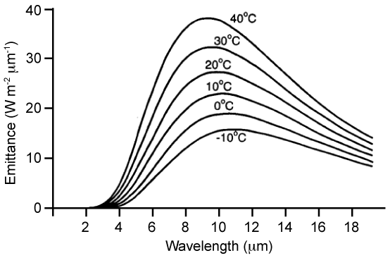
Reminder: Black bodies
The spectrum and intensity of radiation emitted an object depends on its temperature.
If the earth's surface is regarded as a blackbody emitter, its apparent temperature (known as the brightness temperature) and its emitted radiation are related by Planck's law.
The atmospheric window at 10-12 µm and higher Blackbody emissions overlap:
The peaks of the Planck function for temperatures typical of the sea surface are close to the infrared atmospheric window.
This is, therefore, well suited to SST measurement.
Plank’s law for a blackbody emitter
Atmospheric windows
Robinson 2004
Notes:
However, as we saw in the 101 presentation, according to Plank’s law, there is a relationship between the temperature of the Earth, and its emitted radiation. For the range of temperatures on the Earth’s surface, the peak of the Planck function is around 10-12µm, which corresponds to one of the atmospheric windows in the infrared. The apparent temperature of the Earth’s surface is called its brightness temperature.

Slide 12


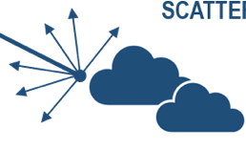


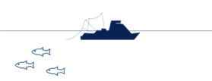

Reminder: The atmosphere alters the EMR signal
ABSORPTION &
SCATTERING
ABSORPTION &
SCATTERING
Absorption and scattering by components of the atmosphere attenuate the signal reaching the sensor.
ABSORPTION
SCATTERING
SCATTERING
ABSORPTION
SCATTERING
SCATTERING
ABSORPTION
EMISSION
Credit: Jan Yoshioka, CI
Notes:
However, as we saw in the 101 presentation, the emission from the Earth’s surface is affected by the atmosphere – it can be scattered or absorbed by atmospheric gases and aerosols. Those phenomenon end up attenuating the original signal as it makes its ways to the satellite sensors.

Slide 13
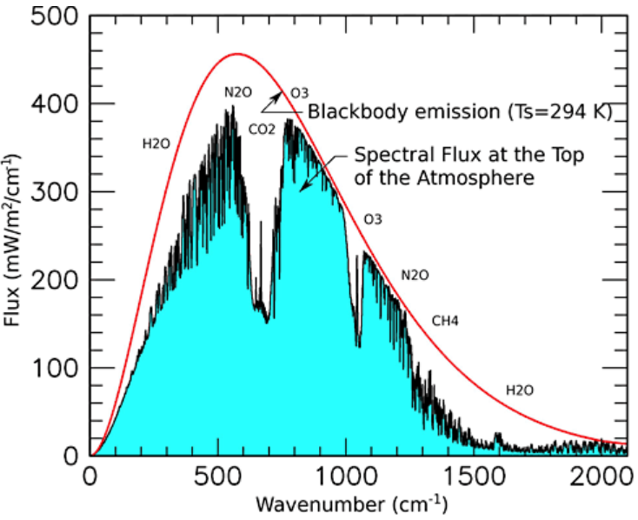

The influence of the atmosphere on EMR attenuation
21ºC
As a result, the blackbody emission from the Earth are altered when viewed through the atmosphere.
-> correction for the attenuation by the atmosphere is needed
NASA
Notes:
As a consequence, the resulting Earth’s emission spectrum at an average temperature of 21ºC doesn’t quite match that of a blackbody of the same temperature, shown here by the red line. Instead, the energy emitted, which is highlighted here in light blue, is lower overall than it would be if there were no interactions with the atmosphere, and especially so at certain wavelengths.

Slide 14
Clouds attenuate the infrared signal
Clouds can block the infrared signal from reaching the satellite radiometers.
Minnett 2001
Notes:
This is especially true when there are clouds in the field of view of the sensor. Infrared radiation is completely attenuated by clouds. So a critical step to measure SST from space is cloud detection. What we are seeing here is a map of the average degree of cloudiness for the month of January. Values are greater than 50% over the entire ocean, so clearly dealing with clouds is an important part of ocean remote sensing!

Slide 15
Addition influence of the atmosphere in the infrared signal
Temperature Deficit
Brightness temperatures measured by a spacecraft radiometer through the clear atmosphere are cooler than would be measured by a similar device just above the sea surface.
Even with clear skies a significant fraction of the sea surface emission is absorbed as the signal travels through the atmosphere.
The absorbed energy is re-emitted, but at a cooler temperature that is characteristic of the height in the atmosphere.
The resulting temperature deficit must be corrected for to get accurate SST measurements.
Minnett 2001
Notes:
Even in the absence of clouds, some of the EMR is absorbed by the atmosphere. It is then reemitted at a temperature characteristic of that height in the atmosphere, which is cooler than the surface value we want to measure. So the Earth appears cooler than it would if the temperature was measured at sea level. This is called the temperature deficit and needs to be corrected.

Slide 16
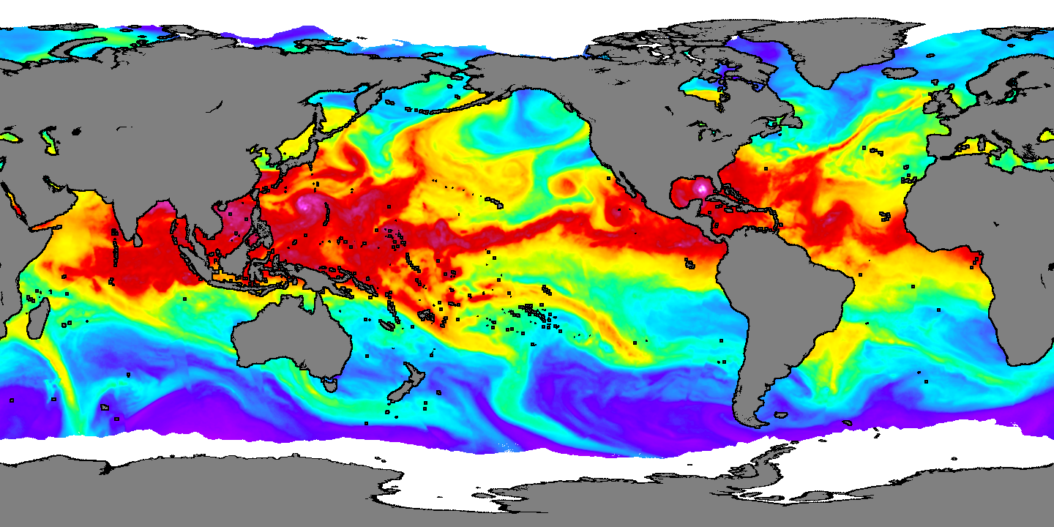
Water vapor complicates temperature deficit corrections
In the infrared, atmosphere water vapor is responsible for most of the temperature deficit.
Water vapor concentration is variable in both space and time.
Other gases are well mixed throughout the atmosphere.
Their contribute to the temperature deficit a relatively and is simple to correct.
Water Vapor
Typhoon Talim
Katrina
Aug 28, 2005
Minnett 2001
Notes:
Most of the temperature deficit in the infrared is due to absorption by water vapor in the atmosphere. Other gases are well mixed and cause a homogenous temperature deficit that is easier to correct. As can be seen in this image, water vapor concentration is very variable in time and space, and requires specific corrections.

Slide 17
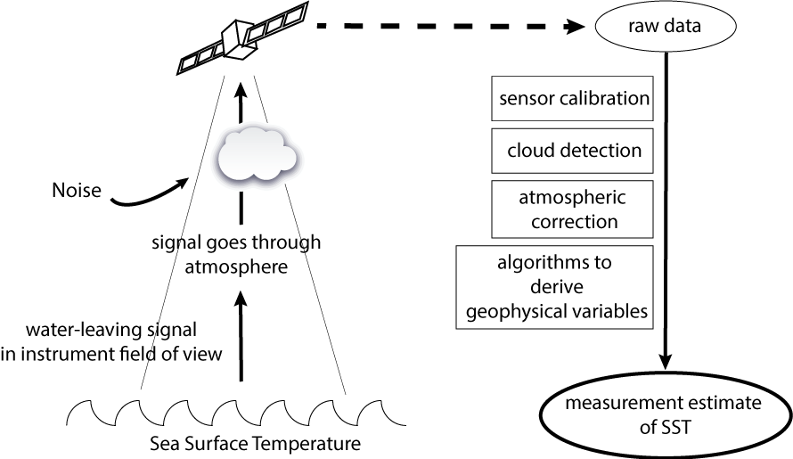
Measurements of SST in the infrared - summary
adapted from Robinson 2004
Notes:
To sum up, SST can be measured from space in the infrared, and to obtain accurate measurements, several steps are needed to process the raw data received from satellites. Those steps are: sensor calibration, cloud detection, atmospheric correction and SST-specific algorithms.

Slide 18
Instruments measuring SST using infrared sensors
Instrument | Satellite(s) | Orbit | Period of operation
AVHRR | TIROS-N, NOAA 6-19, MetOp A/B | Polar | 1978-present
MODIS | Aqua, Terra | Polar | 1999-present
VIIRS | SNPP, NOAA-20 | Polar | 2011-present
Imager | GOES 8-15 | Geostationary | 1994-present
ABI | GOES 16-17 | Geostationary | 2016-present
Many concurrent observations from different sensors,
which can be combined into blended products.
Notes:
Satellites have been measuring SST in the infrared since 1978. We now have multiple concurrent measurements, from geostationary and polar-orbiting platforms. This allows scientists to blend observations from multiple satellites to create SST products that are more accurate and gap-free.

Slide 19
Measurements of SST in the microwaves
Measured accurately in the tropics since 1999 (TRMM) and globally since 2002 (AMSR-E)
Notes:
Satellite measurements of SST using microwaves sensors have been in the tropics since 1999, and globally since 2002.

Slide 20
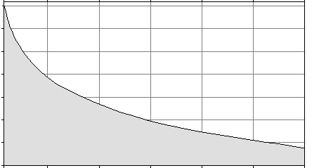
Reminder: Atmospheric windows
In the microwave, the atmosphere is almost 100% transparent but the sun and earth's radiation are weak (need large antennas to collect enough radiation)
Atmospheric Transmission
WAVELENGTH (μm)
10⁻²
10⁻¹
10⁻⁰
10¹
10²
10³
10⁴
10⁵
10⁶
EMR Emitted by the Earth
EMR Intensity
X 10⁶
Infrared
Microwave
Notes:
Remember that in the microwave wavelengths, there is almost no atmospheric absorption of EMR. However, the intensity of the Earth’s surface emissions in the microwave is much lower than in the infrared.

Slide 21
Characteristics of microwave sensors
Low Intensity Signal:
The intensity of microwave radiation at the top of the atmosphere is low
This can be partially compensated for with larger (~m) antennae for microwave instruments.
Diffraction Limits Spatial Resolution:
The longer wavelengths give rise to diffraction effects that limit the spatial resolution
Typically resolution ranges from to 25-50 km
The precision with which thermal ocean fronts can be located is limited with microwave imagery.
Pearson et al, 2018
Notes:
As a result of that low intensity, microwave instruments need to carry large antennas in order to capture enough signal from the surface. And in the microwave, the instruments are more limited by diffraction which spreads the EMR over a broader area and blurs the image. So the spatial resolution of microwave instruments is around 25-50 km.

Slide 22
Characteristics of microwave sensors (continued)
The Coast Contaminates Ocean Signal
The microwave emissivity of land and ice is significantly higher than the ocean.
This leads to contamination of the ocean microwave signal close to the coasts and ice edges
Accurate SST measurements are not possible in these areas.
Sees Through Clouds
An advantage of microwave measurements is that microwaves can penetrate non-precipitating clouds.
Therefore, SST can be measured in cloudy conditions with microwave sensors (not with infrared sensors).
This is useful in persistently cloudy regions such as winter high-latitudes.
Pearson et al, 2018
Notes:
Because the emissivity of land and ice in the microwaves is much higher than the emissivity of the ocean, measurements close to the coast are contaminated by the land signal. As a consequence SST from microwave instruments is not available within about 25 km of the coasts. However, a huge advantage of microwave measurements is that they are not affected by cloud cover, which makes those observations a very important complement of infrared measurements, especially in regions with persistent cloud cover.

Slide 23
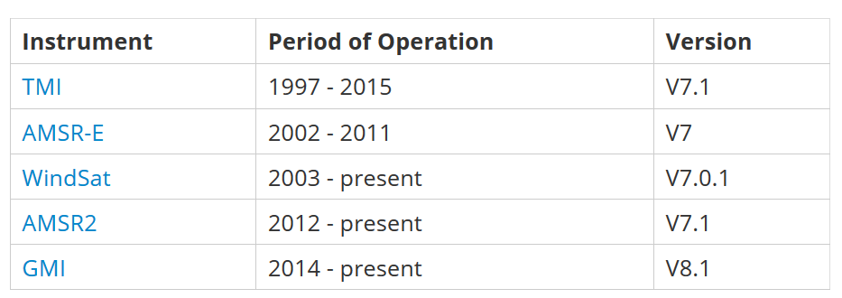
Instruments measuring SST using microwave sensors
Currently only on polar-orbiting satellites.
Pearson et al, 2018
Notes:
Microwave SST measurements are currently only available on polar-orbiting satellites and we now have several concurrent observations.

Slide 24
Reminder: Levels of Data
Level 0: Raw data received from satellite, in standard binary form
Level 1: Unprocessed data in sensor’s geographic coordinates, containing calibration information
Level 2: Derived geophysical variables atmospherically corrected and geolocated, but presented in sensor’s geographic coordinates (granules). Also sometimes referred to as “along-track” data.
Level 3: Derived geophysical variables mapped on uniform space-time grid scales. Spatial and temporal composites.
Level 4: Model output or results from analyses of lower-level data e.g., variables derived from multiple measurements, like cloud-free product
This course focuses primarily on level 3 and level 4 data
Notes:
Remember from the 101 presentation that there are several levels of data. In this course, we are focusing only on level 3 and 4 products. These are products containing geophysical variables or derived variables that are mapped onto uniform space-time grid scales.

Slide 25

Which data set should be used?
User’s wish list:
High-resolution
Satellite data only
Gap-free
Can it be done? Sure: pick any 2 from your wish list
High-res, satellite data only, gap-free ->
L3 products, combining multiple sensors
Satellite data only, gap-free, High-res ->
L3 weekly or monthly composites at a spatial resolution lower than the sensor’s
High-res, gap-free, satellite data only ->
L4
Not guaranteed to be satellite data only, i.e. because interpolation is done to fill in the gaps, users do not know which pixels come from observations and which pixels are interpolated
Slide from Irina Gladkova
Notes:
But with so many SST products available, which should you choose for your project? As with anything in life, you can’t have it all. Each product has its advantages and its drawbacks. You can find products that have the highest resolution and are based entirely on reliable satellite observations, but they can have data gaps due to cloud cover and incomplete spatial coverage between satellite swaths. You can find products that are based entirely on reliable satellite data that are almost gap-free, but they will usually be weekly or monthly composites and have a lower spatial resolution. Alternately, you can find high-resolution level 4 products that are gap-free because they combined observations from multiple satellites and include an interpellation processing step to fill in the data gaps. Typically, such products don’t tell you which pixels are derived from observations and which from interpellation.

Slide 26
Characteristics of some popular SST L4 products
Name | aka | Institution | spatial resolution | temporal resolution | time coverage | cloud-free
Operational Sea Surface Temperature and Sea Ice Analysis | OSTIA | Met Office | 0.05º | daily | 2006-present | yes
AVHRR Pathfinder Sea Surface Temperature | Pathfinder | NOAA/NASA | 4km | daily | 1981-june 2018 | no
Multi-scale Ultra-high Resolution Sea Surface Temperature | JPL MUR | NASA | 1km | daily | 2002-present | yes
NOAA Geo-polar blended Sea Surface Temperature | GOES-POES | NOAA | 5km | daily | 2002-present | yes
Notes:
Here is a list of the most popular Level 4 SST products currently available, with some of their characteristics. I will go over the last two in a bit more detail.

Slide 27
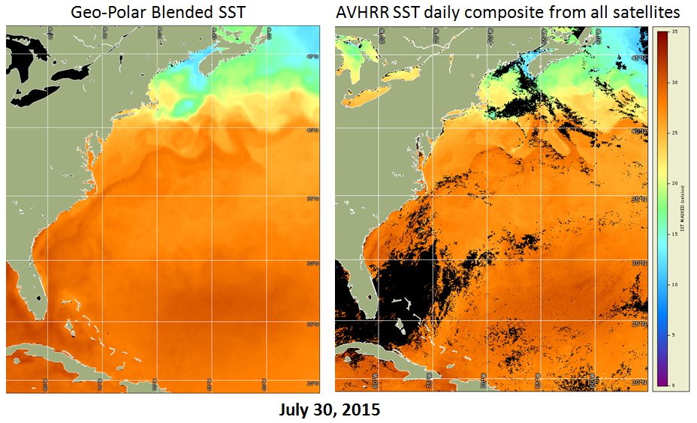
NOAA Geo-Polar Blended SST
Created by NOAA Satellite Service, Satellite Applications & Research
2002 – present
Data from infrared polar & geostationary satellites, blended together
Optimal interpolation assimilation balances detail preservation & noise reduction
Near rear real-time data available on a daily basis (1 day delay)
5 km spatial resolution
Estimate of nighttime SST - must consider diurnal effect
Notes:
The daily NOAA GeoPolar blended SST is available from 2002 to the present, has a spatial resolution of 5km, and is interpellated to be gap-free. It’s available as night-time only, daytime only, or a daytime and night-time average, which allows users to look at diurnal variation if needed. The product is also available in near real-time and science quality versions.

Slide 28
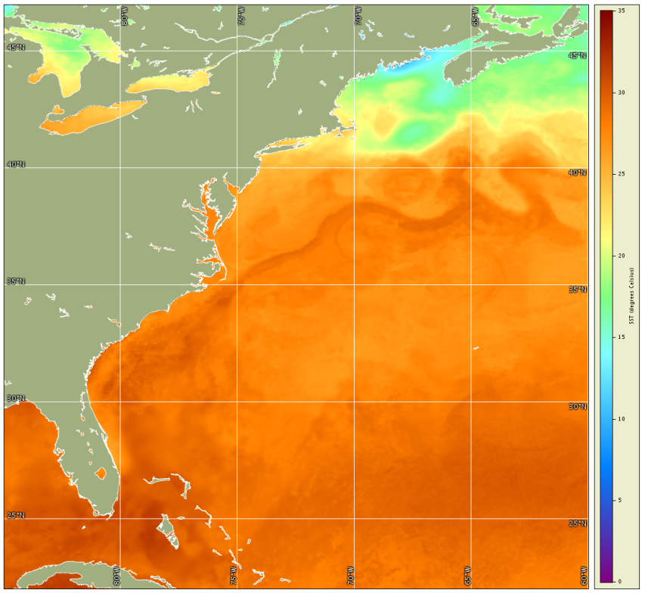
Multiscale Ultra-high Resolution (MUR) SST
July 30, 2015
Created by NASA Jet Propulsion Laboratory
June 1, 2002 – present
Daily, global, cloud-free
Data from polar-orbiting infrared and microwave sensors blended together
Data assimilated with global in-situ SST data to account for differences in the source data sets (in situ data from NOAA’s iQuam database)
New data available on a daily basis (NRT & science quality)
1 km spatial resolution
Estimate of nighttime foundation SST -must consider diurnal effect
Notes:
The daily MUR SST from NASA is a 1km product, available from 2002 to the present, and is gap-free.

Slide 29
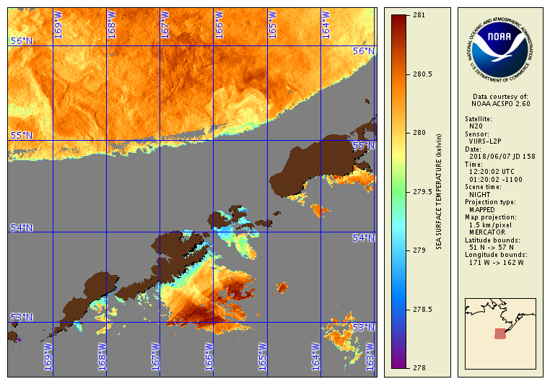
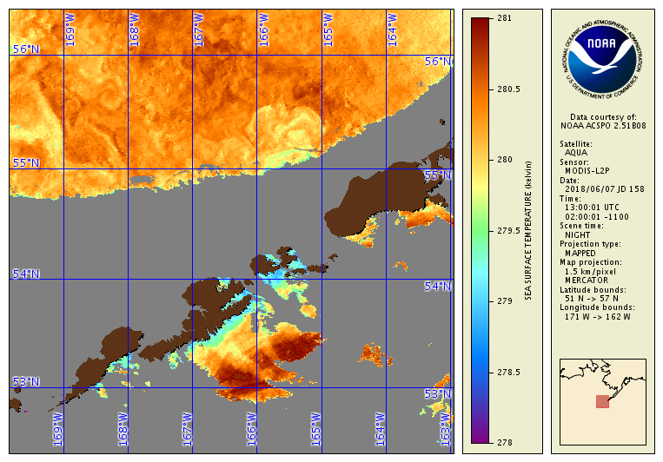
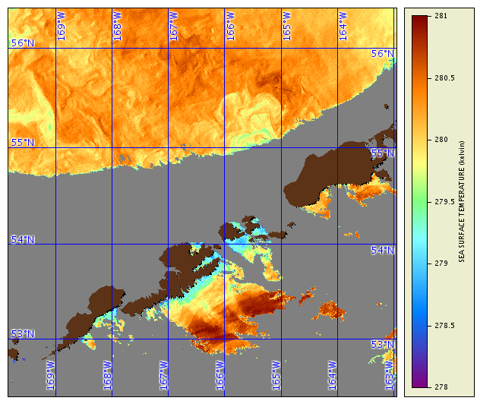
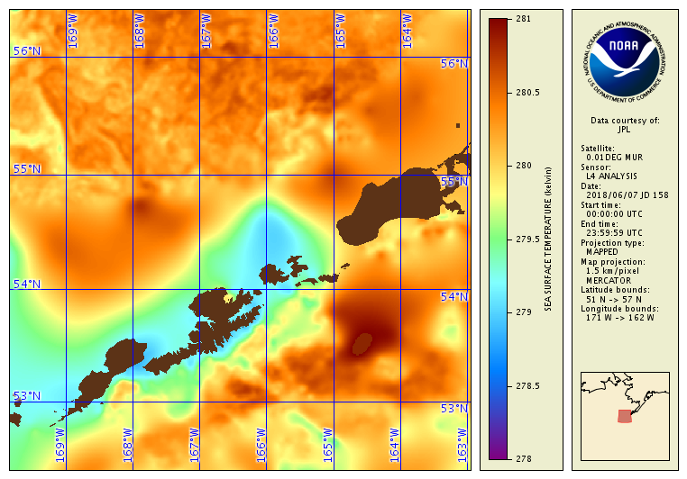
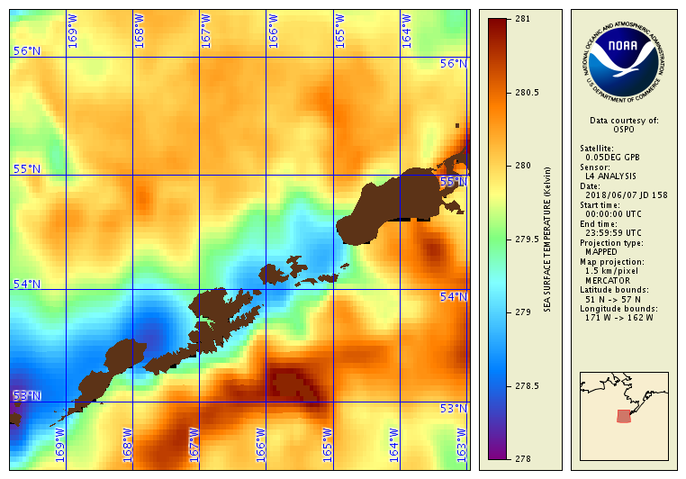
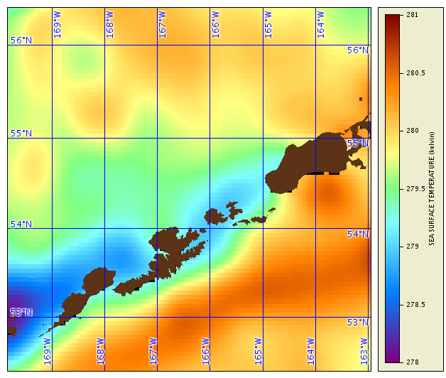
Is gap-free more important than satellite-based?
Example: Aleutian Island
June 7, 2018
N-20
12:20
Aqua
13:00
SNPP
13:10
L4 MUR
L4 Geo-Polar blended
L4 OSTIA
Slide from Irina Gladkova
Notes:
This figure shows a few examples of level 3 and level 4 SST over the same area on the same day to get you thinking about the pros and cons of various products based on your needs. You can think of the level 3 SST as the “truth” where there is data.These are the top 3 images. They are pretty accurate, high-resolution observations, but quite a bit of data is missing. The 3 bottom images, are level 4 products that attempt to fill in these gaps. The MUR product, shown on the left, is very high-resolution, and where there is data, does a really good job at reproducing the observations, but where there is no data the image can become very blurred. The OSTIA product on the right is the same resolution as the geopolar blended product in the middle, but the OSTIA product apprears more blurred. The GeoPolar and OSTIA products do not capture many of the fine features present in the top images. This is partially due to the lower resolution of the of these two L4 products, which are 5 km, and partially due to the interpellation process. Although it’s the same resolution as the GeoPolar Blended product, more of the feature of the SST field appear to be lost with the OSTIA product. The results shown in this example are unique to the time and place of the image we selected. Therefore, when selecting a dataset for your application it’s good practice to select a few products and compare them for several time steps and regions.

Slide 30
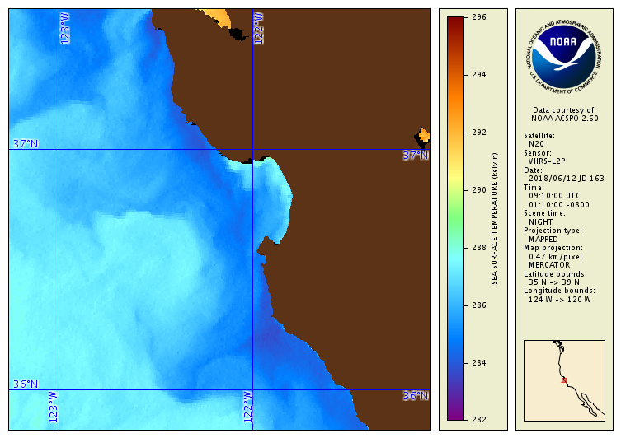
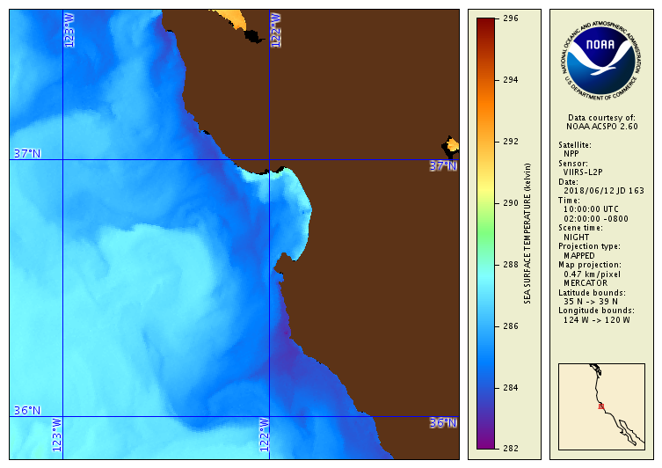
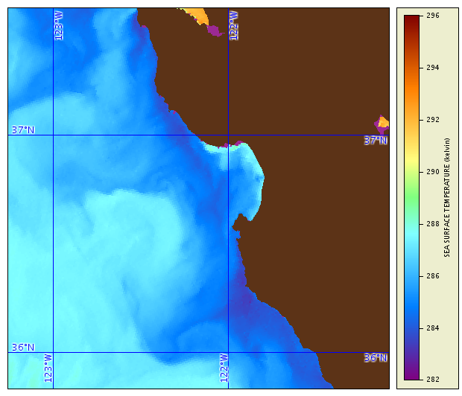
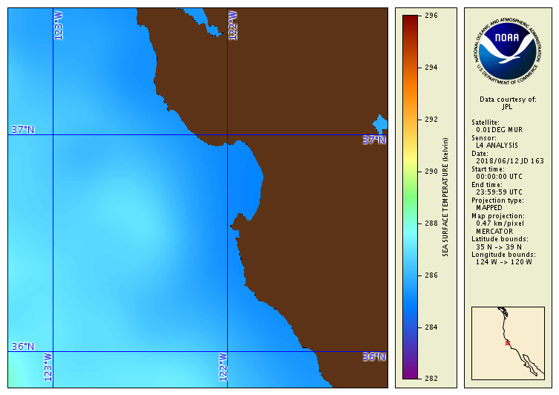
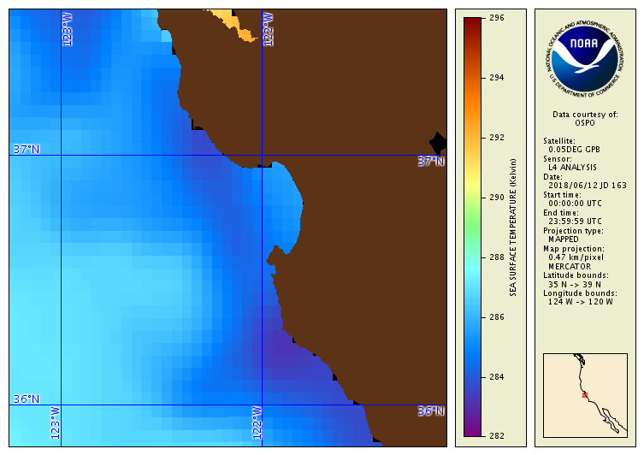
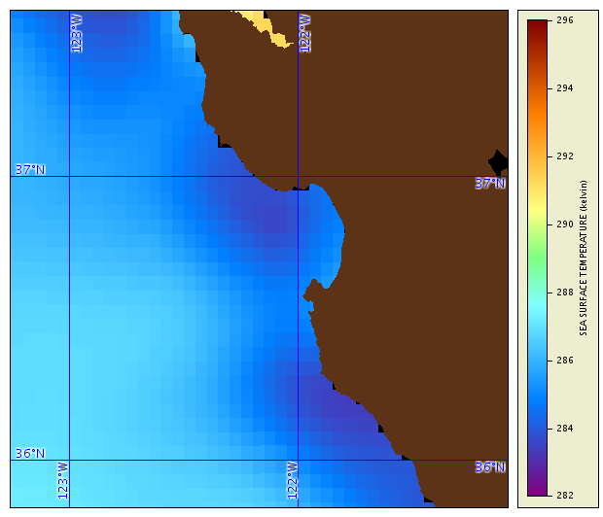
The high resolution is not always the best choice
Example: Monterey Bay June 12, 2018
N-20
09:10
SNPP
10:00
Aqua
10:05
L4
Geo-Polar
blended 5km
L4 MUR 1km
L4 OSTIA 5km
Slide from Irina Gladkova
Notes:
In this example for the Monterey Bay region, you can see that sometimes, higher resolution products like MUR can actually have a harder time at reproducing the overall patterns in SST, compared to the GeoPolar Blended or OSTIA. So be sure to look at different products for your region.

Slide 31
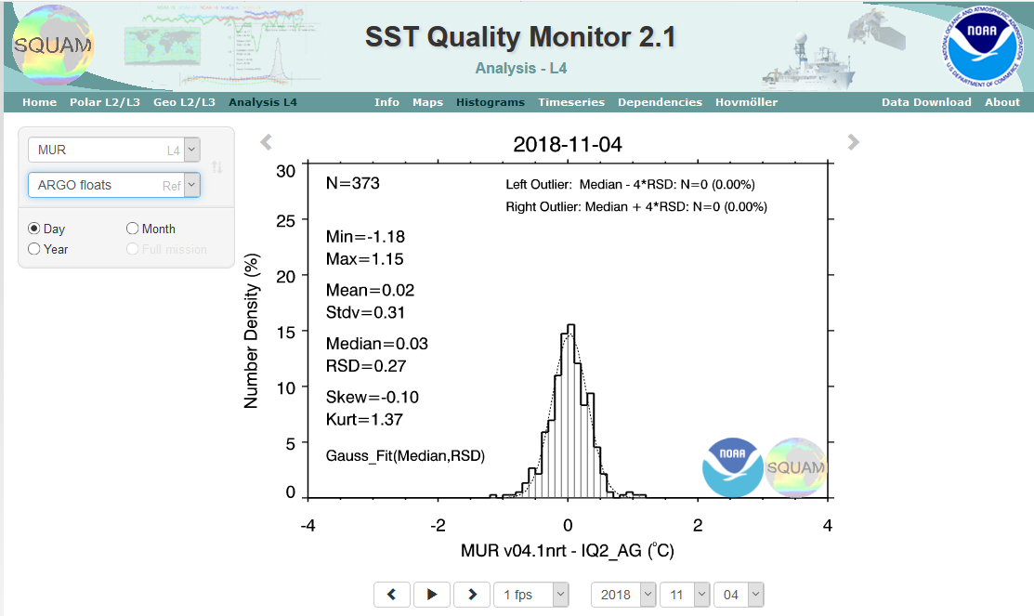
SST Quality Monitor in available from NOAA SQUAM*
NOAA developed a tool to compare different products with each other and with in-situ data
*SQUAM - SST Quality Monitor
https://www.star.nesdis.noaa.gov/sod/sst/squam/index.php
Notes:
Finally, when choosing a product, you can also compare the quality of different products using the NOAA SST Quality Monitor. You can compare them against each other or against in-situ observations from buoys and ships.

Slide 32
Review important concepts for satellite SST measurements
Infrared instruments:
SST_{skin} – the top ~ 20 um
High spatial resolution
Measurements blocked by clouds
Sensors in both polar and geo orbit
Microwave instruments:
SST_{subskin} top ~ several mm
Reduced spatial resolution
Sees through clouds (fuller coverage)
No measurements close to land (50-100km)
Sensors only in polar orbit
Blended Products:
Data from multiple satellites and/or multiple passes of the same satellite are combined
Often data-gaps are filled by interpellation
Products Selection
There are many SST products to choose from
Before picking a product, select a few and compare them for several time steps and regions.
Notes:
So lets review some of the important aspects of satellite SST measurements. SST measurements are made in different part of the EMR spectra, in both the infrared and also in the microwave. Infrared measurements, which are more common, have a higher spatial resolution, but are blocked by clouds. Microwave measurements get fuller coverage since they can see through clouds, but have reduced spatial resolution and can not be made close to land. IR SST measurements are also made from geosynchronous satellites, which can make measurements sub-hourly, and can thus mitigate the cloud issue. There are a number of products that blend these different SST data together. It’s important to compare how these different datasets perform in your region of interest to determine which one is best suited for your project.

Slide 33
NOAA CoastWatch Satellite Course - Narrated Presentations
Satellite 101 – Part 1
Satellite 101 – Part 2
Fundamentals of Ocean Color
Fundamentals of Sea-Surface Temperature
Fundamentals of Altimetry, Wind and Salinity
Introduction to ERDDAP
What Dataset to Choose?
Bringing Satellite Data into ARCGIS
Notes:
This concludes this presentation on sea surface temperature. This is one of several presentations put together as part of the CoastWatch Ocean Satellite Course. We have additional presentations that cover how measurements are made for ocean color, and for measurements made in the microwave, i.e. altimetry, salinity and wind.

