Slide 1
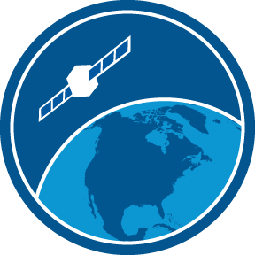

Salinity, Wind, Altimetry NOAA CoastWatch Satellite Course
Last Updated: 10/20/2020
coastwatch.info@noaa.gov
Notes:
Welcome to the online course on oceanographic satellite data products, produced by NOAA’s CoastWatch Program. In this module we will discuss the measurement of sea surface salinity, surface winds, and sea surface height using satellite remote sensing techniques. The information presented here builds on the concepts discussed in the Satellite 101 Part 1 and Part 2 modules of the online course. You might want to review those modules first before viewing this module.
My name is Cara Wilson, I’m the node manager of the West Coast Node of NOAA’s CoastWatch Program. The materials I will be presenting in this video were produced from a collaboration from many members of NOAA’s CoastWatch Program including Dale Robinson, Melanie Abecassis, Ron Vogel, Shelly Tomlinson, me and the late Dave Foley.

Slide 2


The presentation will cover the following topics
Microwave transmission in the atmosphere
Passive and active satellite sensors
SSS, Wind, and SSH measurements and products
Notes:
Salinity, winds, and sea surface height are all measured with instruments that use the microwave portion of the electromagnetic spectrum. So first I will review the characteristics of measuring microwaves from satellites.
I will also cover the two basic types of satellite microwave sensors: Passive and Active sensors
Finally, I will cover how sea surface salinity, surface wind, and sea surface height measurements are made and the products derived from the measurement.

Slide 3
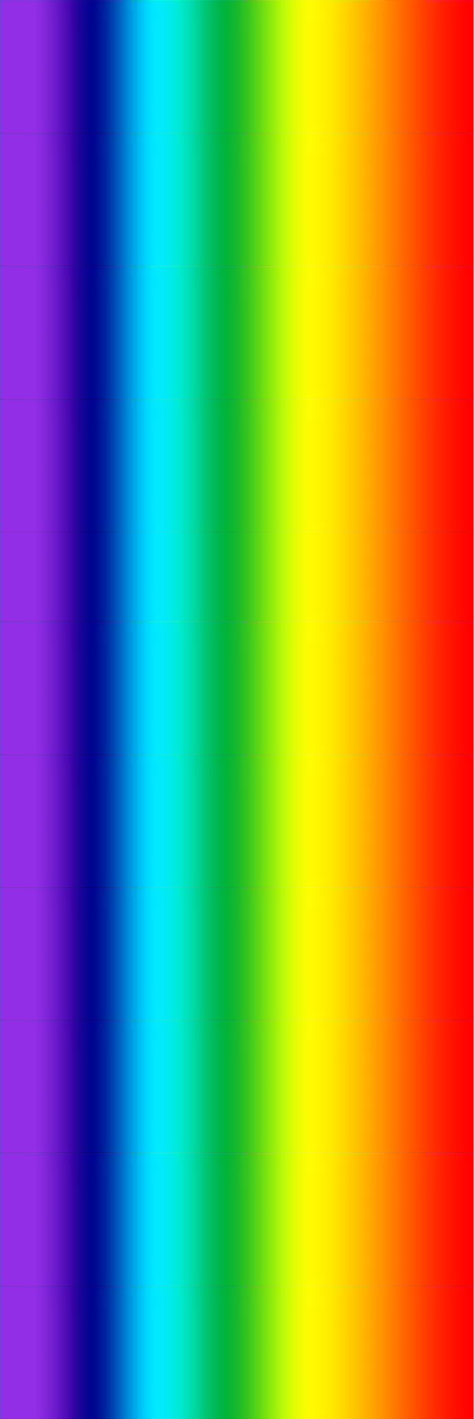
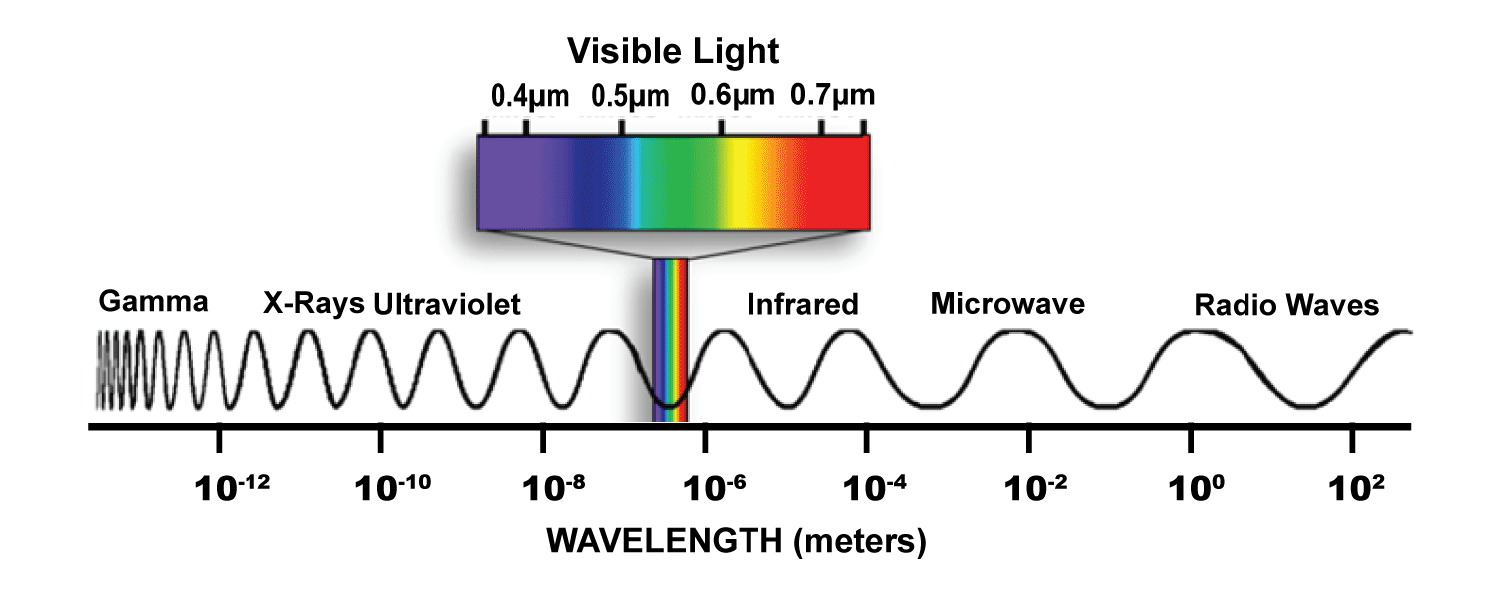
Sea surface height, sea surface salinity, and wind are measured in the microwave bands
Visible Light
Ultraviolet
Infrared
Microwave
Characteristics of microwaves
Microwaves are at longer wavelengths than visible and infrared light
Usually measured in frequency not wavelength (300 GHz to 0.3 GHz)
0.01
1
100
10⁴
10⁶
Wavelength (μm)
10⁸
10⁷
10⁶
10⁵
10⁴
10³
100
10
1
Frequency (GHz)
Band | Freq. (GHz)
Ka | 40–27
K | 27–18
Ku | 18–12
X | 12.5–8
C | 4–8
S | 4–2
L | 2–1
P | 1–0.3
Notes:
On the left, the EMR spectrum is pictured showing the range of wavelengths from ultraviolet to the microwave. Microwaves are at longer wavelengths than the rest of this spectrum.
However, microwaves are typically measured in frequency rather than wavelength. The microwave range is approximately 300 GHz to 0.3 GHz.
Sometimes parts of this range are referred to as lettered bands, such as the K-band and the X-band.

Slide 4
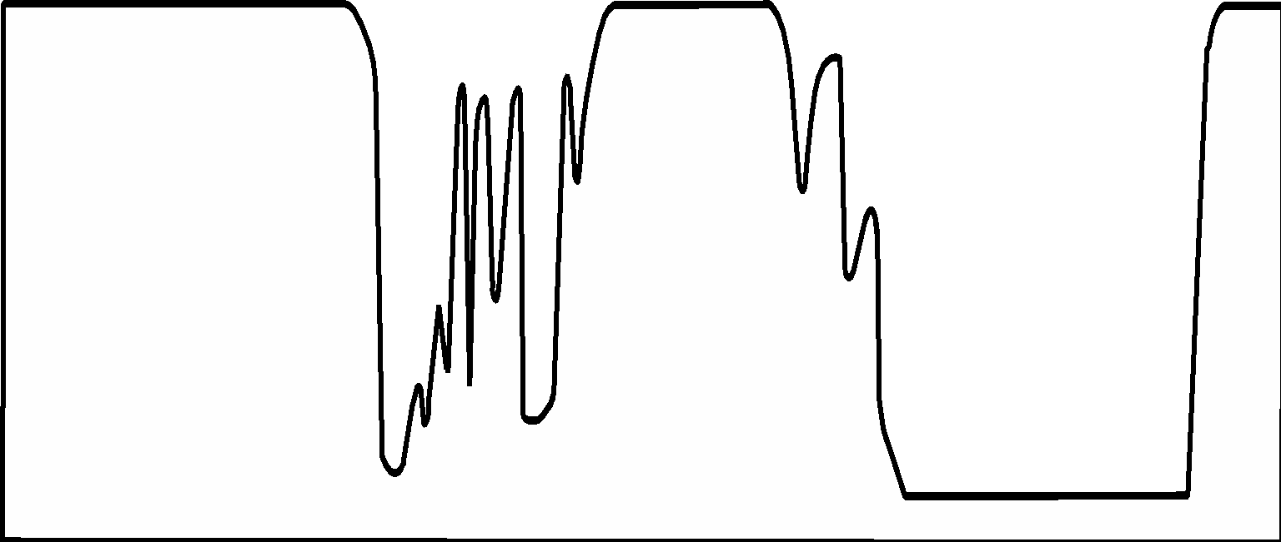
Atmosphere is very transparent to microwaves
Visible Light
Ultraviolet
Infrared
Microwave
Characteristics of microwaves
100%
Microwaves are at longer wavelengths than visible and infrared light
Usually measured in frequency not wavelength (300 GHz to 0.3 GHz)
Atmospheric “window” covers most of the microwave range
50%
Atmospheric opacity
0%
0.01
1
100
10⁴
10⁶
Wavelength (μm)
10⁸
10⁷
10⁶
10⁵
10⁴
10³
100
10
1
Frequency (GHz)
Notes:
As discussed in Satellites 101 Part 2 module of this course, satellites primarily use the visible, infrared, and microwave wavelengths to view the Earth. This is because other wavelengths are strongly absorbed by the Earth’s atmosphere.
On the plot, I have overlain the opacity of the atmosphere on the EMR spectrum, you can see the “atmospheric windows” in the visible, infrared, and microwave bands where EMR can pass through the atmosphere. Notice that most of the microwave range falls within a very transparent atmospheric window.

Slide 5
Microwaves can see through clouds
Visible Light
Ultraviolet
Infrared
Microwave
Characteristics of microwaves
100%
Microwaves are at longer wavelengths than visible and infrared light
Usually measured in frequency not wavelength (300 GHz to 0.3 GHz)
Atmospheric “window” covers most of the microwave range
Clouds do not block transmission of microwaves
50%
Atmospheric opacity
Cloud
Attenuation
0%
0.01
1
100
10⁴
10⁶
Wavelength (μm)
10⁸
10⁷
10⁶
10⁵
10⁴
10³
100
10
1
Frequency (GHz)
Notes:
Another advantage of using microwaves for remote sensing, is that they can see through clouds. If I overlay the attenuation of EMR by clouds, the visible and infrared frequencies are blocked. However, the microwave range frequencies are unaffected, making the microwave range useful for remote sensing in almost any weather condition, except during heavy rain.

Slide 6

Satellite sensors measure naturally occurring or instrument-generated microwave signals
Passive sensors
Active sensors
The sensors measure microwave radiation naturally emitted from the sea.
Microwave signals generated by the satellite are sent to the sea surface.
The sensors measure the signal that is reflected back to the sensor.
Notes:
Passive sensors, shown on the left, detect microwaves from radiation that is naturally emitted by the Earth.
Active sensors, shown on the right, generate microwave pulses that are sent to the sea. The pulses interact with the sea surface and part of the pulse energy is reflected back into the atmosphere. The sensors measure the reflected signal that returns to the satellite.
First, let’s take a closer look at how passive sensors work and what they measure.

Slide 7
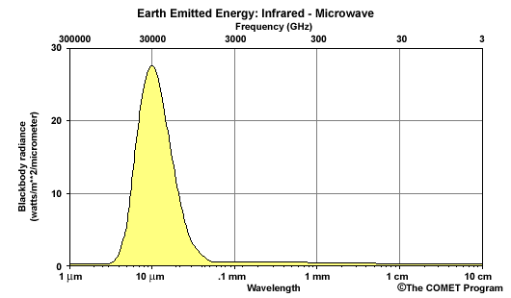
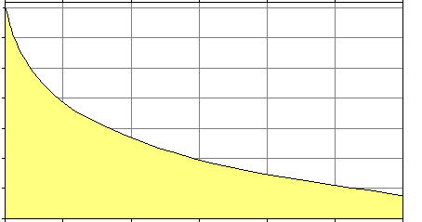
Passive microwave radiometers measure blackbody radiation naturally emitted by the sea
Earth Radiation Emissions
Microwave radiation
The intensity of the emissions is low compared to the infrared
The intensity decreases with frequency
300000
30000
3000
300
30
3 GHz
30
infrared
20
W m-2 μm-1
microwave
10
10⁻⁶
0
1 μm
10 μm
0.1 mm
1 mm
1 cm
10 cm
10⁻⁸
W m⁻² μm⁻¹
10⁻¹⁰
10⁻¹²
300
30
15
10
7.5
6
5
Frequency (GHz)
Notes:
Passive microvave radiometers measure the blackbody radiation emitted by the ocean. This radiation is emitted at intensities and frequencies defined by temperature. At the temperatures found on the Earth, most of the emissions are in the infrared range, as shown in the figure on the left. The inset plot on the right shows a close up of the microwave part of the emission. There are two important features to note about the microwave plot.
First, the intensity of the emissions is very low compared to the intensity in the infrared.
Second, the intensity of the emissions decreases as frequency decreases

Slide 8
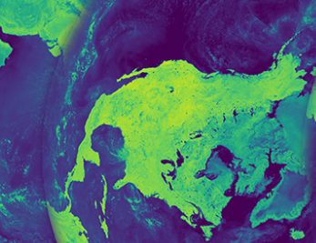
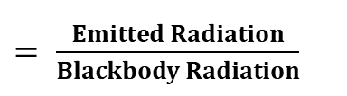

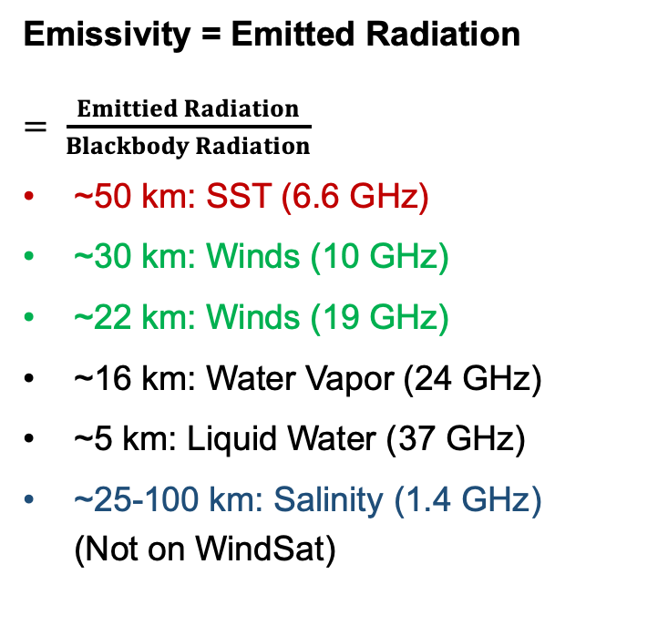
The Earth is a less efficient emitter than a blackbody
Emissivity of sea water at constant conditions
(temperature, salinity, flat surface)
Real objects have emissivity values less than 1.0 that vary with frequency.
Emissivity can be changed by physical properties of the emitting surface, e.g. land vs. water.
Changes in physical properties of sea water can change emissivity and the strength of the signal e.g. salinity, temperature, and surface roughness.
37 GHz Microwave Channel
Land Emissivity 0.95
Sea Water Emissivity 0.45
Notes:
However, blackbody objects are theoretical, and do not exist in nature. For the real objects that do exist, the efficiency at which blackbody radiation is released is less than for a blackbody at the same temperature. Emissivity is a measure of how efficient an object is at emitting radiation compared to a blackbody, where a value of 1 is 100% as efficient as a blackbody. All materials have unique emissivity spectra, where values are less than one and emissivity varies with frequency.
For example, at a frequency of 37 GHz, sea water has an emissivity of ~0.45 and land has an emissivity of ~0.95. So, it is easy to distinguish between these 2 surfaces based on the strength of the microwave signal at 37 GHz. On the left is an image of the Earth taken a 37 GHz where the division between land and sea is easy to determine.
Similarly, physical properties like salinity and surface roughness change the emissivity. For example, the strength of the microwave signal where salinity is 30 parts per thousand will be different than where the salinity is 36 parts per thousand. This difference in signal can be used to determine surface salinity values.

Slide 9
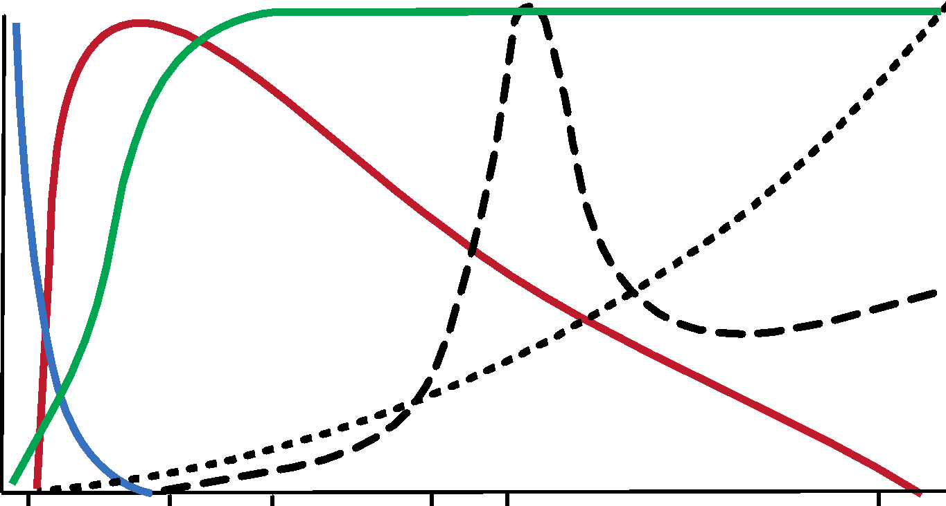
Passive emissions respond uniquely to the change in each parameter
valid measurements for one parameter requires correction for the influence of the other parameters
Sea Surface Temperature
Wind Speed (surface roughness)
Sea Surface Salinity
Max △
Approximate sensor frequencies used for measurements:
Salinity 1.4 GHz
SST 6.6 GHz
Wind 10.7 &19 GHz
Water Vapor 21 GHz
Liquid Water 37 GHz
Liquid Water
Sensitivity of signal to change in a parameter
Water Vaper
No △
37
24
19
11
7
1.4
Frequency (GHz)
Notes:
The plot shows at which frequencies we will see a maximum change in the microwave signal due to change in a physical property. The maximum change for salinity is near 1.4 GHz
Wind speed shows maximum change at frequencies greater than 10Ghz.
SST shows a peak near 7GHz
The maxima for liquid water and water vapor are also shown. Based on these characteristics, the frequencies used to measure the parameters are chosen. Some typical frequencies used for each parameter are presented on the right.
In reality, the signal measured at each frequency will have contributions from many parameters. Those contaminating contributions are corrected for by collecting measurements at many frequencies and subtracting the unwanted signal during the signal processing.

Slide 10





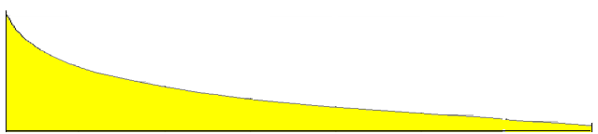
A drawback to passive microwave sensors is low spatial resolution
Footprint (spatial resolution) for WindSat channels
40 X 60 km
12 X 20 km
25 X 38 km
3 X 8 km
16 X 27 km
Microwave blackbody radiation by the sea is very low compared to infrared
To collect enough energy for measurements, microwave sensors require:
Larger antennas and/or larger footprints
Microwave spatial resolution: ~5km - 100 km
37
24
19
10
6.8
10⁻⁹
Frequency(GHz)
10⁻¹⁰
W m⁻² μm⁻¹
Radiation Intensity
10⁻¹¹
10⁻¹²
40
30
15
10
7.5
6
5
Frequency(GHz)
Notes:
As we saw in the SST lesson, a drawback of passive microwave sensors is their low spatial resolution. Spatial resolution in the infrared can be in the sub-kilometer range. However, the intensity of ocean blackbody emissions in the microwave is a small fraction of that measured in the infrared. Therefore, to collect enough energy to make a measurement, microwave sensors must have larger antennas and collect energy from a larger footprint on the sea surface.
There are technical limits to antenna size that make antennas bigger than about 1m impractical. Consequently, microwave sensors have a larger footprint, which translate to lower spatial resolution.
The graph on the lower left shows the decreasing black body emission intensity in the microwave range with decreasing frequency. Above are the footprint sizes required in the frequency bands on the WindSat radiometer.
In general, the spatial resolution of passive microwave sensors ranges from 25 to 100 km.

Slide 11

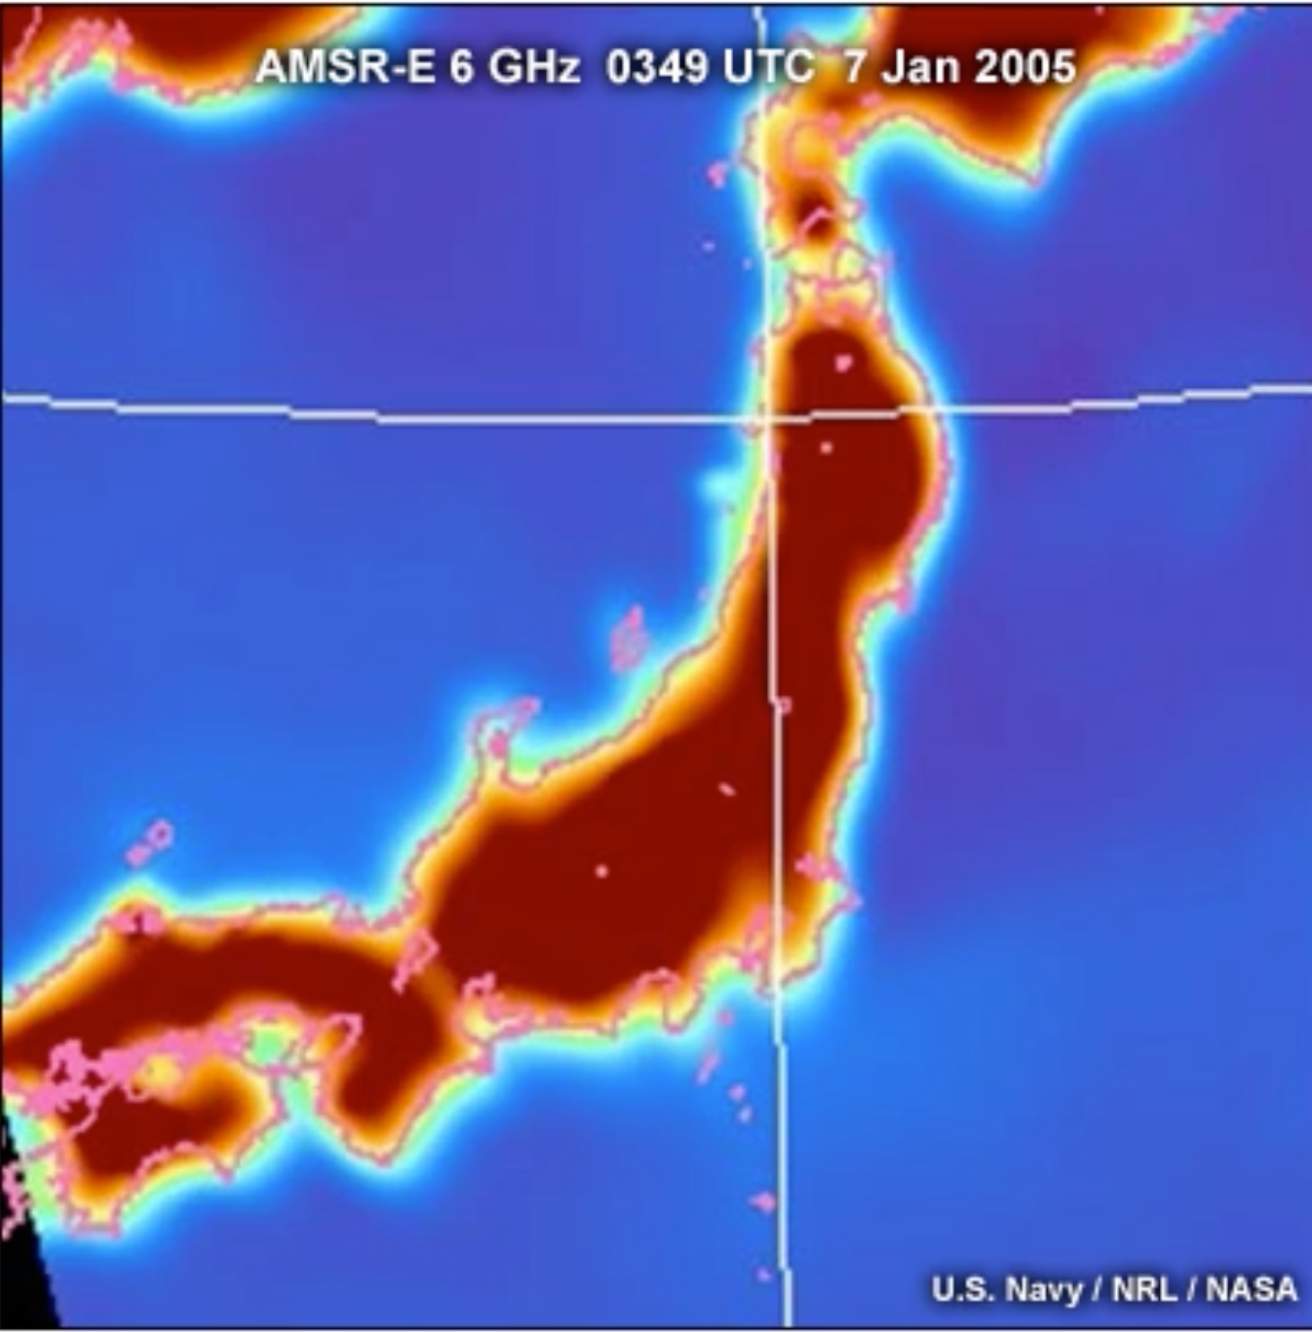
Passive microwave measurements cannot be made close to the coast
Emissivity
Land ~ 0.95
Sea water ~ 0.30 - 0.50
Coastline of Japan
6 GHz channel
sea signal
land signal
Near the coast, the strong microwave emissions from land contaminate the signal from the sea.
Data within ~50 km of the coast are removed from satellite products to eliminate bad values.
40º N
140º E
land signal
sea signal
Notes:
A second drawback to passive microwave sensors is that measurements cannot be made close to the coast. Land has a much higher emissivity than sea water, so it emits a strong microwave signal. When the sensor’s footprint includes land and sea, like in the top left image, the signal is contaminated with radiation from the land. Even when the footprint is 100% over the sea but near land, radiation from land can be scattered into the sensor’s field of view.
The image to the right shows 6 GHz data from the coast of Japan. The halo around the island represents the bad data values that are a blend of the land and sea microwave signal.
In general, for passive microwave satellite products, measurements within about 50 km of land are masked out to remove the bad data.

Slide 12
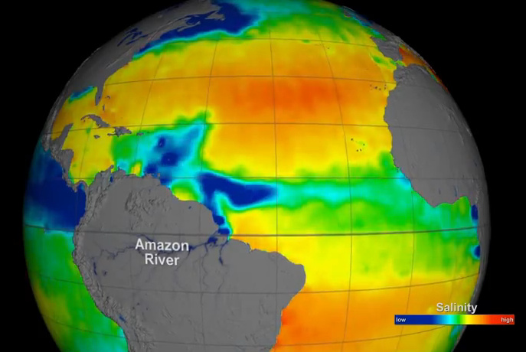
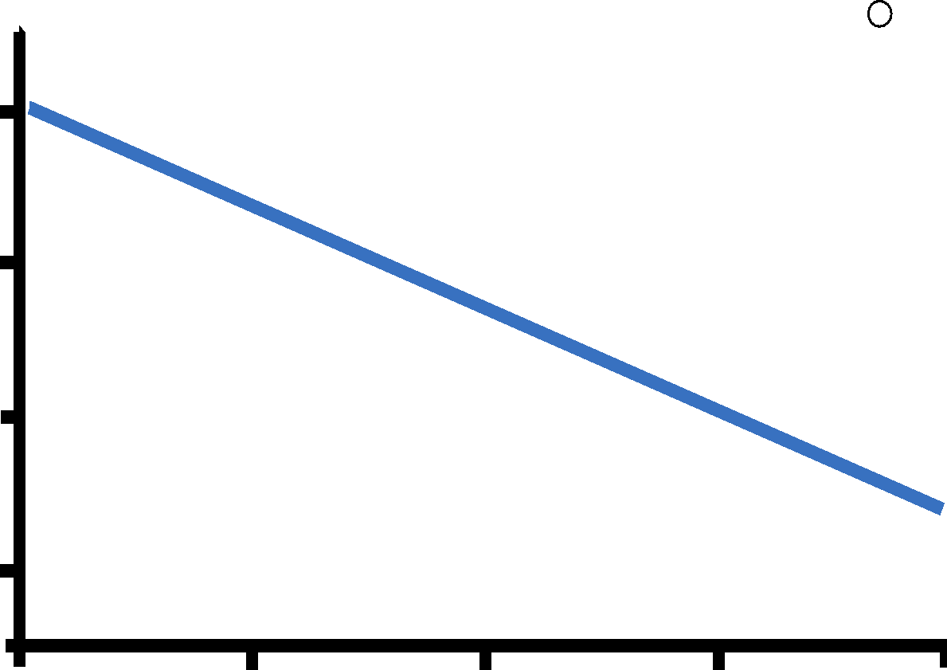
Sea Surface Salinity is measured with passive sensors
Salinity changes the brightness of the microwave signal emitted by the ocean
6
ocean
water
4
△ Microwave Signal
2
0
20
25
30
35
40
Salinity (psu)
Radiometers measure salinity at 1.4 GHz
Notes:
Sea Surface Salinity is measured with passive sensors. The salinity sensors measure the blackbody radiation emitted by the sea at 1.4 GHZ, which decreases with increasing salinity, as seen on the the plot to the right. This relationship between emission and salinity is used to determine salinity with satellite passive sensors.

Slide 13
Satellite salinity is a relatively new measurement
Aquarius
SMOS¹
Temporal coverage: 2010 - Present
Spatial resolution: 0.25 – 1 degree
Global coverage: 3 – 8 days
Accuracy: 0.15-0.25 PSS
Depth: 1–2 cm
SMAP²
2010
2015
2020
¹Soil Moisture and Ocean Salinity mission
²Soil Moisture Active Passive mission
Notes:
Salinity is a relatively new satellite measurement. Three missions have flown since 2010, and currently two sensors are still collecting data. Because data are collected at 1.4 GHz, where the signal from the Earth is weaker, the spatial resolution is relatively low: ranging from 25 km to 100 km, depending on the satellite mission. Complete global coverage takes 3-8 days. The accuracy of the measurement is 0.15 - 0.25 units on the practical salinity scale. It is important to remember that satellites can measure the salinity only in the top few centimeters of the sea.

Slide 14
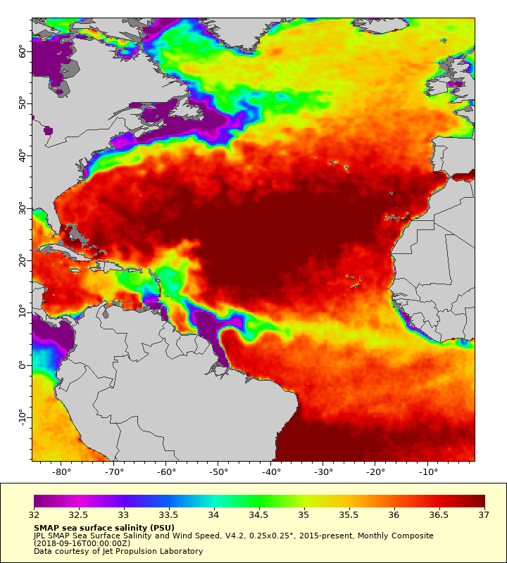
Uses for satellite salinity
Global thermohaline circulation
Dynamic ecosystem modeling
Tracking surface salinity events
SMOS data – 0.25º resolution
Practical Salinity Scale
Notes:
Uses of salinity measurements include studies of global circulation patterns, defining animal habitats, and tracking surface salinity events. The salinity map on this slide, made from the SMOS data, shows the distribution of a lower salinity water plume resulting from strong fresh water outflow from the Amazon River.

Slide 15
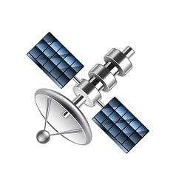
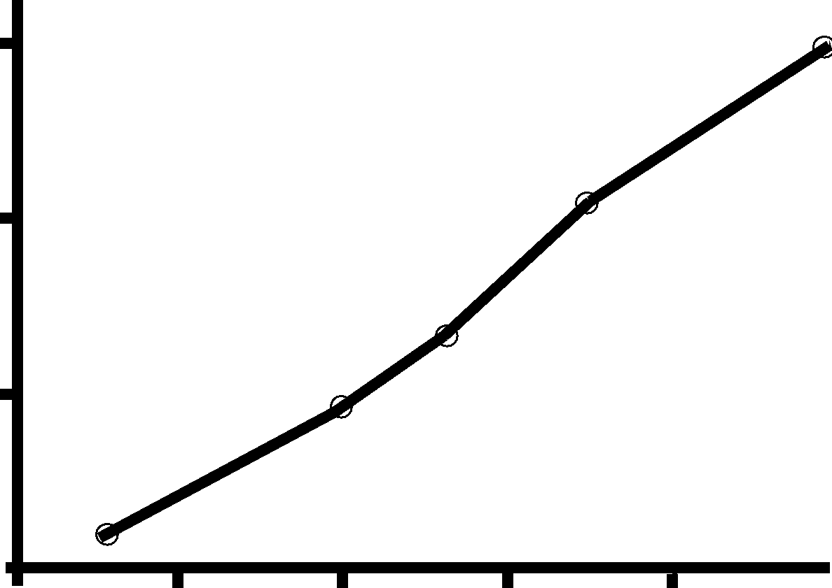
Wind speed (not direction*) is measured with passive radiometer sensors
radiometers measure sea surface roughness and use it as a proxy for wind speed
Sea surface roughness changes the brightness of the microwave signal emitted by the ocean
signal change
20
lighter wind
40
△ Microwave Signal
20
signal change
0
stronger wind
0
10
20
30
40
Surface roughness converted to Wind Speed (m s⁻¹)
Radiometers measure roughness at ca. 10.7 GHz
*WindSat radiometer can measure wind direction using polarization
6.6
Notes:
Wind speed can be measured with radiometers, which are passive sensors. The radiometers measure surface roughness that is produced by wind blowing across the sea surface. As shown on the left, surface roughness increases as winds increase. The microwave signal intensity from the sea increases as surface roughness increases, as shown by the plot on the right. Measurements of surface roughness with radiometers are used as a proxy for wind speed.

Slide 16

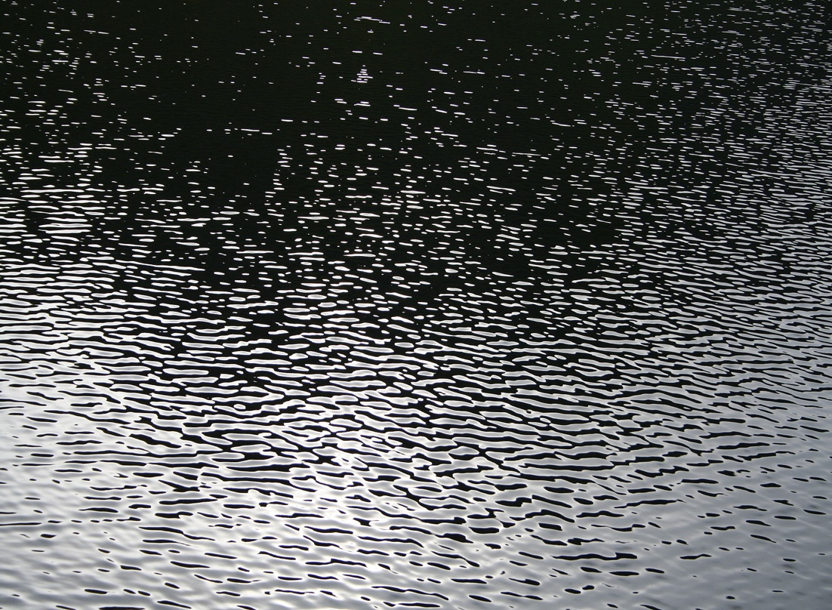
Wind speed and direction are measured with active scatterometer sensors
no wind
Scatterometers send a microwave pulse to the sea surface
The strength of the signal backscattered to the sensor is measured
Higher wind speed increases backscatter by increasing ripples (capillary waves)
stronger wind
Notes:
To get both wind speed and wind direction we need to make measurements with scatterometers, which are active sensors.
Wind speed and direction are measured with Scatterometers, which are active sensors.
Scatterometers send pulses of microwave radiation to the sea surface.
If the water is flat, the pulse is reflected like a mirror, which is called specular reflection, and most of the reflected signal doesn't return to the sensor
With more wind, ripples on the sea surface increase. The ripples increase the amount of the pulse that is backscattered as a signal to the sensor.
You may have experienced something similar with visible light at a placid lake. When the wind is still, the light hitting the lake is reflected like a mirror to your eye, and you can clearly see the landscape in the foreground. As the wind increases, ripples on the lake surface scatter light in many directions away from your eye, making the reflected landscape in the foreground harder to see.

Slide 17
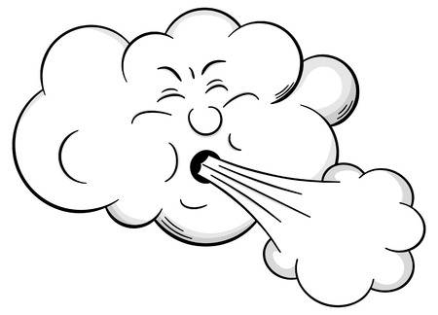

Signal backscatter is also dependent on wind direction
for a single wind speed, backscatter is sensitive to the pulse direction relative to the wind direction
minimal with the pulse pointed crosswind
maximal with the pulse pointed upwind
reduced with the pulse pointed
downwind
Notes:
In addition, for any single wind speed, the amount of the signal that is returned to the sensor via scattering is sensitive to the wind direction relative to the direction of the pulse sent by the instrument.
The maximum return occurs when the pulse is in the upwind direction
The return is reduced when the pulse is in the downwind direction, and
Minimal returns occur when the pulse is at 90 degrees to wind direction or at crosswinds

Slide 18
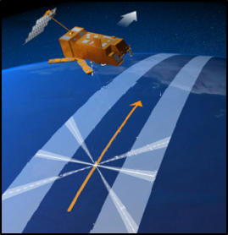
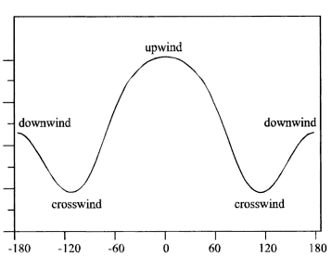
Scatterometers measure backscatter at several pulse directions
solve for the wind speed and direction that best fits all of the measurements
backscatter values at 15º pulse direction
Wind +15º
upwind
45º
downwind
downwind
Backscatter power (relative)
satellite track
90º
135º
crosswind
crosswind
-180
-120
-60
0
60
120
180
Pulse direction (º from upwind direction)
Notes:
To obtain both wind speed and direction, scatterometers are built to put out pulses in many directions. The instruments measure the scattered signal from each pulse direction.
On the figure on the right, the line represents the function of relative backscatter at different angles to the wind. The blue circles are the measured backscatter from the scatterometer pulses. These multiple measurements are used to calculate the wind speed and direction that best fits the function.

Slide 19
Wind measurements date back to the late-1980s
SSMI F08
SSMI F10
SSMI F11
SSMI F13
Passive sensors (wind speed only)
Time span: 1987 - Present
Global coverage: ca. 6 hours - 3 days
Spatial resolution: 1/8º – 1º (12–100km)
SSMI F14
TMI
SSMI F15
AMSRE
WINDSAT
SSMI F16
SSMI F17
SSMI F18
SMOS
Active sensors (wind speed & direction)
Time span: 1999 - Present
Global coverage: ca. 1 - 3 days
Spatial resolution: 0.25º – 1º (25-100 km)
AMSER2
GMI
SMAP
QuickScat
ASCAT METOP-A
ASCAT METOP-B
ASCAT METOP-C
1990
2000
2010
2020
Notes:
Passive measurements of wind speed with radiometers date back to 1987. At present, there are multiple sensors that are orbiting the Earth. With so many instruments flying at the same time, complete global coverage can be obtained as quickly as every 6 hours.
Active measurements of wind speed began in 1999, with QuickScat, and continue with ASCAT sensors on METOP satellites. Depending on the mission, these instruments can give complete global coverage in 1 to 3 days.

Slide 20
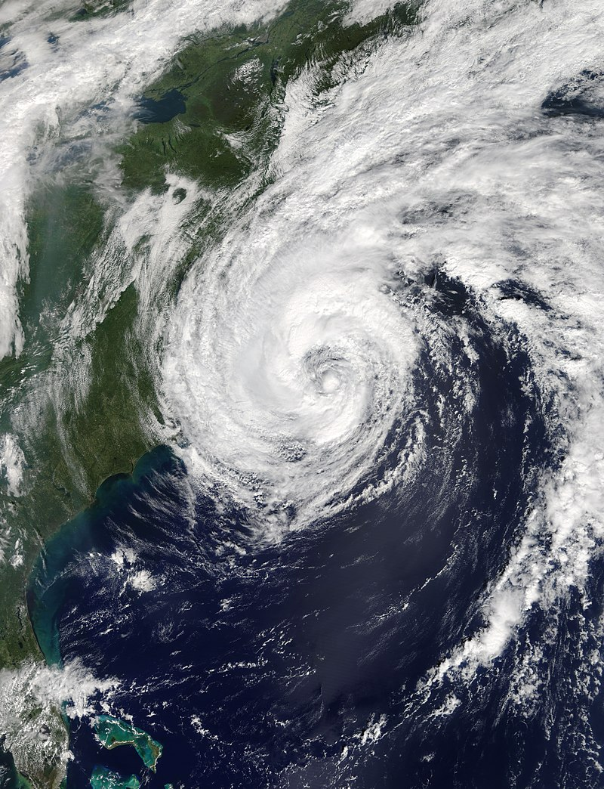
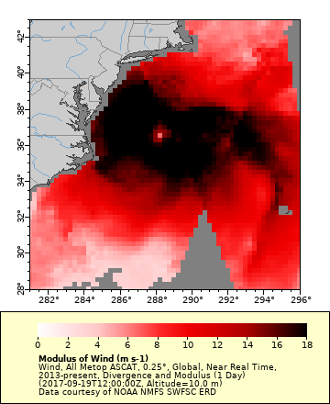
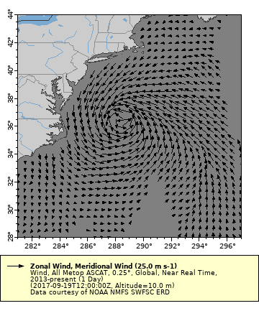
Ocean features can be tracked with wind data
Hurricane Jose September 5, 2017
Wind Speed (black is high winds)
Wind Vectors (direction and speed)
MODIS true color image
You can make these maps. Follow the instructions in Chapter 6 of the ERDDAP tutorial.
https://coastwatch.pfeg.noaa.gov/projects/erddap/vectors.html
Notes:
Here is an example of tracking events with wind data
On the left is a true-color image of Hurricane Jose from 2017
On the right are maps from ASCAT wind data
The reddish map shows just wind speed, with black as the fastest speeds. Strong winds are visible toward the center, with the eye of the storm in the middle
On the right, wind direction and speed are shown with vector arrows. You can see the counterclockwise movement of the storm.

Slide 21
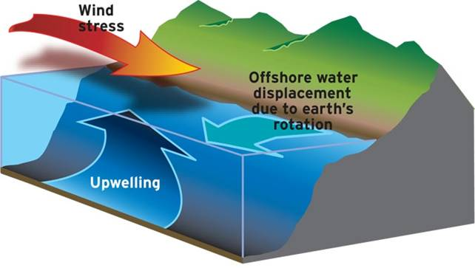
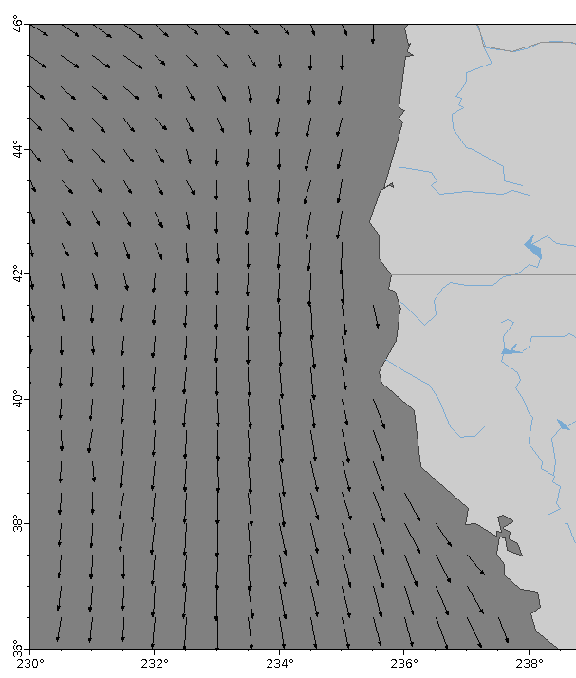
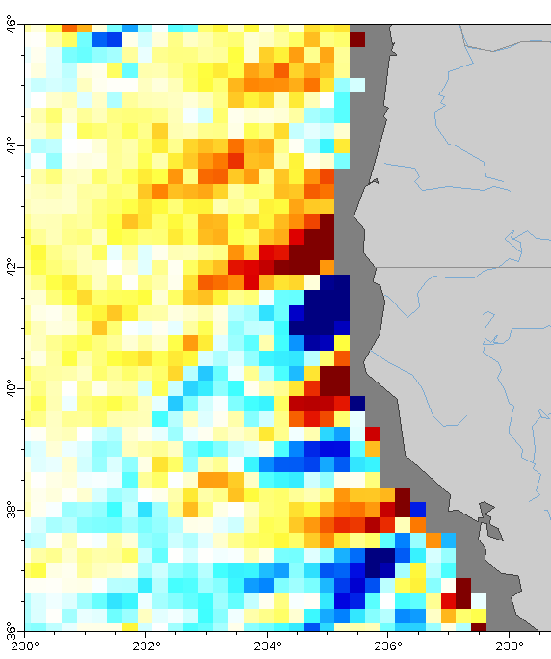
Coastal upwelling can be derived from wind speed and direction
Coastal Upwelling
Wind Vectors (direction and speed)
Ekman Upwelling (red is up)
Notes:
Once you know wind speed and direction you can calculate other derived products. One of those products is Ekman upwelling.
As illustrated on the left, when winds blow parallel to the coast on the western sides of continents, the forces from the wind and those due to the earth's rotation push surface water offshore. The displaced water is replaced with cold, nutrient rich water from depth, which helps to drive increased productivity.
On the right, the satellite wind vector product shows wind blowing parallel to the shore along Oregon and California. The map of the Ekman Upwelling satellite product shows regions of upwelling in yellow and red. You can see a strong upwelling signal along the coast, quite often just south of a cape.

Slide 22
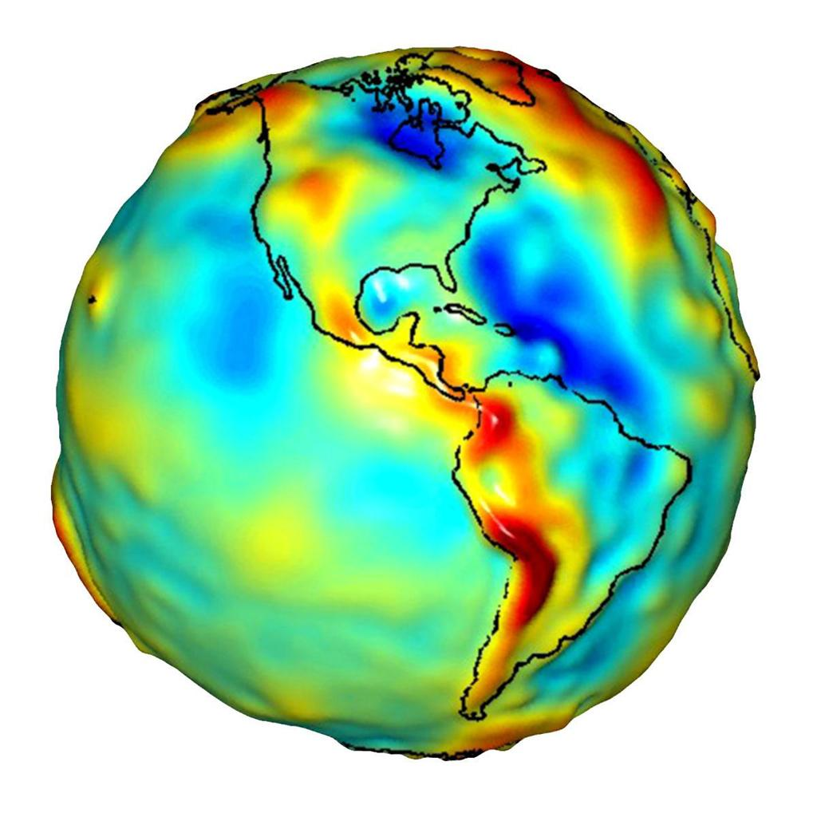
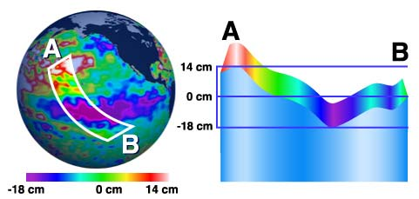
Sea surface height (SSH): the ocean surface is not flat
the ocean’s bumpiness (SSH) is measured with altimetry (active sensors)
Bumpy Earth
Notes:
The ocean is not flat, it's bumpy. These differences are measured as sea surface height. The globe on the left shows areas of low SSH in blue, high in red, and exaggerated relief shows the bumpiness.
The figure on the right shows a transect of sea surface height across the Central Pacific where the height difference is 32 cm. World-wide the difference in sea surface height can be up to 200 meters. Most of this difference is constant, though, and is due to the Earth's gravity and ocean circulation. For most oceanographic purposes we are interested in the anomalies which illustrate phenomena such as El Nino events.

Slide 23
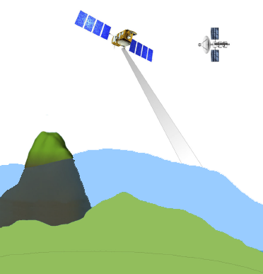
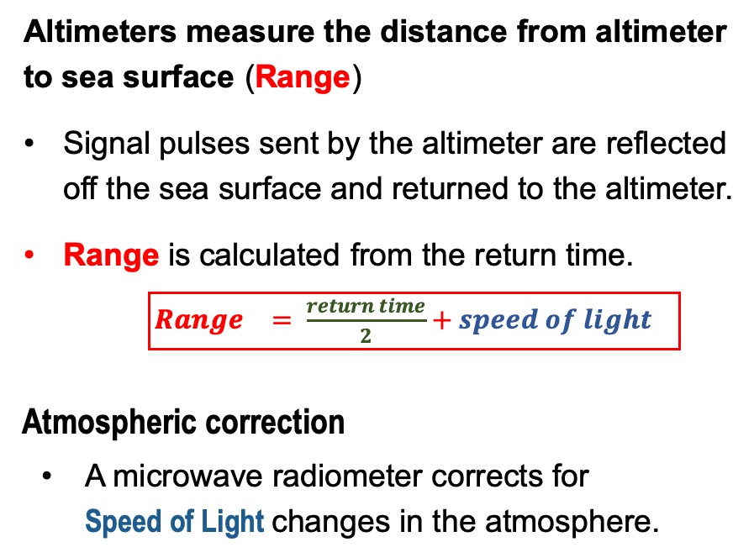

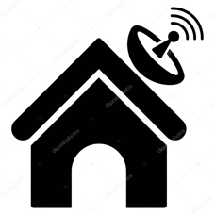
Sea surface height measurements are made with satellite altimeters
reflection
Range
pulse
Microwave radiometer
Sea Surface
Ocean Floor
Reference Ellipsoid
Notes:
Sea surface height is measured with altimeters, which are active microwave sensors.
Altimetry works much like police radar
The sensor sends a pulse that bounces off the surface and returns to the sensor
The time the pulse takes to return to the altimeter and the speed of light are used to calculate range, which is the distance from the altimeter to the sea surface.
Because of atmospheric conditions, the speed of light varies through the atmosphere. A microwave radiometer aboard the satellite is used to correct for changes in the speed of light.

Slide 24
The altimeter position is determined in four dimensions
GPS Satellite
GPS satellites and ground stations determine the altimeter’s position
Altitude above the reference
Latitude, longitude, time
Ground
Station
Satellite Altitude
Sea Surface
Ocean Floor
Reference Ellipsoid
Notes:
The exact position of the altimeter is measured in 4 dimensions, by GPS satellites and ground stations.
Altitude is measured relative to a known reference, the reference ellipsoid.
Latitude, longitude, and time are also recorded.

Slide 25
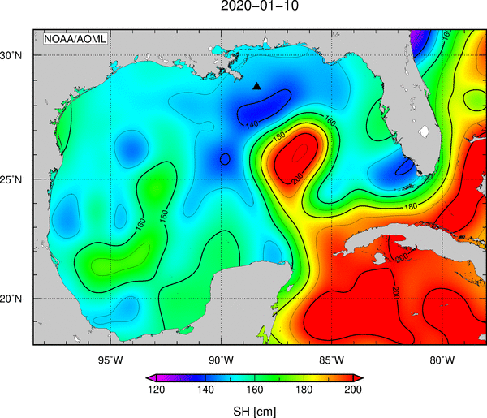
Put it all together to determine SSH and other parameters
GPS Satellite
Sea Surface Height = Satellite Altitude – Range
Ground
Station
Range
Gulf of Mexico Sea Surface Height
Satellite Altitude
Sea Surface
Ocean Floor
Reference Ellipsoid
Notes:
Putting it all together we get:
Range from altimeter
Satellite altitude from GPS and ground stations
Subtract range from the altitude to get sea surface height
And locate the sea surface height measurement in space and time
The map on the right shows sea surface height for the Gulf of Mexico. Blue are lower values and red are higher values.

Slide 26


Sea Level Anomaly (SLA) is a derived product of SSH
derived from subtracting the long-term mean sea level from measured SSH
Long-term sea level mean
currently the 1993-2012 mean
Positive
Sea Level Anomaly
Sea
Mean
Level
Sea Surface
Height
Sea Surface
Height
Negative
Sea Level Anomaly
Notes:
Several useful products can be derived from sea surface height.
One example is sea level anomaly, which is a measure of how different a sea surface height value is from a typical value.
To determine, sea level anomaly, a long-term mean of SSH measurement is created to get a climatology of typical sea surface height values
At present that climatology is from 1993-2012 (19 years)
The climatological values of sea surface height are then subtracted from the measured values
When SSH is greater than normal, the anomaly is positive
When SSH is less than normal, the anomaly is negative

Slide 27
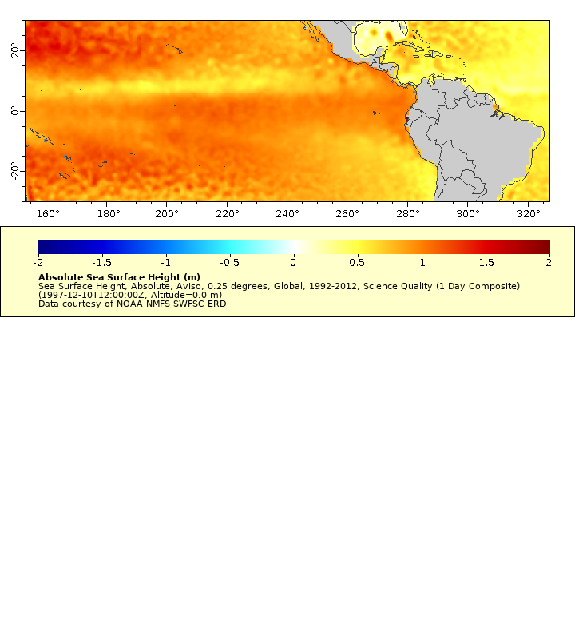
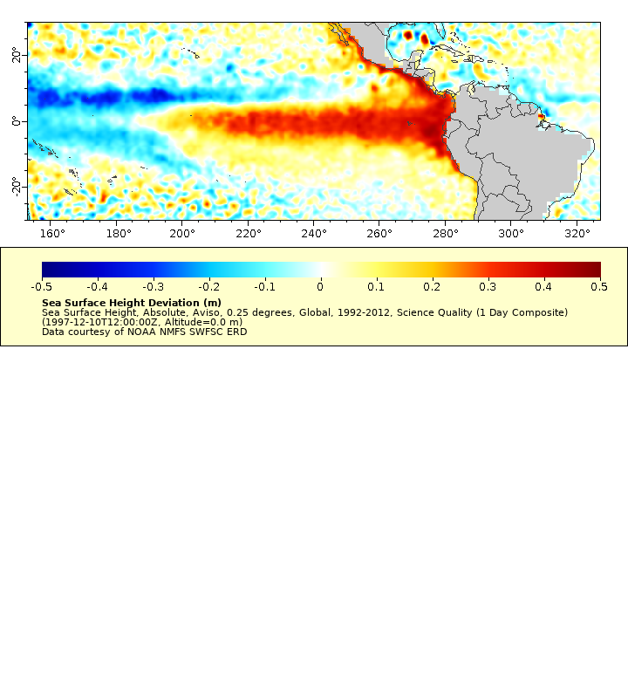
SLA helps detect ocean phenomena from subtle changes in SSH
1997-1998 El Niño visualized with the SSH anomaly
SSH
During an El Niño, a shift in wind causes warm water to accumulate off the coast of Peru.
The warming water expands, increasing SSH beyond what is typically observed.
The SSH anomaly helps to visualize the non-typical SSH values.
0 m
1 m
2 m
Sea Level Anomaly
-0.5 m
0 m
0.5 m
Notes:
SLA helps detect ocean phenomena from subtle changes in SSH.
An event like El Nino can cause changes in SSH that measure in the tens of centimeters. Total SSH has a range of plus or minus 100 meters, so the El Nino signal may be hard to detect from SSH measurement.
The map at the top shows the SSH during the 1997-1998 El Niño. It would take a trained eye to detect the El Niño signature from SSH.
The map at the bottom shows the SLA. The unusually high SSH signature near the Peruvian coast can be easily detected in the SLA map.

Slide 28
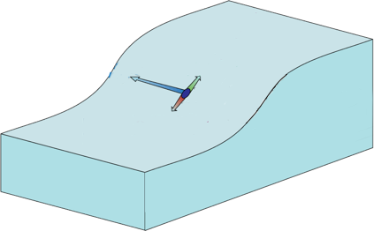
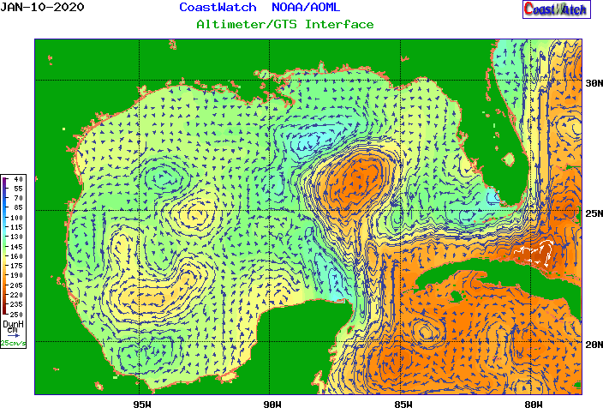
Geostrophic currents are derived from SSH information
Geostrophic currents are currents driven by a sea level gradient
Geostrophic Currents Mechanism
Geostrophic Currents in the Gulf of Mexico
Coriolis force
current flow
higher sea level
sea level gradient
lower
sea level
Jan 10, 2020
https://www.aoml.noaa.gov/phod/dhos/altimetry.php
Notes:
Geostrophic currents are important products that are derived from SSH information. These are currents that are driven by a gradient of high to low sea level.
Geostrophic currents can be used to identify features like large scale circulation and larger eddies.
On the left is a map of geostrophic currents generated by the CoastWatch Gulf of Mexico Node, which shows eddies formed in the Gulf of Mexico.

Slide 29
Satellite altimetry dates back to the early 1990s
ERS-1
Jason-3/Sentinel-6
TOPEZ-Poseidon
Sentinel-3
ERS-2
Many missions, always with some overlap
Blending the sensor data together allows:
Creating long timeseries
Getting better spatial coverage at any one time
GeoSat
Jason-3
Jason-1
SWOT
EnviSat
Jason-2
CryoSat
HY-2A
AltiKa
1990
2000
2010
2020
Notes:
Operational altimetry missions date back to the early 1990’s
The missions have overlapped over that time period, which has a couple of benefits.
First, the mission data can be blended together to create a long time series.
Second, blending data from the large number of sensors flying at the same time gives better spatial coverage than a single sensor.

Slide 30
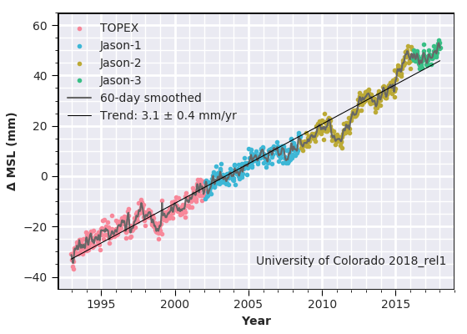
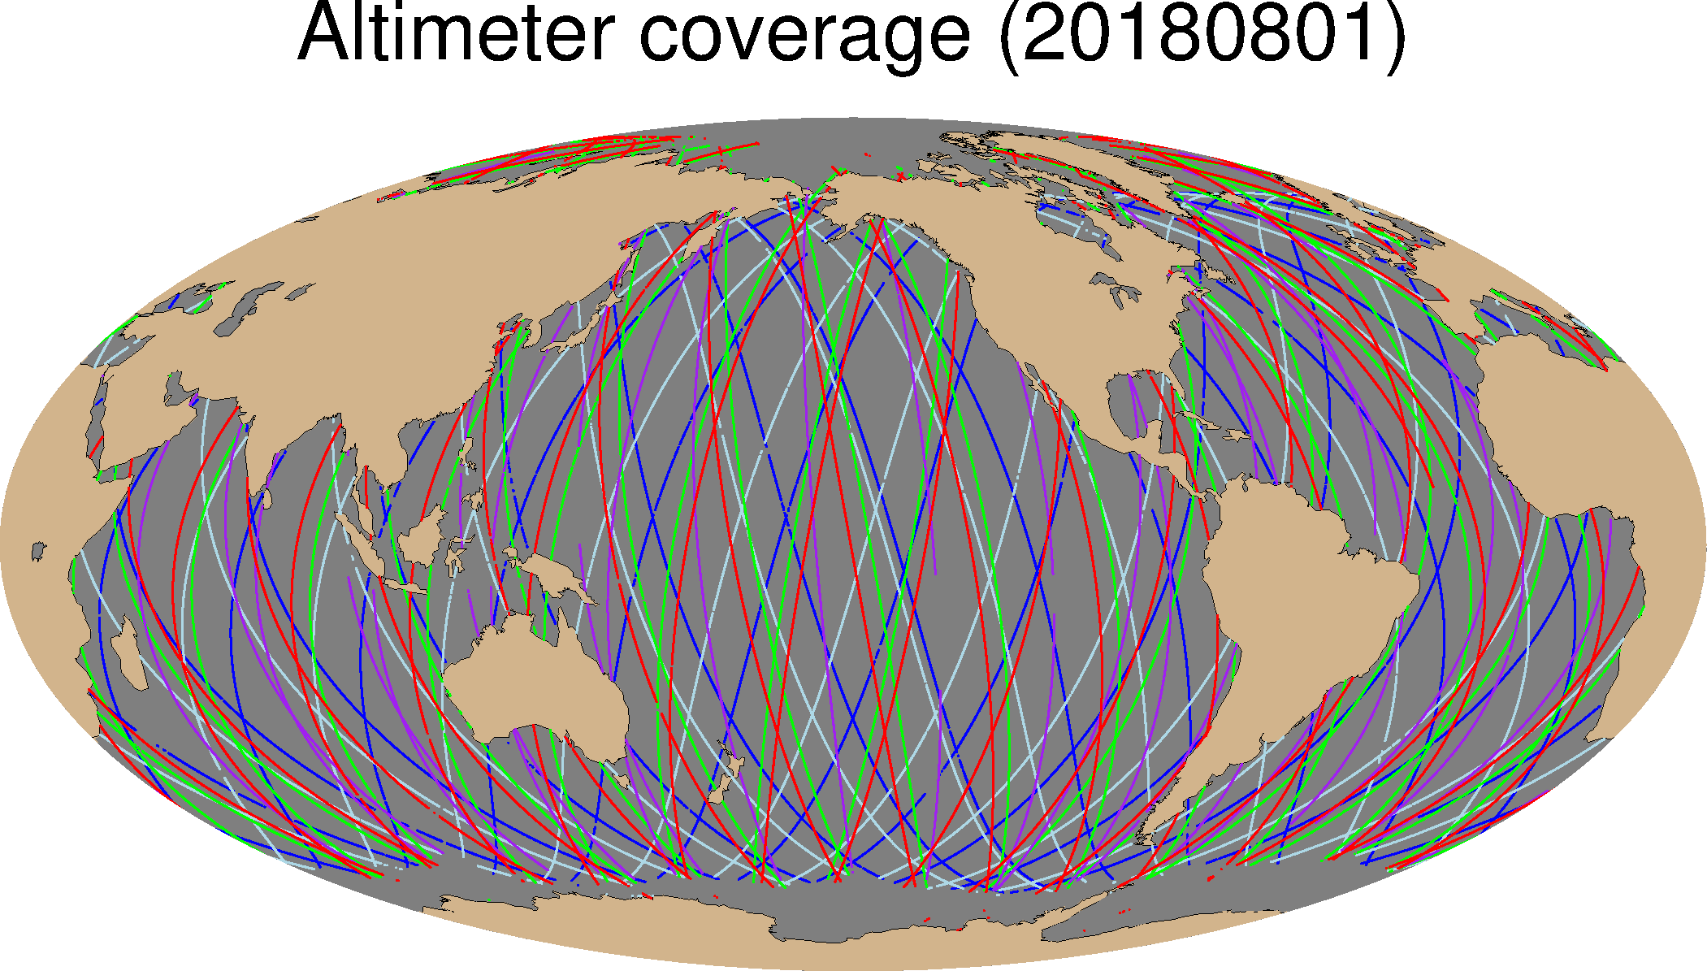
Blended products give improved temporal and spatial coverage
Four sensor products extend the mean sea level timeseries back to 1993
Satellites
TOPEX Jason-2 Jason-1 Jason-3
Mean Sea Level (mm)
1995
2000
2005
2010
2015
Combining data from five sensors
improves daily spatial coverage
Satellites
Jason-2 AltiKa Jason-3
Cryosat-2 Sentinel-3A
8/1/2018
Notes:
The image on the left tracks the rise in mean sea level, from 1993 -2018. The data for this 25-year time series are a compilation of four altimetry sensors.
The image on the right shows the coverage for all altimeters flying on a single day in 2018. By blending these data into a single product, far better spatial coverage is achieved than with any single sensor.

Slide 31
Review of SSS, Surface Winds, and SSH
Characteristics of microwave measurements
Measured with passive and active microwave sensors
Measurements are taken day and night, and in nearly all-weather conditions
Spatial resolution (~ 25km) is lower that visible and infrared.
Passive sensors cannot measure close to the coast
Salinity
2010 - present
Global coverage in 1-3 days
Accuracy ~0.2 PSS
Winds
1987 - present
Global coverage 6-hours
Accuracy ~ 0.1 m/s
SSH
1990 - present
Daily global coverage
Accuracy ~ 3 cm
Notes:
To summarize, all of the parameters I discussed, salinity, winds and sea-surface height, are all measurements made in the microwave port of the EMR spectrum. Because they are microwave measurements they can be made day or night and in nearly all-weather conditions. However the spatial resolution is lower than for measurements made in the visible and the IR, and passive measurements can not be made close to land.

Slide 32
NOAA CoastWatch Satellite Course - Narrated Presentations
Satellite 101 – Part 1
Satellite 101 – Part 2
Fundamentals of Ocean Color
Fundamentals of Sea-Surface Temperature
Fundamentals of Altimetry, Wind and Salinity
Introduction to ERDDAP
What Dataset to Choose?
Bringing Satellite Data into ARCGIS
Notes:
This concludes this presentation on sea surface salinity, surface winds, and sea surface height. This is one of several presentations put together as part of the CoastWatch Ocean Satellite Course. We have additional presentations that cover how measurements are made for ocean color and sea-surface temperature.

