Slide 1
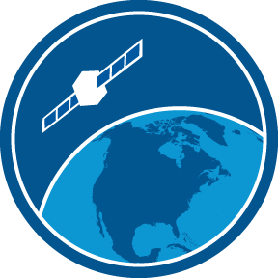
Introduction to CoastWatch and the CoastWatch Satellite Training Cara Wilson, Dale Robinson, Michael Soracco,
Andrea Vander Woude, Sunny Hospital and Daisy Shi CoastWatch Course - Micronesia 2024
Training Coordinator:
Melanie Abecassis NOAA CoastWatch
UMD CISESS
coastwatch.info@noaa.gov

Slide 2
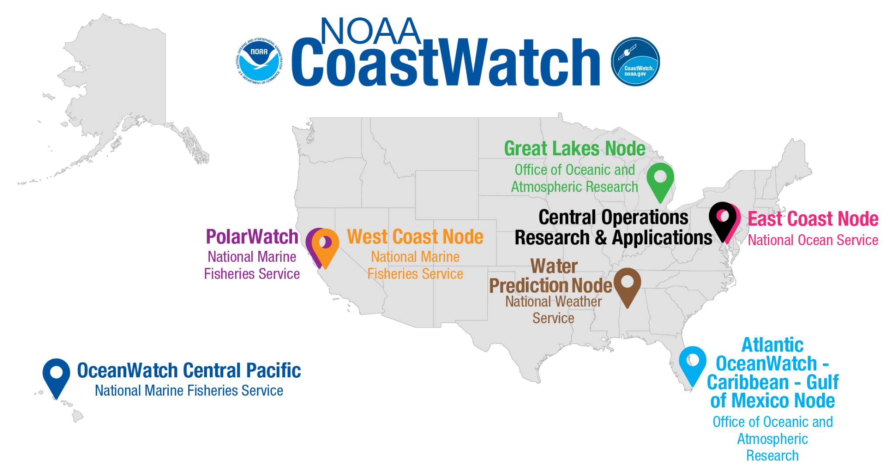
NOAA CoastWatch is a national program funded by NOAA/NESDIS¹
Mission: Provide access to and promote the use of satellite data products
for oceanic, freshwater, & polar applications
¹National Environmental Satellite, Data, and Information Service

Slide 3
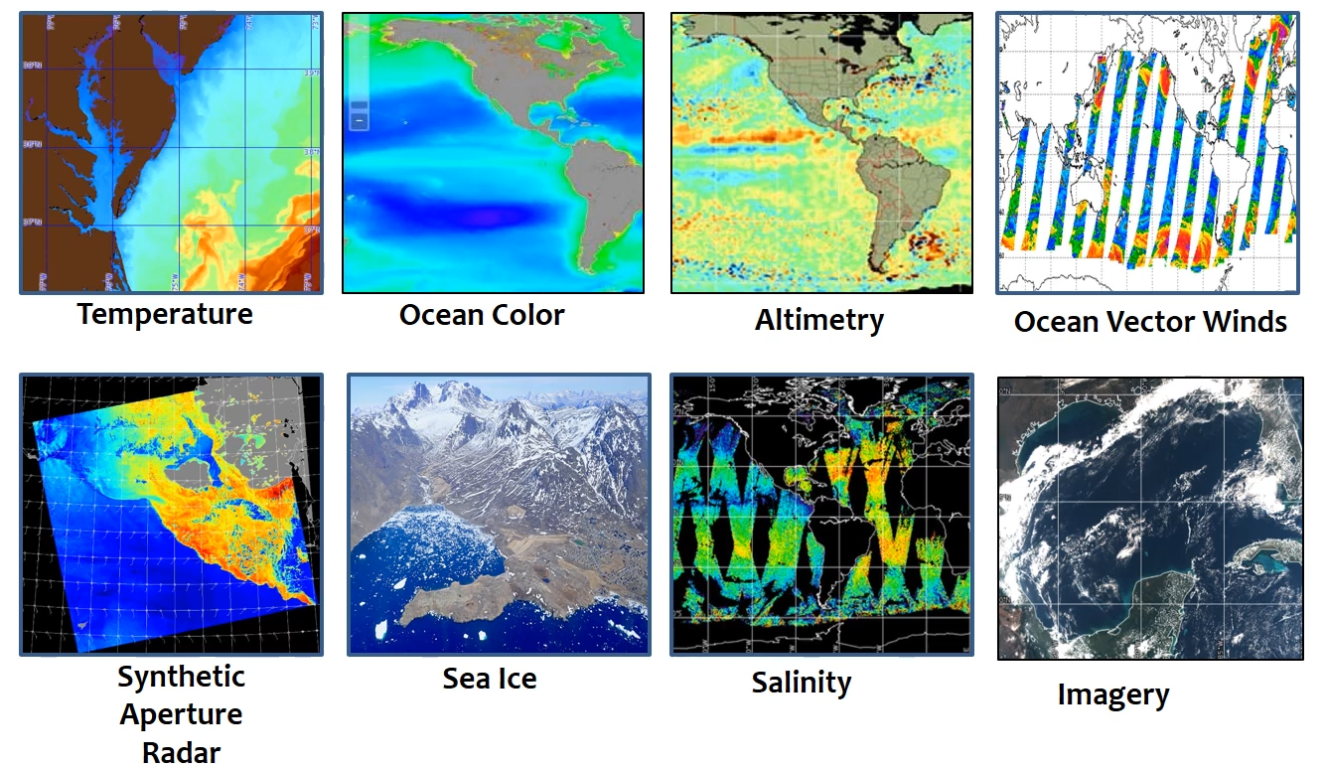
CoastWatch distributes ocean satellite data

Slide 4
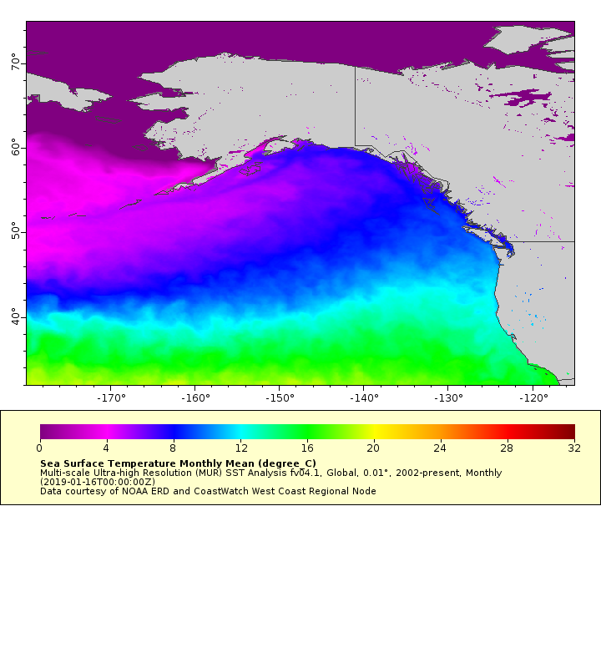
West Coast Node (WCN) – NOAA Fisheries
Service area - US West Coast from California to Alaska
Personnel at NMFS/SWFSC
Dale Robinson – Coordinator
Cara Wilson – Manager
User Community
Users from Alaska to California
Extensive data holdings
Eastern Pacific and global coverage
One stop shopping with easy data access
1000's of datasets from NOAA, NASA and other sources
https://coastwatch.pfeg.noaa.gov

Slide 5
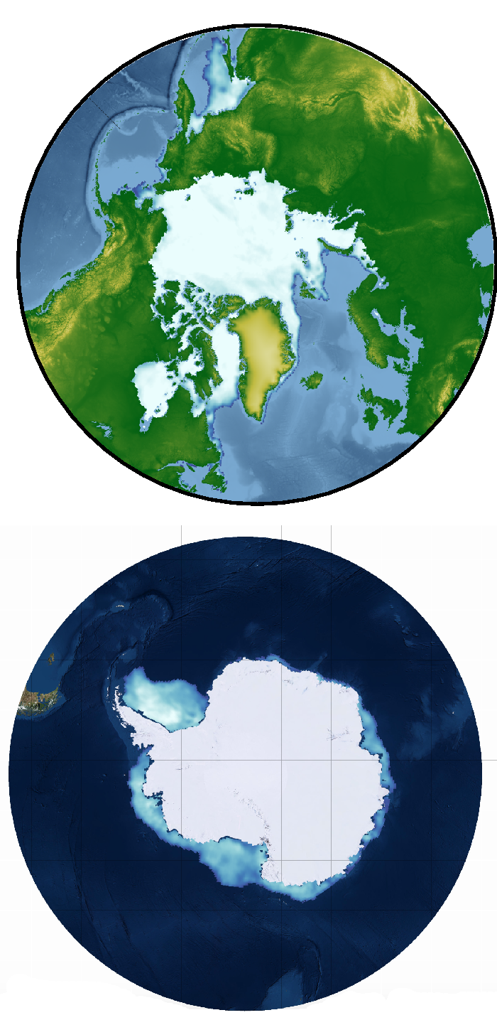
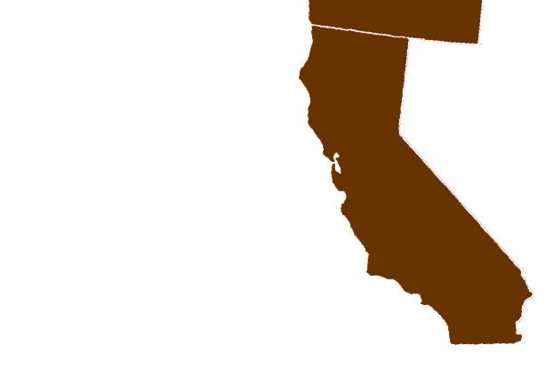
PolarWatch (PW) – NOAA Fisheries
Personnel
Cara Wilson – Manager
Dale Robinson – Deputy Manager
Sunny Bak Hospital – Coordinator
Node Highlights
Providing easier access to polar satellite data
Previewing data online with polar maps
Serving sea ice datasets
Serving polar projected datasets
Collaborators
National Ice Center
National Snow and Ice Data Center
STAR Science Teams (Sea Ice, SAR, LSA)
Location
Housed at SWFSC, CA
Focused on high latitude regions
https://polarwatch.noaa.gov/

Slide 6
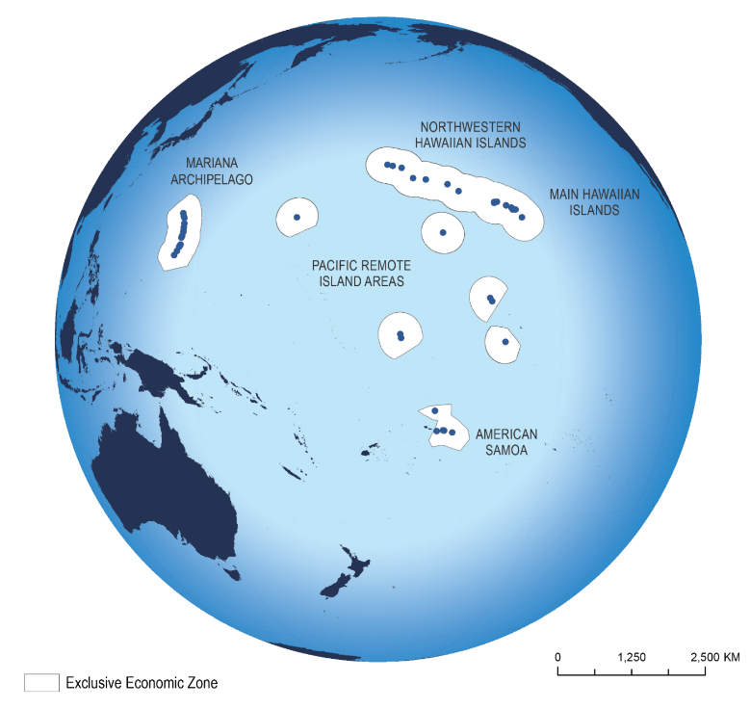
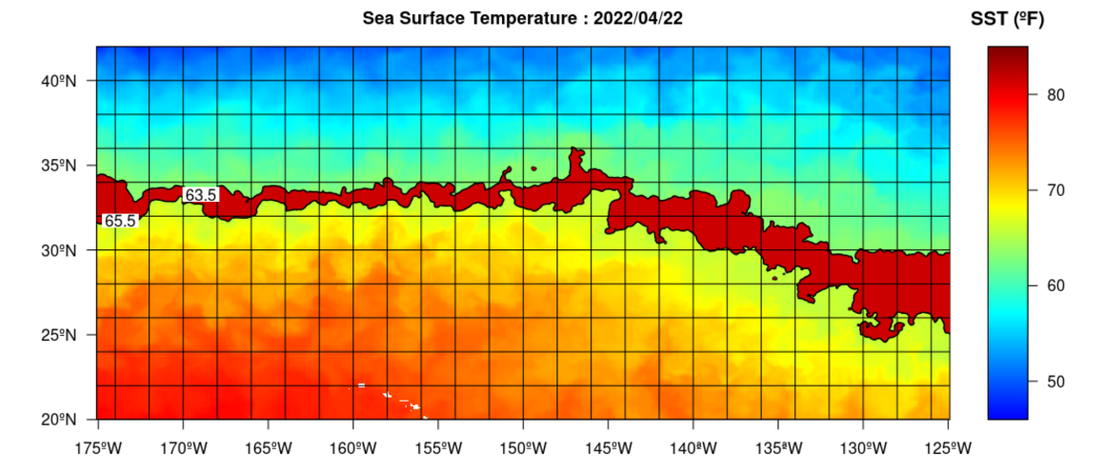
OceanWatch Central Pacific (OWCP) – NOAA Fisheries
Personnel
Ryan Rykaczewski – Manager
Daisy Shi – Operations Manager
Location
Housed at PIFSC, HI
Focused on the Pacific Islands Region
Node Highlights
Focused on user needs in the tropics and the subtropical gyre from island-scale to basin-scale. Providing easier access to satellite data across the dateline.
TurtleWatch
Oceanic and Climate indicators
Capacity Building
https://oceanwatch.pifsc.noaa.gov/

Slide 7

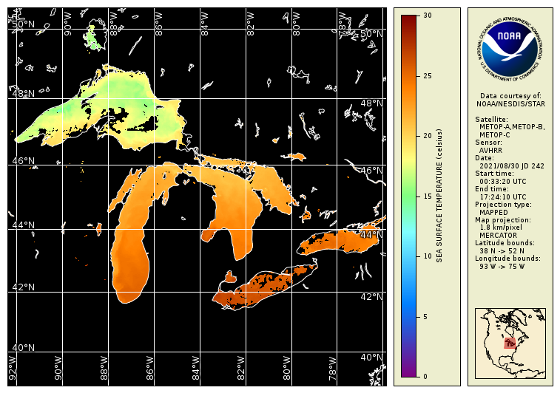
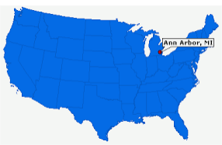
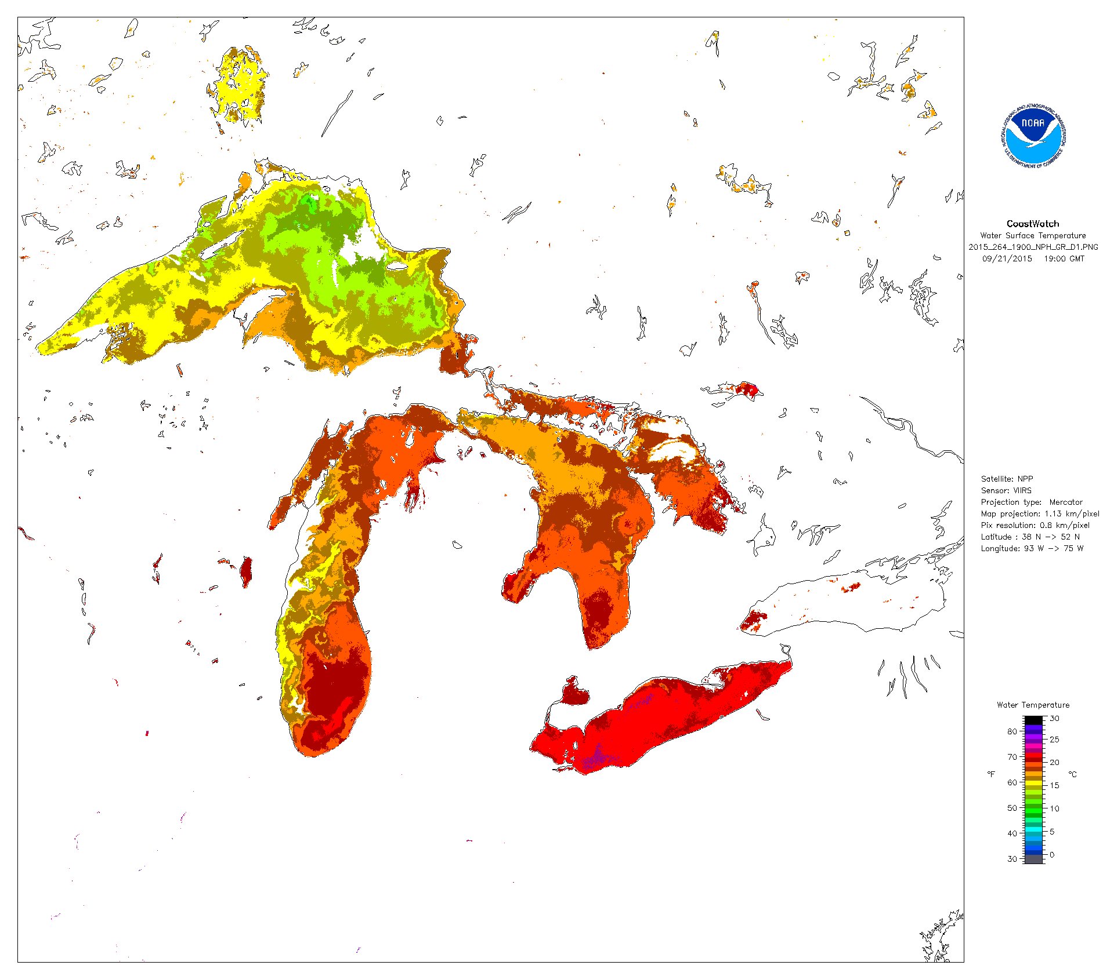
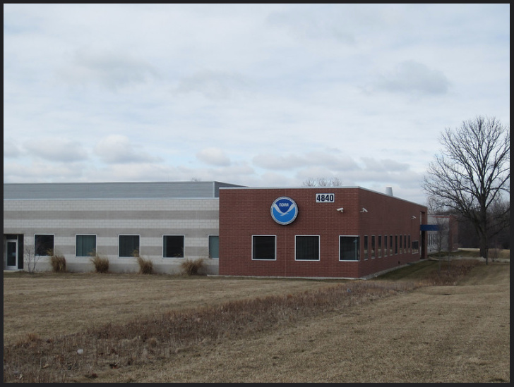
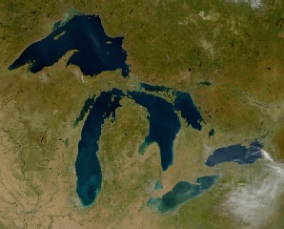
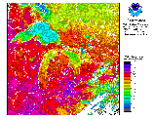
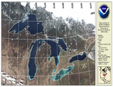
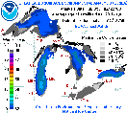
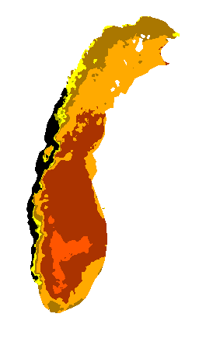

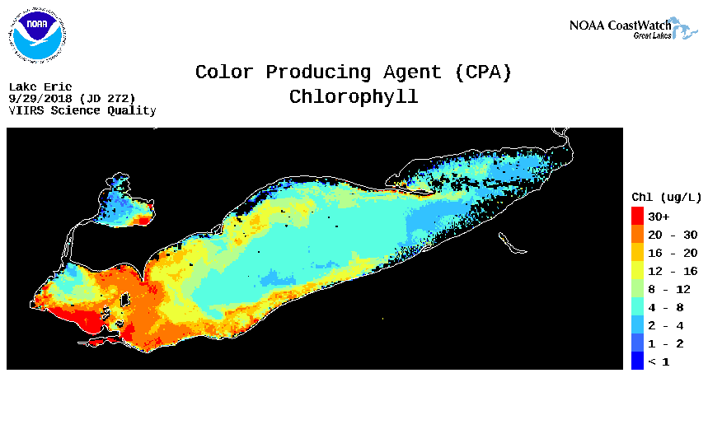
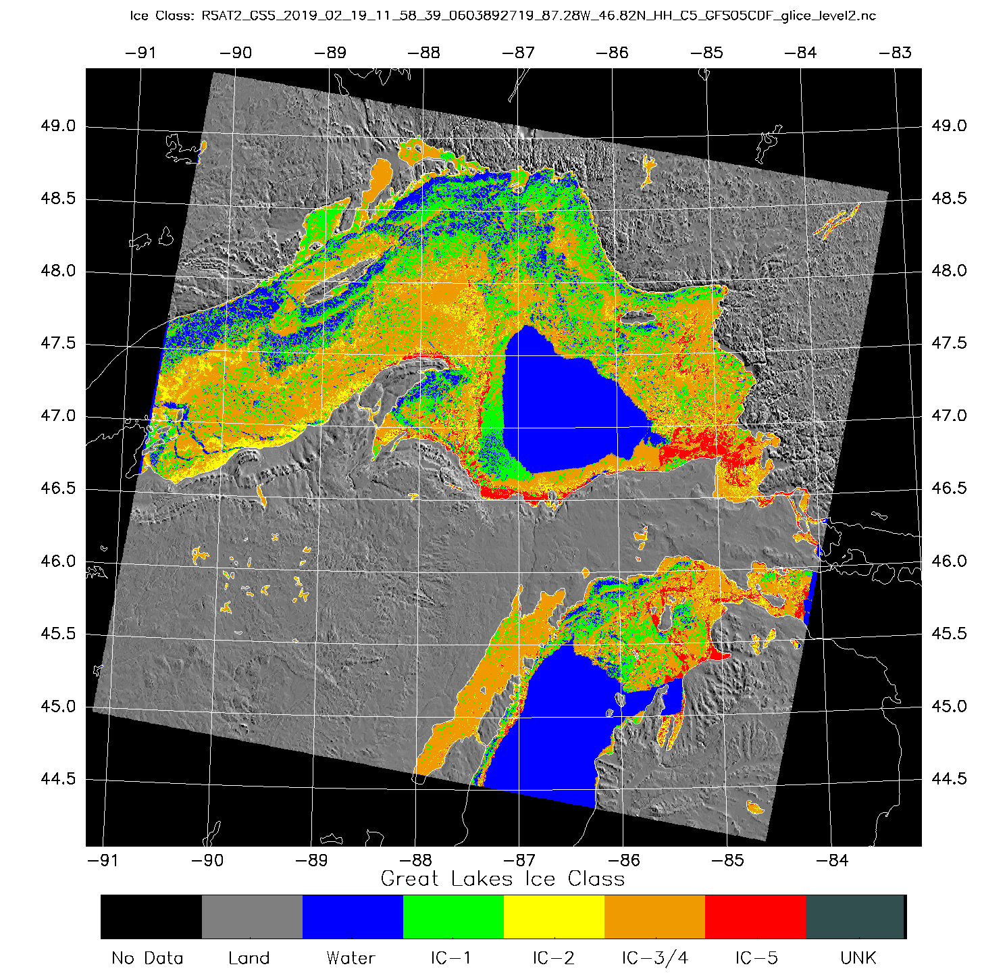
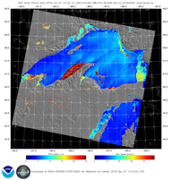
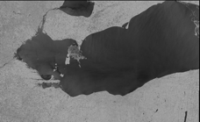
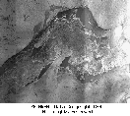
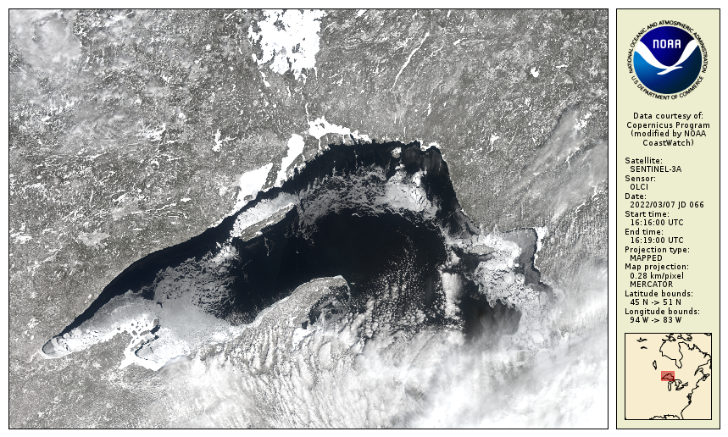
Great Lakes Node – NOAA Research (OAR)
Node Highlights
Established in 1990
Housed at NOAA Great Lakes Environmental Research Laboratory (GLERL),Ann Arbor, MI
The service area is the Great Lakes region
User Community
GLERL, NCEP, NWS, US Coast Guard, Local Government agencies, Universities, and Public Users
Satellite Data Products
Hundreds of datasets including water surface temperature, color producing agents, ice concentration and ice type classification
Personnel
Andrea Vander Woude – Manager
Songzhi Liu – Operations Manager
GOES SST
ACSPO SST
VIIRS SST
MODIS True Color
AVHRR SST
https://coastwatch.glerl.noaa.gov/
VIIRS True Color
GLSEA
CPA
Upwellings
ICECON
Winds
SENTINEL 1A/B
RADARSAT
GOES Visible
OLCI True Color

Slide 8
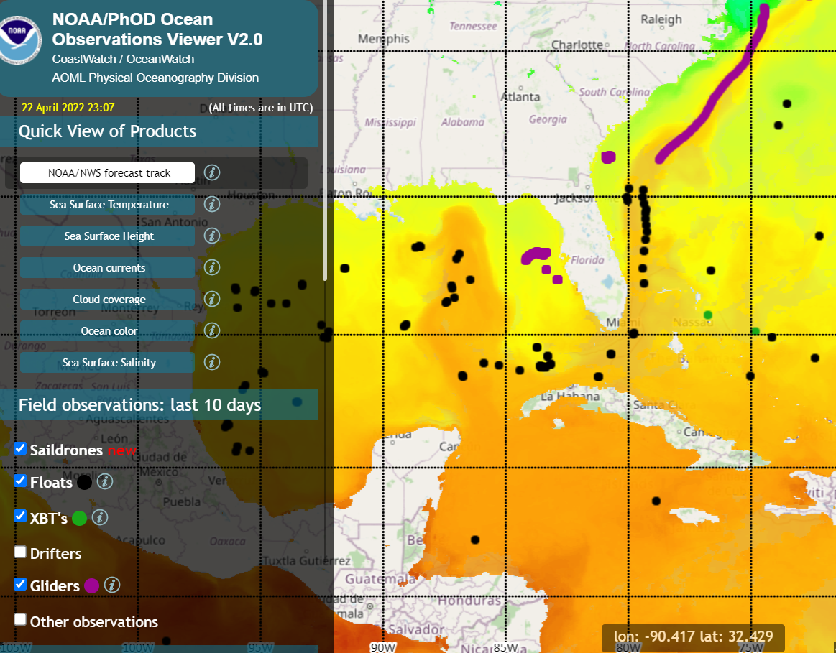
Gulf of Mexico Node – NOAA Research (OAR)
Personnel
Joaquín Trinanes – Ops Manager
Gustavo Goñi – Manager
User Community
Gulf of Mexico & Caribbean
Focus
Hurricanes, Sargassum, Vibrio, Seascapes
https://cwcaribbean.aoml.noaa.gov/

Slide 9
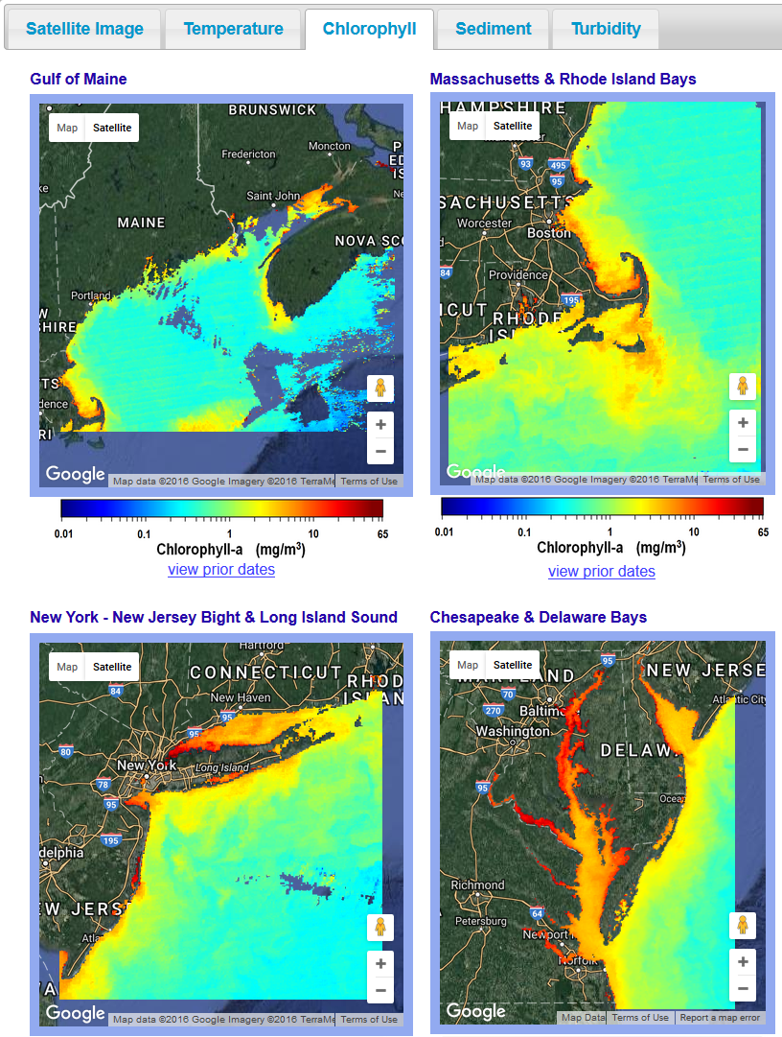
East Coast Node (ECN) – NOAA Ocean Service (NOS)
Service area - US East Coast from Maine to Florida
Personnel at National Ocean Service, NOAA Chesapeake Bay Office, and Center for Satellite Applications & Research
Shelly Tomlinson – Manager
Ron Vogel – Coordinator
User Community
Environmental decision-makers, researchers, commercial data providers & the general public from Maine to Florida
Providing Support
Making data usable for water quality, fisheries, aquaculture, algal bloom tracking, climate change, and more
Building tailored applications by engaging directly with stakeholders
Data holdings in temperature, water clarity, chlorophyll
https://eastcoast.coastwatch.noaa.gov

Slide 10
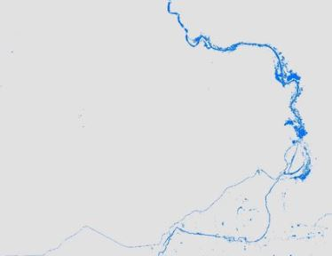
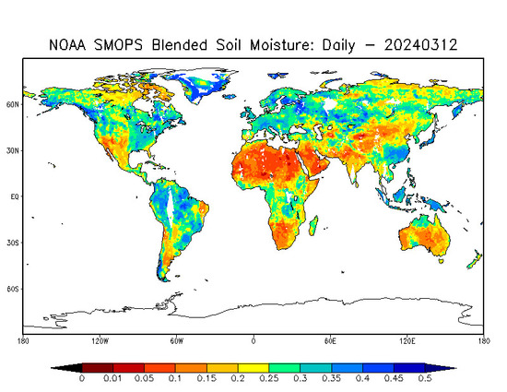
Water Prediction Node – NOAA Office of Water Prediction
Personnel
David Vallee – Manager
Dylan Lee – Operations Manager
User Community
National Water Center, NOAA River Forecast Centers, Researchers at Cooperative Institute for Research to Operations in Hydrology (CIROH)
Focus
Remotely sensed inundated extents, snow cover, soil moisture, vegetation indices, estimates of hydraulic geometry
Node Summary
Founded in 2023 as a thematic node dedicated to remote sensing data related to inland and coastal hydrology
Inundated extents
https://waternode.ciroh.org/
Soil Moisture

Slide 11
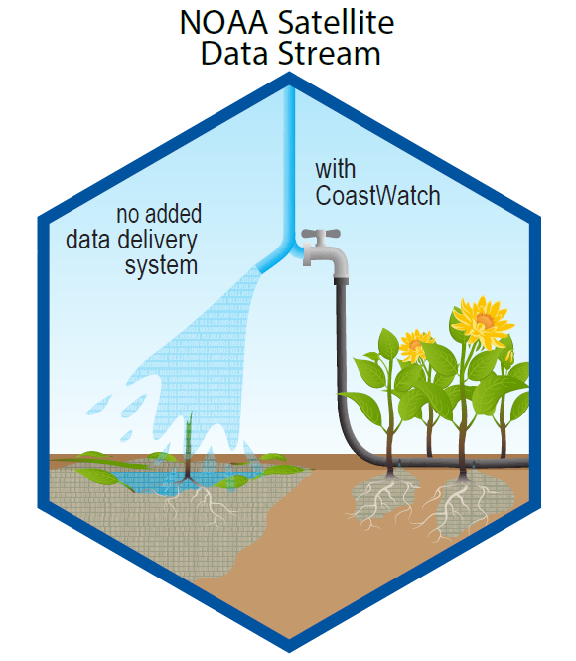
CoastWatch offers several levels of service to help users with satellite data
Provide access to datasets with data servers
Develop tools and tutorials to help users interact with the server and use the data
Provide training and hands-on assistance
Find or create products and tools to address users needs
Work directly with users on projects
Increasing Assistance to User
COASTWATCH IS A VALUE ADDED PROVIDER

Slide 12
NOAA CoastWatch Satellite Course Philosophy
The objective of the course is to show people how to access satellite data and use it in the environment they are used to working in – a somewhat challenging task!
We focus on the software used the most widely by participants – primarily R, ArcGIS, and python, and to a lesser extent Matlab. However it is not necessary to have any experience with any of these software in order to take the course.
Not a “GIS course”, or “R course” or “Python” course but it includes all those elements.
The course focuses on datasets available on CoastWatch ERDDAPs

Slide 13
Course Schedule
Day 1: Satellite 101 (2 pts), tools & strategies, ERDDAP, Panoply
Day 2: Ocean Color, SST, SSH/Winds/Altimery/Salinity, Software modules
Day 3: Water Quality, Sea Ice (optional), Project work
Day 4: HABs, SAR, Submit your slide!
Day 5: Student presentations - 1 slide, 1 minute!

Slide 14
Getting help during the course
Post questions on Slack This is the most efficient easy for us to share information. If one participant has the question, channels are many others so as well and by posting it on slack the answer will be available to everyone
Ask during the daily session at 9 AM ChST
Schedule a one-on-one appointment with any of the instructors. Their schedules are available on the Instructors page. We encourage everyone to schedule a one-on-one appointment so that we have a chance to talk with you about your projects, datasets etc.

Slide 15
Course Project
The course project reflects what you want to get out of the course. Some generic examples include:
making maps of satellite data
making timeseries of satellite data
comparing satellite data to other in-situ datasets

Slide 16
Cloud computing resources (JupyterHub)
We have cloud computing resources equipped with pre-installed QGIS, RStudio and Python, ready for use. https://training.coastwatchhub.org/
As the resource is limited, please coordinate with your instructors regarding availability or contact Sunny (sun.bak-hospital@noaa.gov) for more information
This is our first time using JupyterHub so there might be some issues
Instructions: https://coastwatch-training.github.io/coastwatchhub/

Slide 17
Project Slide
Your project slide should include:
Your name
Where you work
What you are trying to do
A figure you were able to make as a result of this course
What datasets and software you used
Any challenges you faced, or datasets you wished you had (optional)

Slide 18
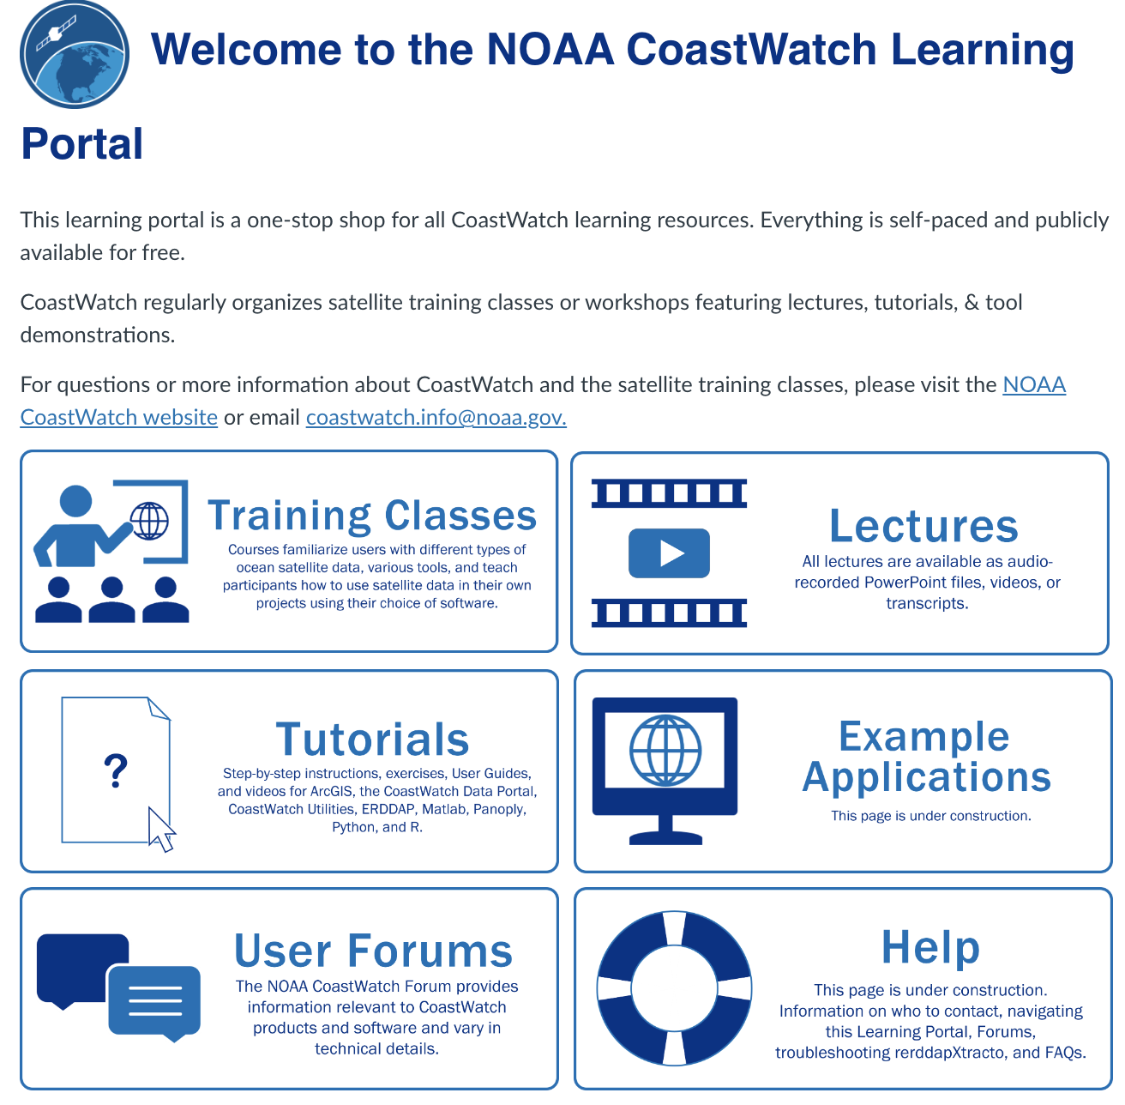
CoastWatch Learning Portal
https://umd.instructure.com/courses/1364405

Slide 19
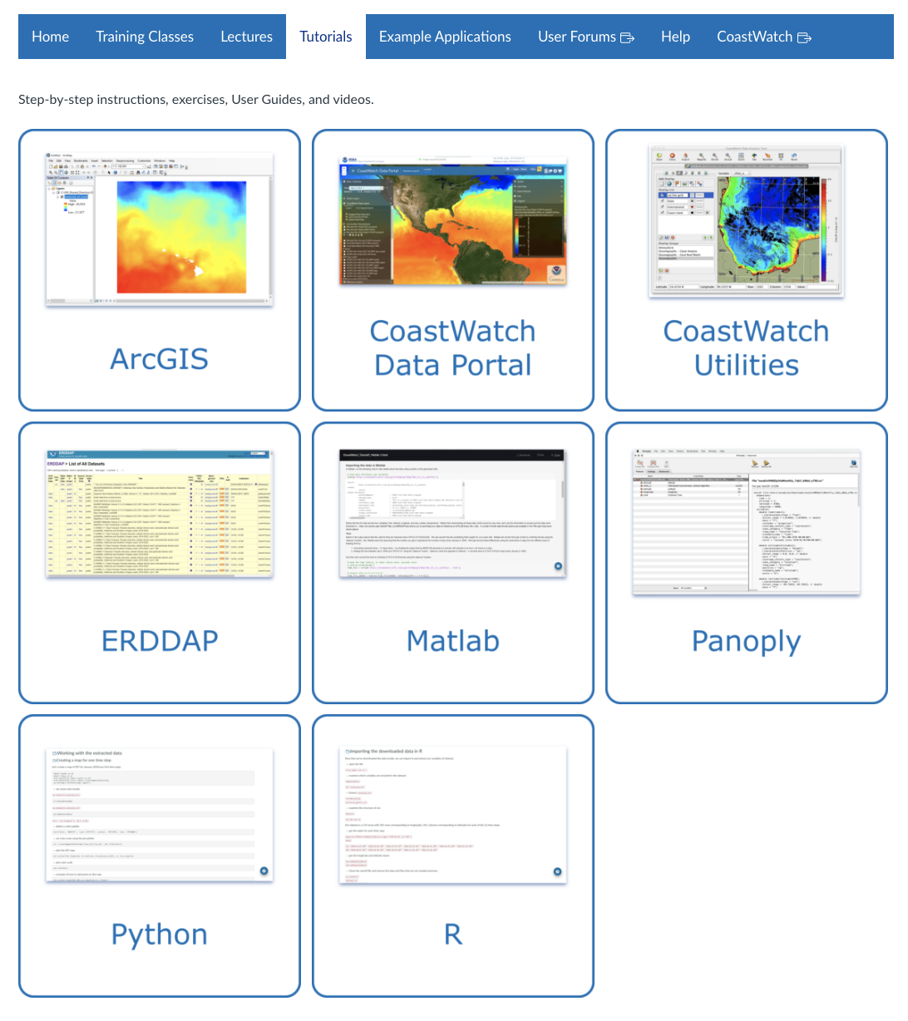
CoastWatch Learning Portal

Slide 20
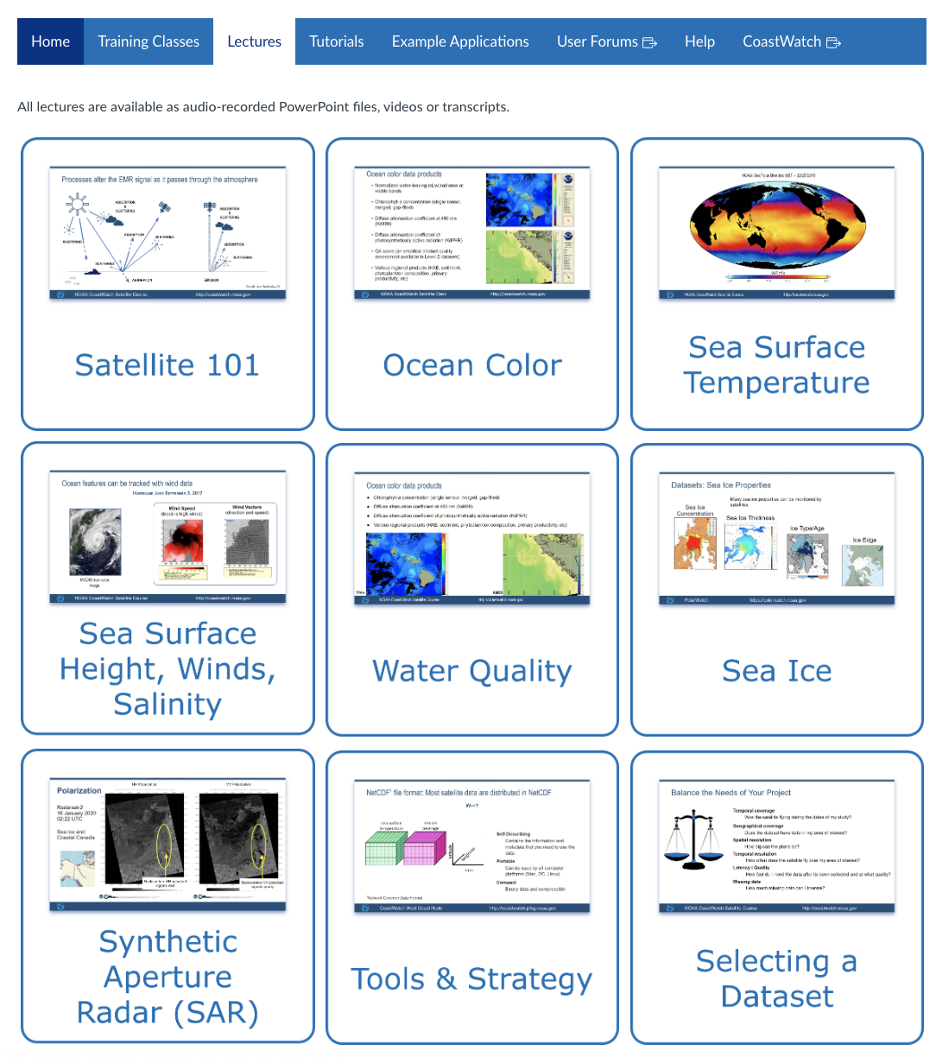
CoastWatch Learning Portal

Slide 21
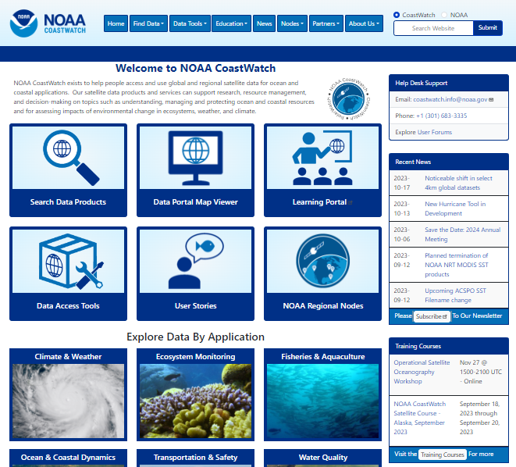
coastwatch.noaa.gov
Questions?
Coastwatch.info@noaa.gov
Subscribe to our newsletter for announcements for satellite classes:
subscribe

