Slide 1
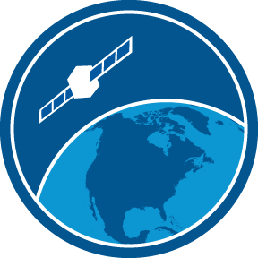
CoastWatch Tutorials on GitHub
NOAA CoastWatch Satellite Course
Last Update: Sept 14, 2023
Notes:
In this presentation we will give an overview of the different software tutorials we have on GitHub and show what they do. We try to have code that does the same thing in either R or python.

Slide 2
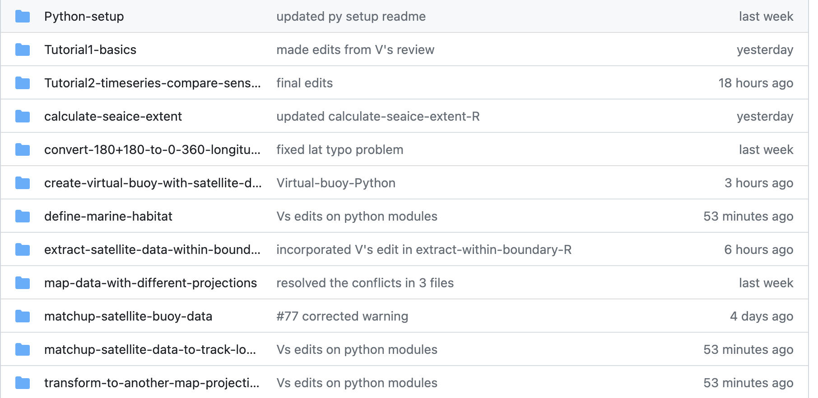
Software Tutorials on GitHub
https://github.com/coastwatch-training/CoastWatch-Tutorials
Each tutorial module is designed to illustrate the process of accessing and manipulating satellite data from the CoastWatch ERDDAP data servers.
Code is usually available for both R and python
R folders contain both .md (for internet viewing) and .rmd (for downloading) files
Notes:
On the CoastWatch GitHub site we have a bunch of folders, each having code to to illustrate the process of accessing and manipulating satellite data from the CoastWatch ERDDAP data servers for commonly performed analyses. Code is available for both R and python. On the left is a screenshot showing the layout of the GitHub page, In this presentation I will briefly showcase what the code in each folder does.

Slide 3
List of Tutorials on GitHub
Tutorial1-basics Learn to access satellite data from CoastWatch ERDDAP data server and to work with NetCDF files. Visualize sea surface temperature on a map and plot time series data.
Tutorial2-timeseries-compare-sensors Learn common ways to download data from ERDDAP servers to access time-series chlorophyll data from four different satellite datasets and summarize and visualize the data for comparison.
calculate-seaice-extent View sea ice concentration (SIC) data on a map with the polar stereographic projection. Calculate and compare sea ice area/extent from multi-year SIC datasets.
convert-180+180-to-0-360-longitude Work with datasets with -180° to +180° longitude values in a region that crosses the antimeridian. Convert the coordinates from (-180, +180) to (0, 360) and visualize data on a map.
create-virtual-buoy-with-satellite-data Create a “virtual” buoy using satellite data to fill the gaps in in-situ data collected by a physical buoy. Extract data from a location close to an existing buoy. Clean dataset by removing outliers, and aggregate (resample) to achieve a reduced temporal resolution. Plot time series data.
extract-satellite-data-within-boundary Extract sea surface temperature satellite data for an non-rectangular geographical region from an ERDDAP server using a shapefile, make maps, and plot a timeseries of the seasonal cycle of SST within the boundary.
map-data-with-different-projections Download and examine a polar stereographic projected dataset, plot the data on a projected map. Add animal track data with geographical coordinates onto the projected map.
matchup-satellite-buoy-data Temporally and geospatially subset satellite data to match with buoy data (tabular), run statistical analysis and produce a map of the satellite data with overlaying buoy data.
matchup-satellite-data-to-track-locations Extract satellite data along a set of points defined by longitude, latitude, and time coordinates like that produced by an animal telemetry tag, a ship track, or a glider track.
transform-to-another-map-projection Access satellite data with polar stereographic coordinates and transform it into a different coordinate system using EPSG code.
Notes:
This is an expanded list of the code modules on the GitHub site, with descriptions of what each one does. I’m not going to go through each one on this slide, because in the next slides I will go over each in detail.

Slide 4
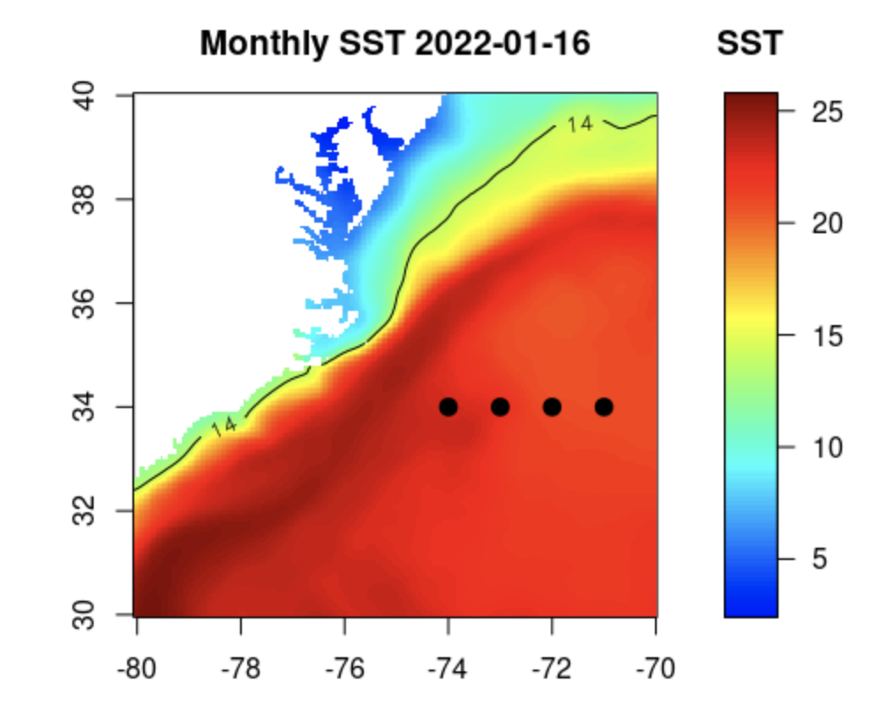
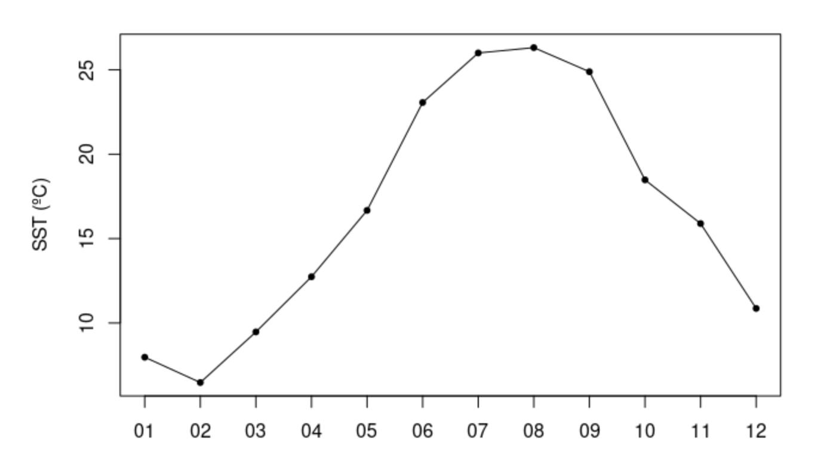
Tutorial1-basics
Learn to access satellite data from CoastWatch ERDDAP data server and to work with NetCDF files. Visualize sea surface temperature on a map and plot time series data.
Tutorial demonstrates:
Locating a satellite product in ERDDAP
Manually changing the constraints
Copying the URL defining the data request
Downloading the resulting NetCDF file
Opening and examining the NetCDF file
Making basic maps and time series plots

Slide 5
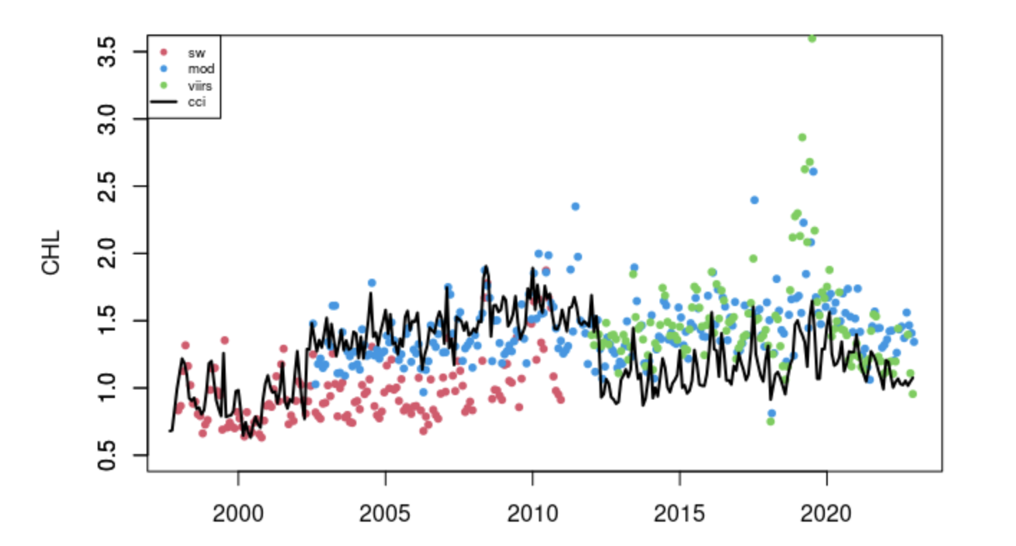
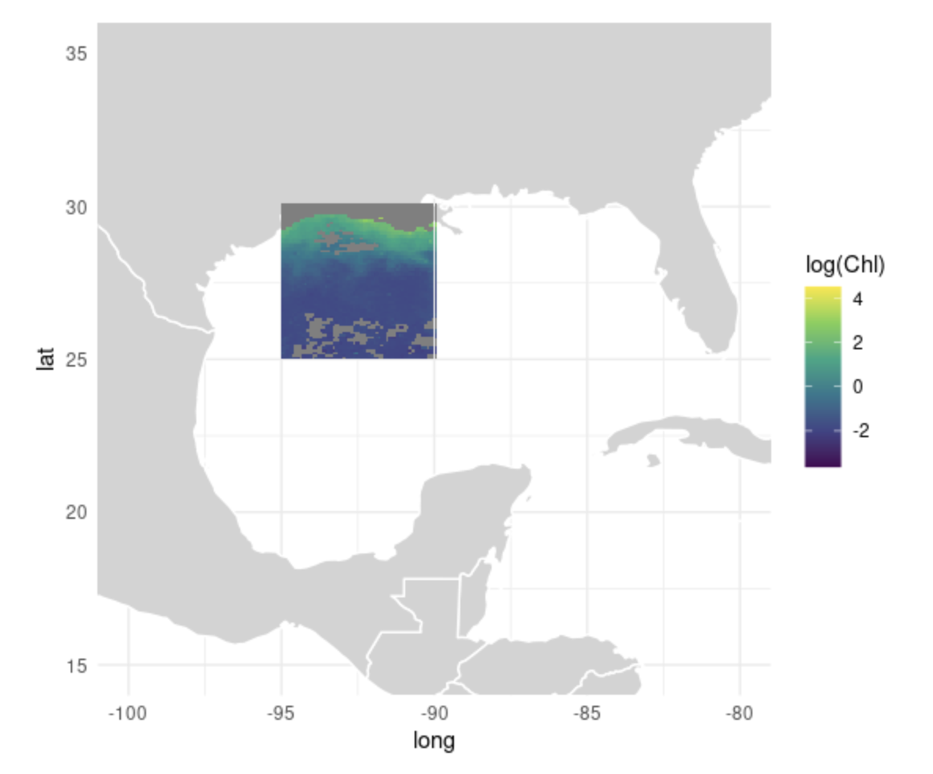
Tutorial2-timeseries-compare-sensors
Learn common ways to download data from ERDDAP servers to access time-series chlorophyll data from four different satellite datasets and summarize and visualize the data for comparison.
Tutorial demonstrates:
Using rerddap to extract data from a rectangular area of the ocean over time
Retrieve information about a dataset from ERDDAP
Comparing results from different sensors
Averaging data spatially
Producing timeseries plots
Drawing maps with satellite data

Slide 6
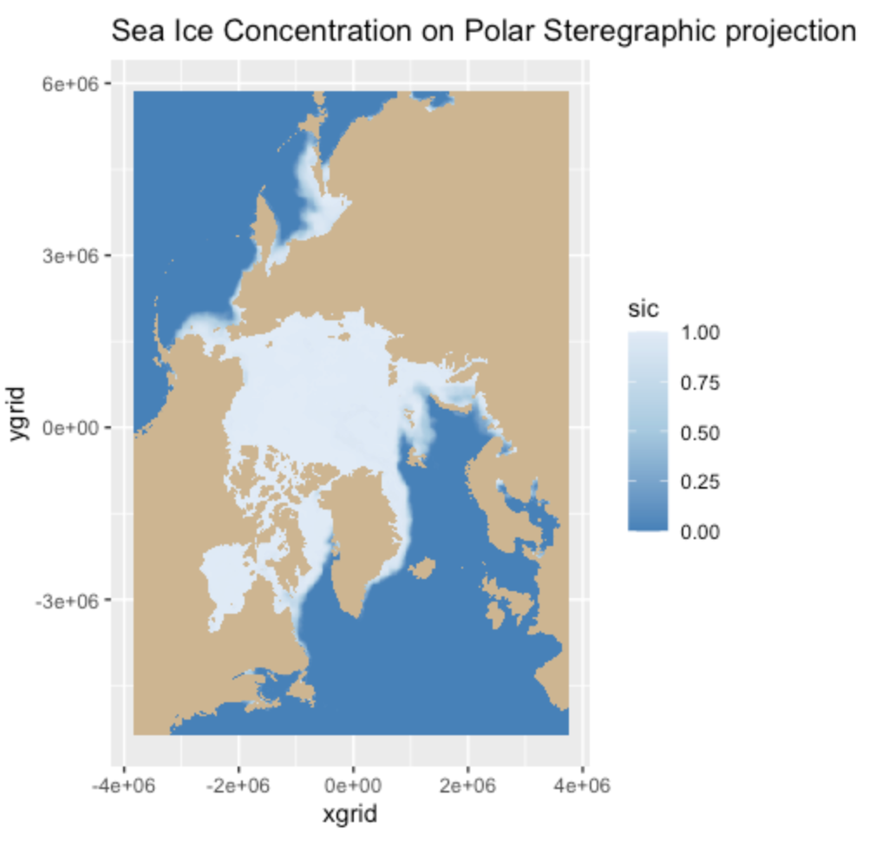
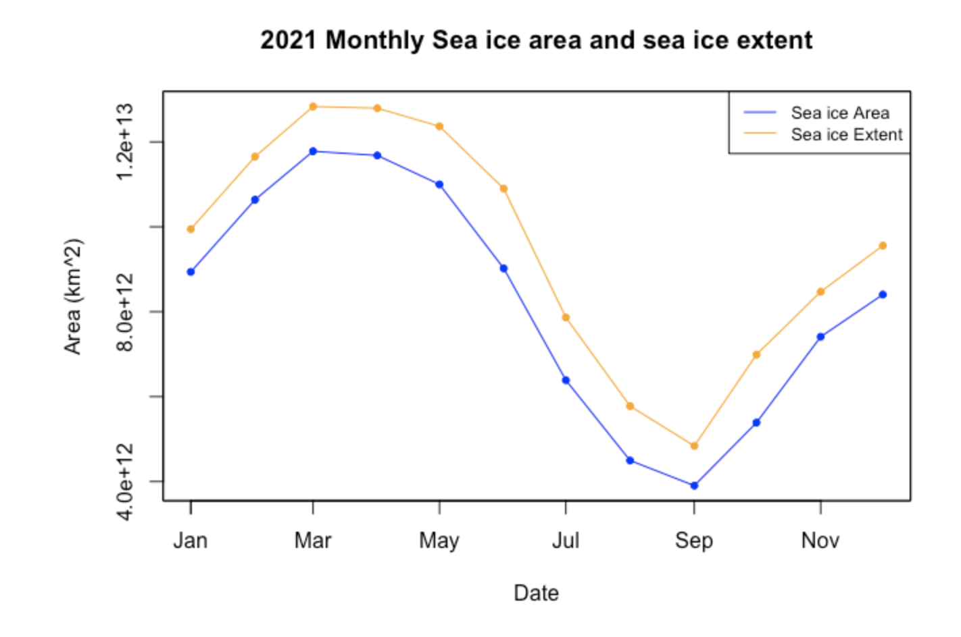
calculate-seaice-extent
View sea ice concentration (SIC) data on a map with the polar stereographic projection. Calculate and compare sea ice area/extent from multi-year SIC datasets.
Tutorial demonstrates:
Downloading and saving a netcdf file from the PolarWatch ERDDAP
Accessing satellite data and metadata in polar stereographic projection
Downloading and adding grid cell area data to a map
Computing sea ice area and extent using sea ice concentration data
Plotting a time series of sea ice area and extent

Slide 7
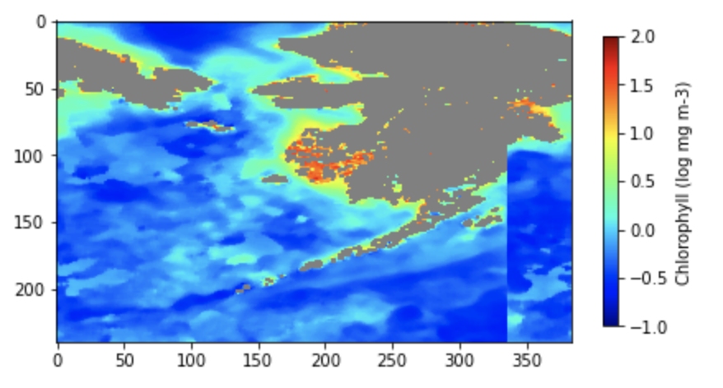
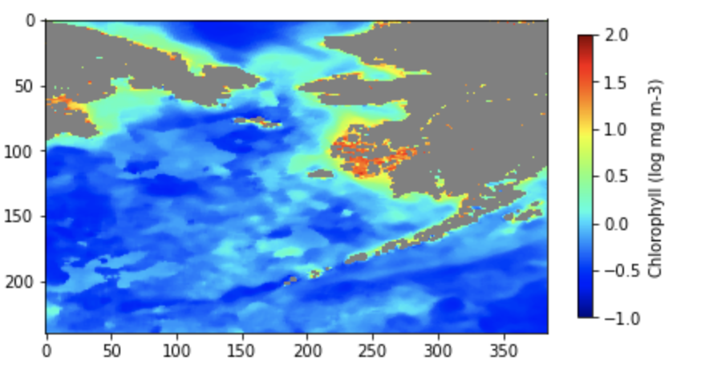
Convert-180+180-to-0-360-longitude
Python only
Work with datasets with -180° to +180° longitude values in a region that crosses the antimeridian. Convert the coordinates from (-180, +180) to (0, 360) and visualize data on a map
Tutorial demonstrates:
Downloading data that crosses the antimeridian from a dataset with -180 to +180 longitude values
Converting the data to a 0-360 longitude values
Reordering the longitude axis so that the longitude values are in ascending order
Correcting
this
Map ->
To this
Map ->

Slide 8
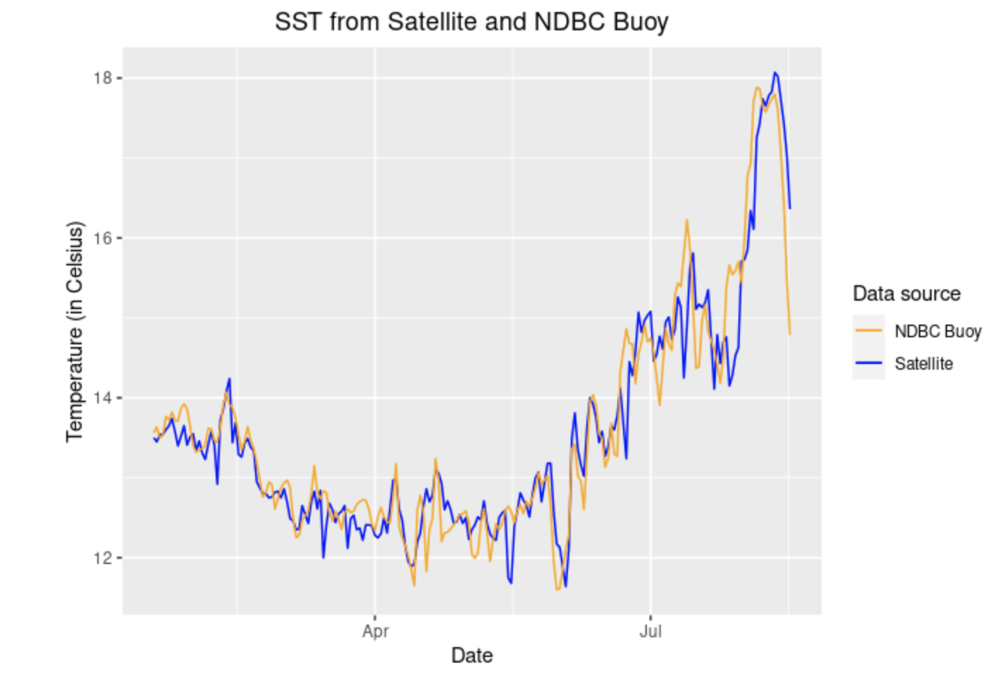
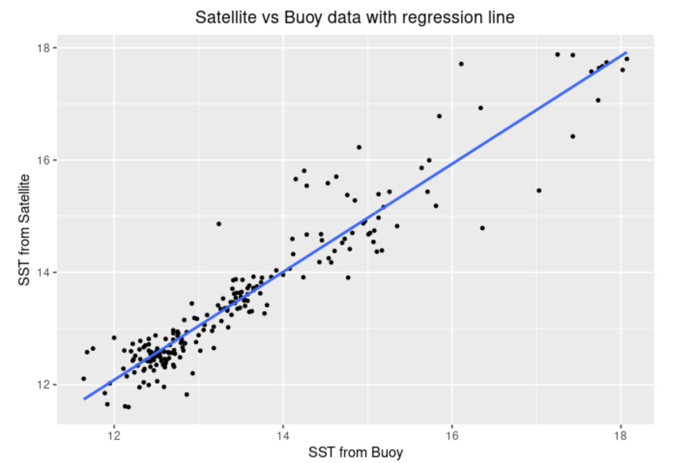
create-virtual-buoy-with-satellite-data
Create a “virtual” buoy using satellite data to fill the gaps in in-situ data collected by a physical buoy. Extract data from a location close to an existing buoy. Clean dataset by removing outliers, and aggregate (resample) to achieve a reduced temporal resolution.
Tutorial demonstrates:
Downloading the satellite and buoy data from ERDDAP
Visualizing the datasets
Reshaping the satellite data into a buoy data format
Resampling buoy data (aggregation) to match satellite data temporal resolution
Validating the satellite data with the actual buoy data
Performing a linear regression of satellite vs. buoy data
Creating a scatter plot of satellite vs. buoy data with the regression line

Slide 9
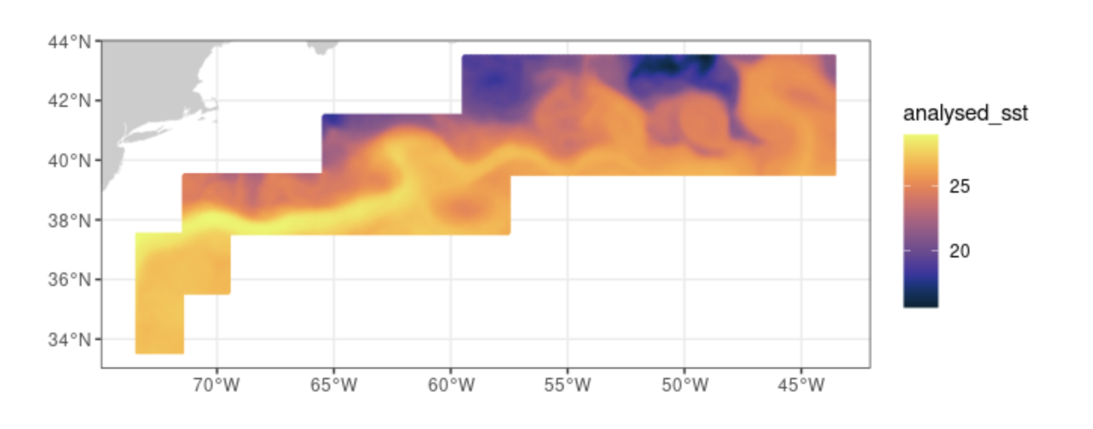
extract-satellite-data-within-boundary
Extract satellite data for an non-rectangular geographical region from ERDDAP using a shapefile, make maps, and plot a timeseries of the seasonal cycle of data within the boundary.
Tutorial demonstrates:
Using rerddapXtracto package to extract data from a polygon
Downloading data from ERDDAP
Visualizing data on a map

Slide 10
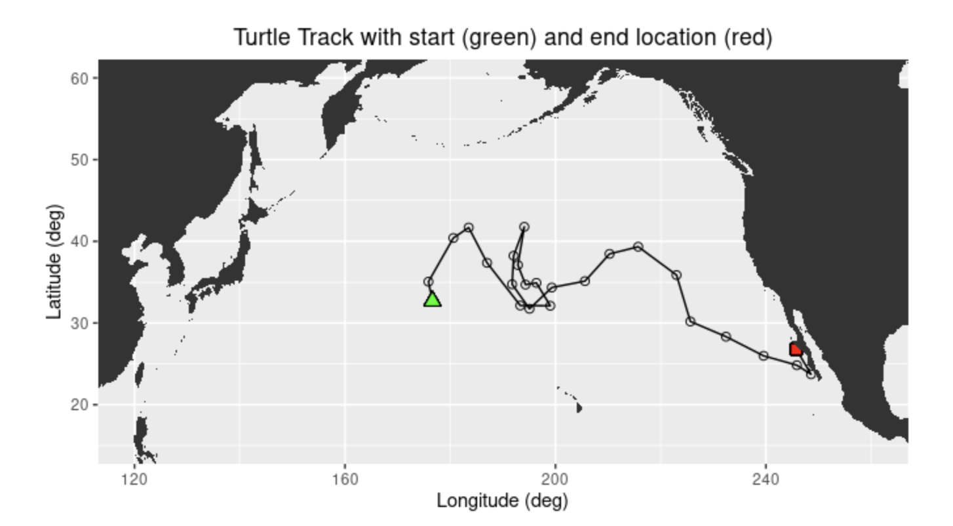
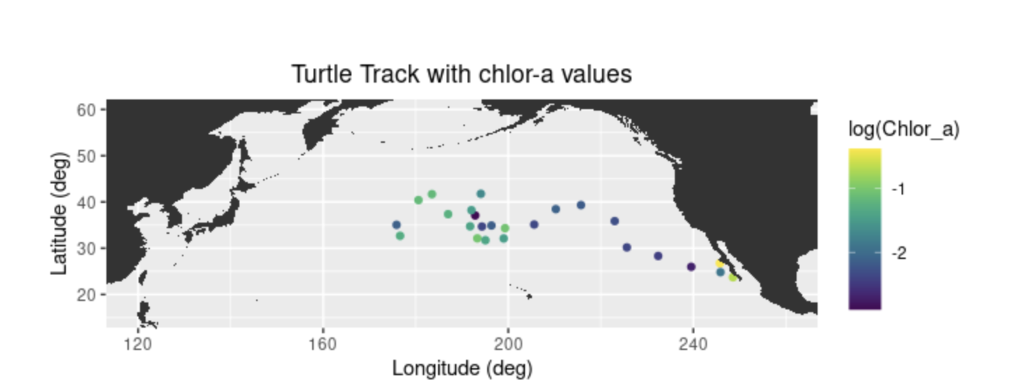
matchup-satellite-data-to-track-locations
Extract satellite data along a set of points defined by longitude, latitude, and time coordinates like that produced by an animal telemetry tag, a ship track, or a glider track.
Tutorial demonstrates:
Importing track data in csv file to data frame
Using rerddapXtracto package to extract satellite data associated with xyt points
Plotting the latitude/longitude points onto a map
Extracting satellite data from an ERDDAP data server along a track
Plotting the satellite data onto a map

Slide 11
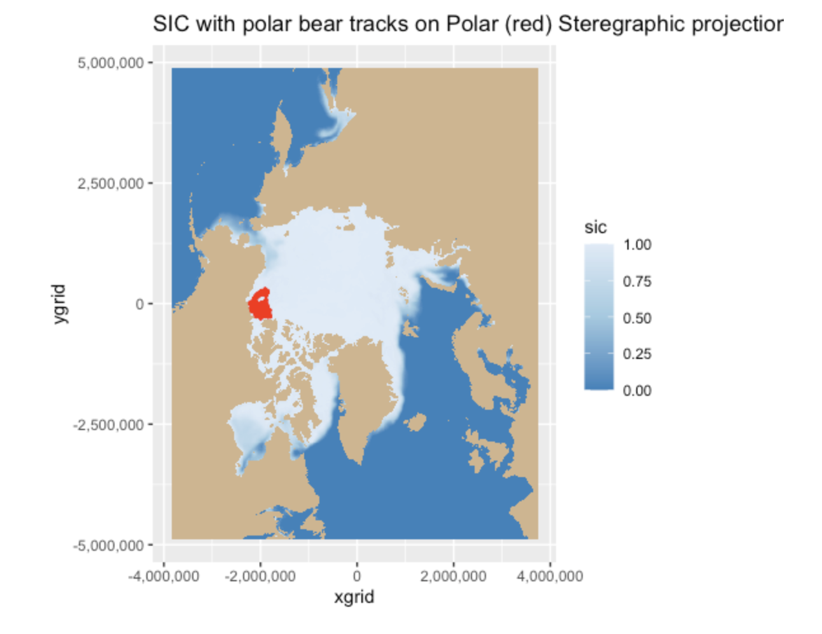
map-data-with-different-projections
Download and examine a polar stereographic projected dataset, plot the data on a projected map. Add animal track data with geographical coordinates onto the projected map.
Tutorial demonstrates:
Accessing satellite data from ERDDAP
Making a projected map
Adding projected data
Adding geographical data

Slide 12
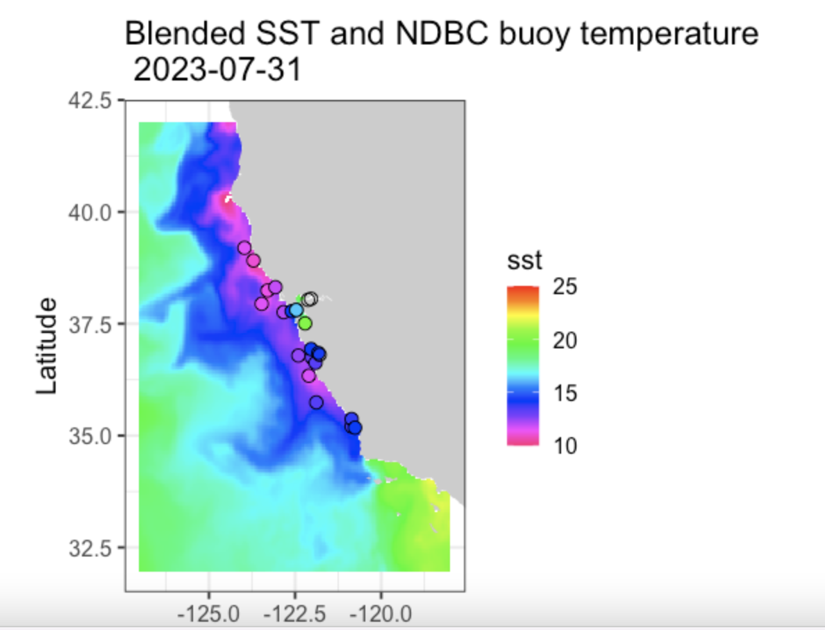
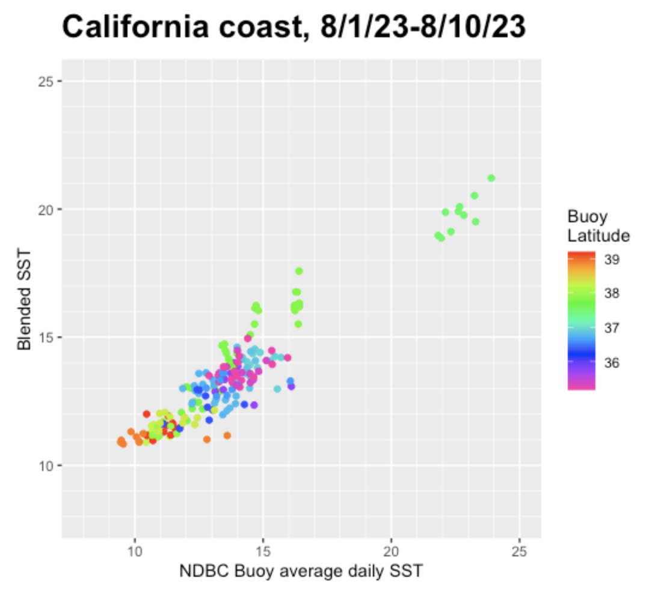
matchup-satellite-buoy-data
R only
Temporally and geospatially subset satellite data to match with buoy data (tabular), run statistical analysis and produce a map of the satellite data with overlaying buoy data.
Tutorial demonstrates:
Downloading tabular data (buoy data) from ERDDA
Retrieving information about a dataset from ERDDAP
Matching satellite data with the buoy data
Running statistical analysis to compare buoy and satellite data
Producing satellite maps and overlaying buoy data

Slide 13
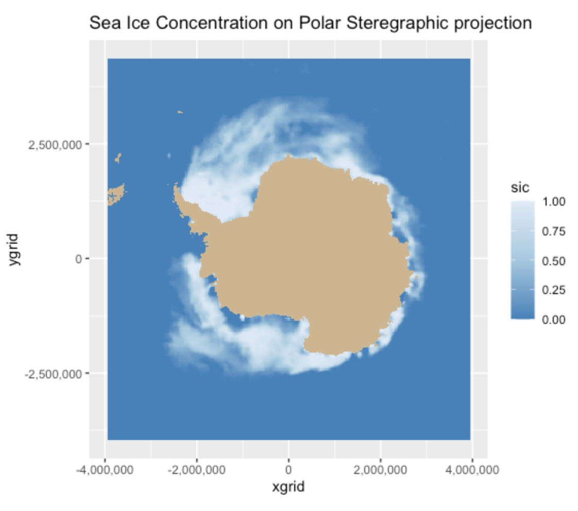
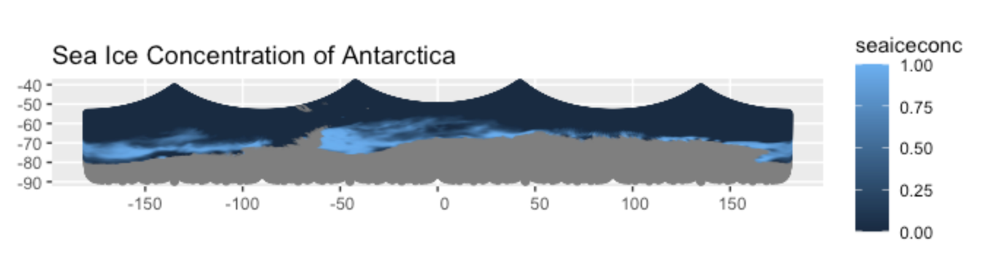
Transform-to-another-map-projection
Access satellite data with polar stereographic coordinates and transform it into a different coordinate system using EPSG code.
Tutorial demonstrates:
Downloading a netcdf file from PolarWatch ERDDAP
Accessing satellite data and metadata in polar stereographic projection
Converting netcdf data into a dataframe
Transforming coordinates using EPSG codes
Mapping data using the transformed coordinates

Slide 14
rerddapXtracto package
R package written by Roy Mendelssohn (SWFSC/ERD), based on code originally developed by Dave Foley for Matlab
Uses the rerddap and plotdap packages
erddap, plotdap and rerddapXtracto are all available on cran
rerddapXtracto contains several functions: rxtracto: extracts a variable along xyt points (i.e. a tagged animal) rxtractogon: extracts a variable within a user-supplied polygon rxtracto_3D: extracts a 3-dimensional (latitude, longitude and time) cube of a variable plotTrack: plots the results from rxtracto (including creating animations) plotBox: plots the output from rxtracto_3D
Will work on any dataset on any ERDDAP (option to enter a url to change the ERDDAP accessed)
Notes:
Today I’m going to talk in detail about one of those packages, the rerddapXtracto package. This package was written by Roy Mendelssohn at NOAA’s Southwest Fisheries Science Center to help with some of the most common tasks that participants of the NOAA Satellite Course typically want to do. Like many R packages it utilizes other R packages, in this case the rerrdap and plotdap packages which were written to more easily access and plot data served by ERDDAP. All three of these packages are available on the cran, and can easily be downloaded using the default setup in R to install packages.
Within the rerddapXtracto package there are several different functions. Rxtracto is the primary function it was designed to do. What this function does is match up satellite data to a set of user-supplied xyt data, ie coordinates of latitude, longitude and time. This is task commonly done by biologists with data from tagged animals that they want to acquire coincident satellite data for.
rxtractogon extracts satellite data from within user supplied polygon. This is useful is you want all the data from an irregularly shaped area, like a marine sanctuary or a fishery management area.
Rxtracto_3D extracts a 3-dimensional cube, meaning latitude, longitude and time, within the boundaries of a user suppled box.
plotTrack will plot the results of rxtracto and
plotBox will plot the results of Rxtracto3d
In the this presentation I will show you examples of using all of these functions based on the notebooks that we have available online.

