Slide 1


R and ERDDAP
NOAA CoastWatch Satellite Course
Last Update: Apr 14, 2021
Notes:
In this module we will demonstrate how to access datasets on ERDDAP from within R software. If you aren’t familiar with ERDDAP, you should view the ERDDAP video before viewing this one.

Slide 2
The R Software Package
R is a language and environment for statistical computing and graphics
Available at https://www.r-project.org/about.html
Software is free
Thousands of different R packages exist to do specialized functions
Notes:
Let’s start off by briefing discussing what R is. R is a free software package that is frequently used by marine scientists to do statistically computing and graphics. There is a huge R user community worldwide, and this community has led to the establishment of a repository of R packages that do many specialized functions. If there is some way you want to access or analyze data, chances are there is a R package that will make that task easier for you.

Slide 3
rerddapXtracto package
R Scripts featuring rerddapXtracto
R package written by Roy Mendelssohn (SWFSC/ERD), based on code originally developed by Dave Foley for Matlab
Uses the rerddap and plotdap packages
erddap, plotdap and rerddapXtracto are all available on cran
rerddapXtracto contains several functions: rxtracto: extracts a variable along xyt points (i.e. a tagged animal) rxtractogon: extracts a variable within a user-supplied polygon rxtracto_3D: extracts a 3-dimensional (latitude, longitude and time) cube of a variable plotTrack: plots the results from rxtracto (including creating animations) plotBox: plots the output from rxtracto_3D
Will work on any dataset on any ERDDAP (option to enter a url to change the ERDDAP accessed)
Notes:
Today I’m going to talk in detail about one of those packages, the rerddapXtracto package. This package was written by Roy Mendelssohn at NOAA’s Southwest Fisheries Science Center to help with some of the most common tasks that participants of the NOAA Satellite Course typically want to do. Like many R packages it utilizes other R packages, in this case the rerrdap and plotdap packages which were written to more easily access and plot data served by ERDDAP. All three of these packages are available on the cran, and can easily be downloaded using the default setup in R to install packages.
Within the rerddapXtracto package there are several different functions. Rxtracto is the primary function it was designed to do. What this function does is match up satellite data to a set of user-supplied xyt data, ie coordinates of latitude, longitude and time. This is task commonly done by biologists with data from tagged animals that they want to acquire coincident satellite data for.
rxtractogon extracts satellite data from within user supplied polygon. This is useful is you want all the data from an irregularly shaped area, like a marine sanctuary or a fishery management area.
Rxtracto_3D extracts a 3-dimensional cube, meaning latitude, longitude and time, within the boundaries of a user suppled box.
plotTrack will plot the results of rxtracto and
plotBox will plot the results of Rxtracto3d
In the this presentation I will show you examples of using all of these functions based on the notebooks that we have available online.

Slide 4
Notebooks using rerddapXtracto
R Scripts featuring rerddapXtracto
02-sanctuary uses the rxtractogon function to download satellite data within the boundaries of a user-supplied polygon, in this case the Monterey Bay (or the Olympic Coast) sanctuary
03-xyt_matchup uses the rxtracto function to extract satellite data along the coordinates of a user-supplied telemetry track, in this case from a tagged marlin
03-xyt_matchup uses the rxtracto function to extract satellite data for a survey grid that spans the dateline
04-Timeseries_Chl uses the rxtracto_3d function to download a bunch of chlorophyll datasets, spatially average them, and plot their timeseries
05-SSTBuoy uses the tabledap function in rerddap to download SST data from NDBC buoys and the rxtracto function to extract satellite SST from those same buoy locations
06-TurtleWatch uses rxtracto_3d function to import SST data ands apply a temperature threshold to look at turtle habitat
08-ProjectedData uses base functions to work with a projected sea ice dataset on the PolarWatch ERDDAP
Notes:
Our online notebook contains several chapters as outlined here.
Chapter 2 uses the rxtractogon function to plot chlorophyll data within the boundaries of the Monterey Bay Sanctuary
Chapter 3 uses the rxtracto function to plot the satellite data corresponding to a tagged marline fish in the Pacific.
Chapter 4 makes a timeseries of chl data by downloading several overlapping datasets. The data is averaged spatially to make a timeseries, and averaged temporally to make maps.
Chapter 5 shows how to used the tabledap function in rerddap to download tabular in situ SST data and use the rxtracto fuction to get corresponding satellite data to compare against the in situ data
Chapter 6 uses the xtracto_3D function to import SST data and uses a temperature threshold to look at turtle habitat
Next I will give a brief overview of each of these chapters

Slide 5
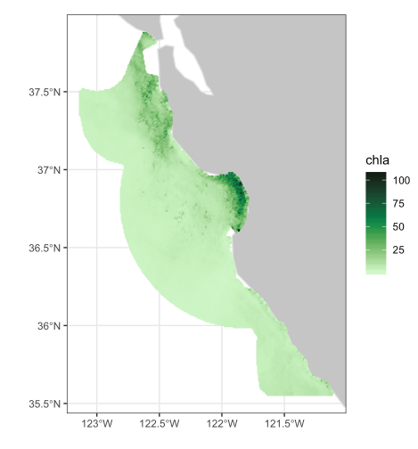
02-Sanctuary.RMD
R Scripts featuring rerddapXtracto
rxtractogon function used to read in data within the boundaries of the Monterey Bay Sanctuary
Chlorophyll is selected as the satellite dataset
Produces a map of data just within the polygon
Notes:
Chapter 2 of the online tutorial uses the rxtractogon function to read in the chl data within the boundaries of the Monterey Bay Sanctuary and generates a map of this data. To provide this example the boundaries of the Monterey Bay Sanctuary are embedded within the function. To modify this to work in a different region the user needs to have the x and y coordinates of the polygon they are interested in.

Slide 6
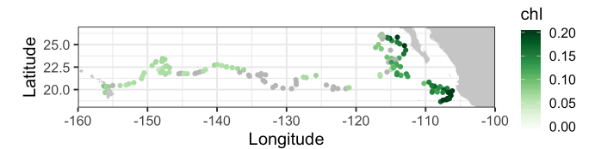
03-xyt_matchup.RMD
R Scripts featuring rerddapXtracto
The telemetry file (lat, lon and time) of a tagged marlin is read in
Chlorophyll is selected as the satellite data
rxtracto function used to extract satellite values around the tagged points
Plots the track with points color-coded by chlorophyll value
Notes:
Chapter 3 of the online tutorial uses the rxtracto function to extract the chl data synoptic with the tracks of a tagged marlin in the Pacific..

Slide 7
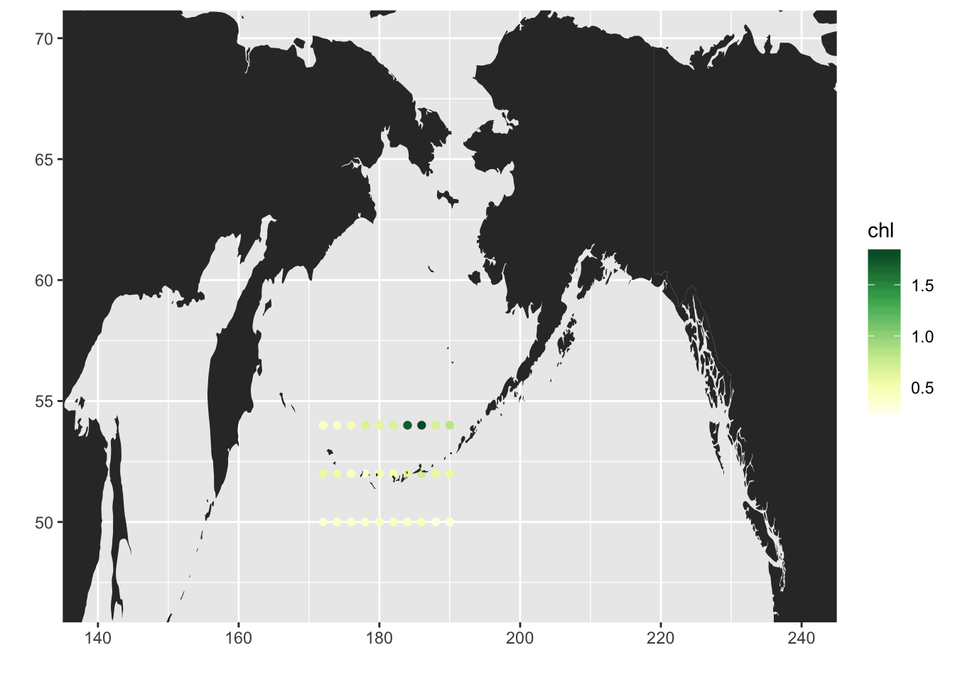
03-xyt_matchup.RMD
R Scripts featuring rerddapXtracto
A survey grid of stations that cross the dateline is created
rxtracto function used to extract satellite values for the survey grid
Stations are mapped across the dateline
Notes:
Chapter 3 of the online tutorial also uses the rxtracto function to extract the chl data synoptic with some virtual survey stations in the Pacific, showing that Rxtracto is capable of dealing with data that span the dateline.

Slide 8
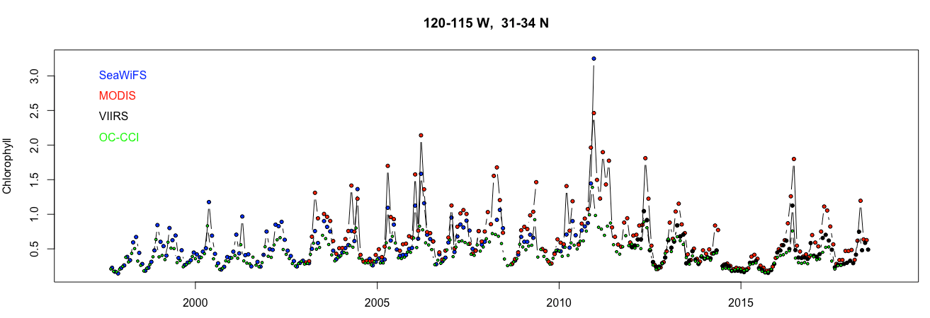
04-Timeseries.RMD
R Scripts featuring rerddapXtracto
rxtracto_3D function used to download 3D cubes (lat, long and time) of 4 different chlorophyll datasets: SeaWiFS, MODIS, VIIRS, and OC-CCI
Each dataset is spatially averaged into a timeseries
Each dataset is temporally averaged into a map
Notes:
Chapter 4 of the online tutorial uses the rxtracto_3D function to download data from 4 different chlorophyll datasets and spatially average the data into timeseries.

Slide 9
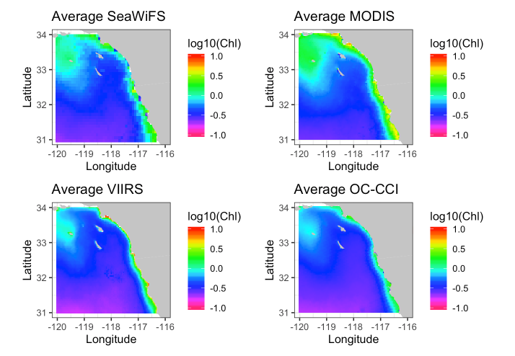
04-Timeseries.RMD
R Scripts featuring rerddapXtracto
rxtracto_3D function used to download 3D cubes (lat, long and time) of 4 different chlorophyll datasets: SeaWiFS, MODIS, VIIRS, and OC-CCI
Each dataset is spatially averaged into a timeseries
Each dataset is temporally averaged into a map
Notes:
It also shows how to temporally average the data into average maps for each dataset.

Slide 10
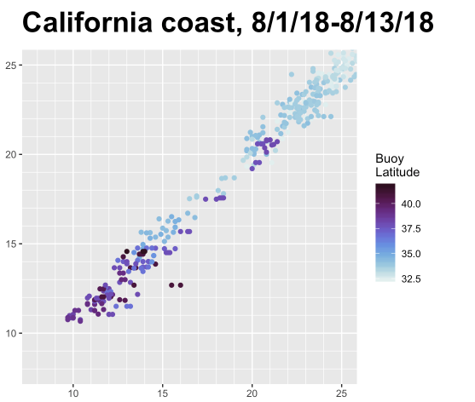
05-SSTBuoy.RMD
R Scripts featuring rerddapXtracto
uses the tabledap function in rerddap to download SST data from NDBC buoys
the rxtracto function is used to extract satellite SST from those same buoy locations
The satellite and buoy SSTs are plotted
Buoy SST data are overlain on a map of satellite SST
VIIRS SST
NDBC Buoy SST @ 2pm
Notes:
Chapter 5 shows how to use the tabledap function in rerddap to download in situ buoy data and then uses the rxtracto_3D function to get corresponding satellite SST data to compare with that data. The graph shown here shows the match-up of VIIRS SST data against buoy data along the California coast.

Slide 11
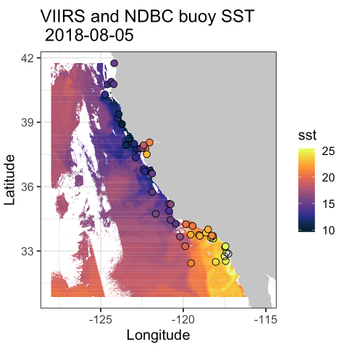
05-SSTBuoy.RMD
R Scripts featuring rerddapXtracto
uses the tabledap function in rerddap to download SST data from NDBC buoys
the rxtracto function is used to extract satellite SST from those same buoy locations
The satellite and buoy SSTs are plotted
Buoy SST data are overlain on a map of satellite SST
Notes:
This chapter also shows how to compare the data graphically. This map of satellite SST is overlain with buoy data from the same timeperiod.

Slide 12
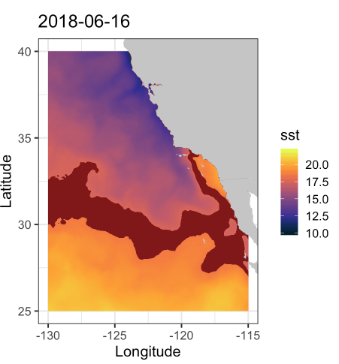
06-TurtleWatch.RMD
R Scripts featuring rerddapXtracto
Uses rxtracto_3D to import SST data from ERDDAP
Identifies potential turtle habitat assuming a specific temperature range
Uses ggplot graphics to make map
Notes:
Chapter 6 uses rxtracto_3D to import SST data from ERDDAP, and uses a specifc temperature threshold to identify potential turtle habitat

Slide 13
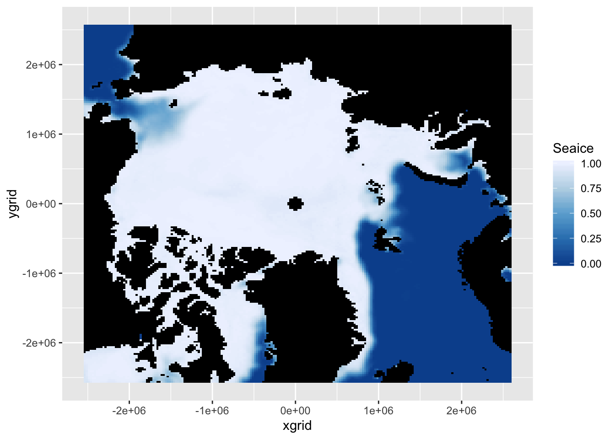
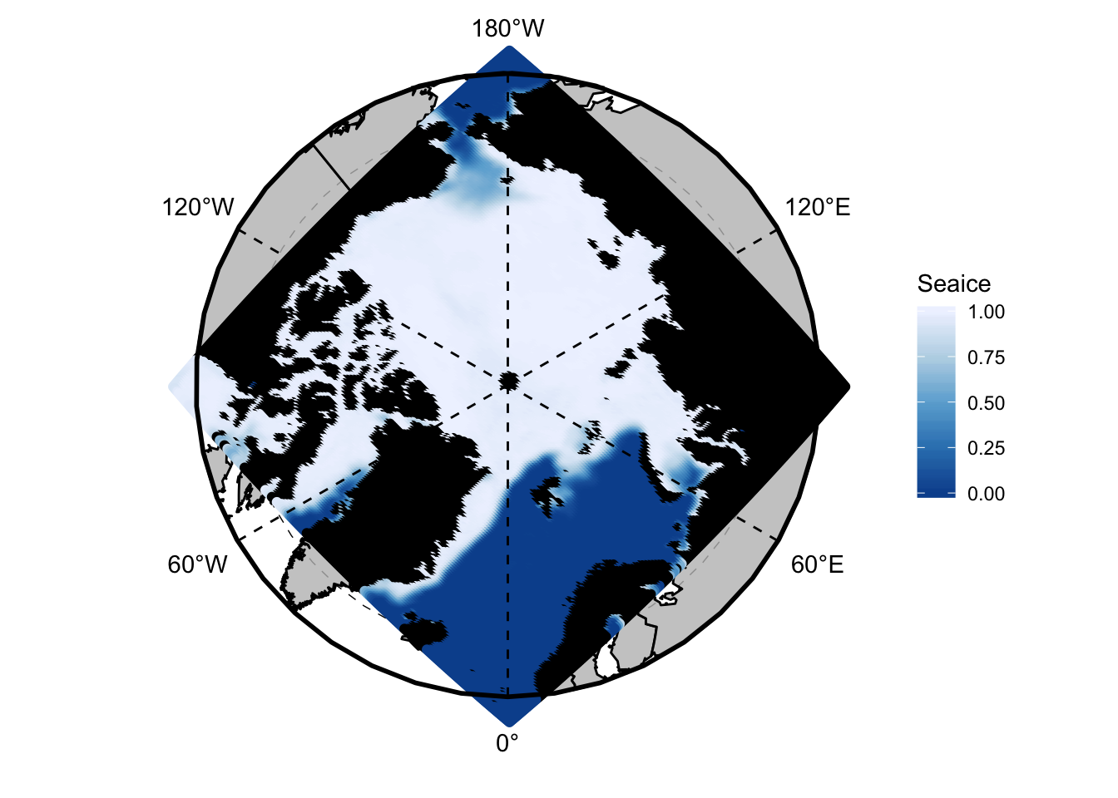
08-Mapping_Projected_Datasets.RMD
R Scripts
Shows how to download the associated latitude/longitude grid of a projected dataset and get the desired indices (defined by lat & lon) of the projected dataset
Makes several different maps of the downloaded data
Notes:
Chapter 8 shows how to map projected datasets that are served on the PolarWatch ERDDAP. This also demonstrates how to access an ERDDAP other than the default ERDDAP.

Slide 14
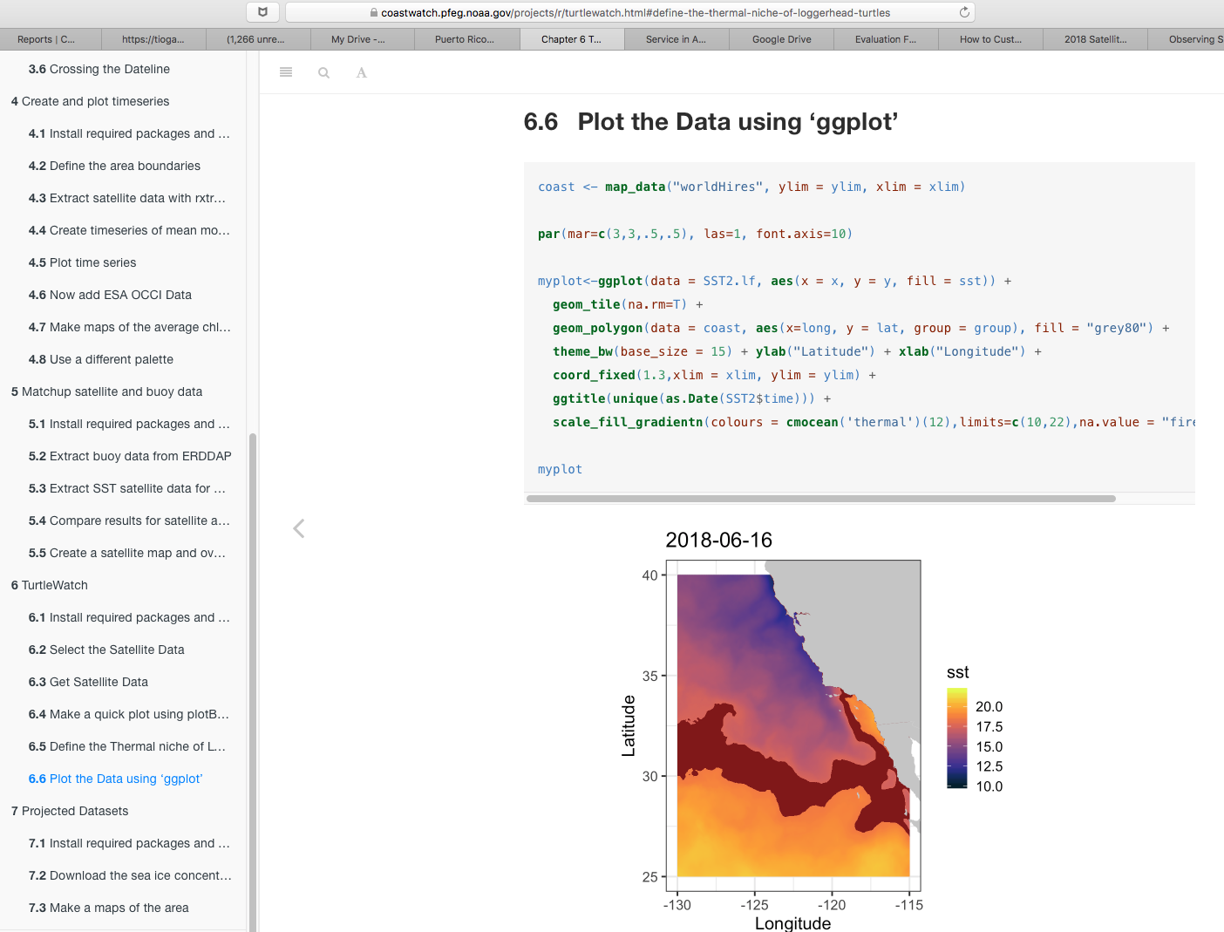
Online R Tutorial
All these scripts are available online, along with the output generated by them.
Also available on GitHub: https://github.com/CoastWatch-WestCoast/course_lessons/
R Scripts featuring rerddapXtracto
https://coastwatch.pfeg.noaa.gov/projects/r/
Notes:
This was a quick overview of what is covered in our online R tutorial. The tutorial gives all the code needed to make these graphs

Slide 15
Online Tutorials
Introduction to ERDDAP https://coastwatch.pfeg.noaa.gov/projects/erddap/
Using the the R package rerddapXtracto https://coastwatch.pfeg.noaa.gov/projects/r/
Working with netCDF file and satellite data with ArcGIS https://coastwatch.pfeg.noaa.gov/projects/arcgis/
R Scripts featuring rerddapXtracto
Notes:
We also have other online Tutorials. We have an overview of ERDDAP, and we have one covering different ways to import satellite data into ArcGIS

