Slide 1
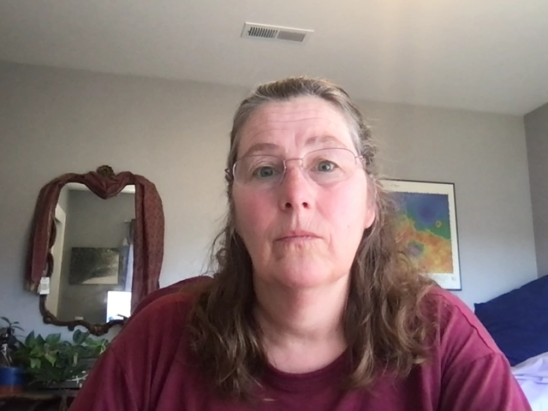
Tools and strategies for your satellite data project NOAA Coastwatch Satellite Course
Last Updated: 4/28/21
Notes:
Welcome to the online course on oceanographic satellite data products, produced by NOAA’s CoastWatch Program. In this module we will present strategies for discovering, accessing, and downloading ocean satellite data, and some tools you can use to accomplish these tasks
My name is Cara Wilson, I’m the node manager of the West Coast Node of NOAA’s CoastWatch Program. The materials I will be presenting in this video were produced from a collaboration from many members of NOAA’s CoastWatch Program including Dale Robinson, Melanie Abecassis, Ron Vogel, Shelly Tomlinson, me and the late Dave Foley.

Slide 2
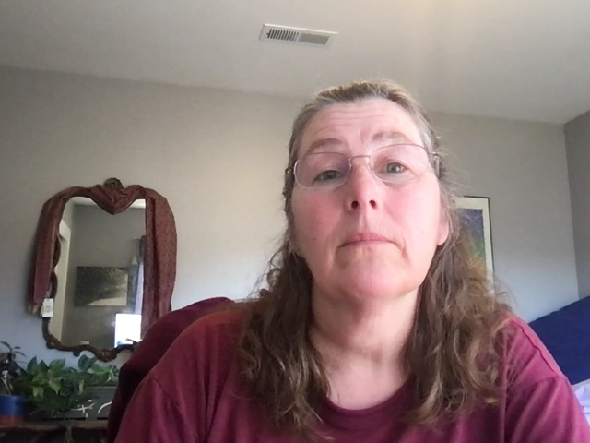
Accessing satellite data can be challenging
A short list of data servers
NASA Jet Propulsion Laboratory PO.DAAC
NASA Ocean Biology (OB.DAAC)
NASA Goddard Space Flight Center
NOAA Center for Satellite Applications and Res.
NOAA CoastWatch Central Operations
NOAA Office of Satellite and Products
NOAA National Centers for Environmental Info.
NOAA Comprehensive Large Array-data Stewardship System
European Space Agency
Japan Aerospace Exploration Agency
Each with its own
Data products
File formats
Download protocols
Subsetting abilities
Previewing abilities
Notes:
For many people, discovering, accessing, and downloading ocean satellite data can be challenging.
There are dozens of data providers online, each with its own:
data products, file formats, download protocols, subsetting abilities, and previewing abilities

Slide 3


Getting data should not be difficult
The topics to cover in this presentation
Data viewers and file formats
Introduction to tools for the course
Advanced tools
Class participation – Using the ERDDAP data server
Notes:
At CoastWatch we believe that getting data should not be difficult.
People experienced with using satellite data typically have a strategy for finding satellite data that works for their application. If you are new to satellite data, suggest the following strategy to get you started.
To start with, use online data viewers to explore datasets and to look for interesting ocean features.
Next, develop a basic understanding of the data file formats used with satellite data and how they can benefit working with the data. Finding a good viewer for visualizing the data in the files will also help you work with the data.
Find a good online site with an easy to use data server, for accessing and downloading data. In this course we will focus on using ERDDAP.
Next steal, I mean, borrow code from other people. There is no need to start from scratch. You can improve and customize existing code for your purposes. There are even code packages written in languages like R, Python, and MATLAB specifically developed for working with satellite data. We go into this in further detail in the tutorials.
Finally, there are software plugins available to help with bringing data into applications like ArcGIS. We will be exploring all of these during this course.

Slide 4
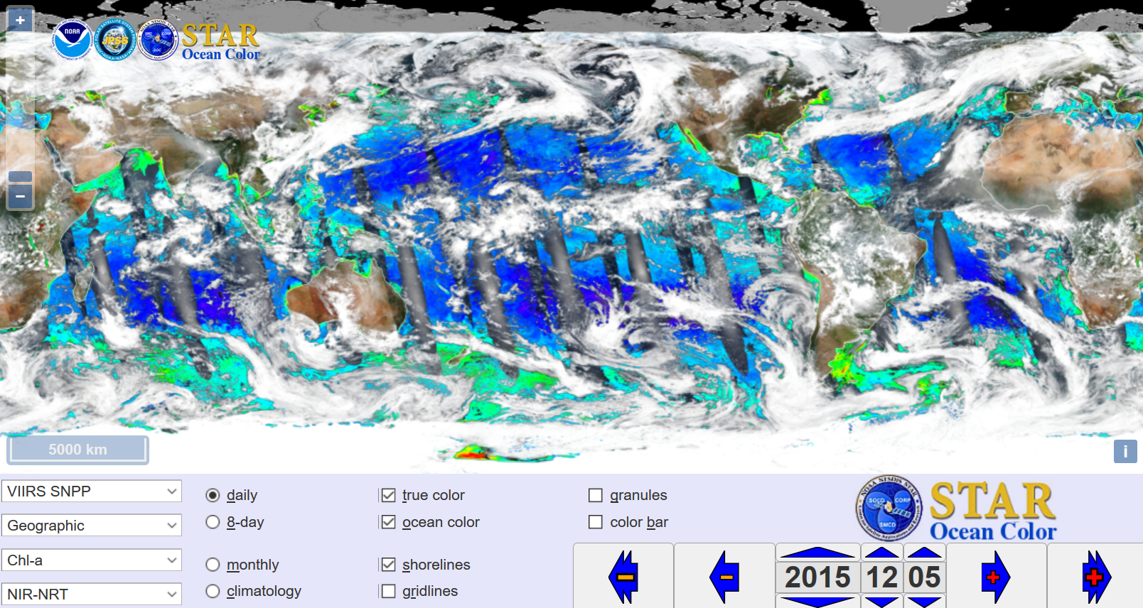
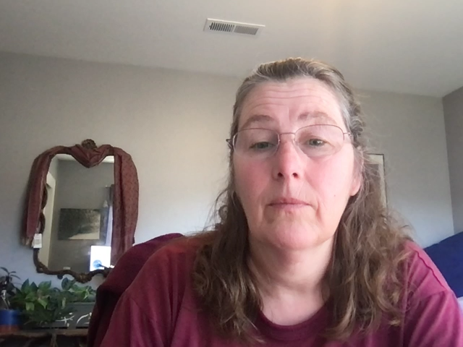
Data Viewers are a good place to start for exploring data
OCView
CoastWatch Data Viewer
coastwatch.noaa.gov/cw_html/cwViewer.html
OCView (NOAA/NESDIS STAR)
star.nesdis.noaa.gov/sod/mecb/color/ocview/ocview.html
State of the Ocean - SOTO (NASA PO.DAAC)
podaac-tools.jpl.nasa.gov/soto/
Worldview (NASA EOSDIS)
worldview.earthdata.nasa.gov/
OceanViewer (CoastWatch Caribbean/Gulf of Mexico Node)
cwcgom.aoml.noaa.gov/cgom/OceanViewer
Notes:
To start a project or to look for interesting ocean features, a great place to start is to use an online data viewer. The viewers allow you to explore a variety of datasets and examine your area of interest. Using data viewers is like looking through department store windows: they let you shop around before you buy.
There are many good data viewers available. I’ve listed a few below, including the CoastWatch viewer. Try visiting one of these sites and explore a few datasets that are of interest to you.

Slide 5
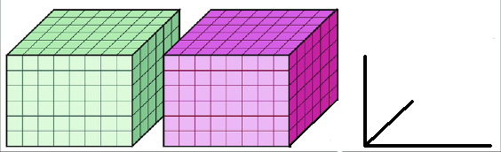
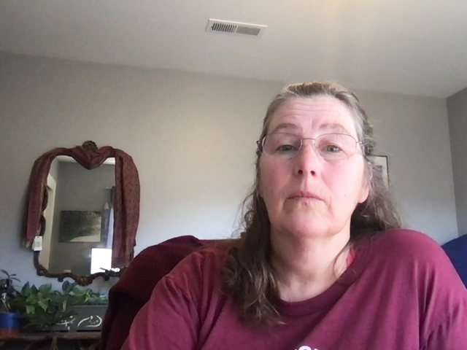
NetCDF¹ file format: Most satellite data are distributed in NetCDF
Why?
sea surface temperature
sea ice coverage
Self-Describing
Contains the information and metadata that you need to use the data
Portable
Can be used by all computer platforms (Mac, OC, Linux)
Compact
Binary data and compressible
latitude
longitude
time
¹Network Common Data Format
Notes:
If you will work a lot with satellite data, you will need to get familiar with the netCDF file format, as most satellite data is delivered in this format
Why NetCDF?
The files are self-describing, meaning they contain all the information you need to use the data, including geographical and temporal coverage, details about how the data were processed, how you are allowed to use the data, and who to acknowledge if you use the data.
The files are portable. They can be used by all computer platforms.
The binary format is compact, so file sizes are smaller

Slide 6
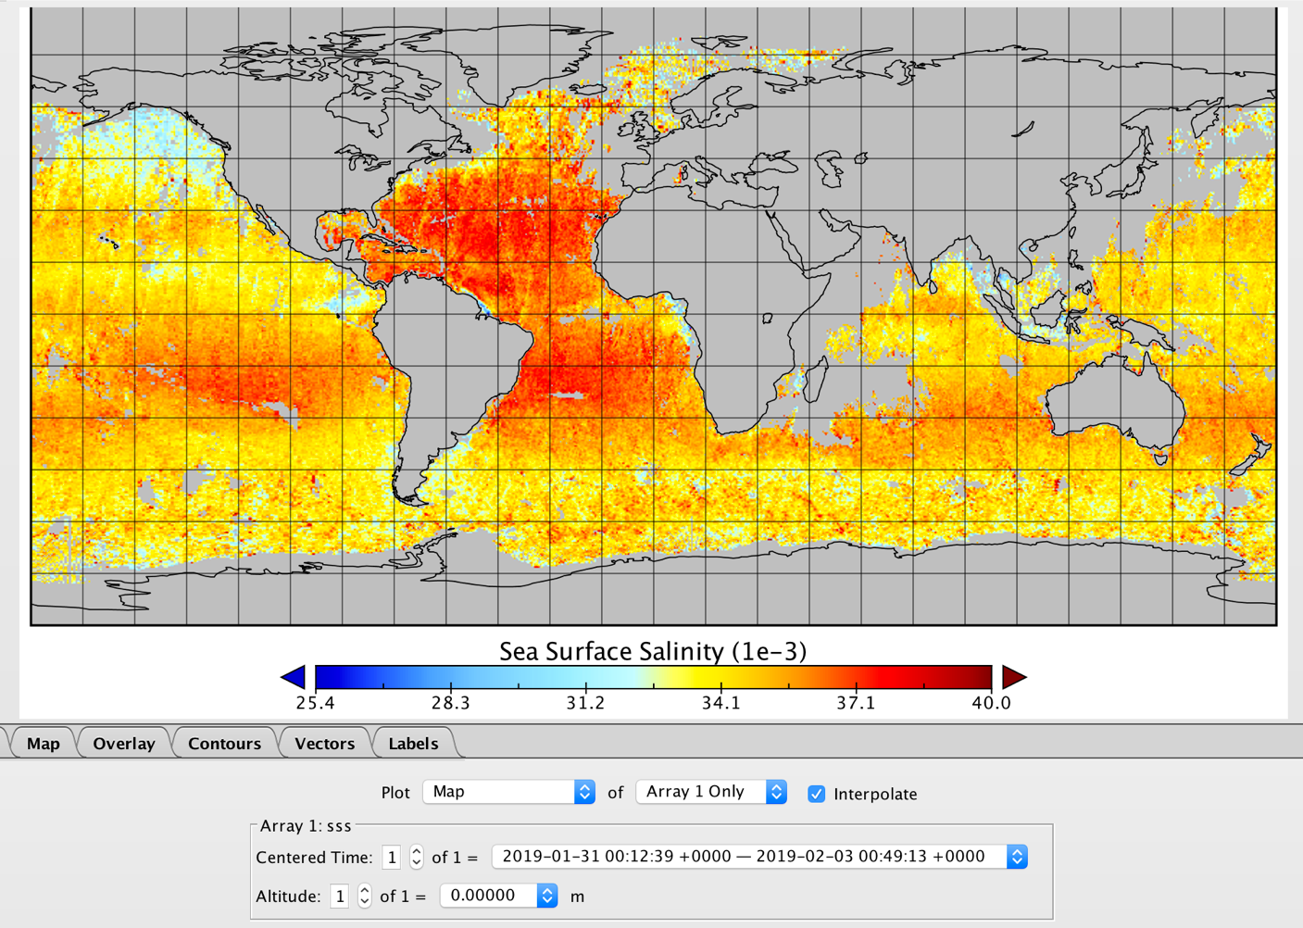
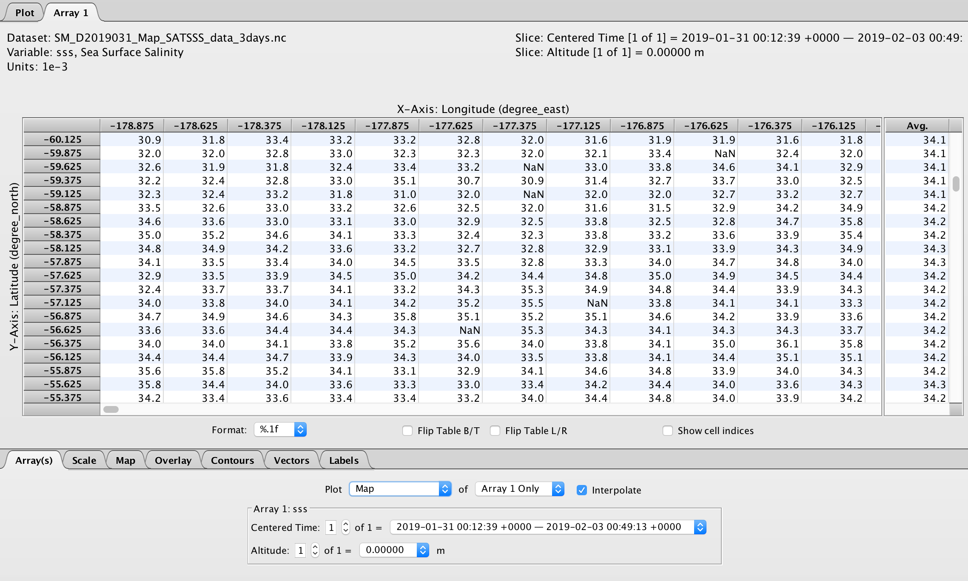
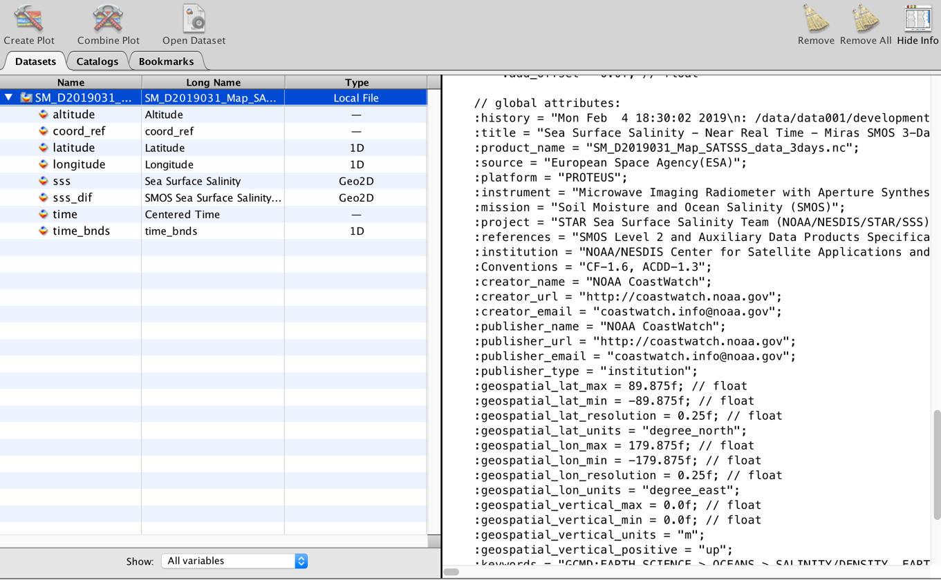
Software for visualizing NetCDF files – NASA Panoply
Visualize data from netCDF and HDF files
Reproject the visualization
View the metadata
View the data
Freeware
Example netCDF salinity file
(SM_D2019031_Map_SATSSS_data_3days.nc)
Information and download
www.giss.nasa.gov/tools/panoply/
Notes:
If you are using netCDF, it is helpful to use a good netCDF viewer. A good one is NASA's Panoply. With Panoply you can map the data, reproject maps, save the maps as images, see data and metadata, and much more. Of course if you want to do any more complicated analysis of the data you will need to use software like R, python or ArcGIS.
There is tutorial assignment in your syllabus where you will find out more about netCDF and Panoply.

Slide 7
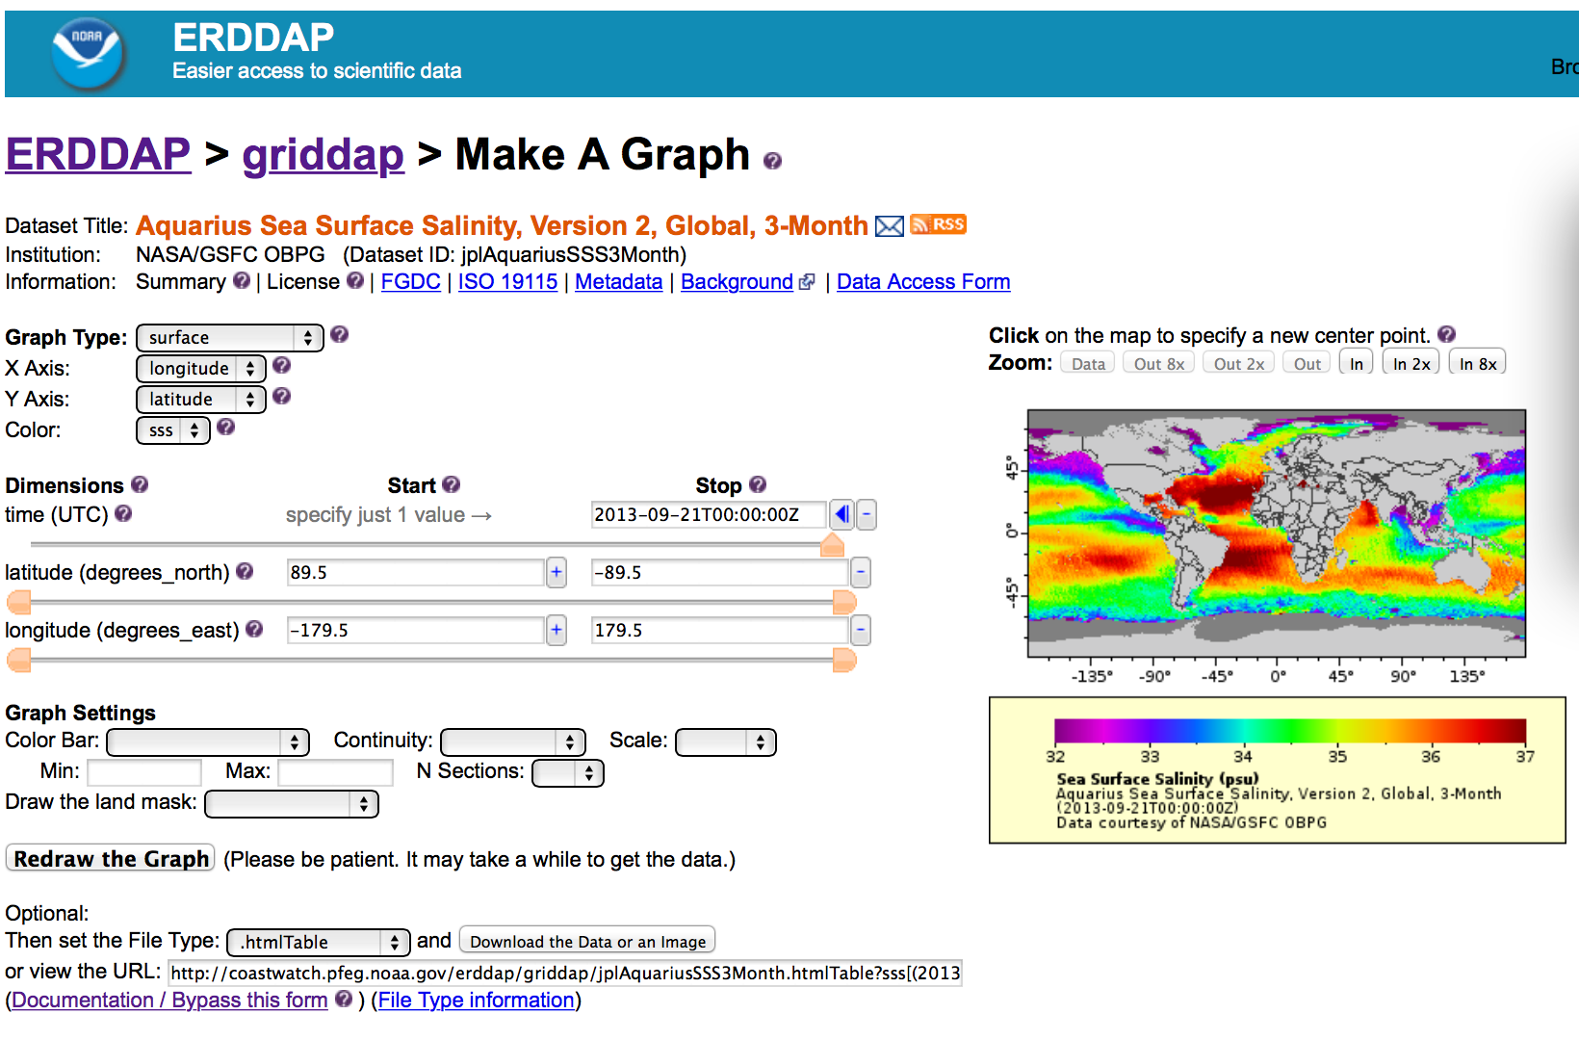
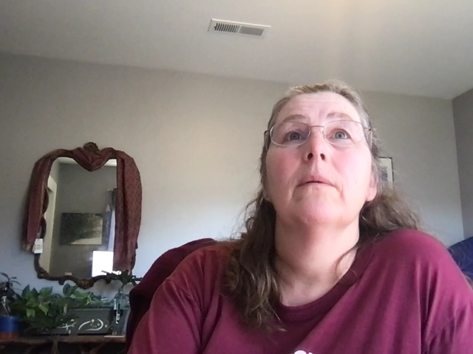
The ERDDAP data server simplifies data access
WC Node’s ERDDAP server gives you:
A simple, consistent way to download data
For the area and time period of interest
In the format that works with your analysis tools
ERDDAP works for humans and machines
Notes:
For the workshop, we will get most of our data from the ERDDAP data server
developed at SWFSC by Bob Simons. ERDDAP gives you a consistent way to download data, the option to subset in time and space, and the choice to download the data in your preferred file format. ERDDAP has both a human interface and machine to machine capabilities.

Slide 8



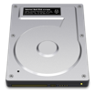






ERDDAP allows one-stop data shopping
LOCAL STORAGE
DATA DISTRIBUTION
Internal Servers
Automated Scripts
Database
Web-Based
Applications
Flexible distribution is possible because data queries are completely defined within a url
RAID
ERDDAP
REMOTE SERVERS
Download
By Hand
NSIDC
NCEI
Software
Applications
JPL PO.DAAC
NESDIS STAR
Notes:
Here is how it works. On the data catalog side, ERDDAP can host local files. But one of ERDDAP’s strengths is that it can serve data from other remote servers. Remember that list of data servers from many different data providers that I showed on the first slide? ERDDAP can point to those servers and pull data from them when you make an ERDDAP request. So, you don't have to learn how to get data from all of those other servers. You just have to know one way, the ERDDAP way.
On the data distribution side,
You can get data by hand with the ERDDAP web interface
You can pull data directly into software apps
You can get data with automatic scripts for machine to machine data exchange,
You can use ERDDAP as a backend for web applications. Maybe you want to build a website about your project. You can pull data directly from ERDDAP to populate websites with data or images.
This is made possible by Restful URL, where an entire data request is defined in a single URL.
There is a tutorial assignment in your syllabus where you will find out more about ERDDAP.

Slide 9
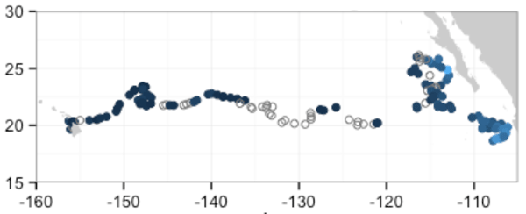
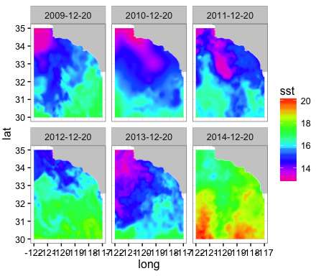
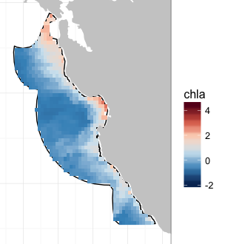
Xtractomatic R scripts talk to ERDDAP for you
create and execute erddap data requests - do common tasks
Premade scripts that perform common functions
Extract data around ship stations or animal tracks
Extract data for rectangular area over time
Extract data for any area (polygon) over time
Notes:
Some talented people have developed software libraries to help you access data from ERDDAP. One that we use in the course is RerddapXtracto, a package for R developed by Roy Mendelssohn at SWFSC ERD. The package helps you accomplish some common tasks that fisheries and management people often need, like getting satellite data at stations along a cruise or animal track, and getting satellite data from a polygon shaped area over time.
Coastwatch also provides sample code in R and Python to help get you started developing your own code.
You will find a lesson and a tutorial on the RerddapXtracto package in your syllabus. There are also tutorial assignments in your syllabus where you will find sample R and python code.

Slide 10
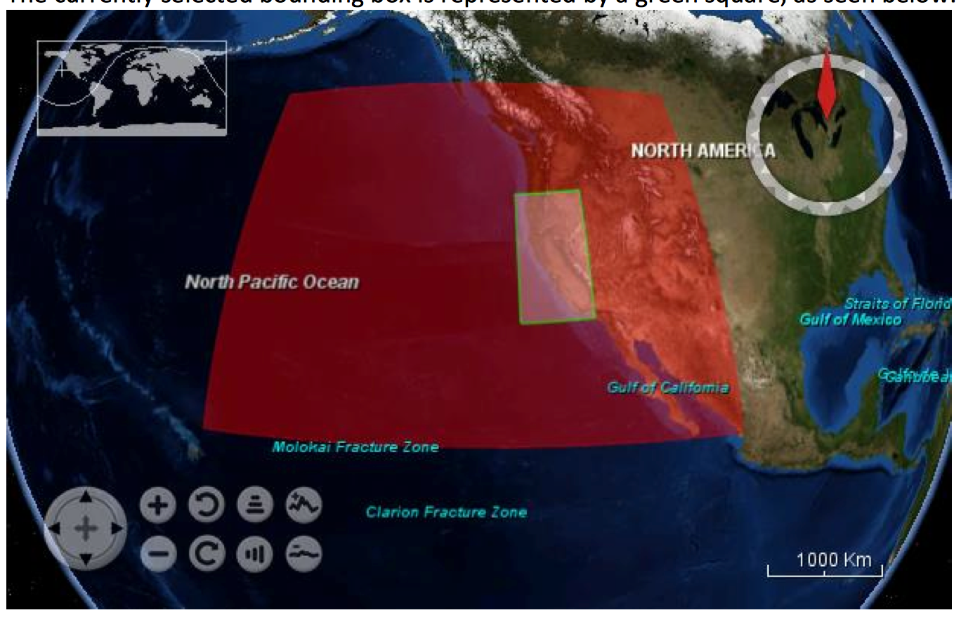
Environmental Data Connector: a plug-in for ArcGIS users
Free graphical interface for browsing, sub-setting, and downloading data from OPeNDAP, SOS, THREDDS, and ERDDAP
User guide and download
coastwatch.pfeg.noaa.gov/EDC/index.html
Tutorial www.youtube.com/watch?v=czr6M0877gE
Notes:
The ERD and CoastWatch West Coast Node also commissioned the development of the Environmental Data Connector. The Environmental Data Connector is a plug-in for ArcGIS that makes it easy to bring raster data into ArcGIS. It is particularly helpful to bring in spatial data with several time steps. You can also use it to extract data from station locations and from a specified area over time.
There is a tutorial assignment in your syllabus where you will find out more about using the EDC.

Slide 11
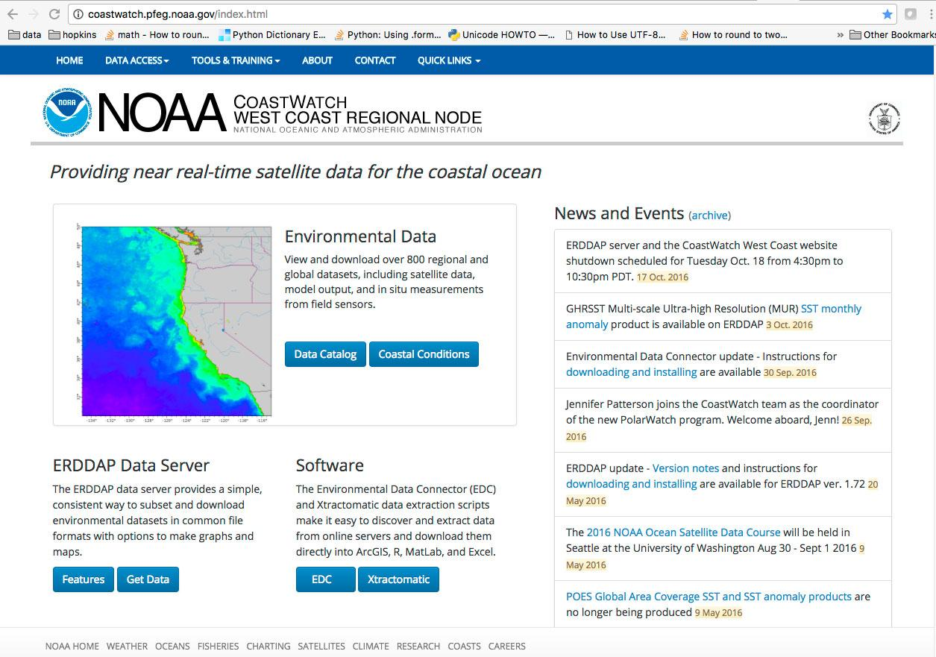
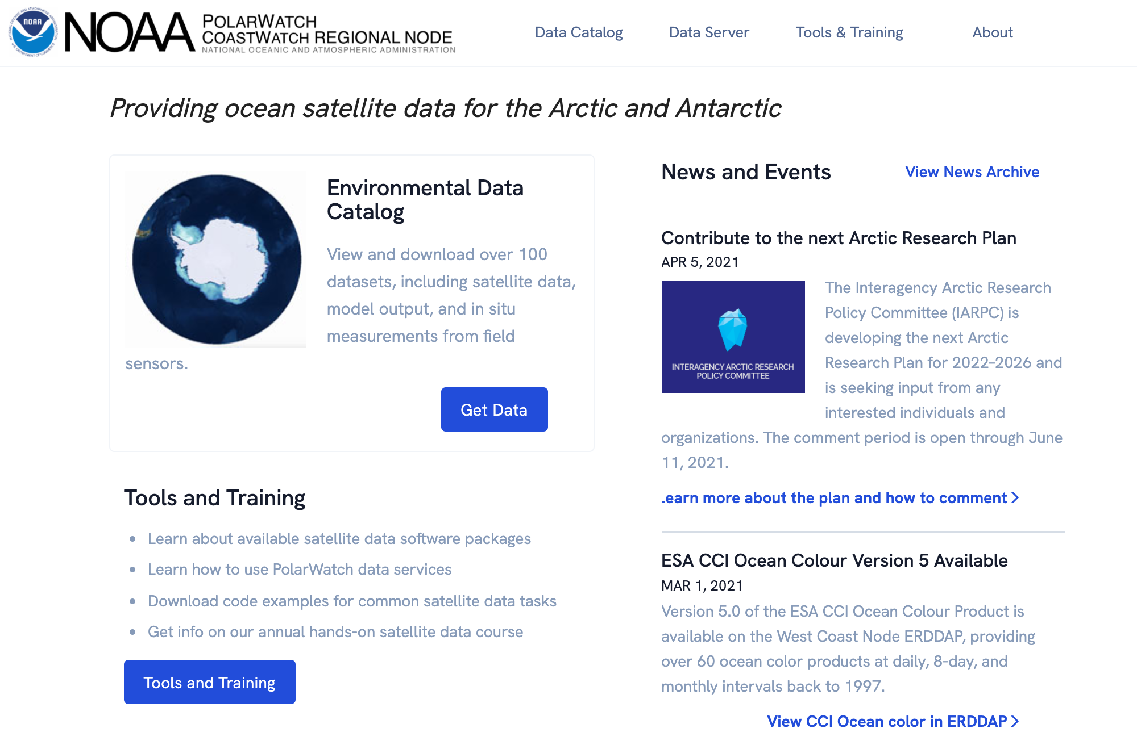
Visit the CoastWatch Websites
for data, information, tutorials, software, and more
West Coast Node
PolarWatch
Any CoastWatch Node
Central Pacific oceanwatch.pifsc.noaa.gov
Caribbean cwcaribbean.aoml.noaa.gov
East Coast eastcoast.coastwatch.noaa.gov
Great Lakes coastwatch.glerl.noaa.gov
CoastWatch Central coastwatch.noaa.gov
coastwatch.pfeg.noaa.gov
polarwatch.noaa.gov
Notes:
Lastly there are multiple different CoastWatch nodes, all geared towards a particular geographical region. The West Coast node has a lot of datasets with global coverage, but if your study area falls within the domain of one of the other nodes of CoastWatch you might want to check out those nodes for regional products. This concludes this presentation. Thank you for listening, I hope you have found it useful

