Slide 1
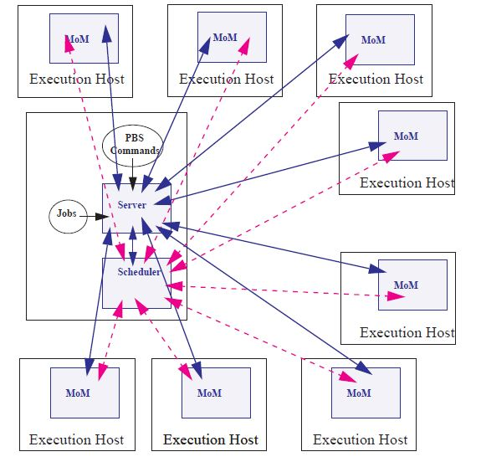
Torque Scheduler
Portable Batch System (PBS) :
a software which is used in cluster computing to schedule jobs on multiple nodes.
Terascale Open-source Resource and QUEue Manager (TORQUE)

Slide 2

Submitting a job
Script (R Script/matlab/python/etc)
PBS file

Slide 3
R script (demo.r)
args = commandArgs(trailingOnly=TRUE)
nsim <- as.numeric(args[1])
mean <- as.numeric(args[2])
sd <- as.numeric(args[3])
dir <- '~/project-stat/PSS_ICC/'
temp <- rnorm(nsim, mean, sd)
write.csv(temp, paste0(dir,"temp_",mean))

Slide 4
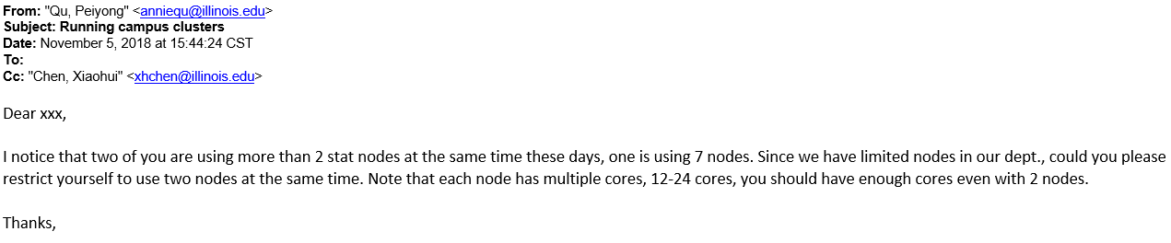
Simple PBS File
#!/bin/bash <- shebang
#PBS -N cluster_demo_0 <- JOB NAME
#PBS -l walltime=02:00:00 <- Max time for jobs
#PBS -o cluster_demo_0.out <- rename output log file
#PBS -j oe <- standard output and error streams are to be merged, intermixed, as standard output
#PBS -l naccesspolicy=shared <- sharing the node, because by default, you don't share
#PBS -l nodes=1:ppn=2 <- nodes used and cores on that node being used
module load R/3.5.1 <- load R and subsequent dependencies
Rscript directory/to/demo.r 100 0 1
For more details on other PBS directives

Slide 5
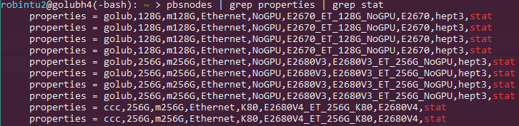
Submit PBS files
Secondary Queue
qsub my_pbs_file.pbs
Stat Queue
qsub –q stat my_pbs_file.pbs

Slide 6
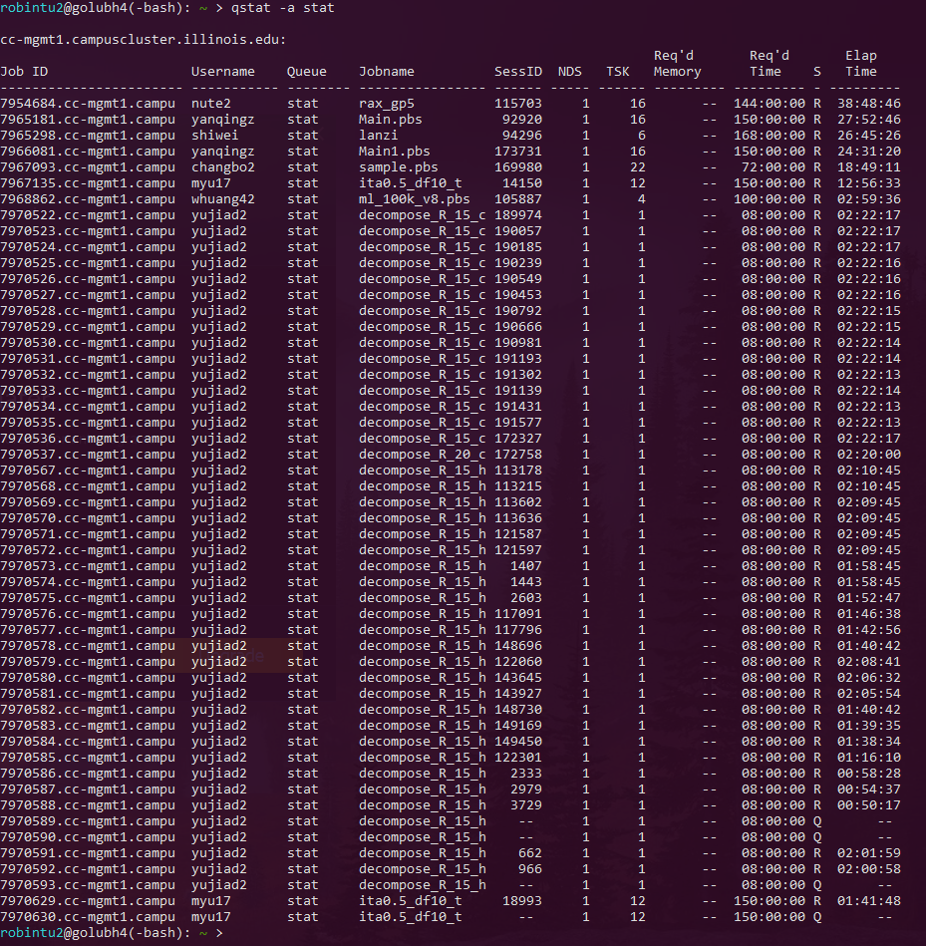
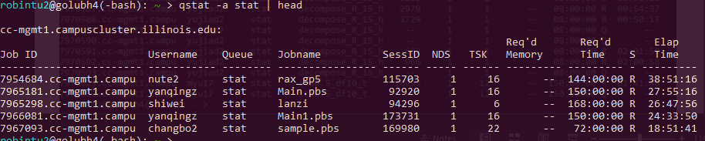
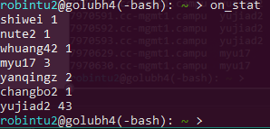
Job Status
qstat –a stat
Notes:
3 job status’ Q, R, C

Slide 7
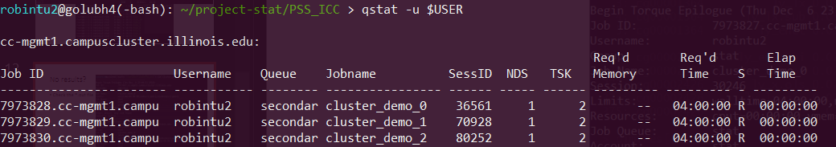
Your running jobs
qstat –u $USER

Slide 8
Killing Jobs
qdel your_job_number
#kill all jobs
alias kill_all='qselect -u $USER | xargs qdel'

Slide 9
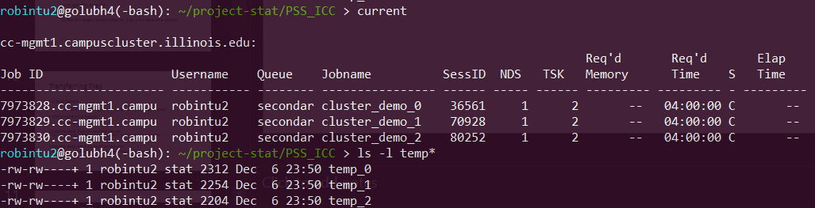
Completed jobs

Slide 10
File output
Print to console
results sent to wherever your pbs output file is directed
*.csv
your generic data file. Can combine using terminal easily
e.g. cat temp_* > final_temp
*.rds
Great for large, sparse objects. Can only save one object

Slide 11
Transferring files
Client Based:
WinSCP (windows), Filezilla (windows, Mac, Linux)
Command Line Based:
PuTTY, terminal
Copying data files to remote server
Copying data back to local computer
scp /path/to/local/file remote_user@remote_host:/path/to/remote/file
scp remote_user@remote_host:/path/to/remote/file /path/to/local/file

Slide 12
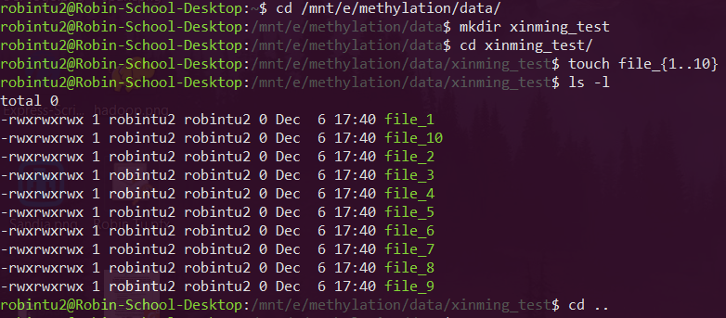
Example

Slide 13
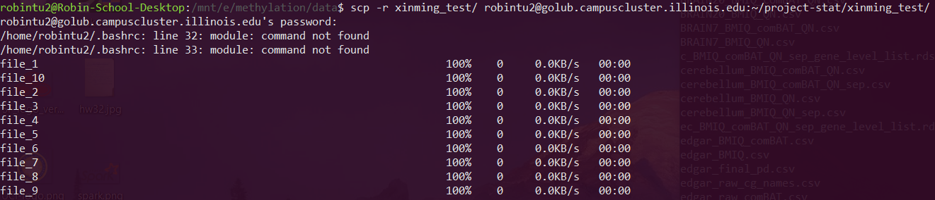
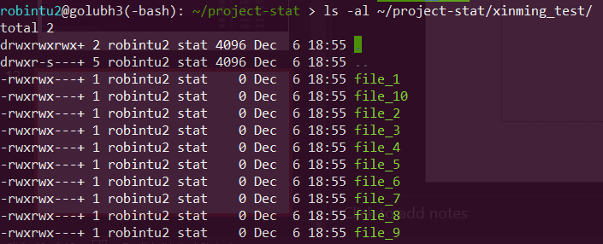
Example

Slide 14
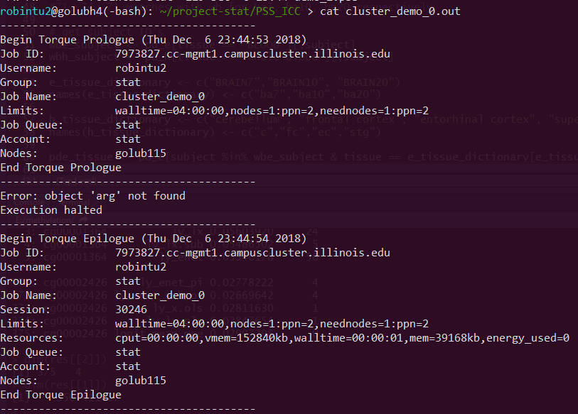
No results?
Check the *.out file

Slide 15

Can’t log on?
Maintenance?
Check your email:

Slide 16
Final Remarks:
Stat: …for long computations
Please enable sharing, sharing is off by default
keep number of nodes used to less than 2 (<32-48 cores)
Secondary: …for jobs you can split up
max walltime of 4 hours
Cannot share cores
Ram is divided proportional to the number of cores requested

