Slide 1
Digital Workplace Conference Australia
Sydney
2017

Slide 2
Office Client Development
Andrew Coates Microsoft

Slide 3
Notes:
Story Time

Slide 4


Slide 5

Andrew Coates
Microsoft
@coatsy
blogs.msdn.com/acoat

Slide 6
Agenda
What’s new
Single Sign On
Script Lab

Slide 7

What’s New
Notes:
This is an interesting question – what’s new since when?
Movable feast – constant releases

Slide 8
Rich API object set() method
https://dev.office.com/reference/add-ins/shared/richapiobject.set

Slide 9
Automatically open a task pane with a document
https://dev.office.com/docs/add-ins/design/automatically-open-a-task-pane-with-a-document

Slide 10

Single Sign On

Slide 11
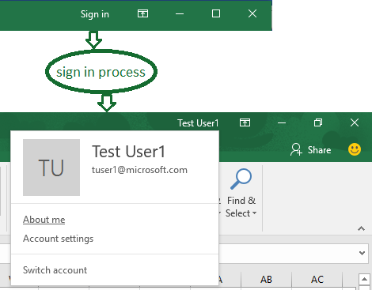
Signing in

Slide 12
Now you can
Authorize the user
Authorize the add-in
Fine Print
This feature is currently in preview and is subject to change in future releases. For this preview, single sign-on is supported only for work or school (Office 365) accounts and only for desktop versions of Office. Also, for Outlook, SSO only works if the Outlook account matches the Office user account listed in File > Office account.

Slide 13
Anatomy of an SSO Add-in
Calls to Graph from same FQDN as add-in source
Manifest specifies AAD registration and permissions

Slide 14


Sign In & Consent
Azure AD V2
3
4
2
5
Office Client
File
Home
Insert View Format
text
text
14
text
text
text
text
9
10
text
text
text
text
1
11
12
8
6
7
13
Microsoft Graph & Office365
Add-in server-side
Notes:
JavaScript in the add-in calls a new Office.js API getAccessTokenAsync. This tells the Office host application to obtain an access token to the add-in. (Hereafter, this is called the “add-in token”.)
[Occurs only if needed] If the user is not signed in, the Office host application opens a pop-up window for the user to sign in.
[Occurs only if needed] If this is the first time the current user has used your add-in, he or she is prompted to consent.
The Office host application requests the add-in token from the Azure AD v2.0 endpoint for the current user.
Azure AD sends the add-in token to the Office host application.
The Office host application sends the add-in token to the add-in as part of the result object returned by the call getAccessTokenAsync call.
JavaScript in the add-in makes an HTTP request to a web API that is hosted at the same fully-qualified domain as the add-in, and it includes the add-in token as authorization proof.
Server-side code validates the incoming add-in token.
Server-side code uses the “on behalf of” flow (defined at OAuth2 Token Exchange and the daemon or server application to web API Azure scenario) to obtain an access token for Microsoft Graph (hereafter, the "MSG token") in exchange for the add-in token.
Azure AD returns the MSG token (and a refresh token, if the add-in requests offline_access permission) to the add-in.
Server-side code caches the token(s).
Server-side code makes requests to Microsoft Graph and includes the MSG token.
Microsoft Graph returns data to the add-in, which can pass it on to the add-in’s UI.
[Occurs as needed] When the MSG token expires, the server-side code can use its refresh token to get a new MSG token.

Slide 15
Sso Add-in Development Steps
Register Add-in
Configure Add-in
Client-side code
Server-side code

Slide 16
Register Add-in
https://apps.dev.microsoft.com
Get ClientID and Secret
Specify Permissions

Slide 17
Configure Add-in
Manifest needs
WebApplicationInfo
Id
Resource
Scopes
Scope1
Scope2

Slide 18
Client-side Code
Call Office.context.auth.getAccessTokenAsync(myTokenHandler)
Create a Handler
function mytokenHandler(asyncResult) {
// Passes asyncResult.value (which has the add-in access token)
// to the add-in’s web API as an Authorization header.
}

Slide 19
Server-side Code
Validate add-in token
On-behalf-of flow to AAD
Cache MSG token
Use MSG token to get data from MS Graph

Slide 20
Build a SSO Add-in with ASP.NET
https://dev.office.com/docs/add-ins/develop/create-sso-office-add-ins-aspnet

Slide 21
Build a SSO Add-in with node.js
https://dev.office.com/docs/add-ins/develop/create-sso-office-add-ins-nodejs

Slide 22

ScriptLab

Slide 23
Install ScriptLab
https://store.office.com/en-us/app.aspx?assetid=WA104380862&ui=en-US&rs=en-US&ad=US&appredirect=false

Slide 24
Configure ScriptLab

Slide 25
A Lap Around ScriptLab

Slide 26
Agenda
What’s new
Single Sign On
Script Lab

Slide 27
Resources
dev.office.com
github.com/officedev
github.com/coatsy

Slide 28
Related Sessions
Microsoft Graph
Elaine van Bergen
Tomorrow 11:45
Microsoft Identity in the Cloud
Mark Rhodes
Tomorrow 15:00

Slide 29

Questions …
… and, possibly, answers

Slide 30

Do this!
Build Office Add-Ins

Slide 31
Andrew Coates
Microsoft
@coatsy
blogs.msdn.com/acoat

Slide 32

















Thank you to our sponsors!

