Slide 1


The Power of LightSwitch on Windows Azure
Andrew Coates http://blogs.msdn.com/acoat @coatsy

Slide 2
Today
Time | Activity
7:30 | Registration opens (will run throughout the day)
8:00-9:00 | Business Applications and the “Un”-Professional Developer: LightSwitch on Windows Azure
9:00-9:30 | Breakfast
9:30-10:30 | Discover Windows Azure Platform Part 1: Business Overview
10:30-11:00 | Morning Tea
11:00-12:00 | Discover Windows Azure Platform Part 2: Technical Overview
12:00-13:00 | Break (lunch will not be provided)
13:00-15:00 | Build your first Azure application using Visual Studio LightSwitch – with (almost) no code!

Slide 3
Agenda
What is LightSwitch?
Why should you care?
How does Azure fit in?

Slide 4


The simplest way to create business applications for the desktop and the cloud

Slide 5

What’s the problem?
http://www.flickr.com/photos/ooocha/3062591360/sizes/l/in/photostream/
Notes:
IT don’t have time
SMB don’t have infrastructure
Photo cc Attrib: http://www.flickr.com/photos/ooocha/3062591360/sizes/l/in/photostream/

Slide 6
Care Factor?
Devolve busy work
Engage SME
Enforce standards
Fast, scalable, robust

Slide 7

LightSwitch is for End User Developers

Slide 8
What do End User Developers Want?
A smooth on-ramp to development
Built-in plumbing that handles common application requirements
Simple and flexible deployment

Slide 9
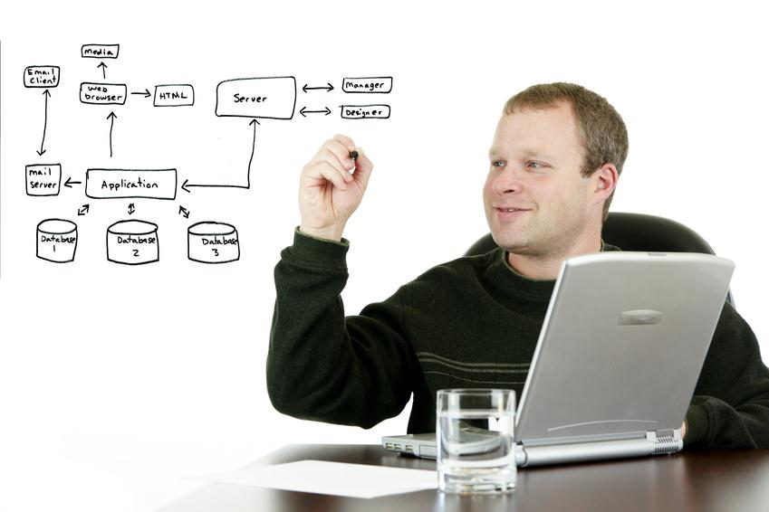
LightSwitch is for Professional Developers

Slide 10
The LightSwitch Development Experience
Start
Refine
Extend
Describe your data
Author business logic
Explore ecosystem components
Create screens for common tasks
Customise screen layouts
Create custom Silverlight controls
Define custom queries
Integrate with custom data sources

Slide 11

Introduction to LightSwitch
demo

Slide 12
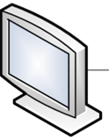


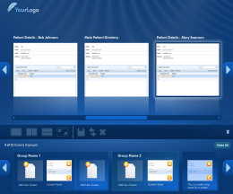
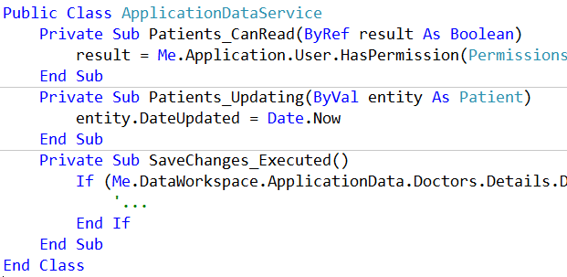
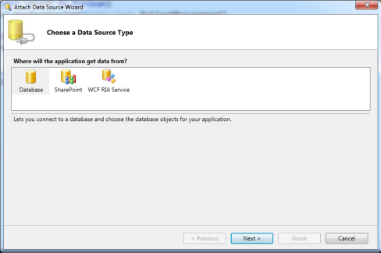
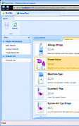
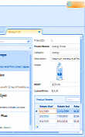
LightSwitch Application Overview
Client Tier
Middle Tier
Data Access
Screens
Methods
Controls
Submit Pipeline
Queries
Data Workspace
Data Workspace
WCF RIA Services
WCF RIA Services
Other
SQL Server
SQL Azure
Silverlight 4.0
ASP.NET 4.0
SharePoint
Browser Host
Desktop Host
IIS 6.0/7.0

Slide 13


Azure
Efficient pay-as-you go infrastructure
Scalable to almost any size
Easy deploy and maintain

Slide 14
Deploying LightSwitch on Windows Azure
demo

Slide 15
Summary
LightSwitch
Care factor
Azure

Slide 16
Where do you get it?
LightSwitch Trial: http://aka.ms/lsmsau
Windows Azure Trial http://aka.ms/AuAzTrial

Slide 17
Next Steps
Download LightSwitch
Sign up for Azure
Call your Developers
Tick Yes (later events)

Slide 18
Later Today
09:00-09:30 | Breakfast
09:30-10:30 | Discover Windows Azure Platform Part 1: Business Overview
10:30-11:00 | Morning Tea
11:00-12:00 | Discover Windows Azure Platform Part 2: Technical Overview
12:00-13:00 | Break (lunch will not be provided)
13:00-15:00 | Build your first Azure application using Visual Studio LightSwitch – with (almost) no code!

Slide 19


Fill in your eval form
Tick yes
please …

Slide 20

© 2011 Microsoft Corporation. All rights reserved. Microsoft, Windows, Windows Vista and other product names are or may be registered trademarks and/or trademarks in the U.S. and/or other countries.
The information herein is for informational purposes only and represents the current view of Microsoft Corporation as of the date of this presentation. Because Microsoft must respond to changing market conditions, it should not be interpreted to be a commitment on the part of Microsoft, and Microsoft cannot guarantee the accuracy of any information provided after the date of this presentation. MICROSOFT MAKES NO WARRANTIES, EXPRESS, IMPLIED OR STATUTORY, AS TO THE INFORMATION IN THIS PRESENTATION.

