Slide 1
Architecture (colour chooser)
Mobile service API
Colour Name
Colour Name
Colour Name
Colour Name
Colour Name
Go
Colour Name
Go
Colour Name
Go
Colour Name
Go
Go
Go
Go
POST
Colour (r, g, b)
Name (string)
Go

Slide 2
Architecture (Approval)
Mobile Service API
Colours Awaiting Approval
 | Jimmy Blue | ✓ | ✗
 | Patsy’s Purple | ✓ | ✗
 | Randy Red | ✓ | ✗
GET
List<ColourSubmission>
PATCH (Id)
- Approved (bool?)

Slide 3
Data Structure
Name | Type
Id | Int
Colour | Int
ColourName | String
Approved | Bool?
Submitted | DateTimeUTC

Slide 4
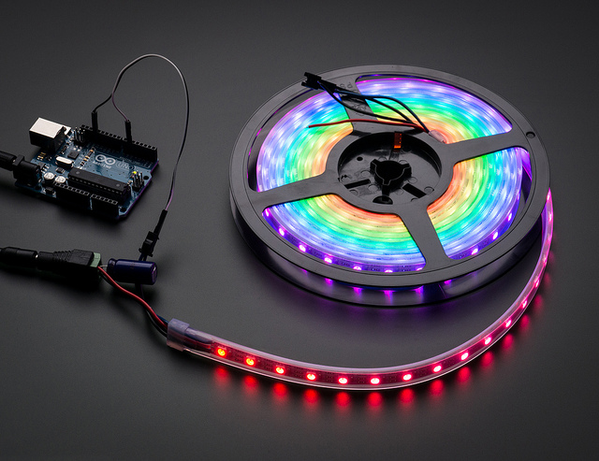
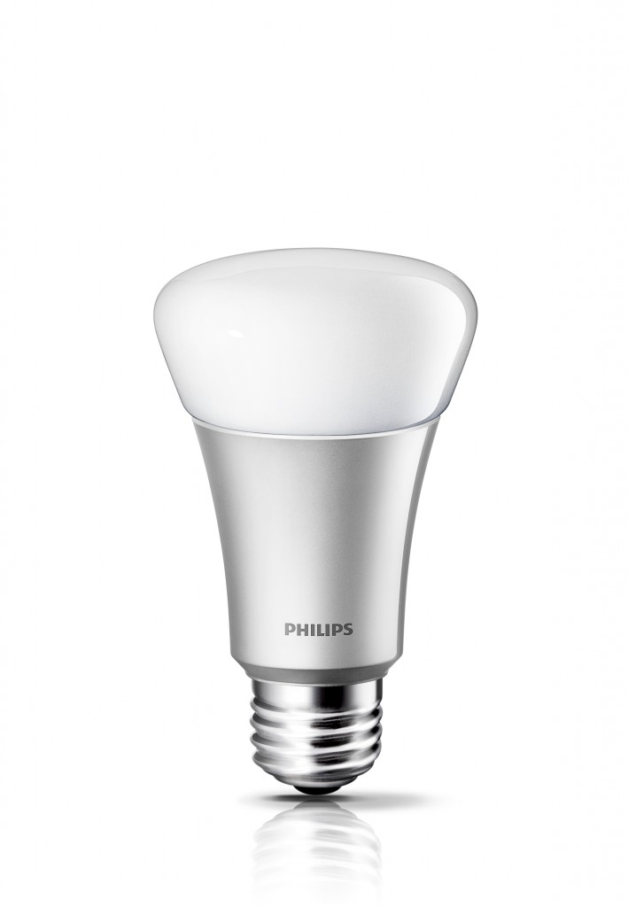
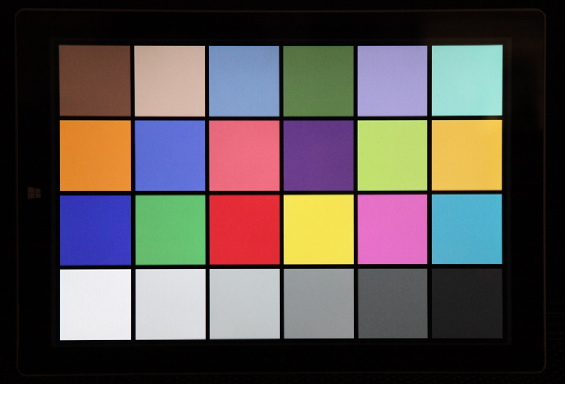
Architecture (colour display)
Mobile Service API
SignalR Message
Controller
(with cache)
GET
List<ColourSubmission>

