Slide 1
Building Cross-Platform Applications with the Microsoft Graph
Simon Jäger
Andrew Coates

Slide 2

Agenda
Introduction
Graph Endpoints
Graph SDKs
Auth with ADAL and MSAL
Building Common Code
DEMOs!

Slide 3
Introduction

Slide 4
Microsoft Graph API
Authentication
Services
App Registration

Slide 5
Cross-Platform Development Strategies
Hybrid
Native

Slide 6
Hybrid
Pros
Cons

Slide 7
Native
Pros
Cons

Slide 8
Xamarin
Forms
Native UI

Slide 9
Graph Endpoints

Slide 10
That lovely graph graphic
Maybe something about v1.0/ and beta/

Slide 11
Graph Endpoints
Excel REST API
Groups
Explanation of these two particularly

Slide 12
Demo
Excel and Groups with the Graph Explorer
Notes:
Open OneDrive for Business with AAD Credentials (from http://office.com)
Create a new Excel Workbook
Open Graph Explorer
Split display so you can see the workbook and graph explorer
Login with AAD credentials
Excel
Find the workbook you created
/beta/me/drive/root/children?$select=name,id
Get a reference to the workbook without the excel reference (file only)
/beta/me/drive/items/[id]
Now get a reference with the excel reference
/beta/me/drive/items/[id]/workbook
List the sheets
/beta/me/drive/items/[id]/workbook/worksheets
Get a reference to Sheet1
/beta/me/drive/items/[id]/workbook/worksheets('Sheet1')
Retrieve the contents of the range Sheet1!A1:C1
/beta/me/drive/items/[id]/workbook/worksheets('Sheet1')/range(address='Sheet1!A1:C1')
Write to the range Sheet1!A1:C1
PATCH
/beta/me/drive/items/[id]/workbook/worksheets('Sheet1')/range(address='Sheet1!A1:C1')
{
"values" : [["First Name", "Last Name", "Company"]]
}
Create a table based on the headers we just added
POST
/beta/me/drive/items/[id]/workbook/worksheets('Sheet1')/tables/$/add
{
"address" : “Sheet1!A1:C1“,
"hasheaders" : true
}
List the tables
GET
/beta/me/drive/items/[id]/workbook/worksheets('Sheet1')/tables
Add a row to the table
POST
/beta/me/drive/items/[id]/workbook/worksheets('Sheet1')/tables(‘Table1')/rows
{
“values" : [["Bill", "Gates", "Microsoft"]]
}
And another
POST
/beta/me/drive/items/[id]/workbook/worksheets('Sheet1')/tables('Table1')/rows
{
“values" : [["Elon", "Musk", "SpaceX"]]
}

Slide 13
Graph SDKs

Slide 14
Cross-Platform Auth with MSAL

Slide 15
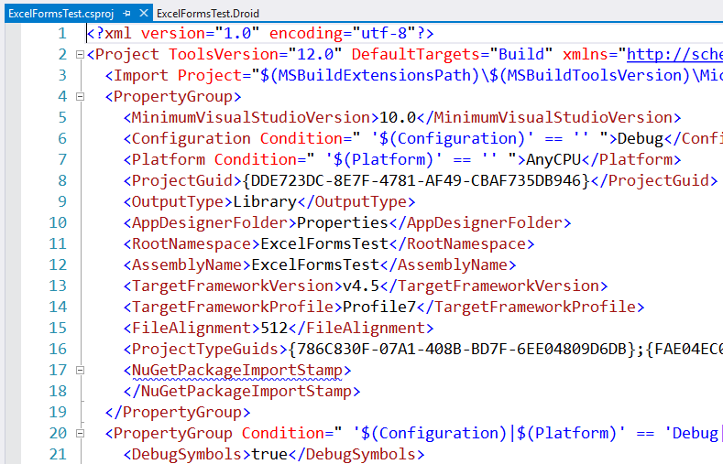
Gotchas
You need PCL Profile 7 (no WP8)
Default is 111
Edit the Project file

Slide 16
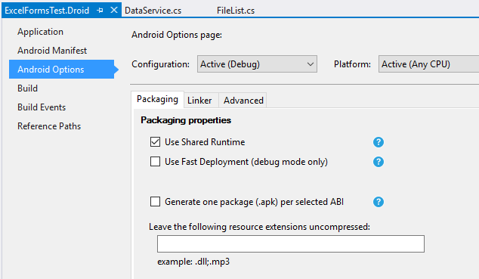
Gotchas (Android)
Turn off Fast Deployment

Slide 17
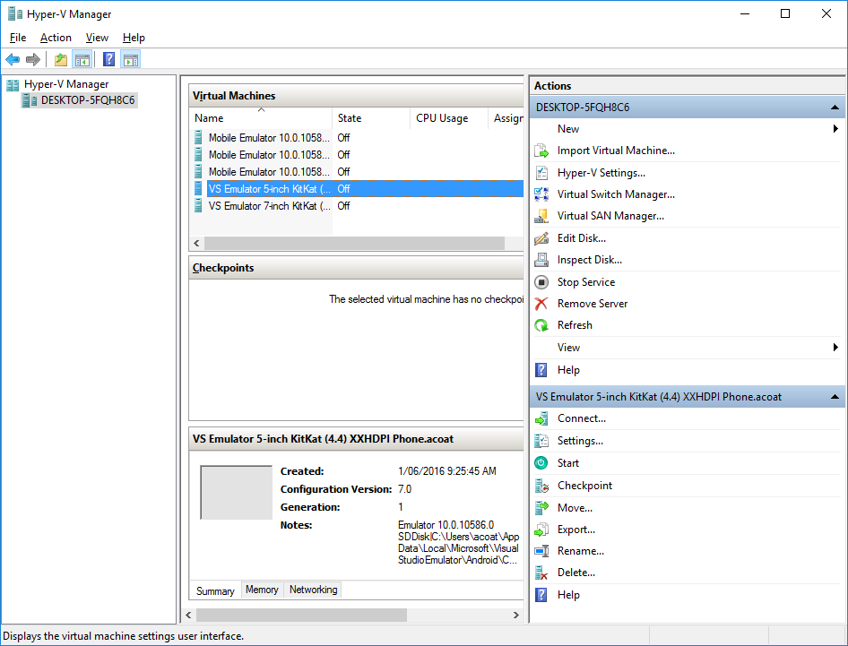
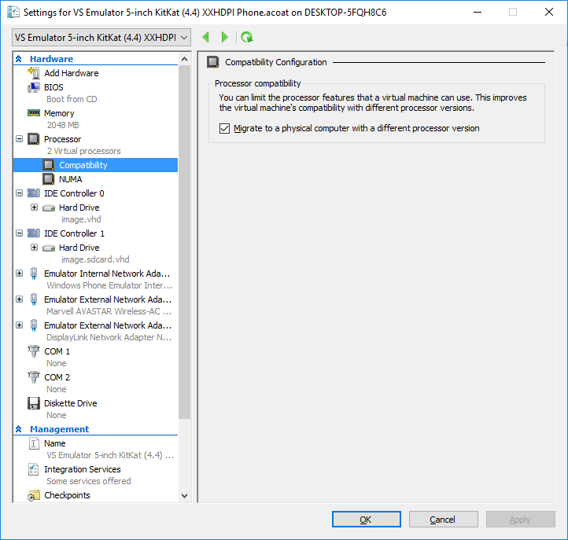
Gotchas (Android cont)
Enable x-machine CPU support in Hyper-V

Slide 18
Building Common Code

Slide 19
Bringing It All Together

Slide 20
Resources
Main MS Graph Landing Page https://graph.Microsoft.io
MS Graph Change Log https://graph.microsoft.io/changelog
Excel REST API Documentation http://graph.microsoft.io/en-us/docs/api-reference/beta/resources/excel
//build MSAL announcement https://blogs.technet.microsoft.com/ad/2016/03/31/microsoft-identity-at-build-2016/

Slide 21
Resources (cont)
Office Developer Show on MSAL https://channel9.msdn.com/Shows/Office-Dev-Show/Office-Dev-Show-Episode-27-Azure-AD-Converged-Authentication-and-the-Microsoft-Graph
Office Developer Show on Excel REST API https://channel9.msdn.com/Shows/Office-Dev-Show/Office-Dev-Show-Episode-28-Microsoft-Graph-and-Excel-APIs

Slide 22
Resources (Sample Code)
Xamarin Blog on MSAL and Forms https://blog.xamarin.com/authenticate-mobile-apps-using-microsoft-authentication-library/
https://github.com/OfficeDev/Microsoft-Graph-ASPNET-REST-Excel-Donations
https://github.com/microsoftgraph/xamarin-csharp-connect-sample

Slide 23
Resources (//build/ videos)
Microsoft Graph Overview https://channel9.msdn.com/Events/Build/2016/P569
Working with Excel Documents with the Microsoft Graph https://channel9.msdn.com/Events/Build/2016/P556
What's New with Microsoft Graph SDKs https://channel9.msdn.com/Events/Build/2016/P563
What's New in the People API on the Microsoft Graph https://channel9.msdn.com/Events/Build/2016/P571

Slide 24
Resources (Office Blog Posts)
Microsoft Graph findMeetingTimes API update http://dev.office.com/microsoft-graph-findmeetingtimes-api-update
Office Dev PnP Web Cast – Introduction to Microsoft Graph for Office 365 developer http://dev.office.com/blogs/Introduction-to-Microsoft-Graph-for-Office-365-developer

Slide 25
Agenda
Introduction
Graph Endpoints
Graph SDKs
Auth with ADAL and MSAL
Building Common Code
DEMOs!

Slide 26
Building Cross-Platform Applications with the Microsoft Graph
Simon Jäger
Andrew Coates

