Slide 1
Chapter 3
Describing Syntax and Semantics

Slide 2
Chapter 3 Topics
Introduction
The General Problem of Describing Syntax
Formal Methods of Describing Syntax
Attribute Grammars
Describing the Meanings of Programs: Dynamic Semantics
Quora link on Communication
Copyright © 2015 Pearson. All rights reserved.
1-<number>
Notes:
Book example (algol & algol 68) difficult catching on due to complicated or difficult to understand language description

Slide 3
Introduction*
Syntax: the form or structure of the expressions, statements, and program units
Semantics: the meaning of the expressions, statements, and program units
Syntax and semantics provide a language’s definition
  Users of a language definition
    Other language designers
    Implementers
    Programmers (the users of the language)
Copyright © 2015 Pearson. All rights reserved.
1-<number>

Slide 4
The General Problem of Describing Syntax: Terminology *
A sentence is a string of characters over some alphabet
A language is a set of sentences
A lexeme is the lowest level syntactic unit of a language (e.g., *, sum, begin) *
A token is a category of lexemes (e.g., identifier) *
Lexeme vs Token *
Copyright © 2015 Pearson. All rights reserved.
1-<number>

Slide 5
Formal Definition of Languages
Recognizers
  A recognition device reads input strings over the alphabet of the language and decides whether the input strings belong to the language
  Example: syntax analysis part of a compiler
  - Detailed discussion of syntax analysis appears in
  Chapter 4
  - Kind of like a state machine
Generators
  A device that generates sentences of a language
  One can determine if the syntax of a particular sentence is syntactically correct by comparing it to the structure of the generator
Generator vs Recognizer *
Copyright © 2015 Pearson. All rights reserved.
1-<number>
Notes:
Parsers are Recognizers. Only used to determine if syntax is correct.

Slide 6
BNF and Context-Free Grammars
Context-Free Grammars
  Developed by Noam Chomsky in the mid-1950s
  Language generators, meant to describe the syntax of natural languages
  Define a class of languages called context-free languages
Backus-Naur Form (1959)
  Invented by John Backus to describe the syntax of Algol 58
  BNF is equivalent to context-free grammars
Copyright © 2015 Pearson. All rights reserved.
1-<number>

Slide 7
BNF Fundamentals *
In BNF, abstractions are used to represent classes of syntactic structures--they act like syntactic variables (also called nonterminal symbols, or just terminals)
Terminals are lexemes or tokens
A rule has a left-hand side (LHS), which is a nonterminal, and a right-hand side (RHS), which is a string of terminals and/or nonterminals
In English…
  “The angle brackets distinguish syntax rules names (also called non-terminal symbols) from terminal symbols which are written exactly as they are to be represented.”
See also… or this…
Copyright © 2015 Pearson. All rights reserved.
1-<number>

Slide 8
BNF Fundamentals (continued) *
Nonterminals are often enclosed in angle brackets
  Examples of BNF rules:
  <ident_list> → identifier | identifier, <ident_list>
  <if_stmt> → if <logic_expr> then <stmt>
Grammar: a finite non-empty set of rules
A start symbol is a special element of the nonterminals of a grammar
Copyright © 2015 Pearson. All rights reserved.
1-<number>

Slide 9
BNF Rules *
An abstraction (or nonterminal symbol) can have more than one RHS
<stmt> → <single_stmt>
| begin <stmt_list> end
Copyright © 2015 Pearson. All rights reserved.
1-<number>

Slide 10
Describing Lists *
Syntactic lists are described using recursion
<ident_list> → ident
| ident, <ident_list>
A derivation is a repeated application of rules, starting with the start symbol and ending with a sentence (all terminal symbols)
Copyright © 2015 Pearson. All rights reserved.
1-<number>

Slide 11
An Example Grammar
<program> → <stmts>
<stmts> → <stmt> | <stmt> ; <stmts>
<stmt> → <var> = <expr>
<var> → a | b | c | d
<expr> → <term> + <term> | <term> - <term>
<term> → <var> | const
Copyright © 2015 Pearson. All rights reserved.
1-<number>

Slide 12
In-Class Exercise 1
Can you identify all of the lexemes in the Example Grammar on the previous slide?
+, -, =, ;, a, b, c, d, const
Copyright © 2015 Pearson. All rights reserved.
1-<number>

Slide 13
An Example Grammar
<program> → <stmts>
<stmts> → <stmt> | <stmt> ; <stmts>
<stmt> → <var> = <expr>
<var> → a | b | c | d
<expr> → <term> + <term> | <term> - <term>
<term> → <var> | const
Copyright © 2015 Pearson. All rights reserved.
1-<number>

Slide 14
In-Class Exercise 2
Can you identify or name what tokens this grammar might consist of and match them with possible lexemes?
Token | Lexemes
var | a, b, c, d
add_op | +
sub_op | -
assgn_op | =
const | const
semi | ;
Copyright © 2015 Pearson. All rights reserved.
1-<number>

Slide 15
An Example Grammar
<program> → <stmts>
<stmts> → <stmt> | <stmt> ; <stmts>
<stmt> → <var> = <expr>
<var> → a | b | c | d
<expr> → <term> + <term> | <term> - <term>
<term> → <var> | const
Copyright © 2015 Pearson. All rights reserved.
1-<number>

Slide 16
In-Class Exercise 3
Modify the Example grammar on the previous slide so that you can also multiply and divide…
  Note: you do not have to worry about operator precedence for this exercise.
<program> → <stmts>
<stmts> → <stmt> | <stmt> ; <stmts>
<stmt> → <var> = <expr>
<var> → a | b | c | d
<expr> → <term> + <term> | <term> - <term>
| <term> * <term> | <term> / <term>
<term> → <var> | const
Copyright © 2015 Pearson. All rights reserved.
1-<number>

Slide 17
Derivations *
Every string of symbols in a derivation is a sentential form
A sentence is a sentential form that has only terminal symbols
A leftmost derivation is one in which the leftmost nonterminal in each sentential form is the one that is expanded
A derivation may be neither leftmost nor rightmost
Copyright © 2015 Pearson. All rights reserved.
1-<number>
Notes:
Can think about a derivation as the process of going from a starting rule in a gramar to a sentence (only terminal symbols)

Slide 18
An Example Derivation
<program> => <stmts> => <stmt>
=> <var> = <expr>
=> a = <expr>
=> a = <term> + <term>
=> a = <var> + <term>
=> a = b + <term>
=> a = b + const
* Derivation is going from <program> to a = b + const
* Note that for each sentencial form (everything preceded by => up to the next => symbol), we always choose to expand the leftmost (or the first) non-terminal symbol we find.
* If we wanted to perform a rightmost derivation, we would simply do the opposite (expand from right to left)
Copyright © 2015 Pearson. All rights reserved.
1-<number>

Slide 19
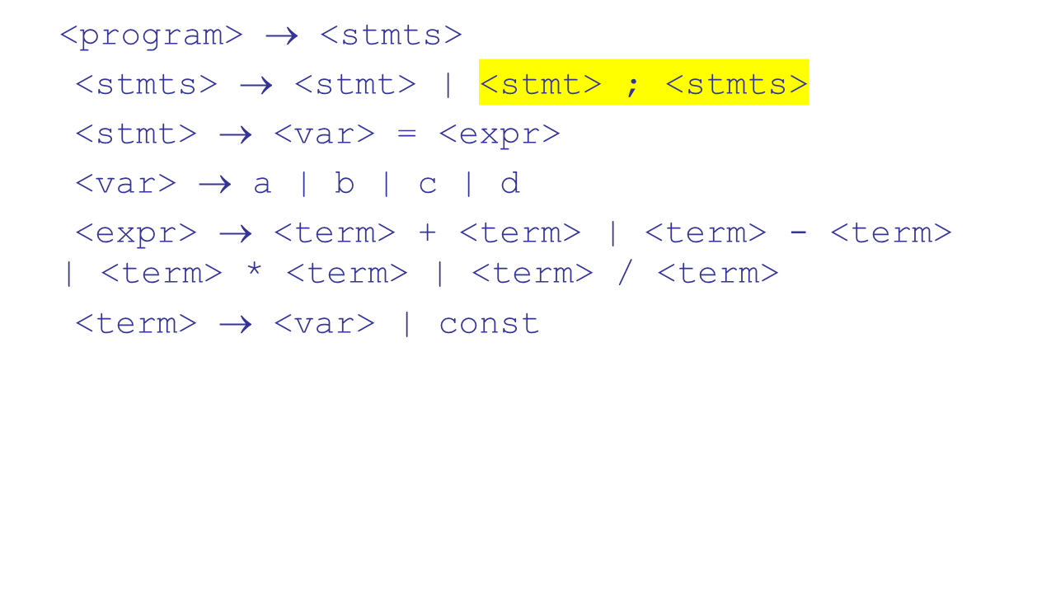
Modified Example Grammar
Copyright © 2015 Pearson. All rights reserved.
1-<number>

Slide 20
In-Class Exercise 4
Write out a sample derivation of your modified grammar using left-most derivation. Your sample derivation must use the second rule of the grammar - the right side of the | statement –
<stmt> ; <stmts>
  Next Slide
Copyright © 2015 Pearson. All rights reserved.
1-<number>

Slide 21
In-Class Exercise 4
<program> => <stmts> => <stmt> ; <stmts>
=> <var> = <expr> ; <stmts>
=> c = <expr> ; <stmts>
=> c = <term> * <term> ; <stmts>
=> c = <var> * <term> ; <stmts>
=> c = b * <term> ; <stmts>
=> c = b * const ; <stmts>
=> c = b * const ; <stmt>
=> c = b * const ; <var> = <expr>
=> c = b * const ; a = <expr>
=> c = b * const ; a = <term> + <term>
=> c = b * const ; a = const + <term>
=> c = b * const ; a = const + const
Copyright © 2015 Pearson. All rights reserved.
1-<number>

Slide 22
Key Points Thusfar *
Tokens & Lexemes
BNF Grammars
  Rules
  Non-terminals (LHS)
  Terminals (RHS)
Derivations
Copyright © 2015 Pearson. All rights reserved.
1-<number>

Slide 23
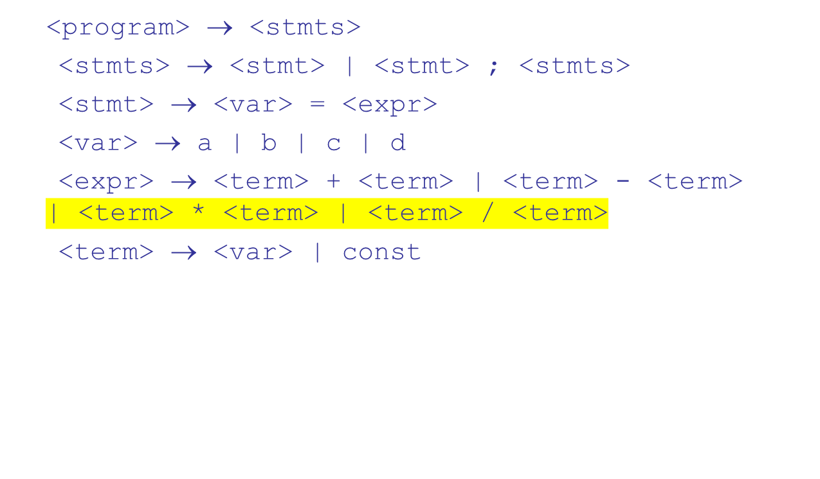
Modified Example Grammar
Copyright © 2015 Pearson. All rights reserved.
1-<number>

Slide 24
Parse Tree *
A hierarchical representation of a derivation
<program> => <stmts>
=> <stmt>
=> <var> = <expr>
=> a = <expr>
=> a = <term> + <term>
=> a = <var> + <term>
=> a = b + <term>
=> a = b + const
<program>
<stmts>
<stmt>
<var>
=
<expr>
a
<term>
+
<term>
<var>
const
b
Copyright © 2015 Pearson. All rights reserved.
1-<number>

Slide 25
Ambiguity in Grammars *
A grammar is ambiguous if and only if it generates a sentential form that has two or more distinct parse trees
Copyright © 2015 Pearson. All rights reserved.
1-<number>

Slide 26
An Ambiguous Expression Grammar
<expr> → <expr> <op> <expr> | const
<op> → / | -
<expr>
<expr>
<expr>
<op>
<expr>
<expr>
<op>
<op>
<expr>
<expr>
<op>
<expr>
<expr>
<op>
<expr>
const
-
const
/
const
const
-
const
/
const
Copyright © 2015 Pearson. All rights reserved.
1-<number>

Slide 27
An Unambiguous Expression Grammar
If we use the parse tree to indicate precedence levels of the operators, we cannot have ambiguity
<expr> → <expr> - <term> | <term>
<term> → <term> / const | const
<expr>
<expr>
-
<term>
<term>
<term>
/
const
const
const
Copyright © 2015 Pearson. All rights reserved.
1-<number>

Slide 28
Associativity of Operators
Operator associativity can also be indicated by a grammar
<expr> -> <expr> + <expr> | const (ambiguous)
<expr> -> <expr> + const | const (unambiguous)
<expr>
<expr>
<expr>
+
const
<expr>
+
const
const
Copyright © 2015 Pearson. All rights reserved.
1-<number>

Slide 29
Unambiguous Grammar for Selector
Java if-then-else grammar
<if_stmt> -> if (<logic_expr>) <stmt>
| if (<logic_expr>) <stmt> else <stmt>
Ambiguous!
- An unambiguous grammar for if-then-else
<stmt> -> <matched> | <unmatched> | a non-if statement
<matched> -> if (<logic_expr>) <matched> else <matched>
| a non-if statement
<unmatched> -> if (<logic_expr>) <stmt>
| if (<logic_expr>) <matched> else
<unmatched>
*<stmt> -> <if_stmt> | a non-if statement
Copyright © 2015 Pearson. All rights reserved.
1-<number>

Slide 30
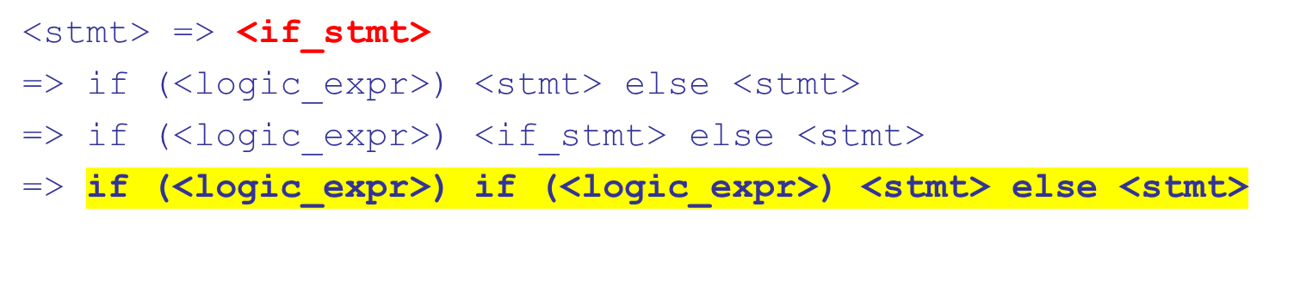
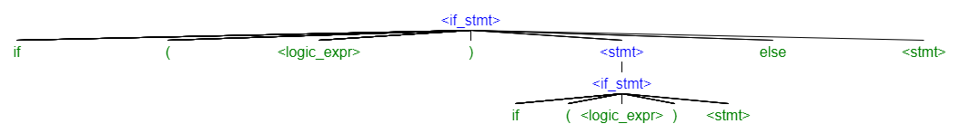
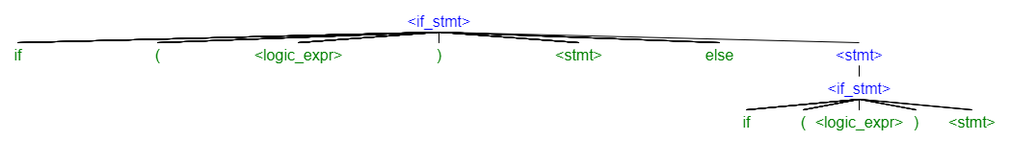
Example of Ambiguous If-then-else

Slide 31
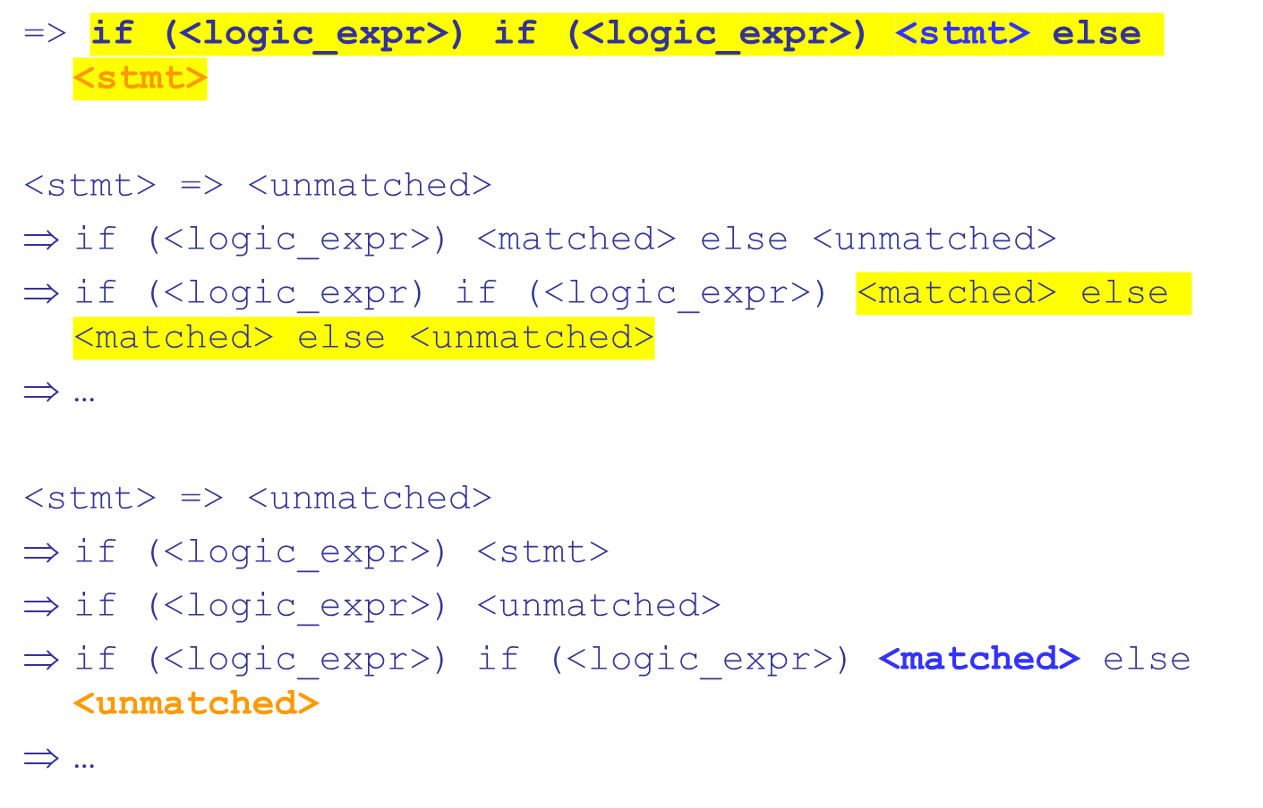
Example of Un-Ambiguous If-then-else

Slide 32
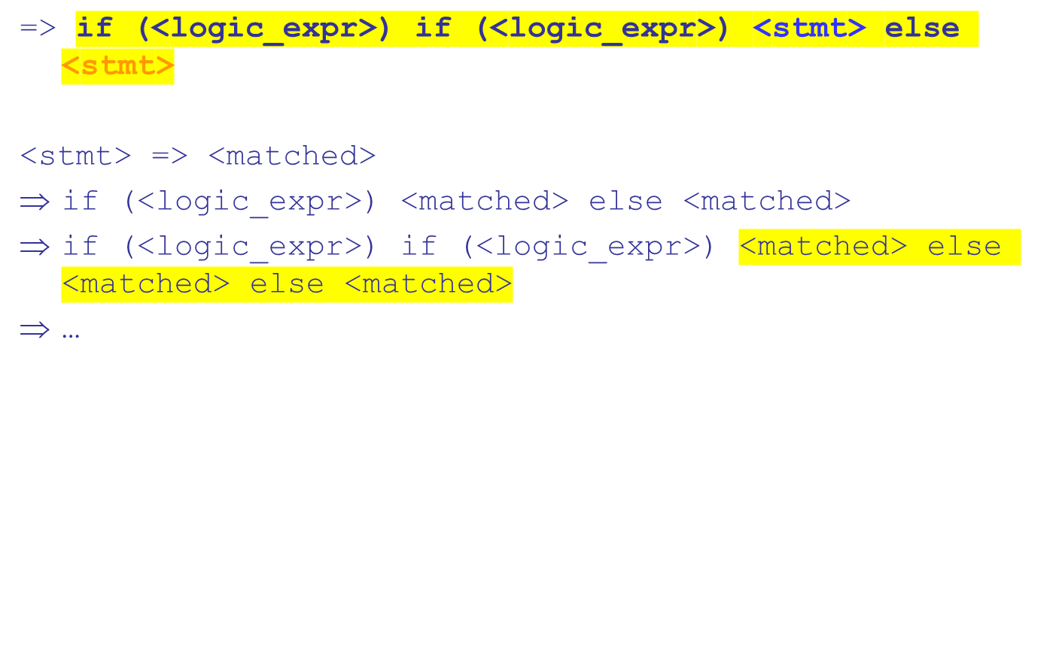
Example of Un-Ambiguous If-then-else

Slide 33
In-Class Exercise 5
Pick any of the incomplete derivations on the prior two slides and:
Finish the derivation
Draw a parse tree for it
Copyright © 2015 Pearson. All rights reserved.
1-<number>

Slide 34
Extended BNF (EBNF)
Notations (metasymbols)
  [] Optional or repeated
  {}, {}+ Repetition or iteration
  ( choices | separated | by | or bar ) choose 1
Copyright © 2015 Pearson. All rights reserved.
1-<number>

Slide 35
Extended BNF
Optional parts are placed in brackets [ ]
<proc_call> -> ident [(<expr_list>)]
Alternative parts of RHSs are placed inside parentheses and separated via vertical bars
<term> → <term> (+|-) const
Repetitions (0 or more) are placed inside braces { }
<ident> → letter {letter|digit}
Copyright © 2015 Pearson. All rights reserved.
1-<number>

Slide 36
BNF and EBNF
BNF
<expr> → <expr> + <term>
| <expr> - <term>
| <term>
<term> → <term> * <factor>
| <term> / <factor>
| <factor>
EBNF
<expr> → <term> {(+ | -) <term>}
<term> → <factor> {(* | /) <factor>}
Copyright © 2015 Pearson. All rights reserved.
1-<number>

Slide 37
Recent Variations in EBNF
Alternative RHSs are put on separate lines
Use of a colon instead of =>
Use of _{opt} for optional parts
Use of oneof for choices
Copyright © 2015 Pearson. All rights reserved.
1-<number>

Slide 38
Static Semantics
Nothing to do with meaning
Context-free grammars (CFGs) cannot describe all of the syntax of programming languages
Categories of constructs that are trouble:
- Context-free, but cumbersome (e.g.,
types of operands in expressions)
- Non-context-free (e.g., variables must
be declared before they are used)
Copyright © 2015 Pearson. All rights reserved.
1-<number>

Slide 39
Attribute Grammars
Attribute grammars (AGs) have additions to CFGs to carry some semantic info on parse tree nodes
Primary value of AGs:
  Static semantics specification
  Compiler design (static semantics checking)
Copyright © 2015 Pearson. All rights reserved.
1-<number>

Slide 40
Attribute Grammars : Definition
Def: An attribute grammar is a context-free grammar G = (S, N, T, P) with the following additions:
  For each grammar symbol x there is a set A(x) of attribute values
  Each rule has a set of functions that define certain attributes of the nonterminals in the rule
  Each rule has a (possibly empty) set of predicates to check for attribute consistency
Copyright © 2015 Pearson. All rights reserved.
1-<number>
Notes:
Attributes like variables; can have values, associated with non-terminals
Attribute computation function – functions that define or can be used to apply attributes to non-terminals
Predicate functions – state semantic rules, associated with grammar rules

Slide 41
Attribute Grammars: Definition
Let X₀ → X₁ ... X_{n} be a rule
Functions of the form S(X₀) = f(A(X₁), ... , A(X_{n})) define synthesized attributes
Functions of the form I(X_{j}) = f(A(X₀), ... , A(X_{n})), for i <= j <= n, define inherited attributes
Initially, there are intrinsic attributes on the leaves
Copyright © 2015 Pearson. All rights reserved.
1-<number>
Notes:
Intrinsic attributes are attributes that come from outside of the parse tree (for example, token was defined as an int, did not have to be inferred from surrounding context
Inherited are inferred; ex: adding float and int, result saved as float, float is inherited value

Slide 42
Attribute Grammars: An Example
Syntax
  <assign> -> <var> = <expr>
  <expr> -> <var> + <var> | <var>
  <var> A | B | C
actual_type: synthesized for <var> and <expr>
expected_type: inherited for <expr>
Copyright © 2015 Pearson. All rights reserved.
1-<number>

Slide 43
Attribute Grammar (continued)
Syntax rule: <expr> → <var>[1] + <var>[2]
Semantic rules:
<expr>.actual_type ← <var>[1].actual_type
Predicate:
<var>[1].actual_type == <var>[2].actual_type
<expr>.expected_type == <expr>.actual_type
Syntax rule: <var> → id
Semantic rule:
<var>.actual_type ← lookup (<var>.string)
Copyright © 2015 Pearson. All rights reserved.
1-<number>

Slide 44
Attribute Grammars (continued)
How are attribute values computed?
  If all attributes were inherited, the tree could be decorated in top-down order.
  If all attributes were synthesized, the tree could be decorated in bottom-up order.
  In many cases, both kinds of attributes are used, and it is some combination of top-down and bottom-up that must be used.
Copyright © 2015 Pearson. All rights reserved.
1-<number>

Slide 45
Attribute Grammars (continued)
<expr>.expected_type ← inherited from parent
<var>[1].actual_type ← lookup (A)
<var>[2].actual_type ← lookup (B)
<var>[1].actual_type =? <var>[2].actual_type
<expr>.actual_type ← <var>[1].actual_type
<expr>.actual_type =? <expr>.expected_type
Copyright © 2015 Pearson. All rights reserved.
1-<number>

Slide 46
Semantics
There is no single widely acceptable notation or formalism for describing semantics
Several needs for a methodology and notation for semantics:
  Programmers need to know what statements mean
  Compiler writers must know exactly what language constructs do
  Correctness proofs would be possible
  Compiler generators would be possible
  Designers could detect ambiguities and inconsistencies
Copyright © 2015 Pearson. All rights reserved.
1-<number>

Slide 47
Operational Semantics
Operational Semantics
  Describe the meaning of a program by executing its statements on a machine, either simulated or actual. The change in the state of the machine (memory, registers, etc.) defines the meaning of the statement
To use operational semantics for a high-level language, a virtual machine is needed
Copyright © 2015 Pearson. All rights reserved.
1-<number>

Slide 48
Operational Semantics
A hardware pure interpreter would be too expensive
A software pure interpreter also has problems
  The detailed characteristics of the particular computer would make actions difficult to understand
  Such a semantic definition would be machine- dependent
Copyright © 2015 Pearson. All rights reserved.
1-<number>

Slide 49
Operational Semantics (continued)
A better alternative: A complete computer simulation
The process:
  Build a translator (translates source code to the machine code of an idealized computer)
  Build a simulator for the idealized computer
Evaluation of operational semantics:
  Good if used informally (language manuals, etc.)
  Extremely complex if used formally (e.g., VDL), it was used for describing semantics of PL/I.
Copyright © 2015 Pearson. All rights reserved.
1-<number>

Slide 50
Operational Semantics (continued)
Uses of operational semantics:
- Language manuals and textbooks
- Teaching programming languages
Two different levels of uses of operational semantics:
- Natural operational semantics
- Structural operational semantics
Evaluation
- Good if used informally (language
manuals, etc.)
- Extremely complex if used formally (e.g.,VDL)
Copyright © 2015 Pearson. All rights reserved.
1-<number>

Slide 51
Axiomatic Semantics
Based on formal logic (predicate calculus)
Original purpose: formal program verification
Axioms or inference rules are defined for each statement type in the language (to allow transformations of logic expressions into more formal logic expressions)
The logic expressions are called assertions
Copyright © 2015 Pearson. All rights reserved.
1-<number>
Notes:
C assert statements before and after function execution

Slide 52
Axiomatic Semantics (continued)
An assertion before a statement (a precondition) states the relationships and constraints among variables that are true at that point in execution
An assertion following a statement is a postcondition
A weakest precondition is the least restrictive precondition that will guarantee the postcondition
Copyright © 2015 Pearson. All rights reserved.
1-<number>
Notes:
Example: precondition to add two numbers and result not be negative

Slide 53
Axiomatic Semantics Form
Pre-, post form: {P} statement {Q}
An example
  a = b + 1 {a > 1}
  One possible precondition: {b > 10}
  Weakest precondition: {b > 0}
Copyright © 2015 Pearson. All rights reserved.
1-<number>

Slide 54
Axiomatic Semantics Key Areas
Assignment
Sequences
Selection
Loops
Copyright © 2015 Pearson. All rights reserved.
1-<number>

Slide 55
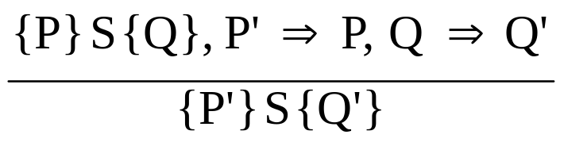
Axiomatic Semantics: Assignment
An axiom for assignment statements
(x = E): {Q_{x->E}} x = E {Q}
The Rule of Consequence:
Copyright © 2015 Pearson. All rights reserved.
1-<number>
Notes:
Show how precondition can be expressed using post-condition
Discuss briefly how theorum can be applied to assignment statements

Slide 56

Axiomatic Semantics: Sequences
An inference rule for sequences of the form S1; S2
{P1} S1 {P2}
{P2} S2 {P3}
Copyright © 2015 Pearson. All rights reserved.
1-<number>
Notes:
Similar to previous. Calculate precondition for last statement, apply it as post for first, then calculate first pre-condition

Slide 57
Axiomatic Semantics: Selection
An inference rules for selection
- if B then S1 else S2
{B and P} S1 {Q}, {(not B) and P} S2 {Q}
{P} if B then S1 else S2 {Q}
Copyright © 2015 Pearson. All rights reserved.
1-<number>

Slide 58
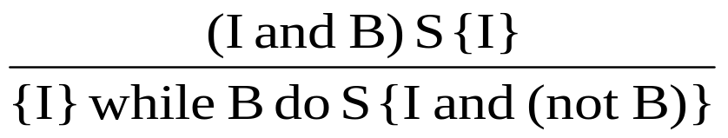
Axiomatic Semantics: Loops
An inference rule for logical pretest loops
{P} while B do S end {Q}
where I is the loop invariant (the inductive hypothesis)
Copyright © 2015 Pearson. All rights reserved.
1-<number>

Slide 59
Axiomatic Semantics: Axioms
Characteristics of the loop invariant: I must meet the following conditions:
  P => I -- the loop invariant must be true initially
  {I} B {I} -- evaluation of the Boolean must not change the validity of I
  {I and B} S {I} -- I is not changed by executing the body of the loop
  (I and (not B)) => Q -- if I is true and B is false, Q is implied
  The loop terminates -- can be difficult to prove
Copyright © 2015 Pearson. All rights reserved.
1-<number>
Notes:
Evaluate inductively
Compute relationship for a few cases, look for pattern
Give example

Slide 60
Loop Invariant
The loop invariant I is a weakened version of the loop postcondition, and it is also a precondition.
I must be weak enough to be satisfied prior to the beginning of the loop, but when combined with the loop exit condition, it must be strong enough to force the truth of the postcondition
Copyright © 2015 Pearson. All rights reserved.
1-<number>

Slide 61
Program Proof Process
The postcondition for the entire program is the desired result
  Work back through the program to the first statement. If the precondition on the first statement is the same as the program specification, the program is correct.
Copyright © 2015 Pearson. All rights reserved.
1-<number>
Notes:
Read the book

Slide 62
Evaluation of Axiomatic Semantics
Developing axioms or inference rules for all of the statements in a language is difficult
It is a good tool for correctness proofs, and an excellent framework for reasoning about programs, but it is not as useful for language users and compiler writers
Its usefulness in describing the meaning of a programming language is limited for language users or compiler writers
Copyright © 2015 Pearson. All rights reserved.
1-<number>

Slide 63
Denotational Semantics
Based on recursive function theory
The most abstract semantics description method
Originally developed by Scott and Strachey (1970)
Copyright © 2015 Pearson. All rights reserved.
1-<number>

Slide 64
Denotational Semantics - continued
The process of building a denotational specification for a language:
- Define a mathematical object for each language
entity
  Define a function that maps instances of the language entities onto instances of the corresponding mathematical objects
The meaning of language constructs are defined by only the values of the program's variables
Copyright © 2015 Pearson. All rights reserved.
1-<number>

Slide 65
Denotational Semantics: program state
The state of a program is the values of all its current variables
s = {<i₁, v₁>, <i₂, v₂>, …, <i_{n}, v_{n}>}
Let VARMAP be a function that, when given a variable name and a state, returns the current value of the variable
VARMAP(i_{j}, s) = v_{j}
Copyright © 2015 Pearson. All rights reserved.
1-<number>

Slide 66
Decimal Numbers
<dec_num> → '0' | '1' | '2' | '3' | '4' | '5' |
'6' | '7' | '8' | '9' |
<dec_num> ('0' | '1' | '2' | '3' |
'4' | '5' | '6' | '7' |
'8' | '9')
M_{dec}('0') = 0, M_{dec} ('1') = 1, …, M_{dec} ('9') = 9
M_{dec} (<dec_num> '0') = 10 * M_{dec} (<dec_num>)
M_{dec} (<dec_num> '1’) = 10 * M_{dec} (<dec_num>) + 1
…
M_{dec} (<dec_num> '9') = 10 * M_{dec} (<dec_num>) + 9
Copyright © 2015 Pearson. All rights reserved.
1-<number>

Slide 67
Expressions
Map expressions onto Z ∪ {error}
We assume expressions are decimal numbers, variables, or binary expressions having one arithmetic operator and two operands, each of which can be an expression
Copyright © 2015 Pearson. All rights reserved.
1-<number>

Slide 68
Expressions
M_{e}(<expr>, s) Δ=
case <expr> of
<dec_num> => M_{dec}(<dec_num>, s)
<var> =>
if VARMAP(<var>, s) == undef
then error
else VARMAP(<var>, s)
<binary_expr> =>
if (M_{e}(<binary_expr>.<left_expr>, s) == undef
OR M_{e}(<binary_expr>.<right_expr>, s) =
undef)
then error
    else
    if (<binary_expr>.<operator> == '+' then
    M_{e}(<binary_expr>.<left_expr>, s) +
    M_{e}(<binary_expr>.<right_expr>, s)
    else M_{e}(<binary_expr>.<left_expr>, s) *
    M_{e}(<binary_expr>.<right_expr>, s)
    ...
Copyright © 2015 Pearson. All rights reserved.
1-<number>

Slide 69
Assignment Statements
Maps state sets to state sets U {error}
M_{a}(x := E, s) Δ=
if M_{e}(E, s) == error
then error
else s’ = {<i₁,v₁’>,<i₂,v₂’>,...,<i_{n},v_{n}’>},
where for j = 1, 2, ..., n,
if i_{j} == x
then v_{j}’ = M_{e}(E, s)
else v_{j}’ = VARMAP(i_{j}, s)
Copyright © 2015 Pearson. All rights reserved.
1-<number>

Slide 70
Logical Pretest Loops
Maps state sets to state sets U {error}
M_{l}(while B do L, s) Δ=
if M_{b}(B, s) == undef
then error
else if M_{b}(B, s) == false
then s
else if M_{sl}(L, s) == error
then error
else M_{l}(while B do L, M_{sl}(L, s))
Copyright © 2015 Pearson. All rights reserved.
1-<number>

Slide 71
Loop Meaning
The meaning of the loop is the value of the program variables after the statements in the loop have been executed the prescribed number of times, assuming there have been no errors
In essence, the loop has been converted from iteration to recursion, where the recursive control is mathematically defined by other recursive state mapping functions
- Recursion, when compared to iteration, is easier
to describe with mathematical rigor
Copyright © 2015 Pearson. All rights reserved.
1-<number>

Slide 72
Evaluation of Denotational Semantics
Can be used to prove the correctness of programs
Provides a rigorous way to think about programs
Can be an aid to language design
Has been used in compiler generation systems
Because of its complexity, it is of little use to language users
Copyright © 2015 Pearson. All rights reserved.
1-<number>

Slide 73
Denotation Semantics vs Operational Semantics
In operational semantics, the state changes are defined by coded algorithms
In denotational semantics, the state changes are defined by rigorous mathematical functions
Copyright © 2015 Pearson. All rights reserved.
1-<number>

Slide 74
Summary
BNF and context-free grammars are equivalent meta-languages
  Well-suited for describing the syntax of programming languages
An attribute grammar is a descriptive formalism that can describe both the syntax and the semantics of a language
Three primary methods of semantics description
  Operation, axiomatic, denotational
Copyright © 2015 Pearson. All rights reserved.
1-<number>

