Slide 1
Chapter 4
Lexical and Syntax Analysis

Slide 2
Chapter 4 Topics
Introduction
Lexical Analysis
The Parsing Problem
Recursive-Descent Parsing
Bottom-Up Parsing
Copyright © 2015 Pearson. All rights reserved.
1-<number>

Slide 3
Introduction
Language implementation systems must analyze source code, regardless of the specific implementation approach
Nearly all syntax analysis is based on a formal description of the syntax of the source language (BNF)
Copyright © 2015 Pearson. All rights reserved.
1-<number>

Slide 4
Syntax Analysis *
The syntax analysis portion of a language processor nearly always consists of two parts:
  A low-level part called a lexical analyzer (mathematically, a finite automaton based on a regular grammar)
  A high-level part called a syntax analyzer, or parser (mathematically, a push-down automaton based on a context-free grammar, or BNF)
Copyright © 2015 Pearson. All rights reserved.
1-<number>
Notes:
Lexical – homework

Slide 5
Advantages of Using BNF to Describe Syntax
Provides a clear and concise syntax description
The parser can be based directly on the BNF
Parsers based on BNF are easy to maintain
Copyright © 2015 Pearson. All rights reserved.
1-<number>

Slide 6
Reasons to Separate Lexical and Syntax Analysis
Simplicity - less complex approaches can be used for lexical analysis; separating them simplifies the parser
Efficiency - separation allows optimization of the lexical analyzer
Portability - parts of the lexical analyzer may not be portable, but the parser always is portable
Copyright © 2015 Pearson. All rights reserved.
1-<number>

Slide 7
Lexical Analysis *
A lexical analyzer is a pattern matcher for character strings
A lexical analyzer is a “front-end” for the parser
Identifies substrings of the source program that belong together - lexemes
  Lexemes match a character pattern, which is associated with a lexical category called a token
  sum is a lexeme; its token may be IDENT
Copyright © 2015 Pearson. All rights reserved.
1-<number>

Slide 8
Lexical Analysis (continued)
The lexical analyzer is usually a function that is called by the parser when it needs the next token
Three approaches to building a lexical analyzer:
  Write a formal description of the tokens and use a software tool that constructs a table-driven lexical analyzer from such a description
  Design a state diagram that describes the tokens and write a program that implements the state diagram
  Design a state diagram that describes the tokens and hand-construct a table-driven implementation of the state diagram
Copyright © 2015 Pearson. All rights reserved.
1-<number>

Slide 9
State Diagram Design
  A naïve state diagram would have a transition from every state on every character in the source language - such a diagram would be very large!
  <id> -> <letter>+
  <letter> -> a | b | c | d
b
Repeat for a, c, and d…
s2
b
s0
c
s3
d
a
s4
s1
Copyright © 2015 Pearson. All rights reserved.
1-<number>

Slide 10
Lexical Analysis (continued)
In many cases, transitions can be combined to simplify the state diagram
  When recognizing an identifier, all uppercase and lowercase letters are equivalent
    Use a character class that includes all letters
  When recognizing an integer literal, all digits are equivalent - use a digit class
Copyright © 2015 Pearson. All rights reserved.
1-<number>

Slide 11
Lexical Analysis (continued)
Reserved words and identifiers can be recognized together (rather than having a part of the diagram for each reserved word)
  Use a table lookup to determine whether a possible identifier is in fact a reserved word
    Match word, search table for reserved word first
    Treated as exceptions of names tokens (subset of all name tokens)
Copyright © 2015 Pearson. All rights reserved.
1-<number>

Slide 12
Lexical Analysis (continued)
Convenient utility subprograms (function):
  getChar - gets the next character of input, puts it in nextChar, determines its class and puts the class in charClass
  addChar - puts the character from nextChar into the place the lexeme is being accumulated, lexeme
  lookup - determines whether the string in lexeme is a reserved word (returns a code)
Copyright © 2015 Pearson. All rights reserved.
1-<number>

Slide 13
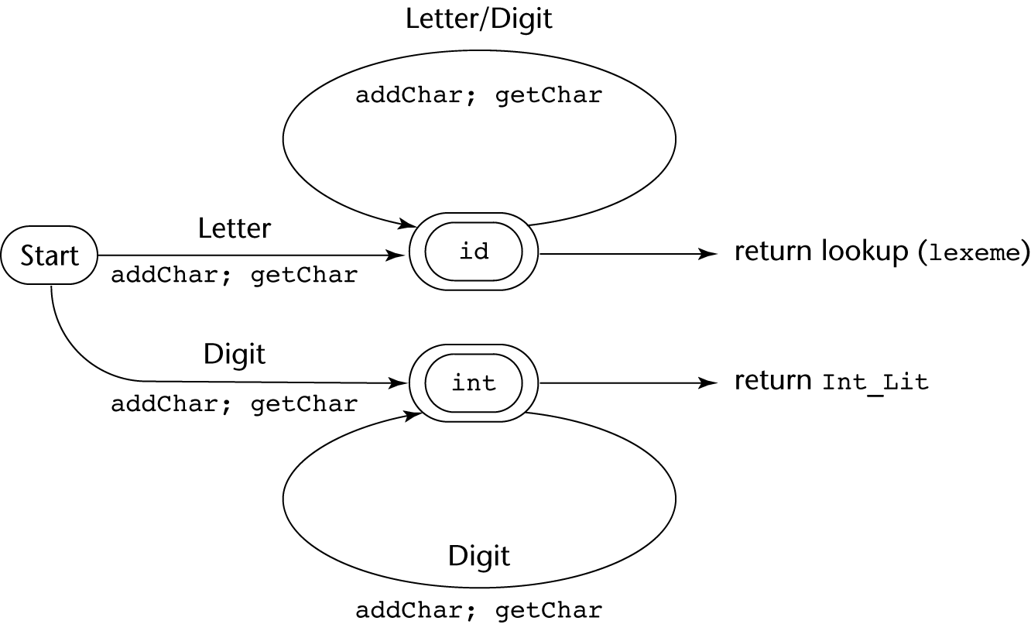
State Diagram
Copyright © 2015 Pearson. All rights reserved.
1-<number>

Slide 14
Lexical Analyzer
Implementation:
→ See Book front.c (pp. 166-177)
- Following is the output of the lexical analyzer of
front.c when used on (sum + 47) / total
Next token is: 25 Next lexeme is (
Next token is: 11 Next lexeme is sum
Next token is: 21 Next lexeme is +
Next token is: 10 Next lexeme is 47
Next token is: 26 Next lexeme is )
Next token is: 24 Next lexeme is /
Next token is: 11 Next lexeme is total
Next token is: -1 Next lexeme is EOF
Copyright © 2015 Pearson. All rights reserved.
1-<number>

Slide 15
The Parsing Problem *
Goals of the parser, given an input program:
  Find all syntax errors; for each, produce an appropriate diagnostic message and recover quickly
  Produce the parse tree, or at least a trace of the parse tree, for the program
Copyright © 2015 Pearson. All rights reserved.
1-<number>

Slide 16
The Parsing Problem (continued) *
Two categories of parsers
  Top down - produce the parse tree, beginning at the root
    Order is that of a leftmost derivation
    Traces or builds the parse tree in preorder
  Bottom up - produce the parse tree, beginning at the leaves
    Order is that of the reverse of a rightmost derivation
Useful parsers look only one token ahead in the input
Copyright © 2015 Pearson. All rights reserved.
1-<number>

Slide 17
The Parsing Problem (continued) *
Top-down Parsers
  Given a sentential form, xAα , the parser must choose the correct A-rule to get the next sentential form in the leftmost derivation, using only the first token produced by A
The most common top-down parsing algorithms:
  Recursive descent - a coded implementation
  LL(k) parsers - table driven implementation
Copyright © 2015 Pearson. All rights reserved.
1-<number>

Slide 18
The Parsing Problem (continued) *
Bottom-up parsers
  Given a right sentential form, α, determine what substring of α is the right-hand side of the rule in the grammar that must be reduced to produce the previous sentential form in the right derivation
  The most common bottom-up parsing algorithms are in the LR family
Copyright © 2015 Pearson. All rights reserved.
1-<number>

Slide 19
The Parsing Problem (continued)
The Complexity of Parsing
  Parsers that work for any unambiguous grammar are complex and inefficient ( O(n³), where n is the length of the input )
  Compilers use parsers that only work for a subset of all unambiguous grammars, but do it in linear time ( O(n), where n is the length of the input )
Copyright © 2015 Pearson. All rights reserved.
1-<number>

Slide 20
Recursive-Descent Parsing *
There is a subprogram for each nonterminal in the grammar, which can parse sentences that can be generated by that nonterminal
EBNF is ideally suited for being the basis for a recursive-descent parser, because EBNF minimizes the number of nonterminals
Copyright © 2015 Pearson. All rights reserved.
1-<number>

Slide 21
Example Grammar 1
BNF
<assgn> -> <var> = <expr>
<expr> -> <var> + <var>
<var> -> a | b | c
Derivation
<assgn> => <var> = <expr>
a = <expr> => a = <var> + <var>
a = b + <var> => a = b + c
Copyright © 2015 Pearson. All rights reserved.
1-<number>

Slide 22
Example Grammar 1 Parse Tree
<assgn>
<var> = <expr>
a <var> + <var>
b c
Copyright © 2015 Pearson. All rights reserved.
1-<number>

Slide 23
Example Grammar 1 Parse Trace
Enter <assgn>
Enter <var>
Token: a
Token: =
Enter <expr>
Enter <var>
Token: b
Token: +
Enter <var>
Token: c
Copyright © 2015 Pearson. All rights reserved.
1-<number>

Slide 24
Recursive-Descent Parsing (continued)
A grammar for simple expressions:
<expr> → <term> {(+ | -) <term>}
<term> → <factor> {(* | /) <factor>}
<factor> → id | int_constant | ( <expr> )
Copyright © 2015 Pearson. All rights reserved.
1-<number>

Slide 25
Recursive-Descent Parsing (continued)
Assume we have a lexical analyzer named lex, which puts the next token code in nextToken
The coding process when there is only one RHS:
  For each terminal symbol in the RHS, compare it with the next input token; if they match, continue, else there is an error
  For each nonterminal symbol in the RHS, call its associated parsing subprogram
Copyright © 2015 Pearson. All rights reserved.
1-<number>

Slide 26
Recursive-Descent Parsing (continued)
/* Function expr
Parses strings in the language
generated by the rule:
<expr> → <term> {(+ | -) <term>}
*/
void expr() {
/* Parse the first term */
term();
/* As long as the next token is + or -, call
lex to get the next token and parse the
next term */
while (nextToken == ADD_OP ||
nextToken == SUB_OP){
lex();
term();
}
}
Copyright © 2015 Pearson. All rights reserved.
1-<number>

Slide 27
Recursive-Descent Parsing (continued)
This particular routine does not detect errors
Convention: Every parsing routine leaves the next token in nextToken
Copyright © 2015 Pearson. All rights reserved.
1-<number>

Slide 28
Recursive-Descent Parsing (continued)
A nonterminal that has more than one RHS requires an initial process to determine which RHS it is to parse
  The correct RHS is chosen on the basis of the next token of input (the lookahead)
  The next token is compared with the first token that can be generated by each RHS until a match is found
  If no match is found, it is a syntax error
Copyright © 2015 Pearson. All rights reserved.
1-<number>

Slide 29
Recursive-Descent Parsing (continued)
/* term
Parses strings in the language generated by the rule:
<term> -> <factor> {(* | /) <factor>)
*/
void term() {
/* Parse the first factor */
factor();
/* As long as the next token is * or /,
next token and parse the next factor */
while (nextToken == MULT_OP || nextToken == DIV_OP) {
lex();
factor();
}
} /* End of function term */
Copyright © 2015 Pearson. All rights reserved.
1-<number>

Slide 30
Recursive-Descent Parsing (continued)
/* Function factor
Parses strings in the language
generated by the rule:
<factor> -> id | int_constant | (<expr>) */
void factor() {
/* Determine which RHS */
if (nextToken) == ID_CODE || nextToken == INT_CODE)
/* For the RHS id, just call lex */
lex();
/* If the RHS is (<expr>) – call lex to pass over the left parenthesis,
call expr, and check for the right parenthesis */
else if (nextToken == LP_CODE) {
lex();
expr();
if (nextToken == RP_CODE)
lex();
else
error();
} /* End of else if (nextToken == ... */
else error(); /* Neither RHS matches */
}
Copyright © 2015 Pearson. All rights reserved.
1-<number>

Slide 31
Recursive-Descent Parsing (continued)
- Trace of the lexical and syntax analyzers on (sum + 47) / total
Next token is: 25 Next lexeme is ( Next token is: 11 Next lexeme is total
Enter <expr> Enter <factor>
Enter <term> Next token is: -1 Next lexeme is EOF
Enter <factor> Exit <factor>
Next token is: 11 Next lexeme is sum Exit <term>
Enter <expr> Exit <expr>
Enter <term>
Enter <factor>
Next token is: 21 Next lexeme is +
Exit <factor>
Exit <term>
Next token is: 10 Next lexeme is 47
Enter <term>
Enter <factor>
Next token is: 26 Next lexeme is )
Exit <factor>
Exit <term>
Exit <expr>
Next token is: 24 Next lexeme is /
Exit <factor>
Copyright © 2015 Pearson. All rights reserved.
1-<number>

Slide 32
Problems for Recursive-Descent Parsing (LL)*
Direct Recursion
A -> A + B | some_terminal
Indirect recursión
A -> B a A
B -> A b
Copyright © 2015 Pearson. All rights reserved.
1-<number>

Slide 33
Recursive-Descent Parsing (continued) *
Removing DIRECT Left Recursion
The LL Grammar Class
  The Left Recursion Problem
    If a grammar has left recursion, either direct or indirect, it cannot be the basis for a top-down parser
      A grammar can be modified to remove direct left recursion as follows:
      For each nonterminal, A,
      Group the A-rules as A → Aα₁ | … | Aα_{m} | β₁ | β₂ | … | β_{n}
      where none of the β‘s begins with A
      2. Replace the original A-rules with
      A → β₁A’ | β₂A’ | … | β_{n}A’
      A’ → α₁A’ | α₂A’ | … | α_{m}A’ | ε
Copyright © 2015 Pearson. All rights reserved.
1-<number>
Notes:
Direct Recursion
A -> A + B | some_terminal
Indirect recursión
A -> B a A
B -> A b

Slide 34
Example (DIRECT Left Recursion)
E -> E + T | T
T -> T * F | F
F -> (E) | id
For the E-rules, we have α1 = + T and β = T, so we replace the E-rules with
E -> TE’
E’ -> + TE’ | ε
Can we remove left-recursion from the other rule?
T → FT‘
T' → * FT' | ε
F → (E) | id
Copyright © 2015 Pearson. All rights reserved.
1-<number>

Slide 35
DIRECT Left Recursion Recap
Create a new rule
For every definition in rule A that does NOT start with a recursive call to A, leave it as a definition of A and add a call to the new rule
For every definition in rule A that DOES START with a recursive call to A
  Remove the recursive call to A (only that)
  Put the rest of it in the new rule as another definition and add a recursive call to the new rule after
Add epsilon to new rule
1-<number>

Slide 36
Example (DIRECT Left Recursion) – Numbers from previous slide
E -> E + T | T
T -> T * F | F
F -> (E) | id
E -> TE’
E’ -> + TE’ | ε
T → FT‘
T' → * FT' | ε
F → (E) | id
2
3
1
4
2
3
1
4
Copyright © 2015 Pearson. All rights reserved.
1-<number>

Slide 37
Recursive-Descent Parsing (continued) *
Removing INDIRECT Left Recursion
The LL Grammar Class
  The INDIRECT Left Recursion Problem
  Rewrite the rule with the indirect left recursion such that it’s definitions INCLUDE the definitions of the Rule that it is indirectly calling recursively
  THEN, simply remove direct recursion using the technique of the previous slides
Copyright © 2015 Pearson. All rights reserved.
1-<number>
Notes:
Direct Recursion
A -> A + B | some_terminal
Indirect recursión
A -> B a A
B -> A b

Slide 38
Example (INDIRECT Left Recursion)
E -> E + T | T
T -> T * F | F
F -> E | id
Here one definition for E calls rule F and one definition for rule F indirectly calls rule E again
We FIRST need to remove the direct recursion in E (This will be a problem for the next step if we don’t).
THEN, rewrite F to include definitions in E (so that we now JUST have direct recursion in F.
THEN, simply remove the direct recursion from F.
1-<number>

Slide 39
Example (INDIRECT Left Recursion)
E -> E + T | T E -> TE’
T -> T * F | F E’-> + TE’ | ε
F -> E | id T -> T * F | F
F -> E | id
We FIRST need to remove the direct recursion in E (This will be a problem for the next step if we don’t).
1-<number>

Slide 40
Example (INDIRECT Left Recursion)
E -> TE’ | FE’ E -> TE’
E’-> + TE’ | ε E’-> + TE’ | ε
T -> T * F | F T -> FT’
F -> E | id T’-> * FT’ | ε
F -> E | id
Since E could be T and T could be F and F could be E, we also need to remove the direct recursion in T.
1-<number>

Slide 41
Example (INDIRECT Left Recursion)
E -> TE’ E -> TE’
E’-> + TE’ | ε E’-> + TE’ | ε
T -> FT’ T -> FT’
T’-> * FT’ | ε T’-> * FT’ | ε
F -> E | id F -> FT’E’ | id
F -> E -> TE’
*TE’ ALWAYS reduces to FT’E’
THEN, rewrite F to include definitions in E and T (so that we now JUST have direct recursion in F.
1-<number>

Slide 42
Another way to think about it
(math equalities)
E -> TE’
E’-> + TE’ | ε
T -> FT’
T’-> * FT’ | ε
F -> E | id
Equalities:
E = TE’
E’ = + TE’
E’ = ε
T = FT’
T’ = * FT’
T’ = ε
F = E
F = id
1-<number>

Slide 43
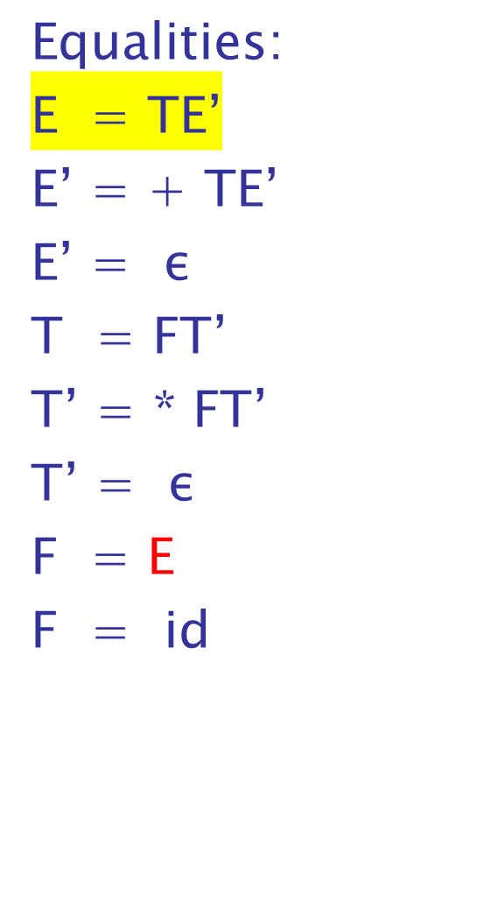
Another way to think about it
(math equalities)
E -> TE’
E’-> + TE’ | ε
T -> FT’
T’-> * FT’ | ε
F -> E | id
1-<number>

Slide 44
Another way to think about it
(math equalities)
E -> TE’
E’-> + TE’ | ε
T -> FT’
T’-> * FT’ | ε
F -> E | id
Equalities:
E = TE’
E’ = + TE’
E’ = ε
T = FT’
T’ = * FT’
T’ = ε
F = E
F = id
1-<number>

Slide 45
Example (INDIRECT Left Recursion)
E -> TE’ E -> TE’
E’-> + TE’ | ε E’-> + TE’ | ε
T -> FT’ T -> FT’
T’-> * FT’ | ε T’-> * FT’ | ε
F -> FT’E’ | id F -> idF’
F’-> T’E’F’| ε
Now, we can simply remove the direct recursion in F.
1-<number>

Slide 46
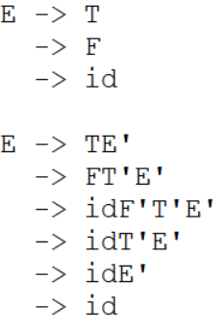
Example (INDIRECT Left Recursion)
E -> E + T | T E -> TE’
T -> T * F | F E’-> + TE’ | ε
F -> E | id T -> FT’
T’-> * FT’ | ε
F -> idF’
F’-> T’E’F’ | ε
Are they semantically equivalent?
1-<number>

Slide 47
Exercise (INDIRECT Left Recursion)
E -> E + T | T E -> TE’
T -> T * F | F E’-> + TE’ | ε
F -> E | id T -> FT’
T’-> * FT’ | ε
F -> idF’
F’-> T’E’F’ | ε
Derive “id * id” using both the left and the right versions of this grammar.
1-<number>

Slide 48
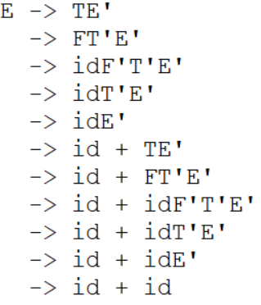
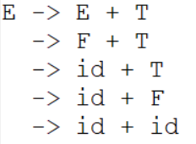
Example (INDIRECT Left Recursion)
E -> E + T | T E -> TE’
T -> T * F | F E’-> + TE’ | ε
F -> E | id T -> FT’
T’-> * FT’ | ε
F -> idF’
F’-> T’E’F’ | ε
Are they semantically equivalent?
1-<number>

Slide 49
Recursive-Descent Parsing (continued) *
The other characteristic of grammars that disallows top-down parsing is the lack of pairwise disjointness
  The inability to determine the correct RHS on the basis of one token of lookahead
  Def: FIRST(α) = {a | α =>* aβ }
(If α =>* ε, ε is in FIRST(α))
- In English: For any rule with multiple
definitions, the FIRST set is the first terminal
symbol that appears in each definition.
=>* means 0 or more derivation steps
1-<number>
Notes:
=>* means 0 or more derivation steps

Slide 50
In-Class Exercise FIRST set *
What is the FIRST set for the A rule in the grammar below?
A -> aB | bAb | Bb
B -> cB | d
a, b, c, d
Copyright © 2015 Pearson. All rights reserved.
1-<number>

Slide 51
Recursive-Descent Parsing (continued) *
Pairwise Disjointness Test:
  For each nonterminal, A, in the grammar that has more than one RHS, for each pair of rules, A → α_{i} and A → α_{j}, it must be true that
FIRST(α_{i}) ⋂ FIRST(α_{j}) = φ
Example:
A → a | bB | cAb
A → a | aB
Copyright © 2015 Pearson. All rights reserved.
1-<number>

Slide 52
Recursive-Descent Parsing (continued) *
Left factoring can resolve the problem
Replace
<variable> → identifier | identifier [<expression>]
with
<variable> → identifier <new>
<new> → ε | [<expression>]
or
<variable> → identifier [[<expression>]]
(the outer brackets are metasymbols of EBNF)
Copyright © 2015 Pearson. All rights reserved.
1-<number>

Slide 53
In-Class Exercise
Can you resolve the pairwise disjointness of the following rule? Do so by creating a new rule (not by using EBNF notation).
A → a | aB
A → aA’
A’ → ε | B
Copyright © 2015 Pearson. All rights reserved.
1-<number>

Slide 54
Bottom-up Parsing
The parsing problem is finding the correct RHS in a right-sentential form to reduce to get the previous right-sentential form in the derivation
Copyright © 2015 Pearson. All rights reserved.
1-<number>

Slide 55
Bottom-up Parsing (continued) *
Intuition about handles (continued):
  The handle of a right sentential form is its leftmost simple phrase
  Given a parse tree, it is now easy to find the handle
  Parsing can be thought of as handle pruning
Copyright © 2015 Pearson. All rights reserved.
1-<number>

Slide 56
Sample Derivation Showing Handles
Grammar
E -> E + T | T
T -> T * F | F
F -> (E) | id
Rightmost Derivation
E => E + T
=> E + T * F
=> E + T * id
=> E + F * id
=> E + id * id
=> T + id * id
=> F + id * id (“prune” id)
=> id + id * id (handle is id)
The underlined pieces are what is getting “pruned” from the tree. Think about pruning as removing some set of symbols from a derivation and replacing them with some other set of symbols.
Copyright © 2015 Pearson. All rights reserved.
1-<number>

Slide 57
Bottom-up Parsing (handles & phrases)
Intuition about handles:
  Def: β is the handle of the right sentential form
γ = αβw if and only if S =>*_{rm} αAw =>_{rm} αβw
  Def: β is a phrase of the right sentential form
γ if and only if S =>* γ = α₁Aα₂ =>+ α₁βα₂
S =>* γ = E + T * F => E + T * id (id is
a phrase & a simple phrase & a handle)
S =>* γ = E + T * F => E + T * id (T * id is a phrase only,
there are others)
* A Phrase can also be a simple phrase and a Handle
* The current Handle will ALWAYS be a simple phrase
* A simple phrase is not necessarily a Handle (only the left-most will be the current handle if there are more than one simple phrases present)
Notes:
=>* 0 or more derivation steps
Exactly 1 derivation step
+ 1 or more derivation step

Slide 58
Bottom-up Parsing (Sentential Ex)
The parsing problem is finding the correct RHS in a right-sentential form to reduce to get the previous right-sentential form in the derivation
Sentential Form Example:
Grammar αAw: A = F
E -> E + T | T RHS1 = F + id * id
T -> T * F | F RHS2 = id + id * id
F -> (E) | id αβw: β = id
β is the handle
Copyright © 2015 Pearson. All rights reserved.
1-<number>

Slide 59
Bottom-up Parsing (Partial Tree Ex)
The parsing problem is finding the correct RHS in a right-sentential form to reduce to get the previous right-sentential form in the derivation
Partial Tree Example:
E -> E + T | T
T -> T * F | F
F -> (E) | id
Sentencial Form:
E + T * id
E
T
F
E
+
T
*
id
Copyright © 2015 Pearson. All rights reserved.
1-<number>

Slide 60
Bottom-up Parsing (Handle Pruning)
Once you find a handle, “prune” it from the tree and look for the next handle.
Pruning is simply replacing a handle with the rule it was derived from. The result should be the previous sentential form in a right-most derivation
Partial Tree Example:
E -> E + T | T
T -> T * F | F
F -> (E) | id
Current Sentencial Form:
E + T * id
Previous Sentential Form: E + T * F
Handle: id
E
T
F
E
+
T
*
id
1-<number>

Slide 61
Phrases & Simple Phrases
E
T
F
E + T * id
Phrases Simple Phrases
E + T * id id
T * id Handle
id id

Slide 62
In Class Exercise *
After Removing the handle of the tree from the previous slide:
  What are the phrases now?
  What are the simple phrases now?
  What is the handle that you “prune”?
  Draw the new tree (after “pruning” it)
1-<number>

Slide 63
Bottom-up Parsing (continued) *
Shift-Reduce Algorithms
  Reduce is the action of replacing the handle on the top of the parse stack with its corresponding LHS
  Shift is the action of moving the next token to the top of the parse stack
Other useful Examples:
  Good and bad parse using shift-reduce
  Shift-reduce example using table
  Another Shift-reduce example
  DFA’s
Copyright © 2015 Pearson. All rights reserved.
1-<number>

Slide 64
Bottom-up Parsing (continued) *
Advantages of LR parsers:
  They will work for nearly all grammars that describe programming languages.
  They work on a larger class of grammars than other bottom-up algorithms, but are as efficient as any other bottom-up parser.
  They can detect syntax errors as soon as it is possible.
  The LR class of grammars is a superset of the class parsable by LL parsers.
Copyright © 2015 Pearson. All rights reserved.
1-<number>

Slide 65
Bottom-up Parsing (continued)
LR parsers must be constructed with a tool
Knuth’s insight: A bottom-up parser could use the entire history of the parse, up to the current point, to make parsing decisions
  There are only a finite and relatively small number of different parse situations that could have occurred, so the history could be stored in a parser state, on the parse stack
Copyright © 2015 Pearson. All rights reserved.
1-<number>

Slide 66
Bottom-up Parsing (continued) *
LR parsers are table driven, where the table has two components, an ACTION table and a GOTO table
  The ACTION table specifies the action of the parser, given the parser state and the next token
    Rows are state names; columns are terminals
  The GOTO table specifies which state to put on top of the parse stack after a reduction action is done
    Rows are state names; columns are nonterminals
Copyright © 2015 Pearson. All rights reserved.
1-<number>

Slide 67
LR Parser
An LR configuration stores the state of an LR parser
stack input
(S₀X₁S₁X₂S₂…X_{m}S_{m},| a_{i}a_{i+1}…a_{n}$)
input string: E . + T
Copyright © 2015 Pearson. All rights reserved.
1-<number>

Slide 68

Structure of An LR Parser
Copyright © 2015 Pearson. All rights reserved.
1-<number>

Slide 69
Bottom-up Parsing (continued) *
Initial configuration: (S₀, a₁…a_{n}$)
Parser actions:
  For a Shift, the next symbol of input is pushed onto the stack, along with the state symbol that is part of the Shift specification in the Action table
  For a Reduce, remove the handle from the stack, along with its state symbols. Push the LHS of the rule. Push the state symbol from the GOTO table, using the state symbol just below the new LHS in the stack and the LHS of the new rule as the row and column into the GOTO table
Copyright © 2015 Pearson. All rights reserved.
1-<number>

Slide 70
Bottom-up Parsing (continued)
Parser actions (continued):
  For an Accept, the parse is complete and no errors were found.
  For an Error, the parser calls an error-handling routine.
Copyright © 2015 Pearson. All rights reserved.
1-<number>

Slide 71
Bottom-up Parse Example *
(this slide to the end) *
Rewrite our rules (no |’s)
E -> E+T | T E -> E + T
T -> id E -> T
T -> id
Copyright © 2015 Pearson. All rights reserved.
1-<number>

Slide 72
Bottom-up Parse Example
Rewrite our rules (no |’s)
Add a starting rule
S’ ->E$
E -> E+T | T E -> E + T
T -> id E -> T
T -> id
Copyright © 2015 Pearson. All rights reserved.
1-<number>

Slide 73
Bottom-up Parse Example
Rewrite our rules (no |’s)
Add a starting rule
Number the rules
r0: S’ ->E$
E -> E+T | T r1: E -> E + T
T -> id r2: E -> T
r3: T -> id
Copyright © 2015 Pearson. All rights reserved.
1-<number>

Slide 74
Bottom-up Parse Example
Rewrite our rules (no |’s)
Add a starting rule
Number the rules
Create closures for all the rules (DFA)
Number the closures
r0: S’ ->E$
E -> E+T | T r1: E -> E + T
T -> id r2: E -> T
r3: T -> id
Copyright © 2015 Pearson. All rights reserved.
1-<number>

Slide 75
Closures
An LR configuration stores the state of an LR parser
stack input
(S₀X₁S₁X₂S₂…X_{m}S_{m},| a_{i}a_{i+1}…a_{n}$)
input string: E . + T
Copyright © 2015 Pearson. All rights reserved.
1-<number>

Slide 76
Create closures for rules
A closure represents all possible configurations for a given state
If the next symbol (after the .) is a non-terminal, then all productions of that non-terminal are included
We want to define states for valid sequences of symbols (terminal and non-terminal)
Begin with start production
S’ ->E$
E -> E + T
E -> T
T -> id
S’ -> .E
Copyright © 2015 Pearson. All rights reserved.
1-<number>

Slide 77
Create closures for rules
A closure represents all possible configurations for a given state
If the next symbol (after the .) is a non-terminal, then all productions of that non-terminal are included
We want to define states for valid sequences of symbols (terminal and non-terminal)
Begin with start production
S’ ->E$
E -> E + T
E -> T
T -> id
S’ -> .E
E -> .E + T
E -> .T
Copyright © 2015 Pearson. All rights reserved.
1-<number>

Slide 78
Create closures for rules
A closure represents all possible configurations for a given state
If the next symbol (after the .) is a non-terminal, then all productions of that non-terminal are included
We want to define states for valid sequences of symbols (terminal and non-terminal)
Begin with start production
S’ ->E$
E -> E + T
E -> T
T -> id
S’ -> .E
E -> .E + T
E -> .T
T -> .id
Copyright © 2015 Pearson. All rights reserved.
1-<number>
Notes:
Id in source code file
Remember we’re doing this backwards
Show quick derivation for just id + id
Nonterminals (E, T, etc…) represent some combination of lexemes
The state you’re defining actually represents what’s on the stack

Slide 79
Create closures for rules
S’ ->E$
E -> E + T
E -> T
T -> id
S0
S’ -> .E
E -> .E + T
E -> .T
T -> .id
Copyright © 2015 Pearson. All rights reserved.
1-<number>

Slide 80
Define closures for all transitions
S’ ->E$
E -> E + T
E -> T
T -> id
S0
S’ -> .E
E -> .E + T
E -> .T
T -> .id
id
S1
T -> id.
(This will be a reduction state)
Copyright © 2015 Pearson. All rights reserved.
1-<number>

Slide 81
Create closures for all transitions
S’ ->E$
E -> E + T
E -> T
T -> id
S2
S0
S’ -> .E
E -> .E + T
E -> .T
T -> .id
E
S’ -> E.$
E -> E. + T
id
S1
T -> id.
(This will be a reduction state)
Copyright © 2015 Pearson. All rights reserved.
1-<number>

Slide 82
Create closures for all transitions
S’ ->E$
E -> E + T
E -> T
T -> id
(These will be a reduction state)
S3
E -> T.
T
S2
S0
S’ -> .E
E -> .E + T
E -> .T
T -> .id
E
S’ -> E.$
E -> E. + T
id
S1
T -> id.
(This will be a reduction state)
Copyright © 2015 Pearson. All rights reserved.
1-<number>

Slide 83
Create closures for all transitions
S’ ->E$
E -> E + T
E -> T
T -> id
(These will be a reduction state)
S3
E -> T.
T
S2
S4
S0
S’ -> .E
E -> .E + T
E -> .T
T -> .id
E
S’ -> E.$
E -> E. + T
+
E -> E +. T
T -> .id
id
S1
T -> id.
(This will be a reduction state)
Copyright © 2015 Pearson. All rights reserved.
1-<number>

Slide 84
Create closures for all transitions
S’ ->E$
E -> E + T
E -> T
T -> id
(These will be a reduction state)
S3
E -> T.
T
S2
S4
S0
S’ -> .E
E -> .E + T
E -> .T
T -> .id
E
S’ -> E.$
E -> E. + T
+
E -> E +. T
T -> .id
id
T
id
S1
T -> id.
S5
E -> E + T.
(This will be a reduction state)
(This will be a reduction state)
Copyright © 2015 Pearson. All rights reserved.
1-<number>

Slide 85
Bottom-up Parse Example
Rewrite our rules (no |’s)
Add a starting rule
Number the rules
Create closures for all the rules (DFA) and number them
Create Transition table from our DFA
r0: S’ ->E$
E -> E+T | T r1: E -> E + T
T -> id r2: E -> T
r3: T -> id
Copyright © 2015 Pearson. All rights reserved.
1-<number>

Slide 86
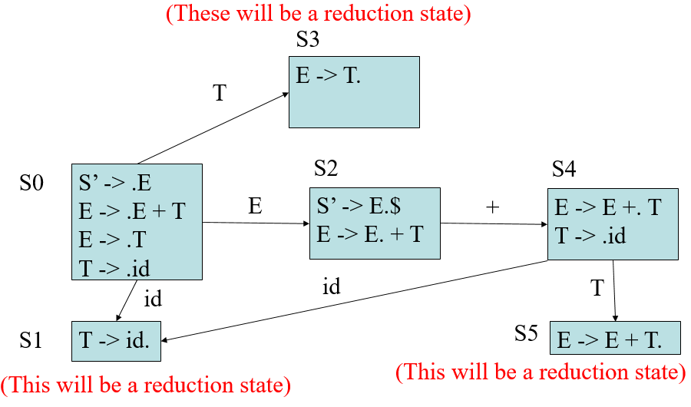
Create Transition Table
r0: S’ ->E$
r1: E -> E + T
r2: E -> T
r3: T -> id
 | + | id | E | T
0 |  | 1 | 2 | 3
1
2
3
4
5
Copyright © 2015 Pearson. All rights reserved.
1-<number>

Slide 87
Create Transition Table
r0: S’ ->E$
r1: E -> E + T
r2: E -> T
r3: T -> id
 | + | id | E | T
0 |  | 1 | 2 | 3
1 | Nothing | Yet!
2
3
4
5
Copyright © 2015 Pearson. All rights reserved.
1-<number>

Slide 88
Create Transition Table
r0: S’ ->E$
r1: E -> E + T
r2: E -> T
r3: T -> id
 | + | id | E | T
0 |  | 1 | 2 | 3
1
2 | 4
3
4
5
Copyright © 2015 Pearson. All rights reserved.
1-<number>

Slide 89
Create Transition Table
r0: S’ ->E$
r1: E -> E + T
r2: E -> T
r3: T -> id
 | + | id | E | T
0 |  | 1 | 2 | 3
1
2 | 4
3 | No | transition
4
5
Copyright © 2015 Pearson. All rights reserved.
1-<number>

Slide 90
Create Transition Table
r0: S’ ->E$
r1: E -> E + T
r2: E -> T
r3: T -> id
 | + | id | E | T
0 |  | 1 | 2 | 3
1
2 | 4
3
4 |  | 1 |  | 5
5
Copyright © 2015 Pearson. All rights reserved.
1-<number>

Slide 91
Bottom-up Parse Example
Rewrite our rules (no |’s)
Add a starting rule
Number the rules
Create closures for all the rules (DFA) and number them
Create Transition table from DFA
Create Parser Table from Transition table
  Sn -> next state is n
  Rn -> reduce using rule n
  acc -> accept as valid input
  <empty>/error -> invalid input
Copyright © 2015 Pearson. All rights reserved.
1-<number>

Slide 92
Create Parser Table
r0: S’ ->E$
r1: E -> E + T
r2: E -> T
r3: T -> id
State | Action |  |  | Goto
 | + | Id | $ | E | T
0
1
2
3
4
5
 | + | id | E | T
S0 |  | 1 | 2 | 3
S1
S2 | 4
S3
S4 |  | 1 |  | 5
S5
Copyright © 2015 Pearson. All rights reserved.
1-<number>

Slide 93
Create Parser Table
r0: S’ ->E$
r1: E -> E + T
r2: E -> T
r3: T -> id
State | Action |  |  | Goto
 | + | Id | $ | E | T
0 |  | S1 |  | 2 | 3
1
2
3
4
5
 | + | id | E | T
S0 |  | 1 | 2 | 3
S1
S2 | 4
S3
S4 |  | 1 |  | 5
S5
Copyright © 2015 Pearson. All rights reserved.
1-<number>

Slide 94
Create Parser Table
r0: S’ ->E$
r1: E -> E + T
r2: E -> T
r3: T -> id
State | Action |  |  | Goto
 | + | Id | $ | E | T
0 |  | S1 |  | 2 | 3
1 | R3 | R3 | R3
2 | …
3
4
5
 | + | id | E | T
S0 |  | 1 | 2 | 3
S1
S2 | 4
S3
S4 |  | 1 |  | 5
S5
Copyright © 2015 Pearson. All rights reserved.
1-<number>

Slide 95
Create Parser Table
r0: S’ ->E$
r1: E -> E + T
r2: E -> T
r3: T -> id
State | Action |  |  | Goto
 | + | Id | $ | E | T
0 |  | S1 |  | 2 | 3
1 | R3 | R3 | R3
2 | S4 |  | acc
3 | R2 | R2 | R2
4 |  | S1 |  |  | 5
5 | R1 | R1 | R1
 | + | id | E | T
S0 |  | 1 | 2 | 3
S1
S2 | 4
S3
S4 |  | 1 |  | 5
S5
Copyright © 2015 Pearson. All rights reserved.
1-<number>

Slide 96
Parse Input String using PDA (Push Down Automata)
stack input
(S₀X₁S₁X₂S₂…X_{m}S_{m},| a_{i}a_{i+1}…a_{n}$)
input string: E . + T
Copyright © 2015 Pearson. All rights reserved.
1-<number>

Slide 97
Parse Input String using PDA (Push Down Automata)
State | Action |  |  | Goto
 | + | Id | $ | E | T
0 |  | S1 |  | 2 | 3
1 | R3 | R3 | R3
2 | S4 |  | acc
3 | R2 | R2 | R2
4 |  | S1 |  |  | 5
5 | R1 | R1 | R1
r0: S’ ->E$
r1: E -> E + T
r2: E -> T
r3: T -> id
input: .id + id $
stack: 0
Output:
Copyright © 2015 Pearson. All rights reserved.
1-<number>

Slide 98
Parse Input String using PDA (Push Down Automata)
State | Action |  |  | Goto
 | + | Id | $ | E | T
0 |  | S1 |  | 2 | 3
1 | R3 | R3 | R3
2 | S4 |  | acc
3 | R2 | R2 | R2
4 |  | S1 |  |  | 5
5 | R1 | R1 | R1
r0: S’ ->E$
r1: E -> E + T
r2: E -> T
r3: T -> id
input: id . + id $
stack: 0 id 1
Output:
Copyright © 2015 Pearson. All rights reserved.
1-<number>

Slide 99
Parse Input String using PDA (Push Down Automata)
State | Action |  |  | Goto
 | + | Id | $ | E | T
0 |  | S1 |  | 2 | 3
1 | R3 | R3 | R3
2 | S4 |  | acc
3 | R2 | R2 | R2
4 |  | S1 |  |  | 5
5 | R1 | R1 | R1
r0: S’ ->E$
r1: E -> E + T
r2: E -> T
r3: T -> id
input: id . + id $
stack: 0 T
Output: 3,
Copyright © 2015 Pearson. All rights reserved.
1-<number>

Slide 100
Parse Input String using PDA (Push Down Automata)
State | Action |  |  | Goto
 | + | Id | $ | E | T
0 |  | S1 |  | 2 | 3
1 | R3 | R3 | R3
2 | S4 |  | acc
3 | R2 | R2 | R2
4 |  | S1 |  |  | 5
5 | R1 | R1 | R1
r0: S’ ->E$
r1: E -> E + T
r2: E -> T
r3: T -> id
input: id . + id $
stack: 0 T 3
Output: 3,
Copyright © 2015 Pearson. All rights reserved.
1-<number>

Slide 101
Parse Input String using PDA (Push Down Automata)
State | Action |  |  | Goto
 | + | Id | $ | E | T
0 |  | S1 |  | 2 | 3
1 | R3 | R3 | R3
2 | S4 |  | acc
3 | R2 | R2 | R2
4 |  | S1 |  |  | 5
5 | R1 | R1 | R1
r0: S’ ->E$
r1: E -> E + T
r2: E -> T
r3: T -> id
input: id . + id $
stack: 0 E
Output: 3, 2,
Copyright © 2015 Pearson. All rights reserved.
1-<number>

Slide 102
Parse Input String using PDA (Push Down Automata)
State | Action |  |  | Goto
 | + | Id | $ | E | T
0 |  | S1 |  | 2 | 3
1 | R3 | R3 | R3
2 | S4 |  | acc
3 | R2 | R2 | R2
4 |  | S1 |  |  | 5
5 | R1 | R1 | R1
r0: S’ ->E$
r1: E -> E + T
r2: E -> T
r3: T -> id
input: id . + id $
stack: 0 E 2
Output: 3, 2,
Copyright © 2015 Pearson. All rights reserved.
1-<number>

Slide 103
Parse Input String using PDA (Push Down Automata)
State | Action |  |  | Goto
 | + | Id | $ | E | T
0 |  | S1 |  | 2 | 3
1 | R3 | R3 | R3
2 | S4 |  | acc
3 | R2 | R2 | R2
4 |  | S1 |  |  | 5
5 | R1 | R1 | R1
r0: S’ ->E$
r1: E -> E + T
r2: E -> T
r3: T -> id
input: id + . id $
stack: 0 E 2 +
Output: 3, 2,
Copyright © 2015 Pearson. All rights reserved.
1-<number>

Slide 104
Parse Input String using PDA (Push Down Automata)
State | Action |  |  | Goto
 | + | Id | $ | E | T
0 |  | S1 |  | 2 | 3
1 | R3 | R3 | R3
2 | S4 |  | acc
3 | R2 | R2 | R2
4 |  | S1 |  |  | 5
5 | R1 | R1 | R1
r0: S’ ->E$
r1: E -> E + T
r2: E -> T
r3: T -> id
input: id + . id $
stack: 0 E 2 + 4
Output: 3, 2,
Copyright © 2015 Pearson. All rights reserved.
1-<number>

Slide 105
Parse Input String using PDA (Push Down Automata)
State | Action |  |  | Goto
 | + | Id | $ | E | T
0 |  | S1 |  | 2 | 3
1 | R3 | R3 | R3
2 | S4 |  | acc
3 | R2 | R2 | R2
4 |  | S1 |  |  | 5
5 | R1 | R1 | R1
r0: S’ ->E$
r1: E -> E + T
r2: E -> T
r3: T -> id
input: id + id . $
stack: 0 E 2 + 4 id
Output: 3, 2,
Copyright © 2015 Pearson. All rights reserved.
1-<number>

Slide 106
Parse Input String using PDA (Push Down Automata)
State | Action |  |  | Goto
 | + | Id | $ | E | T
0 |  | S1 |  | 2 | 3
1 | R3 | R3 | R3
2 | S4 |  | acc
3 | R2 | R2 | R2
4 |  | S1 |  |  | 5
5 | R1 | R1 | R1
r0: S’ ->E$
r1: E -> E + T
r2: E -> T
r3: T -> id
input: id + id . $
stack: 0 E 2 + 4 id 1
Output: 3, 2,
Copyright © 2015 Pearson. All rights reserved.
1-<number>

Slide 107
Parse Input String using PDA (Push Down Automata)
State | Action |  |  | Goto
 | + | Id | $ | E | T
0 |  | S1 |  | 2 | 3
1 | R3 | R3 | R3
2 | S4 |  | acc
3 | R2 | R2 | R2
4 |  | S1 |  |  | 5
5 | R1 | R1 | R1
r0: S’ ->E$
r1: E -> E + T
r2: E -> T
r3: T -> id
input: id + id . $
stack: 0 E 2 + 4 T
Output: 3, 2, 3,
Copyright © 2015 Pearson. All rights reserved.
1-<number>

Slide 108
Parse Input String using PDA (Push Down Automata)
State | Action |  |  | Goto
 | + | Id | $ | E | T
0 |  | S1 |  | 2 | 3
1 | R3 | R3 | R3
2 | S4 |  | acc
3 | R2 | R2 | R2
4 |  | S1 |  |  | 5
5 | R1 | R1 | R1
r0: S’ ->E$
r1: E -> E + T
r2: E -> T
r3: T -> id
input: id + id . $
stack: 0 E 2 + 4 T 5
Output: 3, 2, 3,
Copyright © 2015 Pearson. All rights reserved.
1-<number>

Slide 109
Parse Input String using PDA (Push Down Automata)
State | Action |  |  | Goto
 | + | Id | $ | E | T
0 |  | S1 |  | 2 | 3
1 | R3 | R3 | R3
2 | S4 |  | acc
3 | R2 | R2 | R2
4 |  | S1 |  |  | 5
5 | R1 | R1 | R1
r0: S’ ->E$
r1: E -> E + T
r2: E -> T
r3: T -> id
input: id + id . $
stack: 0 E
Output: 3, 2, 3, 1
Copyright © 2015 Pearson. All rights reserved.
1-<number>

Slide 110
Parse Input String using PDA (Push Down Automata)
State | Action |  |  | Goto
 | + | Id | $ | E | T
0 |  | S1 |  | 2 | 3
1 | R3 | R3 | R3
2 | S4 |  | acc
3 | R2 | R2 | R2
4 |  | S1 |  |  | 5
5 | R1 | R1 | R1
r0: S’ ->E$
r1: E -> E + T
r2: E -> T
r3: T -> id
input: id + id . $
stack: 0 E 2
Output: 3, 2, 3, 1
Copyright © 2015 Pearson. All rights reserved.
1-<number>

Slide 111
Parse Input String using PDA (Push Down Automata)
State | Action |  |  | Goto
 | + | Id | $ | E | T
0 |  | S1 |  | 2 | 3
1 | R3 | R3 | R3
2 | S4 |  | acc
3 | R2 | R2 | R2
4 |  | S1 |  |  | 5
5 | R1 | R1 | R1
r0: S’ ->E$
r1: E -> E + T
r2: E -> T
r3: T -> id
input: id + id $ .
stack: 0 E 2 $
Output: 3, 2, 3, 1
Copyright © 2015 Pearson. All rights reserved.
1-<number>

Slide 112
Parse Input String using PDA (Push Down Automata)
State | Action |  |  | Goto
 | + | Id | $ | E | T
0 |  | S1 |  | 2 | 3
1 | R3 | R3 | R3
2 | S4 |  | acc
3 | R2 | R2 | R2
4 |  | S1 |  |  | 5
5 | R1 | R1 | R1
r0: S’ ->E$
r1: E -> E + T
r2: E -> T
r3: T -> id
input: id + id $ .
stack: accept!
Output: 3, 2, 3, 1
Copyright © 2015 Pearson. All rights reserved.
1-<number>

Slide 113
Parse Input String using PDA (Push Down Automata)
r0: S’ ->E$
r1: E -> E + T
r2: E -> T
r3: T -> id
id + id
Output: 3, 2, 3, 1
Derivation
E => E + T (1)
=> E + id (3)
=> T + id (2)
=> id + id (3)
Copyright © 2015 Pearson. All rights reserved.
1-<number>

Slide 114
Handles, Phrases, Simple Phrases Revisited
Grammar
r0: S’ ->E$
r1: E -> E + T
r2: E -> T
r3: T -> id
Derivation
E => E + T (1)
=> E + id (3)
=> T + id (2)
=> id + id (3)
Example on Chalkboard
Parse tree
  Phrases/simple phrases vs Handles
Derivation
  Terminology (RHS, Sentence, etc…)
Copyright © 2015 Pearson. All rights reserved.
1-<number>

Slide 115
Bottom-up Parsing (continued)
A parser table can be generated from a given grammar with a tool, e.g., yacc or bison
Copyright © 2015 Pearson. All rights reserved.
1-<number>

Slide 116
Summary
Syntax analysis is a common part of language implementation
A lexical analyzer is a pattern matcher that isolates small-scale parts of a program
  Detects syntax errors
  Produces a parse tree
A recursive-descent parser is an LL parser
  EBNF
Parsing problem for bottom-up parsers: find the substring of current sentential form
The LR family of shift-reduce parsers is the most common bottom-up parsing approach
Copyright © 2015 Pearson. All rights reserved.
1-<number>

