Slide 1
THE UNIX SYSTEM
Introduction to Networking , Instructor: Prof. Yan Chen
Ashish Gupta
TA , Intro to Networking
Jan 14 2004
Recital 2

Slide 2
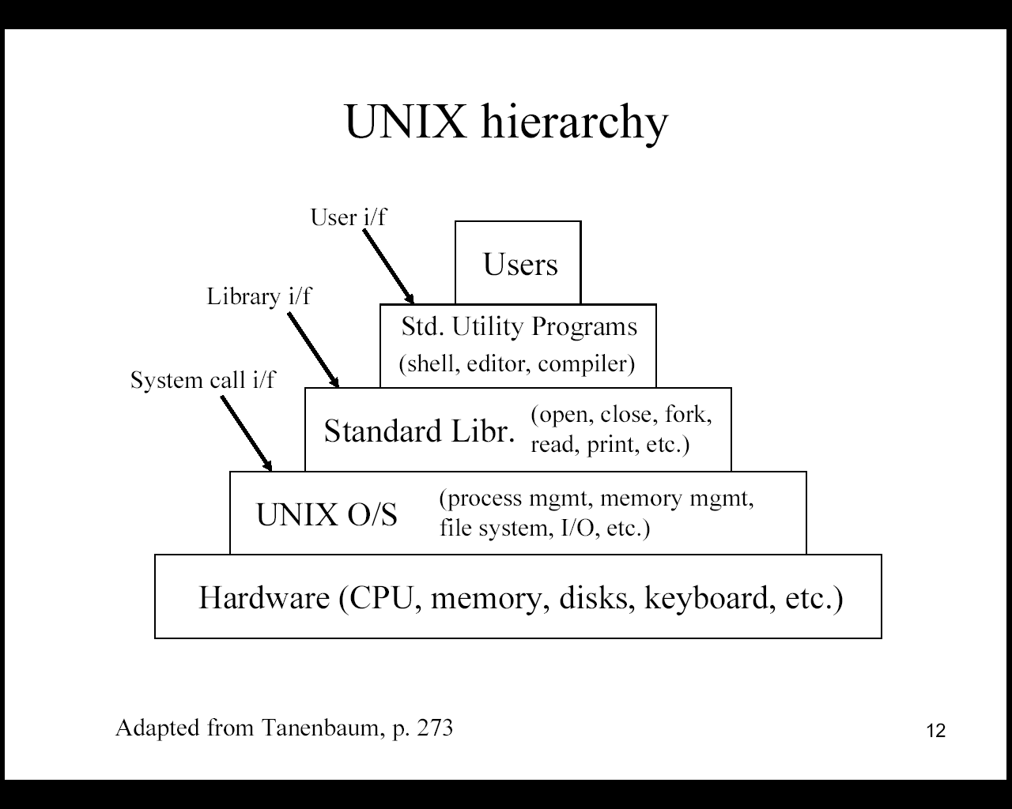

Slide 3
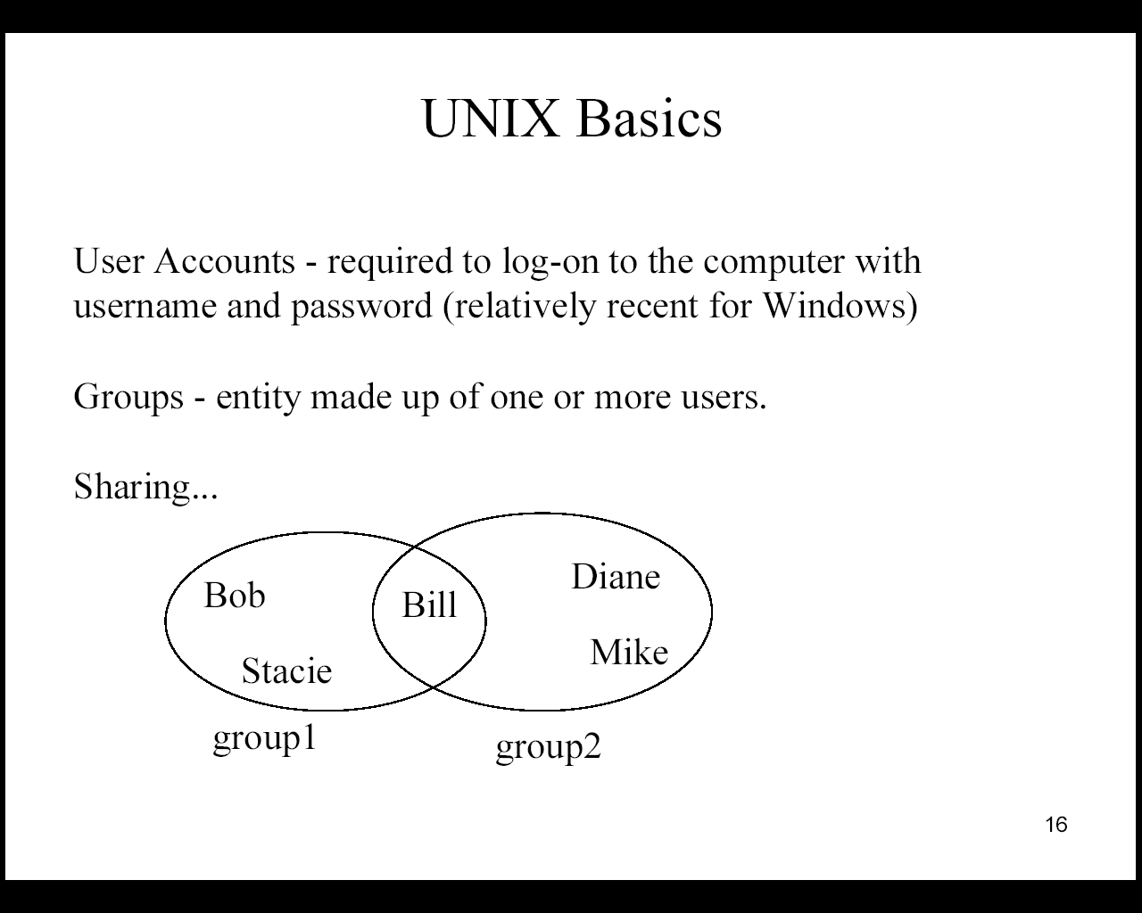

Slide 4
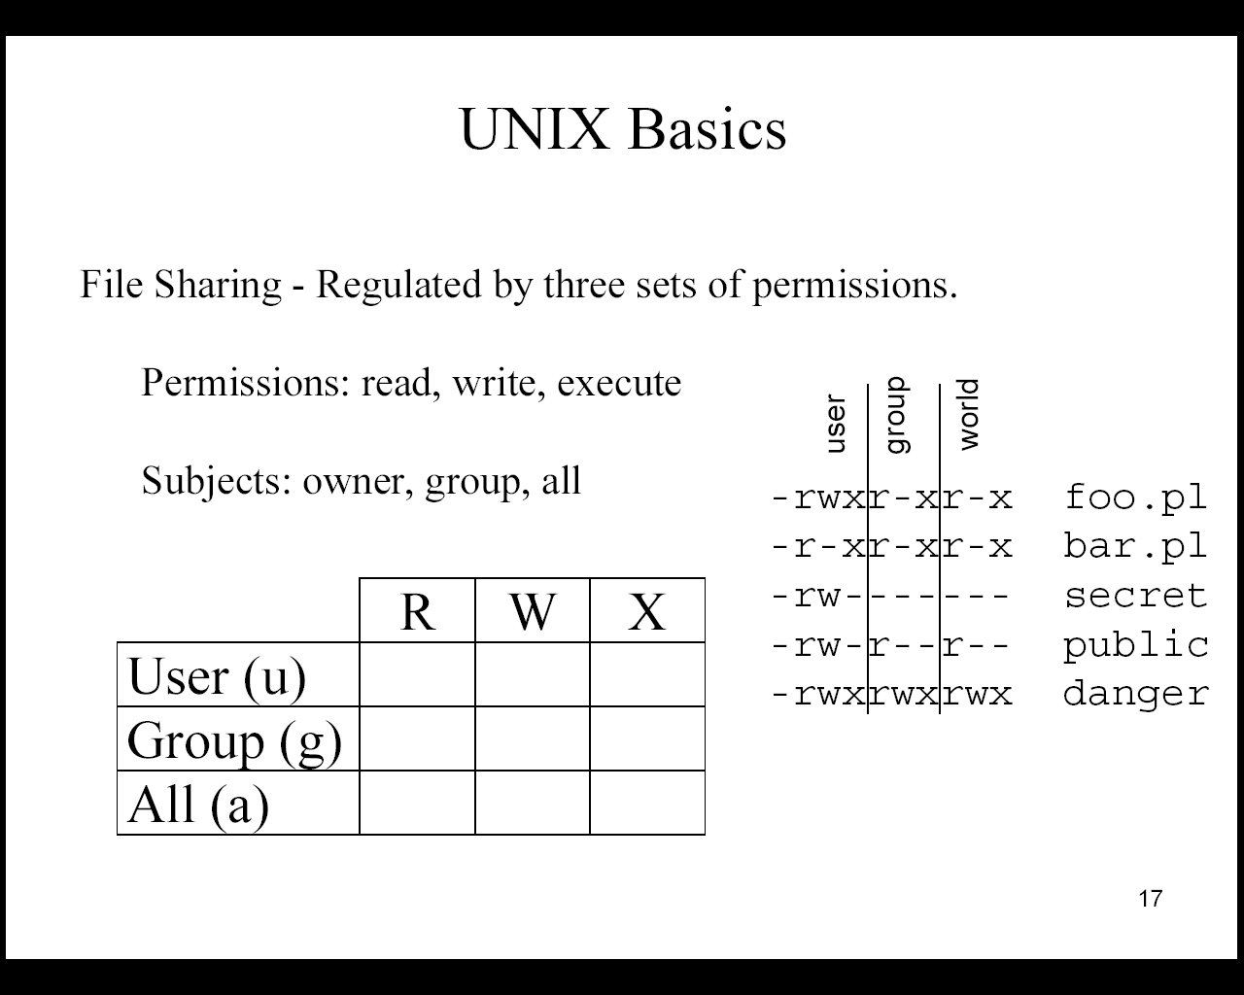

Slide 5
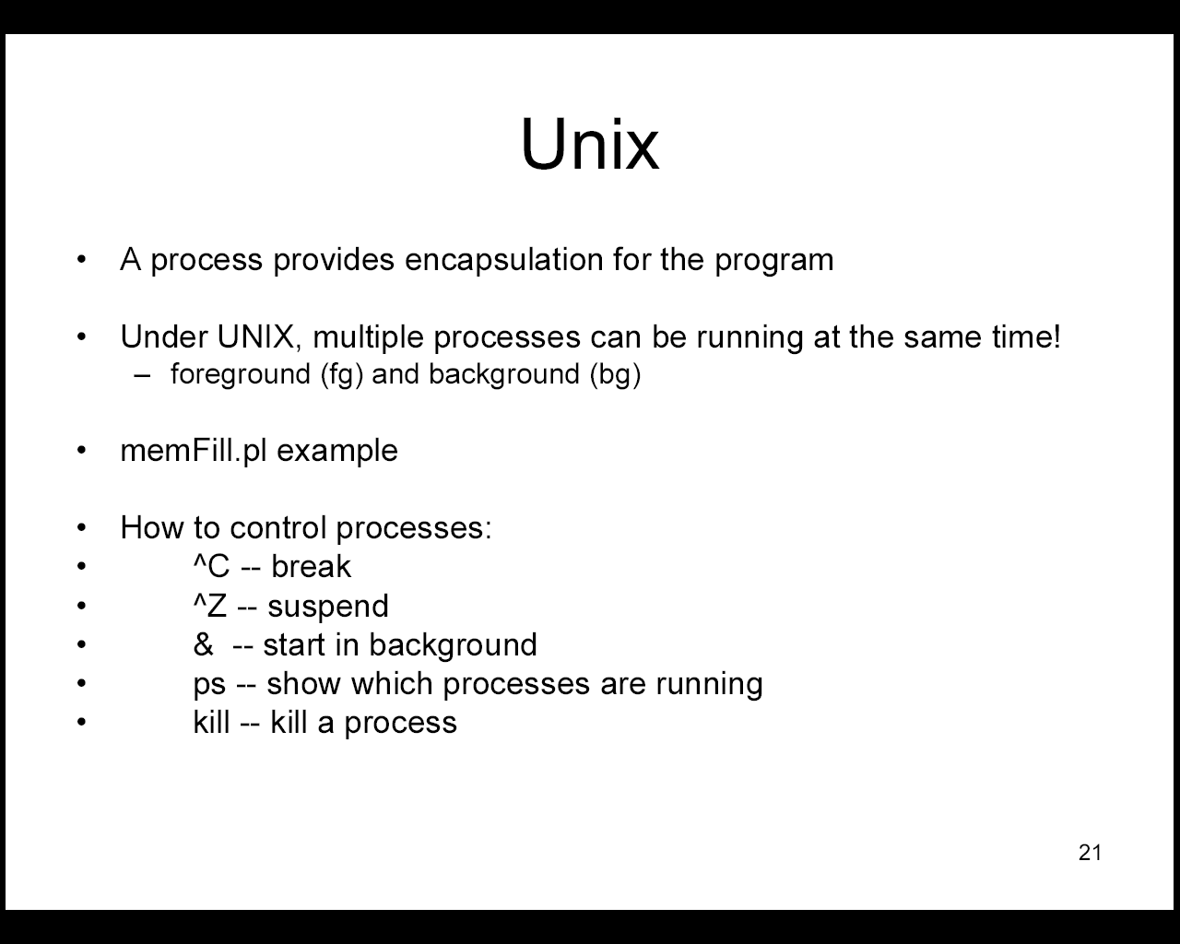

Slide 6
Unix Tools
Shells
Useful Commands
Pipes & Redirects

Slide 7
Shells
sh, csh, ksh, tcsh, bash, zsh
Recommend tcsh or bash for interactive use. Both have command completion, simple command line editing and simple to use history facilities.
Change logon shell using chsh

Slide 8
Intro to Unix: Files
Filesystem a single tree ( no drives )
Filenames case senstitive
Physical devices can be mounted anywhere
/
tmp
dev
etc
home
usr
chris
mary
lib
include
bin
local
lib
include
bin

Slide 9
Some basic commands
• the bash shell has automatic completion, just press <TAB>
• completion is used for command names and for file names
– try:
• pressing <tab> twice gives you all options
– try:

Slide 10
Intro to Unix: Essential Cmds
cd - change directory - cd
mkdir - make a directory - md
cp - copy a file - copy
ls - list files - dir
rm - remove a file - del
mv - move a file - move & ren
grep - expression searching
top - cpu and memory usage
who/w - who else is logged in
man - read documentation

Slide 11
Other unix commands
• where am I?
– pwd
• who is around?
– who
• where is that file?
– find <path> -name <name>
• what is the name of that file?
– grep <patern> <files>

Slide 12
Using find and grep with wildcards
• we can use “wildcard”characters to make searches more general
• “*” is the main one, means any set of characthers
• ex:
– find /home/brian -name “*.ppt” : finds all powerpoint files in the account
– grep human *.txt : look for the word “human” in all the files in my directory.

Slide 13
Pipes & redirects
Pipes are used to pass the output from one Unix command as the input to another Unix command.
ls | grep “mmk”
Redirects are used to pass the output of a Unix command into a file.
ls > directory_listing

Slide 14
Text Editors
Crucial tools for using Unix
Two main editors
  emacs
  vi
Great features in both:
  Syntax highlighting
  Brace matching
  Sophisticated text manipulation/movement
  Scriptable
  …

Slide 15
EMACS
Introduction to Networking , Instructor: Prof. Yan Chen
Ashish Gupta
TA , Intro to Networking
Jan 14 2004
Recital 2

Slide 16
Text Editors: emacs
Configurable, extensible, complicated
emacs and xemacs

Slide 17
Using emacs
• to start emacs just “call it” typing
emacs
• basic editing in emacs is very intuitive
– use arrows, “pg up”and “pg down”to move cursor
– use del key to delete
– back key to delete backwards
– typing insert text at the cursor position
• to edit an existing file type
emacs <name of the file>

Slide 18
Using Emacs: keyboard commands
• there are some keyboard commands you need to know
• we use the folowing abreviations
– “C” is the “Control” key
– “M” is the “Esc”key
– “-” between two letters mean both have to be pressed simoutaniously
• Some basic commands
– C-x, C-s - save the file
– C-x, C-c - exit Emacs

Slide 19
Using Emacs: the minibuffer
• if you look at your screen you see a solid bar in the bottom of your page
• underneath this bar is the “minibuffer”
• the “minibuffer” is used for the communication between you and Emacs
- emacs prints messages there
– you type text that emacs needs to perform a command
– you can type commands here

Slide 20
Commands that use the minibuffer
• C-x C-w “save as” - you type the new name in the minbuffer
• C-x C-f load a new file in Emacs
• C-s : search for a string
– this search is incremental and goes as you search
– typing C-s again will search for the next occurrence of the same string
– to go back to the editing, just press any arrow key
– after you go back, typing C-s twice resumes the search

Slide 21
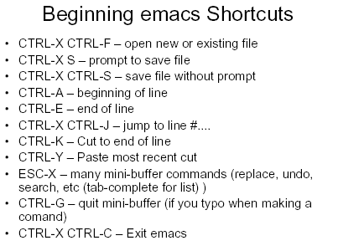

Slide 22
GCC and make
Introduction to Networking , Instructor: Prof. Yan Chen
Ashish Gupta
TA , Intro to Networking
Jan 14 2004
Recital 2

Slide 23
Development tools in UNIX
Creation of source files (.c, .h, .cpp)
  Text editors (e.g. vi)
  Revision control systems (e.g. cvs)
Compilation (e.g. *.c *.o) and linking
  Compilers (e.g. gcc)
  Automatic building tools (e.g. make)
Running and testing programs
  Debuggers (e.g. gdb)

Slide 24
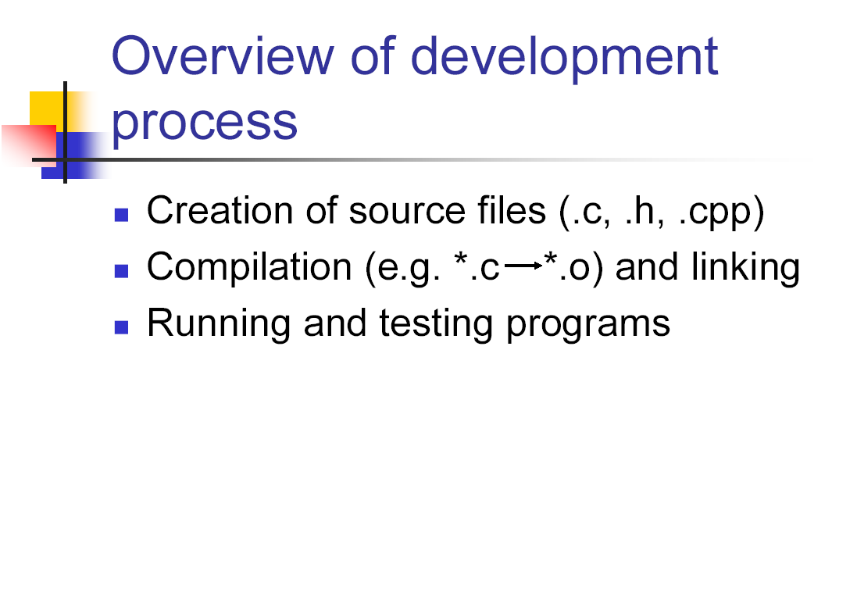

Slide 25
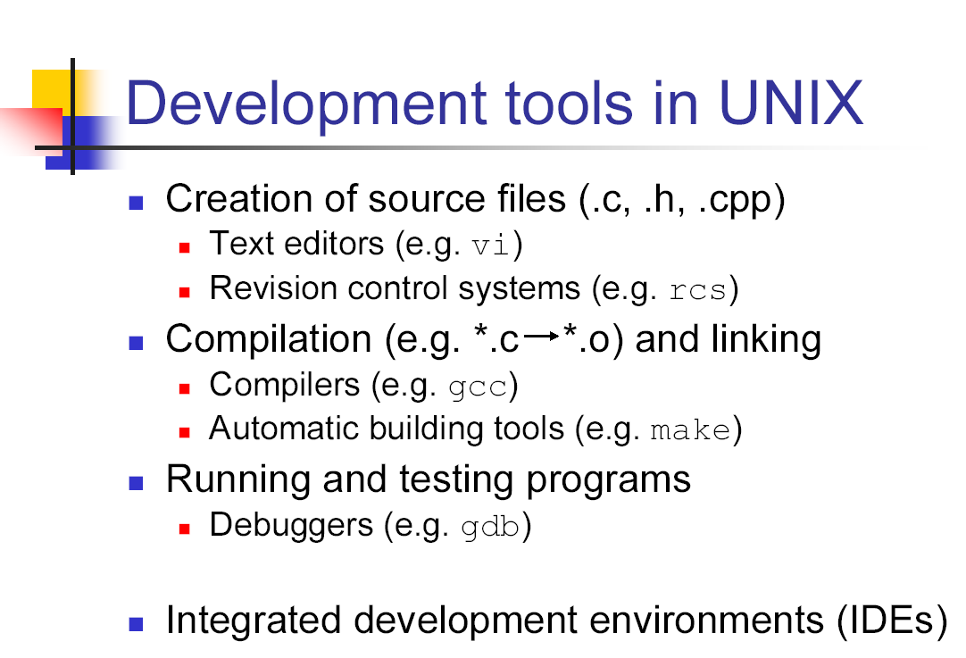

Slide 26
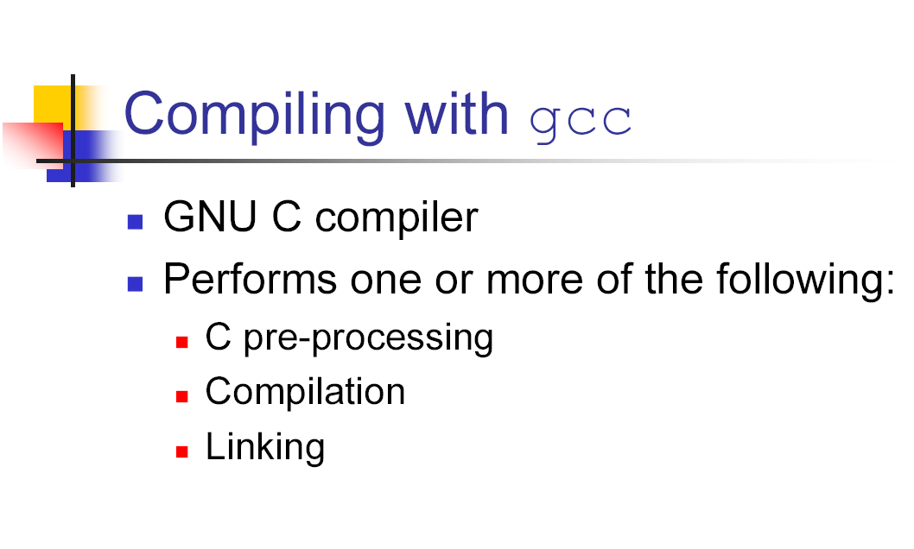

Slide 27
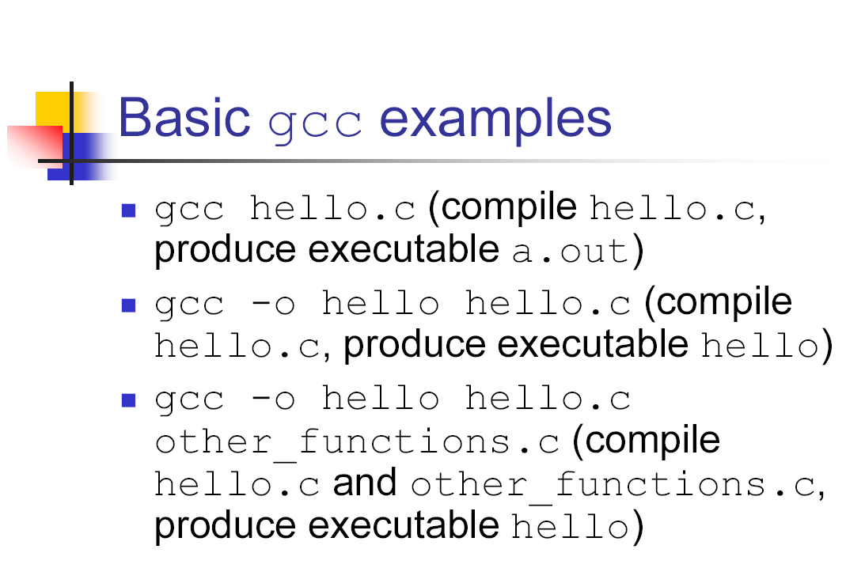

Slide 28
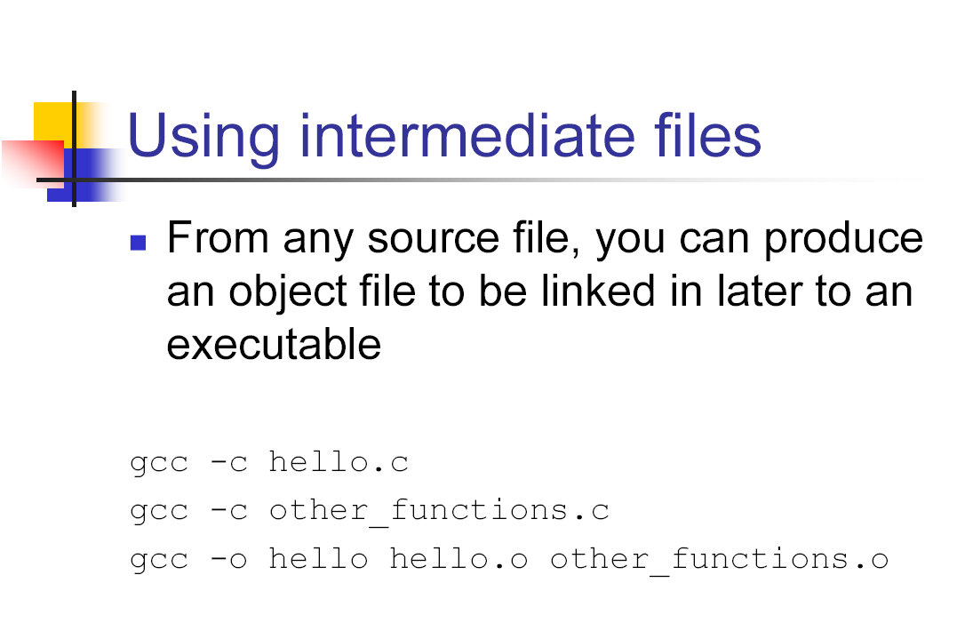

Slide 29
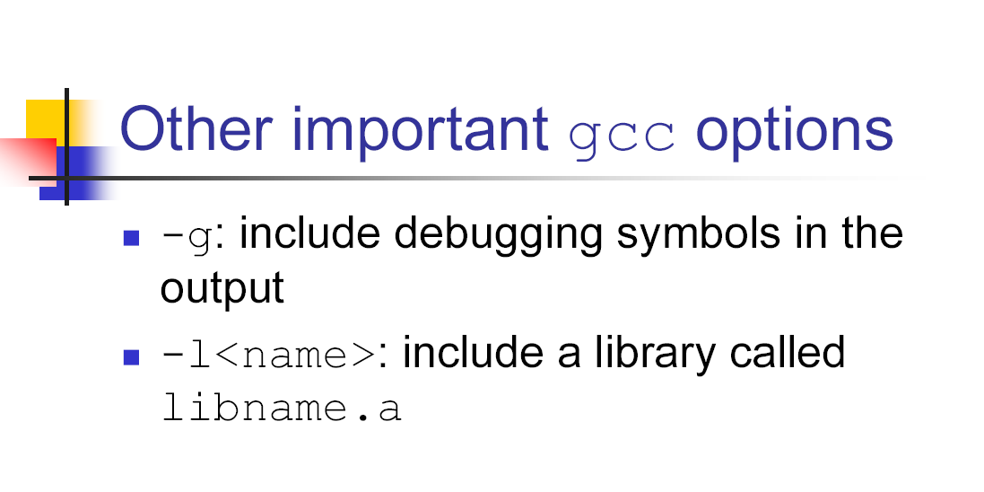

Slide 30
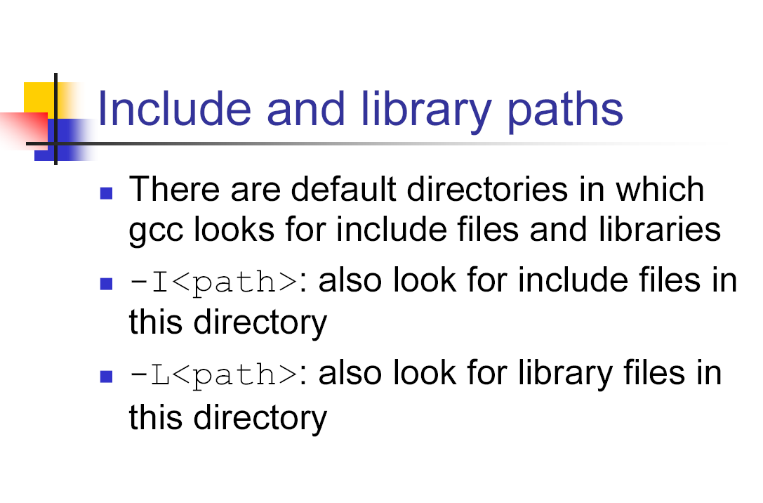

Slide 31
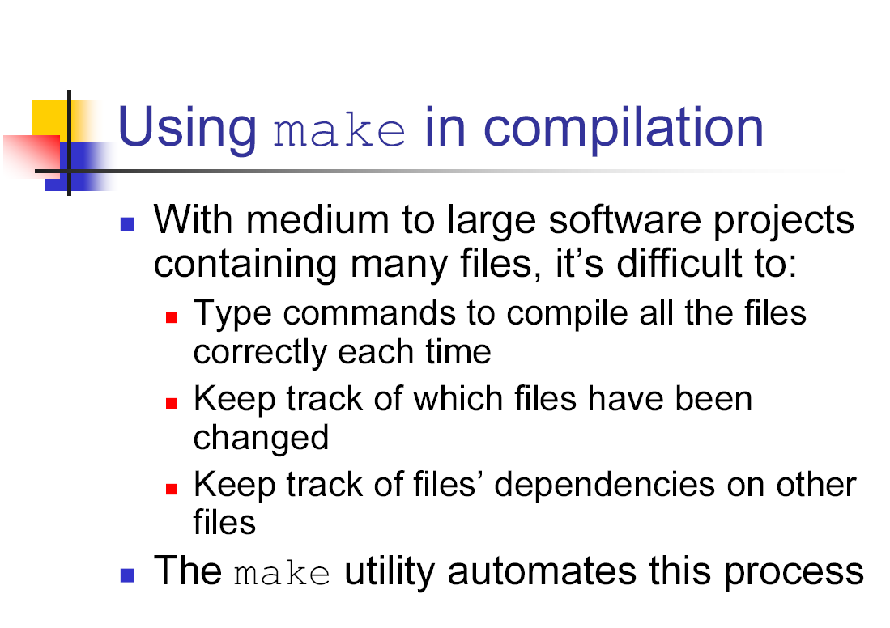

Slide 32
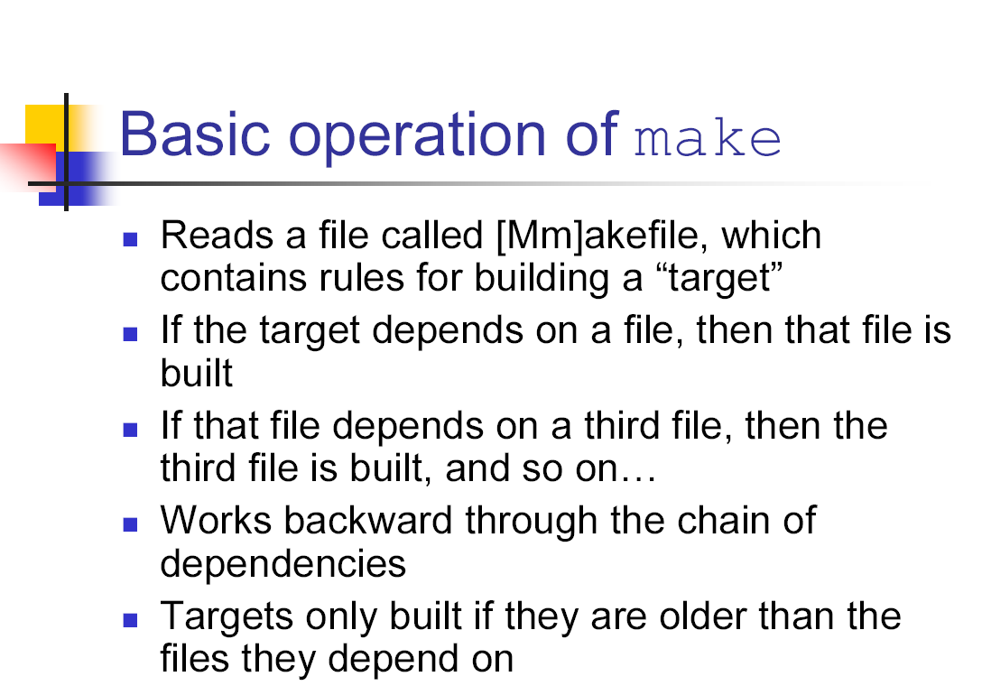

Slide 33
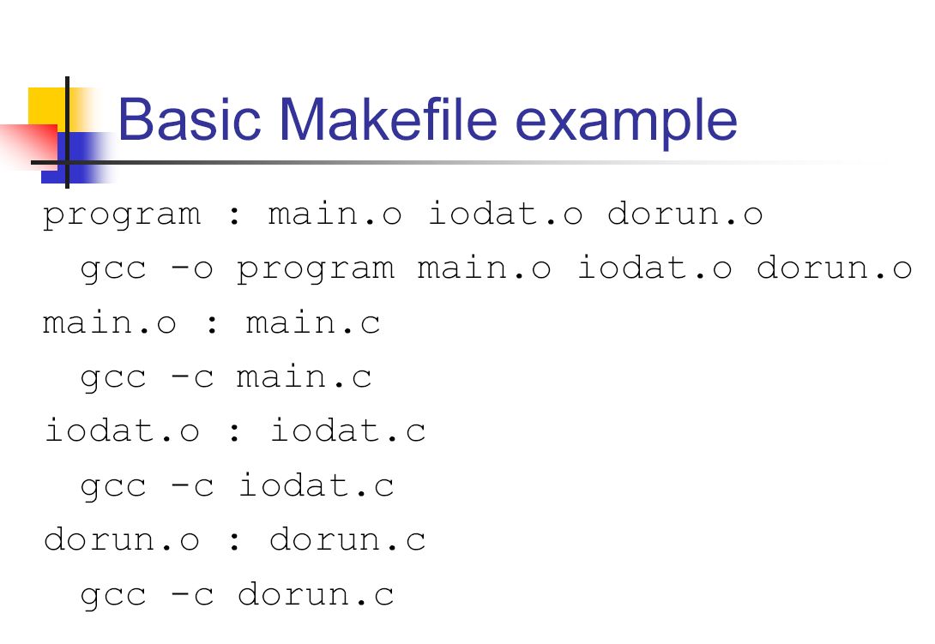

Slide 34
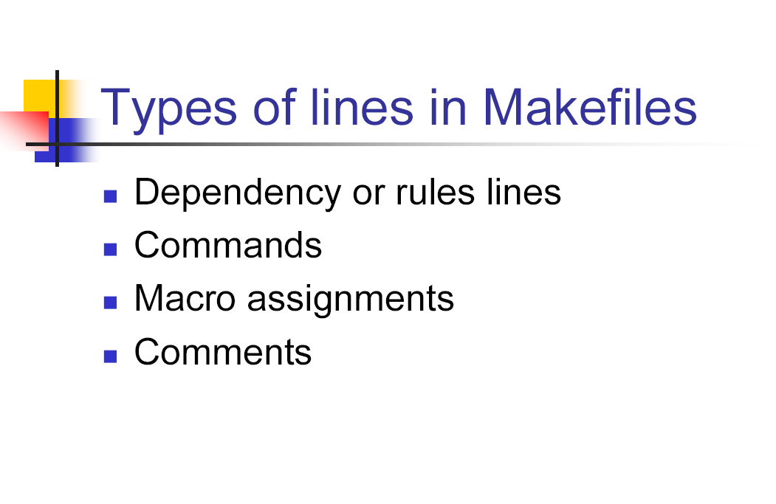

Slide 35
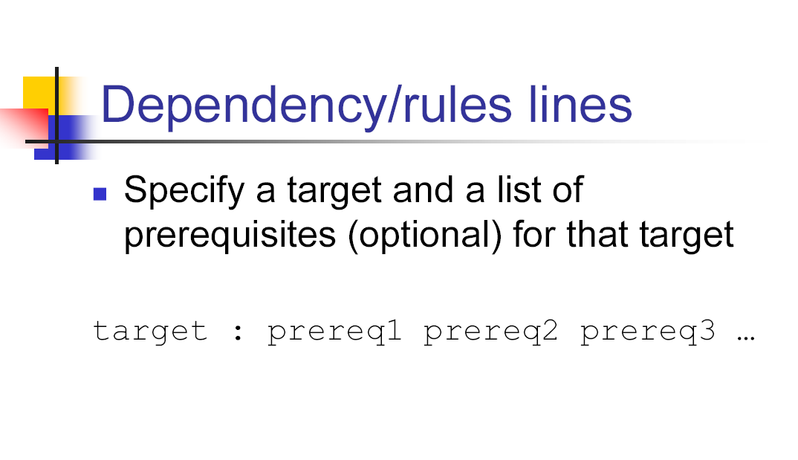

Slide 36
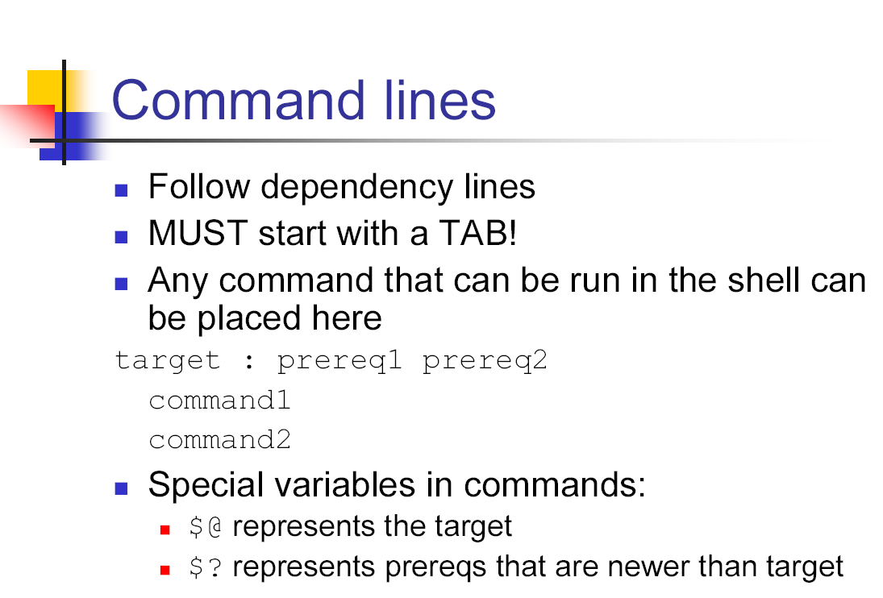

Slide 37
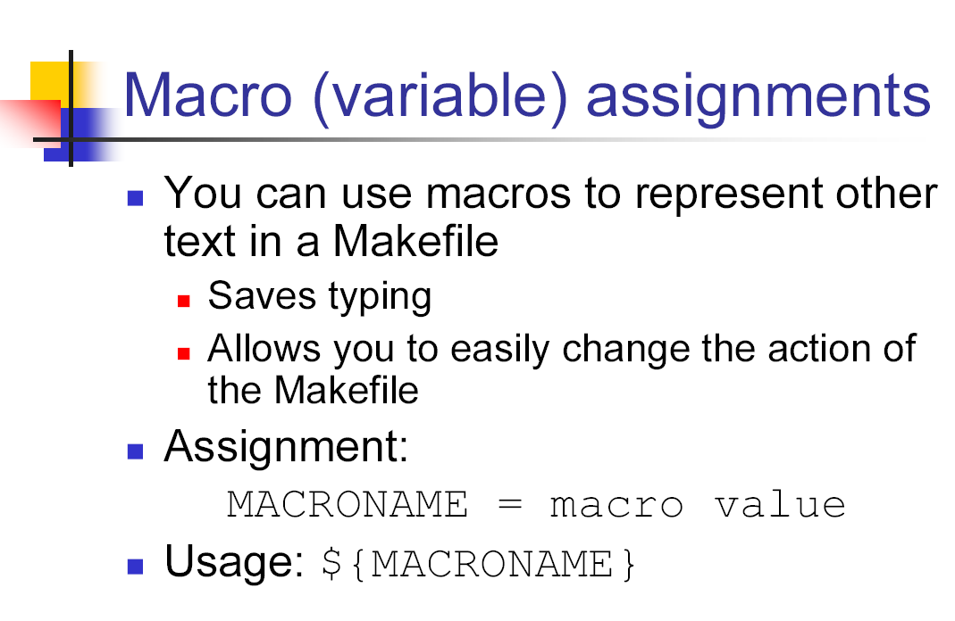

Slide 38
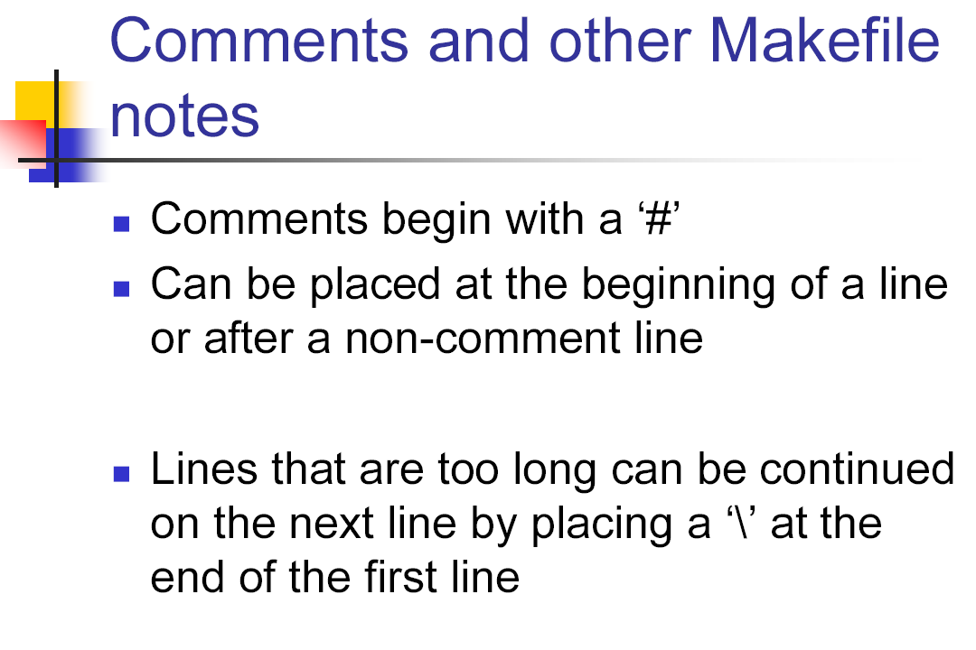

Slide 39
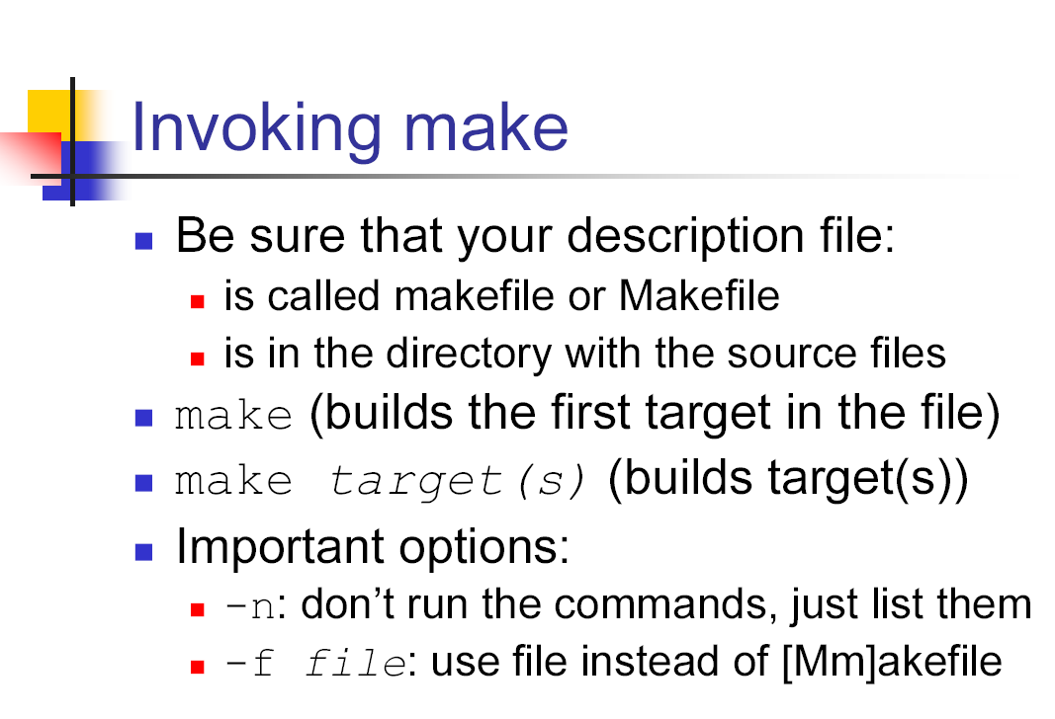

Slide 40
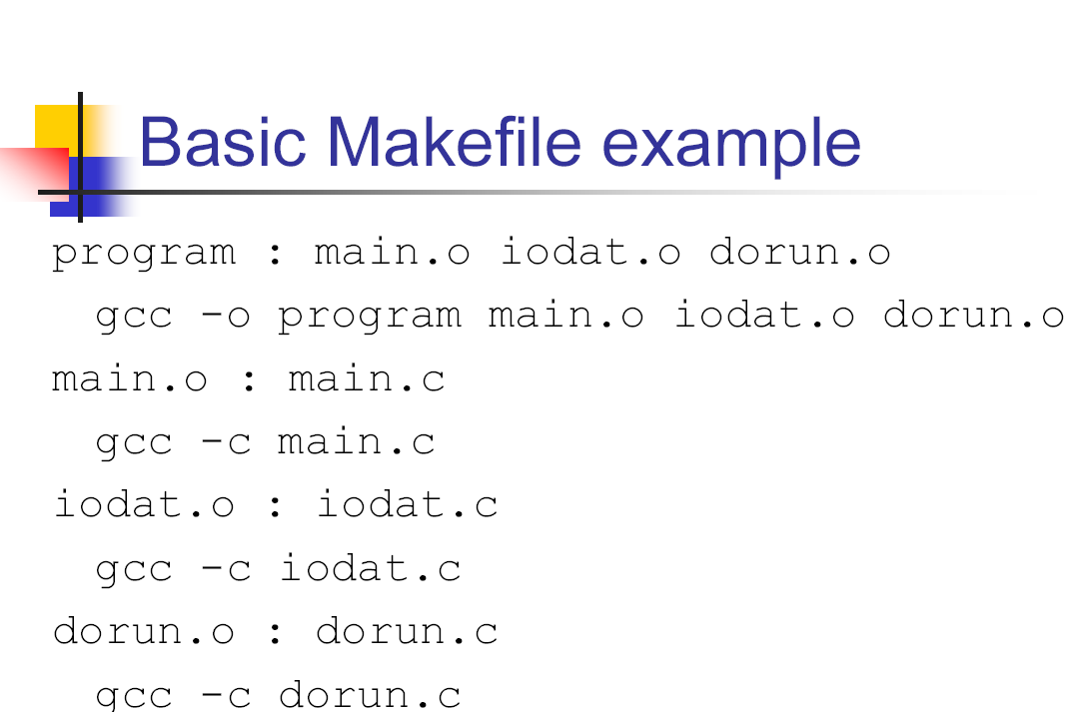

Slide 41
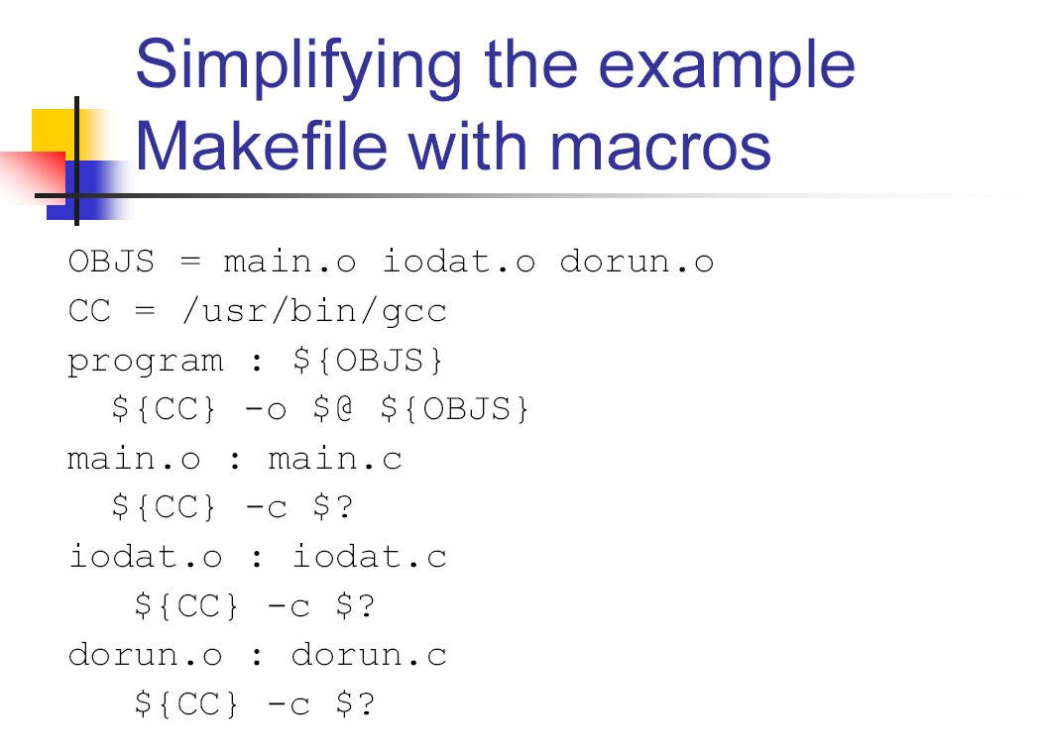

Slide 42
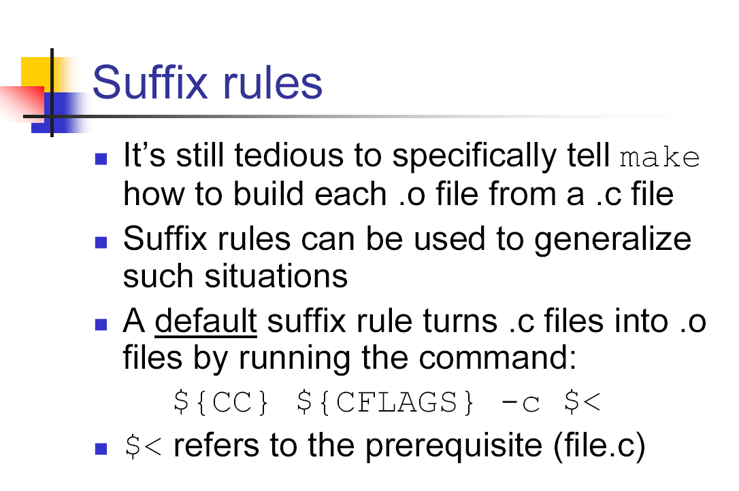

Slide 43
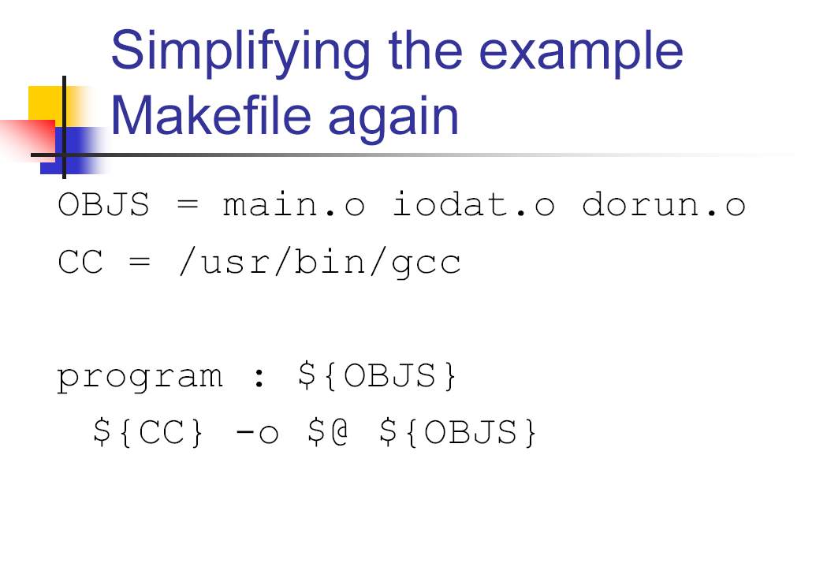

Slide 44
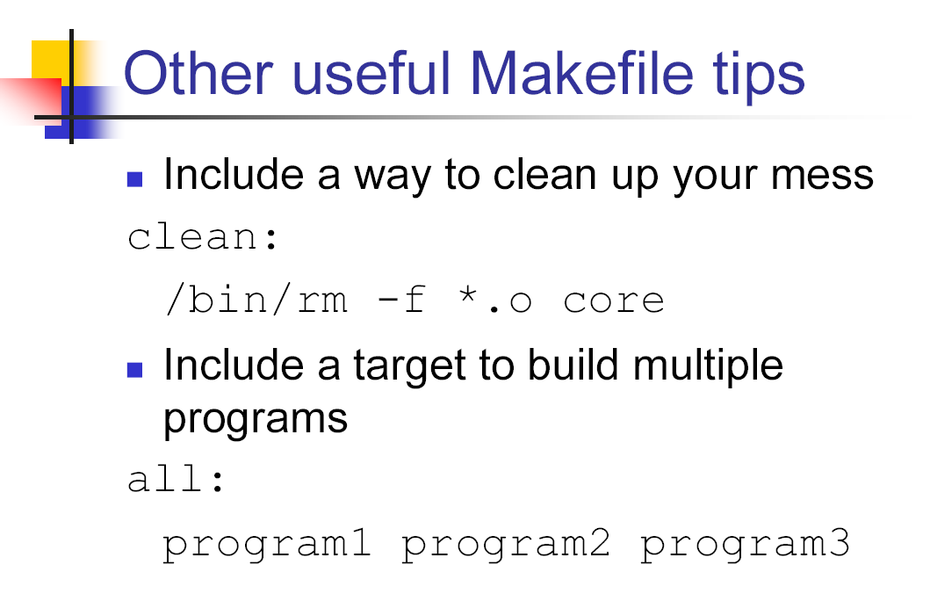

Slide 45
Links
http://acm.cs.virginia.edu/archives/events/workshop/unix/
http://courses.cs.vt.edu/~cs2204/spring2002/schedule.html
http://www.cs.toronto.edu/~culhane/Teaching/209-Fall97/Slides/

