Slide 1
Technical Debt

Slide 2

Definition
Delivering the system in suboptimal way with many short comings which requires re-work later
Requires additional time and rework
It doesn't mean poor internal quality
Persists as long as it is unpaid
Incur interest on top of interest, making it cumbersome to build a project
High probability failure when adding feature or fixing bug

Slide 3
Place holder
Logging, alrams,metricts
Prevent

Slide 4

Existence
Tight timelines with urgency to meet customer deadlines
A POC to move forward
Code or architecture level
Replacing developers
Temporary functions and hacks
Delaying clean-ups and upgrades
Created with conscious decision
No awareness not acknowledge of its existence

Slide 5

Place holder

Slide 6

Impacts
Performance
Extensibility
Modularity
Portability
Reliability
Usability
Security

Slide 7
Place holder
Achieve deadlines in real time systems
Type of supported modifications
Response in the event of a failure
Change in Platform, HW/SW/Middleware/DB
Compensate the internal failures
Separation of responsibilities Client/Server (add more)
Processors/Resources/Caching/Latency/Throughput/Capacity
Redundancy

Slide 8
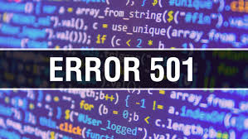
Symptoms
Service going down
Wasting CPU Cycles or Running function longer
Imperfections in code or architecture
Longer to apply simple features
Hard to manage code
Hard to upgrade the project dependencies
Hard to scale
Documentation is out of sync
Deployments are troublesome, often fail for various reasons

Slide 9
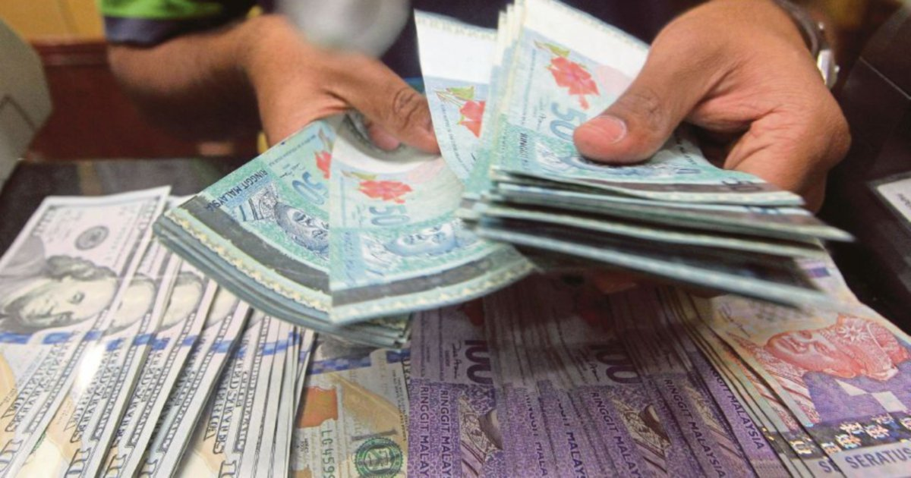
Pay time
Clearing debt earlier is cheaper
Cleaning code by removing dead code and implementing DRY
Refactor the code and make it easier to maintain
Train developers to write clean code
Refactor whenever existing code is changed
when there is no one that understands the code
when making documentation

Slide 10
Pay time
Making dependencies abstract
Improving readability by enforcing code styles and better naming
Breaking bigger chunks of code into smaller chunks
Replacing code gradually with strangler pattern
Add Unit Tests
TDD
Leave the code better than you found it
small changes no need to do all at once
Static Code Analyzers
Review Documentation

Slide 11

References
https://www.overops.com/blog/strangler-pattern-how-to-keep-sane-with-legacy-monolith-applications/
https://www.michielrook.nl/2016/11/strangler-pattern-practice/
https://hackernoon.com/legacy-code-40027792bf85
https://www.joelonsoftware.com/2000/04/06/things-you-should-never-do-part-i/
https://www.perforce.com/blog/qac/8-tips-working-legacy-code
https://resources.sei.cmu.edu/asset_files/ConferencePaper/2016_021_001_493671.pdf
https://resources.sei.cmu.edu/library/asset-view.cfm?assetid=513803

