Slide 1
Data Protection
Distributed Process

Slide 2
Data source Transformations
File
File
DB
DB

Slide 3
Processing Steps
Data Source
part
part
part
part
part
part
Processor
File
DB

Slide 4

Spark Architecture
Standalone
cluster
Kubernetes
mesos
yarn

Slide 5


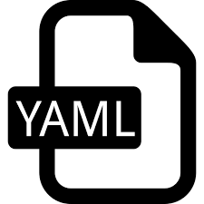

Process Flow
Source
Sink

Slide 6
Processor Runtimes
VM
Kubernetes
Job/pod
Static Spark
Dynamic Spark

Slide 7
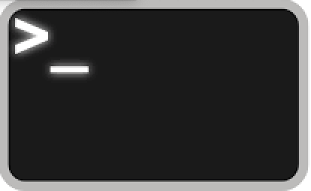
Processor Runtime - VM
VM
Workflow
Jars
Properties
spark-submit/java
Input
Output

Slide 8


K8S - Requirements
props
schemas
workflow
lib

Slide 9

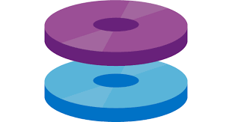




K8S - Job/Pod
Job/Pod
config-map
spark-shell
Input/Output

Slide 10
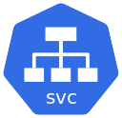

K8S - Static - Spark Cluster
Pod
config-map
spark-submit
Input/Output

Slide 11
K8S - Dynamic - Spark Cluster
Pod
config-map
spark-submit
Input/Output

Slide 12

K8S - Static Spark Cluster
Job/Pod
config-map
pvc
spark-submit/ava
Input
Output

Slide 13
Processor Runtime - K8S
Job/Pod
config-map
pvc
spark-submit/ava
Input
Output

Slide 14
Processor Runtime - K8S
Spark Driver
config-map
pvc/fileshare
spark-submit (local)
Input
Output

Slide 15
Processor Runtime - K8S
Spark Driver/Executor
config-map
pvc
S3/ADLS2
spark-submit (cluster)
Input
Output

