Slide 1
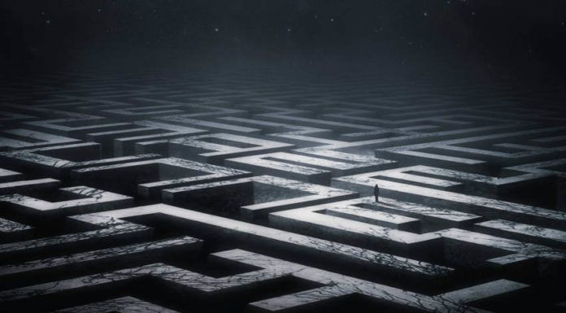
Daedulus

Slide 2
Aesthetics
Facing Fear
Closure
Sympathy
Revenge
Problem Solving

Slide 3
Mechanics
Stuck Walking(Can’t Run From Problems)
Jumping
Opening Doors
Picking up objects(Keys)
Pushing objects
Flashlight(Outlast)

Slide 4
Key Facts
Playstation 4, Xbox One, Pc
Horror/Puzzle
TBC
Game Itself
Single Player
Game length depends on player skill.

Slide 5
Specific Features
Solve Puzzles around the labyrinthian house
Specific Length of Time for each Day(chosen by Player)
Time is adjusted based on number of attempts and progression.
Passive Combat through movement.
Child has a nightmare each night and must survive them.
Scarred Child.

Slide 6


Questions on our AWESOME game?

