Slide 1
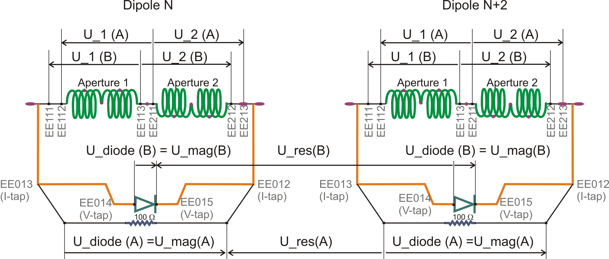
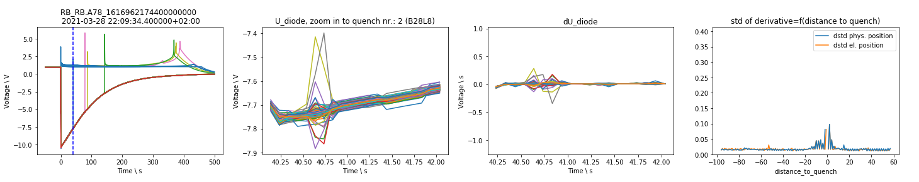
Slow Secondary Quenches
Analysis Script:
https://gitlab.cern.ch/machine-protection-ml/lhc-anomaly-detection/-/blob/dev/scripts/analyze_sec_quench.py

Slide 2
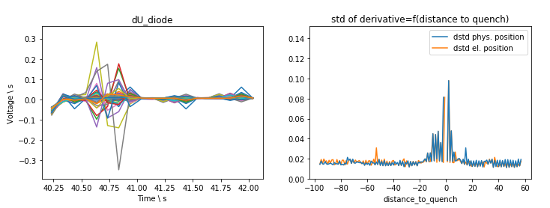
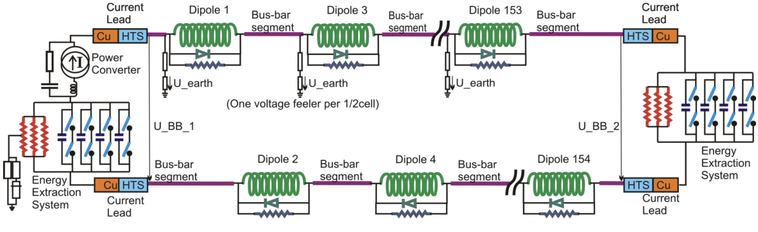
Manual Feature Engineering
Classification of oscillations after secondary quenches
-2
0
150
-1
1
151

Slide 3
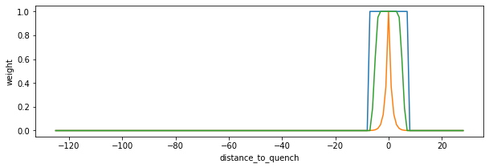
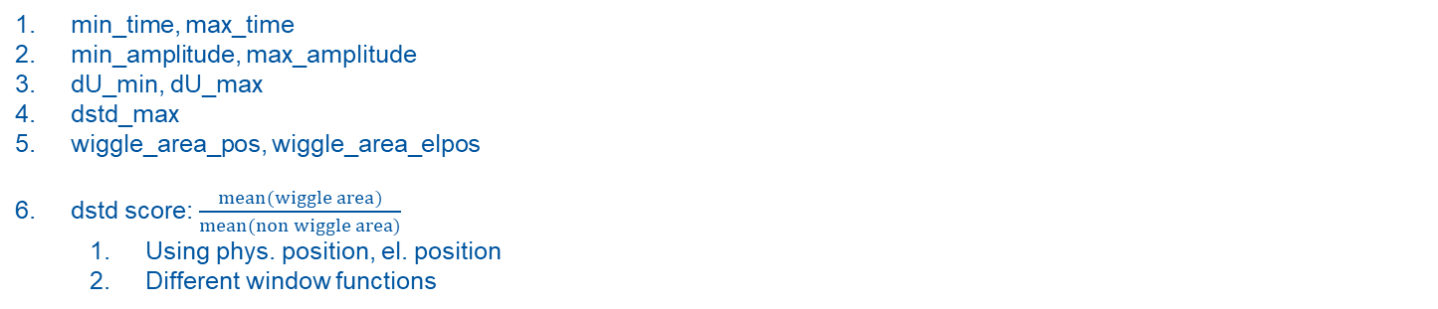
Manual Feature Engineering
2
3
4
2
3
1
min_time, max_time
min_amplitude, max_amplitude
dU_min, dU_max
dstd_max
wiggle_area_pos, wiggle_area_elpos
dstd score: $\frac{mean(wiggle area)}{mean(non wiggle area)}$
Using phys. position, el. position
Different window functions
5
5

Slide 4
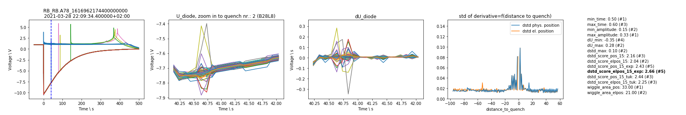
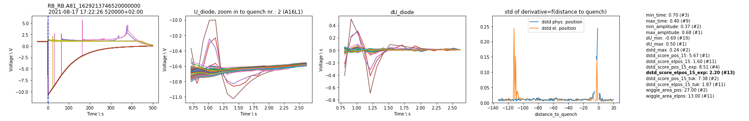
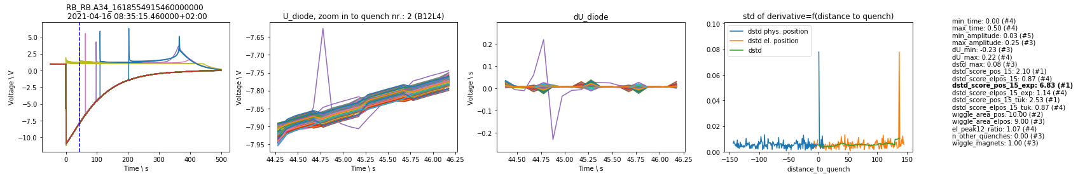
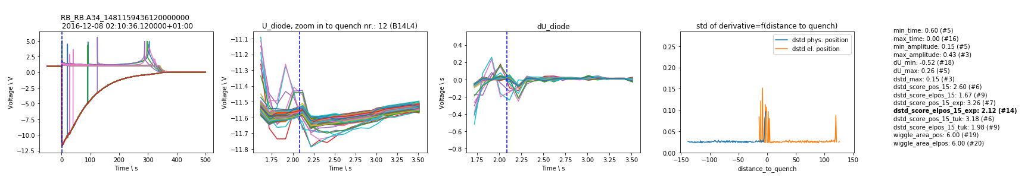
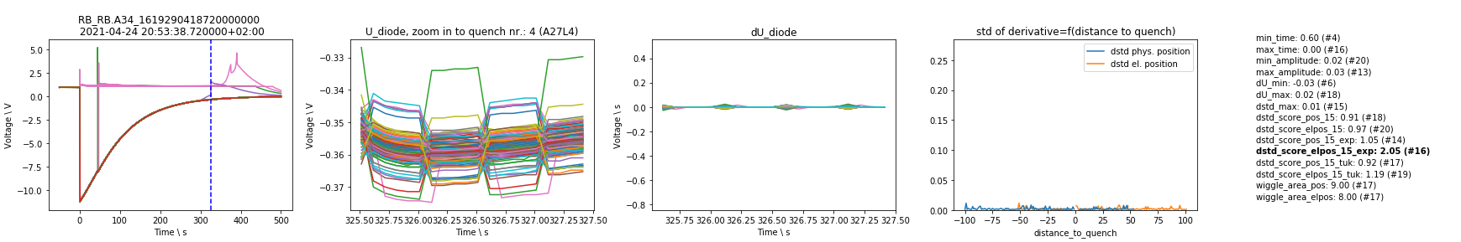
1. Oscillation that only propagates electrically
Reason: electric coupling?
2. Oscillation that propagates physically and electrically
Reason: electric coupling through grounding?
Special case: Oscillation in only one magnet
3. Oscillation due to another quench in time window
Reason: coupling of magnets
4. Oscillation due to acquisition
Reason: acquisition
Manual Threshold

