Slide 1
ezrag Project
Making RAG Easy to Implement
Eh sort of

Slide 2
Highlights
Python
Based on Strategy OO Pattern
Uses abstract classes
Hides non-standard implementation syntax of Python AI libs
Simplify interaction with RAG pieces
Make following/understanding code easier, consistent
Allows for easy swapping out of RAG pieces (chunkers, retrievers, embedders, generators)
Has easy-to-use helper utilities
To easily create, enable virtual python environment
Has python package wrangling helper
Easy-to-use print statements
To show which file statement came from
Start/stop/execution times

Slide 3
RAG Common Terminology
Generator
Retriever
Prompt
LLM
Response
Query
Question
Chunker
Embedder
Search
Re-retriever
Context
Docs
VectorDB
Retrieval augmented Generation
Notes:
Except for Main, these are Abstract classes with common methods

Slide 4
Class Diagram Goal, Phase II
Main
---------------
Public void run(cmdLineArgs)
uses
uses
uses
AbsPromptMucker (?)
---------------
Public cleanPrompt demuck(prompt)
AbsRetriever
---------------
_load_n_chunk_docs()
_create_embeddings()
Public docNames,docChunks retrieveDocs(prompt)
AbsGenerator
---------------
Public generate_response(query, context)
uses
uses
uses
AbsChunker
---------------
Public chunk chunk(doc)
Public chunks[] chunk( docs[])
AbsEmbedder
---------------
Public embedding embed(chunk)
Public embeddings[] embed( chunk[])
AbsEmbedSearchr
---------------
Public addEmbeddings( embedding[])
Notes:
Except for Main, these are Abstract classes with common methods

Slide 5
Current Class Diagram
Main
---------------
Public void run(cmdLineArgs)
uses
uses
uses
utils
---------------
print_start_msg(str)
print_stop_msg(str)
python_package_helper()
AbsRetriever
---------------
_create_embeddings()
_load_n_chunk_docs()
Public docNames,docChunks retrieveDocs()
AbsGenerator
---------------
Public generate_response(query, context)
implements
implements
implements
implements
Naive_ST_FAISS_Retriever
---------------
Naive chunking, MiniLLM embedder, FAISS Vector
Whoosh_Retriever
---------------
Naive chunking, Whoosh embedder, Whoosh Vector
Simple_Retriever
---------------
No chunking, No embedder, No Vector,
Just returns original query
TinyLLM_Generator
---------------
TinyLLM

Slide 6
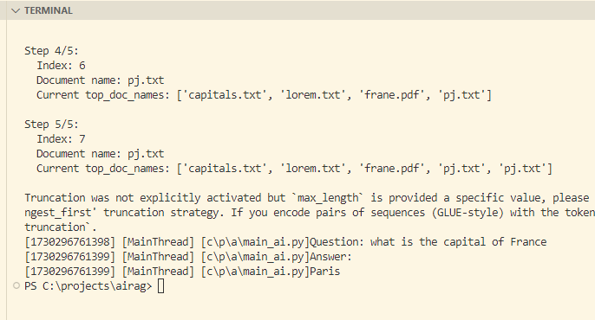
Demo

