Slide 1

Swimming in the Lakes of Microsoft Fabric
Lino Tadros, RD
Founder, The Training Boss
AI Architect, Solliance

Slide 2
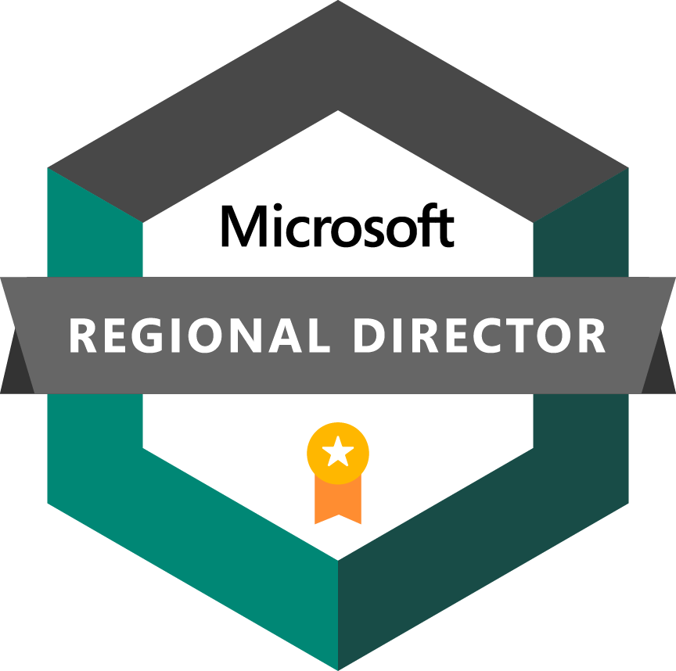


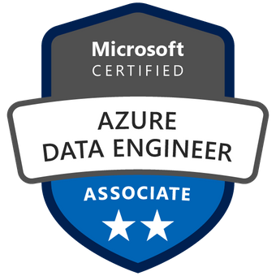
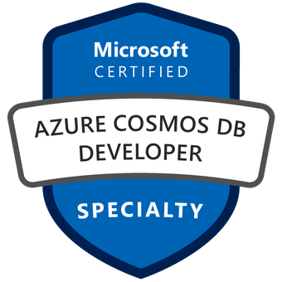

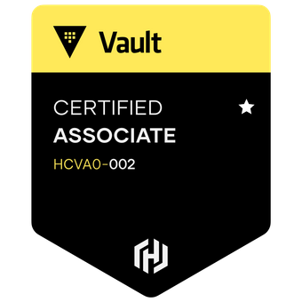
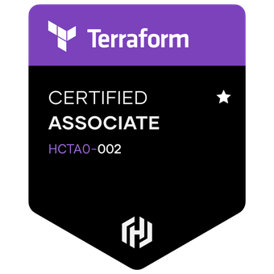
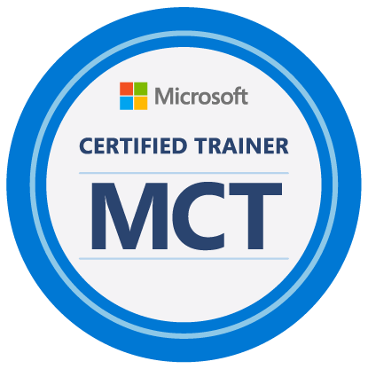


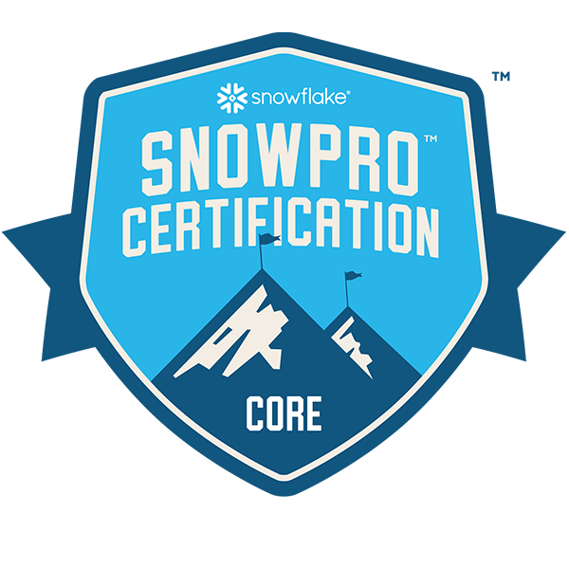
Lino Tadros
President & CEO – The Training Boss LLC
AI and Machine Learning Architect – Solliance, Inc
Microsoft MVP for 15 years
Microsoft Regional Director for 5 years
Sitefinity MVP & Telerik Developer Expert for 19 years
SmartBear Community Leader for 23 years
Former member of the Delphi & C++ development team at Borland.
Microsoft established Technical Speaker worldwide (54 countries) in the last 30 years.
Architect of major projects for NASA, Disney, HP, Morgan Stanley, Johnson & Johnson, Chevron, Shell, Dell, Bank of America, Wells Fargo, State of CA, and many others…
Author of 8 Technical books for the last 18 years
Pluralsight and Udemy established Author
Carry 28 Certifications in AWS, AZURE, GCP, Terraform, Snowflake, Databricks and Microsoft Fabric
Expert on AI & Machine Learning, iOS, Android, ASP.NET, Azure Cloud, AWS, Google Cloud, SQL databases, OpenAI and Generative AI.

Slide 3

Agenda
What is Microsoft Fabric?
OneLake vs LakeHouse vs DirectLake
Parquet Files with Delta and Vorder
Fabric Data Engineering
Fabric Shortcuts
Fabric Data Factory
Fabric Data Warehousing
Fabric Real Time Analytics, KUSTO and KQL
Fabric Data Science
Fabric Power BI
Fabric Data Activator
Fabric CI/CD with Git
I wanted to cover Fabric Capacity and Pricing but the organizers refused to extend my session to 10 hours ☺

Slide 4
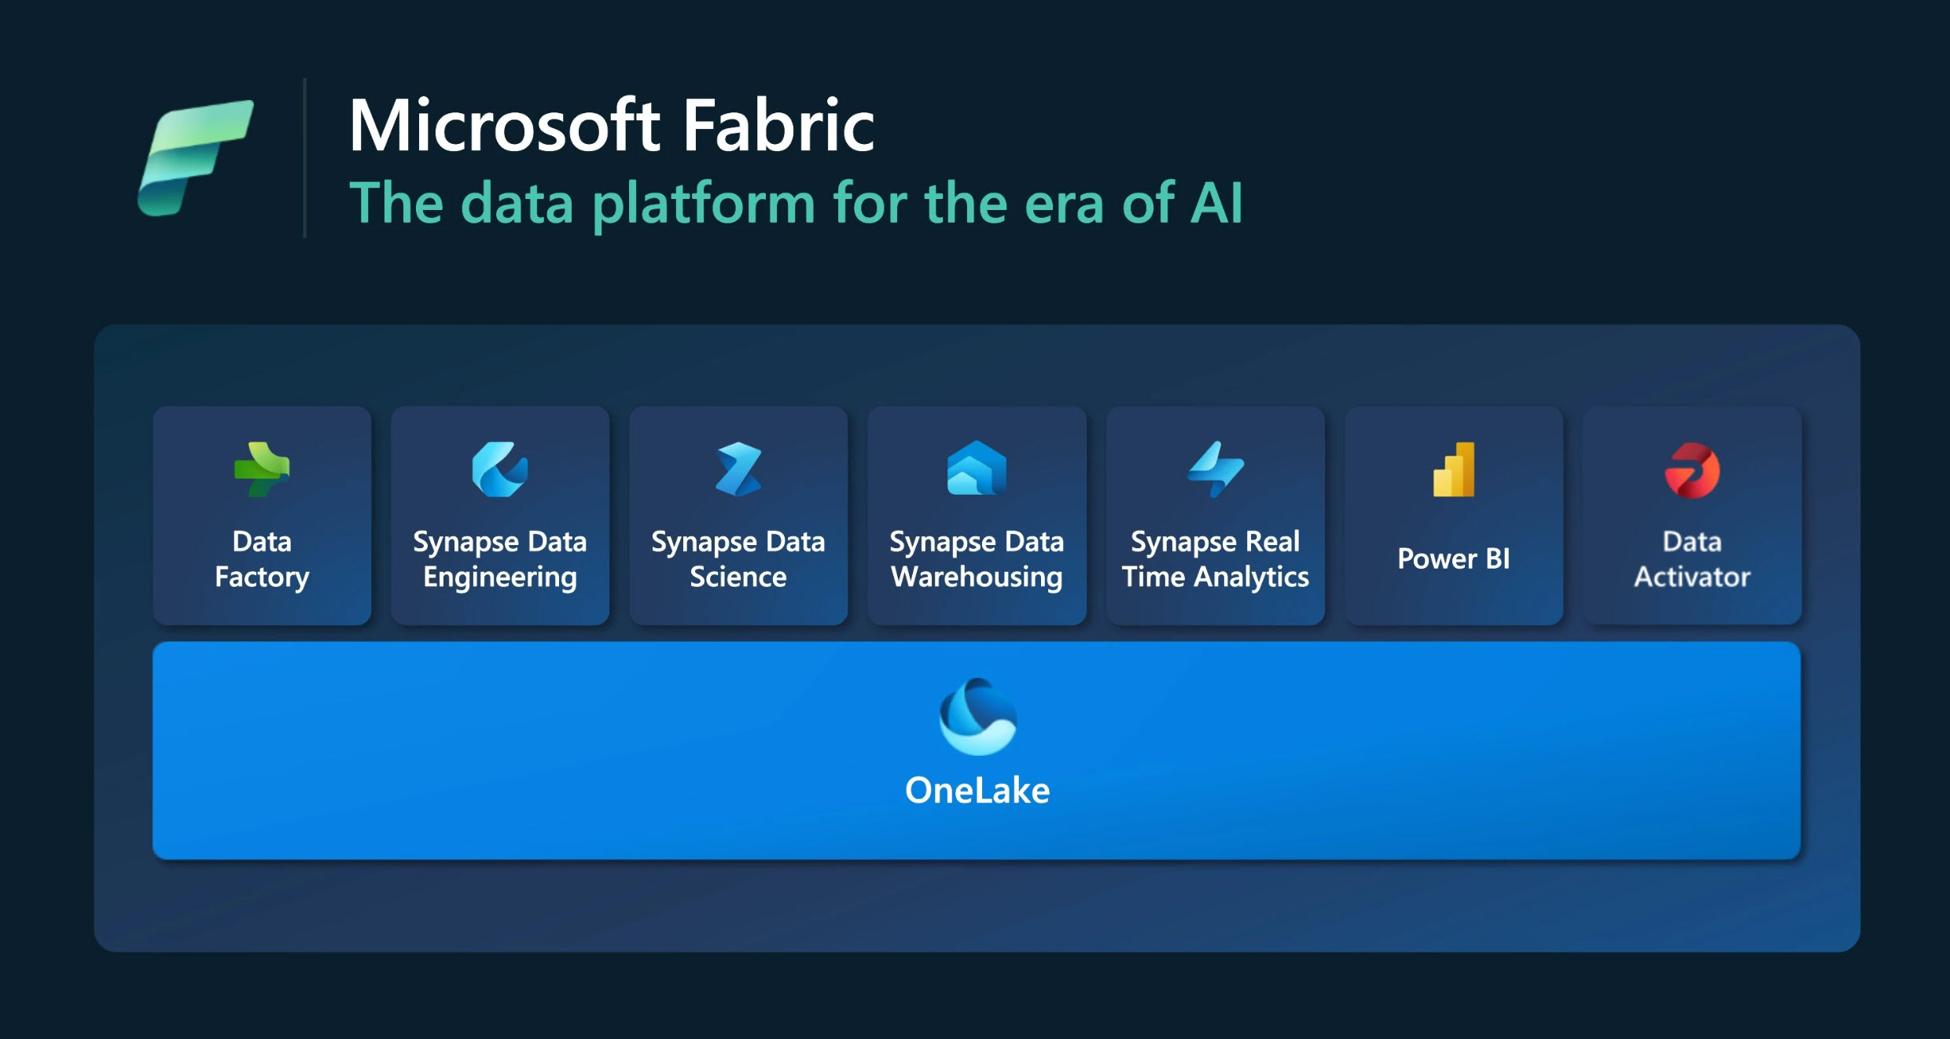
Notes:
Power BI → The world most leading Business Intelligence platform.
Data Engineering → About moving data from point A to point B. Behind the scene it uses Apache Spark for moving large data around. It include Spark Job definitions that submits batch or stream jobs to a Spark cluster. You can access that through Notebooks
Data Factory → About ingesting data from operational databases into analytical databases in OneLake using tools as simple as Power Query using what we call Data Factory pipelines.
Data Science → Helps Data Scientist build, deploy and operationalize the machine learning models within the Fabric environment.
Data Warehousing → Massive SQL Server scale and totally separate from storage
Real Time Analytics → End to end streaming solution like IoT stream and high speed data analysis optimized for Time Series and include automatic indexing. Use Kusto (KQL) to access this data.

Slide 5
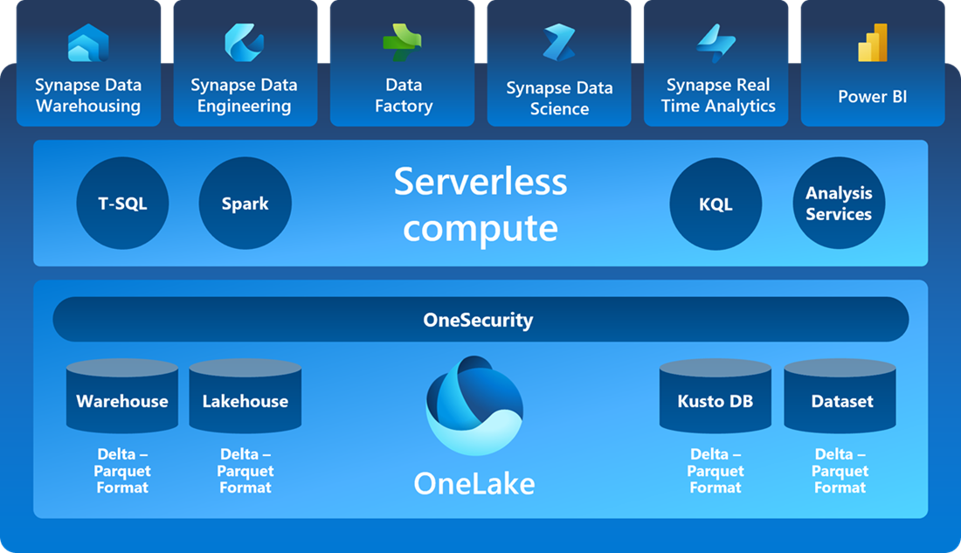
Fabric Compute Power
Notes:
The old days Data engineers, Data Scientist and Business Analysts worked in silos and had to deploy their work for the other members to start their work. In Fabric this is a thing of the past, it is ONE environment when they all share a common platform to accomplish their work.

Slide 6
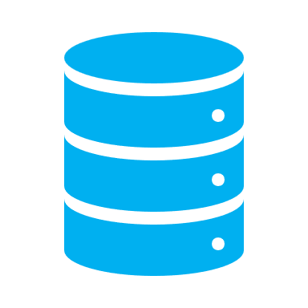

Introduction to OneLake, first the problem – Data Swamp
IT
Sales
Operations
Marketing
Data Movement
Data Movement
Data Movement
Data Movement
Data Movement
Data Movement
Data Movement
Data Movement

Slide 7

OneLake
“OneDrive for Business Data”
“SaaS for Enterprise data as a DataLake”
“Fully Managed, Fully Governed”
“Can be used over multiple Analytical Engines”
“Logical Data Organization”
“Delta Parquet format Universal across your entire Organization”

Slide 8
OneLake
Download Microsoft OneLake File Explorer for Windows
Delta Parquet based format storage on your machine

Slide 9

LakeHouse
Lakehouse is a data architecture platform for
Storing
Managing
Analyzing
Structured and unstructured data in a single location.
In order to achieve seamless data access across all compute engines in Microsoft Fabric, Delta Lake is chosen as the unified table format

Slide 10
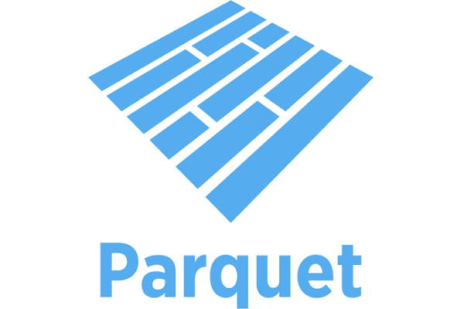
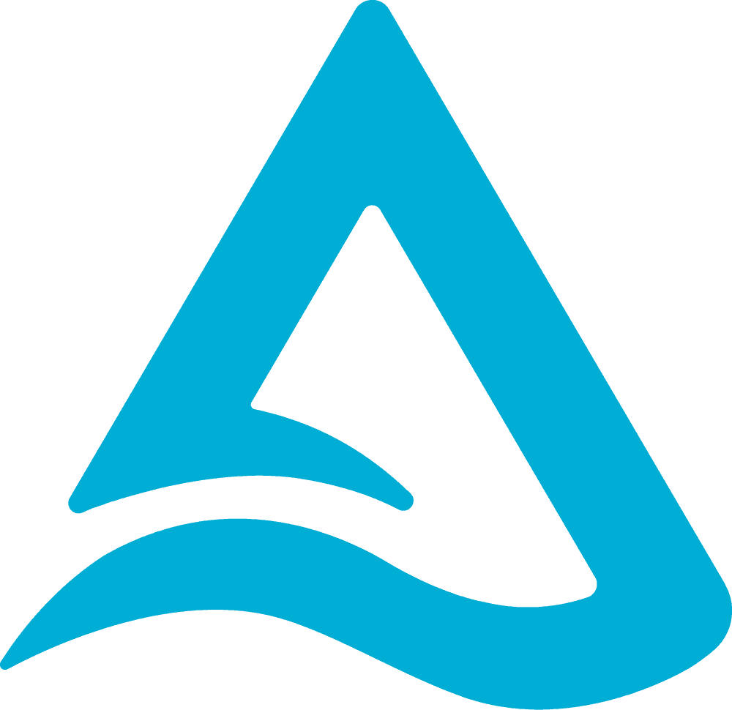
Delta Parquet Files
Download Microsoft OneLake File Explorer for Windows
Delta Parquet based format storage on your machine

Slide 11
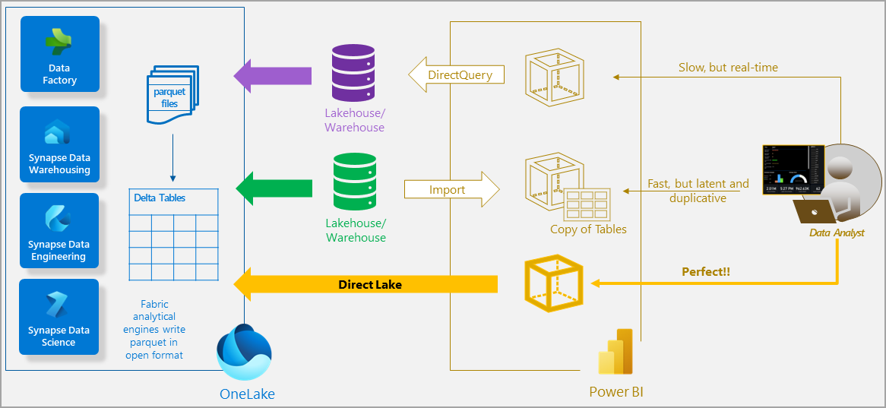
Modes of Access to data
Notes:
Direct Lake mode is a semantic model capability for analyzing very large data volumes in Power BI. Direct Lake is based on loading parquet-formatted files directly from a data lake without having to query a Lakehouse or Warehouse endpoint, and without having to import or duplicate data into a Power BI model. Direct Lake is a fast-path to load the data from the lake straight into the Power BI engine, ready for analysis. The following diagram shows how classic import and DirectQuery modes compare with Direct Lake mode.
In DirectQuery mode, the Power BI engine queries the data at the source, which can be slow but avoids having to copy the data like with import mode. Any changes at the data source are immediately reflected in the query results.
On the other hand, with import mode, performance can be better because the data is cached and optimized for DAX and MDX report queries without having to translate and pass SQL or other types of queries to the data source. However, the Power B
Direct Lake mode eliminates the import requirement by loading the data directly from OneLake. Unlike DirectQuery, there is no translation from DAX or MDX to other query languages or query execution on other database systems, yielding performance similar to import mode. I engine must first copy any new data into the model during refresh. Any changes at the source are only picked up with the next model refresh.

Slide 12

Direct Lake
Supported on F SKUs only $$$
To use it, you have to have a Lakehouse (or a Warehouse) with 1 or more Delta Tables in a workspace.
Notes:
The Lakehouse is required because it provides the storage location for your parquet-formatted files in OneLake.
The Lakehouse also provides an access point to launch the Web modeling feature to create a Direct Lake model.

Slide 13
Thank you!
Lino Tadros – https://www.linkedin.com/in/linotadros
@LinoTadros @TheTrainingBoss

