Slide 1

Entropies plots
Jesús Cobos Jiménez
12/03/24
Universidad del País Vasco/
Euskal Herriko Unibertsitatea

Slide 2

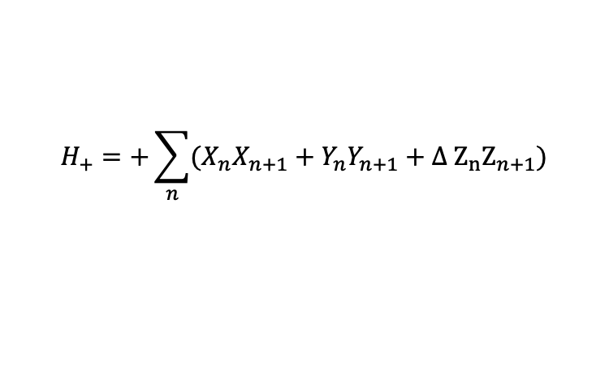




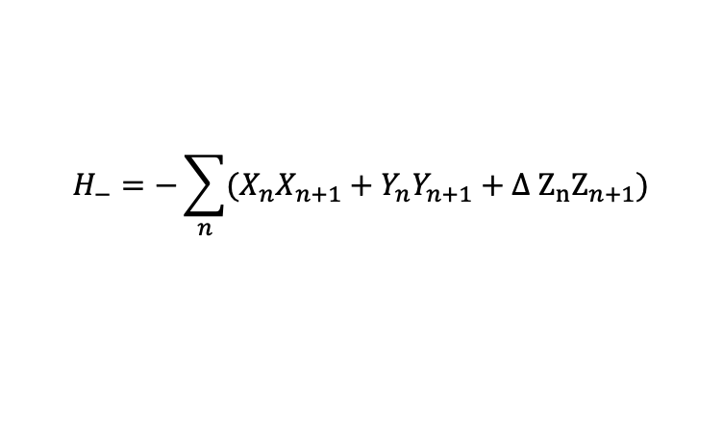

1. Recap of what I was doing
We were struggling with the sign in front of the XXZ Hamiltonian because for odd chains these two Hamiltonians are not equivalent
$$H_{+}=+\sum_{n}{(X_{n}X_{n+1}+Y_{n}Y_{n+1}+Δ Z_{n}Z_{n+1})}$$
$$H_{−}=−\sum_{n}{(X_{n}X_{n+1}+Y_{n}Y_{n+1}+Δ Z_{n}Z_{n+1})}$$
We wanted to know whether the entanglement entropy behaves similarly in both cases.
The problem was that $H_{+}$ presents a 4-fold degeneracy of the ground state for $−1<Δ≤1$ instead of 2-fold as $H_{−}$ does. This degeneracy is broken working in a translational invariant basis.
$$k_{1}≠0$$
No deg
$S_{z}=1/2$:
2-fold deg
$$k_{2}≠0$$
No deg
Quasi-momentum quantum nuber
4-fold deg
k
$$k_{1}≠0$$
No deg
$S_{z}=−1/2$:
2-fold deg
$$k_{1}≠0$$
No deg

Slide 3
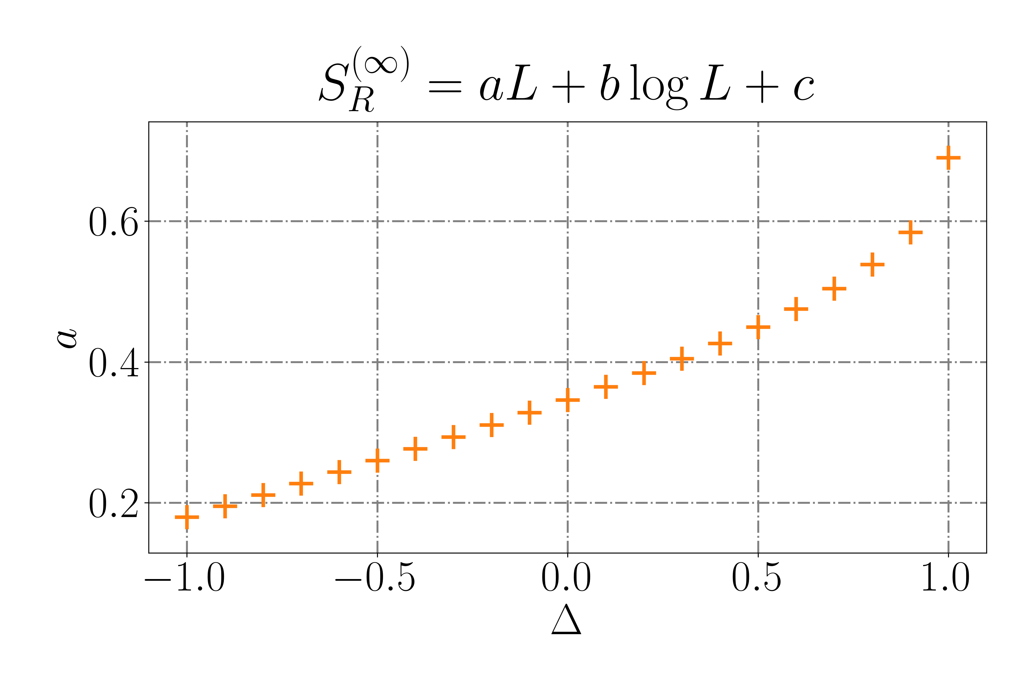
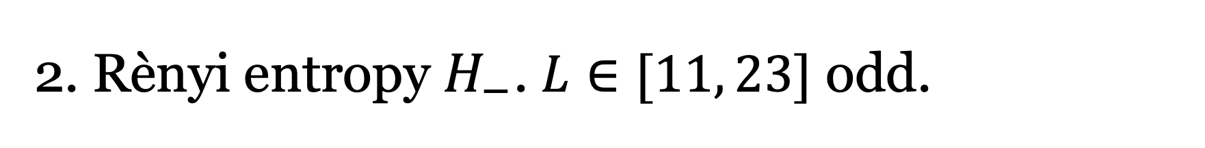
2. Rènyi entropy $H_{−}$. $L∈[11, 23]$ odd.

Slide 4
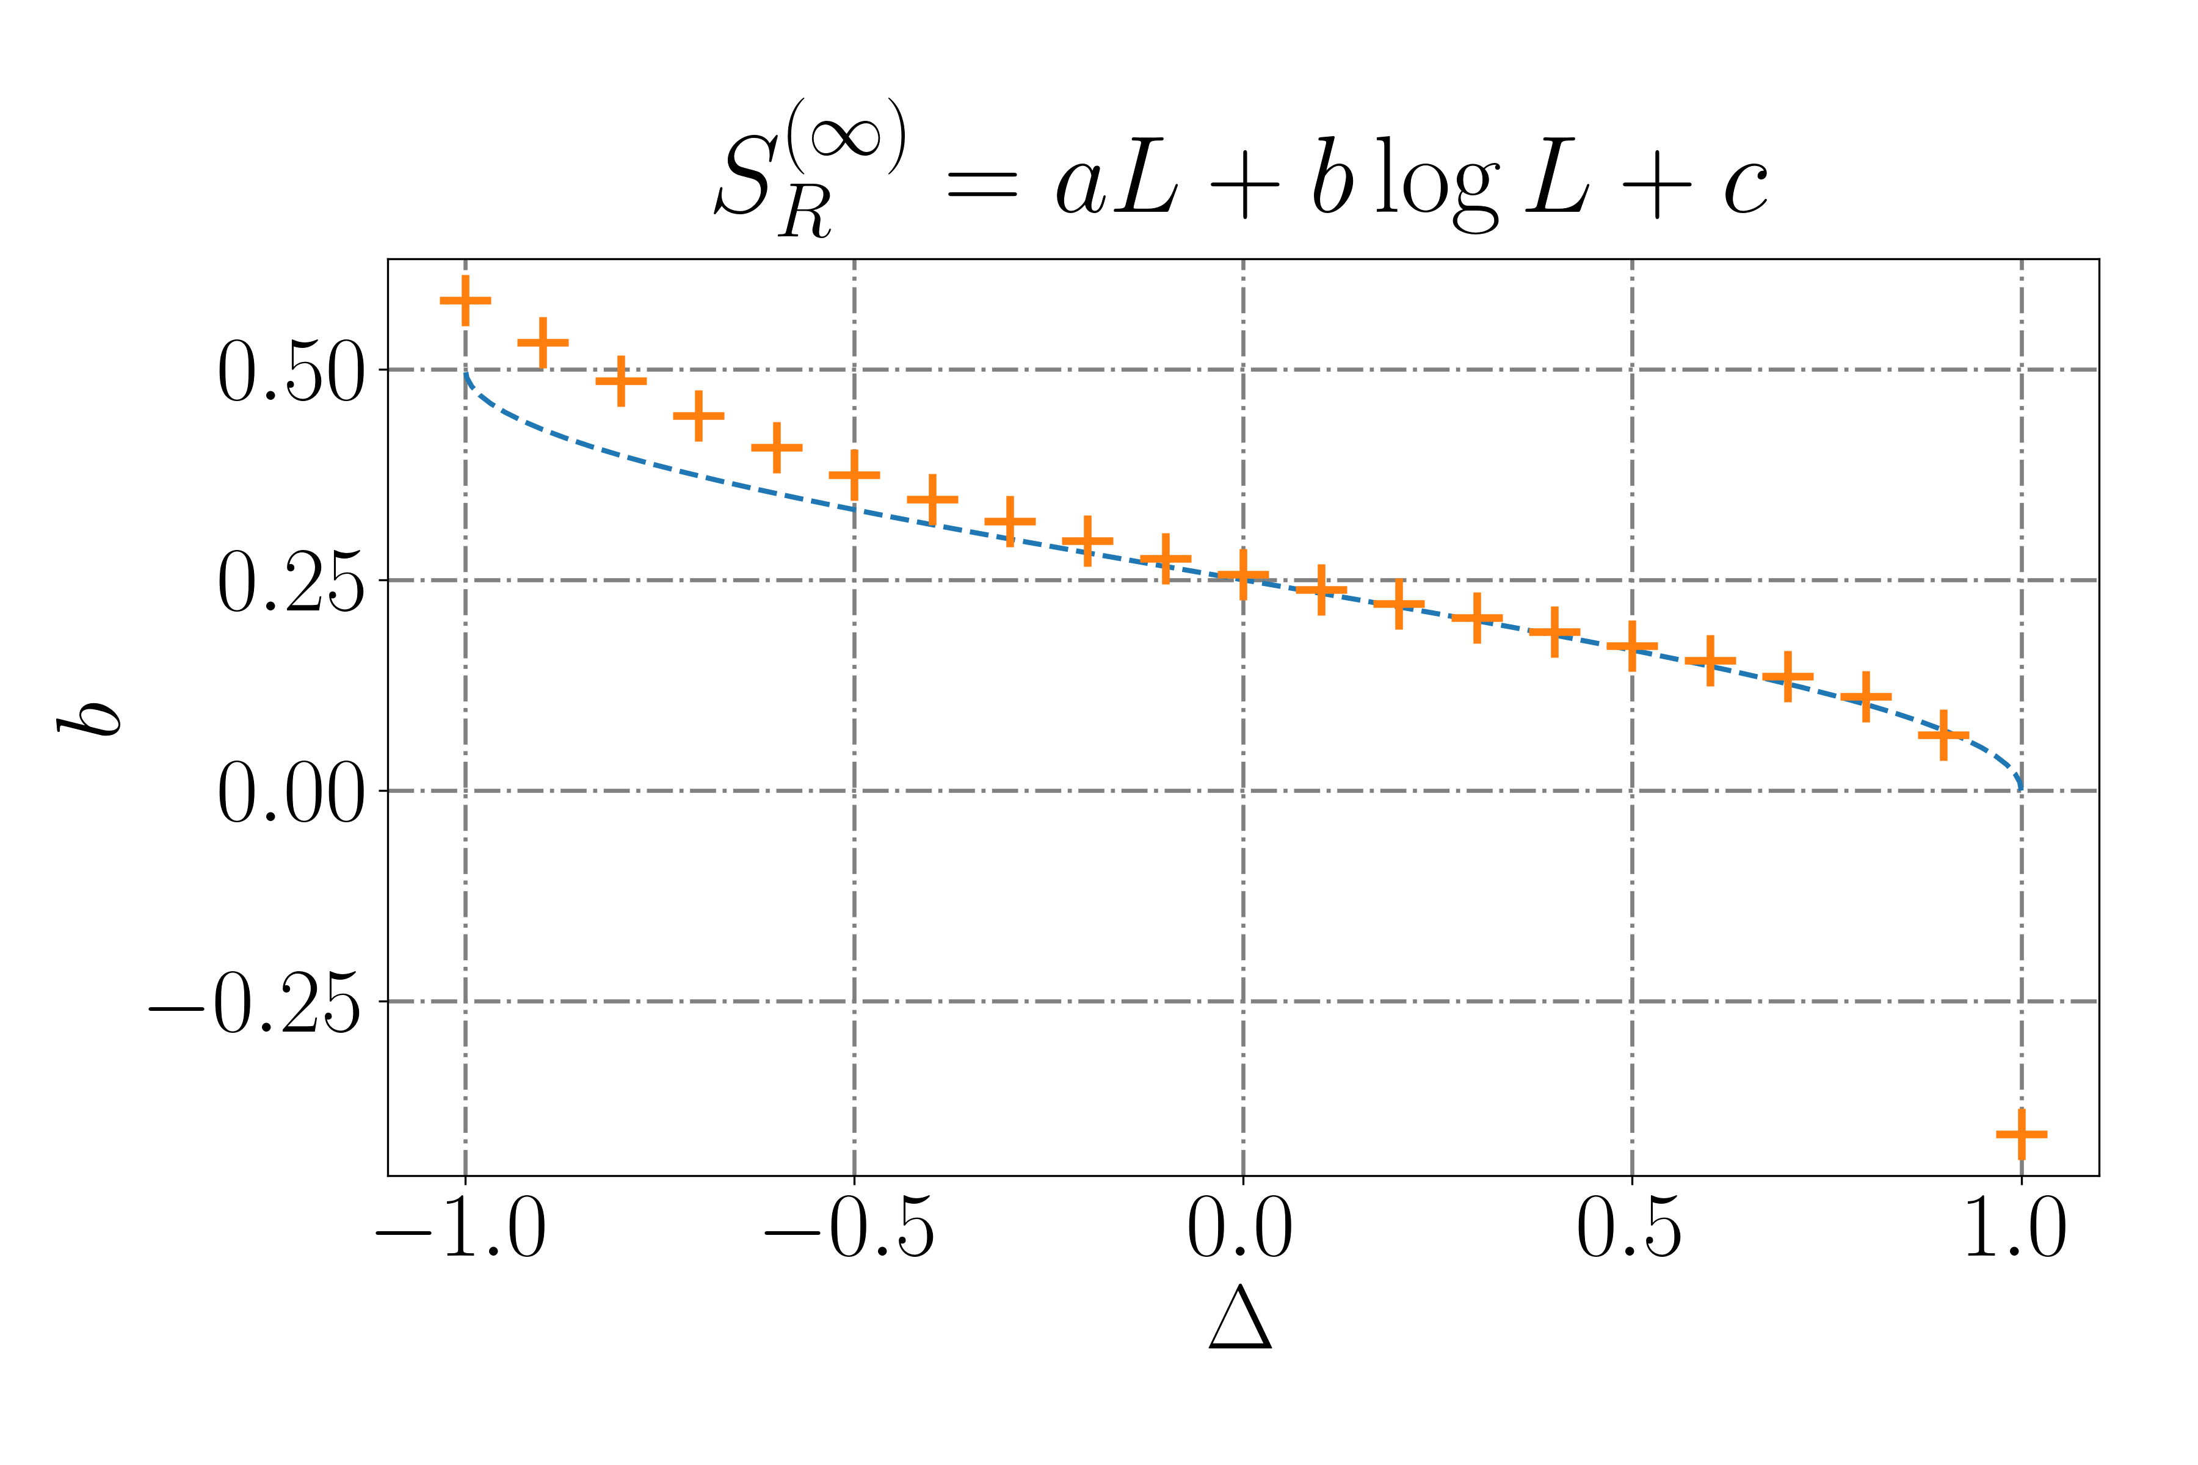
2. Rènyi entropy $H_{−}$. $L∈[11, 23]$ odd.

Slide 5
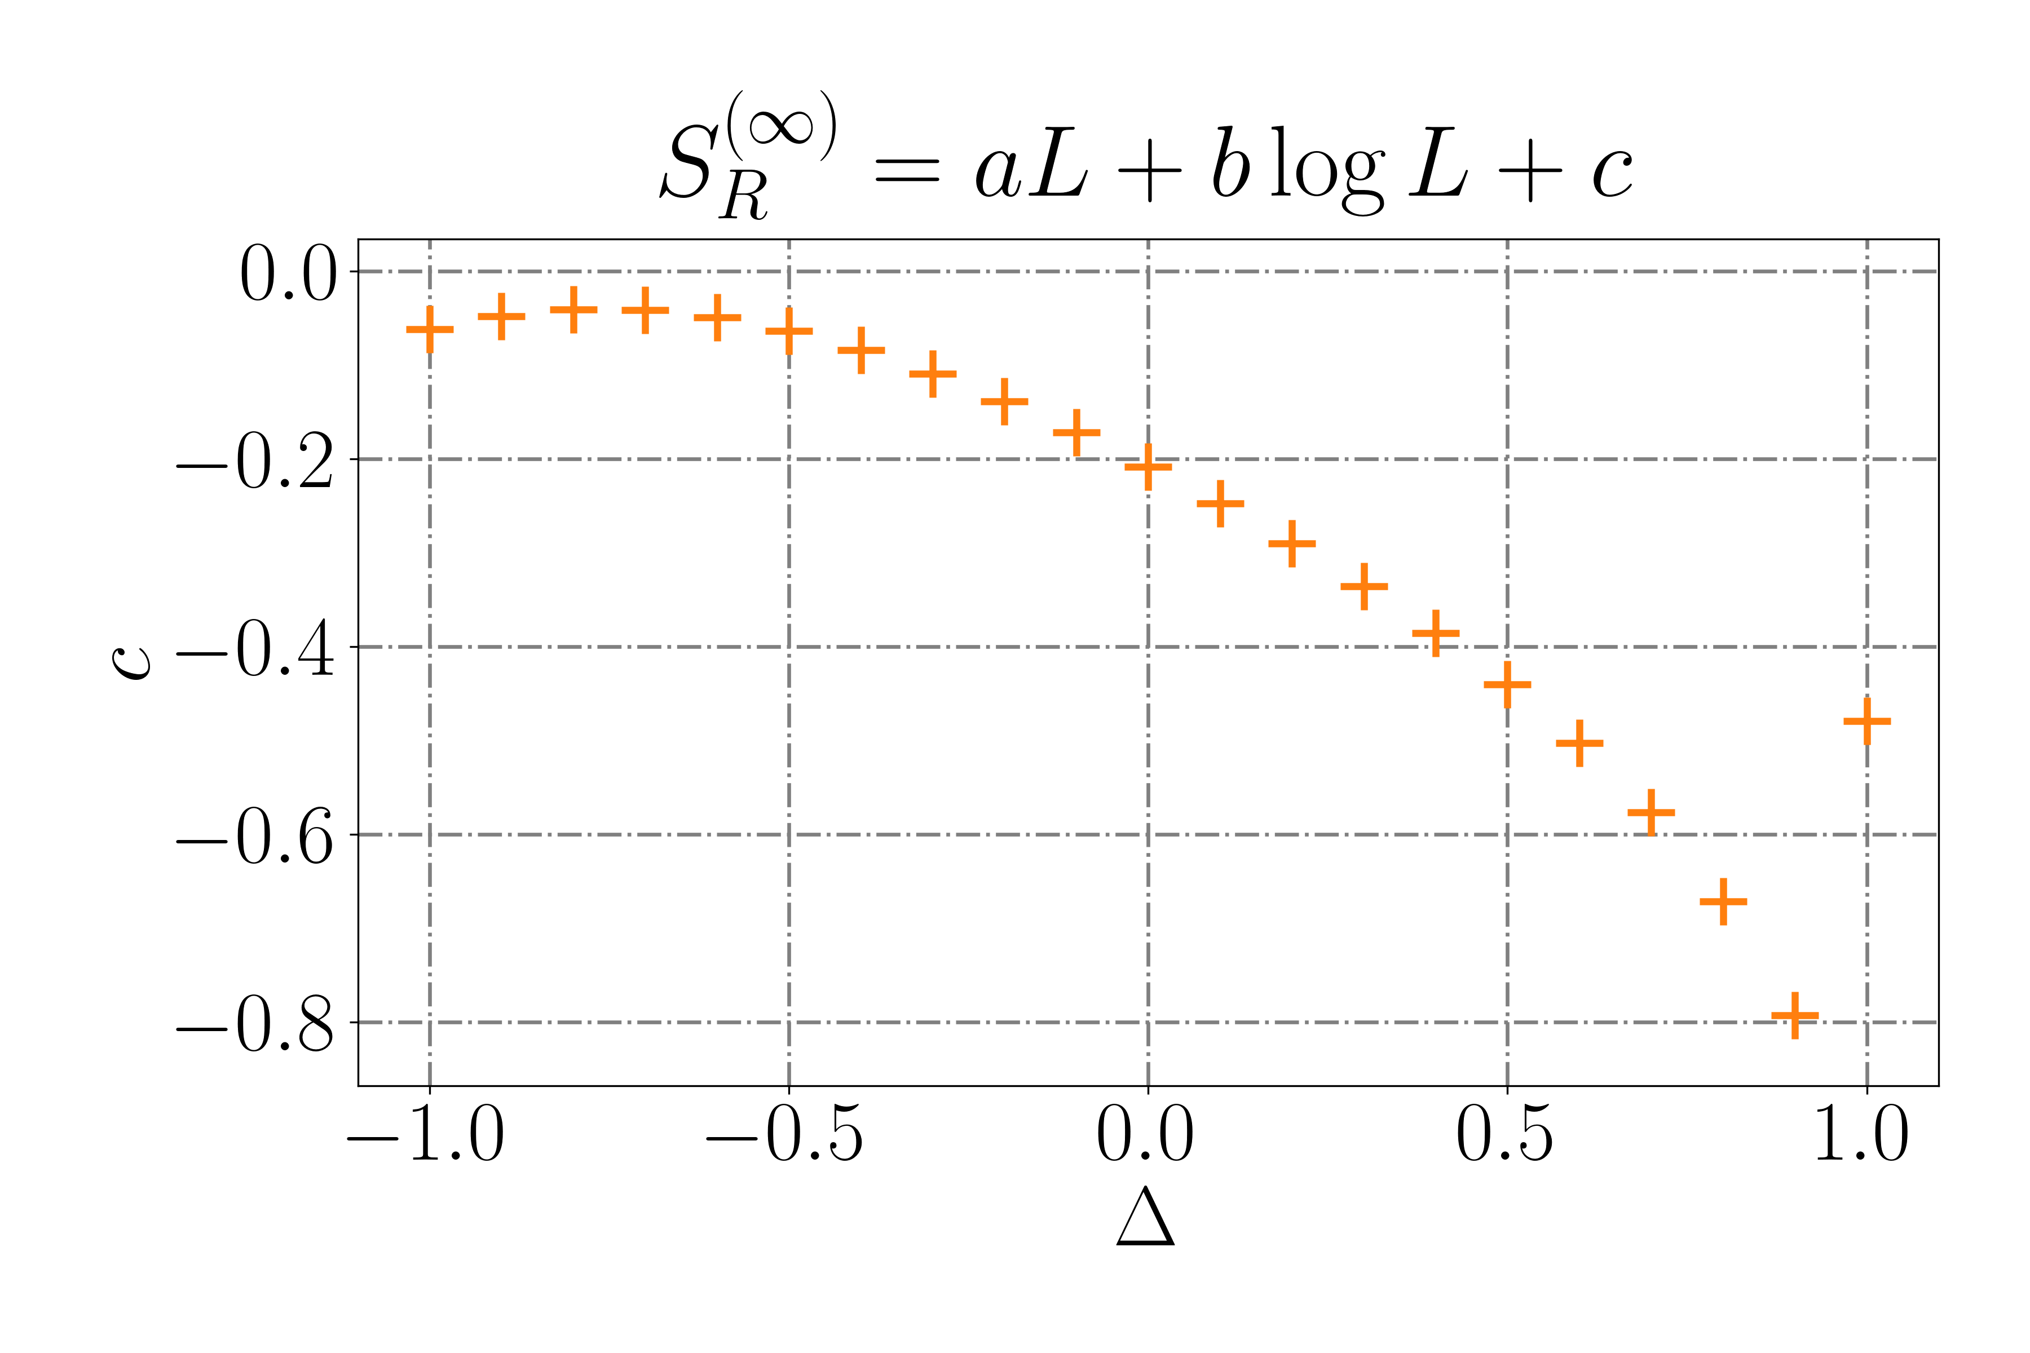
2. Rènyi entropy $H_{−}$. $L∈[11, 23]$ odd.

Slide 6
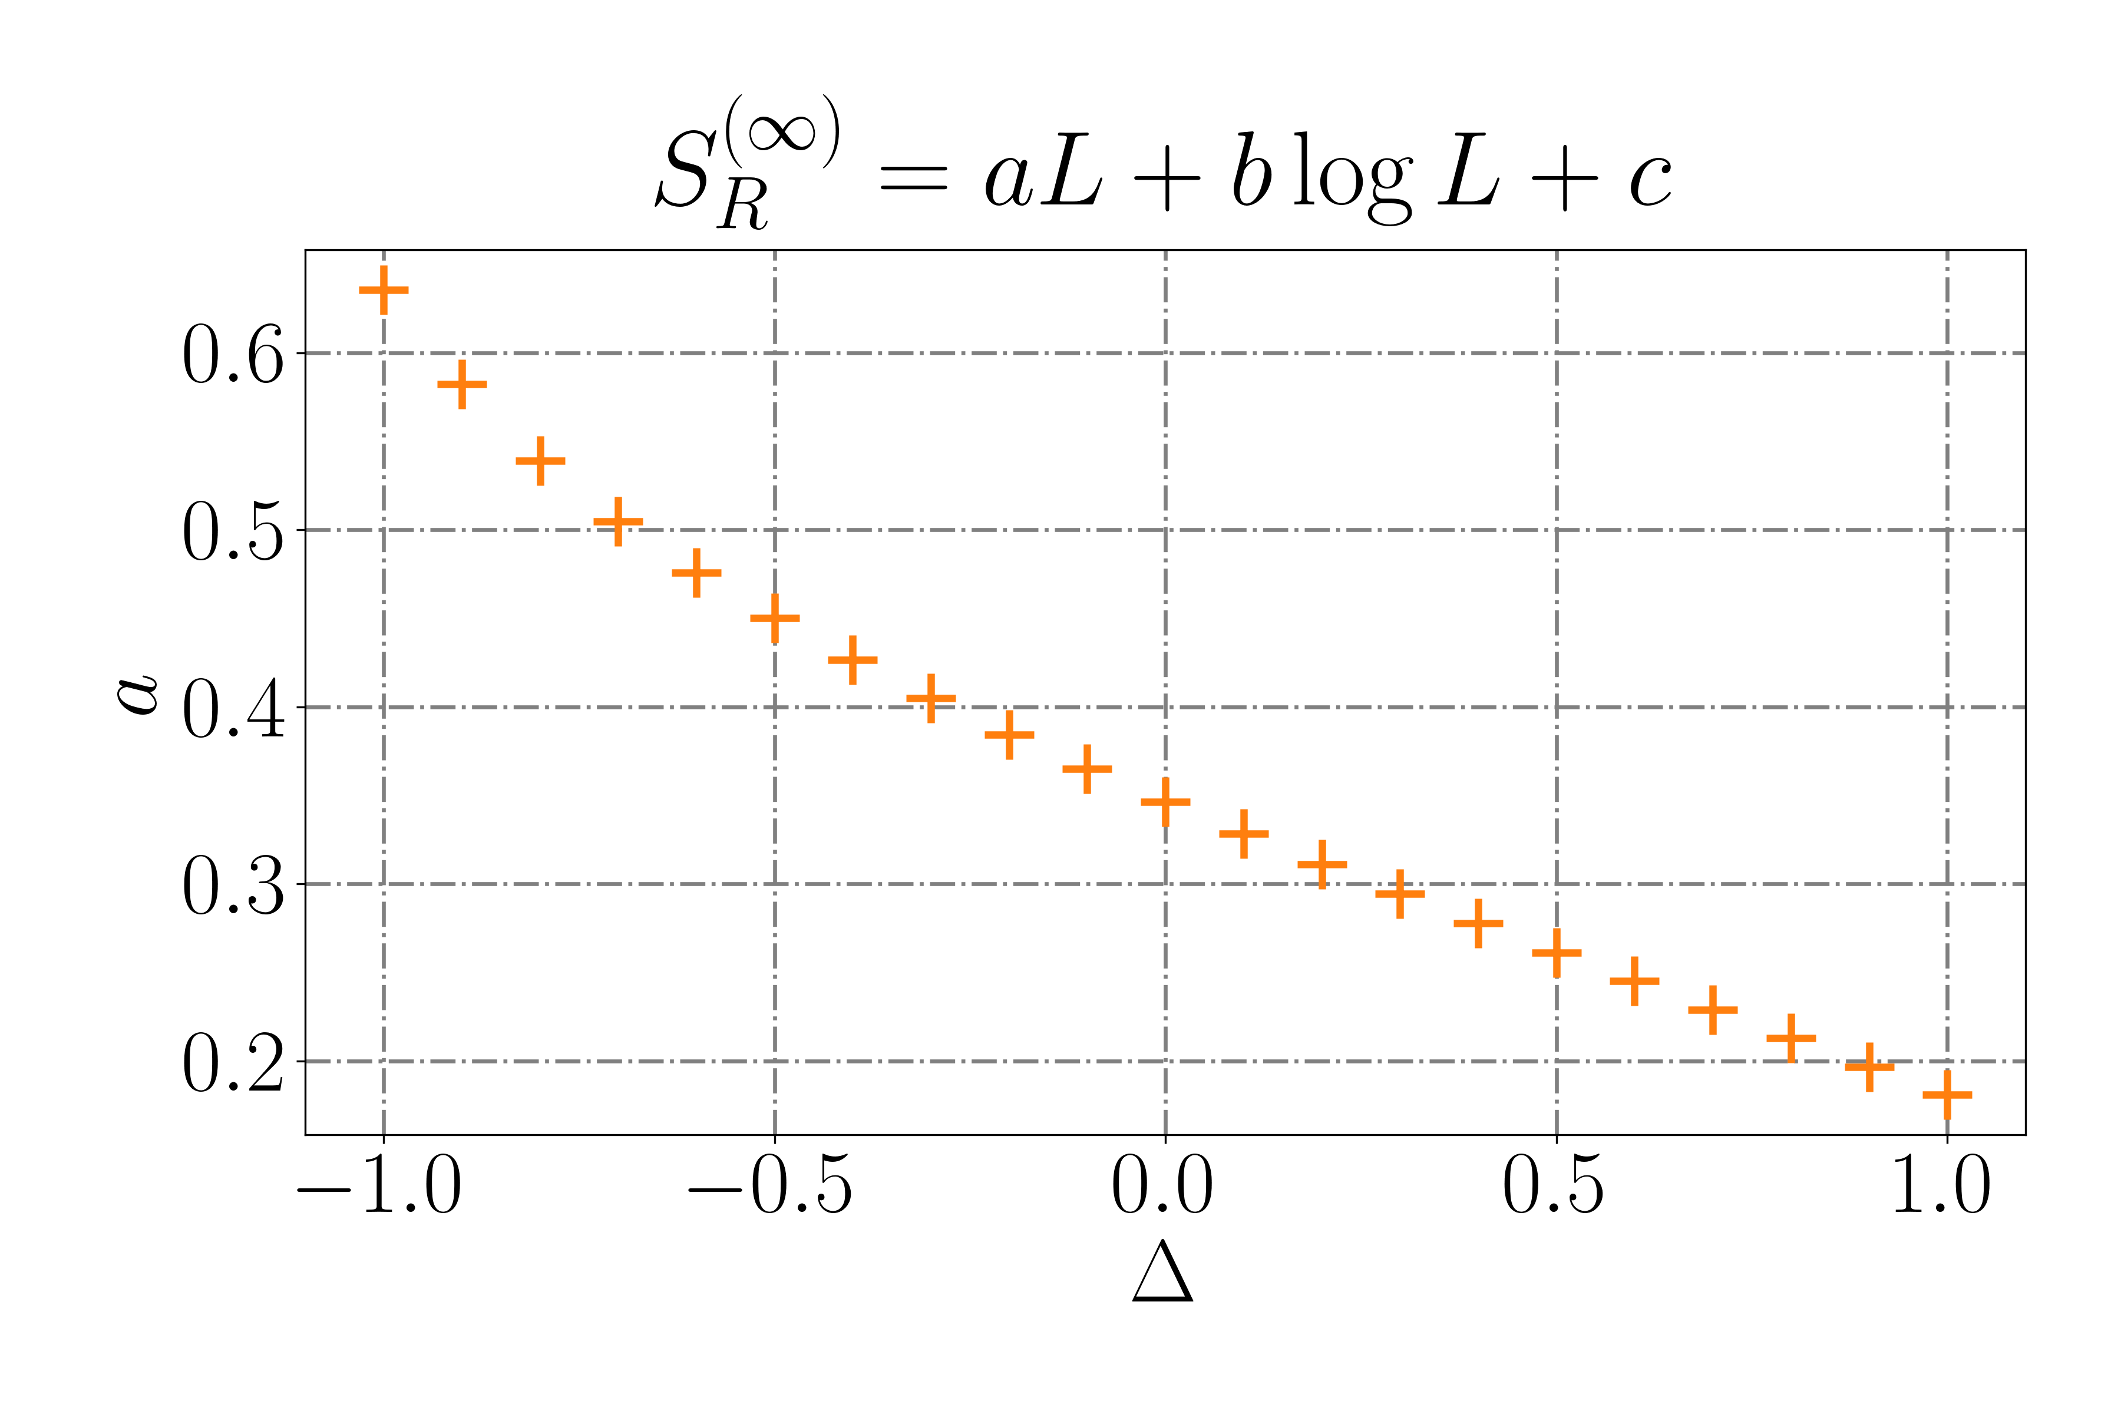
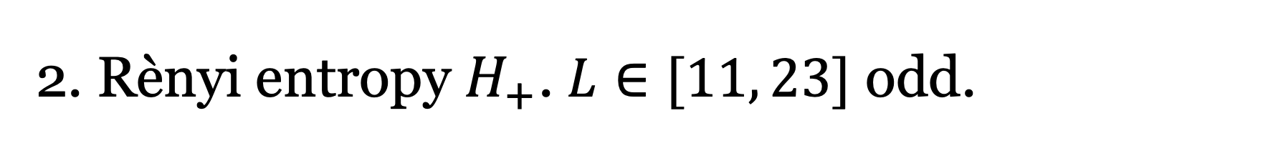
2. Rènyi entropy $H_{+}$. $L∈[11, 23]$ odd.

Slide 7
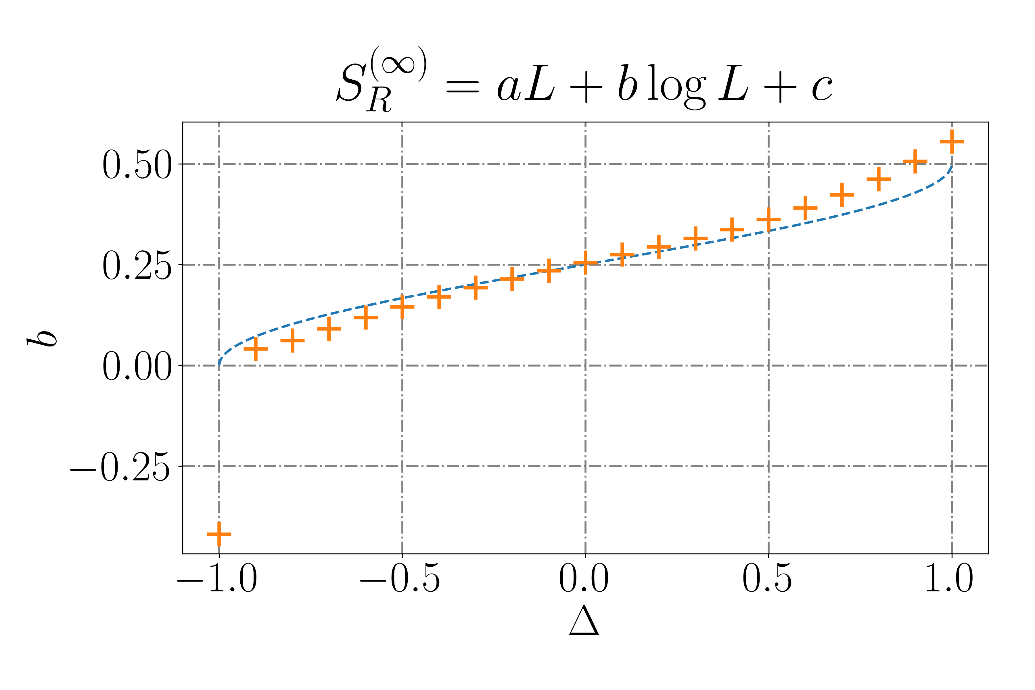
2. Rènyi entropy $H_{+}$. $L∈[11, 23]$ odd.

Slide 8
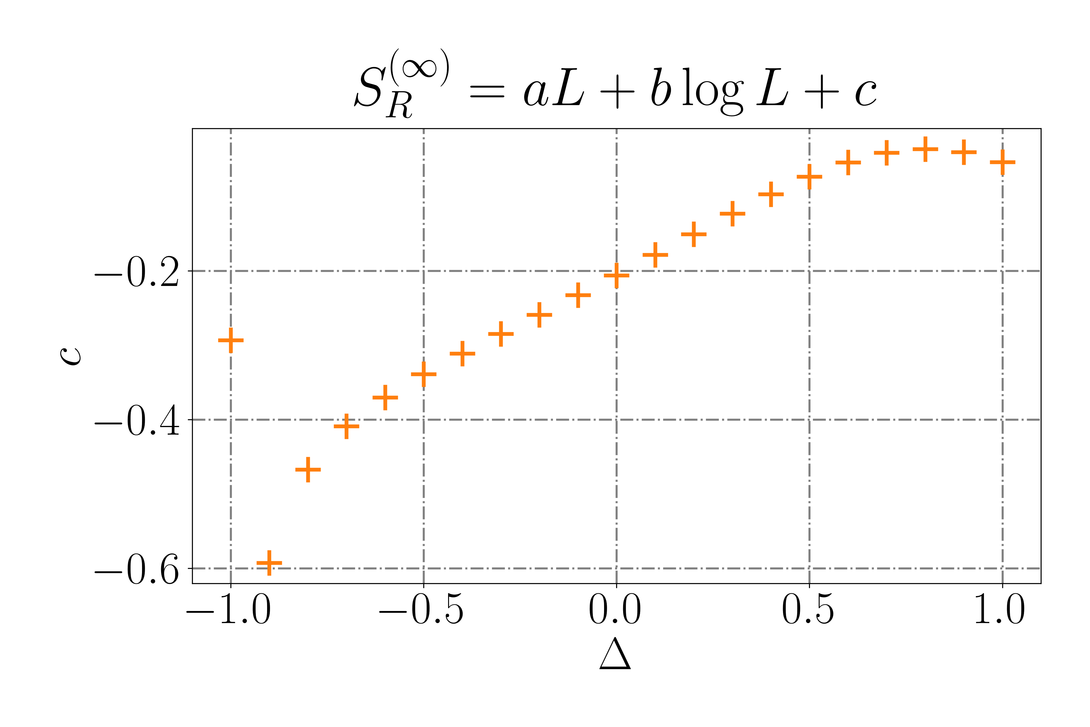
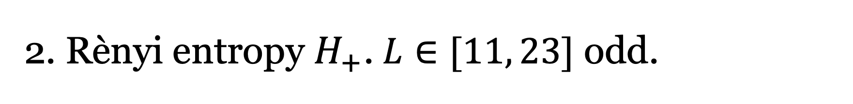
2. Rènyi entropy $H_{+}$. $L∈[11, 23]$ odd.

Slide 9
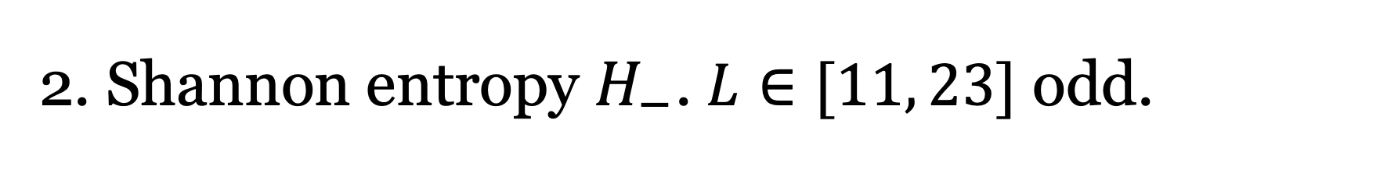
2. Shannon entropy $H_{−}$. $L∈[11, 23]$ odd.

Slide 10
2. Shannon entropy $H_{−}$. $L∈[11, 23]$ odd.

Slide 11
2. Shannon entropy $H_{−}$. $L∈[11, 23]$ odd.

Slide 12
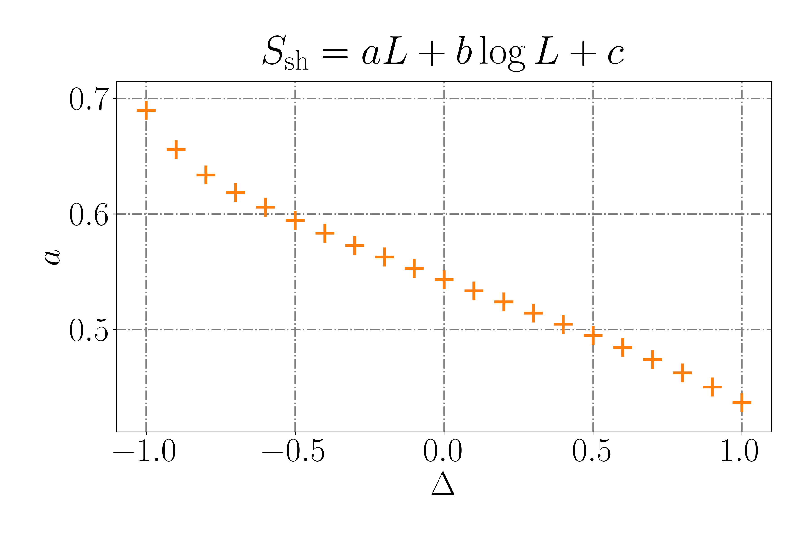
2. Shannon entropy $H_{−}$. $L∈[11, 23]$ odd.

Slide 13
2. Shannon entropy $H_{−}$. $L∈[11, 23]$ odd.

Slide 14
2. Shannon entropy $H_{−}$. $L∈[11, 23]$ odd.

Slide 15
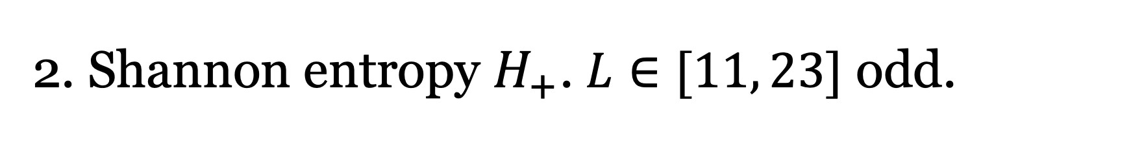
2. Shannon entropy $H_{+}$. $L∈[11, 23]$ odd.

Slide 16
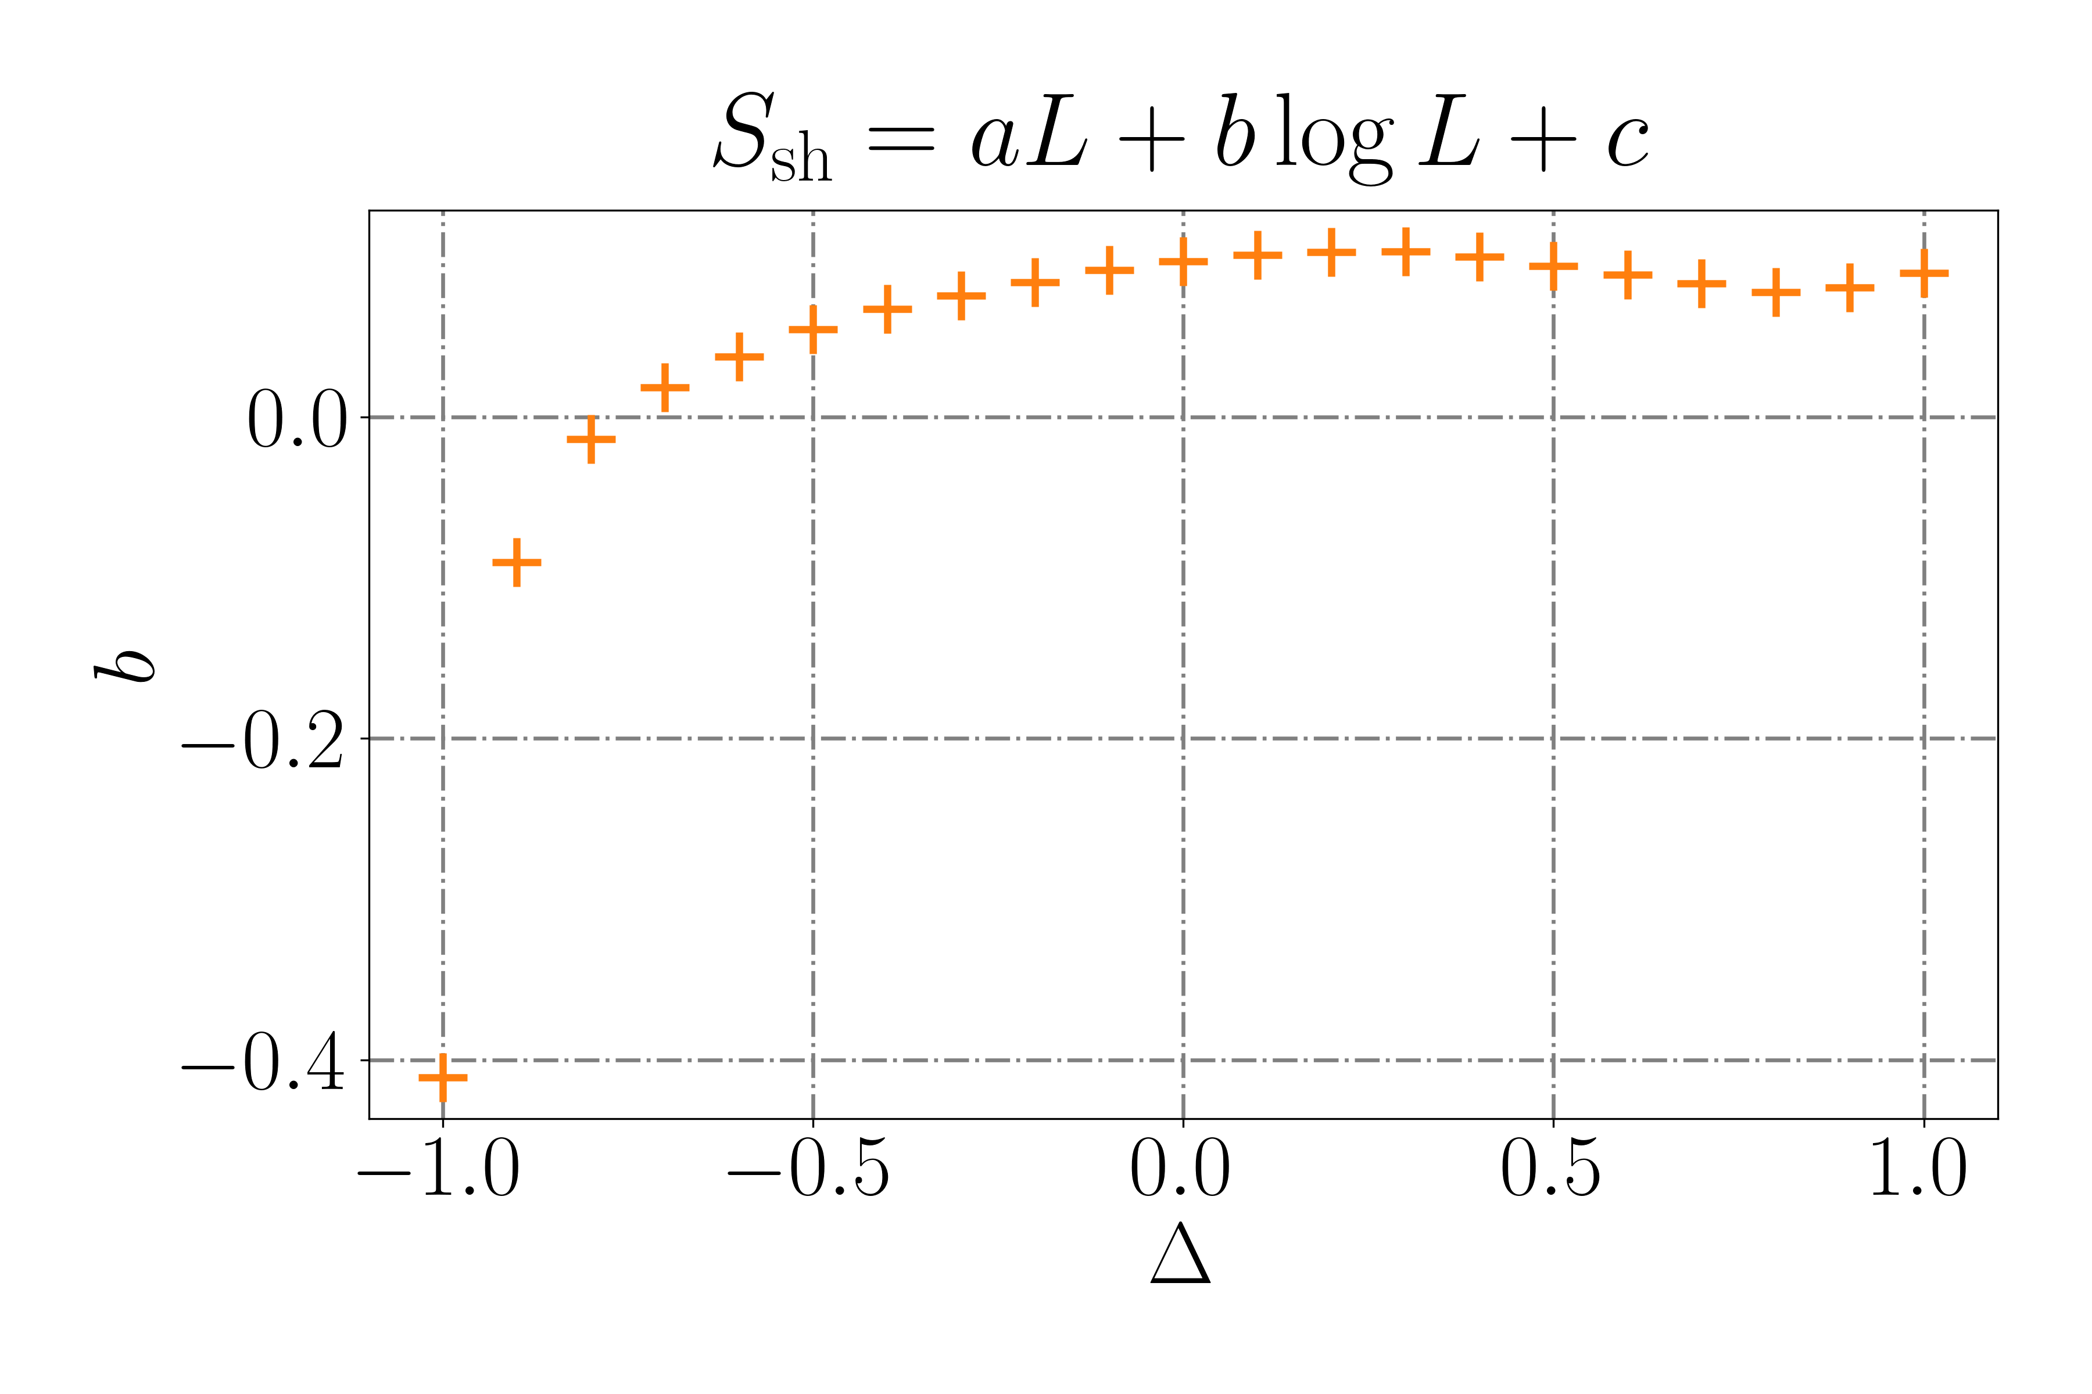
2. Shannon entropy $H_{+}$. $L∈[11, 23]$ odd.

Slide 17
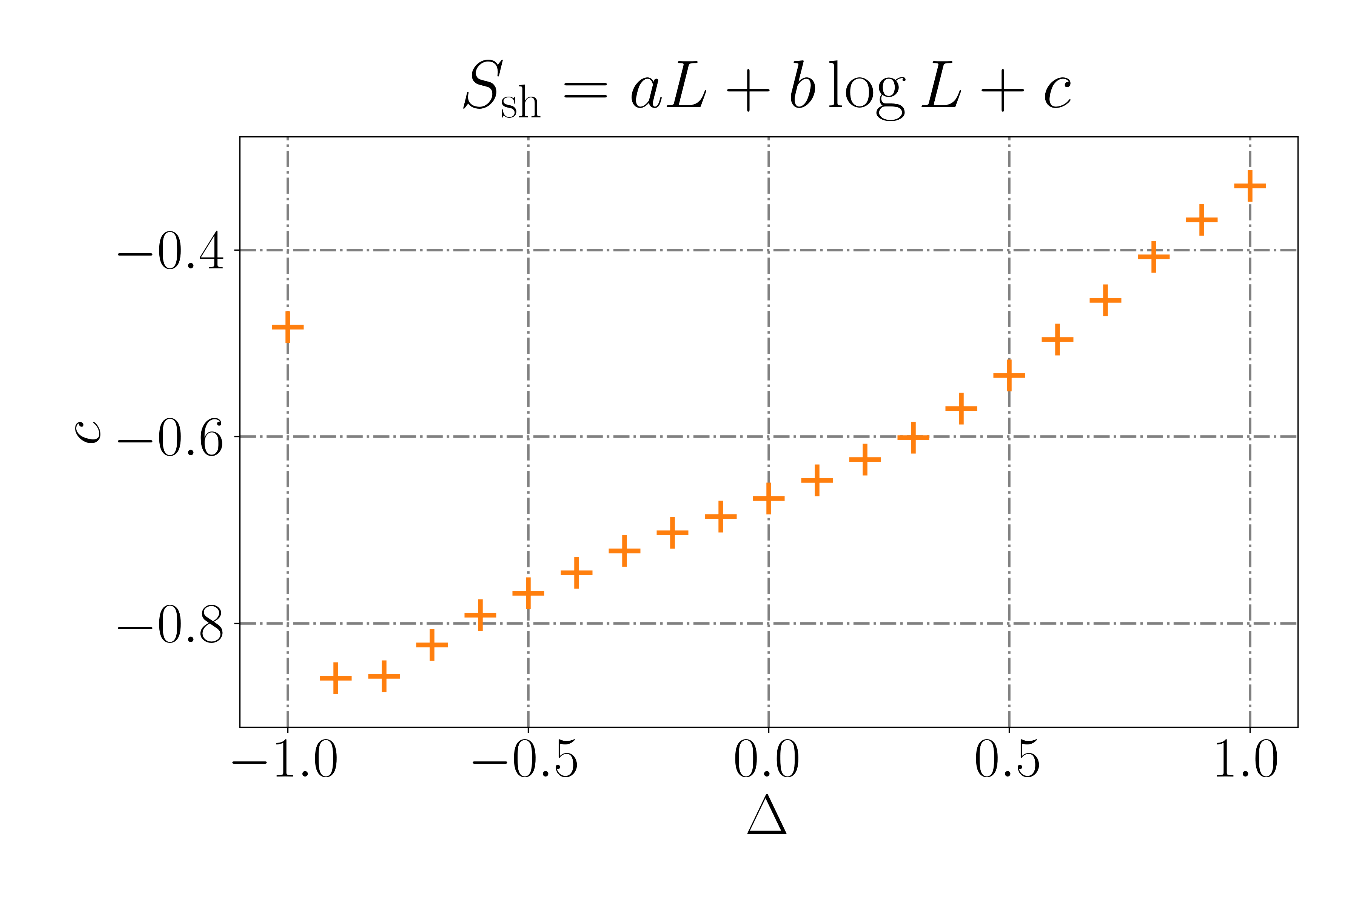
2. Shannon entropy $H_{+}$. $L∈[11, 23]$ odd.

Slide 18
Entropies plots
Jesús Cobos Jiménez
12/03/24
Universidad del País Vasco/
Euskal Herriko Unibertsitatea

