Slide 1
Tumour mutation burden
Jacob Bradley

Slide 2

Immuno-Oncology and immune checkpoint inhibition
“cancer therapy by inhibition of negative immune regulation."
-Some Nordic Nonsense Peddlers, 2018

Slide 3
Immune checkpoints regulate t cells
Immuno-Oncology and immune checkpoint inhibition
(1)
Cells present small peptide antigens ( ) to their surface (1)
In cancer, mutations in sequence mean alterations in antigens ( ) (2)
Cytotoxic T cells recognise these and become activated ( ) (3)
To prevent autoimmunity, T cells’ activation is very heavily regulated via factors such as CTLA-4 ( ) (4)
(2)
(3)
Tc
Attack!
(4)
Tc
Deactivation

Slide 4
Immune checkpoint inhibitors deregulate t cells
Immuno-Oncology and immune checkpoint inhibition
Immune checkpoint inhibitors ( ) bind to the regulatory checkpoint proteins, allowing the T cells’ natural activation
Tc
Attack!

Slide 5
Genomic instability biomarkers predict response to immune checkpoint inhibition
Immuno-Oncology and immune checkpoint inhibition
Since neoantigens incite immune response, total neoantigen burden is a key biomarker
In lieu of being able to count neoantigens, we count the things that cause them: somatic mutations throughout the exome (Tumour Mutational Burden)
Low NAB
High NAB
Low TMB
High TMB

Slide 6
What we want to look at
Tmb and its uses
Estimating TMB effectively
Standardisation
Constructing a gene panel
Clever tricks?
TMB’s utility in a pan-cancer setting
Longitudinal studies and resistance mechanisms
Combining gene expression data

Slide 7
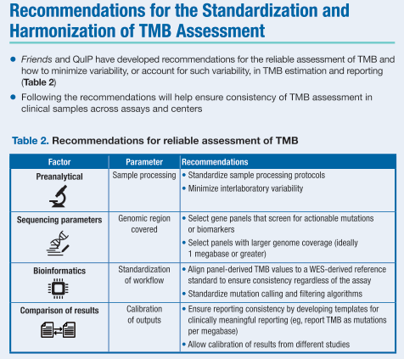
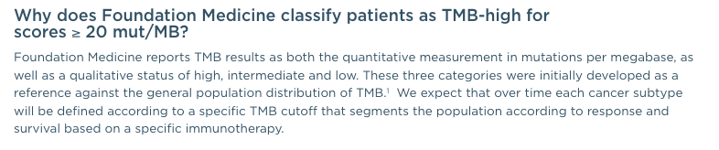
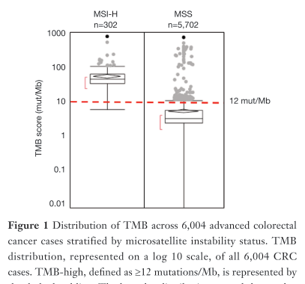
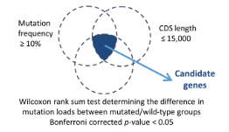
TMB standardisation in research/clinical practice
Estimating tmb effectively
There has been wide variability in research around classifying TMB status, usually retrospectively one-measure-per-study
There are coordinated projects towards uniformity, which will possibly result in guidelines for clinical practice.
Foundation Medicine, TMB FAQs
Stenzinger et al., 2018
Fabrizio et al., 2018
Lyu et al., 2018

Slide 8
Both driver gene regions and specific hotspot loci can inform a gene panel estimate of tmb
Estimating tmb effectively
We want to identify a selection of genes, local sequences and individual hotspot codons whose mutation profile is significant in TMB
Shorter panel length = Clinical Viability + Deeper Reads
Longer panel length = Accuracy + Pan-cancer Viability
Tmb™

Slide 9
Tumour mutation burden identifies potential immune checkpoint blockade recipients with tumour types not normally responsive
TMB’s utility in a pan-cancer setting
TMB demonstrates wide heterogeneity between and within tumour types
It may be possible that individual TMB-High cases would benefit from checkpoint blockade
There is very little clinical data for ICB towards the left of the graph

Slide 10
Adaptive responses to immunotherapy
Longitudinal studies and resistance mechanisms
(1)
Response | ICB | Chemo
TMB- L
TMB-H
A subset of patients respond well to immune checkpoint blockade (1)
Many people still recur with resistance
The dynamics of mutation burden throughout treatment are poorly understood: clonal competition vs adaptive escape (2)
23%
33%
47%
28%
+
Carbone et al., 2017
TMB-H
TMB-H
TMB-H
+
(2)
Mut
TMB-L

Slide 11
Tmb interacts with other biomarkers
Further directions
Gene expression and Lymphocyte infiltrate have both also been acknowledged to be relevant to TMB and appear to occur orthogonally.
These markers couldn’t directly be incorporated into a genome-based product, but it would be helpful to know background.

