Slide 1
Fall 2021 Precalc
Lesson 13.4
Dr. O’Brien
Herbert H. Lehman High School
16 December 2021
Notes:
VOCAB:
nested loop

Slide 2
Do now
be sure to: Get out your binder. Copy the goal and read the information below. Write down any questions you have; be prepared to share out!
Welcome to our new room, B24! Please read the information below:
When you come in, please find a seat at a desk (if one’s available) or one of the six closest desks to the screen. Do not sit in the back of the classroom. We’ll conduct the do now and mini lesson from here.
When I dismiss you for independent work, find a sit at one of the computer workstations.
No food or drink by the computers.
At the end of the period, you’ll be directed to assemble for the exit ticket/debrief. Log out of your computer, and quietly return to a seat near the front.
Notes:
The rocket so a height of 400 m in 20 s. It lands at 40 s.
Vertex: (20, 400). X and y ints: 0. Domain: 0-40. Range: 0-400

Slide 3
framing
what: use functions in Pyret for computational modeling
why: in the real world (science, medicine, engineering) math and computer science is frequently used to analyze and make predictions about real world phenomena
where to: using functions in Pyret to model movement in our video game

Slide 4
Vocab
be sure to: Keep your notebook open. Copy the definition for comp. modeling in your notebook. The other definitions should be in your notes. If not copy them!
REVIEW:
Computational modeling
Using computer programs to analyze and make predictions about real world systems (especially in science, medicine, and engineering)
function
a mathematical object that takes in an input and produces a unique output
function definition
Code that names a function, defines its arguments, and states the expression to compute when code is used

Slide 5
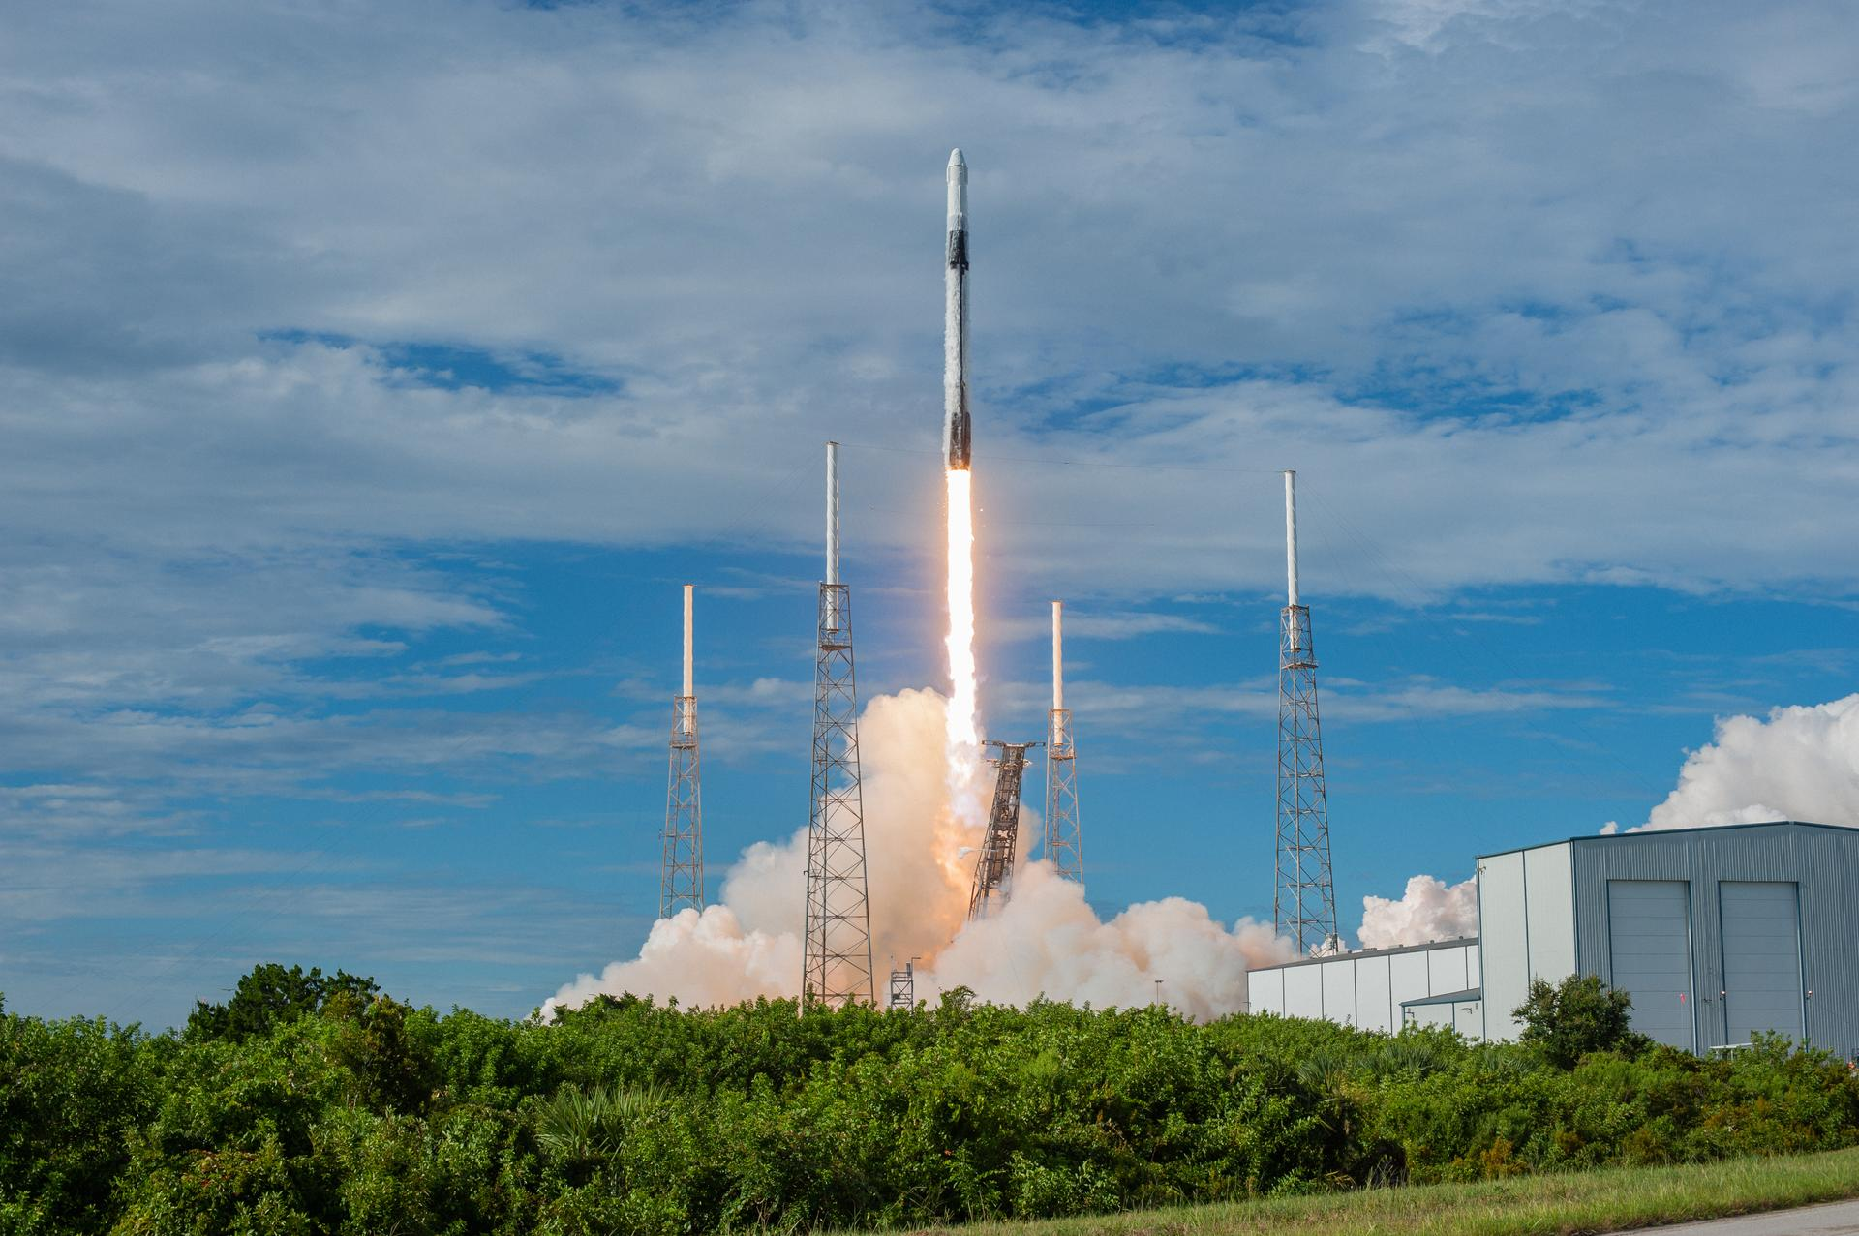
Coding to learn: getting ready
be sure to:
Open your saved copy of the Rocket Height Starter File at code.pyret.org. If you didn’t save it, open the file from Google Classroom. Save a copy.
Get out a sheet of loose leaf paper. You’ll be turning this in at the end of the period.

Slide 6
Coding to learn: activity
Be sure to:
Work with your partner to answer the questions below on a sheet of loose leaf. Be prepared to share out at the end of class! You’ll be turning this in.
You want your rocket to reach its maximum hight after exactly 400 meters and then land after 40 sec.
Sketch a graph of this situation by hand. Identify the family of this function, its other properties, and how it is transformed from its parent. Use this information to find the function (review from yesterday’s do now).
Model your function in Pyret. Explain whether it behaves as expected. If it doesn’t, figure out what you did wrong and try again!
Make the rocket reach its maximum height in exactly 15 sec. and then land. Sketch the graph, and write the function in your notebook. Then model it in Pyret to test if the function works as expected, explain why or why not in your notes.
Make observations about the speed of your rocket at different moments in time . Try this for a variety of functions for rocket height (quadratic, cubic,etc.) Write down your observations in your notes, What can you conclude about the relationship between the rockers height and its speed?
Notes:
What does your graph look like? A quadratic that has been transformed how has it been transformed?
Preplanned qs:
+How could the vertex form of your equation be useful here? you can write your function as f(x) = -(x - a)^2 + 1000.
+How could you use the x/y intercept to solve for a? 0 = -(0 - a)^2 + 1000 -> a^2 = 1000, a = sqrt(100) approx: 31.6
NOTE: - values in Pyret are represented by (0- x) not -x,
Answers:
h(t) = 2t^2
h(t) = -(t - 15)^2 + 225
h(t)= -(t - 20)^2 + 400
If students finish early: make observations about the speed of your rocket at different moments in time . Try this for a variety of specifications of rocket height (quadratic, linear,etx.) Write down your observations in your notes, What can you conclude about the relationship between the rockers height and its speed.

Slide 7
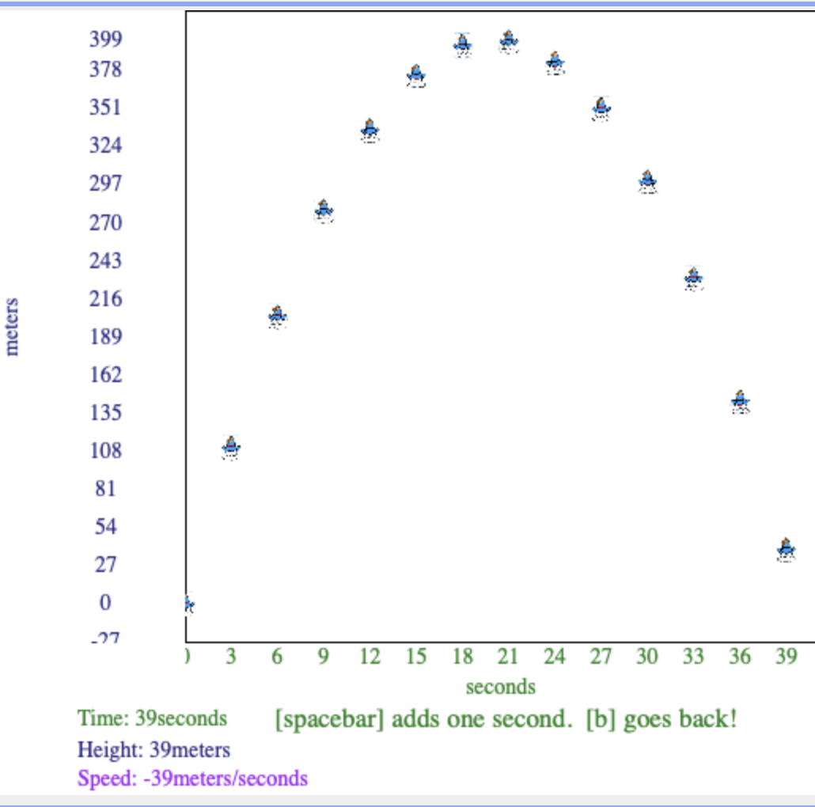
Coding to learn: debrief
Share out your solutions to the first problem! What was challenging about this activity?
When you first modeled your function in Pyret, how did you identify if it worked?

Slide 8
Debrief
be sure to: (re)read the information below. Raise your hand if you have a question!
Hope you enjoyed our new room, B24! Please (re)read the information below:
When you come in, please find a seat at a desk (if one’s available) or one of the six closest desks to the screen. Do not sit in the back of the classroom. We’ll conduct the do now and mini lesson from here.
When I dismiss you for independent work, find a sit at one of the computer workstations.
No food or drink by the computers.
At the end of the period, you’ll be directed to assemble for the exit ticket/debrief. Log out of your computer, and quietly return to a seat near the front.
Notes:
answers will vary.
using functions for manipulating images, e.g. scale(), overlay, etc.

