Slide 1
Fall 2021 Precalc
Lesson 3.1
Dr. O’Brien
Herbert H. Lehman High School
14 February 2022

Slide 2
Do Now
Be sure to…Get out your notebook/binder. Read the paragraph below carefully, then answer the questions below. Show all work and check your results!
Jean is trying to use Gaussian elimination to remove x in row 2. Do you agree that he did it right? Explain why or why not.
What’s the pivot here? What will be the pivot when Jean removes 3y?
x + y + z = 3
x - 2y + 4z = 5
3y + 4z = 5
x + y + z = 3
y + 5z = 5
3y + 4z = 5
$$→$$
Notes:
No, Jean should multiply the first row by -1 and add it to row 2: -x -y - z = -3 +. x -2y. +4z = 5 ______________ -3y + 3z = 2
The pivot is positive 1. In the next step the pivot will be postive 1 (from y).

Slide 3
B24 rules
Welcome to our new room, B24! Please read the information below:
When you come in, please find a seat at a desk (if one’s available) or one of the six closest desks to the screen. Do not sit in the back of the classroom. We’ll conduct the do now and mini lesson from here.
When I dismiss you for independent work, find a sit at one of the computer workstations.
No food or drink by the computers.
At the end of the period, you’ll be directed to assemble for the exit ticket/debrief. Log out of your computer, and quietly return to a seat near the front.

Slide 4
framing
what: use Gaussian elimination to solve nonsquare systems of equations
why: Gaussian elimination is a powerful method for solving systems of equations. It’s what computers use.
where to: matrices

Slide 5
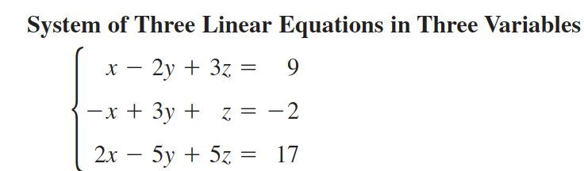
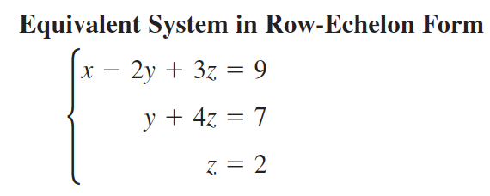
Row-echelon form (review)
To solve systems with more than two variables, we want to transform the system into row-echelon form:
A system is in row-echelon form if it has a stair-step pattern and each equation has a leading coefficient of 1.

Slide 6
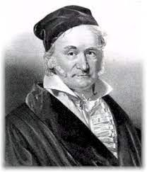
Row operations (review)
Gaussian elimination involves three row operations:
Exchange equations
Multiply one of the equations but some number (but not zero)
Add one equation to a multiple of another equation
Johann Gauss, the guy who came up with this algorithm

Slide 7
Non-square systems
So far all of the systems we’ve dealt with are square. There’s the same number of variables as there are equations. How could we solve a nonsquare system like the following? Let’s apply our gaussian elimination algorithm and see what we get:
x - 2y + z = 2
2x - y - z = 1
Find another solution set that works for this system:
Notes:
x - 2y + z = 2
2x - y - z = 1.
pivot: 1, coefficient: 2, multiplier: -2:
-2x + 4y. -2z = -4 2x. - y. -z = 1
———————
3y. -3z = -3
system:
x - 2y + z = 2
3y - 3z = -3
Next let’s solve for y in terms of z:
y - z = -1
y = z - 1
Let’s solve for z in terms of z:
x - 2(z - 1) + z = 2
x - 2z + 2 + z = 2
x - z + 2 = 2
x - z = 0
x = z
We can pick any random real number for z and find x and y. Let z = 3
x = 3
y = 3 - 1 = 2
z = 3
In general we can say that the solution is
x = a
y = a - 1
z = a
where a is any real number.

Slide 8
Non-square systems
On your own, try to find a solution set for the system below. Be sure to try solving it on your own. Be prepared to share out!
x - 2y + 5z = 2
4x - 4z = 0
Find another solution set that works for this system:
Notes:
x - 2y + 5z = 2
4x - z = 0
-4x. + 8y - 20z = -8
4x - 4z = 0
—————————
8y. -24z = -8
y. - 3z = 1
y = 3z + 1
x - 2(3z + 1) +5z = 2
x - 6z - 2 + 6z = 2
x. -z -2 = 2
x - z = 4
x = z+4
z = a
x = a + 4
y = 3a + 1
where a is any real number

Slide 9
Independent work
Today we’ll be working on Pset #2.
1. Solve the nonsquare system below:
2. Solve the nonsquare system below:
2x - 3y + z = -2
-4x + 9y = 7
x + 2y + 3z = 4
-x - 2y + z = 5
2x + 8y + z = -2
3. Tired of doing precalc homework, you borrowed $775 to build an app that solves systems of linear equations automatically. You borrowed some money at 8% interest, some at 9%, and some at 10%. How much did you borrow at each rate, given that annual interest is $67.5 and the amount of money borrowed at 8% is four times the amount borrowed at 10%?
Notes:
1.
pivot: 2, elimination coefficient: -4, multiplier: 2
4x - 6y + 2z = -4
-4x + 9y. = 7
————————
3y. +2z = 3
y + 2/3 z = 1
y = 1 - 2/3z
4x - 6(1 - 2/3z) +2z = -4
4x. -6 + 4z + 2z = -4
4x +6z. = 2
2x + 3z = 1
x = 0.5 - 1.5z
z = a, where a is any real.
2. This system will appear to end up with a zero pivot in the second row, if students don’t perform a row exchange (see ipad for detailed solution).
3.

Slide 10
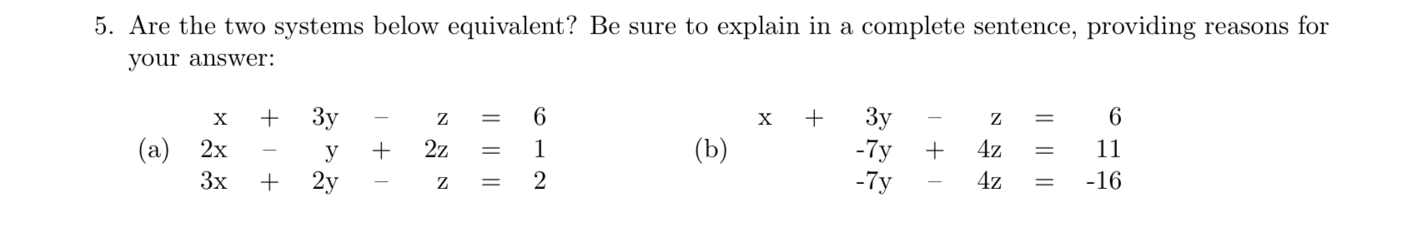
Reflection
REMINDER: quiz on thursday
Notes:
possible exit ticket.
See answer key for detailed solution

Slide 11
wrapping up!
be sure to: read the directions below!
Make sure there isn’t any litter near your workstation.
If you borrowed headphones, sign them back in.
Make sure you are logged out of your computer!
Remain in your seat until the bell rings.

