Slide 1
Fall 2021 AP CS A
Lesson 3.1
Dr. O’Brien
Herbert H. Lehman High School
15 February 2022
Notes:
STANDARDS REFERENCED:
CSTA 11-12th grade standards: 3B-AP-12: Compare and contrast fundamental data structures and their uses.
NY State: 9-12.CT.7
Design or remix a program that
utilizes a data structure to maintain
changes to related pieces of data.
9-12.CT.6
Demonstrate how at least two classic algorithms work and analyze the trade-offs related to two or more algorithms for completing the same task.

Slide 2
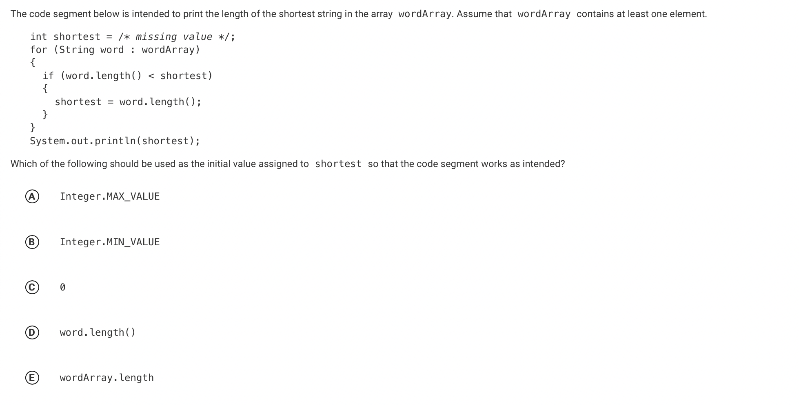
Do now
be sure to: Get out your binder. Copy goal and answer do now questions below. Show all work or write a complete sentence for each answer:
Notes:
string length is counted in integers. The edge case here is the longest possible countable string, which is the max value of integers, so A is the correct answer.

Slide 3
framing
what: recognize and identify common algorithms that utilize array traversals to reorder arrays.
why: These algorithms are widely used and will prove useful in the future!
where to: Getting some practice utilizing these algorithms

Slide 4
Vocab (review)
be sure to: Keep your notebook open. These definitions should be in your Glossary. If not Copy each definition, in your Java Glossary.
Algorithm
A step-by-step procedure for solving a problem
Statement execution count
The number of times a statement is executed by a program.

Slide 5
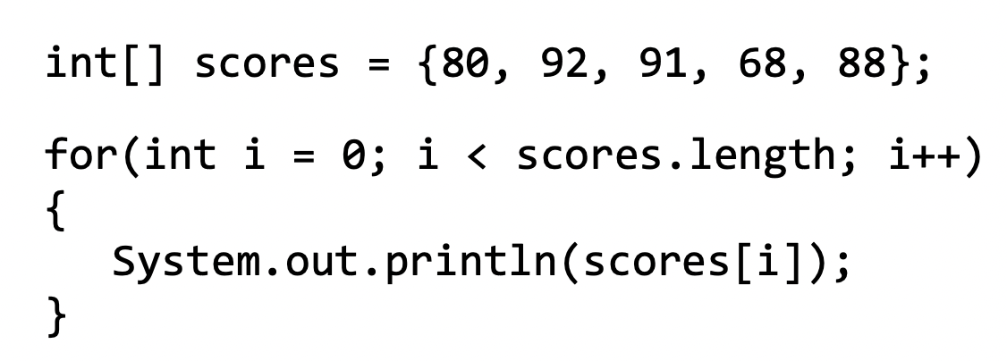
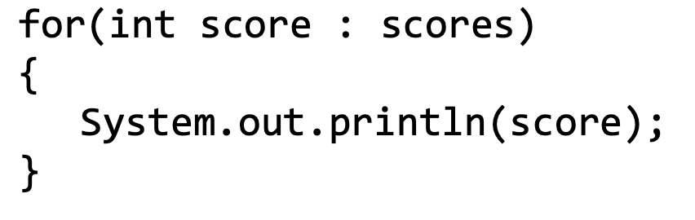
Coding to learn
be sure to: Log in to Workstation. Work on CodeHS exercises below. Make sure to write out a plan before you start coding!
A regular for loop:
Exercise 6.3.6: Print Odds
Excercise 6.3.7: Largest Value
Excercise 6.3.8: Classroom Array
Excercise 6.3.9: Array average
Exercise 6.4.3: Finding the minimum value
Excercise 6.4.5: Finding the Duplicates
Excercise 6.4.8: Most improved
Complete any exercises you don’t finish here as homework!
An enhanced for loop:
Notes:
SOLUTION CODE (REQUIRES CODEHS):
Exercise 6.3.6: Print Odds
Excercise 6.3.7: Largest Value
Excercise 6.3.8: Classroom Array
Excercise 6.3.9: Array average
Exercise 6.4.8: Most improved
https://codehs.com/problemguides/assignment/55325822?section_id=256470
Go through student solutions at the end of class.

Slide 6
Reflection: Thinking about thinking
be sure to: Answer each question below with a complete sentence.
Explain the procedure (in natural language) of how to reorder an array.
What is an “edge case”?
How can you account for edge cases?
Notes:
+Explain the procedure (in natural language) of how to reorder an array.
Create a new temp array that is the same size as the original, copy elements from the original array to the new array in the order that you want and then copy the temp array back over on top of the original array to replace it.
+What is an “edge case”?
An edge case is a situation that requires special handling. A loop may leave out an edge case in order to avoid an error.
+How can you account for edge cases?
Edge cases can be handled after the loop!

