Slide 1
Fall 2021 AP CS A
Lesson 9.5
Dr. O’Brien
Herbert H. Lehman High School
8 April 2022

Slide 2
Do now
$\text{factorial}(n)$ (also written $n!$)
The product of all numbers from $n$…to 1
Be sure to…
Review the vocab items to the left (you don’t need to copy these down)
Find the factorial $5!$.
Find the number of combinations of length 3 from a group of 4 items. Show all work
combination
A selection of items from a group of choices. The number of combinations of $r$ items from a group of $n$ choices is given by $\frac{n!}{r!(n-r)!}$
Notes:
5! = 5*4*3*2*1 = 120
num combinations:
4! / 3!(4-3)! = 4! / 3!*1! = 4! / 3! = 4*3*2*1 / 3*2*1 = 4

Slide 3
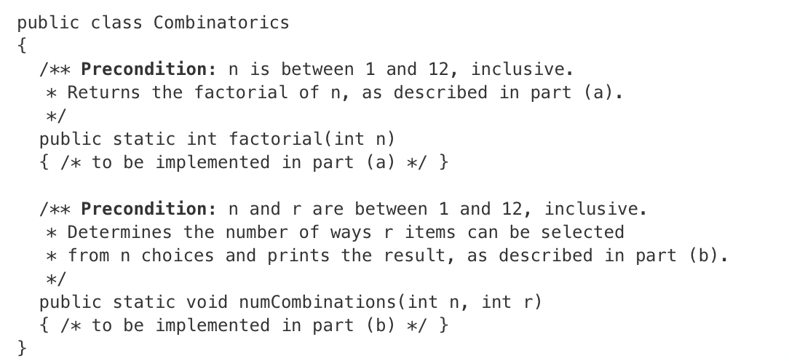
Warm up: writing to learn
Be sure to…
Review the unfinished class to the left
Answer the questions below:
What methods need to be completed?
What do you think these methods do?
What remaining questions do you have?

Slide 4
Today’s activity: coding to learn
Complete the 8 April FRQ Assignment on AP classroom
Use the vocab to your left!
Use the keys to success
We’ll go over both problems at the end of calss
$\text{factorial}(n)$ (also written $n!$)
The product of all numbers from $n$…to 1
combination
A selection of items from a group of choices. The number of combinations of $r$ items from a group of $n$ choices is given by $\frac{n!}{r!(n-r)!}$

Slide 5
framing
what: use recursion to search through data
why: Recursion is a very powerful tool for making algorithms. We’ll see how it makes search easier.
where to: Using recursion in sorting algorithms

