Slide 1
Fall 2021 Precalc
Lesson 4.5
Dr. O’Brien
Herbert H. Lehman High School
4 March 2022

Slide 2
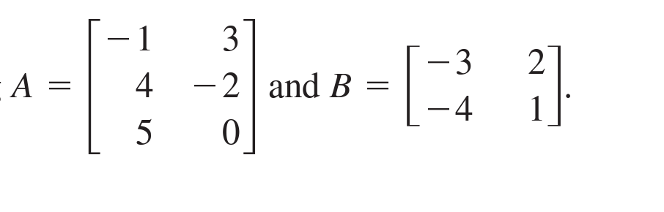
Do now…Get out your notebook/binder.write down the date and goal. Be Sure to carefully answer the questions below in your notebook.
Suppose that
Find the dimensions of A and B.
Can you add A and B? Explain why or why not.
Find $-2B$.
Notes:
3X2 and 2X2
No because they have different dimentions
[ [6, -4] [8, -2]]

Slide 3
framing
what: Mutiply matrices
why: Matrix multiplication is an important part of matrix algebra. It makes it easier to solve systems of equations (though it will seem weird at first)
where to: More matrix algebra

Slide 4
B24 rules
Welcome to our new room, B24! Please read the information below:
When you come in, please find a seat at a desk (if one’s available) or one of the six closest desks to the screen. Do not sit in the back of the classroom. We’ll conduct the do now and mini lesson from here.
When I dismiss you for independent work, find a sit at one of the computer workstations.
No food or drink by the computers.
At the end of the period, you’ll be directed to assemble for the exit ticket/debrief. Log out of your computer, and quietly return to a seat near the front.

Slide 5
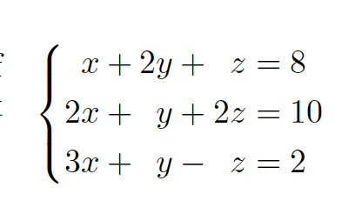
Warm up
let’s represent this linear equation using matrices

Slide 6
Mini lesson
Notes will appear on board. Copy everything. If you arrive late, ask a friend to copy their notes (after class!).
Notes:
see handwritten notes

Slide 7
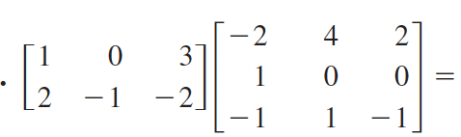
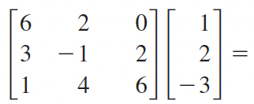
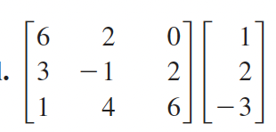
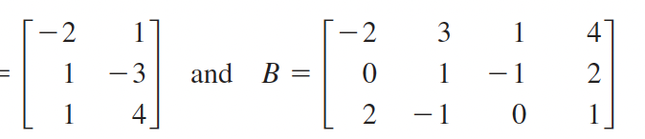
Independent work
Be sure to…
(i) Identify the dimensions of the matrices below. If they cannot be multiplied, explain why. If they can, multiply them. Show all work.
a.
b
c.
Notes:
see pg. 523 of text book for answers

Slide 8
Reflection
Reflection:
be sure to: Answer each question below with a complete sentence. Be prepared to share out!
How is matrix multiplication similar to matrix addition? How is it different?
Why do you think matrix multiplication is defined the way it is?

Slide 9
wrapping up!
be sure to: read the directions below!
Make sure there isn’t any litter near your workstation.
If you borrowed headphones, sign them back in.
Make sure you are logged out of your computer!
Remain in your seat until the bell rings.

