Slide 1
Fall 2021 Precalc
Lesson 1.1
Dr. O’Brien
Herbert H. Lehman High School
2 February 2022

Slide 2
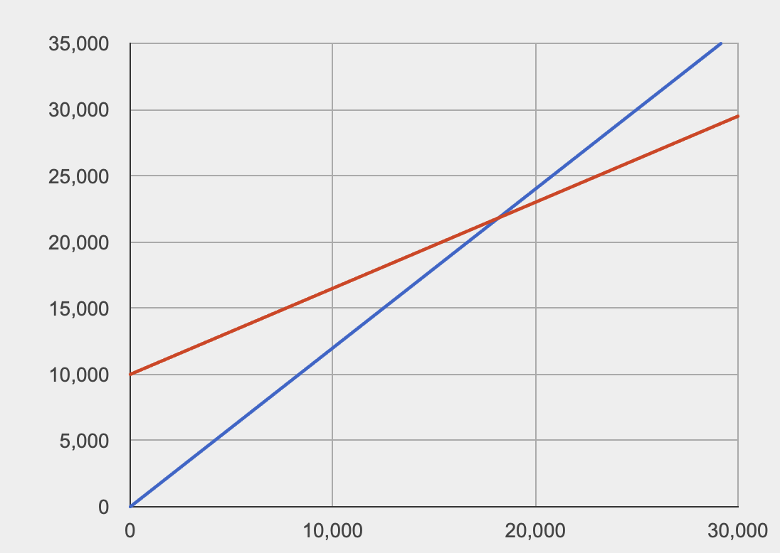
Do Now
Be sure to…Get out your notebook/binder. Read the paragraph below carefully, then answer each question with a complete sentence.
A small business invests $10,000 to produce a new kind of super hot tortilla chip. Each package costs $0.65 to produce and is sold for $1.20.
In the graph to the right, the x-axis represents units of chip sold, the y-axis represents money (in $).
Examine the red and blue lines. Which line represents the cost and which represents revenue? Explain why.
What do you think the point where these two lines intersect represents?
Notes:
The red line represents cost. We know that the base cost is 10000 and the y-axis of the red line is 100000. The blue line must represent revenue. If we look we see that after 20000 units sold we have a y-value of 25000, which corresponds to 1.20 per chip.
The difference between cost and revenue represents Profit, so the intersection is the point where cost and revenue are identical, meaning profit is 0.
We’re looking at the graph for a system of two equations.

Slide 3
B24 rules
Welcome to our new room, B24! Please read the information below:
When you come in, please find a seat at a desk (if one’s available) or one of the six closest desks to the screen. Do not sit in the back of the classroom. We’ll conduct the do now and mini lesson from here.
When I dismiss you for independent work, find a sit at one of the computer workstations.
No food or drink by the computers.
At the end of the period, you’ll be directed to assemble for the exit ticket/debrief. Log out of your computer, and quietly return to a seat near the front.

Slide 4
framing
what: use substitution to solve systems of equations in two variables
why: Systems of equations are useful in situations where variables must satisfy two or more conditions. E.g. cost and revenue per units sold.
where to: Using elimination to solve any system of equations

Slide 5
Vocabulary
System of equations
A set of two or more equations that share the same variables.
solution
An ordered pair $(x,y)$ that solves each equation in a system.
Solving a system of equations: finding all the solutions for a system of equations

Slide 6
Warm-up
Let’s solve the system of equations.
$x+y=4$ (1)
$x-y=2$ (2)
Follow along in your notes, but try to stay one step ahead.
Notes:
DO WORK BELOW IN BOARD. // INDICATES COMMENT (RIGHT SIDE OF BOARD):
solve for y in (1):
y = 4 - x
substitute y into (2):
//write (2)
x - y = 2.
//subsitute 4-x
x - (4 -x) = 2
//distribute -
x - 4 + x = 2
//combine like terms and solve
2x - 4 = 2
2x = 6
x = 3
//**back-substitute** 3 into (1)
//write revised (1)
y = 4 - x
//y = 4 - 3
y = 1
solution: (3,1).
+How do we check this solution?
plug solution into each eq.
x + y = 4
3 + 1 = 4
3 - 1 = 2

Slide 7
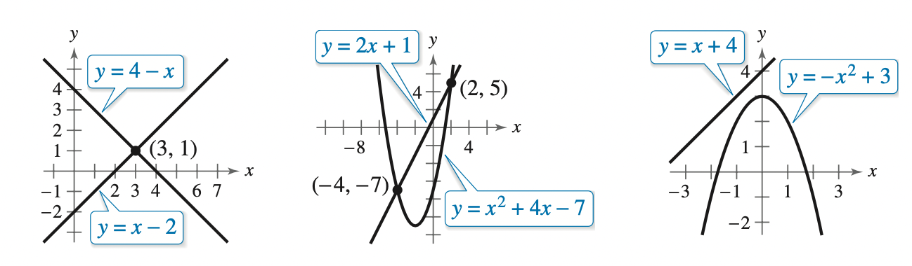
Mini-lesson: 2 more examples
Be sure to…Follow along in your notes, but try to stay one step ahead.
Two-solution case
$x^{2}+4x-y=7$ (1)
$2x-y=-1$ (2)
No-solution case
$-x+y=4$ (1)
$x^{2}+y=3$ (2)
Notes:
DO WORK BELOW IN BOARD. // INDICATES COMMENT (RIGHT SIDE OF BOARD):
two-solution case.
//solve (2) for y
y = 2x + 1
//write (1), substitute, and distribute -
x^2 + 4x - y = 7
x^2 + 4x - (2x+ 1) = 7
x^2 + 4x -2x - 1 = 7
//combine like terms and solve
x^2 +2x - 1 = 7
x^2 + 2x -8 = 0
(x+4)(x-2) = 0
x = -4,2
//back substitute both values into (2)
y = 2(-4) + 1 = -7
solution 1: (-4,-7)
y = 2(2) + 1 = 5
solution 2: (2,5)
Check.
NO SOLUTIONS
y = 4 -x // solve (1) for y
x^2 +4 - x = 3
x^2 - x + 1 = 0
//quadratic form.
x = ((-1) +/- sqrt( 1 - 4(1)(1)) ) / (2)
This gets us a negative sqrt, so no real solutions

Slide 8
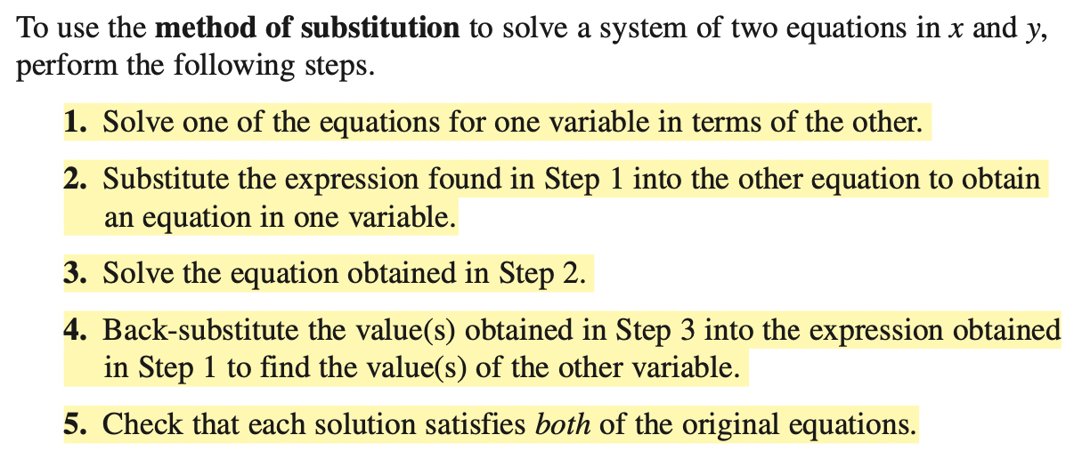
Mini-lesson: notes
Be sure to…copy in your notes
Notes:
DO WORK BELOW IN BOARD. // INDICATES COMMENT (RIGHT SIDE OF BOARD):
two-solution case.
//solve (2) for y
y = 2x + 1
//write (1), substitute, and distribute -
x^2 + 4x - y = 7
x^2 + 4x - (2x+ 1) = 7
x^2 + 4x -2x - 1 = 7
//combine like terms and solve
x^2 +2x - 1 = 7
x^2 + 2x -8 = 0
(x+4)(x-2) = 0
x = -4,2
//back substitute both values into (2)
y = 2(-4) + 1 = -7
solution 1: (-4,-7)
y = 2(2) + 1 = 5
solution 2: (2,5)
Check.
NO SOLUTIONS
y = 4 -x // solve (1) for y
x^2 +4 - x = 3
x^2 - x + 1 = 0
//quadratic form.
x = ((-1) +/- sqrt( 1 - 4(1)(1)) ) / (2)
This gets us a negative sqrt, so no real solutions

Slide 9
Independent work
Be sure to…copy in your notes
Complete problems (1-3) of Pset #1.

Slide 10
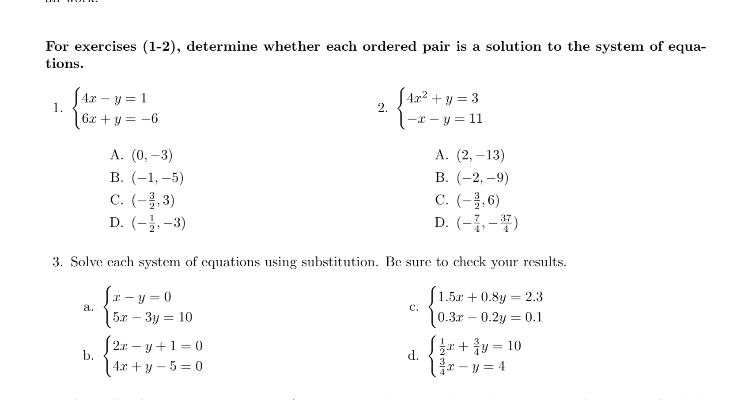
Independent work
Notes:
D.
A.
+why is it important to plug solutions into BOTH equations? Sometimes a solution satisfies one equation and not the other
+hdw square a fraction? The exponent distributes to both numerator and denominator. E.g. (3/2)^2 = 9 / 4

Slide 11
Independent work

Slide 12
Real world examples
Be sure to…Follow along in your notes, but try to stay one step ahead.
A total of $12,000 is invested in two funds paying 9% and 11% simple interest. How much is invested in each if the yearly interest is $1180?
A small business invests $10,000 to produce a new kind of super hot tortilla chip. Each package costs $0.65 to produce and is sold for $1.20. How much has to be sold for the compny to break even?
Notes:
x = amount invested in fund 1
y = amount invested in fund 2
x + y = 12000 (eq. 1)
0.09*x + 0.11*y = 1180
+HDW apply substitution to solve this system?
could go in either direction
y = 12000 - x
0.09x + 0.11(12000 - x) = 1180
0.09x + 1320 - 0.11x = 1180
-0.02x = -140
x = 7000
y = 12000 - 7000 = 5000
solution: (7000, 5000)

Slide 13
wrapping up!
be sure to: read the directions below!
Make sure there isn’t any litter near your workstation.
If you borrowed headphones, sign them back in.
Make sure you are logged out of your computer!
Remain in your seat until the bell rings.

