Slide 1
Fall 2021 AP CS A
Lesson 1.1
Dr. O’Brien
Herbert H. Lehman High School
2 February 2022
Notes:
STANDARDS REFERENCED:
CSTA 11-12th grade standards: 3B-AP-12: Compare and contrast fundamental data structures and their uses.
NY State: 9-12.CT.7
Design or remix a program that
utilizes a data structure to maintain
changes to related pieces of data.

Slide 2
Do now
be sure to: Get out your binder. Copy goal and answer do now questions below. Show all work or write a complete sentence for each answer:
In unit 4, we made a LehmanStudent class. This stores data for an individual Lehman student. Now we want to make a LehmanRoster class with data for every student In the school.
How could we store this information?
What are some difficulties you foresee?
Notes:
We could keep a ‘list’ of this information, each item in the list pointing to a different student object.
It’s unclear how to make such a list in Java.

Slide 3
framing
what: store collections of data using 1D arrays
why: Arrays allow us to store and manipulate collections of data.
where to: Traversing arrays with for and while loops

Slide 4
Vocab
be sure to: Keep your notebook open. These definitions should be in your Glossary. If not Copy each definition, in your Java Glossary.
Array
An object that stores a fixed number of objects of the same type.
What do arrays remind you of (think Python)?
Notes:
+What do arrays remind you of (think Python)? They remind us of lists and tuples in Python.
Later on we’ll actually be seeing some differences between Java arrays and Python lists.

Slide 5
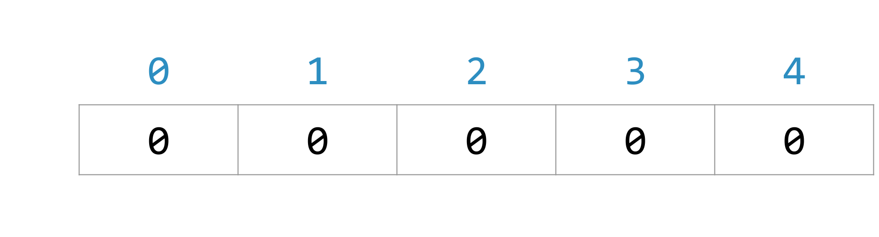
Mini-lesson
be sure to: Take notes and answer questions in your notebook.
Array
An object that stores a fixed number of objects of the same type.
Once an array has been created its size can’t change.
int[] scores = new int[5]
Notes:
int[] refers to the type (an integer array).
It’s an object assigned to the variable scores.
[5] means it has 5 elements.

Slide 6
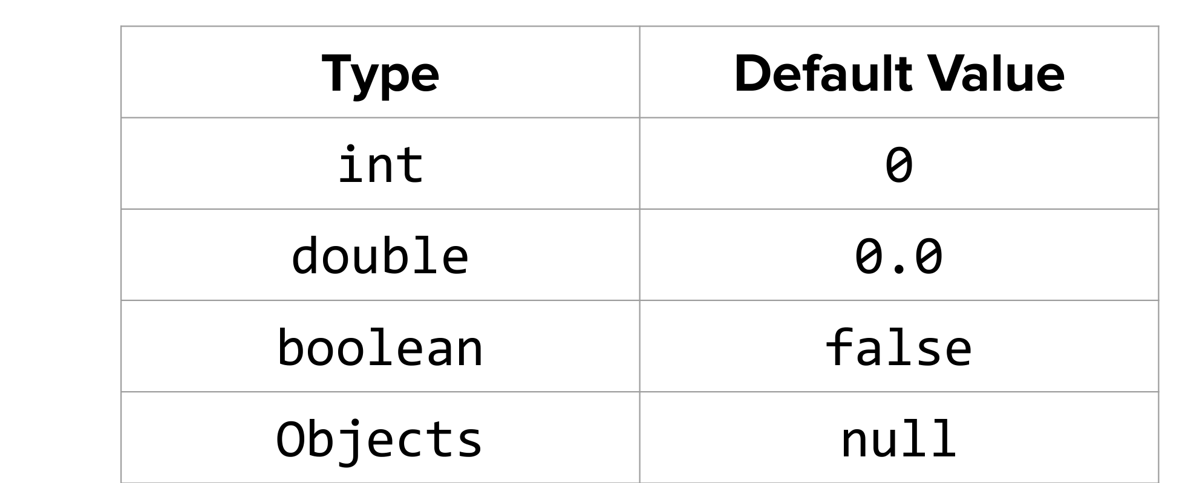
Mini-lesson
be sure to: Take notes and answer questions in your notebook.
int[] scores = new int[5]
Array
An object that stores a fixed number of objects of the same type.
Default values for array elements:

Slide 7
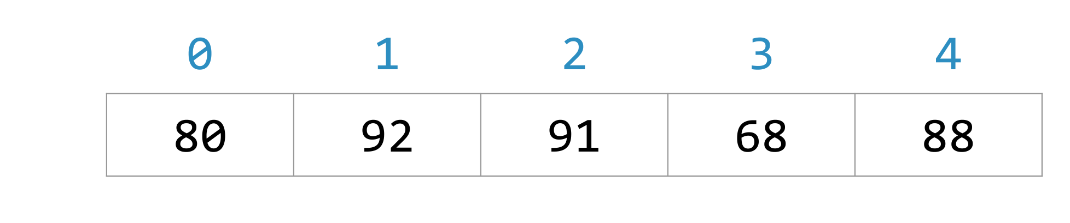
Mini-lesson
be sure to: Take notes and answer questions in your notebook.
Array
An object that stores a fixed number of objects of the same type.
Using an initializer list to make a new array:
int[] scores = {80, 92, 91, 68, 88}

Slide 8
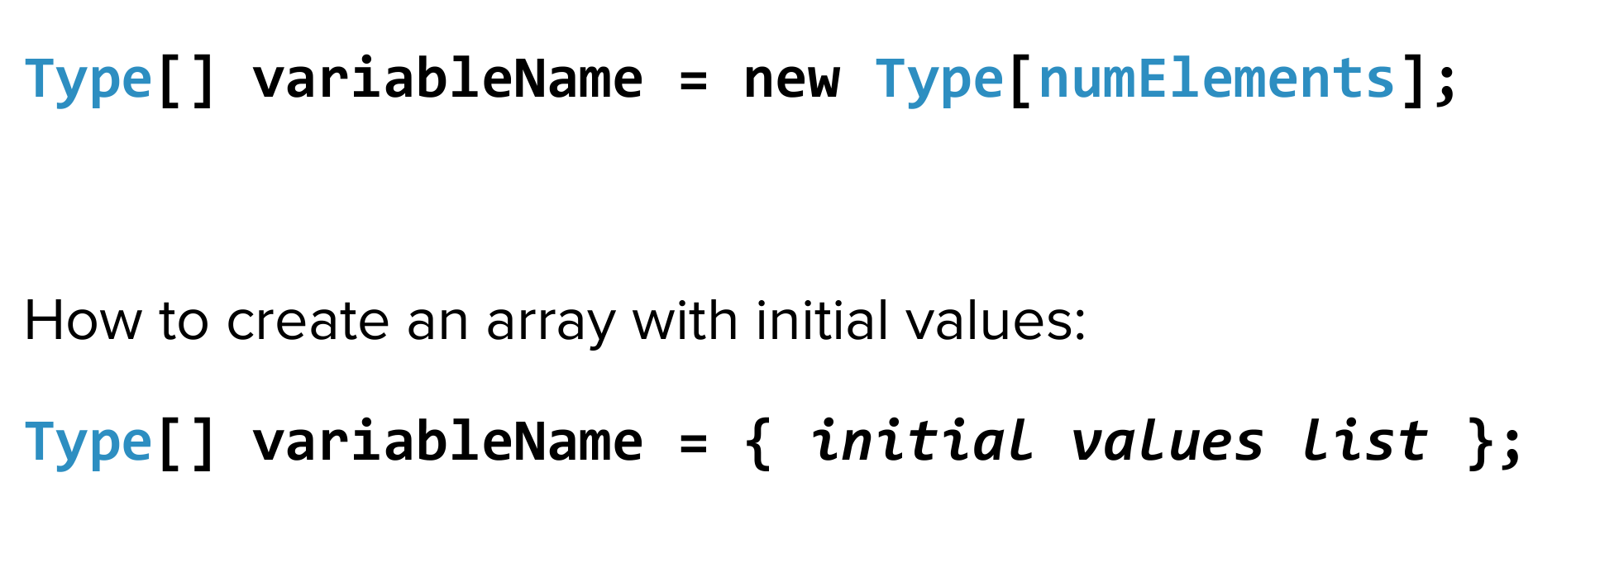
Mini-lesson
be sure to: Take notes and answer questions in your notebook.
Array
An object that stores a fixed number of objects of the same type.
How to make an array of any type:

Slide 9
Mini-lesson
be sure to: Take notes and answer questions in your notebook.
Example:
Let’s create an array of 4 integers:
int[] new_array = {4, 35, -20, 8};
What will new_array[3] give us?
new_array[3] == 8;
What do you think will happen if we enter
new_array[5]
This will give us an ArrayIndexOutofBounds Error
Array
An object that stores a fixed number of objects of the same type.
Array Index out of bound error
Exception that is thrown if a program tries to access an array index that is negative, or greater than or equal to the length of the array.

Slide 10
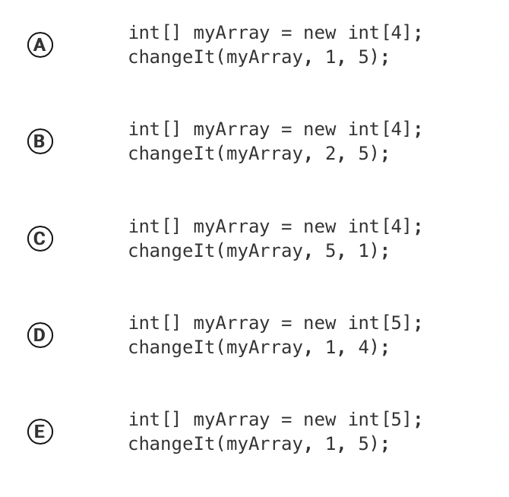
Practice problem
be sure to: Answer the problem below and write a sentence justifying your solution.
Consider the following method.
public void changeIt(int[] arr, int index, int newValue)
{
arr[index] += newValue;
}
Which of the following code segments, if located in a method in the same class as changeIt, will cause the array myArray to contain {0, 5, 0, 0} ?
Notes:
The correct choice is A. myArray is initialized as {0,0,0,0}. The changeIt method takes an array, and index, and a new value, and adds newValue to the item in the array at the index. In this case the item at 1 is 0, so 0+5 = 5. All other items remain unchanged.

Slide 11
Practice problem
be sure to: Answer the problem below and write a sentence justifying your solution.
Write out code for a program to do the following:
1. Initialize an array temperatures with the following four values: 80.2, 65.3, 12.17, 20.21.
2. Change the value of the third item to be 15.2.
Notes:
1.
double[] temperatures = { 80.2, 65.3, 12.17, 20.21};
+What’s another way to do this?
double[] temperatures = new double[4];
temperatures[0] = 80.2,
etc.
2.
temperatures[2] = 15.2;

Slide 12
Reflection: summing up the lesson
be sure to: Answer each question below with a complete sentence.
What is an Array Index Out of Bounds Exception error?
How could you create an array of 6 doubles?
How could you access the last element in an array called myNumbers?
Notes:
What is an Array Index Out of Bounds Exception error?
This error is thrown if an index that does not exist tries to be accessed.
How would you create an array of 6 doubles?
double[] arr = new double[6];
How would you access the last element in an array called myNumbers?
myNumbers[myNumbers.length - 1]

