Slide 1
Fall 2021 Pre-calculus
Lesson 11.4
Dr. O’Brien
Lehman High School
2 December 2021

Slide 2
do now
be sure to: find seat. Get out your binder and answer the do now questions below. Show all work or answer each question with a complete sentence.
Assume $f(x)=x+3$, $g(x)=4x$ and $h(x)=x-2$:
What will the composition $f(g(h(x))$ evaluate to if $x=3$?
Will $f(g(h(x))=h(g(f(x))$? Explain why or why not.
How could we rewrite $f(g(h(x))$ with $∘$ notation?
Notes:
H(3)=1, g(1)=4, f(4)=7
No hgf(x)=22
(f o (g o h))(x)
Why is the second parents pair needed? Otherwise it’s ambiguous with ((f o g) h)(x)

Slide 3
framing
what: HDW use function composition to build complex images in Pyret
why: In this unit we’ll be applying our mathematical knowledge to make a video game using the programming language Pyret. Composing functions is a big part of this.
where to: Next we explore using function composition to draw complex images in Pyret

Slide 4

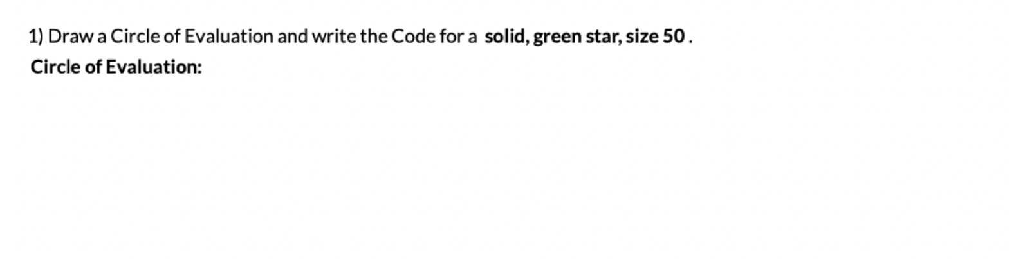
Review
Notes:
How do we write the contract for star()? star:: Number String String —> Image
Draw circle of evaluation and code

Slide 5
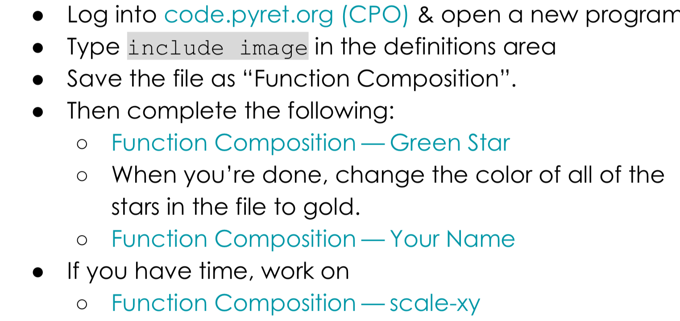
Coding to learn
Open computer and navigate to code.pyret.org. The read the instructions below.
Be sure to…
Notes:
See teacher resources at bootstrap::algebra for answer keys
How do we use the scale function? Use the same method as Tuesday to discover its parameter structure. Scale takes a number and an image as arguments.
How do we rotate functions? Investigate how the rotate function works
How is this even math? When you embed one function in another, that’s function composition. All complex programs in Pyret , along with other functional programming languages like Lisp or Haskell, involve function composition.

Slide 6
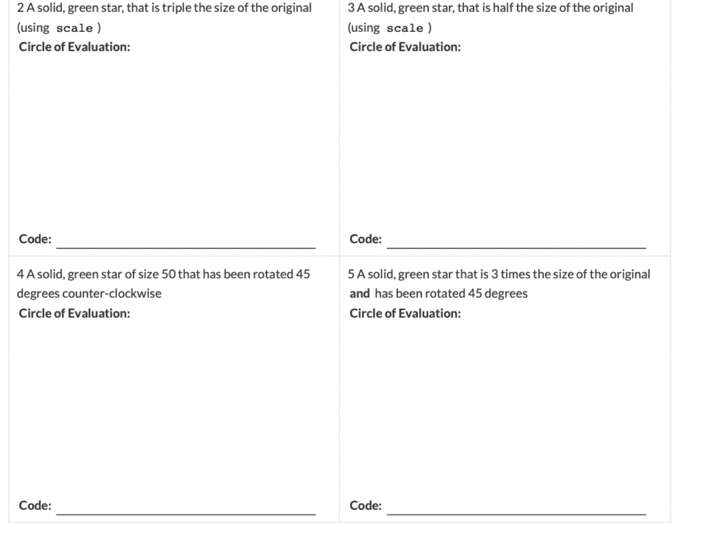
Coding to learn
Open computer and navigate to code.pyret.org. The read the instructions below.

Slide 7
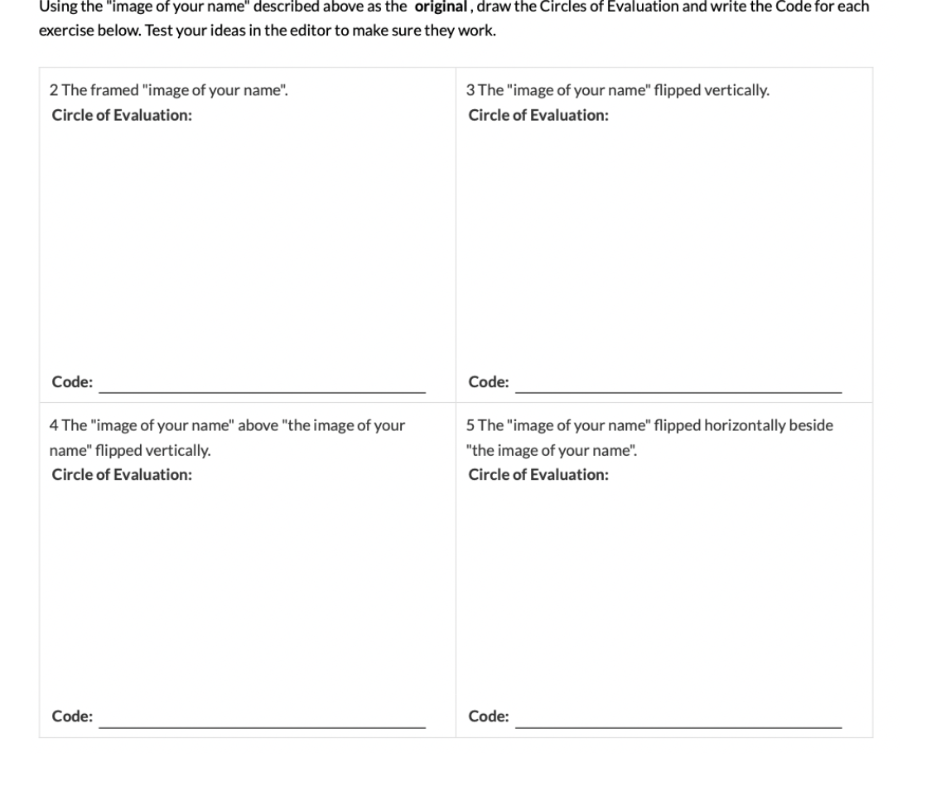
Coding to learn
Open computer and navigate to code.pyret.org. The read the instructions below.

Slide 8
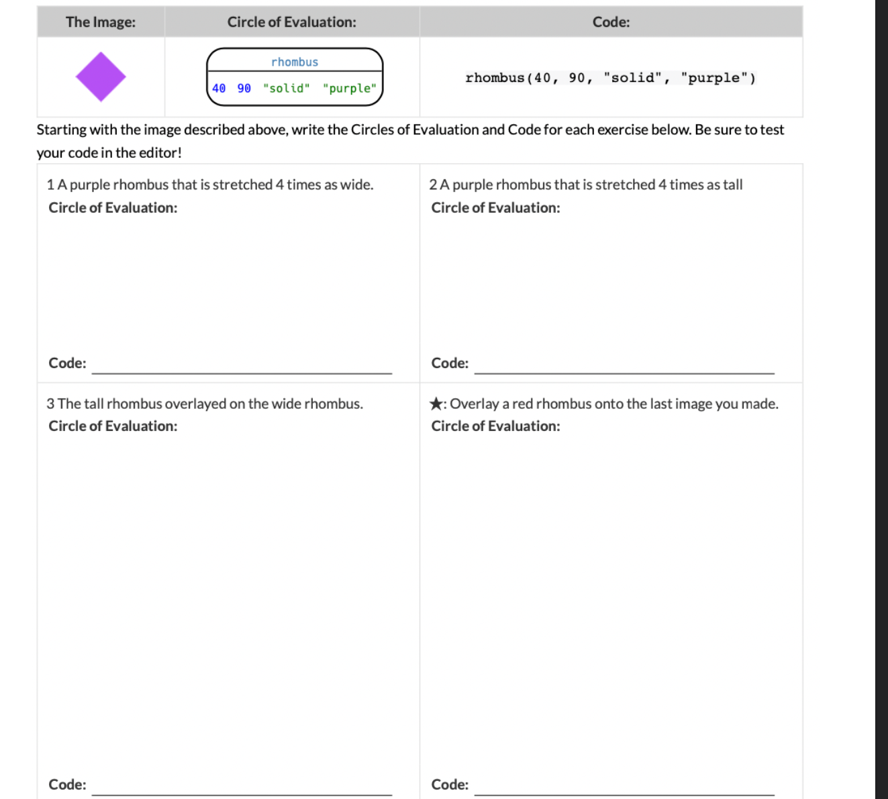
Coding to learn
Open computer and navigate to code.pyret.org. The read the instructions below.

Slide 9
Reflection: Thinking about thinking
be sure to: Answer each question below with a complete sentence.
How is function composition in Pyret similar to function composition in regular math? How is it different?
Why is it useful to pay attention to the contracts when trying to compose two functions?

Slide 10
Exit ticket
Navigate to Google Classroom and open Exit Ticket activity. Complete before the end of the period!
Notes:
Answers will vary. Some contracts have more arguments than others, error messages help by telling you exactly what sort of arguments you need. Students may also notice annotations specifying the type of an argument in their error messages.

